Slide 1
EyeRIS Strobe Concept Review
Kakani Katija, Alana Sherman, Henry Ruhl, Paul Roberts, Jon Erickson, Denis Klimov, Rich Henthorn, Joost Daniels

Slide 2
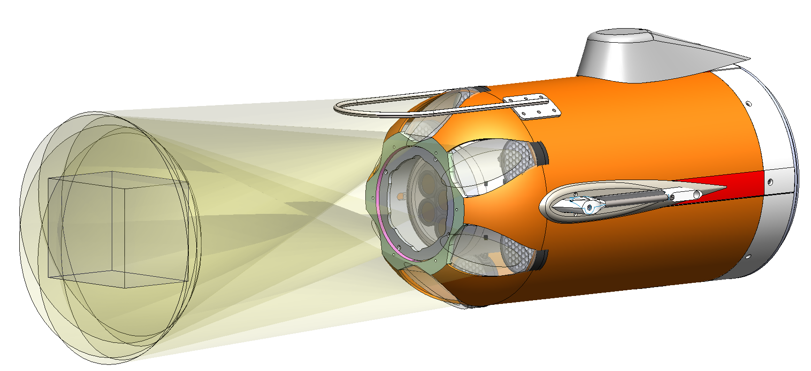
Outline
Strobe Concept
Functional Requirements
Concept Overview
Optical Design
Electrical Design
Mechanical Design
Risks and Mitigation
Concept model of EyeRIS LRAUV imaging system

Slide 3
EyeRIS Imaging on LRAUV
Field of View:
  16 x 16 cm
Range:
  50-65 cm
Vehicle speed
  <= 1 m/s
Targets
  3D particle distributions
  Plankton ID
    Sizes 1 mm - 10 cm
Concept model of EyeRIS LRAUV imaging system

Slide 4
Functional Requirements
EyeRIS Functional Requirements (Autonomous Instrument) (Strobe-related in white)
EyeRIS shall record still image and video data locally
EyeRIS shall operate to a depth of 4000 meters
EyeRIS shall operate autonomously for the duration of an LRAUV mission
Shall record continuously or be able to go in a low power sleep mode
Shall have internal control of camera from a low-power MCU
Shall support vehicle ground fault detection
Shall be controllable with vehicle mission exec
Shall have a flash with illumination duration sufficient to minimize motion smear at maximum vehicle speed
Shall support still imaging at up to 2 Hz and short bursts of video imaging up to 60 Hz

Slide 5
Design Requirements
Optical
  Shall use high-efficiency LEDs
  Shall produce at least 200,000 lumens or 290 watts during flash
  Shall minimize common volume backscatter
  Shall illuminate the FOV with spatial uniformity better than 50% from center to edge of FOV
Electrical
  Shall run off power supplies in the range 9 - 36 VDC
  Shall operate across a wide range of power draw: 5 - 250 W
  Shall provide status and control over common serial protocols: 232 or 485
  Shall allow external control of system to enter/exit low-power state
  Shall allow external synchronization with camera
  Shall allow control of flash duration
  Shall automatically limit strobe output to control temperature rise
  Shall monitor strobe head current and capacitor voltage and publish over serial
Mechanical
  Shall operate to 4000 m depth
  Shall use a silicone potted housing for strobe head
  Shall allow up to 6 strobe heads per ballast

Slide 6
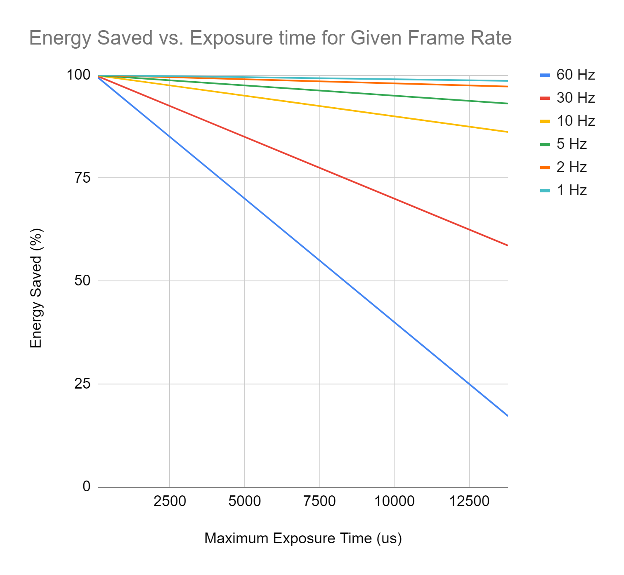
Strobes vs. Lights
On AUV, motion blur is a limiting factor
Maximum exposure time is less than 1 ms
Strobes can either:
  Save energy at the same lux
  Provide more lux at the same energy

Slide 7
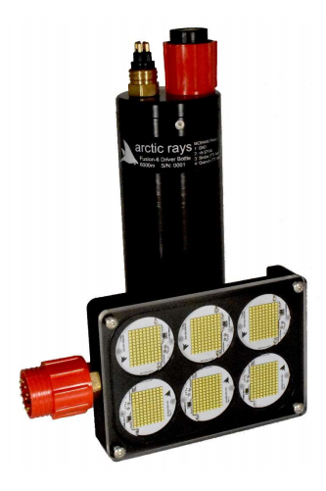
Commercial Options
COTS
  Cathx Ocean
  DSPL
  Arctic Ray
Custom
  Arctic Ray has offered to help as needed with a custom build
Limitations
  Control over beam angle and optics
  Ability use different colors
  Potentially high cost > $10k per strobe

Slide 8
Strobe Concept
9-36 VDC
Serial Comms
External Trigger
GPIO
Strobe Head:
LEDs
Optics
Thermal Dimmer
Strobed
48 VDC
Strobe Ballast:
MCU
Energy Storage Cap(s)
Strobe circuit (FET)
DC/DC converters
Fuses and thermal protection
Ground Fault signal
Up to 6 strobe heads per ballast
Strobe head is potted in silicone 4000 m rated
Ballast is 1-atm
Titanium or Aluminum housing 4000 m rated
Notes:
Paul do you want to specify number of pins required on each end? -jon

Slide 9
Optical Design: Overview
Light Baffle
Reflector
LEDs
Beam Steering
.
.
.
Baseline
EyeRIS
Camera Housing
16 cm FOV
50 cm

Slide 10
Light Baffle
Reflector
Beam Steering
LEDs
.
.
.
Baseline
EyeRIS
Camera Housing
16 cm FOV
50 cm

Slide 11
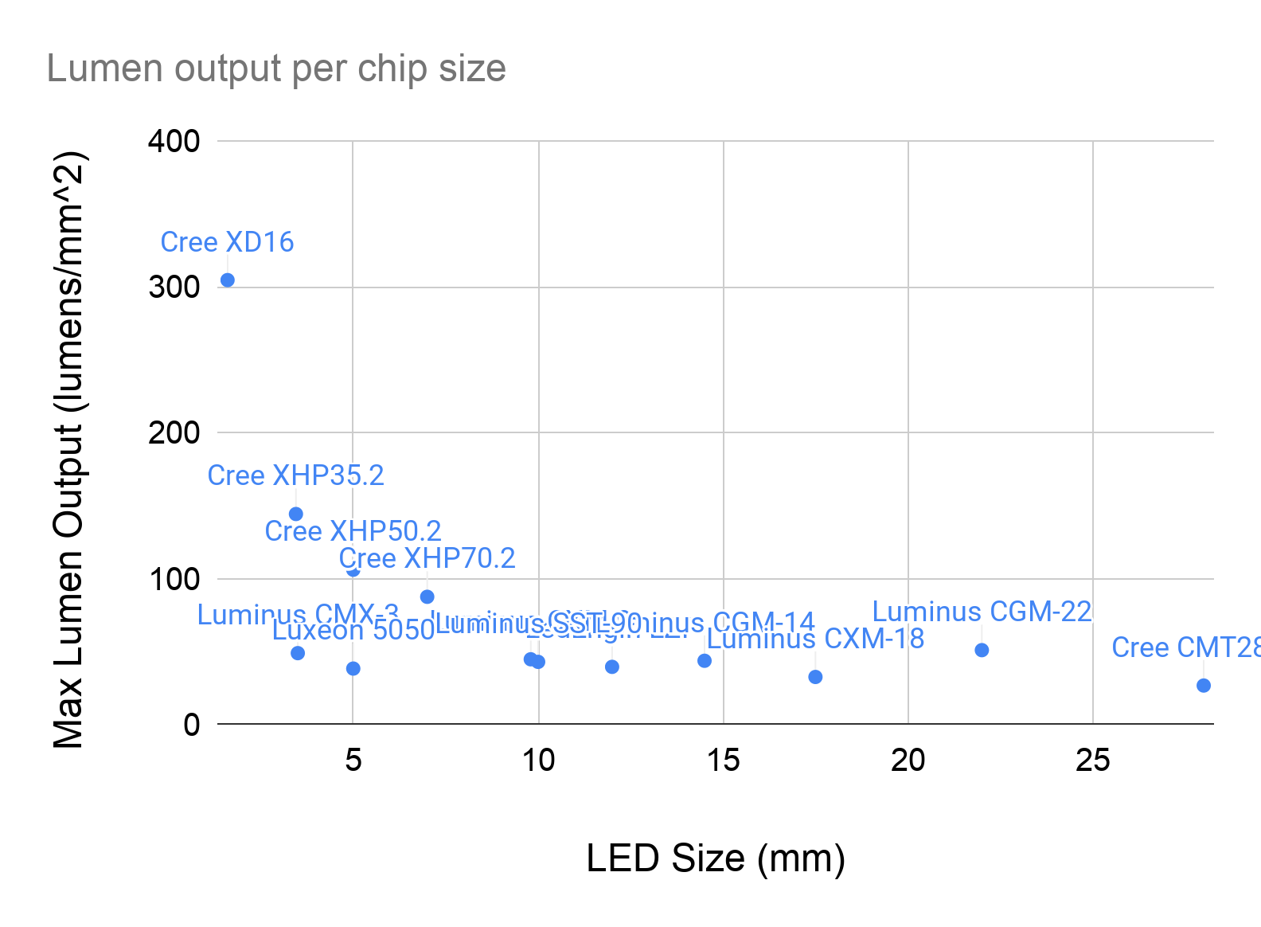
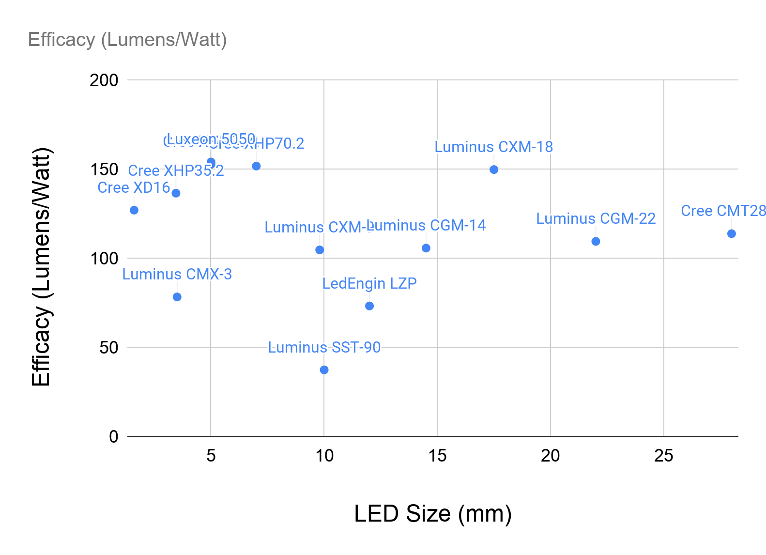
Optical Design: LEDs
Take advantage of recent advances in LEDs
Smaller, high-output LEDs have an advantage in lumen output and also secondary optics height
Notes:
I have not looked a LEDs from an electrical standpoint there must be efficiency differences. Would any of these be “thrown out” based on poor efficiency. (On LRAUV we’re running on battery). -jon

Slide 12
Optical Design: The Need for Reflectors
Modern LED secondary optics use Total Internal Reflection (TIR) lenses for maximum efficiency
TIR assumes air is the propagation medium
Aluminum PVD coating of TIR lens is problematic
In order to pot the strobe head can’t use TIR lenses
TIR Lens in Air
TIR Lens in Silicone

Slide 13
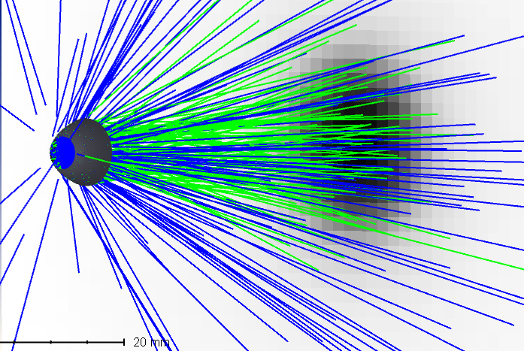
Optical Design: Reflector for Cree XD16
Maximum irradiance and uniformity on target
Optimize freeform-z shape in Zemax with height constraint of 4 mm
Compare with other COTS reflectors
Notes:
4 mm constraint stems from Luximprint maximum surface guarantee limit

Slide 14
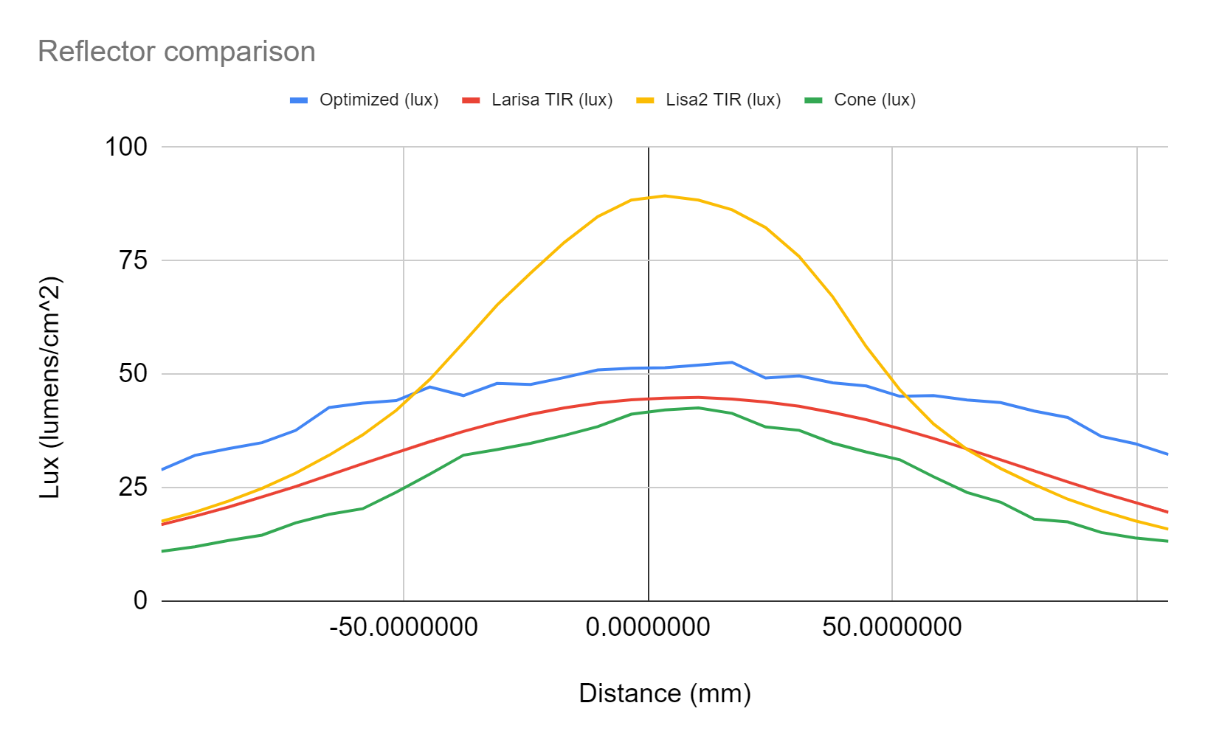
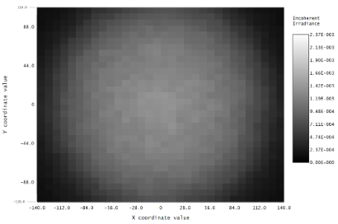
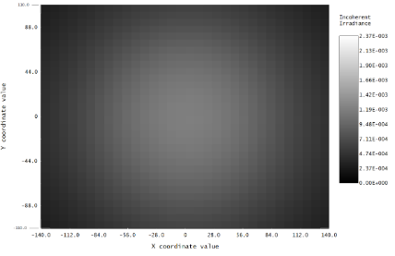
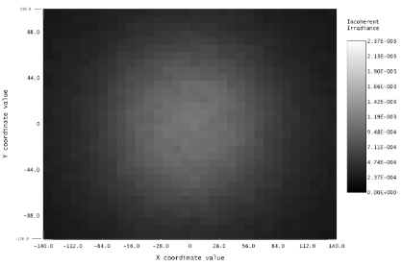
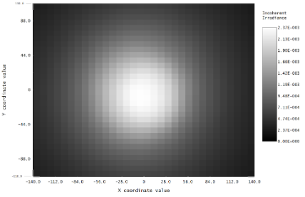
Optical Design: Reflector for Cree XD16
16 cm
14 cm

Slide 15
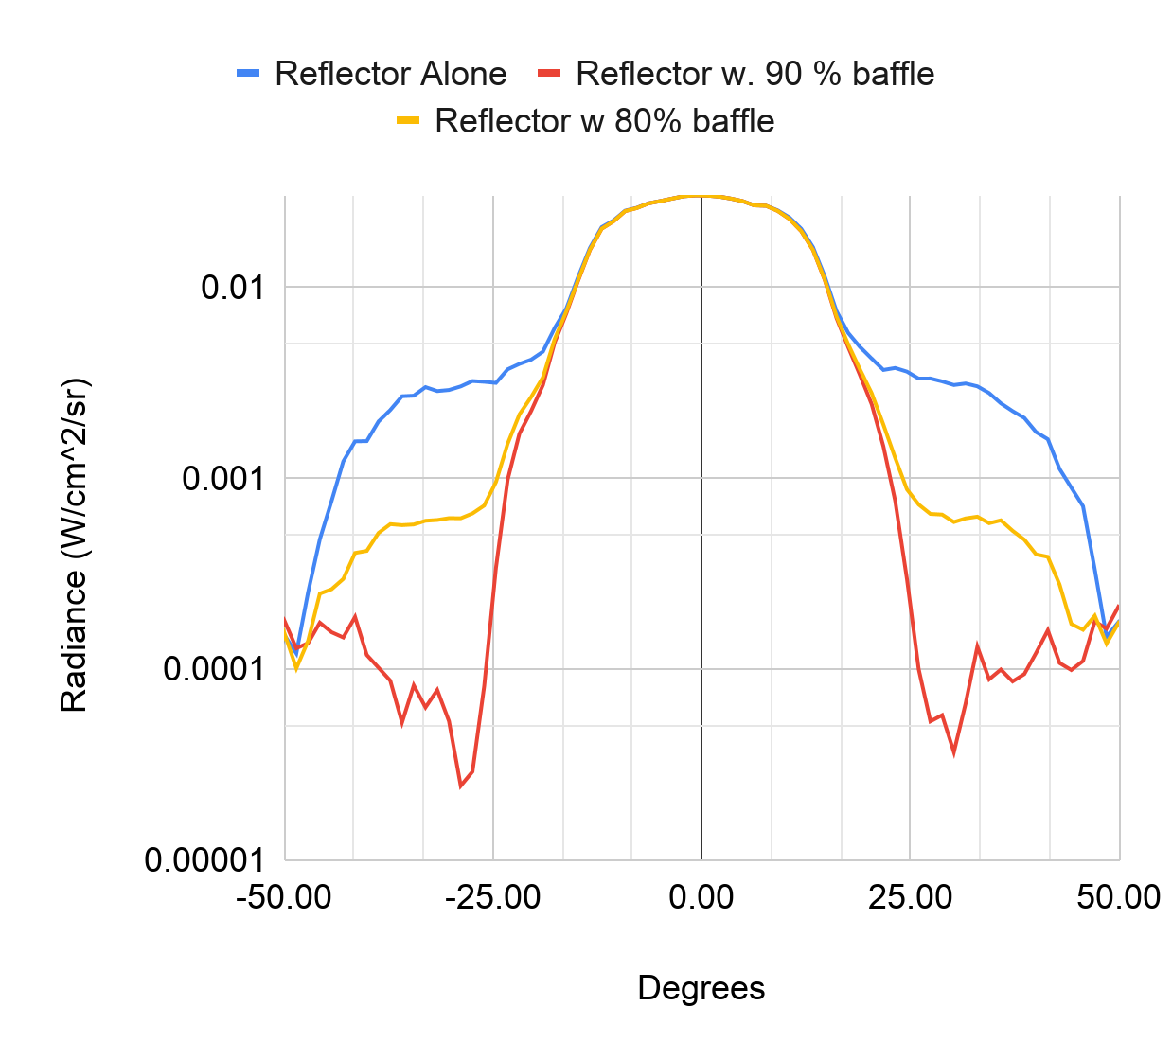
Optical Design: Sidelobe Reduction
Small baffle over each reflector can dramatically reduce sidelobes without any change in on-target lux.
Blocked Oblique Ray
Absorbing
Baffle of 80 or 90 %
Diffuse Scatter
Reflector
LED
Notes:
Paul: I assume that % directly correlates to thickness of the baffle? -jon

Slide 16
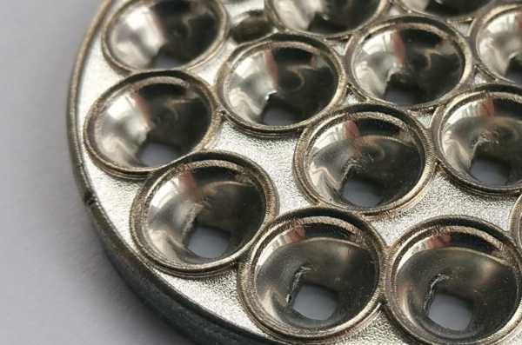
Optical Design: Reflector Fabrication
3D printed Arrays
  $2500 NRE
  3D printed plastic with aluminum PVD coating
  $300 each
CNC machining
  Higher risk level
  Custom tooling for each shape
  Lapping
  ~$2000 each
Luximprint printed reflector

Slide 17
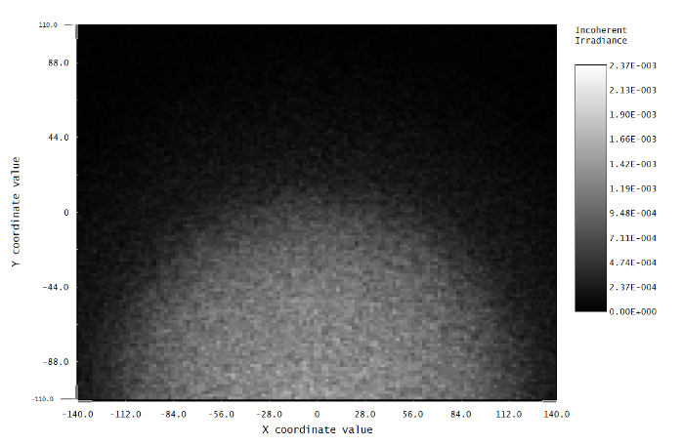
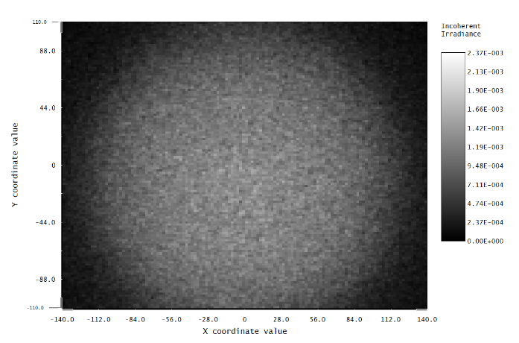
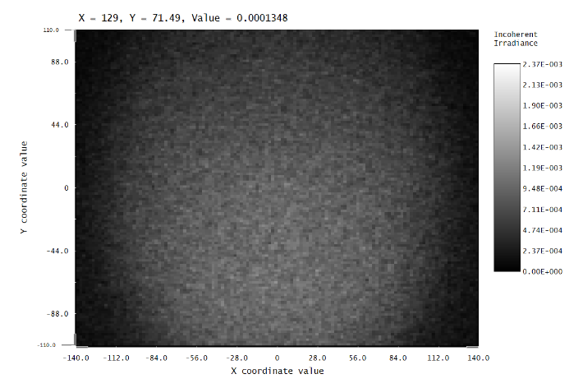
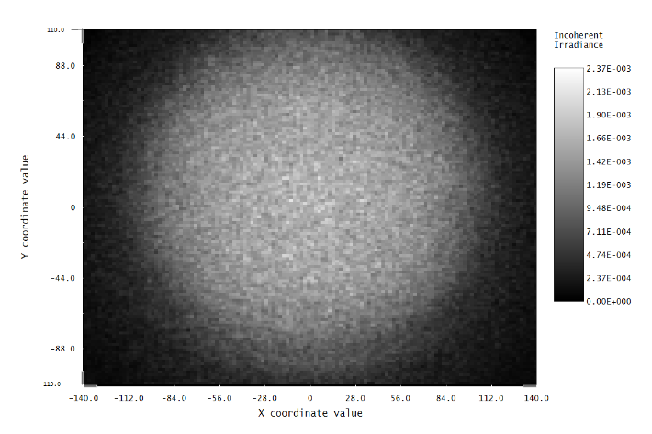
Optical Design: Beam Steering
Need to converge beams from strobes onto FOV
Can use difference in refractive index between acrylic and seawater
This keeps system streamlined
To deflect beam 12 cm over 65 cm range, 𝜽_{a} ~ 55º
Acrylic
Strobe
Seawater
𝜽_{w}
16 cm
𝜽_{a}
14 cm
Notes:
Simulate color images to see what the chromatic effect is
Looking into making ridges on the surface to increase deflection

Slide 18
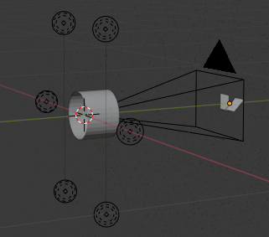
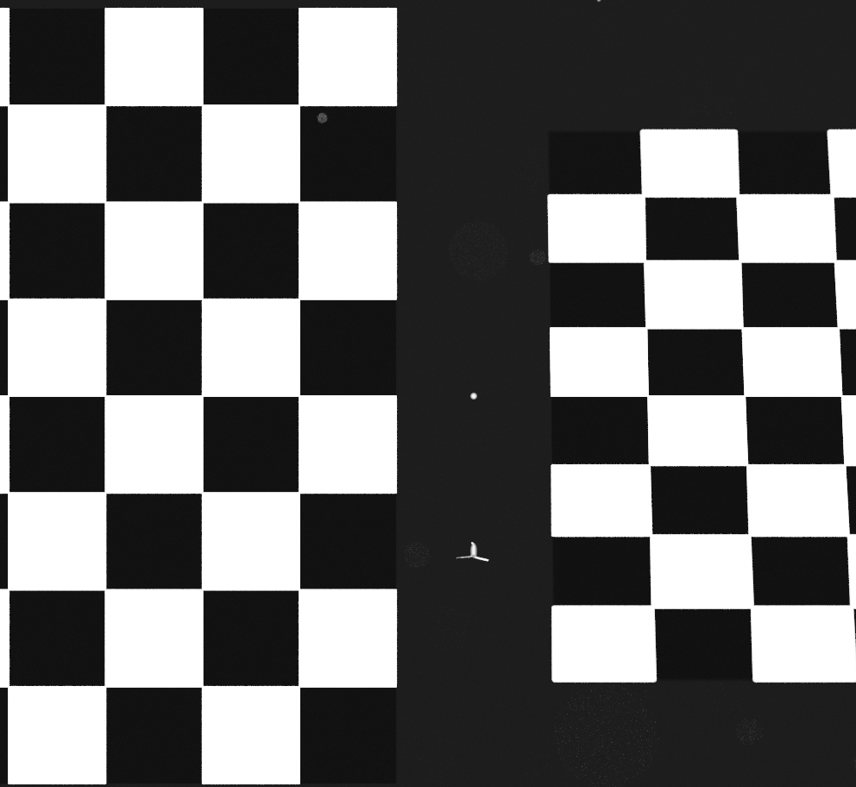
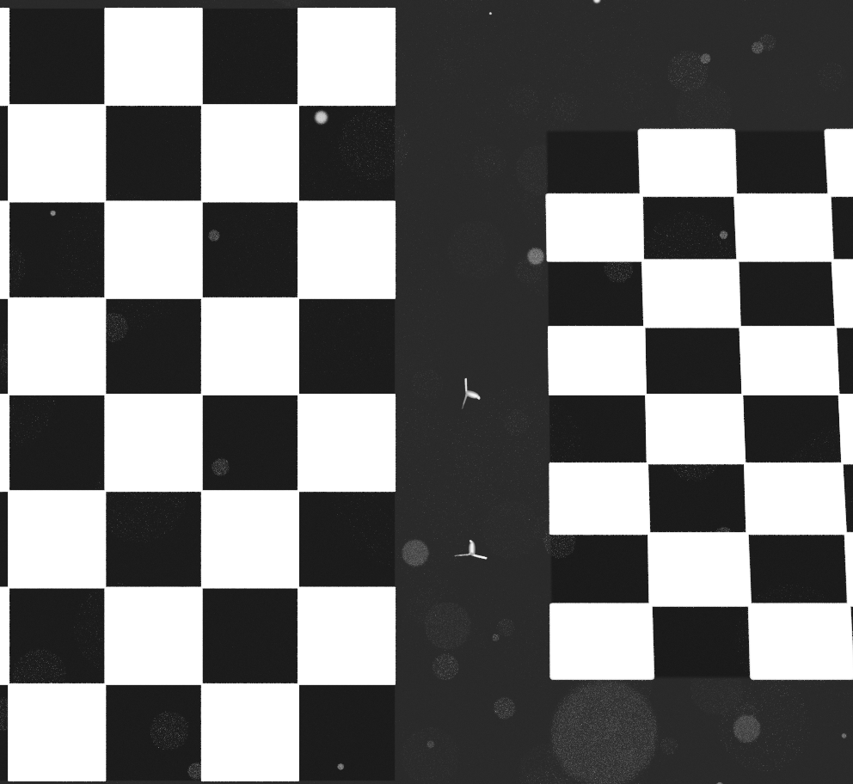
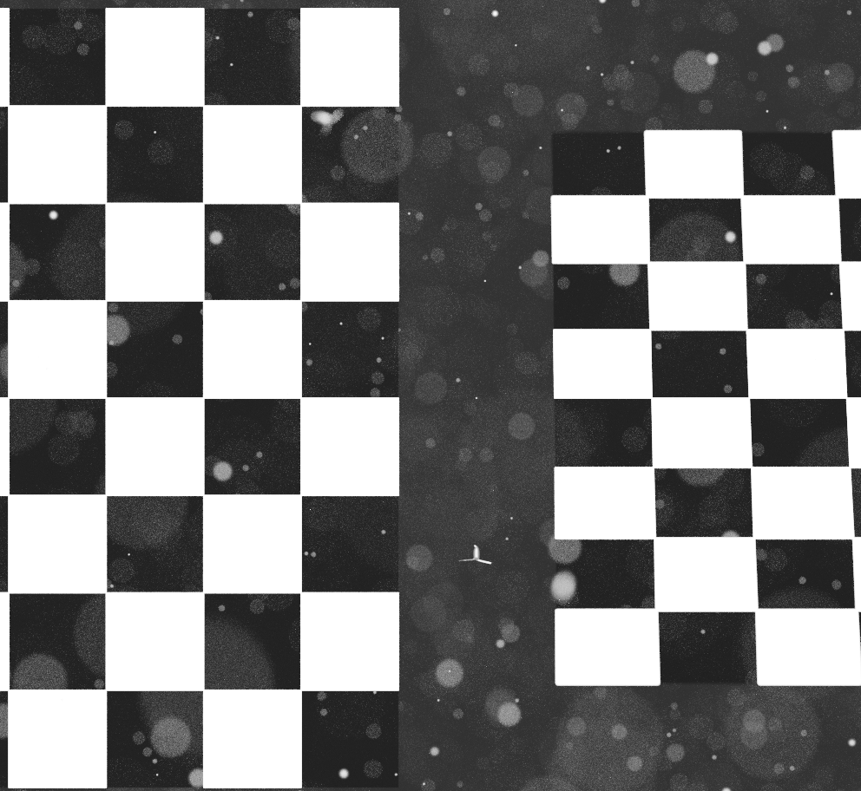



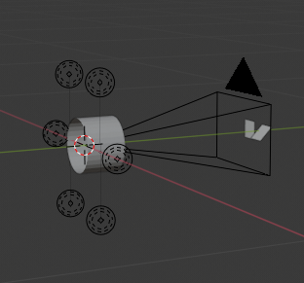
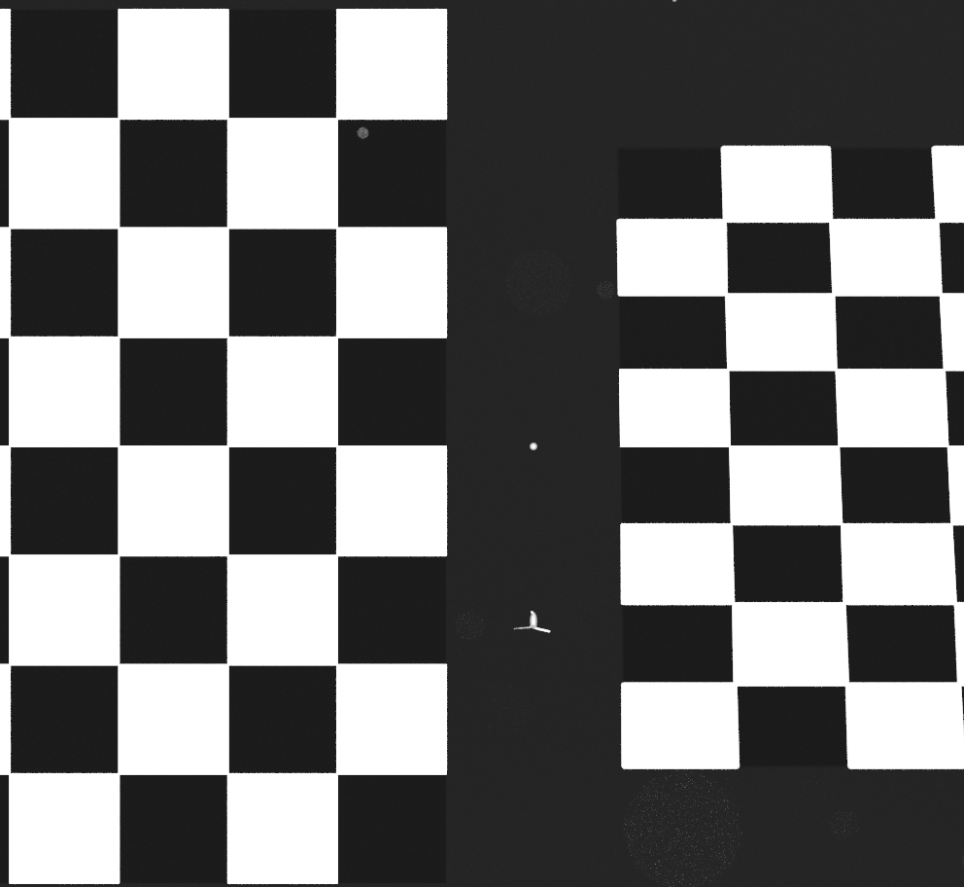

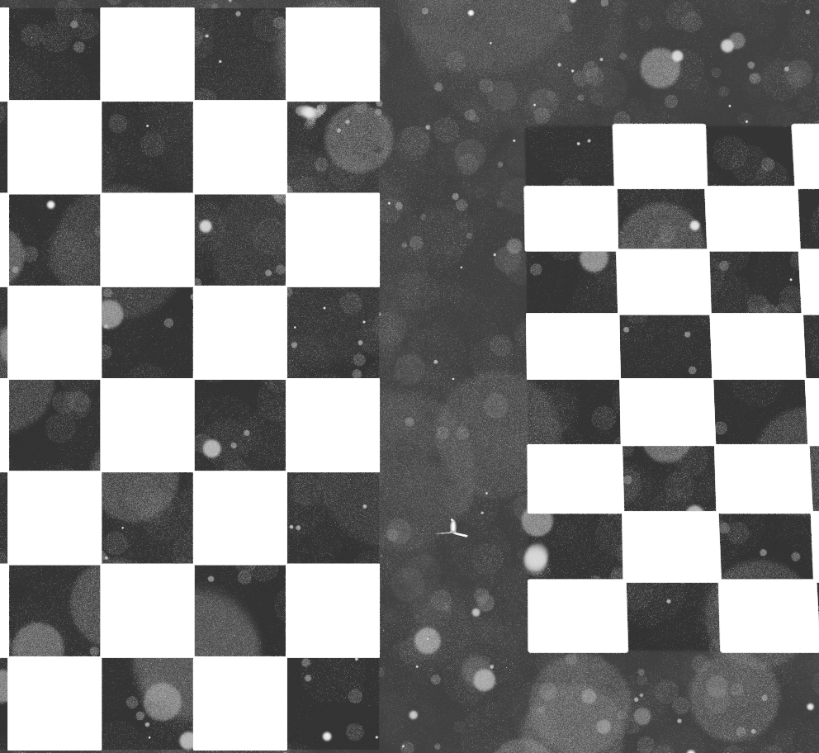



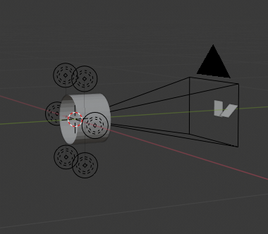






Optical Design: Imaging Geometry
Scattering: 0.1 blender units
0.1, copepod / liter
1, 400 um particle / liter
10, 100 um particle / liter
Scattering: 0.2 blender units
1, Copepod / liter
10, 400 um particle / liter
100, 100 um particle / liter
Scattering: 0.3 blender units
10, Copepods / liter
100, 400 um particles / liter
1000, 100 um particle / liter
66 cm array
5 cm
5 mm
46 cm array
34 cm array

Slide 19
Electrical Design: Overview
Strobe Head x6
Strobe Ballast
48 V
Input Voltage
9-36 V
Cree XD16
15 Series
4 Parallel
63V Cap bank
48V Synchronous Boost (LTC3769)
Fuse and
Reverse
Polarity Protection
CAP
VOLTAGE
PGOOD
RUN
5 V
Thermal Protection
Strobe Switch &
Current Monitor
STROBE
8-bit MCU
Atmega328
5V Synchronous Buck (LT8610)
5 V
Serial
Comms
FLASH
CURRENT
RS-232/485 transceiver
OVP
FLASH
TRIGGER
UART
Exposure
Signal
MUX
Opto
Notes:
Added capacitor voltage monitoring for change and discharge
Added control for camera to drive strobe switch

Slide 20
Strobe Head x6
Strobe Ballast
48 V
Input Voltage
9-36 V
Cree XD16
15 Series
4 Parallel
63V Cap bank
48V Synchronous Boost (LTC3769)
Fuse and
Reverse
Polarity Protection
CAP
VOLTAGE
PGOOD
RUN
5 V
Thermal Protection
Strobe Switch &
Current Monitor
STROBE
8-bit MCU
Atmega328
5V Synchronous Buck (LT8610)
5 V
Serial
Comms
FLASH
CURRENT
RS-232/485 transceiver
OVP
FLASH
TRIGGER
UART
Exposure
Signal
MUX
Opto
Notes:
Added capacitor voltage monitoring for change and discharge
Added control for camera to drive strobe switch

Slide 21
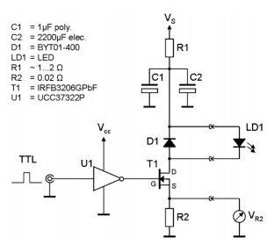
Electrical Design: Strobe Circuit
Simple FET switch
Flash durations on the order of μs are straightforward
Willert et. al 2010 : Pulsed operation of high-power light emitting diodes for imaging flow velocimetry

Slide 22
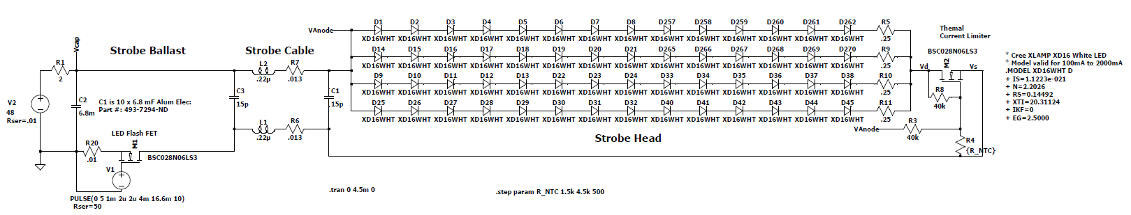
Electrical Design: Strobe Head
Ideal PSU
Strobe FET
Thermal Protection
LTspice Simulation Setup

Slide 23
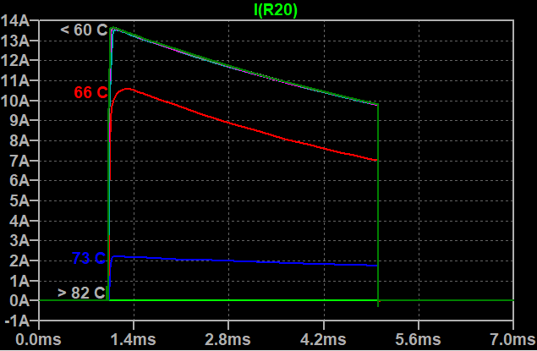
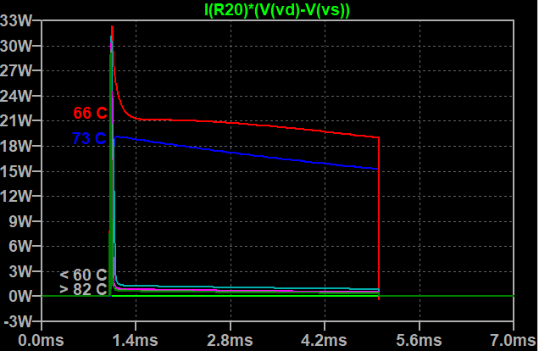
Electrical Design: Strobe Head Simulation
Total LED current at each temp
Thermal protection kicks-in at >60C
Disables LED current at >80C
FET peak power dissipation at each temp
Power dissipation highest as FET begins to turn off at 66 ºC
Notes:
Add the temperature values for NTC resistors
Add the power dissipation in the NTC FET.
Location of NTC on board and LEDs.
Look into thermal dissipation when we get back

Slide 24
Electrical Design: Strobe Head Power Dissipation
 | Continuous operation, duty cycle < 1% | Continuous operation, duty cycle < 10% | Burst operation, duty cycle up to 25%, 1-5 minutes
Peak Pulse Power | 564 W | 504 W | 384 W
Average Power Draw | 5.6 W | 50.4 W | 96 W
Thermal Limiting Active? | No | No | Likely

Slide 25
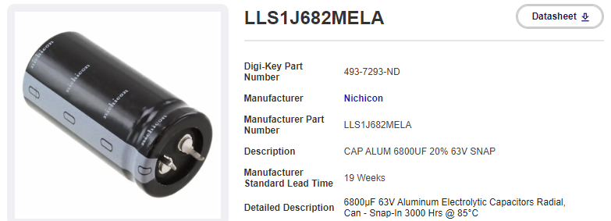
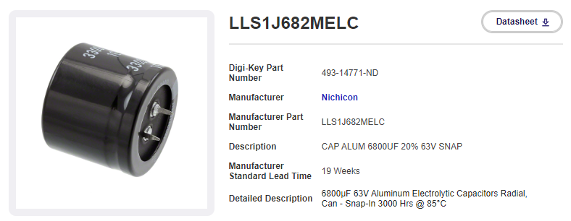
Electrical Design: Capacitor Bank
Required capacitance is on the order of 100 mF at minimum of 63 V
Digikey parametric search
  6800 uF is a sweet spot for cost/size:
    1” OD x 2” height
    1.38” x 1.25” height
    Low-cost ~ $5 each
Design for 1-atm housing
Notes:
Mention availability, and plan to buy lots of spares
Look at the LSR

Slide 26
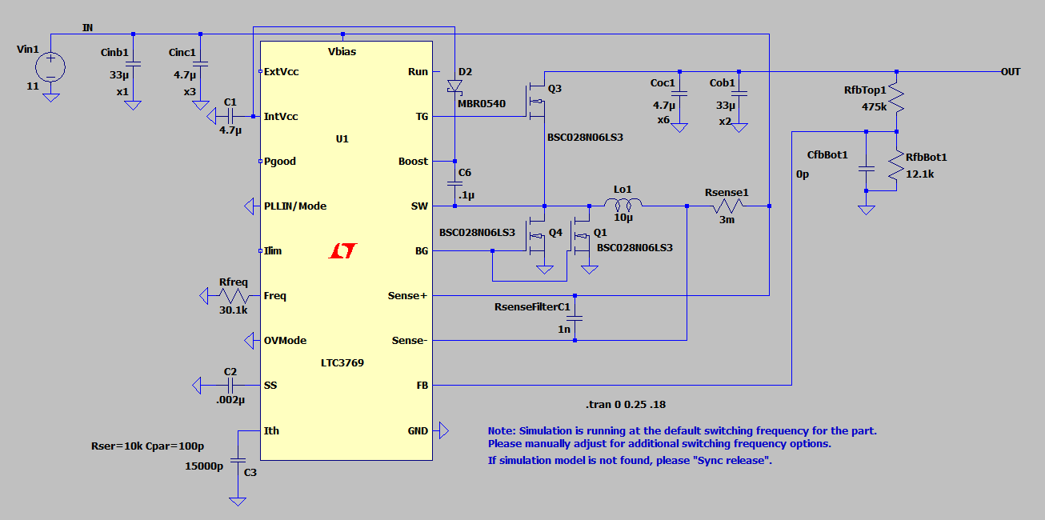
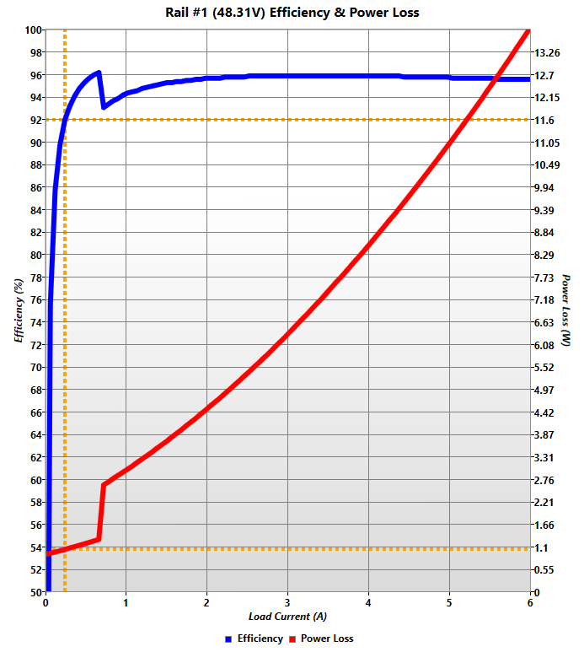
Electrical Design: 48V DC/DC converter
Vin: 9-36 VDC, Vout: 48V, 4 in² board area, 0.71 in height
> 90% efficiency above 100 mA, up to 6A at Vin= 11V

Slide 27
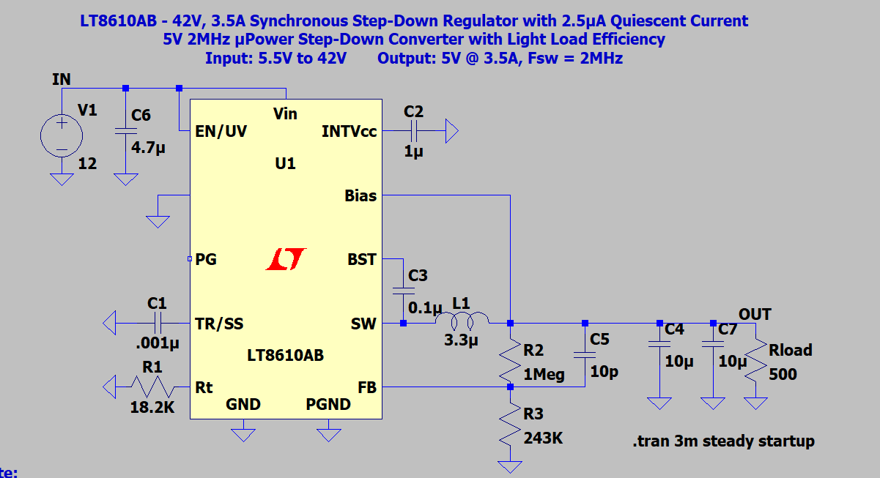
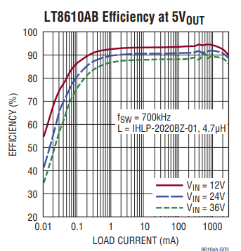
Electrical Design: 5V DC/DC Converter
Vin: 9-36 VDC, Vout: 5V, 1.0 in² board area, 0.35 in height
> 90% efficiency above 10 mA at Vin = 11 V

Slide 28
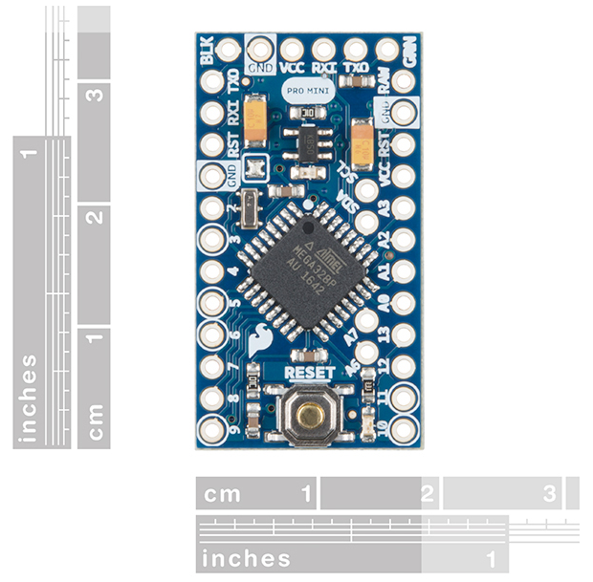
Electrical Design: MCU and Comms
Based on the Atmega328
  1.2uA @ idle:
    https://github.com/sparkfun/BigTime/blob/master/Firmware/BigTime/BigTime.ino
  Programmable with arduino
  Plenty of I/O and A/D
  TQFP-32 package
Opto-Isolate trigger signal from camera to protect MCU
MCU UART connects to RS-232/485 transceiver for comms.
  Over voltage protection on I/O of transceiver
Sparkfun DEV-11113

Slide 29
Mechanical Design: Overview
Cable Splice:
In: 2 x 16 AWG
Out 12 x 18 AWG
Strobe Ballast:
1-atm housing, aluminum
Array of Strobe Heads:
Each head is potted in Silicone

Slide 30
Mechanical Design: Overview
Cable Splice:
In: 2 x 16 AWG
Out 12 x 18 AWG
Strobe Ballast:
1-atm housing, aluminum
Array of Strobe Heads:
Each head is potted in Silicone

Slide 31
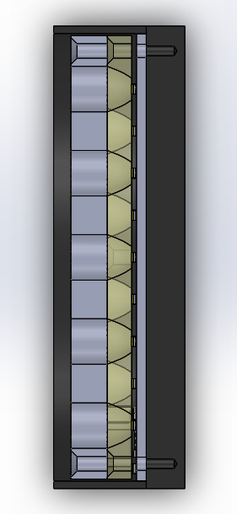
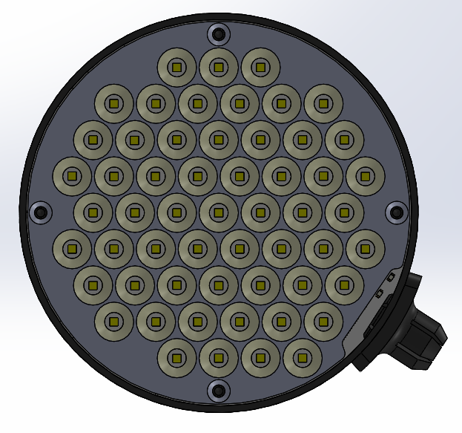
Mechanical Design: Strobe Head
Reflector
Sandwich Assembly
Filled with silicone
  Lumisil® 740/770
  Two-part silicone elastomer
LEDs mounted to MCPCB single-layer
Assembly pressure/vacuum potted
3 in
1 in

Slide 32
Mechanical Design: Strobe Head Thermal
Strobe Head
Seawater at 25 C
All power goes to heat (worst case)
LED temp <= 60 ºC
Continuous Operation
  Up to 75 W per strobe head
Pulsed Operation
  750 W @ 10% duty
60 ºC
LED Array: 6 / 56 = 0.11 ºC / W
56, Cree XD16, 6 ºC / W Die to pad
MCPCB: 0.1mm/(0.002W/mmºC*56*(1.6*1.6mm²) = 0.35 ºC / W
Dielectric (75-100 um), 2.0 W/mºC
Aluminum Backing, 1.5 mm thick
Tgon 800, .01” thick: 0.1 ºC / W
Graphite pad, 0.254 mm thick
Aluminum Plate: 0.005 ºC / W
Aluminum Plate, 6 mm thick
25 ºC Seawater
Notes:
Explode the solid model to show the parts
Add LED Cree XD16 thermal and how it’s scaled
Add the MCPCB scaled and show it’s calculated
Thermal from thermal transfer sheet and how it’s scaled
Preliminary analysis

Slide 33
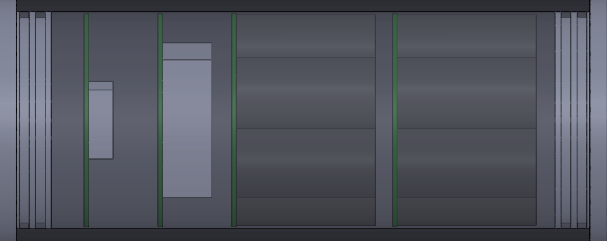
Mechanical Design: Strobe Ballast
5V PSU, MCU
48V PSU
Capacitors
9-36V Input
48V Output
3.5 in
Comms /
Trig
8.5 in
Notes:
3.125 I.D. -jon

Slide 34
Optical Design: Beam Steering
Need to converge beams from strobes onto FOV
Can use difference in refractive index between acrylic and seawater
This keeps system streamlined
To deflect beam 12 cm over 65 cm range, 𝜽_{a} ~ 55º
Acrylic
Strobe
Seawater
𝜽_{w}
16 cm
𝜽_{a}
14 cm
Notes:
Simulate color images to see what the chromatic effect is
Looking into making ridges on the surface to increase deflection

Slide 35
Mechanical Design: Integration with LRAUV
6-Strobe illumination with acrylic beam steering facets
LRAUV “long-Nose” with Standard Payload

Slide 36
Mechanical Design: Integration with LRAUV
6-Strobe illumination with acrylic beam steering facets
LRAUV “long-Nose” with Standard Payload

Slide 37
Risks and Mitigation
Cree XD16 LED not pressure tolerant
  Revise housing to have air gap between LEDs and silicone
  Find alternative LEDs
Beam steering optics cause too much light loss
  Tilt strobe heads and sacrifice streamlined profile
Charged capacitors cause electrocution risk during service
  Make sure caps have bleed resistors so they don’t stay charged
Compromise vehicle buoyancy
  Make sure ground fault detection is connected to 1-atm strobe ballast housing
  Minimize air volume
  Oil-filled ballast housing

