Slide 1
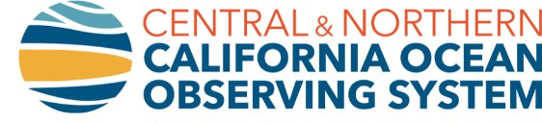
Biological Carbon Pump – Lots of Theories
Boyd et al. Nature 2019, https://www.nature.com/articles/s41586-019-1098-2

Slide 2
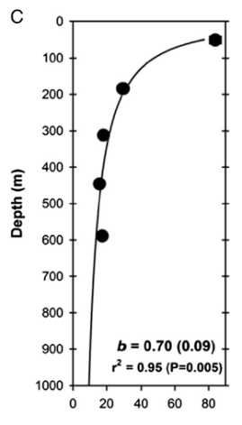
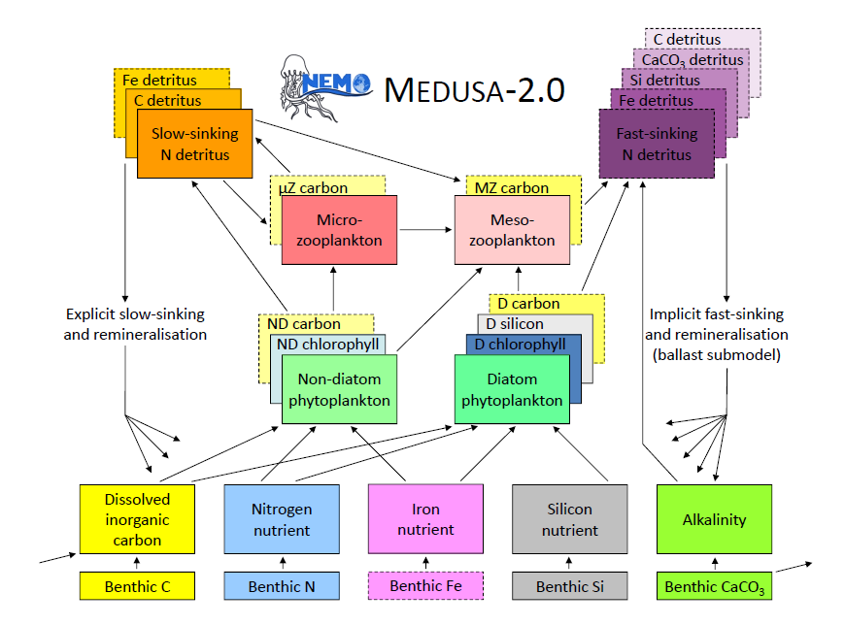
Biological Carbon Pump – Now Lots of Tools
…But, a still not approaches that sufficiently bridge the object sizes and time scales needed to disentangle factors in a way that can are improving modelling of particles (b and RLS)
Boyd et al. 2019, Nature
Marsay et al. 2015, PNAS
Yool et al. 2013, Geosci. Mod. Dev.
Informing United Nations (UN) – Intergovernmental Panel on Climate Change (IPCC)

Slide 3
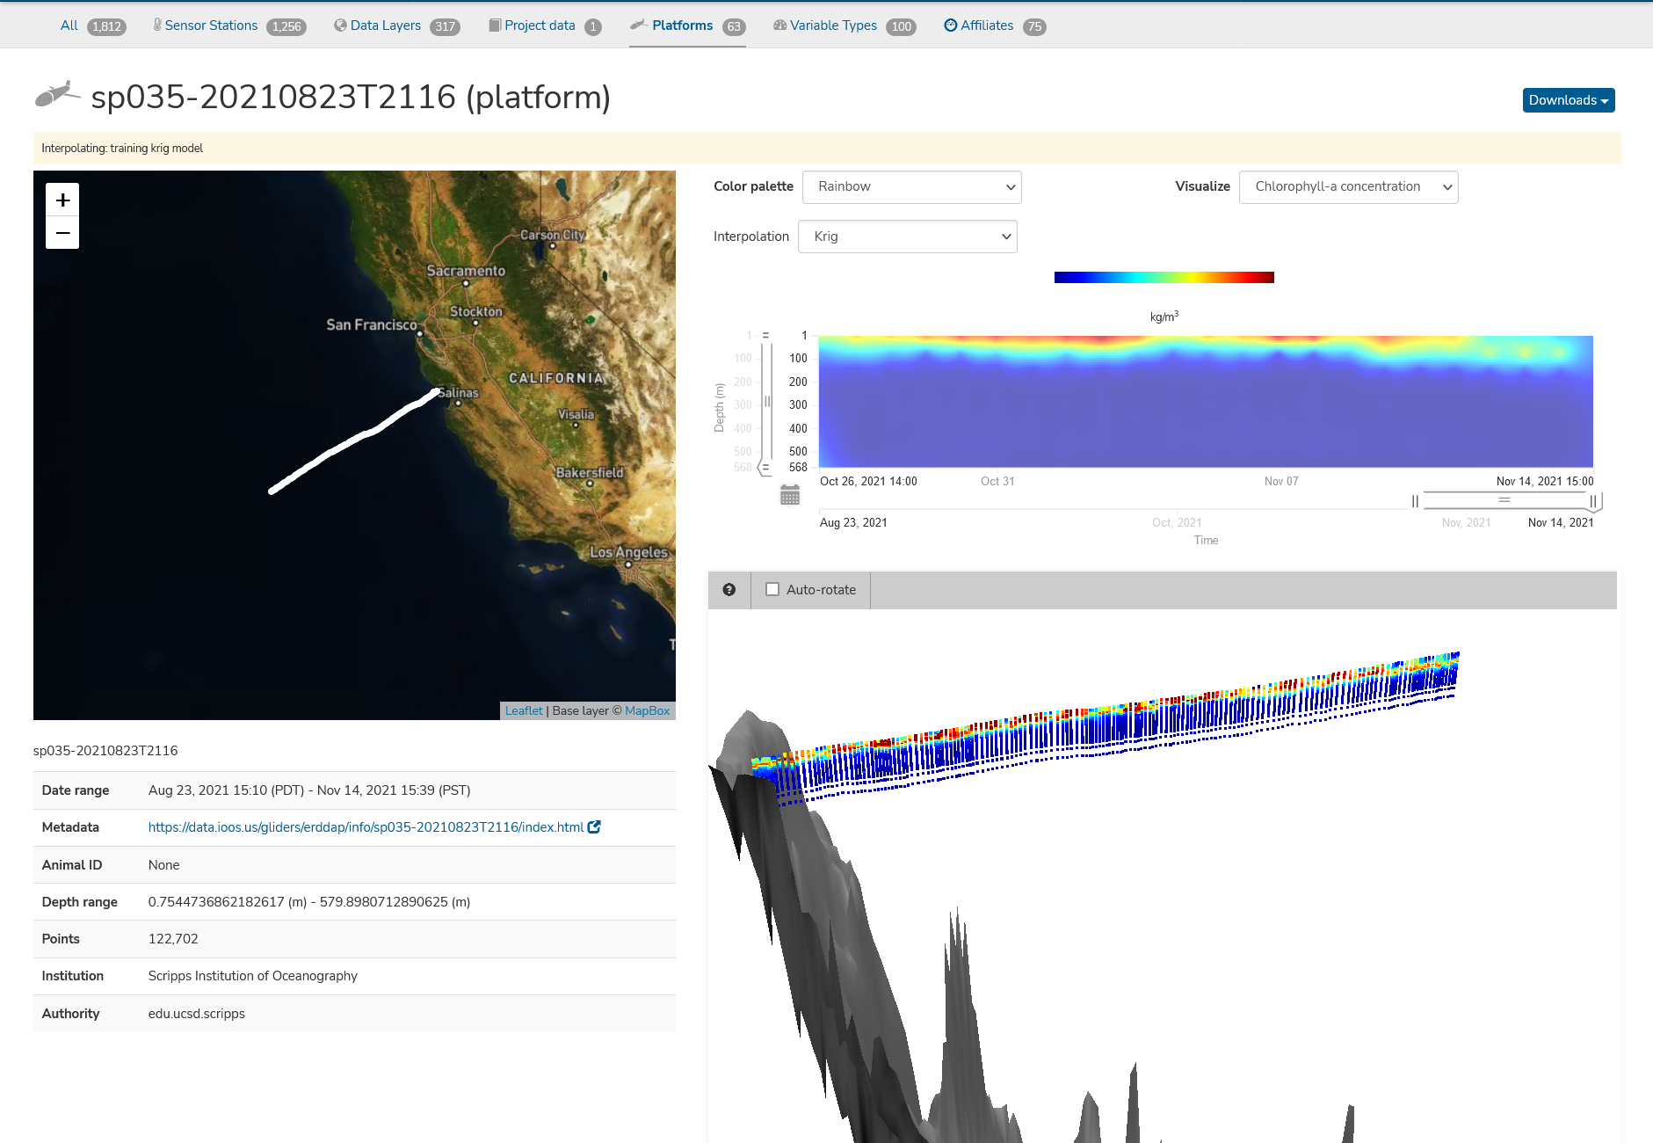
Repeat Profiles and Sections
Potential Scenarios Over Time…………………………………………And Space
Initial bloom - RLS equal size classes Profiles follow exponential or power curves.
Intense export - Production is 3x higher, RLS is ~3x higher for larger particles than small

Slide 4

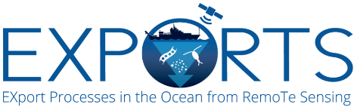
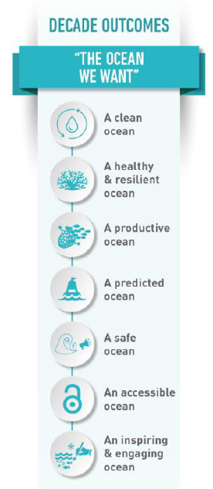

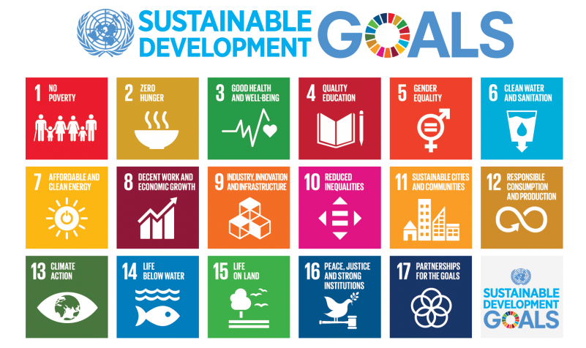

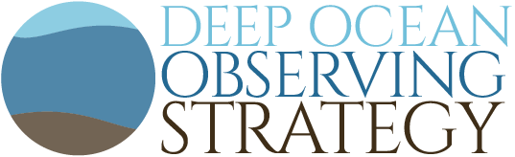
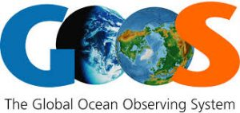
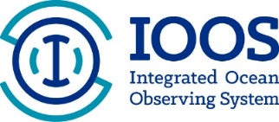



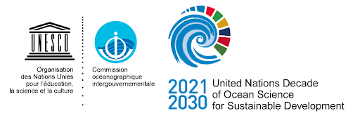
Next Steps/Links to UN Decade for Ocean Science
The science we need for the ocean we want
Ocean Vision AI
Initiative is aligning global efforts to common goals and outcomes
Many, many organizations planning how they can contribute

Slide 5
Rest are extra

Slide 6
MBON – A Systems Approach
Ruhl, HA, JA Brown, AR Harper, E Hazen, L deWitt, P Daniel, A DeVogelaere, R Kudela, J.P. Ryan and FP Chavez, (in press) Oceanography

Slide 7
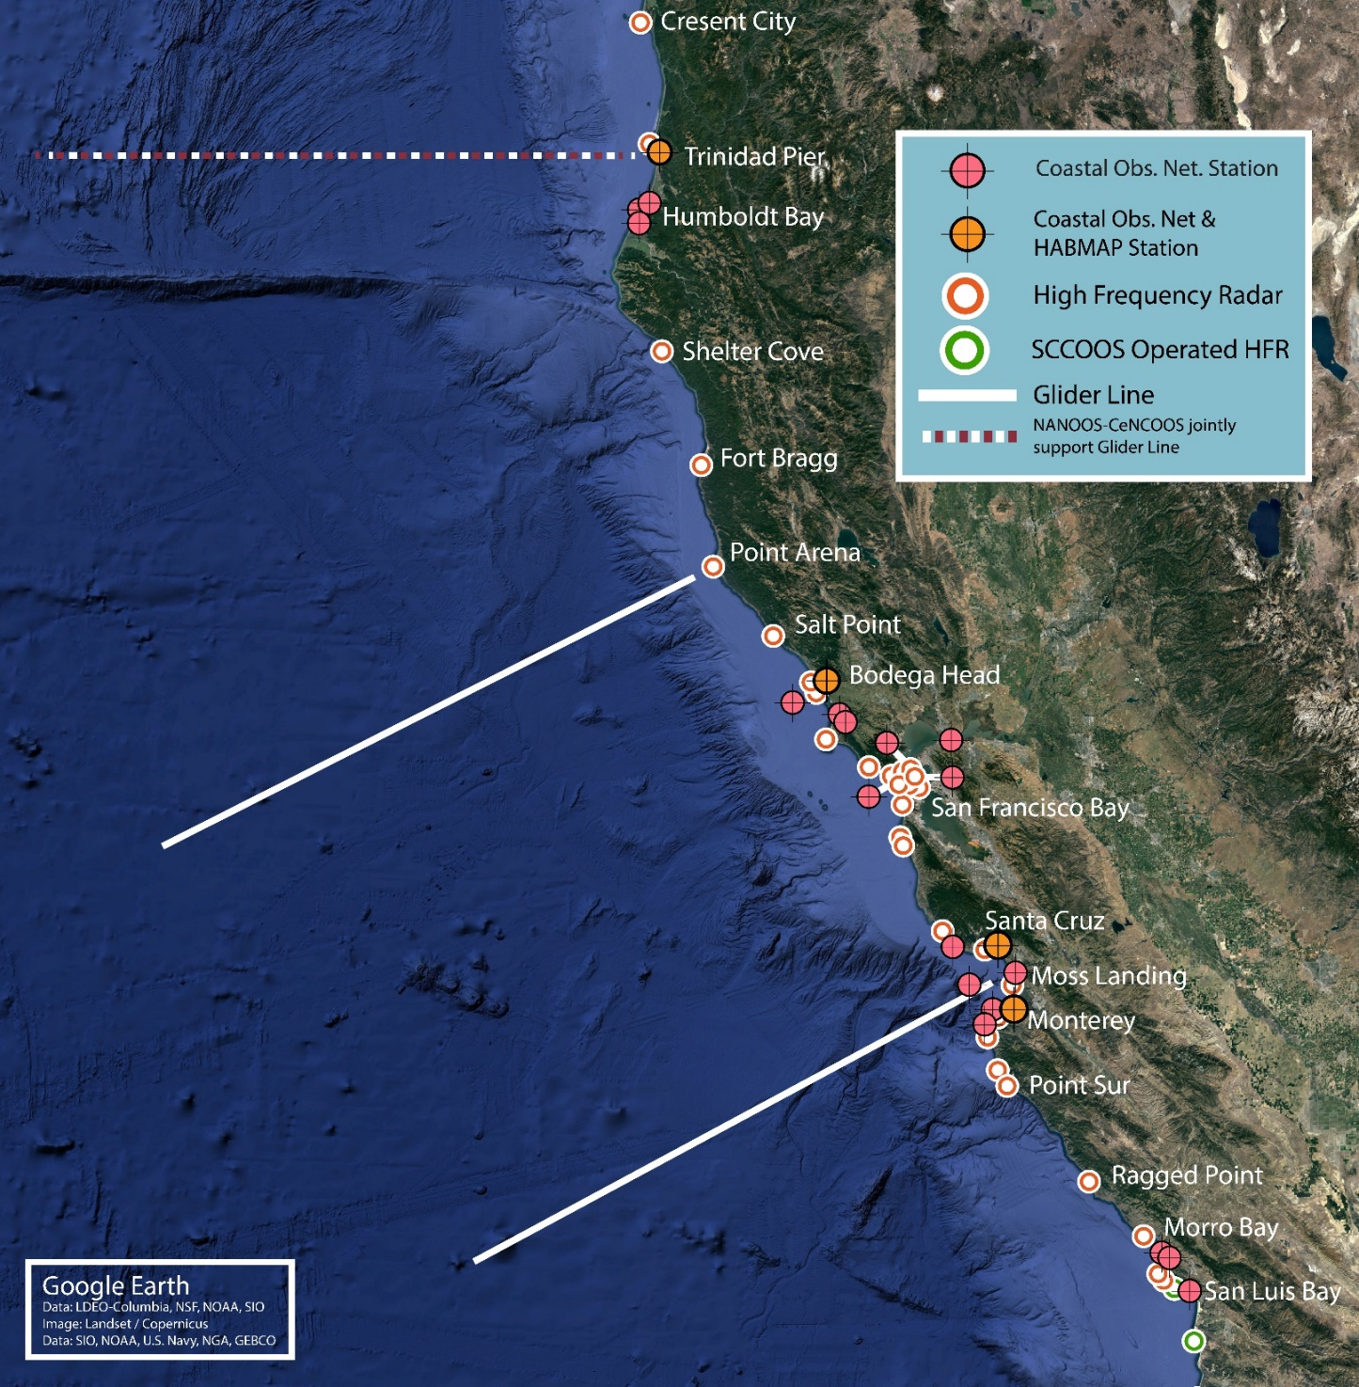
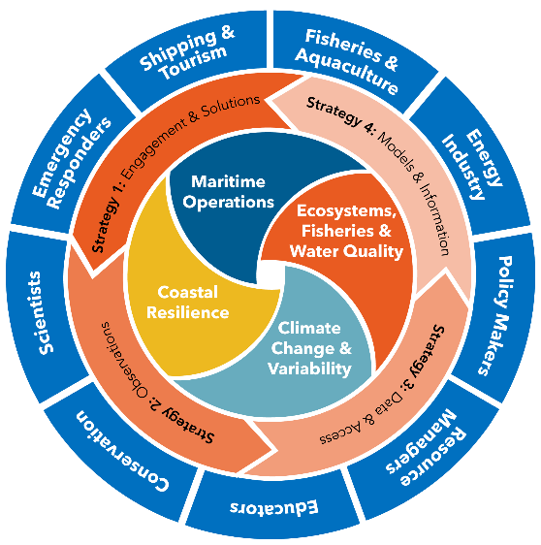
CeNCOOS Evolution w/ BGB and BioEco EOVs
https://data.cencoos.org/
https://www.cencoos.org/strategic-plan/
Notes:
What’s the fundamental problem, question, or issue you are addressing?
The ocean observing community faces challenges in the measurement and prediction of ocean weather and climate variability and change to support safe and efficient transportation and commerce, risk reduction for coastal communities, and sustaining healthy ecosystems and water quality. These issues require measurement and improved information delivery of many ocean, coastal and estuary phenomena including ocean warming and marine heatwaves, acidification and hypoxia, sea-level rise and flooding, managing protecting species and habitats, growing fisheries and aquaculture trade, vessel navigation, and supporting search and rescue operations.
Why is it important/why should anyone care?
Shipping, fisheries, tourism and recreation are key pillars of a Blue Economy that have the potential to double between 2010 and 2030, when powered by information solutions to enable sustainable growth and address the many compounding challenges.

Slide 8
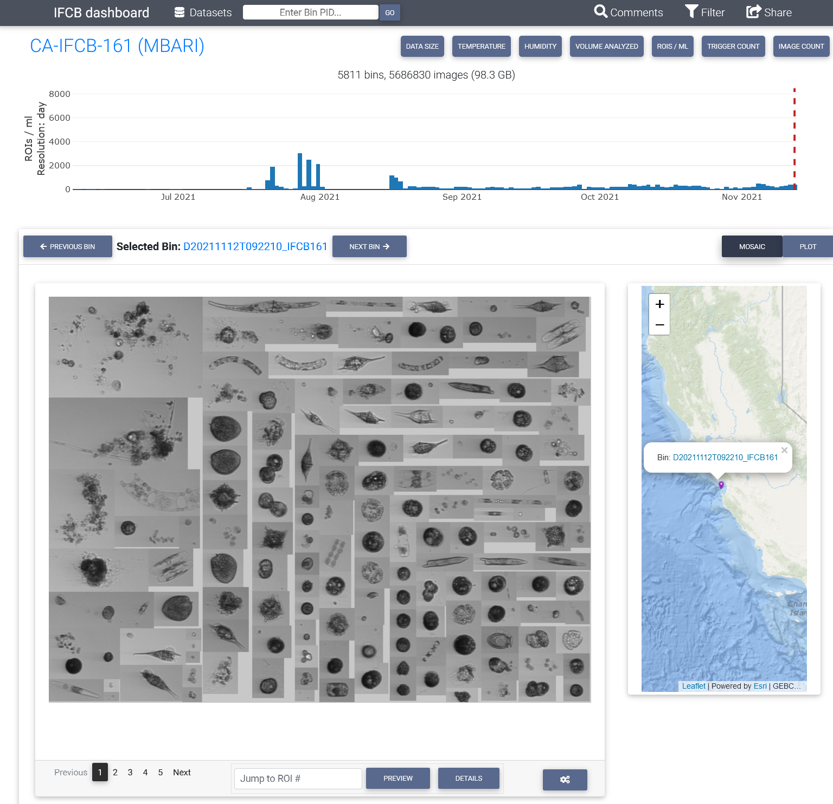
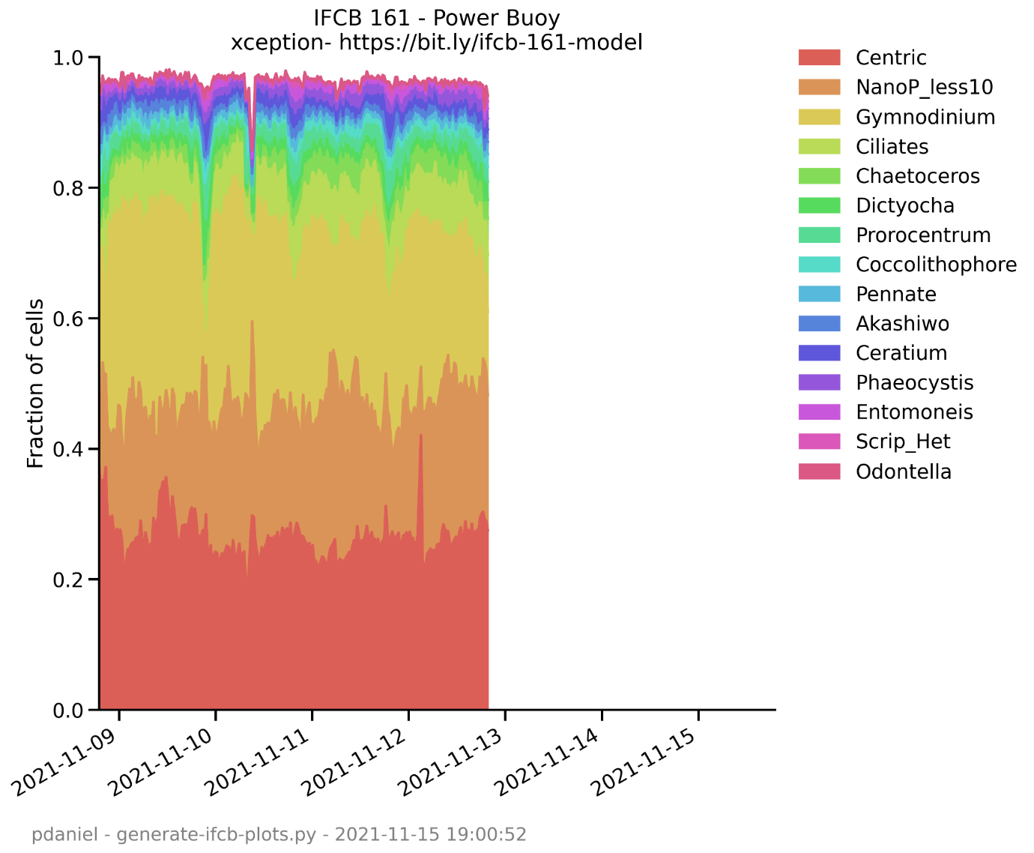
Imaging FlowCytobot (IFCB) Network in CA
P Daniel, R Kudela, F Chavez, C Anderson, Bochenek et al.

Slide 9
Beneficiaries and Networks
Users of CeNCOOS information include:
BOEM Bureau of Ocean Energy Management
CBNMS Cordell Bank National Marine Sanctuary
CCLEAN Central Coast Long-term Environmental Assessment Network
CCLME California Current Large Marine Ecosystem
CDFW California Department of Fish and Wildlife
CDPH California Department of Public Health
CDW California Department of Water
GFNMS Greater Farallones National Marine Sanctuary
GNOME General NOAA Operational Modeling Environment
GTS Global Telecommunication System
HABMAP Harmful Algal Bloom Monitoring and Alert Program
MBNMS Monterey Bay National Marine Sanctuary
NCCOS National Centers for Coastal Ocean Science
NOS National Ocean Service (of NOAA)
OAP Ocean Acidification Program (of NOAA)
OAR Oceanic and Atmospheric Research (of NOAA)
OEHHA California Office of Environmental Health Hazard Assessment
OPC Ocean Protection Council
OSPR Oil Spill Prevention and Response
OST Ocean Science Trust
SAROPS Search and Rescue Optimal Planning System
USCG US Coast Guard
WCOA West Coast Ocean Alliance
WCODP West Coast Ocean Data Portal
Select networks of interest:
AniBOS Animal Borne Ocean Sensors
ATN Animal Telemetry Network
CalCOFI California Cooperative Fisheries Investigations
DOOS Deep Ocean Observing Strategy
GEO BON Group on Earth Observation Biodiversity Observation Network
GOA-ON Global Ocean Acidification Observing Network
GOMO Global Ocean Monitoring and Observation
GOOS Global Ocean Observing System
HABON Harmful Algal Bloom Observing Network (of NOAA)
IPCC Intergovernmental Panel on Climate Change
MARINe Multi-Agency Rocky Intertidal Network
MBON Marine Biodiversity Observation Network
OBIS Ocean Biodiversity Information System
OTN Ocean Tracking Network
PCSGA Pacific Coast Shellfish Growers Association
PISCO Partnership for Interdisciplinary Studies of Coastal Oceans
POGO Partnership for Observing the Global Ocean
ROWG Radiowave Operators Working Group
SACNAS Soc. for Adv. of Chicanos/Hispanics & Native Americans in Science
WAML Western Association of Marine Laboratories

Slide 10
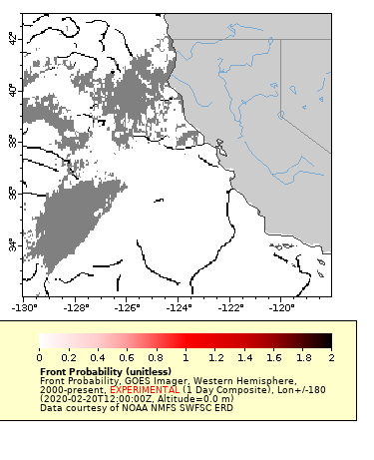
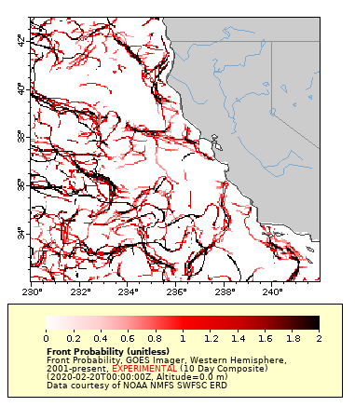
Targeting Ocean Fronts
https://coastwatch.pfeg.noaa.gov/infog/GA_tfnt_las.html

Slide 11
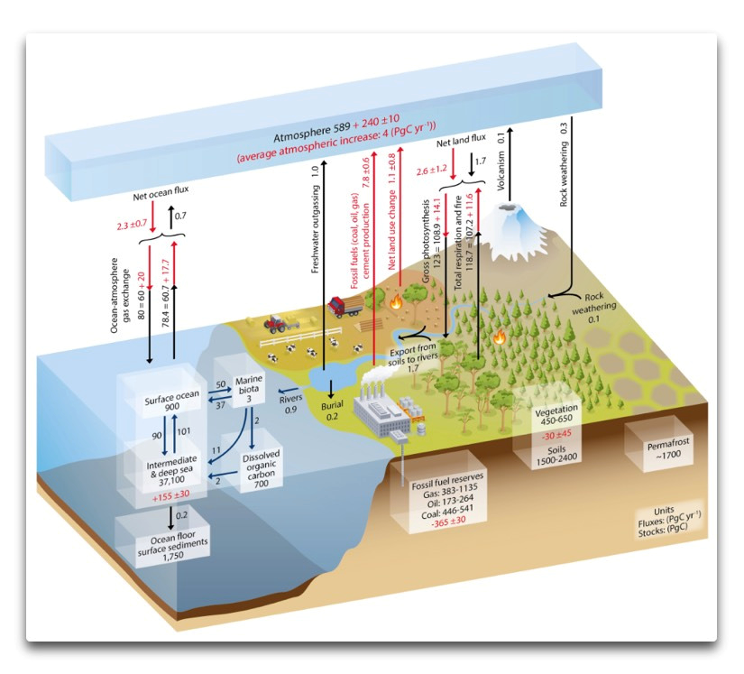
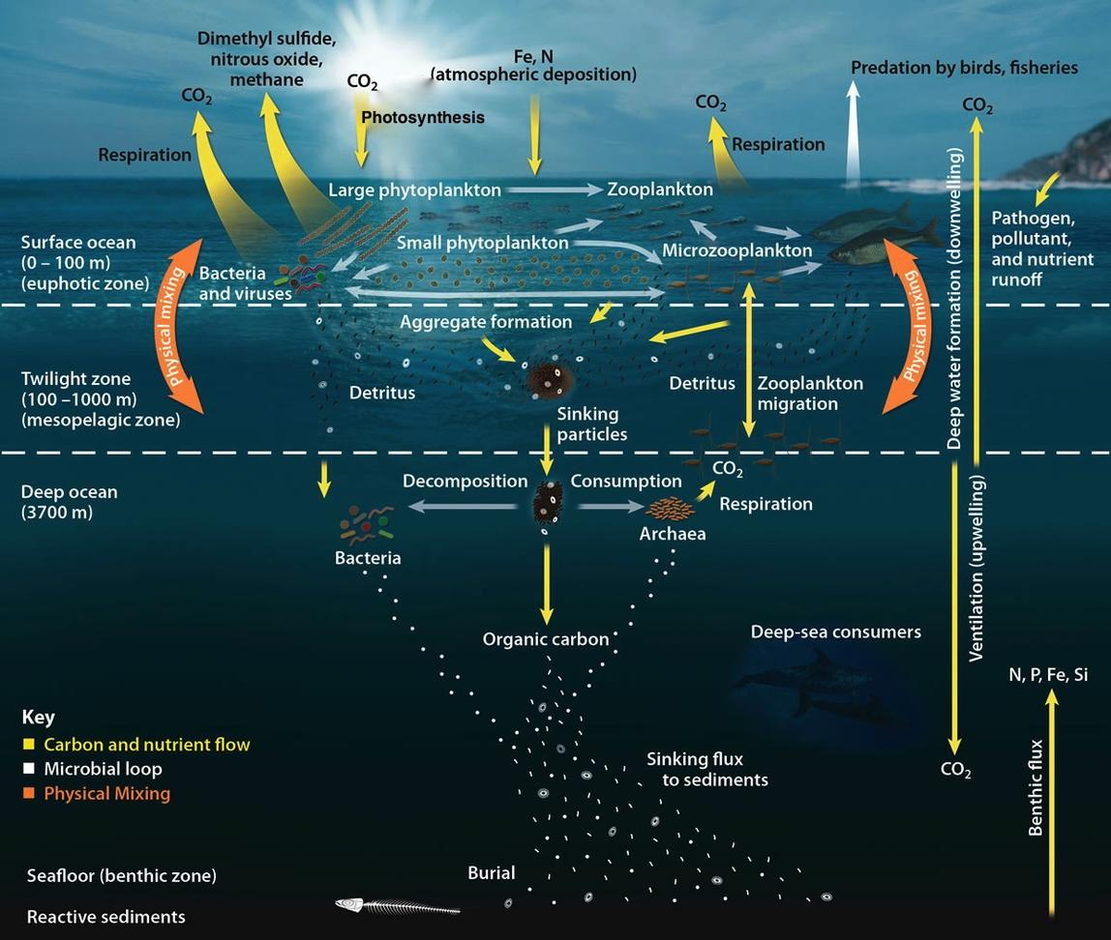
Biological Carbon Pump
Image credit: IPCC AR5
Image credit: Oak Ridge National Laboratory

Slide 12
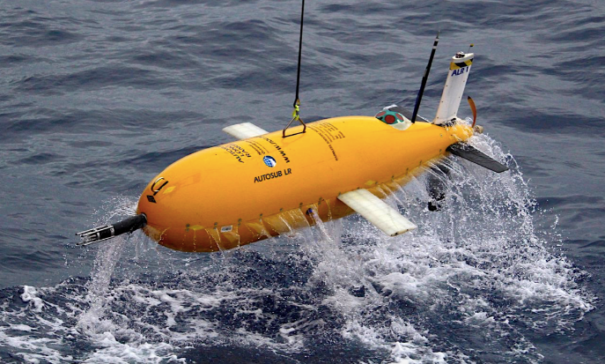
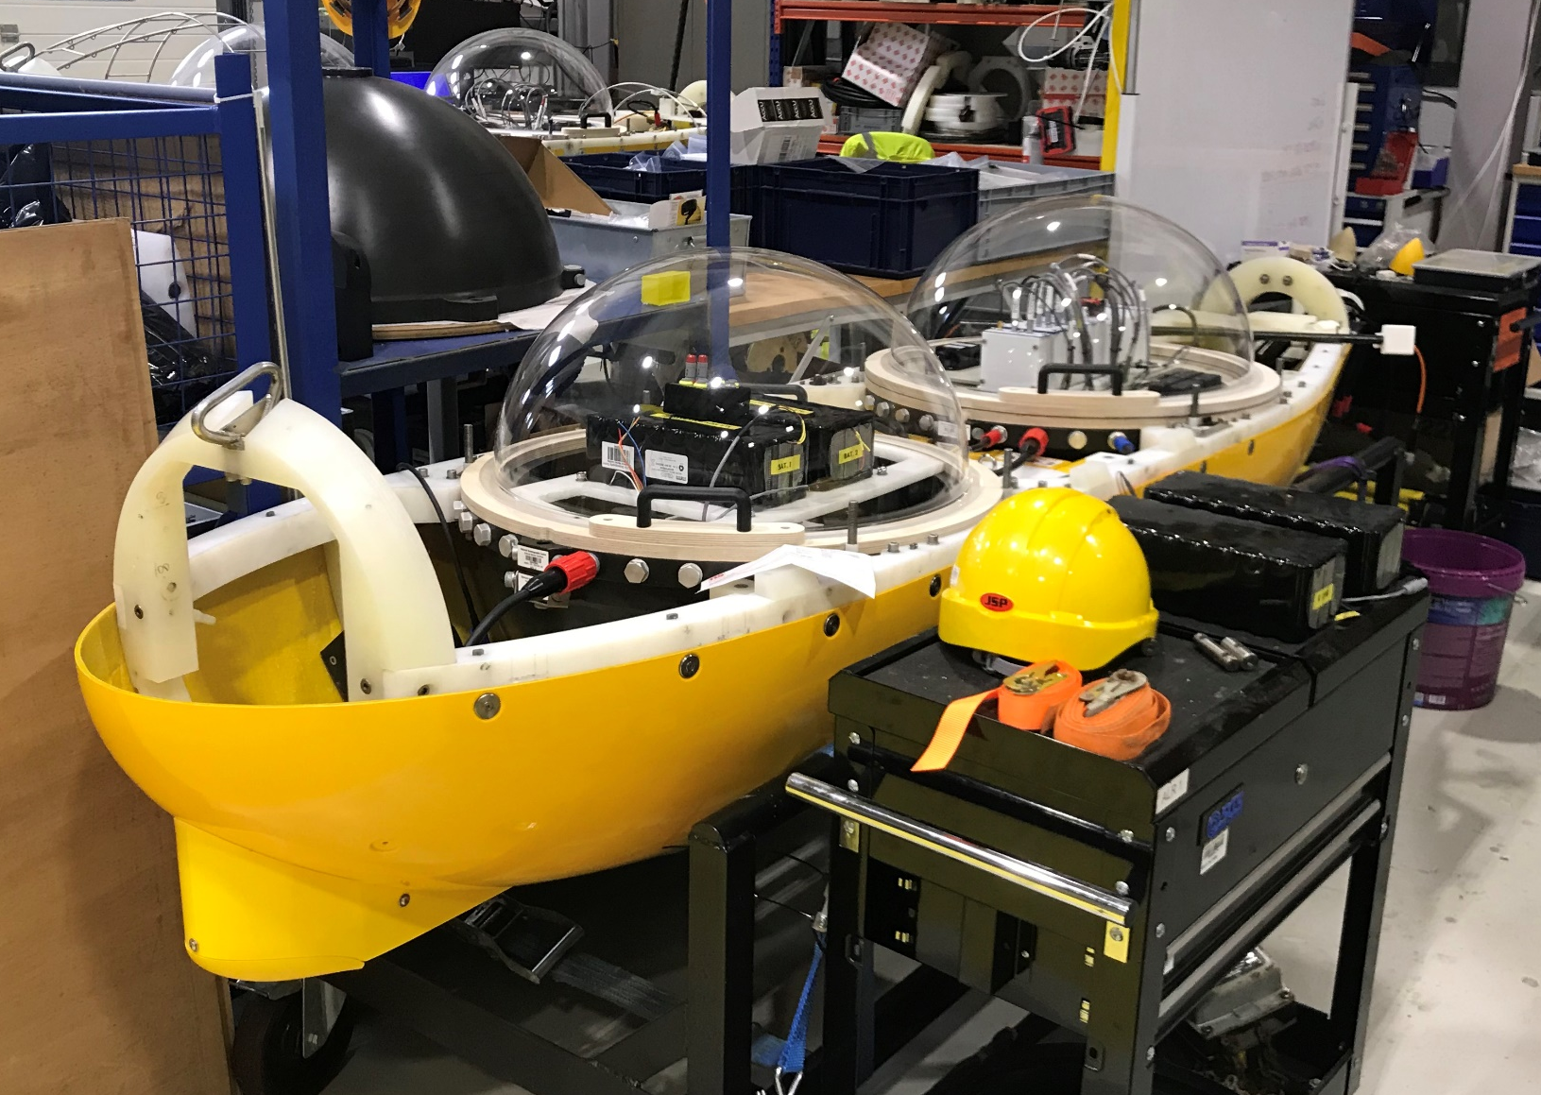
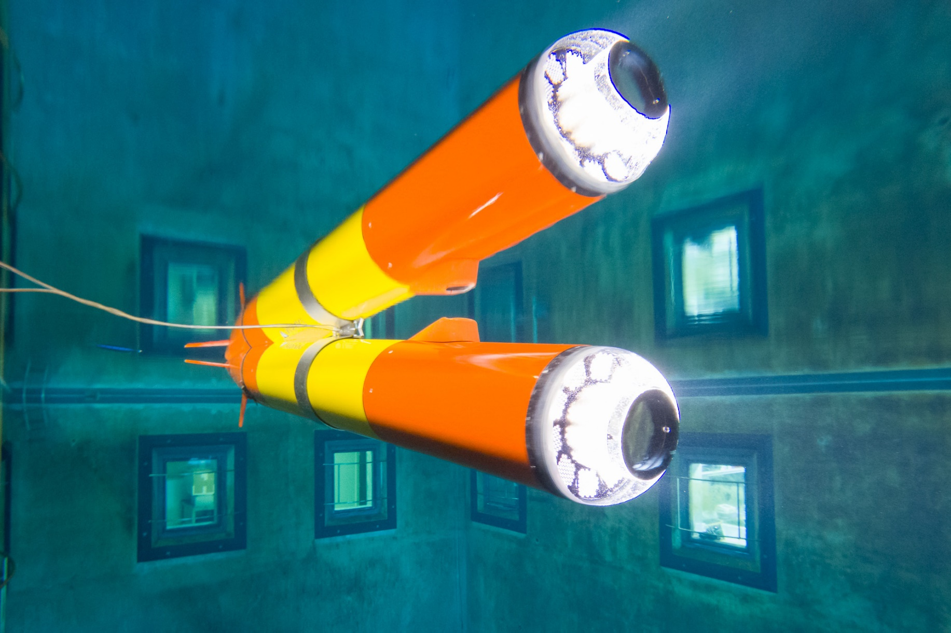
LRAUV and Autosub LR
2000 km range, Depth rating of 6000 m
1000+km range, Depth rating of 300 (soon 2000) m
Boyd et al. 2019, Nature

