Slide 1
EyeRIS on LRAUV
Preliminary Design Review
Kakani Katija, Alana Sherman, Henry Ruhl, Paul Roberts, Jon Erickson, Denis Klimov, Rich Henthorn, Joost Daniels

Slide 2
Outline
Requirements
Roadmap
Electrical Design
Mechanical Design
Software Design
Operations
Risks and Mitigation

Slide 3
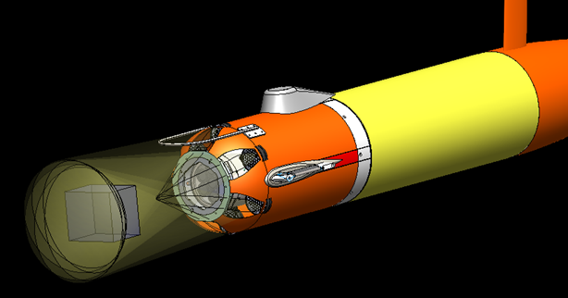
Concept
Camera array and strobes in nose
Three-dimensional, small-scale, high-resolution imaging of plankton, particles, and fluid dynamics on autonomous vehicles
~ 2 liter 3D Imaged Volume
CConcept development

Slide 4
Functional Requirements
3.1. Record still image and video data locally
3.2. Support shallow (300 m), mid (1500 m), and deep (6000m) operations
3.3. Operate autonomously for the duration of a mission
3.4. Record continuously or go in a low power sleep mode
3.5. Have internal control of camera/compute from a low-power MCU
3.6. Support vehicle ground fault detection
3.7. Controllable with vehicle mission exec
3.8. Strobe duration shall minimizes motion blur at maximum vehicle speed
3.9. Support still imaging at up to 2 Hz and short bursts of video up to 60 Hz and same be able to switch between modes on demand during the same mission

Slide 5
Operating Modes Within One Mission
Still Imaging
Continuous operation at frame low frame rate ~ 1 Hz
Rates may be adaptive to depth and/or particle concentration
Applications: glider-like transects, front detection
Video Recording
Infrequent bursts of 30 or 60 FPS video
Vehicle may need to hover during imaging
High power draw and data rate
Applications: 3D particle tracking velocimetry

Slide 6
Key Design Requirements
Depth Rating
  Reusable housing design with material selection and material removal adapted to working depth: Aluminum 300 m / 1500 m version for LR, Titanium 6000 m version for Autosub LR / ROVs
Mechanical Interfacing
  EyeRIS camera and strobes must fit in a LRAUV nose-shell without displacing other standard payload instruments.
Video Recording
  EyeRIS strobe electronics must buffer vehicle battery from high power bursts of video recording that require ~ 300 Watts.
Software and Data Storage
  Embedded system must store raw image data on drives inside the housing
  Must provide a low-data-rate serial stream with system status
  May provide image stats and a compressed image output to send over wireless comms

Slide 7
Current Status
Subsystem
Imaging
Parts in bench testing, close to having IMX138 sensor working with TX2 and J142
Illumination
Assembled two Rev A boards. Serial #1 has been through many pressure tests up to 9000 psi. RevB design is done and will be sent to fab. soon
Electronics
A conceptual diagram with possible DC/DC converter, battery charger, and MCU has been completed. Schematic and layout pending design review
Mechanics
A complete solid model with housing and internal frame is finished. Drawings and fab. are pending design review
Software
No software dev efforts yet outside of IMX183 camera driver integration

Slide 8
RoadMap
Timeline
Subsystem
Oct-Dec 2020
Dev
Jan-Mar 2021
Depl.
Dev
Apr-Jun 2021
Depl.
Dev
Jul-Sep 2021
Oct-Dec 2021
Depl.
Imaging
6-camera, 20 Mp each, MIPI or USB3, one USB3 wide-angle
Revise geometry and imaging requirements
6-camera, 42 Mp each, Raytrix MIPI module with one USB3 wide-angle
Illumination
Rev B of potted Cree XD16 strobes
Multi-Color option
Beam steering optics
Electronics
Minimal functionality to get in the water safely
Rev B with power optimization
Rev C, possibly add LRAUV ½ battery
Rev D
Mechanics
Rev A of 300 m pressure housing and mounts
Rev A of 6000 m pressure housing and mounts
Software
Minimal control to support testing
image compression & two-way comms with vehicle
Optimization of image acquisition, real-time object detection and opportunistic sampling

Slide 9
Electrical Design: Overview
EyeRIS Can
Input Voltage
Ethernet
Battery
Battery Charger & Power Path
Dual Jetson TX2
6 MIPI cameras
1 USB3 camera
Data Storage
Battery or Input voltage
42V Strobe Voltage
Digital Low voltage
Exposure
Signal
Analog Low voltage
SYS
CURRENT
RUN
UART
Input Voltage
9-36 V
RS-232 or 485
SMBus
Input Protection
Strobe Head x10
Ground Fault
Signal
Strobe Ballast and Flash Switch
RUN
32-bit MCU
SAMD21
LowPowerLabs
42 V
5 V
Cree XD16
15 Series
4 Parallel
CAP
VOLTAGE
5V DC/DC
5 V
FLASH
CURRENT
RS-232/485 transceiver
Thermal Protection
UART
Serial
FLASH
TRIGGER
Exposure
Signal
MUX
OVP

Slide 10
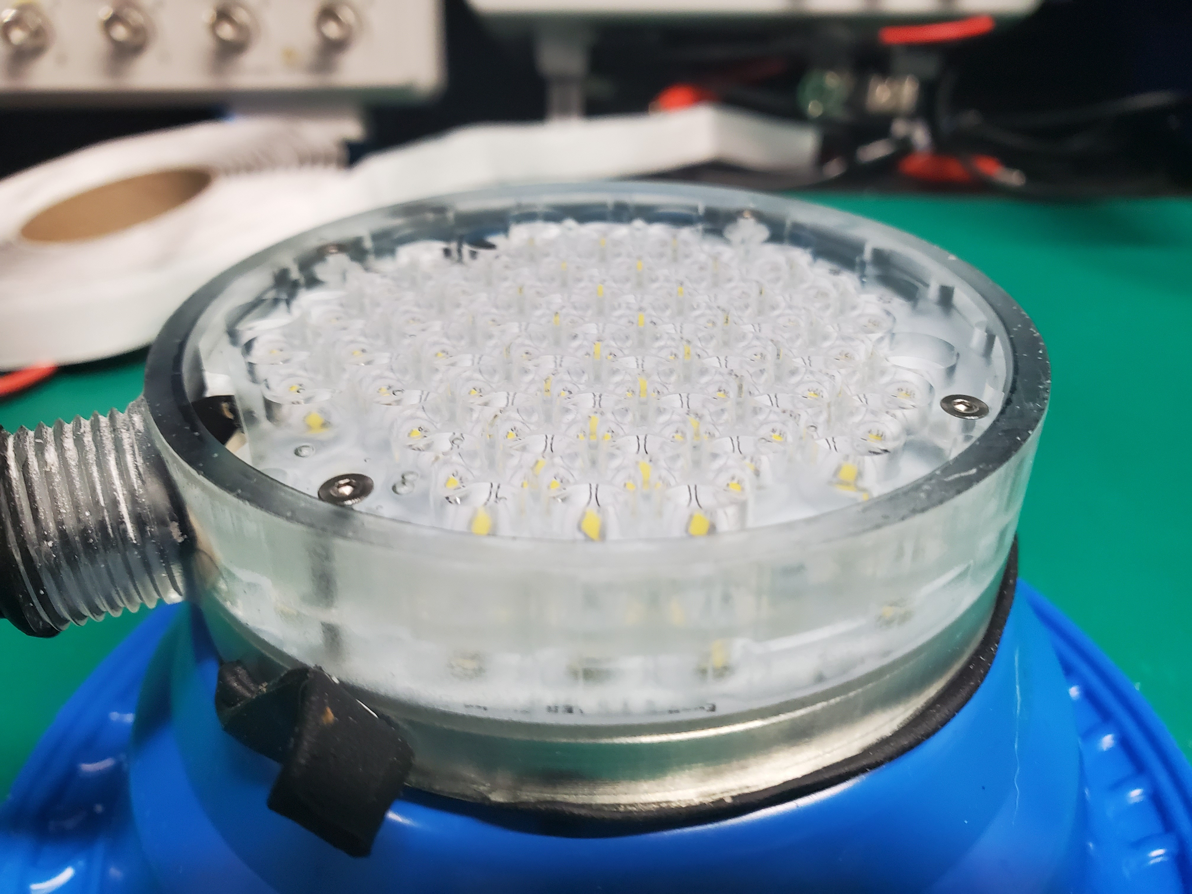
Electrical Design: Strobes
Concept reviewed on April 2, 2020
Current Status:
  XD16 LEDs have passed numerous pressure tests up to 9000 psi without noticeable change in operation
  Have built up one complete assembly with Silicone potting compound and tested to 9000 psi
  Current design is slightly too large for fitting in LRAUV shell
  Rev B will be assembled soon and pressure tested
Additional Info is available: Strobe 9000 psi

Slide 11
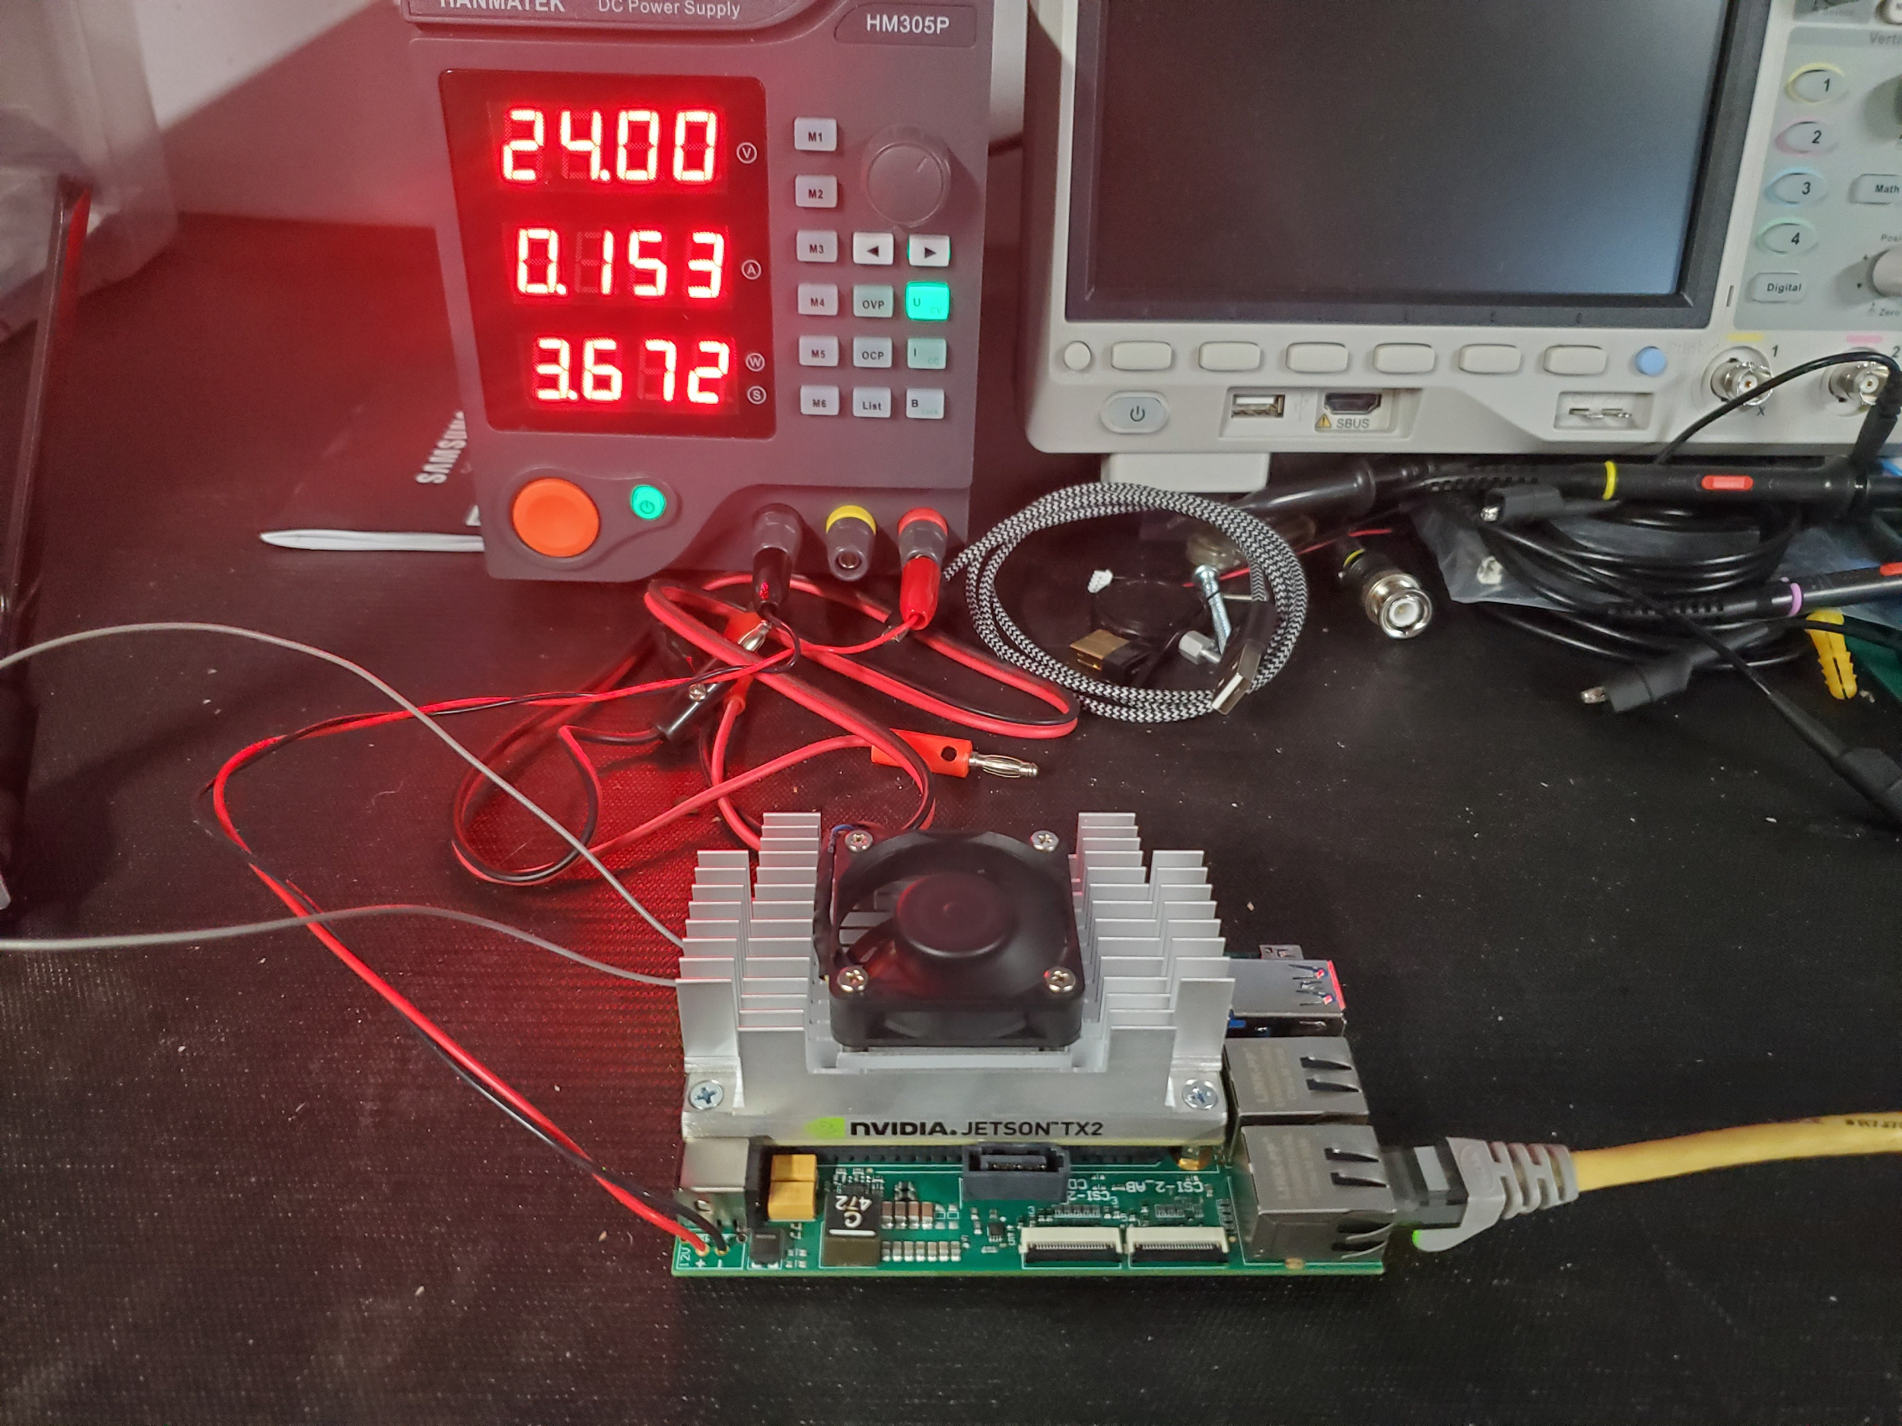
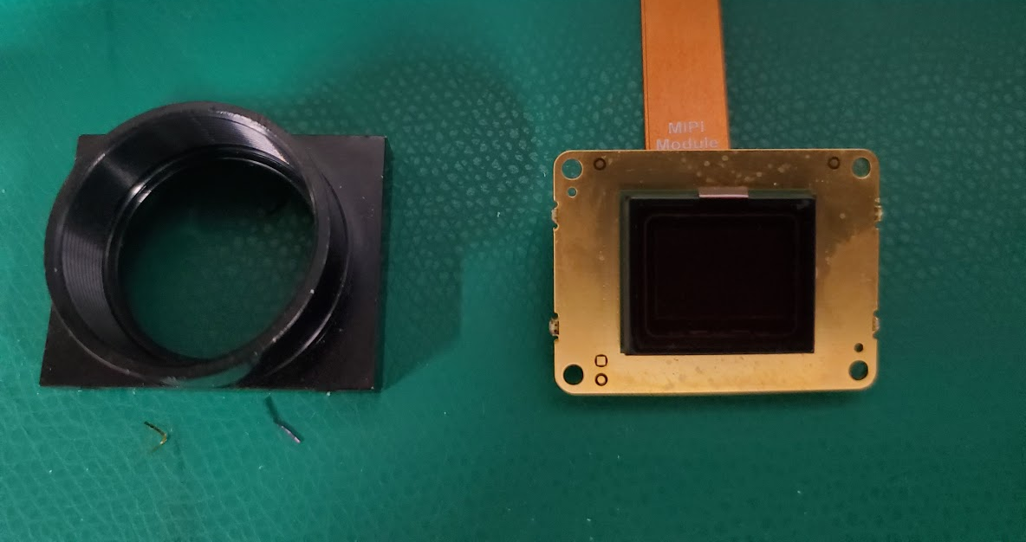
Electrical Design: Cameras and Compute
Camera array with 6, IMX183 sensors in hexagonal formation.
Each camera module draws roughly 1 W
One Jetson TX2 is needed per 3 modules due to CSI-2 lane limitation
TX2 power draw with J142 carrier is under 4 W at idle, 15 W at full load.
Details on camera and lens selection: LRAUV Camera Selection.pdf

Slide 12
Electrical Design: Power Requirements
Component Average Power
System Power Draw
Mode | MCU | Camera / Compute | Strobes | Peak Internal | Peak Draw | Average Draw
MCU only | < 100 mW | < 1 mW | < 1 mW | ~1 W | ~1 W | ~ 100 mW
System Idle | < 100 mW | < 10 W | < 1mW | ~30 W | ~30 W | ~ 10 W
Still Imaging (2 Hz) | < 100 mW | < 20 W | < 10 W | ~1700 W | ~60 W | ~ 30 W
Video (60 Hz) | < 100 mW | 30 W | < 300 W | ~1710 W | ~660 W | ~ 330 W
No Battery Buffer Needed
Battery Buffer Needed

Slide 13
Electrical Design: Battery Buffering Options
Important Considerations (from Denis)
1. Location and capacity: integrated into EyeRIS, or separate battery pack?
2. Charge path: 24V or battery voltage level?
3. Optimization: energy efficiency, ability to isolate?
4. Risk mitigation: over-discharge, overloading fuses in LRAUV pack, flooding?
5. Mechanical configuration: vehicle length, reusing ESP pack design?

Slide 14
Electrical Design: Battery Buffering Options
Integrated battery in EyeRIS
Partial LRAUV Battery in ESP Housing
Pros:
Makes system self-contained
Reduces parts cost and system integration complexity
Reduces vehicle payload size and requirements
Cons:
Adds risk of battery failure to EyeRIS system
Adds complexity to electronic design
Pros:
Greater overall battery capacity
Reuses a well-tested battery system
Simplifies EyeRIS electronics
Cons:
Increases payload size
Increase parts cost (new ESP housing, batteries)

Slide 15
Electrical Design: Integrated Battery Power Path
LRAUV
Low-power MCU
~ 10 mW
2x TX2, cameras, LC shutter driver
~ 15 W Average power
LRAUV Battery
24V Load Controller
93 %
LTC4416 Power Path
Controller
LTC4162-L
16.8V 95 %
LTC4416 Ideal Diode
4S Li-Ion Pack
10A rate, 42 Whr
DC/DC Converter
LTC4162-L
16.8V 95 %
EyeRIS Can
4S Li-Ion Pack
10A rate, 42 Whr
Ideal Diode Power Path
Li-Ion Battery Pack
Load
Strobe Cap Bank
~ Average Power (30W)
LTC3779 Boost to 42V 95%
Details in: EyeRIS LRAUV Video Worksheet

Slide 16
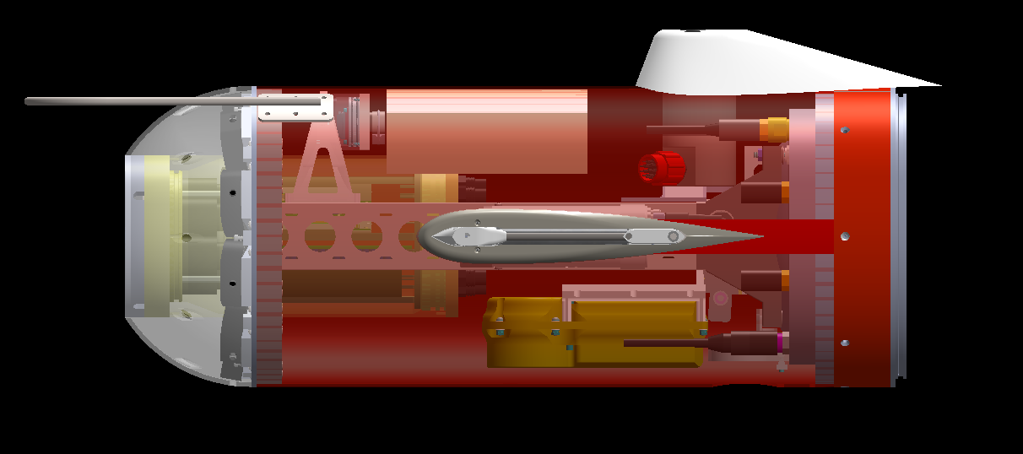
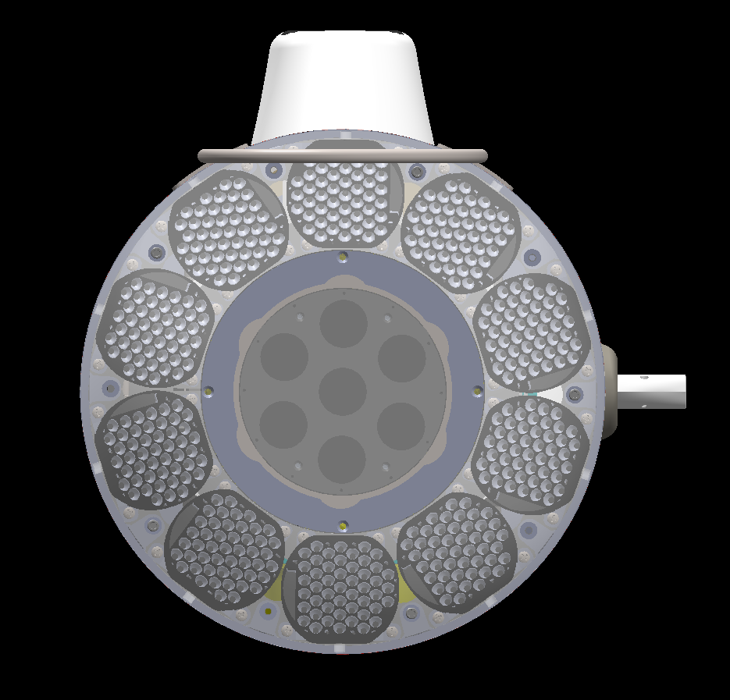
Mechanical Design: Overview
Cameras & Electronics Housing
Foam
Cree XD16, potted strobe (48 LEDs)
20 MP x 7 Camera Array
Flooded Polycarbonate Dome
XLng-Nose Shell with nose cut off
Side View
Front View

Slide 17
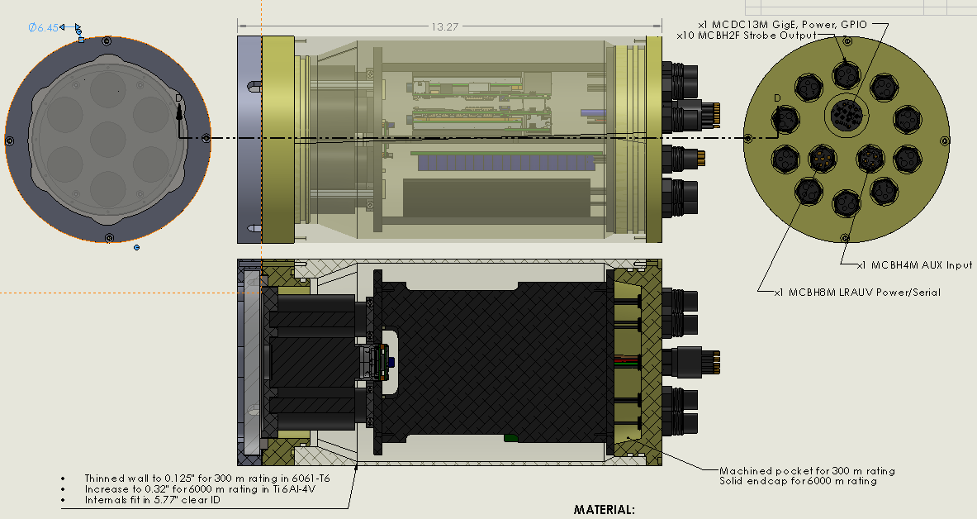
Mechanical Design: Camera & Electronics 300 m
x2 TX2
Lenses
Cameras
Strobe PCB
Battery
6000 m rating requires
Ti 6Al-4V material,
0.32” thick walls,
Same OD,
1.5” longer,
2” thick sapphire port,

Slide 18
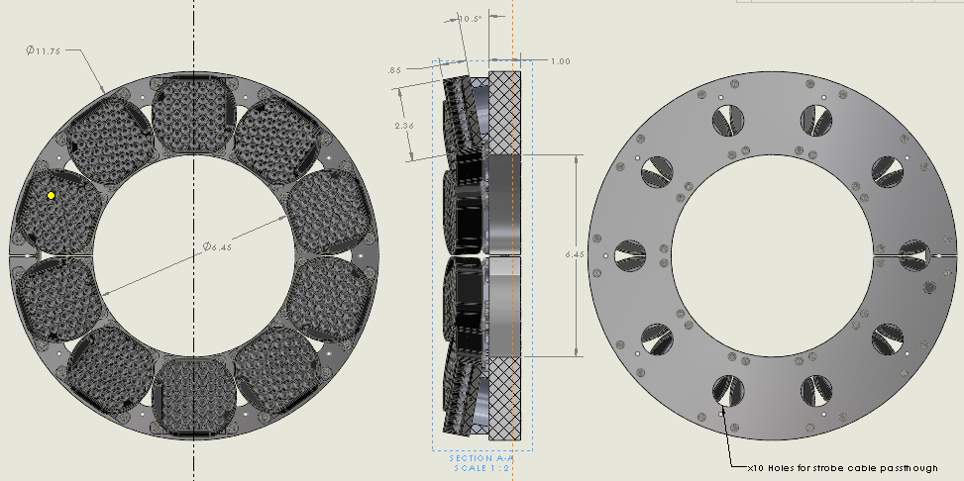
Mechanical Design: Strobe Array

Slide 19
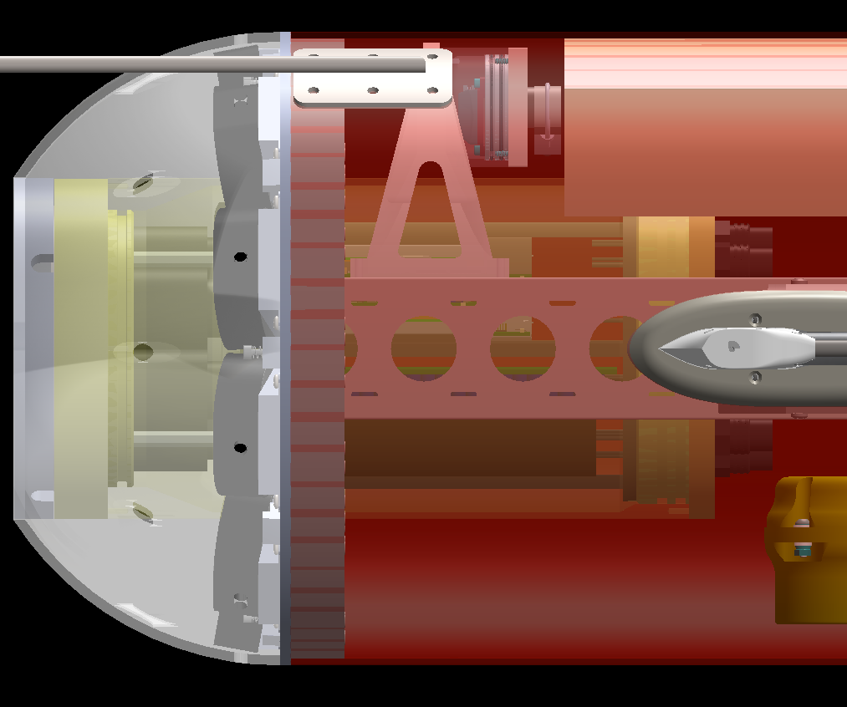
Mechanical Design: Mounting Options
Mount Strobe Clamp to
Ti u-channel with angle brackets
Clamp Camera Tube to Ti u-channel
Screw Strobe Clamp to
Shell as done on vehicle endcap

Slide 20
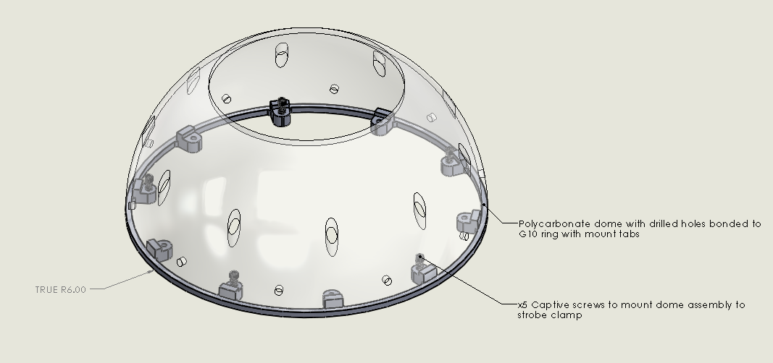
Mechanical Design: Clear Nose Shell

Slide 21
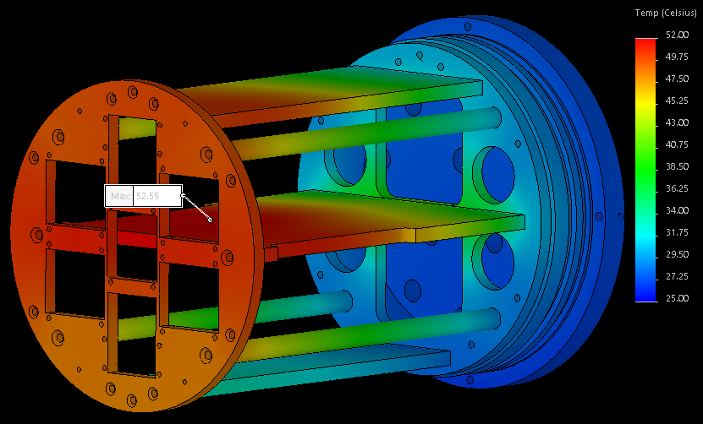
Thermal Considerations: Video
15 W TX2 #1
6 W
cameras
25 C
Water Temp
15 W TX2 #2
Max: 52.55 C
15 W
Strobe PCB @ 95% eff.

Slide 22
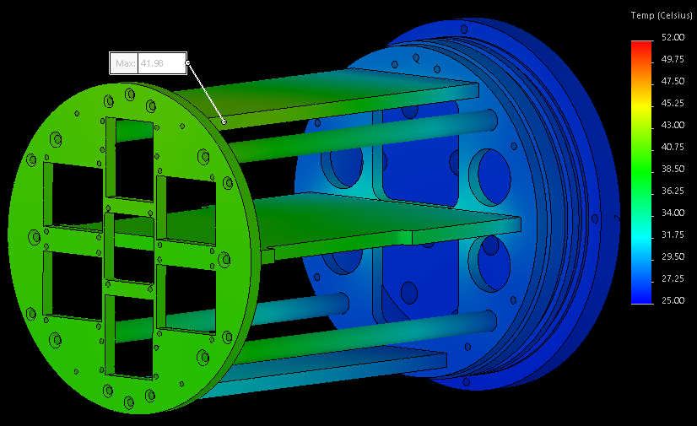
Thermal Considerations: Stills at 2 Hz
12 W TX2 #1
5 W
cameras
25 C
Water Temp
12 W TX2 #2
Max: 41.98 C
1.5 W
Strobe PCB @ 95% eff.

Slide 23
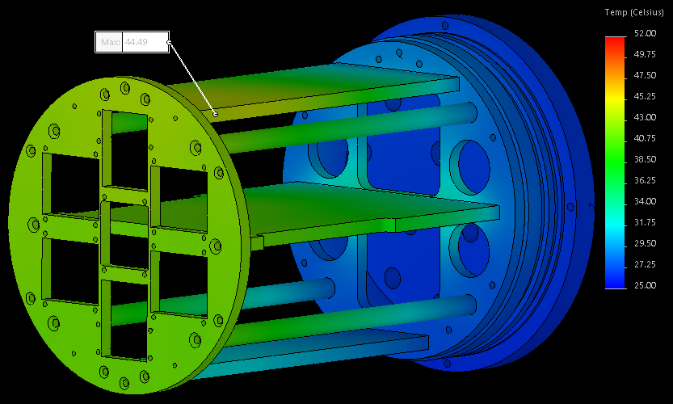
Thermal Considerations: Stills at 2 Hz, 10% Video
12 W TX2 #1
5 W
cameras
25 C
Water Temp
12 W TX2 #2
Max: 44.49
1.5 W
Strobe PCB @ 95% eff.

Slide 24
Software Design: Overview
Compute modules
  One TX2 acts as leader and the other follows. The leader interacts with the MCU and publishes LCM messages to follower.
  Leader communicates with LRAUV over LCM
Serial Comms
  MCU maintains core system state and hardware info
  MCU ingests data from LRAUV over serial port
  MCU sends data continuously to leader TX2 when TX2 is turned on.
Image Acquisition
  Triggered acquisition with C++ or python threaded recorders to handle frames. One process per camera, 3-4 threads per process
    Thread 1 : receive camera frame
    Thread 2 : save raw pixels
    Thread 3 : process frames and save processed data
    Thread 4 : manager and data collator and publisher

Slide 25
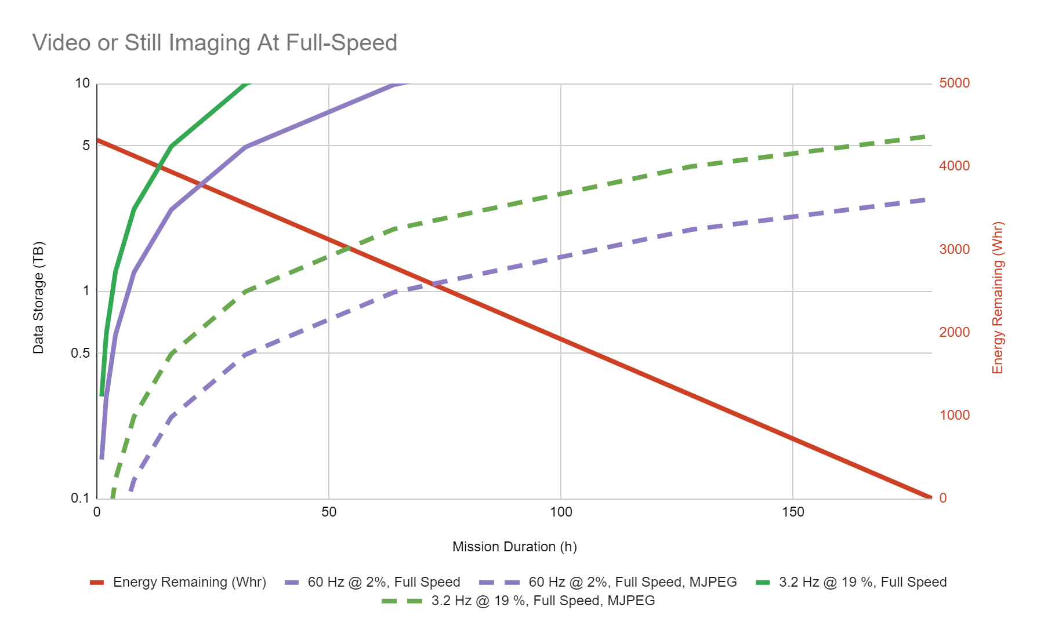
Software Design: Data Management
Mode | Total Images (Frames) | Raw Storage Needed
Max Still Imaging @ full LRAUV speed for 180 hours | 232,790 | 32.59 TB
Max Video Recording @ full LRAUV speed for 180 hours | 253,579 | 8.87 TB
Max Still Imaging @ zero LRAUV speed for 180 hours | 948,825 | 132.83 TB
Max Video Recording @ zero LRAUV speed for 180 hours | 1,033,561 | 36.17
Details in DataAndPowerManagement

Slide 26
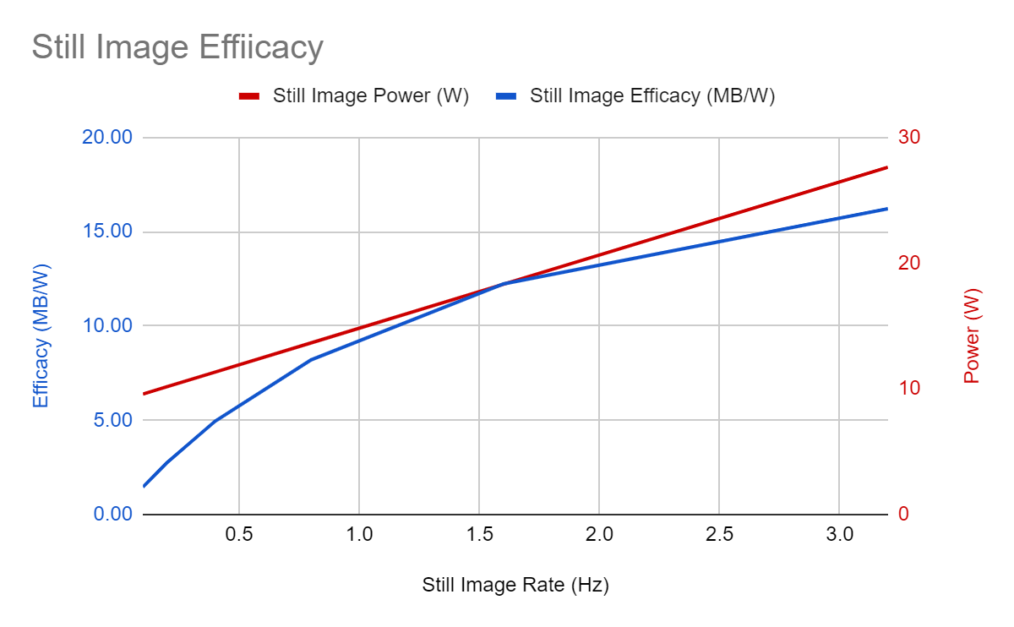
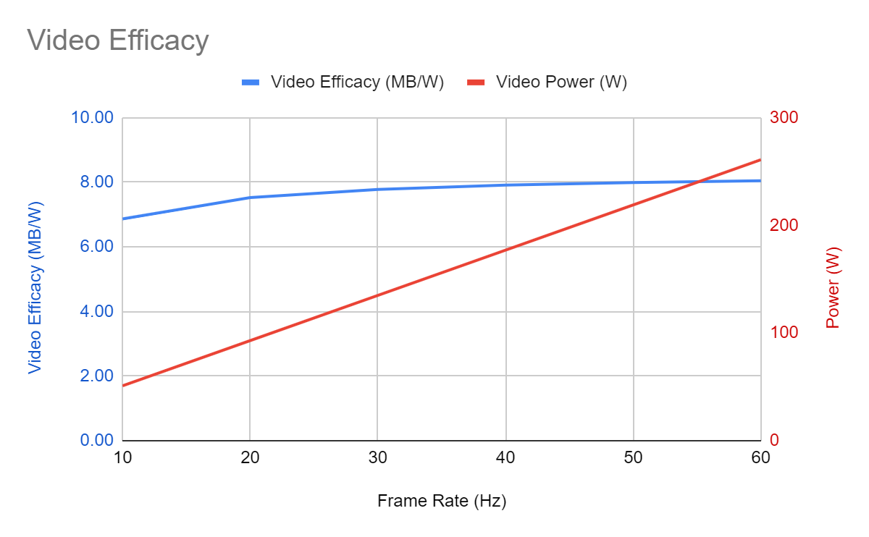
Software Design: Data Management
Raw data rate is limiting factor in most cases.
There is a great deal we can do to optimize:
  Video compression, Still image compression, Opportunistic sampling, Imaging with subset of cameras
Real-time object detection and classification could play a major role in reducing storage requirements

Slide 27
Operations
Scheduling
  How far in advance?
  Which vehicle?
  How long is vehicle available for setup and testing?
Tank Testing
  Test EyeRIS can and strobes in test tank and calibrate camera array
  Confirm serial data provides sufficient ability to ensure cameras are imaging
Field Testing
  Access to serial data?
  Low-res video stream over modems?

Slide 28
Risks and Mitigation
Cameras
  Get stuck on MIPI camera linux kernel driver issues -> Switch to USB3
Strobes
  Insufficient light output to eliminate motion blur -> add camera gain, increase exposure and fly slower
Power Path
  Internal EyeRIS battery cannot support high current -> Custom battery or partial LRAUV battery
Battery Safety
  Batteries get too hot during video -> Throttle video rate based on battery temp
  Housing floods -> Ground fault monitoring and humidity monitoring

Slide 29
Cameras & Electronics Housing
Foam
Cree XD16, potted strobe (48 LEDs)
20 MP x 7 Camera Array
Flooded Polycarbonate Dome
XLng-Nose Shell with nose cut off
Side View
Front View

