Slide 1

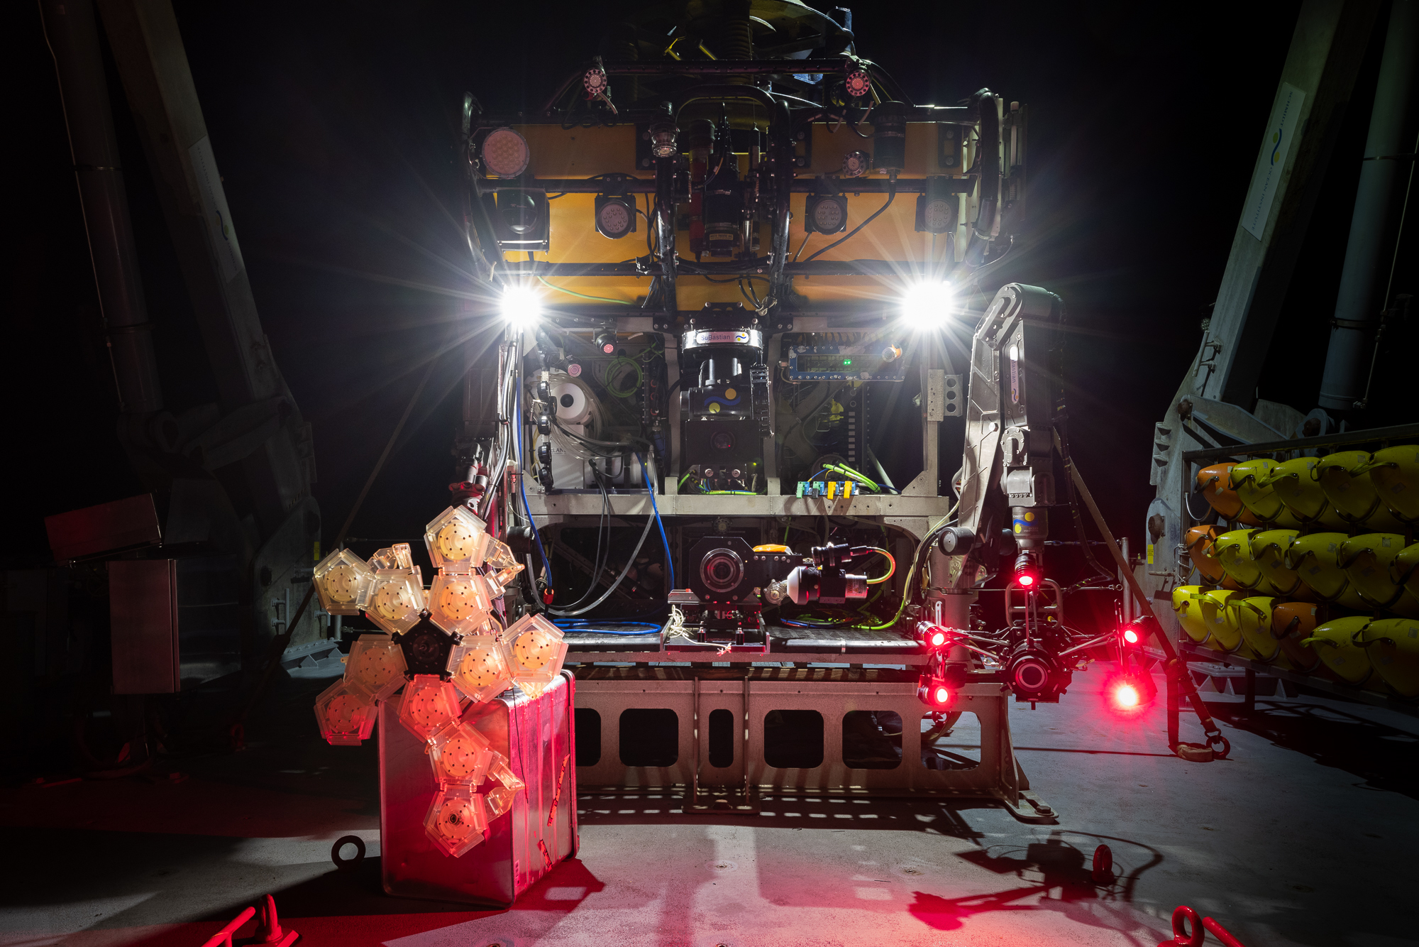
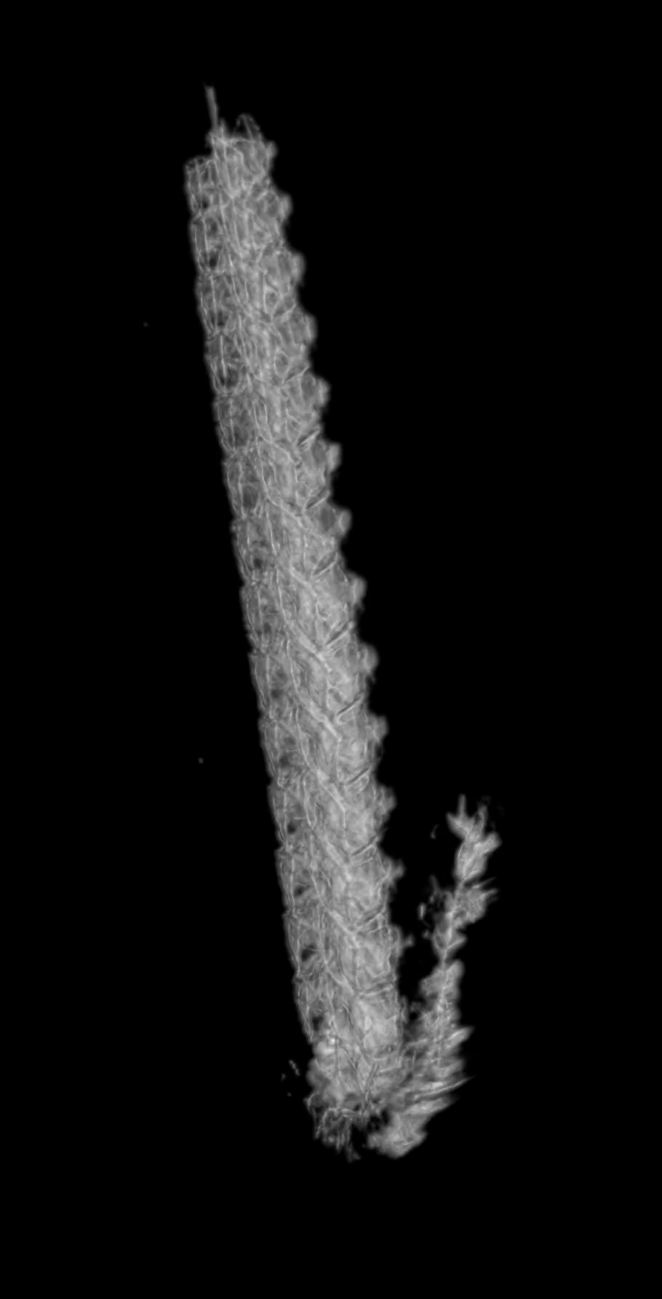
Digital specimen ”vouchers” using ROV SuBastian (SOI)
RAD2 sampler
(URI / Harvard)
EyeRIS
(MBARI)
Bargmannia elongata
3D reconstruction using DeepPIV
DeepPIV
(MBARI)

Slide 2
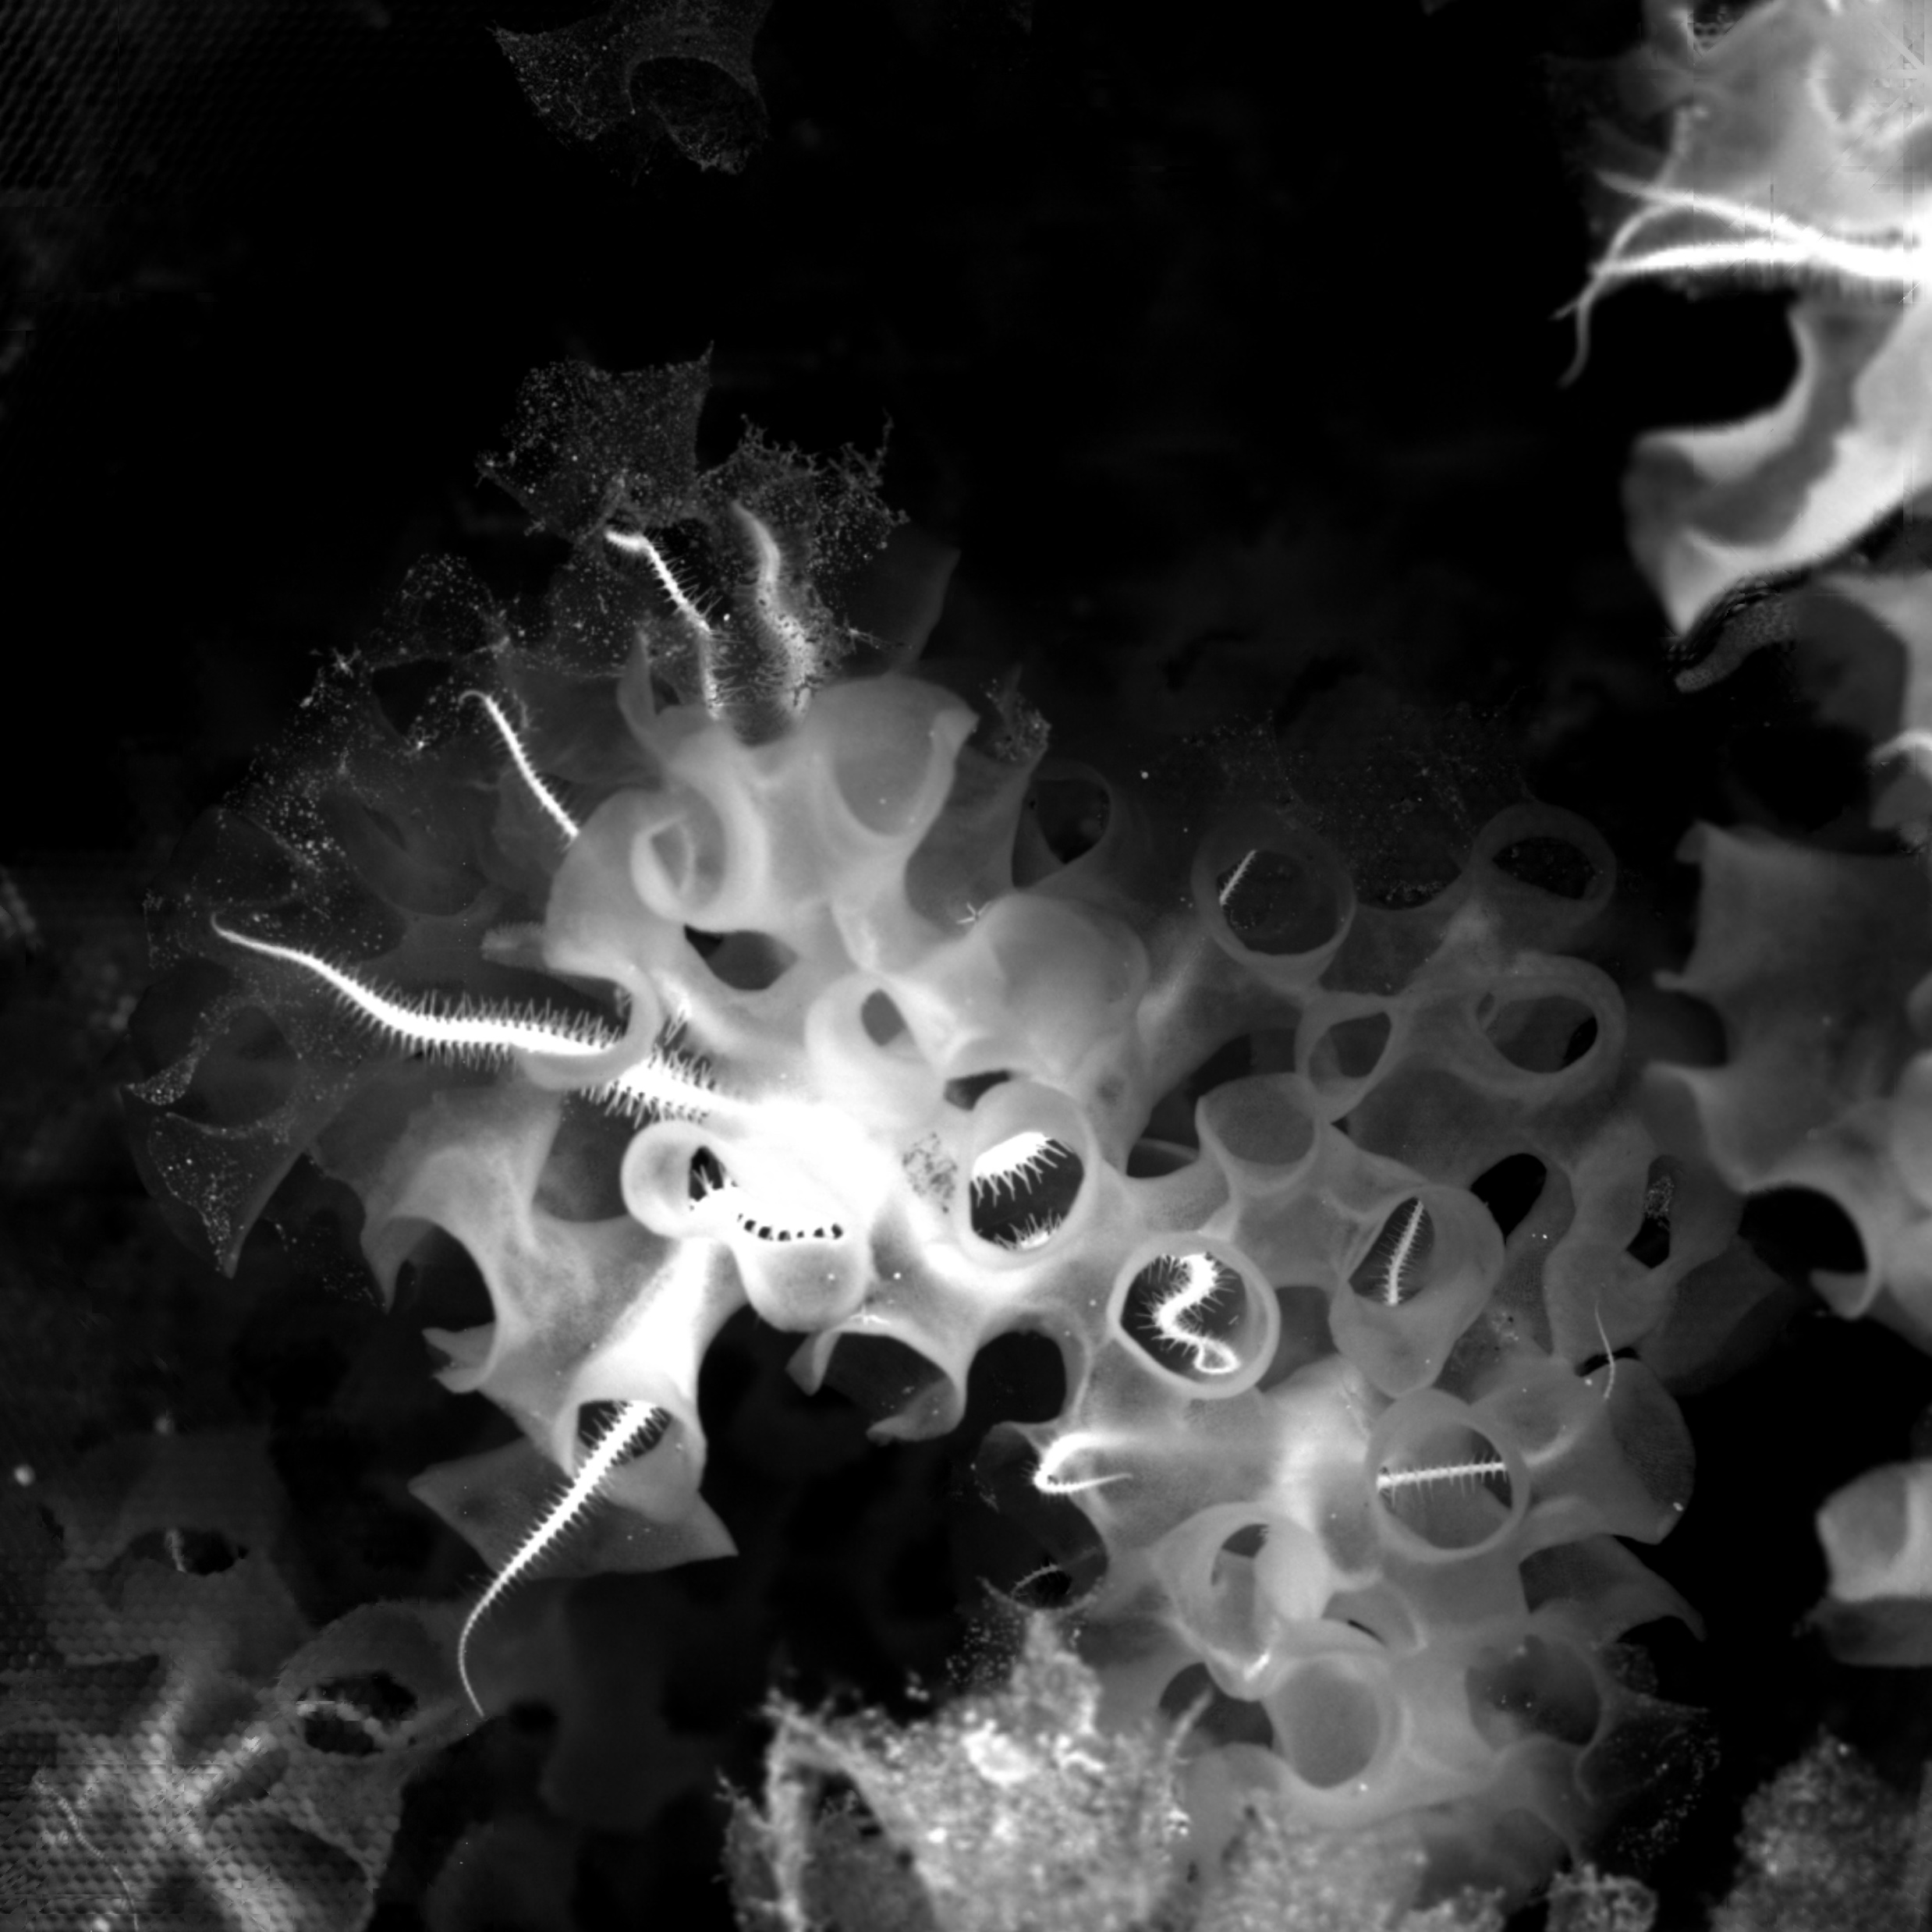
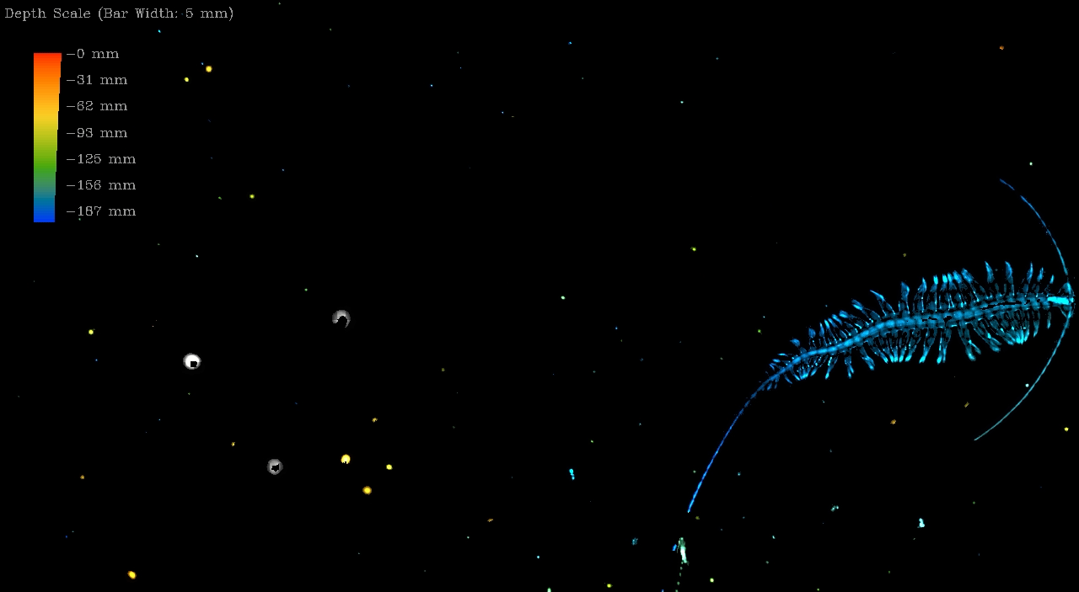
Benefit of using EyeRIS:
Worked when animal was too opaque for DeepPIV
When moving too fast
Documents movement in 3D (4D capture)
Larger depth of field than DeepPIV
Quick sizing before sampling with RAD2

Slide 3
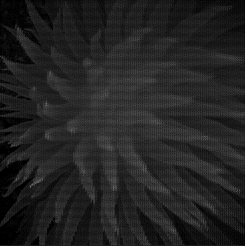
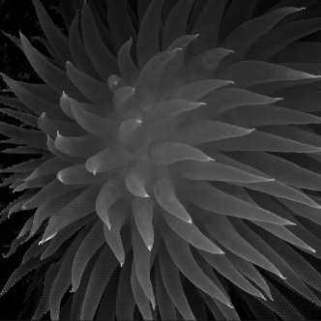
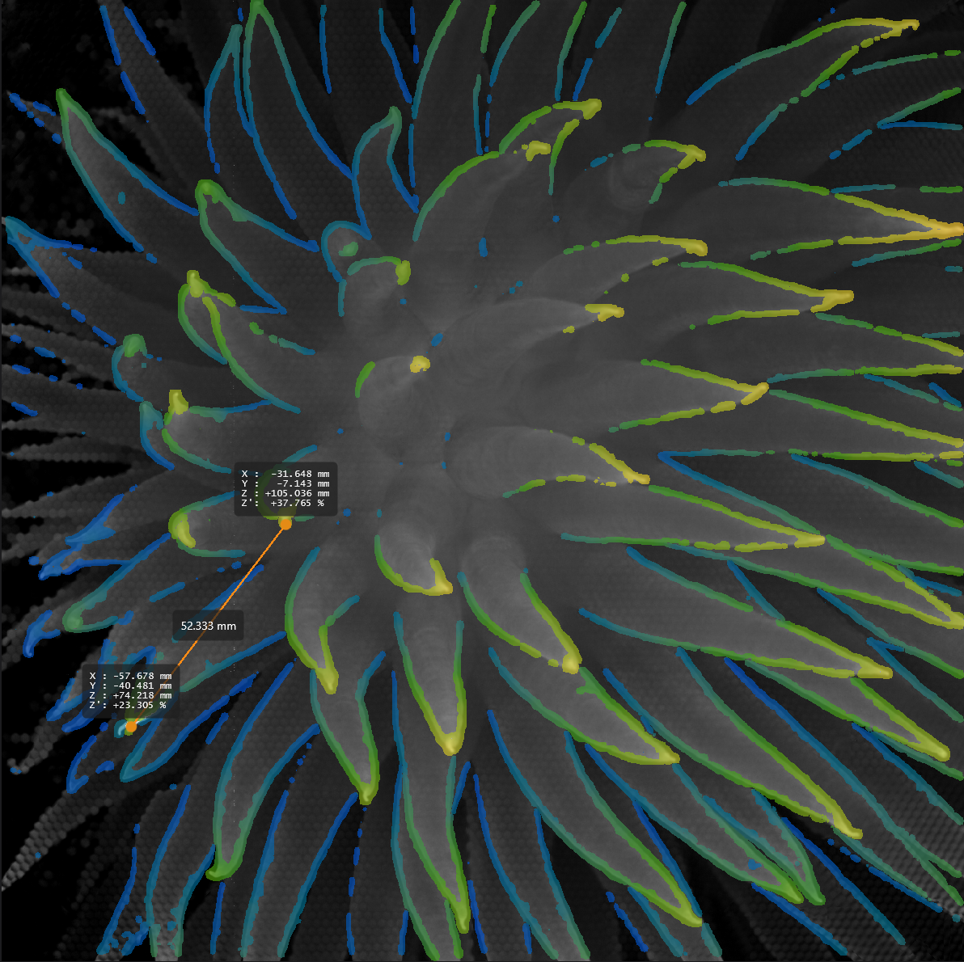
Raw
Total focus
Total focus + Depth map
Liponema (“pom-pom anemone”)

Slide 4
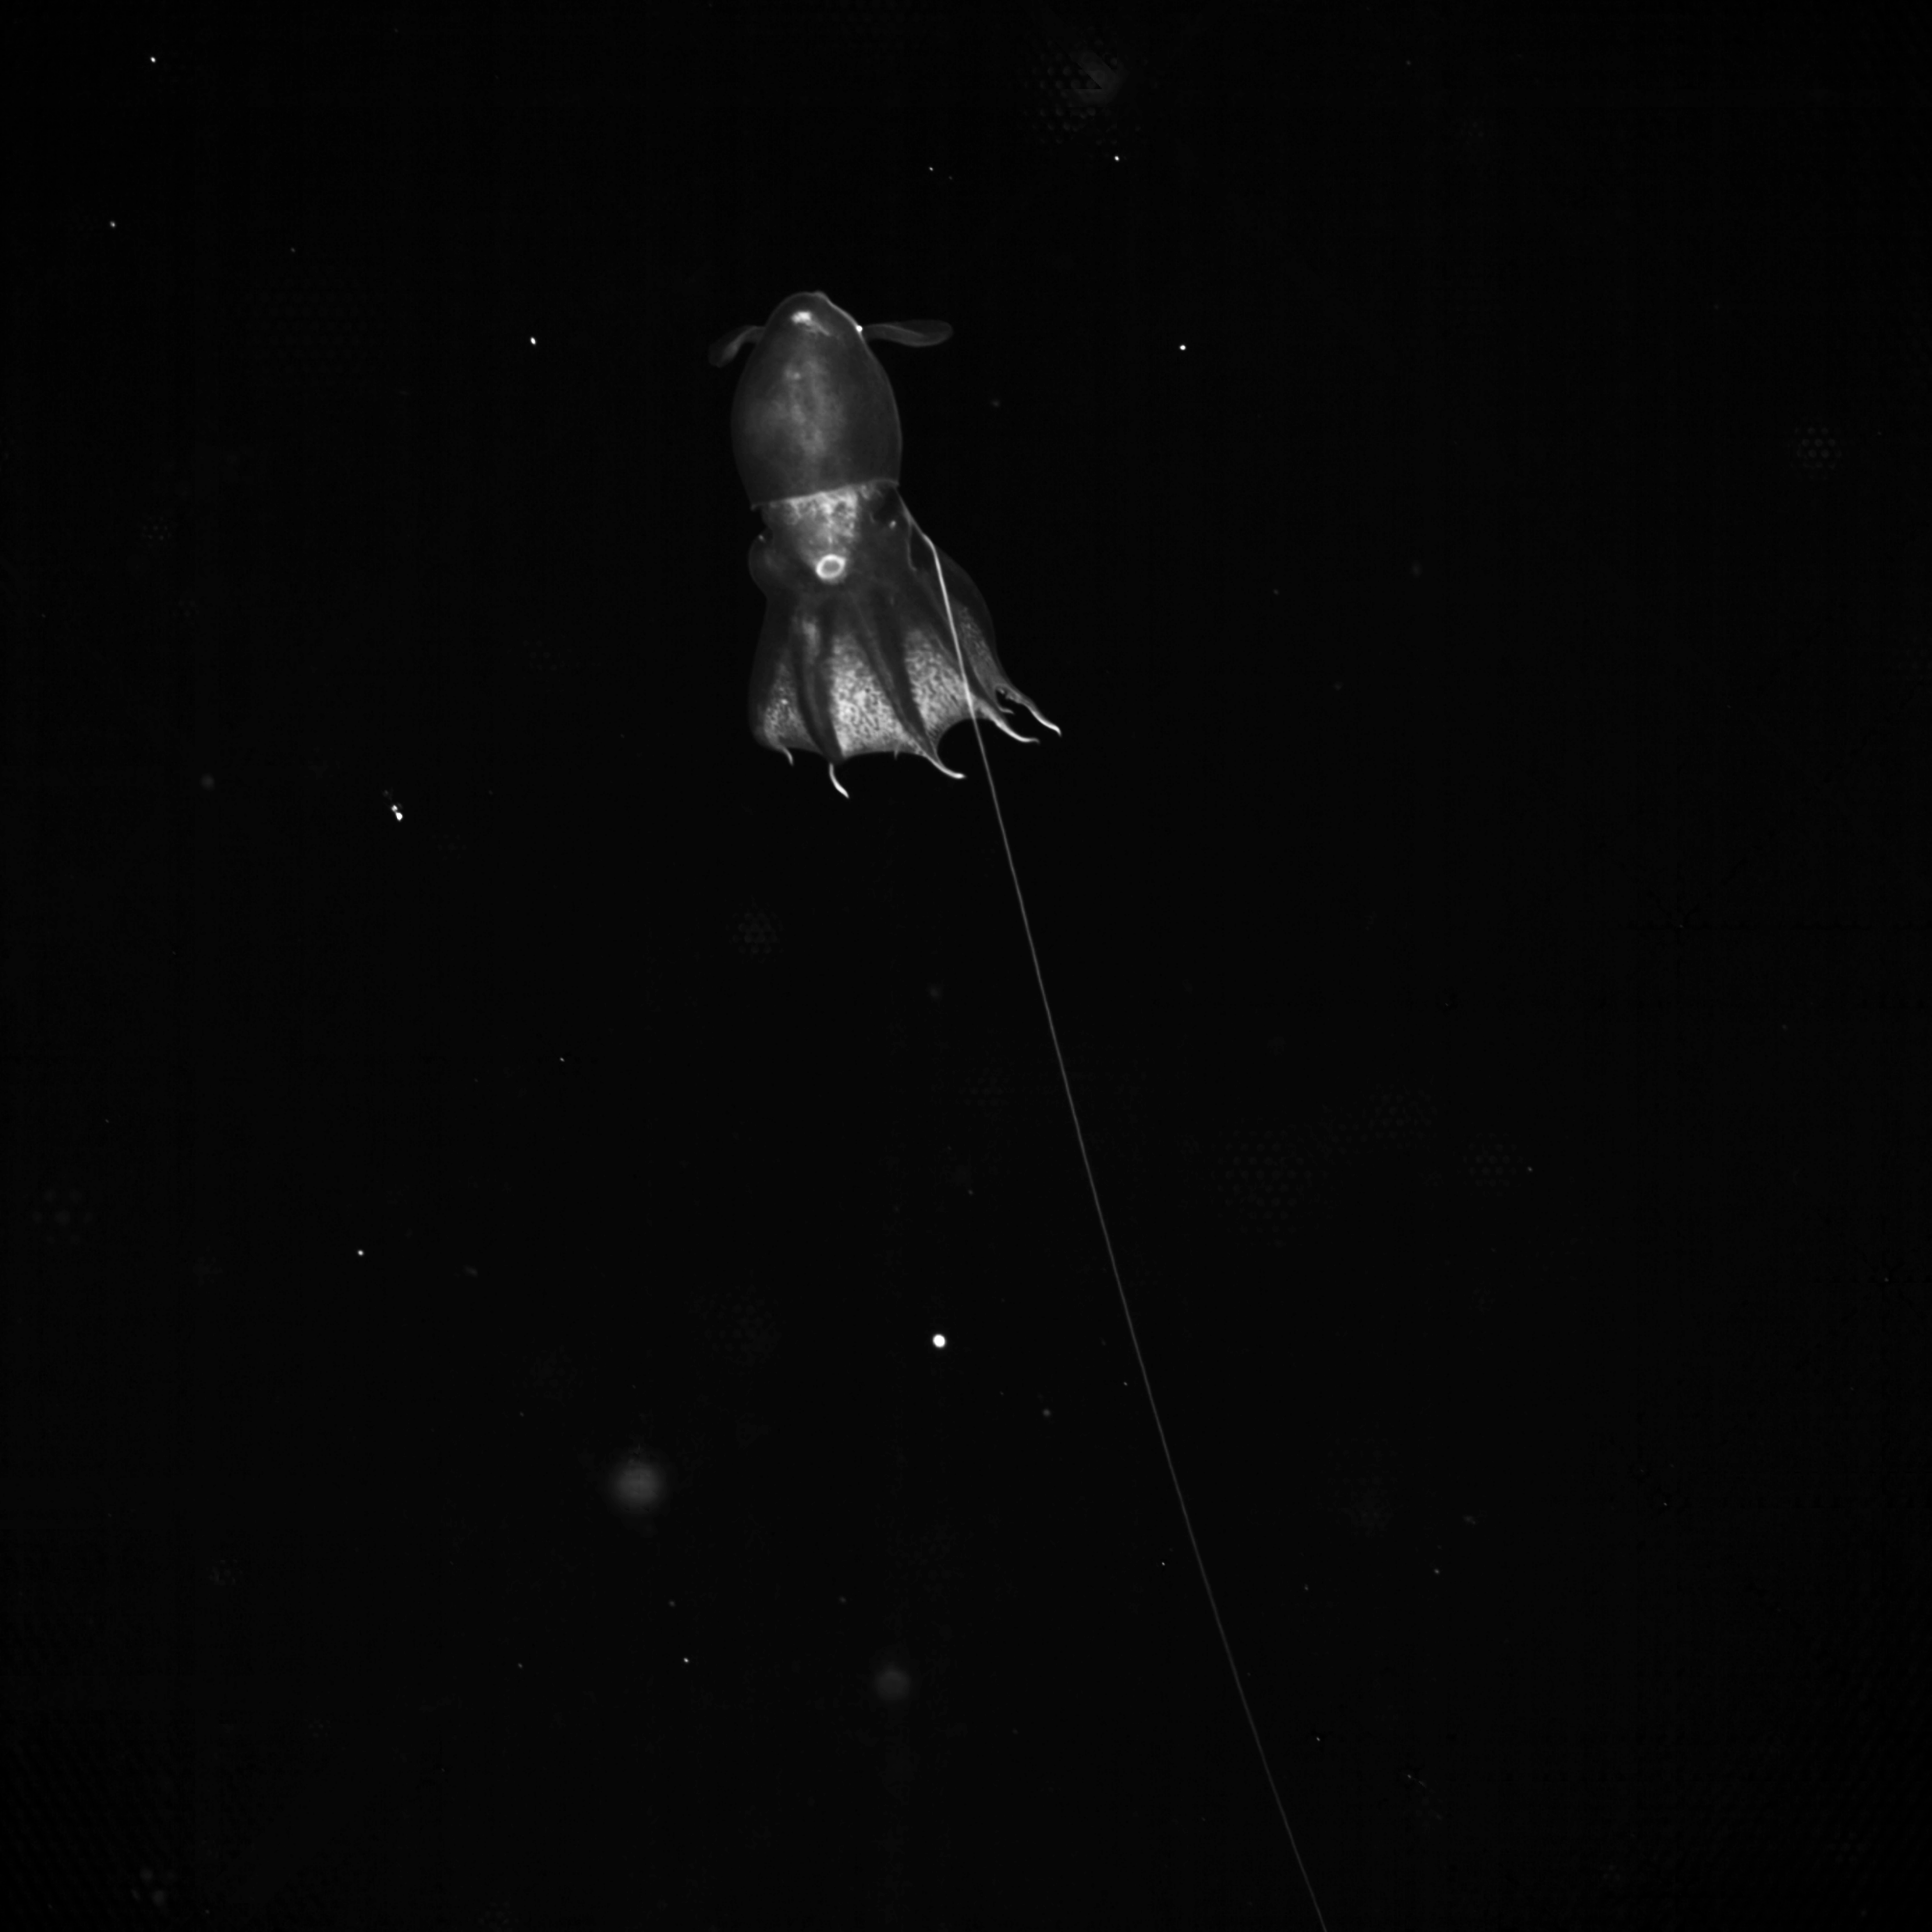
Example Species Measured
Vampyroteuthis
Bargmannia
Tiburonia
Haliscera
Atolla
Frillagalma
Atolla
Lampocteis

