Slide 1


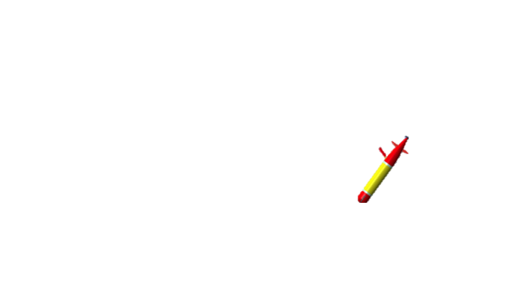
Supervised autonomy
?
?
When the vehicle is underwater, we do not know what is going on
1st Autonomous Control Loop

Slide 2

Supervised autonomy
Only when it reach the surface, it is able to send some information at shore
However, the vehicle can stay underwater for more than 24h. For example, conducting a Lagrangian movement to follow a thermal front

Slide 3
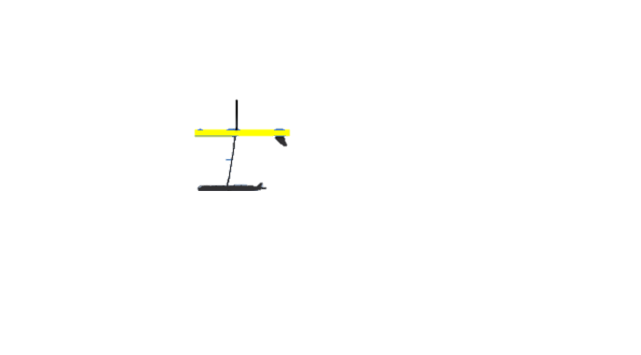

Supervised autonomy
Multi-vehicle approach
2nd Supervised Control Loop
1st Autonomous Control Loop

Slide 4
Supervised autonomy
2nd Supervised Control Loop
1st Autonomous Control Loop:
  Fast response time
  Automatic mission change based on in situ measurements
2nd Supervised Control Loop (Human-in-the-loop):
  Real-time human interaction
  Validating (or invalidating) an output
  Fine tune hyperparameters
  Define new missions on the fly
1st Autonomous Control Loop

Slide 5
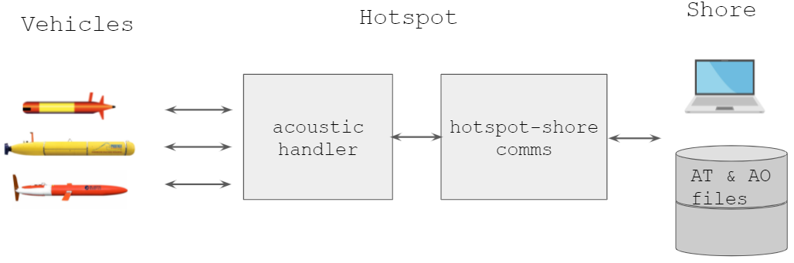

Supervised autonomy
To create this supervised autonomy system two aspects are key:
1- To have bidirectional communications between the LRAUV and the on shore server while the vehicle is underwater
Hotspot Acoustic Relay system:
Status: we are currently conducting laboratory tests and we expect to do some sea test during the next weeks.

Slide 6

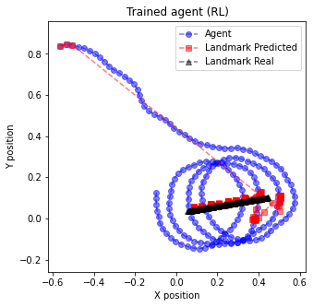
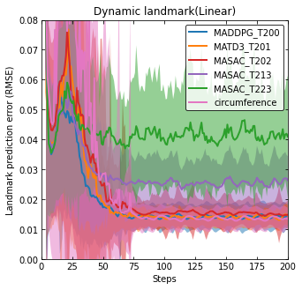

Supervised autonomy
To create this human-in-the-loop system two aspects are key:
2- To have a great localization/tracking system between vehicles
Studying Reinforcement Learning methods to train an agent to learn the best policy for both tracking and communication purposes:
Trained agent in action
Trained agent result
Tracking performance
Status: we have the first simulation results of a trained agent, which has a better performance than traditional methods (greater accuracy at the beginning of the tracking)

