Slide 1
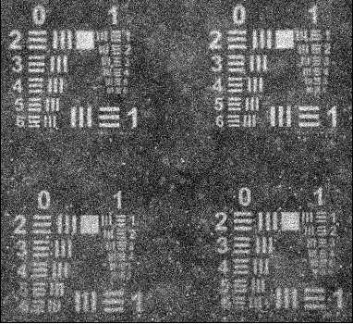
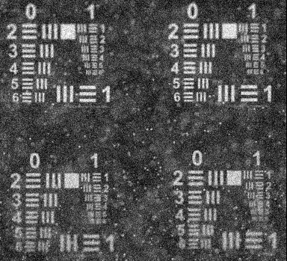
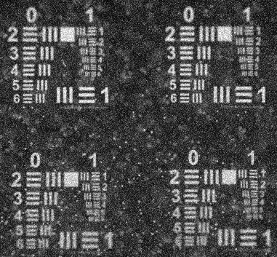
Optical Design: Imaging Geometry Simulation
10 cm
30 cm
60 cm
Individual particles have much better contrast at 30, 60 cm compared to 10 cm
Overall image contrast is significantly higher at 30 or 60 cm compared to 10 cm

Slide 2
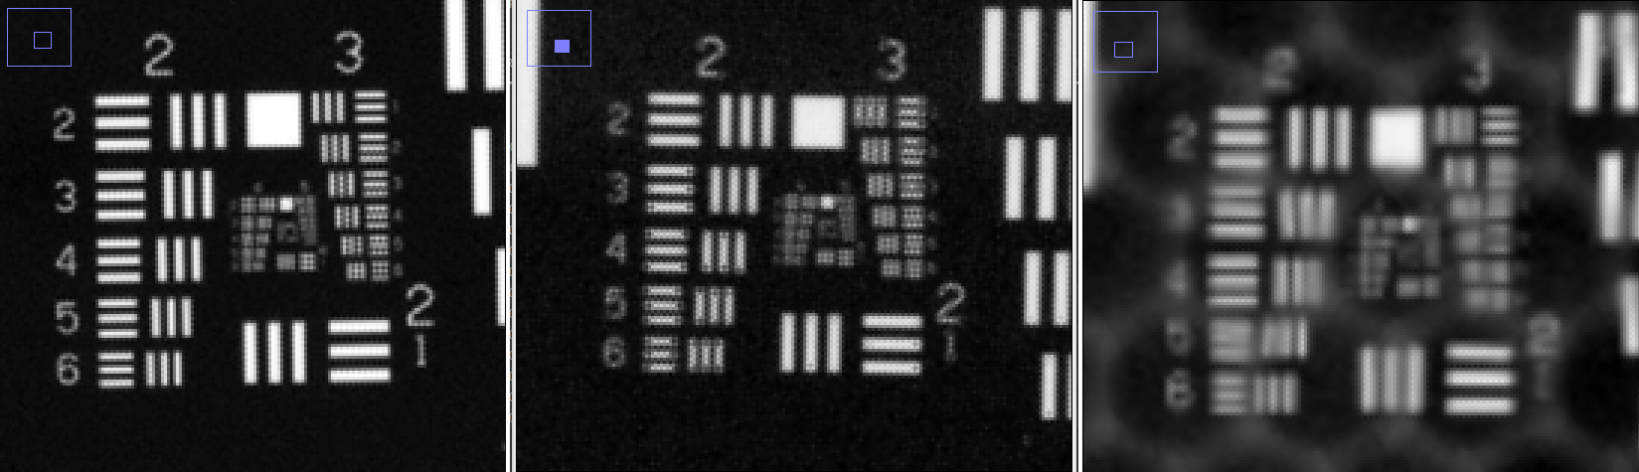
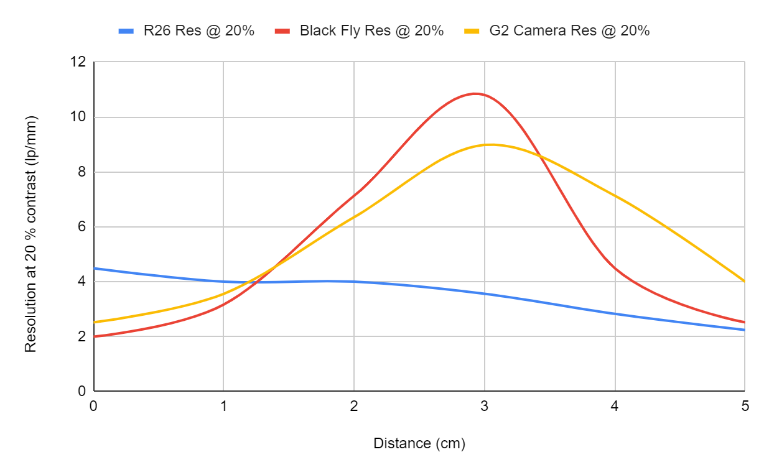
Camera Comparison
Blackfly (IMX183)
Raytrix C42
Raytrix R26

Slide 3
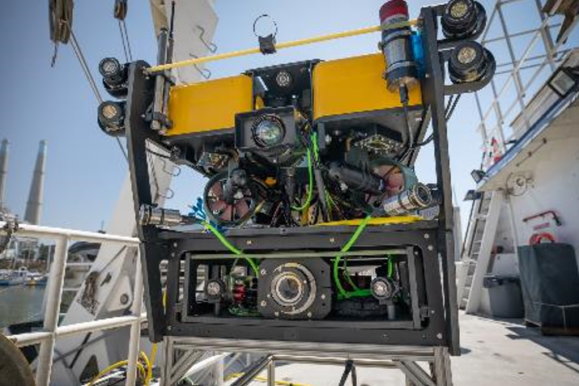
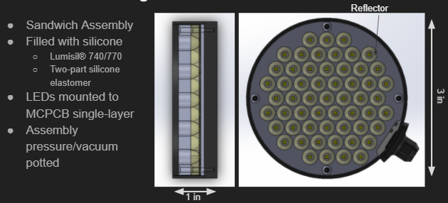
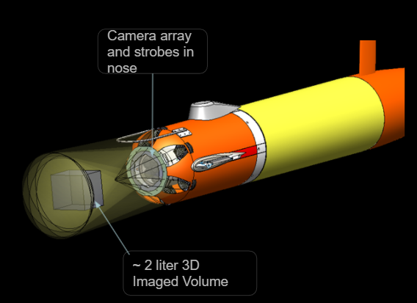
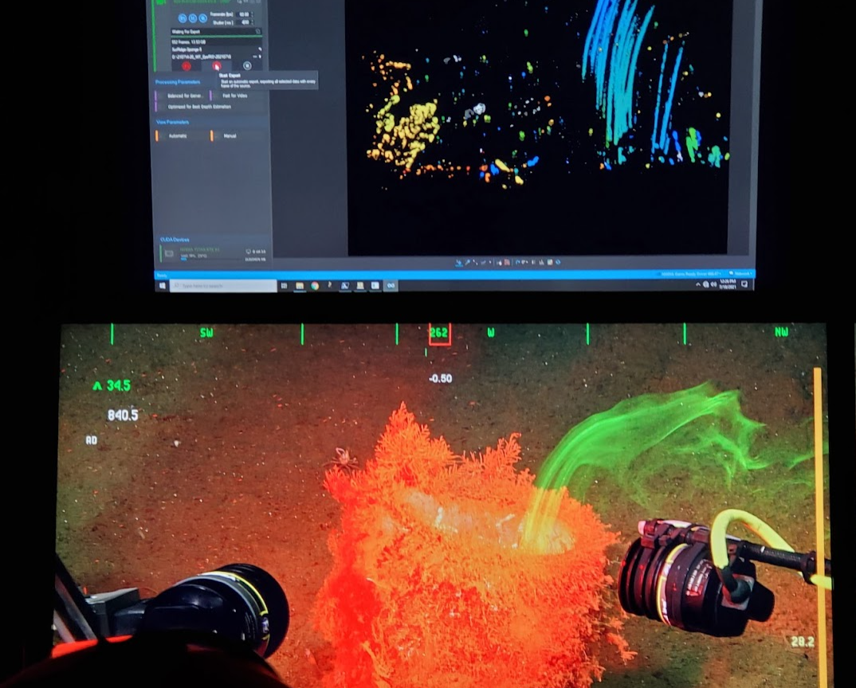
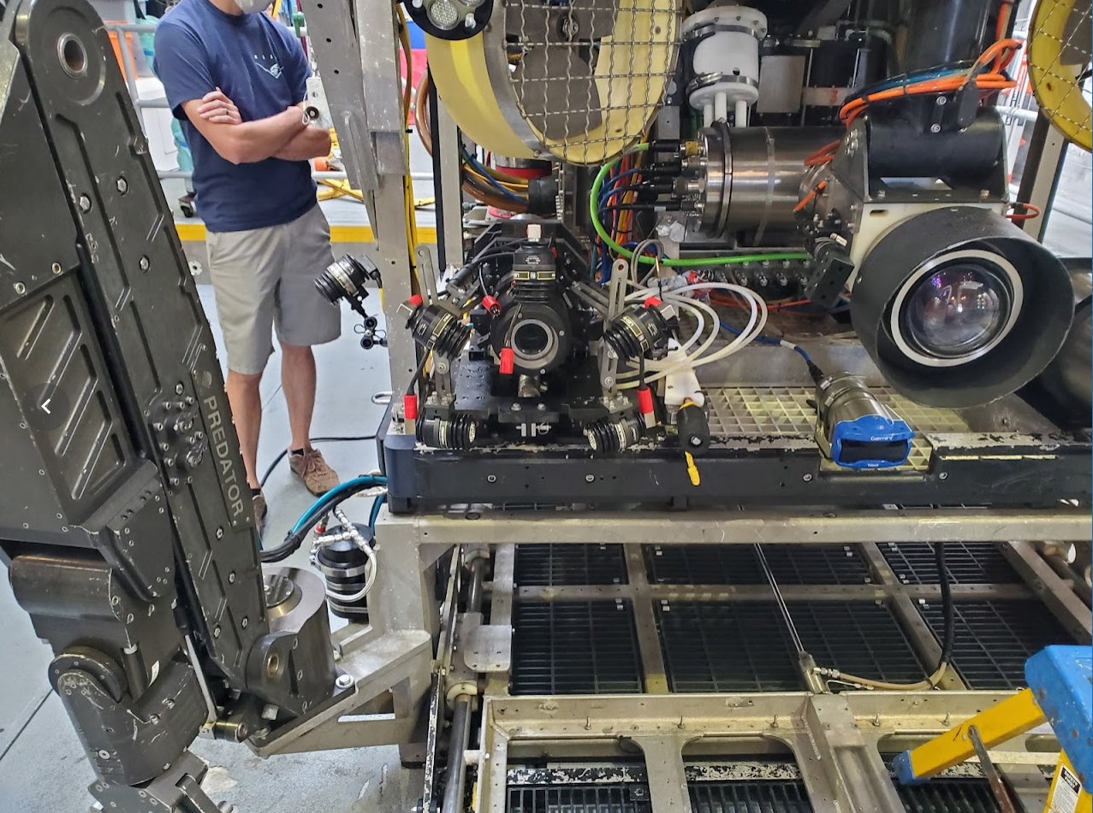
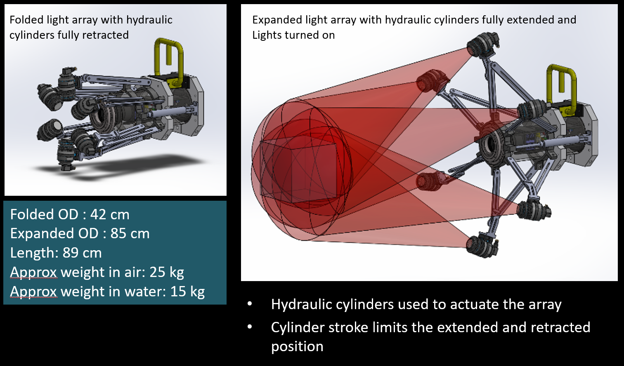
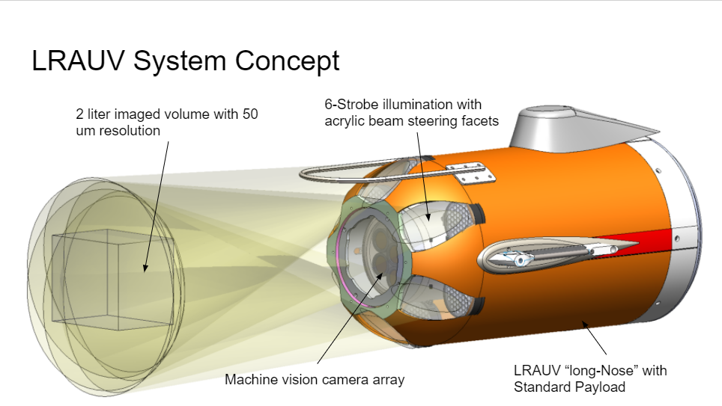
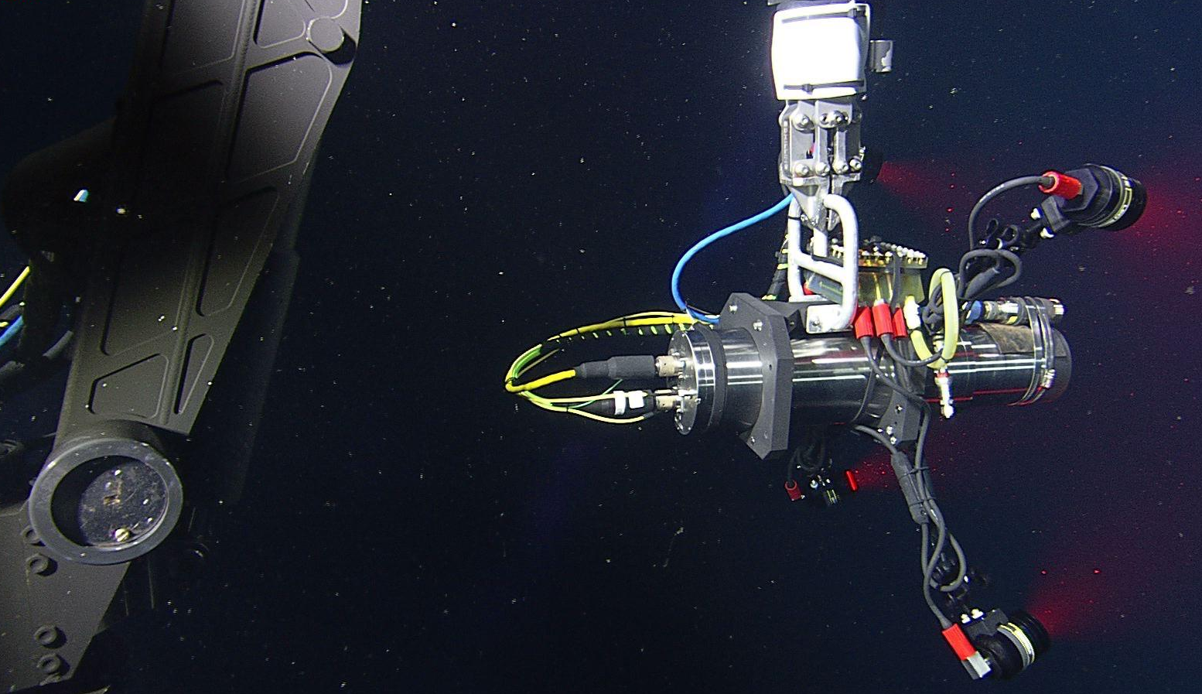
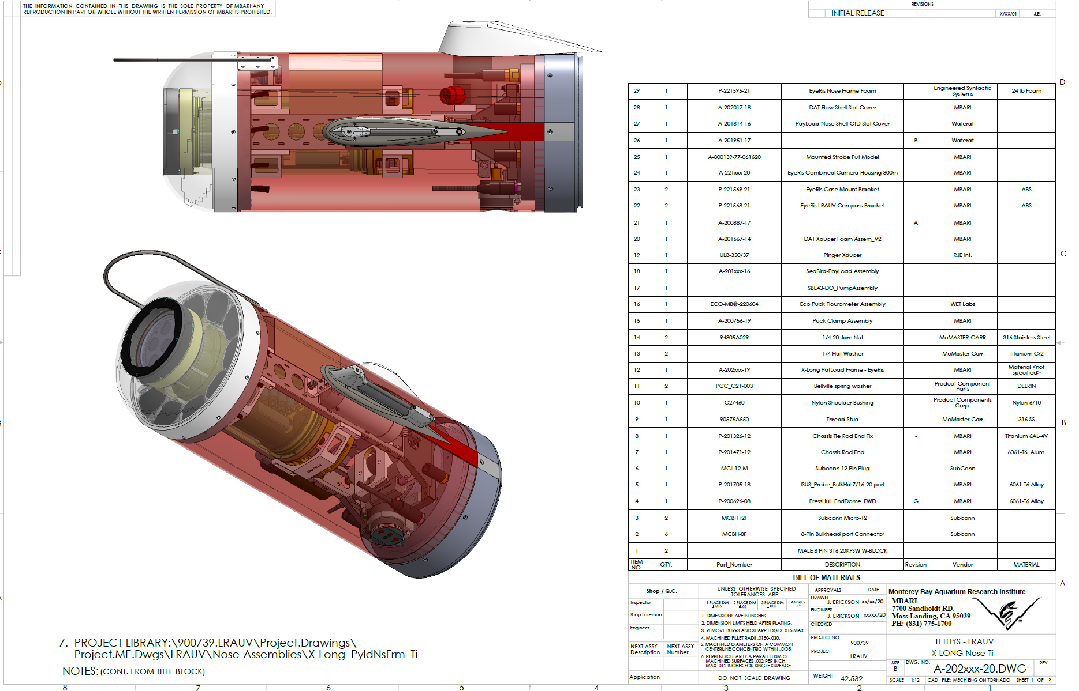
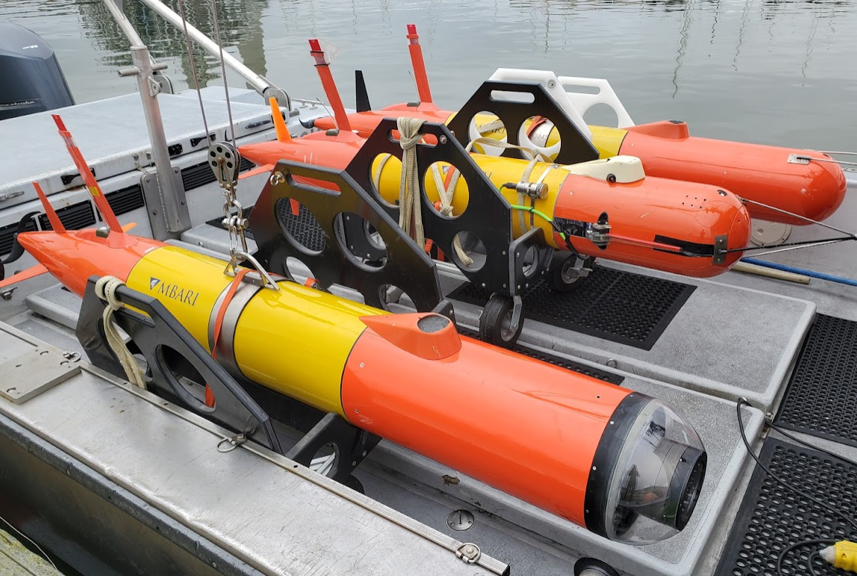
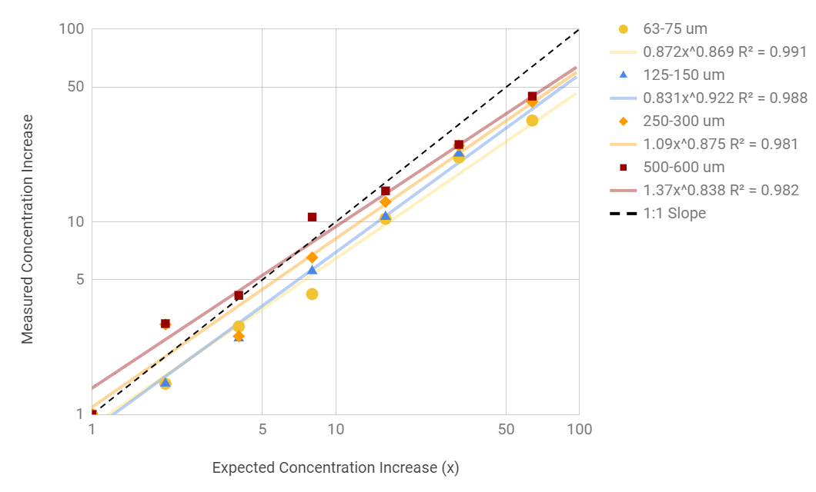
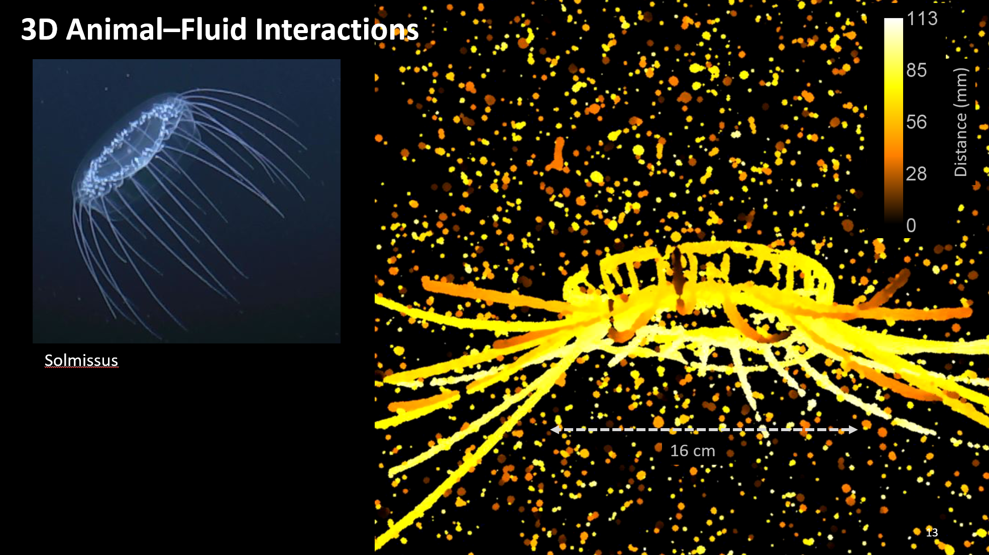
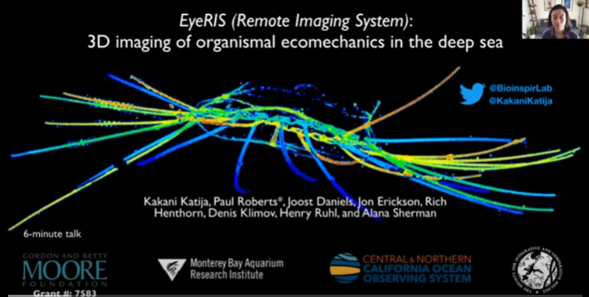
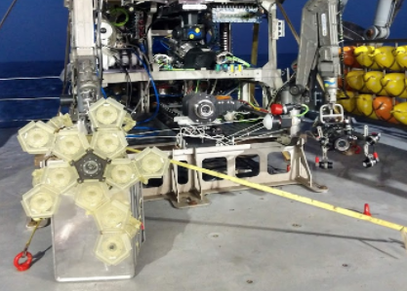
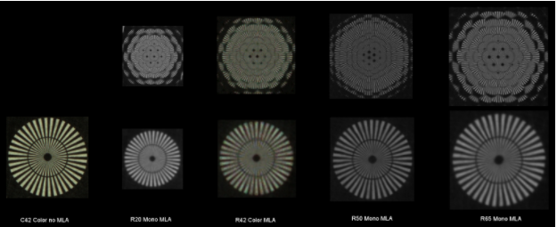
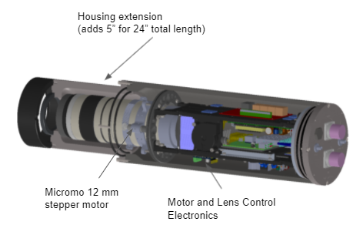
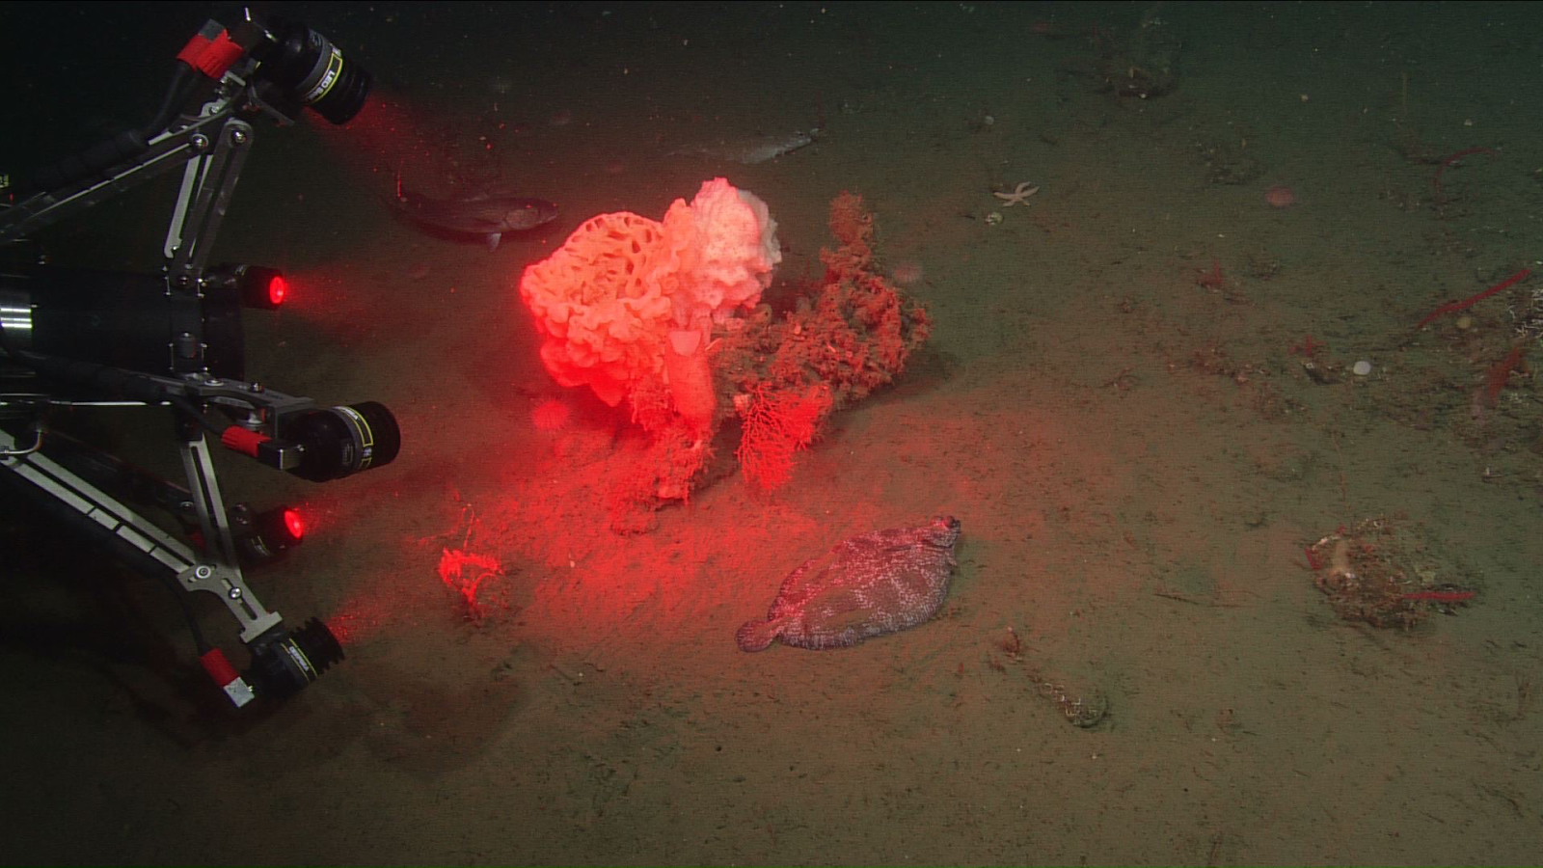

Deployment on MiniROV / WF
Strobe Concept Review
LRAUV Integration
Preliminary Design Review
Deployment on ROV Doc Ricketts / WF
Deployment on ROV Doc Ricketts / WF
Cabled Instrument
Preliminary Design Review
Concept for AUV system
Deployment on
ROV Doc Ricketts / WF
LRAUV Payload
Completed Drawings
Jun
2019
Nov 2019
Feb
2020
Jun
2020
Jan
2021
May
2021
Aug
2021
Apr
2019
Aug 2019
Jan
2020
Apr
2020
Aug
2020
Oct
2020
Mar
2021
July
2021
Oct
2021
Nov
2021
Marine Imaging Workshop 2019
3D particle counting lab studies
Ocean Sciences 2020
SICB 2021
Deployment on ROV SuBastion / FK
Visit to Raytrix, Camera Selection
Zoom Lens Addition
Deployment on ROV Ventana / RC

Slide 4
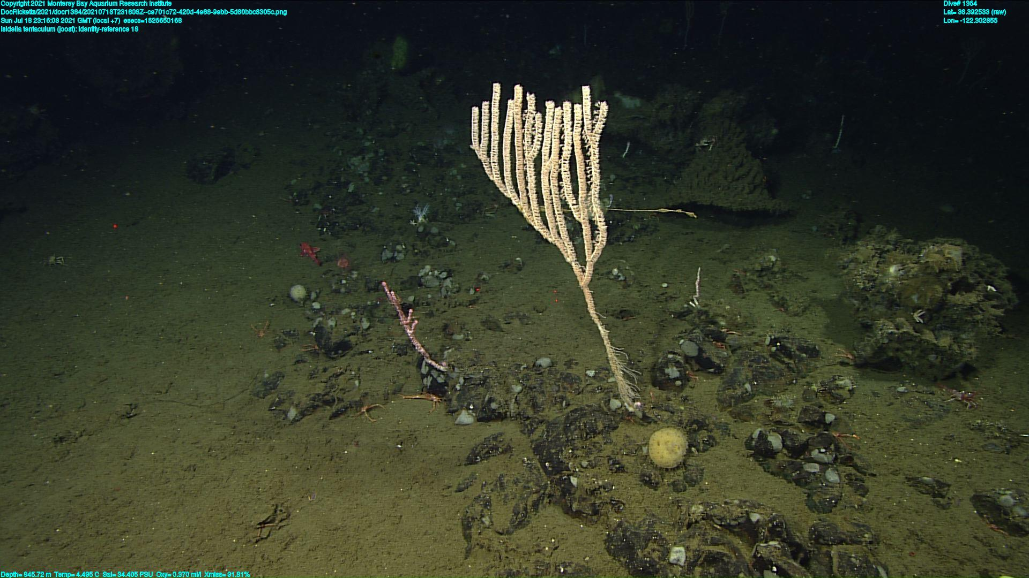
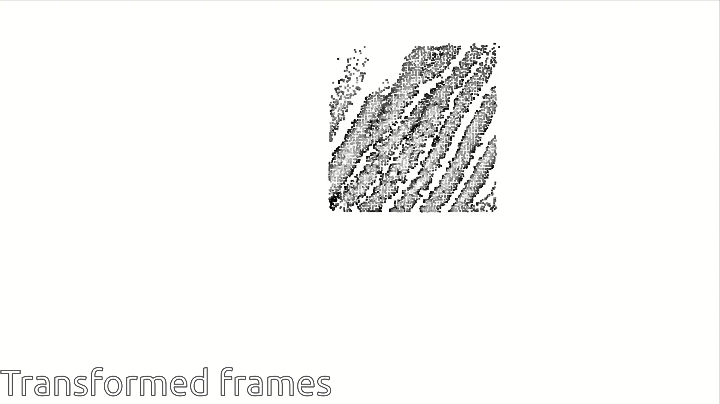
Lightfield Data with Structure from Motion
Combine many point clouds of an Isidella coral together to build a larger point-cloud

Slide 5
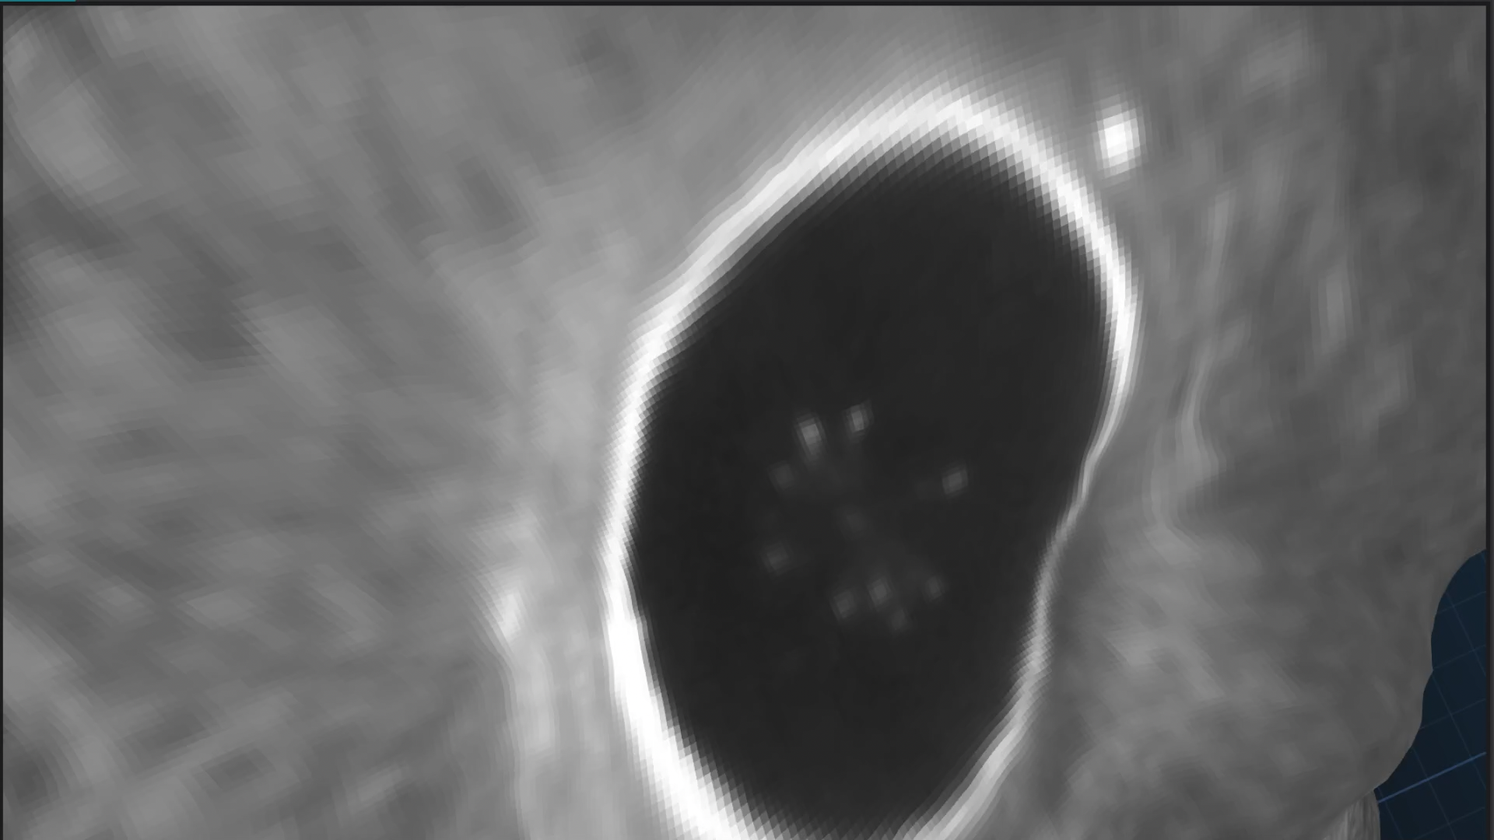
Realtime Surface Visualization

Slide 6
Deployment on MiniROV / WF
Strobe Concept Review
LRAUV Integration
Preliminary Design Review
Deployment on ROV Doc Ricketts / WF
Deployment on ROV Doc Ricketts / WF
Cabled Instrument
Preliminary Design Review
Concept for AUV system
Deployment on
ROV Doc Ricketts / WF
LRAUV Payload
Completed Drawings
Deployment on LRAUV
Jun
2019
Nov 2019
Feb
2020
Jun
2020
Jan
2021
May
2021
Aug
2021
Apr
2019
Aug 2019
Jan
2020
Apr
2020
Aug
2020
Oct
2020
Mar
2021
July
2021
Oct
2021
Nov
2021
Marine Imaging Workshop 2019
3D particle counting lab studies
Ocean Sciences 2020
SICB 2021
Deployment on ROV SuBastion / FK
Visit to Raytrix, Camera Selection
Zoom Lens Addition
Deployment on ROV Ventana / RC

Slide 7
Operation Modes Within One Mission
Still Imaging
Continuous operation at frame low frame rate ~ 1 Hz
Rates may be adaptive to depth and/or particle concentration
Applications: glider-like transects, front detection
Video Recording
Infrequent bursts of 30 or 60 FPS video
Vehicle may need to hover during imaging
High power draw and data rate
Applications: 3D particle tracking velocimetry

Slide 8
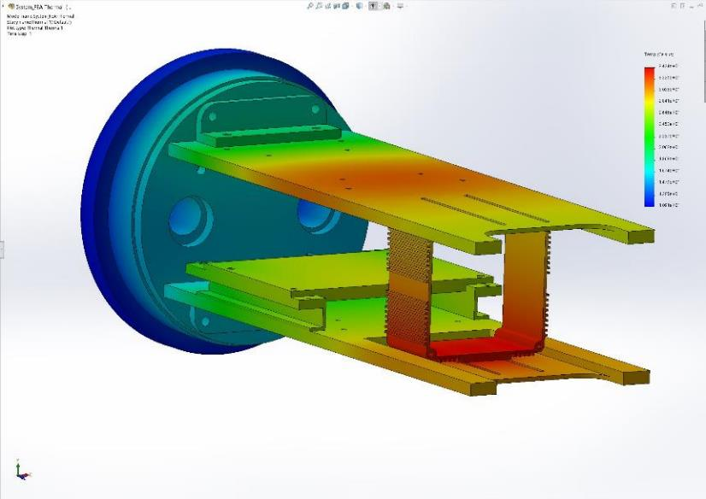
Mechanical Design: Thermal
30 C
11 C
Internal temperature of chassis for 7 C
external temperature in seawater
34.2 C
Details: 08-EyeRIS-Thermal-Calculations.pdf

Slide 9
Lab Calibrations: Estimated Particle Concentrations

Slide 10
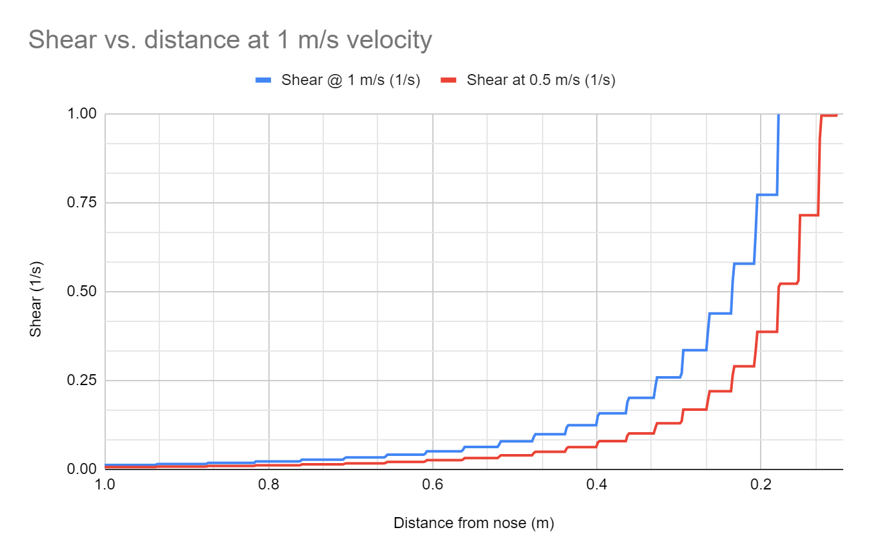
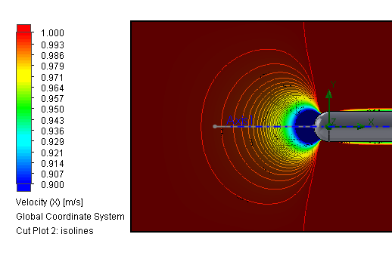
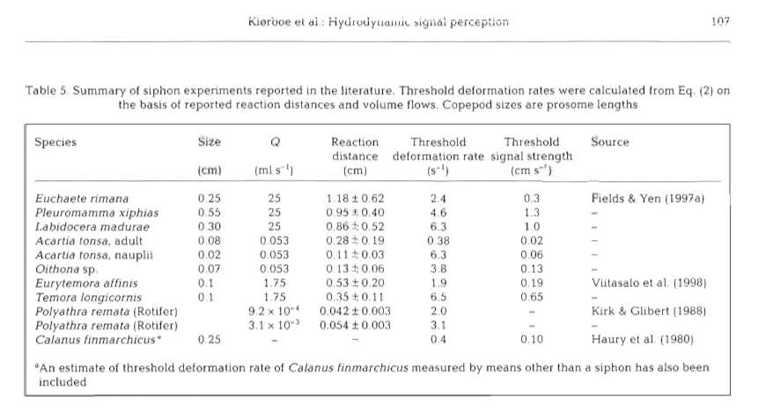
Zooplankton Avoidance
Selected a 0.5 m distance in front of the vehicle as a target for the focal plane.
Simulations showed a shear of less than 0.1 1/s at this range and this level is below the threshold for many of the larger (> 1 mm) plankton
0.1 1/s

Slide 11
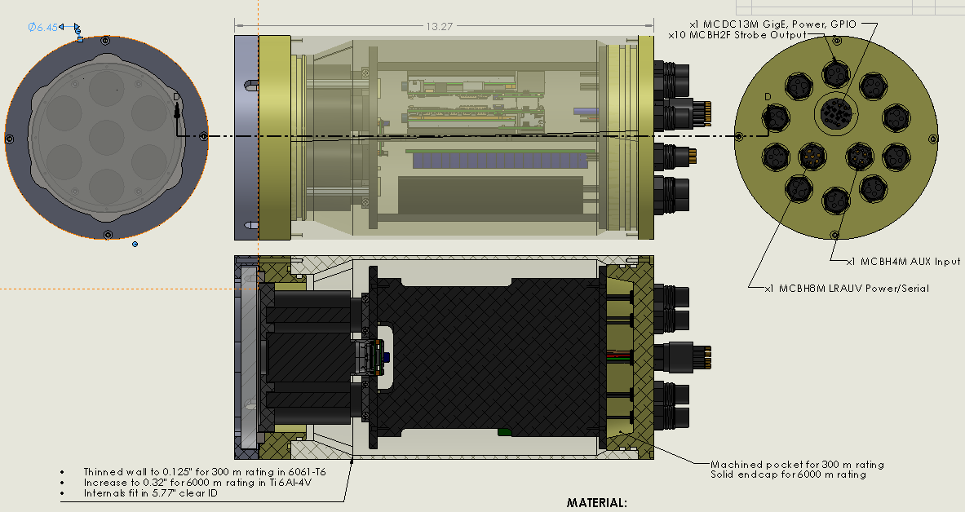
Mechanical Design: Camera and Electronics (300m)
6000 m rating requires
Ti 6Al-4V material,
0.32” thick walls,
Same OD,
1.5” longer,
2” thick sapphire port,

Slide 12
Electrical Design Overview
EyeRIS Can
Input Voltage
Ethernet
Battery
Battery Charger & Power Path
Dual Jetson TX2
6 MIPI cameras
1 USB3 camera
Data Storage
Battery or Input voltage
42V Strobe Voltage
Digital Low voltage
Exposure
Signal
Analog Low voltage
SYS
CURRENT
RUN
UART
Input Voltage
9-36 V
RS-232 or 485
SMBus
Input Protection
Strobe Head x10
Ground Fault
Signal
Strobe Ballast and Flash Switch
RUN
32-bit MCU
SAMD21
LowPowerLabs
42 V
5 V
Cree XD16
15 Series
4 Parallel
CAP
VOLTAGE
5V DC/DC
5 V
FLASH
CURRENT
RS-232/485 transceiver
Thermal Protection
UART
Serial
FLASH
TRIGGER
Exposure
Signal
MUX
OVP

Slide 13
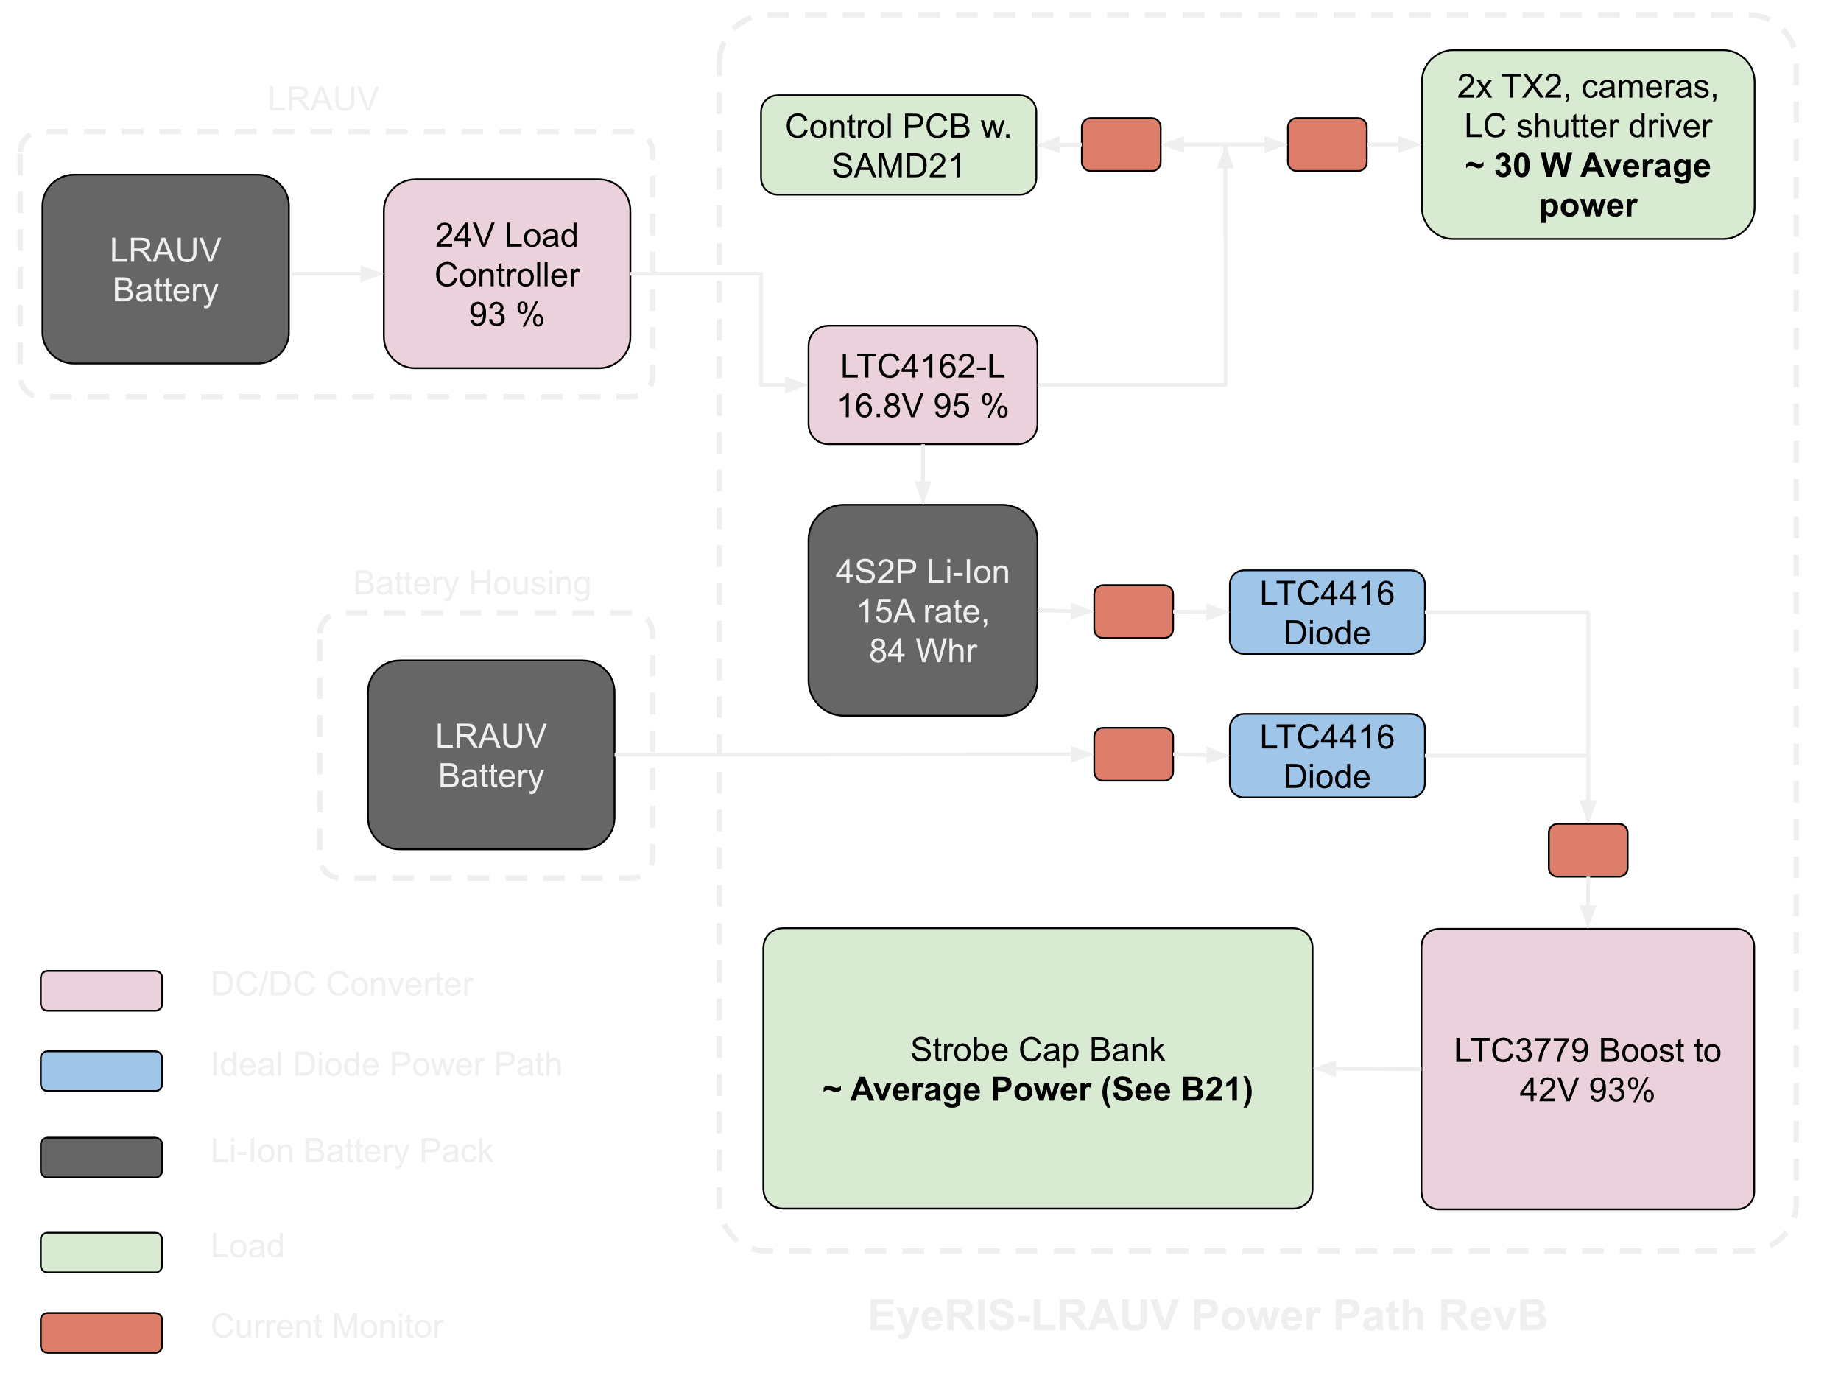
Electrical Design: Power Path

Slide 14
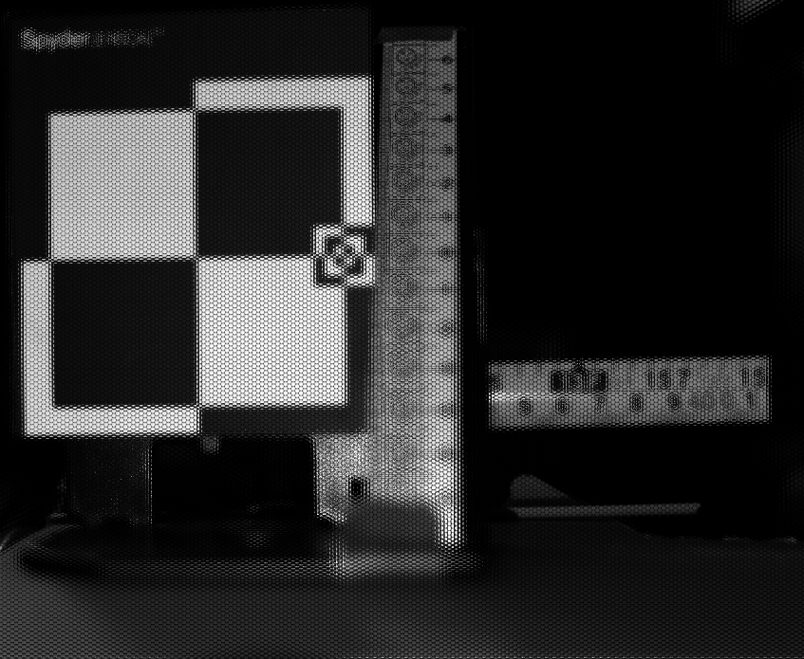
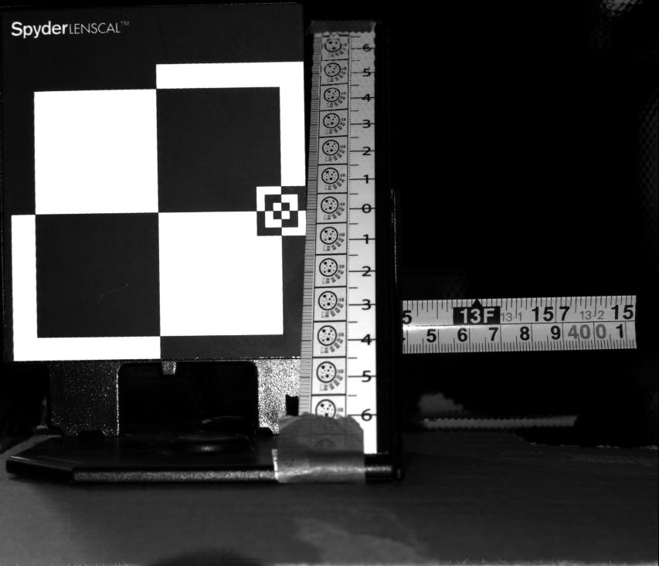
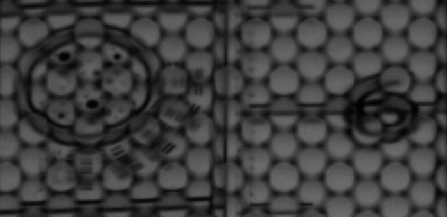
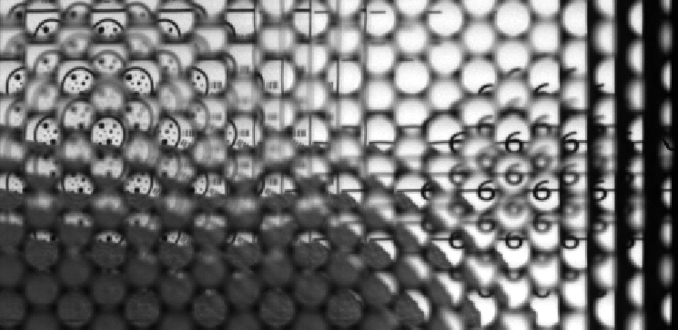
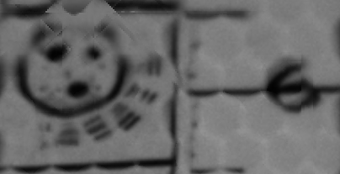
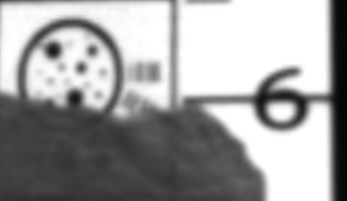
Optical Design: Example Raw and Refocused Images
Raw Image from R26
Total Focus Image from R26
Far
Near
Far
Near
Depth of field target with metric scale on 45 degree ramp, with in/cm ruler in middle position

Slide 15
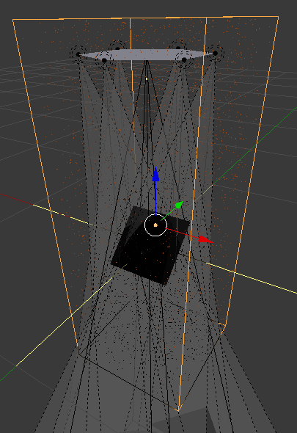
Optical Design: Imaging Geometry Simulation
Blender simulation
  Six lights in hexagon
  One camera at center of hexagon
  Target at 1 m range
Vary the size of the hexagon to test different source-receiver separation
Light1
Light2
Light6
Camera
Light3
Light5
Light4
1 m
Target
10 cm
30 cm
60 cm
Camera
Spot Light

Slide 16
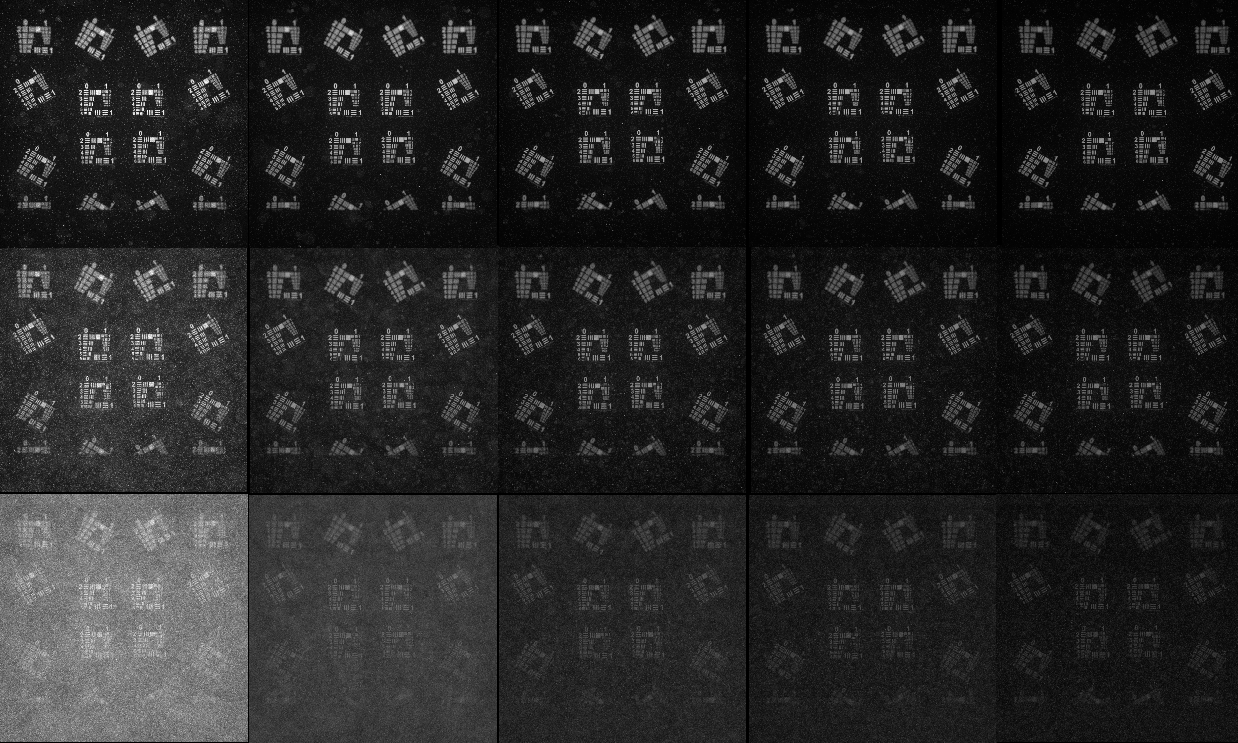
Optical Design: Imaging Geometry Simulation
6.2 particles / liter, scattering density = 0.5
62.5 particles / liter, scattering density = 1.0
625 particles / liter, scattering density = 2.0
10 cm
20 cm
30 cm
45 cm
60 cm
Increasing size of hexagon

Slide 17
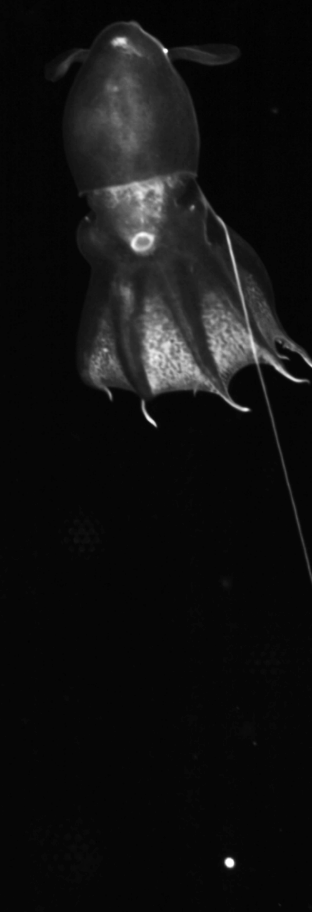

Slide 18
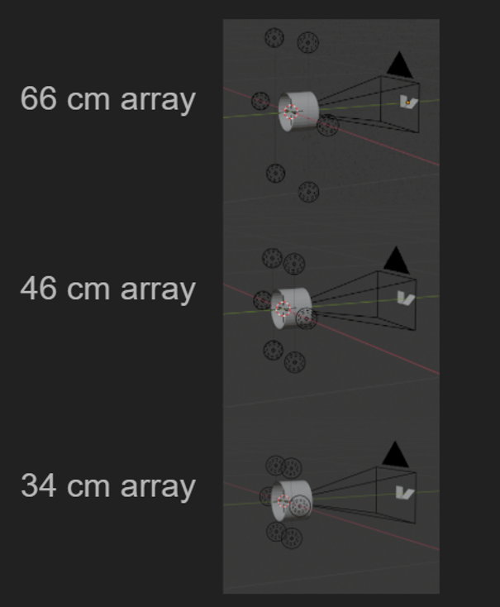
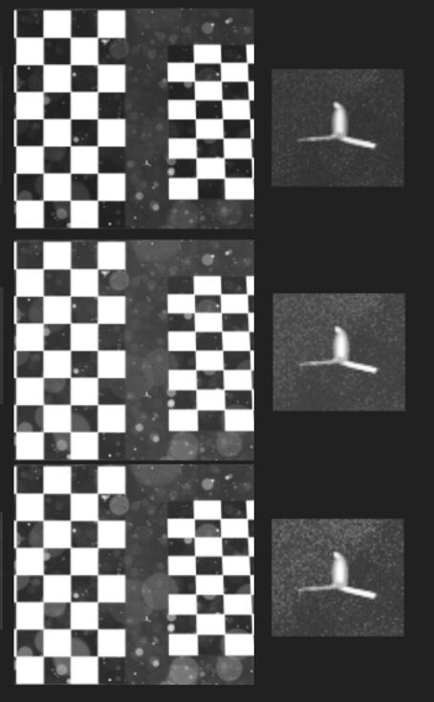
Illumination Design

Slide 19
Future Work Towards Fundamental Problem
Wide-baseline multicamera arrays
Cabled Instrument: Internal Chassis

