Slide 1
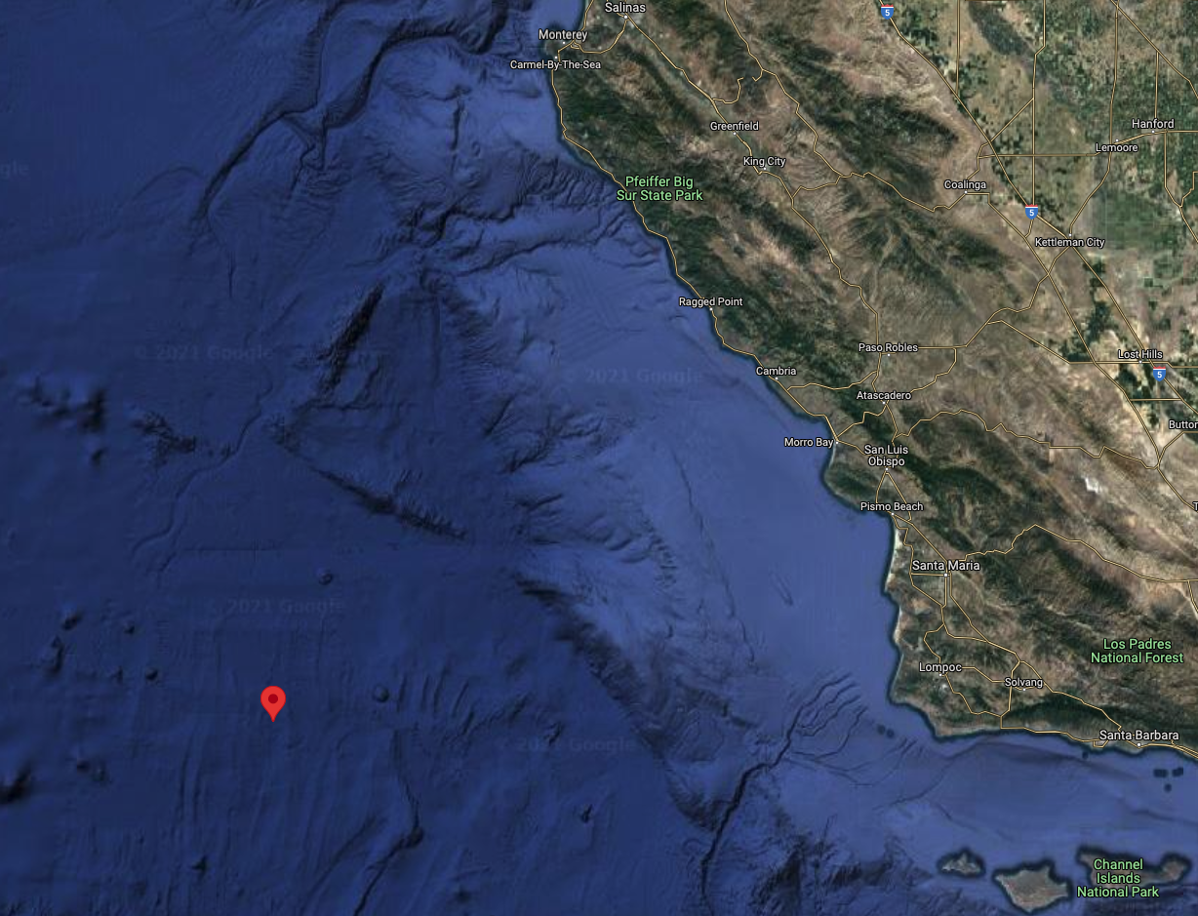
EyeRIS at Station-M
Abyssal monitoring station
Deployed on ram
Dives to 4000m
Notes:
Original plan was to stop periodically to get more volume at discrete depths to better understand particle flux
Cruise logistics got complicated by weather and engine troubles so we only got to deploy EyeRIS on a single dive
Tried to run EyeRIS at the nominal 30 m/min wire speed on ascent and descent but motion was too fast to appropriately sample
Got one good transect along the bottom

Slide 2
EyeRIS at Station-M
Notes:
300m benthic transect, at ~3 m/min
Ran EyeRIS at 2 fps, compute particle size distribution as equivalent spherical diameter from area occupied by particles in 3D depth image
Semilog scale, 20 geometrically evenly spaced bins from 0 to 10 mm. Excludes ~800 very large targets
sampled ~19000 L of fluid based on cumulative convex hull of particle field

Slide 3
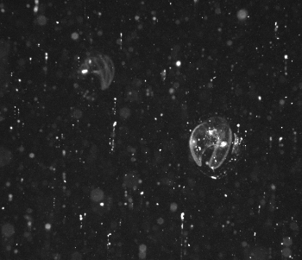
Realtime object detection and supervised autonomy
larvacean
Collate counts from images
Update vehicle behavior
{
larvacean : 2,
copepod: 0,
jelly: 0,
aggregate: 0,
}
if num_larv > threshold:
stop yoyo
signal partner LRAUV
larvacean
Run an on-board object detector
LRAUV Data Slate
(Realtime)
Enumerate and Distribute
Object Logs
(at surface)
Human operator confirms behavior change
LRAUV Image transfer (at surface)

