Slide 1
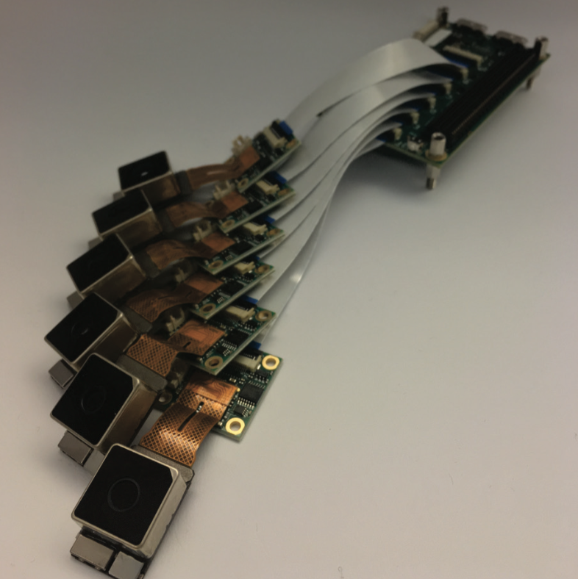
6-Camera EyeRIS Concept
Nvidia Jetson TX1 with 6, 42 megapixel cameras from Raytrix
Frame rates
  6 x 42 MP @ 2 Hz
  6 x 8k @ 6 Hz
  6 x 4k @ 24 Hz
  3 x 4k @ 56 Hz
Multiple configurations
  Lightfield PTV/PIV with 6-camera array
  Stereo with 3x depth of field
  2D images with 6x depth of field
  2D HDR images, up to 12-bits in theory
Parts cost for system
  Cameras x6: ~$2000 from Mouser
  TX1: ~$380 from Mouser
  J106 carrier for TX1: ~335 from Mouser
  M100 breakout for TX1: ~175 from Mouser
  Fujinon lenses x6: ~3600 from RMA Elec.
  Total: ~$6500
Example array geometry, multi-baseline, hexagonal packing

Slide 2
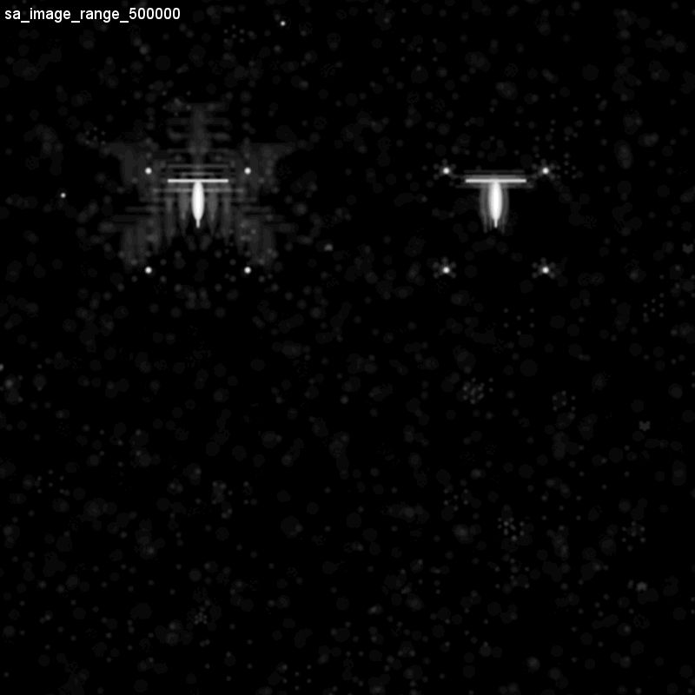
Blender Simulation
6-cameras with hexagonal packing
16mm lens
10 cm cube
Particle field with 16,000, 30 um particles. Concentration = 16 /ml, 0.016/mm^3
Synthetic aperture refocus method with 200 um depth bins
Targets with 5 mm depth spacing and 1.5 mm depth spacing
13 mm

Slide 3
Plenoptic vs. Camera Array Example
Camera | Lens | Raw FOV at 50 cm in water | 3D FOV at 50 cm in water | Minimum effective pixel size | Depth of Field (cm) | Data Rate (MB/s @ 1 Hz) | Real-time processing on AUV
R42 | Fujinon 12 mm, 12 MP lens 2/3” | 22 x 17 | 22 x 17 | 93 um | TBD | 42 | no
6-camera array | Fujinon 12 mm, 12 MP lens 2/3” | 28 x 21 | Min: 16 x 14 Max: 16 x 17 | 31 um | 2D: 22.4 3D: 11.37 Min: 3.79 | Max: 252 Mid: 63 Min: 42 | yes

Slide 4
Plenoptic vs Camera Array
Pros:
  Single camera
  Easy to add zoom optics
  Large multiplicity of views with small form factor
Cons
  High cost
  Low maximum effective resolution
  Restricted lens selection
  Hard to reconfigure
  Closed source software
  Reconstructed images have artifacts
Pros:
  Highest resolution
  2D images without any post processing
  Low-cost
  Easy to reconfigure
  Open source
Cons
  Limited multiplicity of views
  Greater system complexity
  Difficult to add zoom optics

Slide 5
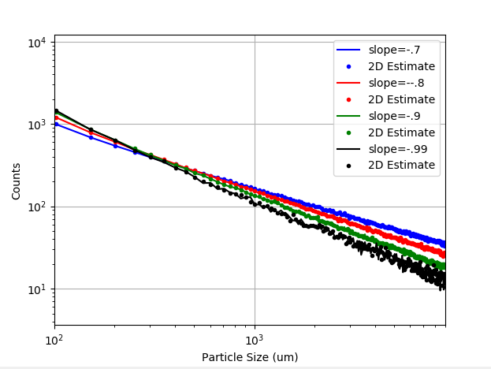
2D Images for Size Spectra Slope Estimation
Sample from powerlaw pdf for size with different slopes.
Sample from quadratic pdf for z position over 45-55 cm
Plot histograms of true size and 2D projected size after correction
Very good agreement without 3D information

