Slide 1
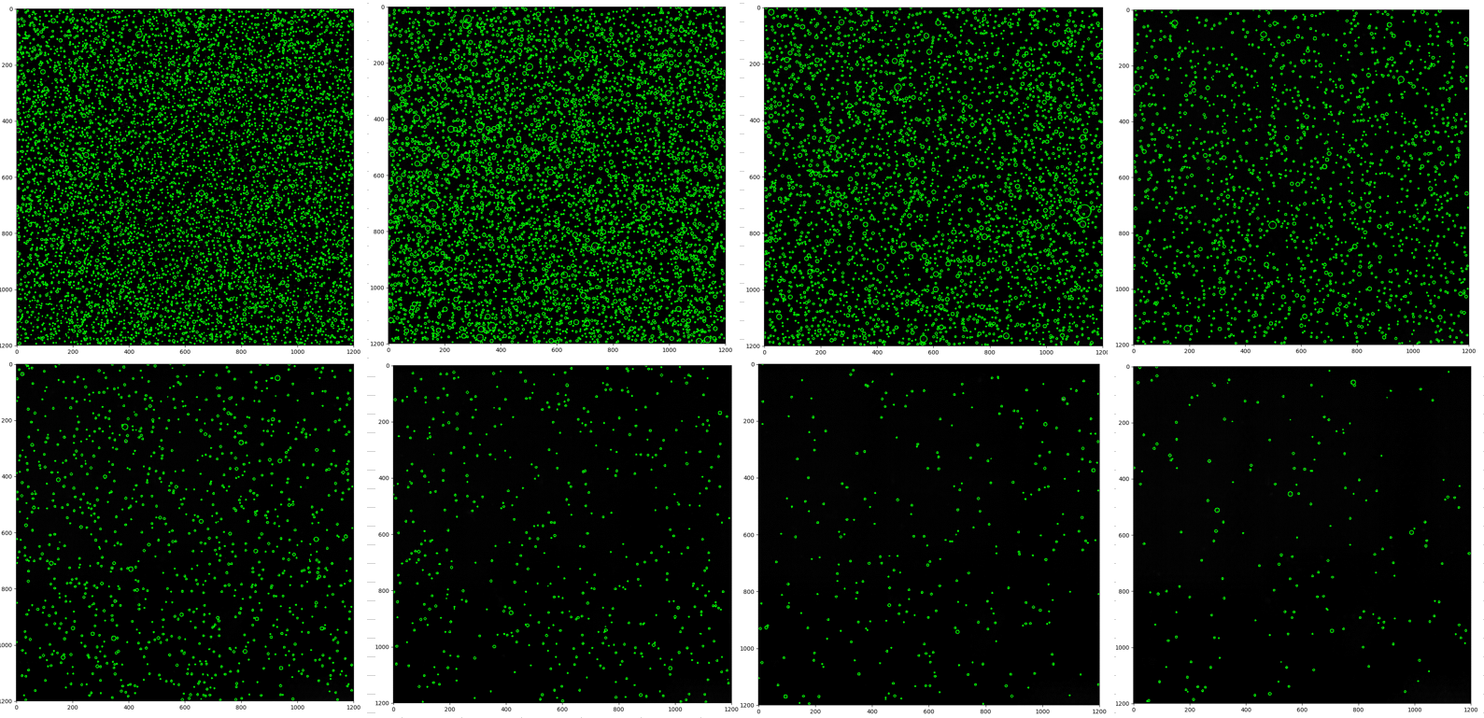
29.6 (#/ml)
15.7 (#/ml)
8.3 (#/ml)
4.4 (#/ml)
2.3 (#/ml)
1.2 (#/ml)
0.7 (#/ml)
0.3 (#/ml)

