Slide 1
EyeRIS First At-Sea Deployment

Slide 2
Dive Locations and Operations

Slide 3
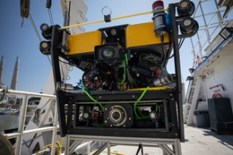
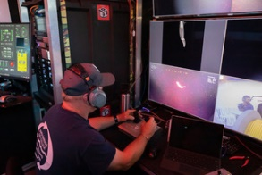
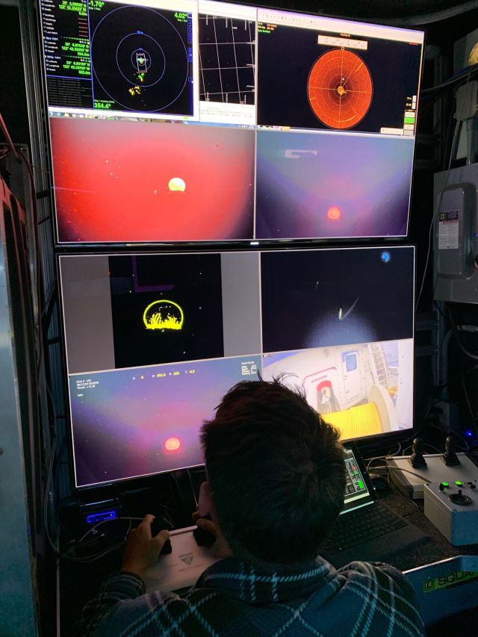
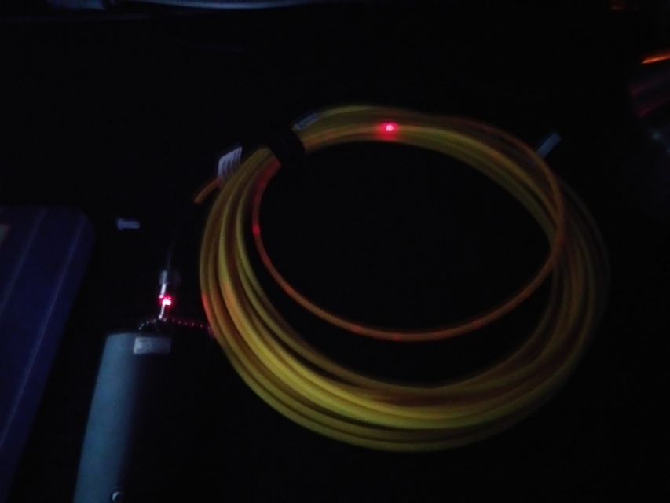
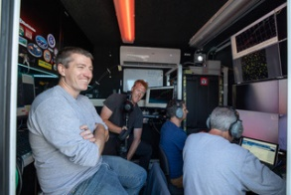
Photos

Slide 4
Vertical Transects
From 50 m down to 1000 m at roughly 10 meters/min
Recorded images at 2 and 4 Hz with 2.5 ms exposure time and lights at 100 %

Slide 6
Summary
Deployed as part of the BioInspiration lab cruise Aug 14 through Aug 20 2019.
Completed 6 dives on the Mini ROV with a max depth of 1000 m
Had only one hardware issue (broken fiber) that was resolved with a spare cable. The broken cable likely had issues before deployment
After some practice, the pilots were able to fly the Mini with EyeRIS and track animals well
We recorded roughly 10 TB of data.

