Slide 1
Effective Resolution estimates from in situ images
Virtual Depth | Effective Pixel Size in Raw Image (um/pixel) | Effective Resolution of R26 in (Megapixels)
2.1 | 150 | 2.64
2.1 | 166 | 2.16
3.1 | 200 | 1.49
5.1 | 330 | 0.54
7.1 | 430 | 0.32

Slide 2
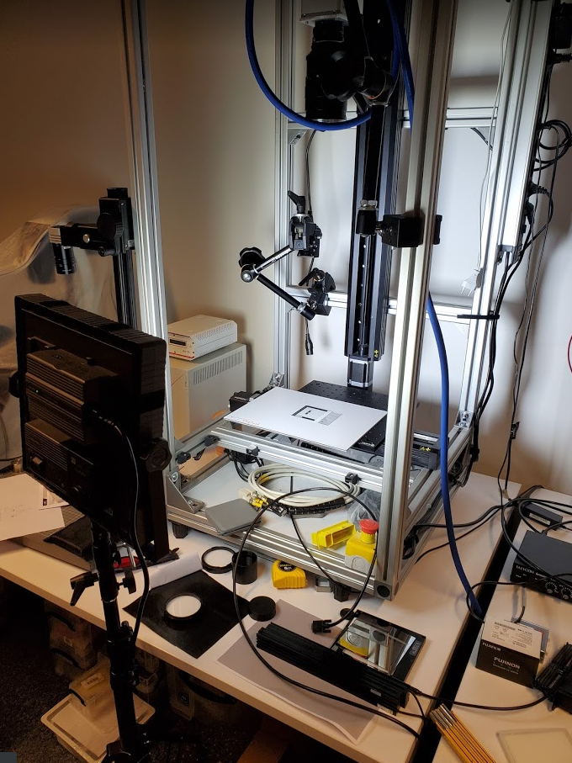
Resolution Tests at Raytrix
Camera/Lens
Several Raytrix cameras: R20, C42, R42, R50, R65
Each camera/ lens combination setup to image roughly a 10 cm vertical FOV
Imaged an IMT test target with star pattern and also a microscopy target with grid pattern
Z-stage
Target

Slide 3
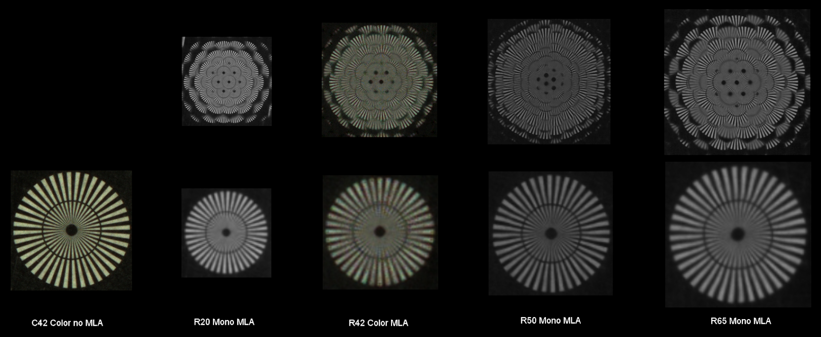
Images of 4 mm star target @ 10 cm FOV

Slide 4
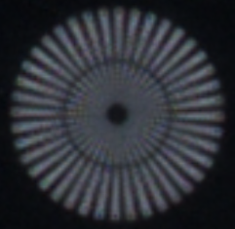
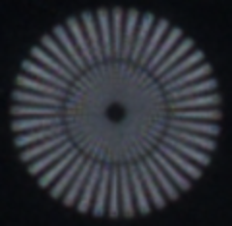
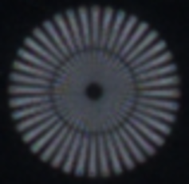
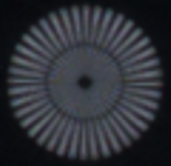
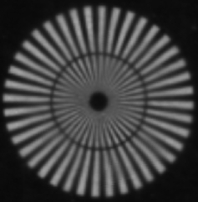

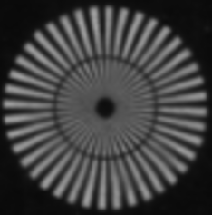
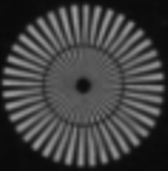
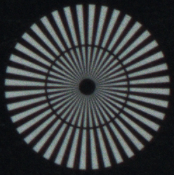
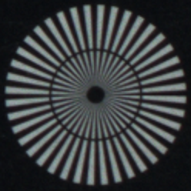
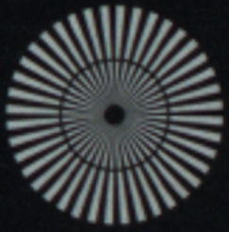
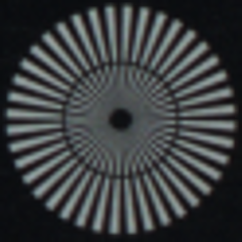
Effective Resolution Tests
Downsample the image then upsample
Look for factor where we see loss of image detail
R42
R65
C42
1x
2x
3x
4x

Slide 5
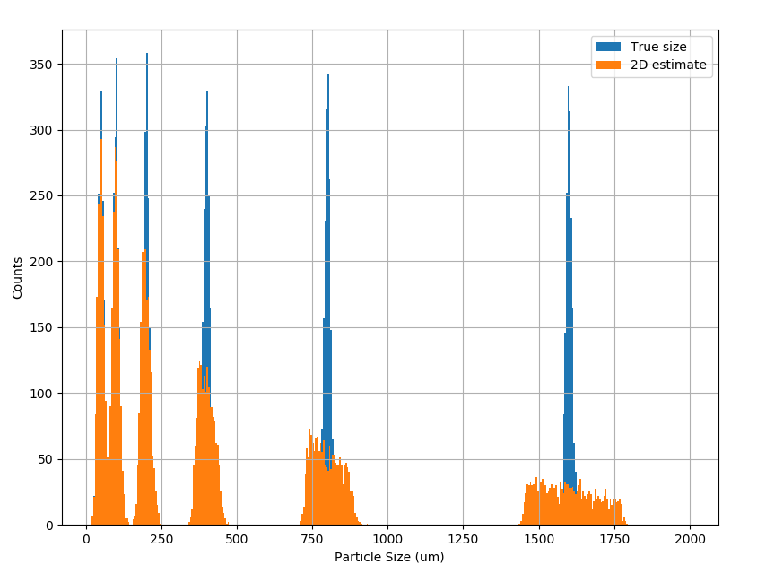
Size estimation with and without depth
From 2D perspective camera, depth must be known to estimate accurate size for individual objects.
How does this apply to statistics of particle size?
Implicitly integrate over imaged volume
Simulate with Monte Carlo:
  Depth range: 45-55 cm
  Focal length 21 mm
  2D estimate assumes 50 cm range

Slide 6
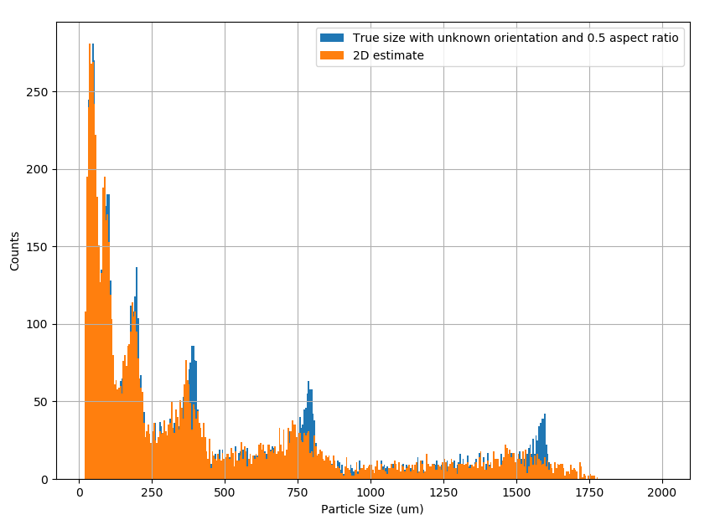
Size estimation with unknown pose
Model object as ellipse with length = 2 * width
Sample orientation of ellipse relative to camera uniformly randomly
Simulate with Monte Carlo:
  Depth range: 45-55 cm
  Focal length 21 mm
  2D estimate assumes 50 cm range

