Slide 1
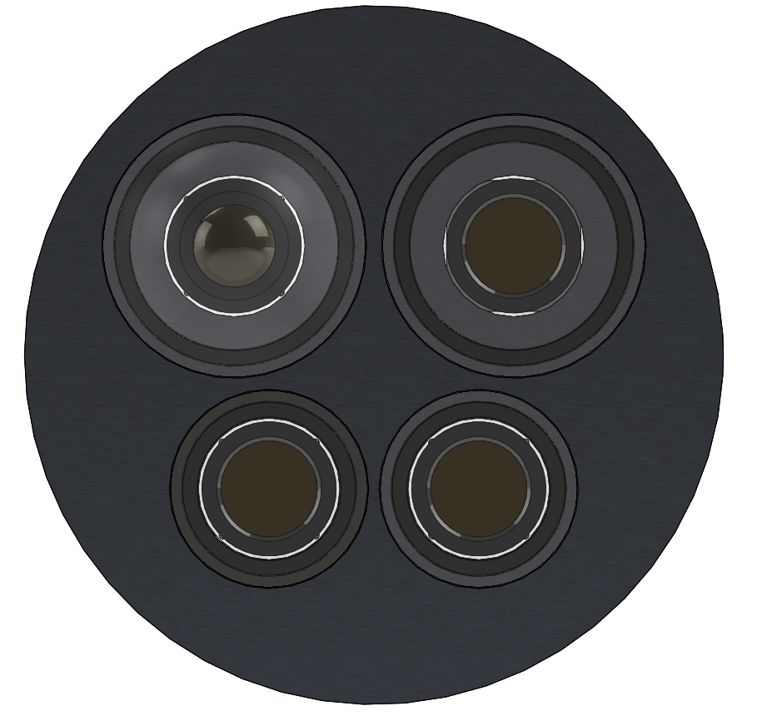
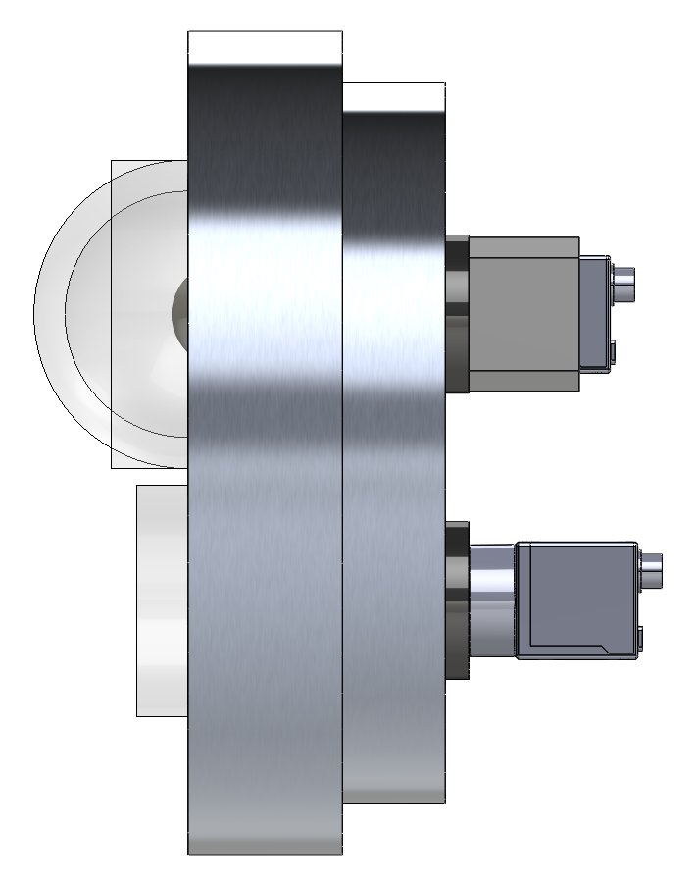
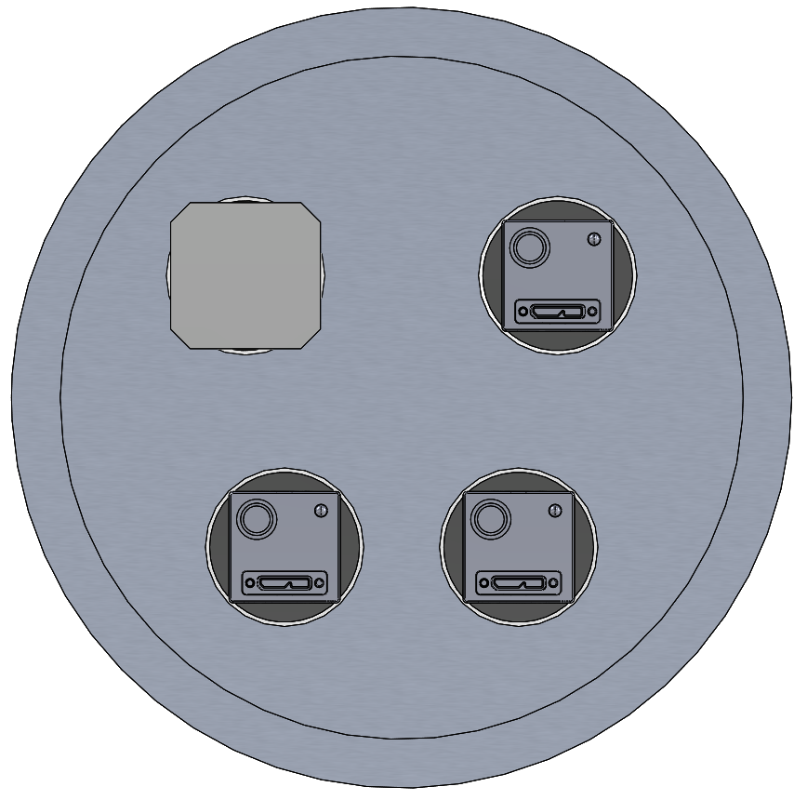
Wide-Right
8 mm, 23 MP Lens
85º x 67º in water
Dome Port
Raytrix Camera/Lens or Wide-Left
5.5 in
R42 or R8 or Blackfly 20 MP, 18 FPS
Blackfly 20 MP, 18 FPS
8 in
Narrow-Right
25 mm, 23 MP Lens
21º x 16º in water
Flat Port
Narrow-Left
25 mm, 23 MP Lens
21º x 16º in water
Flat Port
Blackfly 20 MP, 18 FPS
Blackfly 20 MP, 18 FPS
EyeRIS wide view with 180 um pixel @ 50 cm range
EyeRIS narrow view with 30 um pixel size @ 50 cm range
Planktivore 0.5x with 5 um pixel size telecentric
Planktivore 4x with 0.6 um pixel size telecentric
Size
10-100 um
100 um-1 mm
1 mm – 10 mm
10 mm – 10 cm
10 cm – 1 m

Slide 2
EyeRIS AUV System Requirements

Slide 3
Plenoptic vs Camera Array
Pros:
  Single camera
  Easy to add zoom optics
  Large multiplicity of views with small form factor
Cons
  High cost
  Low maximum effective resolution
  Restricted lens selection
  Hard to reconfigure
  Closed source software
  Reconstructed images have artifacts
Pros:
  Highest resolution
  2D images without any post processing
  Low-cost
  Easy to reconfigure
  Open source
Cons
  Limited multiplicity of views
  Greater system complexity
  Difficult to add zoom optics

Slide 4
Decision Space
Minimum Image Resolution
Plenoptic Camera
Multiplicity of Views of the Object
Camera Array
Single Camera
Ratio of Identifiable Object Size to Field of View

Slide 5
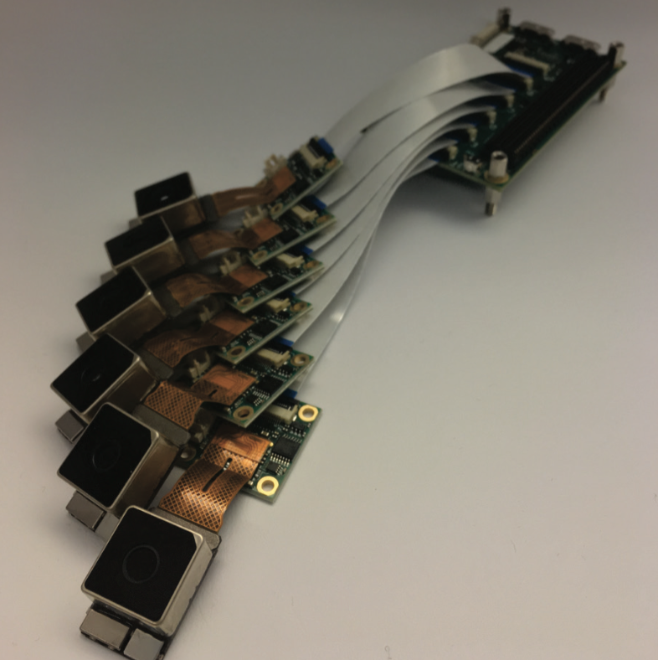
6-Camera EyeRIS Concept
Nvidia Jetson TX1 with 6, 42 megapixel cameras from Raytrix
Frame rates
  6 x 42 MP @ 2 Hz
  6 x 8k @ 6 Hz
  6 x 4k @ 24 Hz
  3 x 4k @ 56 Hz
Multiple configurations
  Lightfield PTV/PIV with 6-camera array
  Stereo with 3x depth of field
  2D images with 6x depth of field
  2D HDR images, up to 12-bits in theory
Parts cost for system
  Cameras: ~1800 euro from Auvidea
  TX1: ~$380
  J106 carrier for TX1: ~335
  M100 breakout for TX1: ~175
  Fujinon lenses x6: ~3600
  Total: ~$6300
Example array geometry, multi-baseline, hexagonal packing

