Slide 1
EyeRIS Cabled Instrument Preliminary Design Review
April 18, 2019
Paul Roberts, Kakani Katija, Alana Sherman, Henry Ruhl, Denis Klimov, Jon Erickson, Rich Henthorn

Slide 2
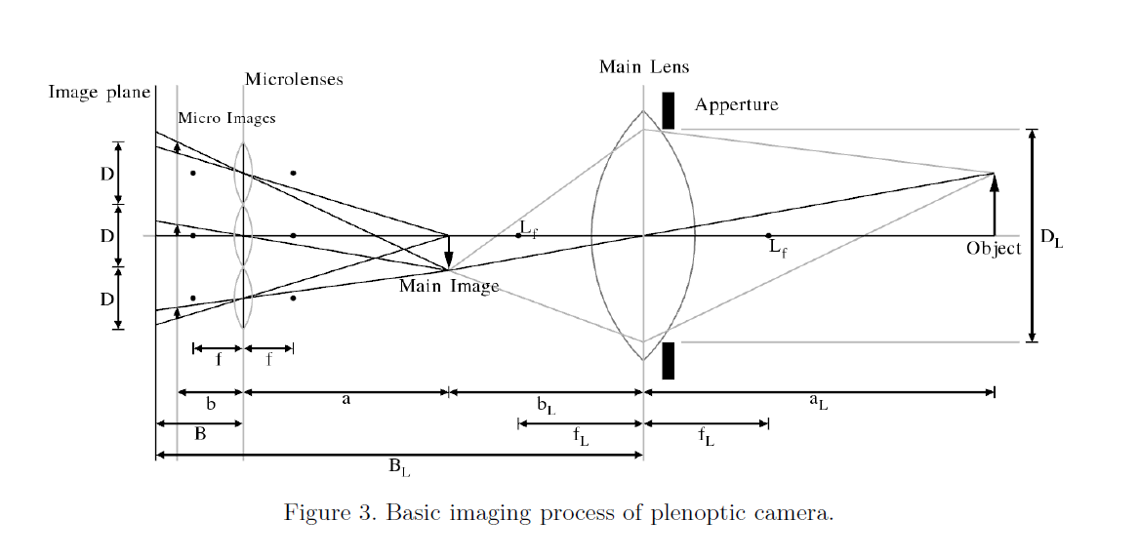
Plenoptic Imaging
Main image creates a miniature version of real object
Microlenses image this miniature version from different perspectives on to the sensor
The different perspectives are used to estimate depth

Slide 3
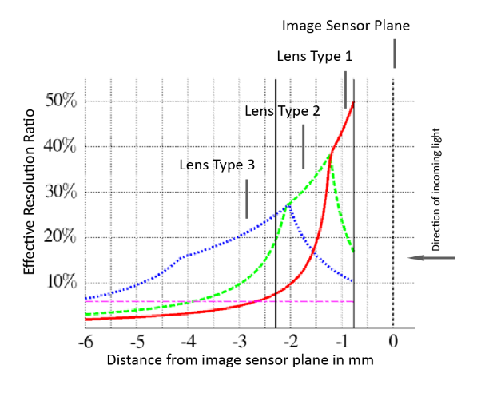
Raytrix Cameras
Use MLA with three different focal lengths
Once the depth of a point in the scene has been estimated, use the microlens images with the sharpest focus to compute the total focus image
This gives significantly more DOF than with a regular plenoptic camera

