Slide 1
EyeRIS Cabled Instrument Preliminary Design Review
April 18, 2019
Paul Roberts, Kakani Katija, Alana Sherman, Henry Ruhl, Denis Klimov, Jon Erickson, Rich Henthorn

Slide 2
Outline
Science goals and motivation
Functional requirements
Cabled instrument design

Slide 3
Science Goals and Motivation
Goal 1:
  Study spatially resolved high-resolution 3D velocity fields in situ
Goal 2:
  Image and track 3D deformable surfaces in situ
Goal 3:
  Combine 1 and 2 to improve our understanding of critical biophysical processes in the oceans
    Entrainment of particles by gelatinous plankton
    Feeding rates of benthic organisms
    3D morphology of in situ organisms and its impact on the fluid environment

Slide 4
Functional Requirements (Cabled Instrument)
  EyeRIS shall provide single-camera, single frame, 3D underwater imaging
  EyeRIS shall be remotely controllable
  EyeRIS shall stream live video to a surface vessel
  EyeRIS shall record data on an external high-resolution recorder on a surface vessel
  EyeRIS shall operate to a depth of 4000 meters
  EyeRIS shall be compatible with existing ROV power and communications
  EyeRIS shall be deployable on a manipulator arm of an ROV
Complete Details: 01-EyeRIS-Functional Requirements-1.0.2.pdf

Slide 5
Cabled Instrument Design
Optical Design
  Camera selection and validation
  Lens and viewport selection
  Underwater imaging geometry: Where to place lights and camera?
  Optical power budget: How much light is needed?
  Light selection
Electrical Design
  High-level interface to provide real-time visualization on ship
  Fiber extenders to transfer data from camera
  Control of lights, camera, and system status
Mechanical Design
  External fixtures
  Internal fixtures
  Thermal considerations
Risks and Mitigation
Safety

Slide 6
Optical Design: 3D Imaging Method
A deep-sea plenoptic imaging system
  Single camera, single-frame, 3D sensor
  High light efficiency compared to traditional camera: better contrast with shorter exposure times and less motion blur
  Simplified system integration
    Smaller form factor
    Fewer connections
    No synchronization needed between multiple cameras
For more details see: 02-EyeRIS-Comparison-of-3D-imaging-methods.pdf

Slide 7
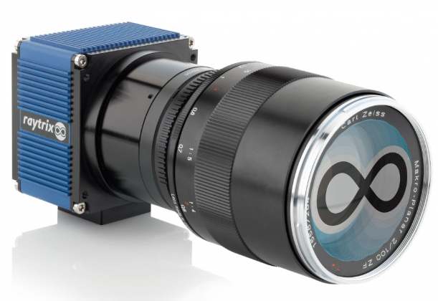
Optical Design: Raytrix R26 Camera
25 MP sensor
80 fps max rate
~ 2 GB/s data rate
4-channel CoaXPress-6 interface
4.5 um x 4.5 um pixels
23 mm x 23 mm sensor
12000 electron full well depth
41 dB peak SNR
/Datasheets: R26 Camera Specifications.pdf, Sensor: NOIP1SN025KA-D.pdf

Slide 8
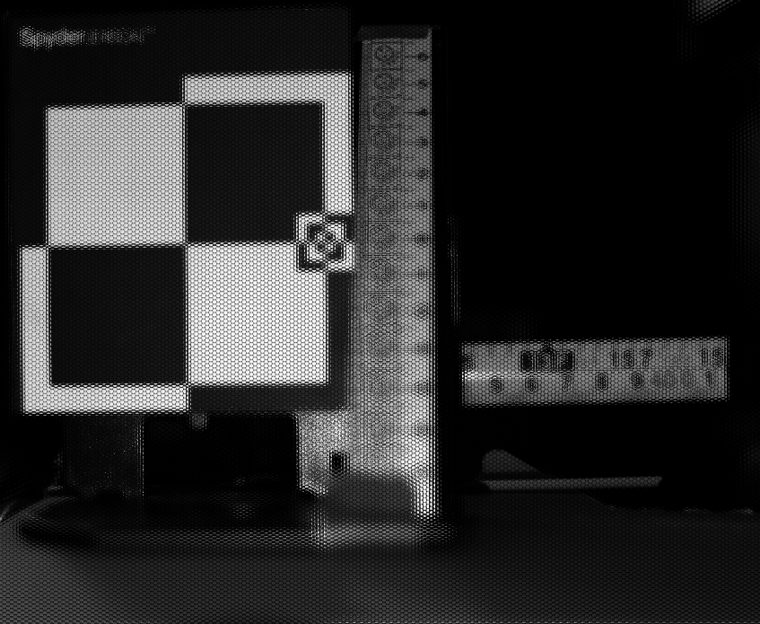
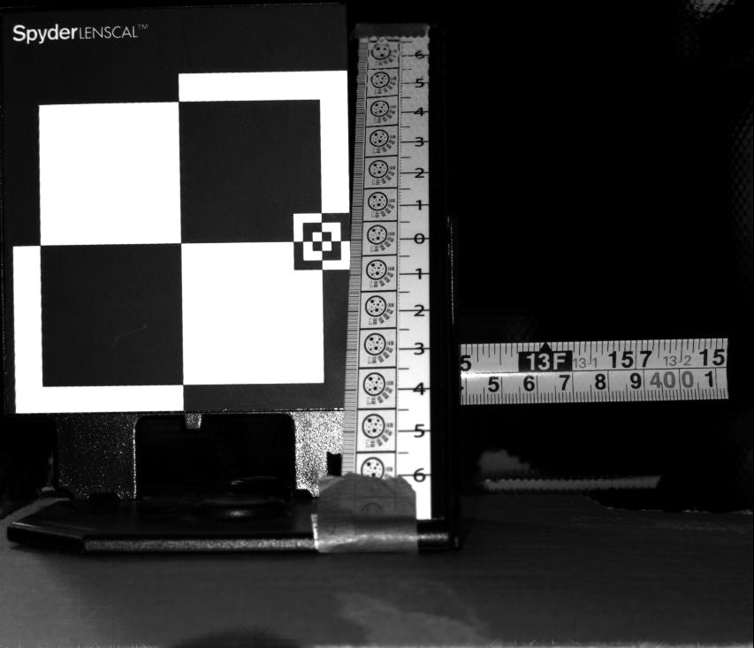
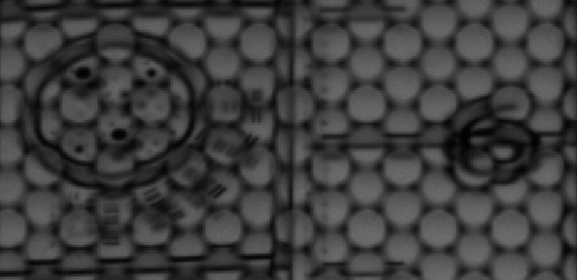
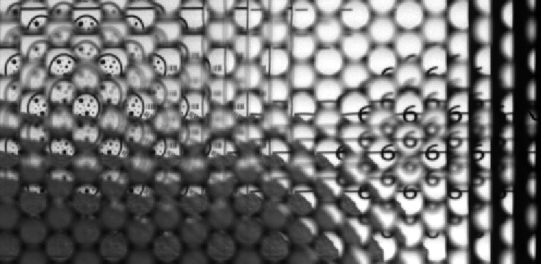
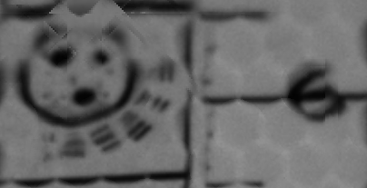
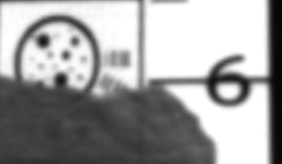
Optical Design: Example Raw and Refocused Images
Raw Image from R26
Total Focus Image from R26
Far
Near
Far
Near
Depth of field target with metric scale on 45 degree ramp, with in/cm ruler in middle position

Slide 9
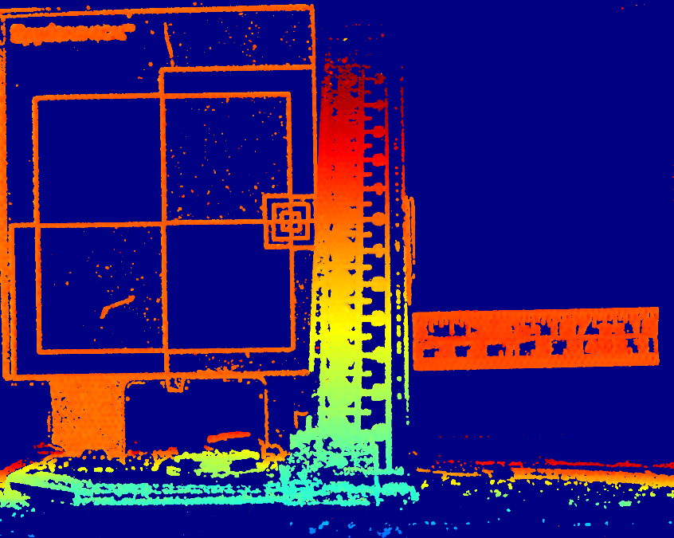
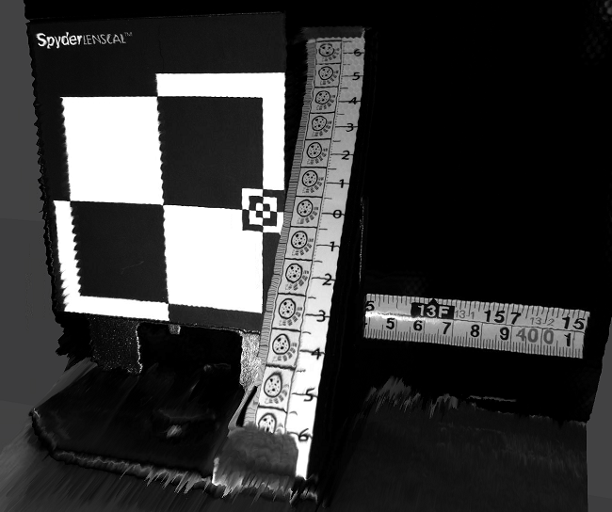
Optical Design: Example 3D Data
Depth Map
+
Total Focus Image
Color used to code depth in the scene
Spots with good features are localizable in 3D and shown in depth map
Depth map is combined with total focus image to yield 3D model.
Can be done in real-time on Nvidia Titan in lab
3D mesh model

Slide 10
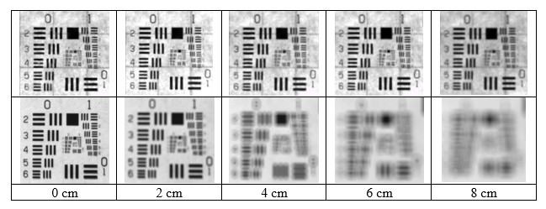
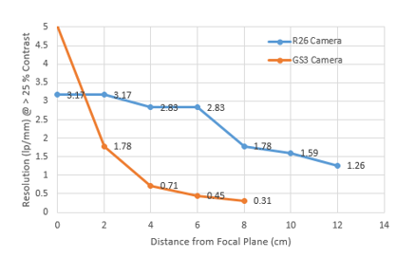
Optical Design: Depth of Field
R26 (Plenoptic) Camera with F/2.8 lens
GS3 (Conventional) Camera with F/2.8 lens
R26 Camera trades lower resolution at the focal plane for much larger depth of field and higher resolution away from the focal plane
Complete Details in: 03-EyeRIS-7583-Activities-and-Results-March-2019.pdf

Slide 11
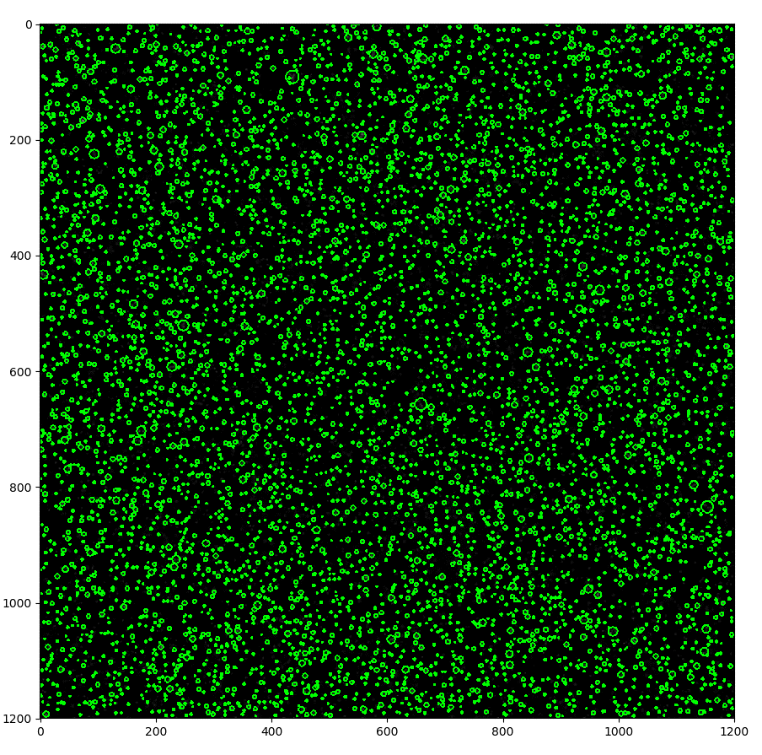
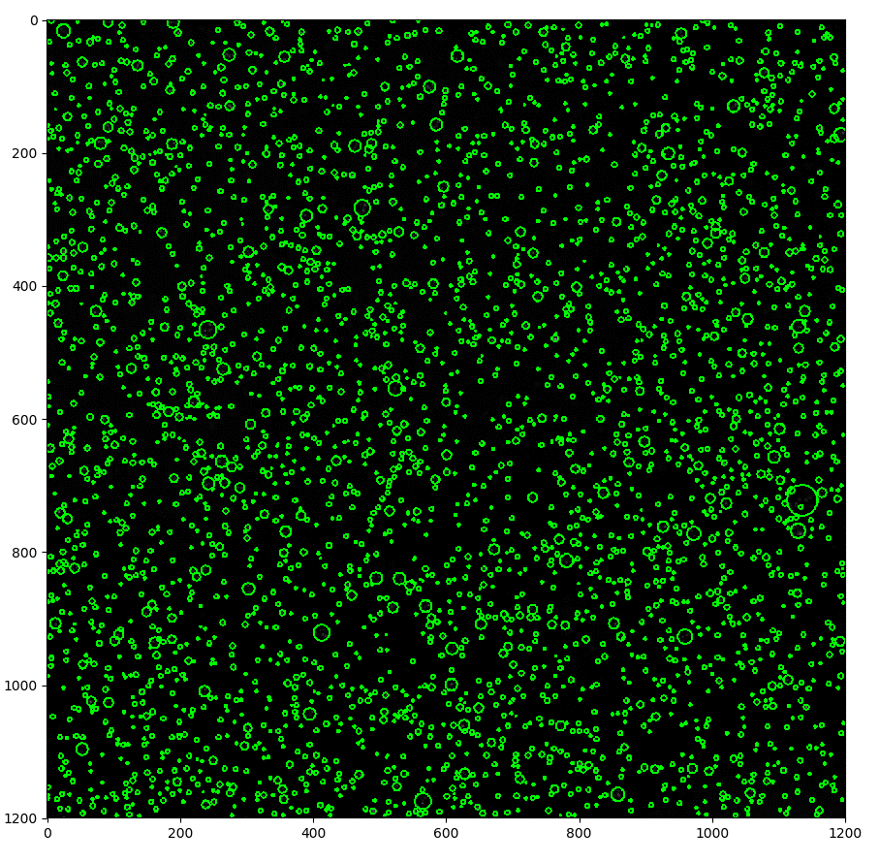
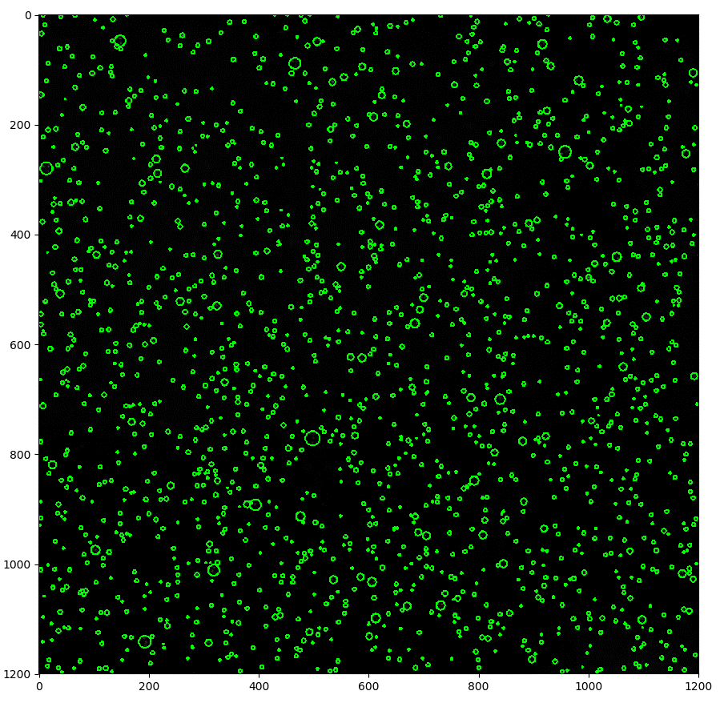
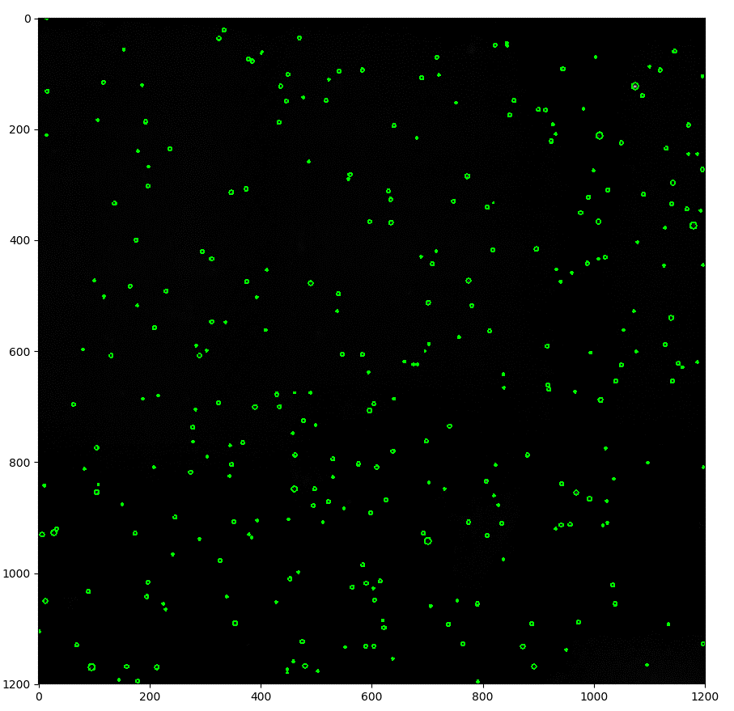
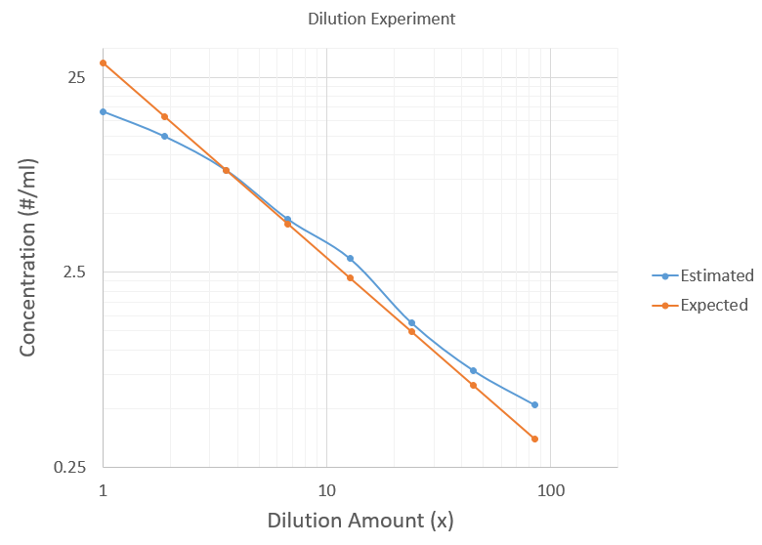
Optical Design: Particle Concentration
1
2
3
4
29.6 #/ml
8.3 #/ml
2.3 #/ml
0.7 #/ml
1
Detected particles in sequential dilution steps
Estimated and expected dilution of particles show good agreement when concentration is not too high
2
3
4
Complete Details in: 03-EyeRIS-7583-Activities-and-Results-March-2019.pdf

Slide 12
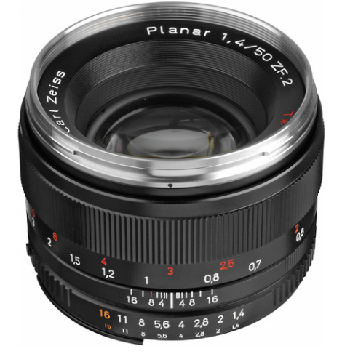
Optical Design: Lens Selection
Lens Selection
  Key constraint: lens must have F# similar to F/2.4 of R26 microlens array.
  F/2.4 is rare we use F/2.8 instead with sufficient fill of microlens
  50 mm lens provides a 18 deg x 18 deg FOV in water with R26 camera
  Plan to use Zeiss 50 mm lens to start but can use others as needed
  Lens 35 mm format (36 mm x 24 mm, conservative for 23 mm x 23 mm sensor)

Slide 13
Optical Design: Port Selection
Is using a flat port okay?
  FOV of interest are narrow, less than 10 degree half angle
  Distortion from flat port is small in this case (Treibtiz et. al CVPR 2008)
We can leverage the optical design of DeepPIV and use the same port
This eliminates a potentially expensive step in designing a new optical port

Slide 14
Optical Design: Imaging Geometry
Where to place lights and camera?
Camera-light separation
  Mitigate backscatter
Spot vs flood
  Small camera FOV benefits from spot light due to higher power density
  Narrow spot light reduces backscatter
Adding more lights
  Reduces shadows
  Compared: 1, 2, 3, 6
Light
Camera
Common-Volume
Backscatter
Target Scatter
Shadow
Complete Details in: 04-EyeRIS-Imaging-Geometry.pdf

Slide 15
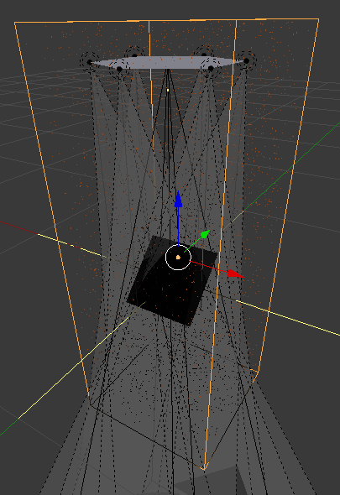
Optical Design: Imaging Geometry Simulation
Blender simulation
  Six lights in hexagon
  One camera at center of hexagon
  Target at 1 m range
Vary the size of the hexagon to test different source-receiver separation
Volume scattering based on Henyey-Greenstein phase function
Uniformly random distribution of 1 mm particles with varied concentration
Light1
Light2
Light6
Camera
Light3
Light5
Light4
1 m
Target
Phase function details: http://www.oceanopticsbook.info/view/scattering/the_henyeygreenstein_phase_function

Slide 16
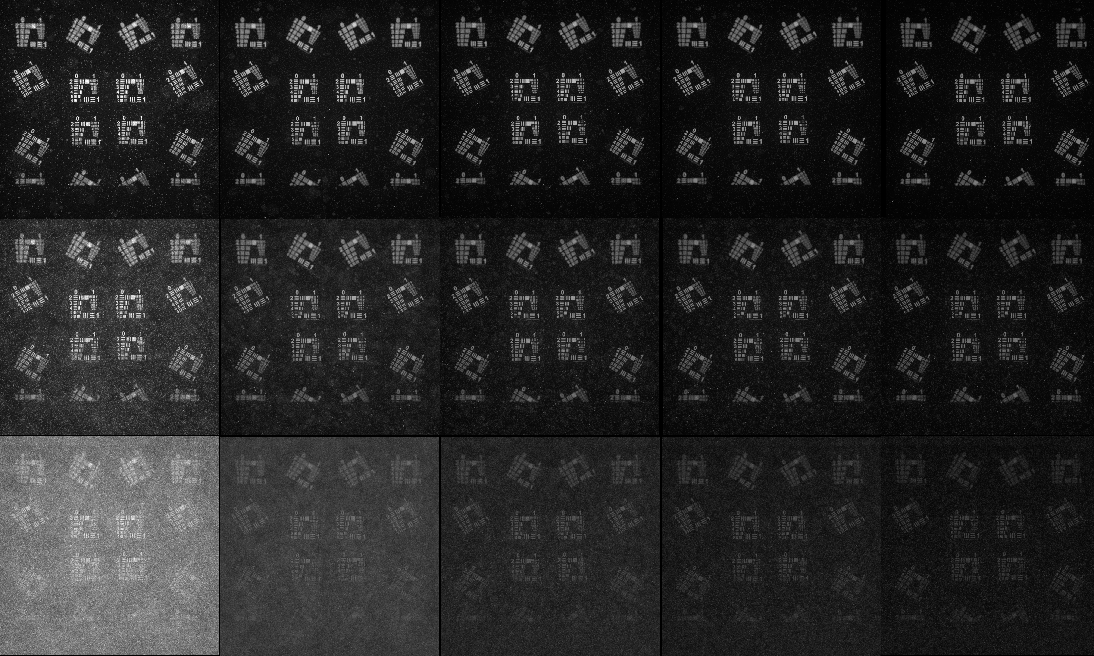
Optical Design: Imaging Geometry Simulation
6.2 particles / liter, scattering density = 0.5
62.5 particles / liter, scattering density = 1.0
625 particles / liter, scattering density = 2.0
10 cm
20 cm
30 cm
45 cm
60 cm
Increasing size of hexagon

Slide 17
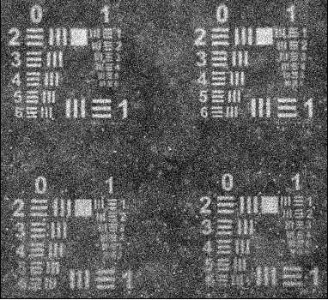
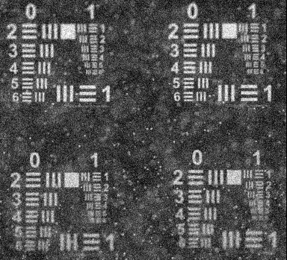
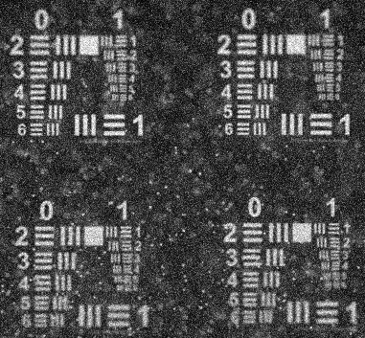
Optical Design: Imaging Geometry Simulation
10 cm
30 cm
60 cm
Individual particles have much better contrast at 30, 60 cm compared to 10 cm
Overall image contrast is significantly higher at 30 or 60 cm compared to 10 cm

Slide 18
Optical Design: Optical Power Budget
How much light is needed?
Received signal calculation
  100 um particle
  Volume scatter
  Particle motion requires short exposure time
  SNR ~ sqrt(QE*photons)
Camera
Light
Received power
Density
Incident power
Density
Backscatter
Forward Scatter

Slide 19
Optical Design: Optical Power Budget
Particle Trajectory During Exposure
Key design constraints
  Motion blur: reduces SNR per-pixel
    SNR ~ 1 /#pixels_moved
  Minimum particle size: larger particle scatter more light
    SNR ~ paticle_radius^2
  Scattering and absorption in water (beam_c): increased IOPs reduce SNR exponentially
    SNR ~ exp(-2* range * beam_c)
Instantaneous
Particle Image
(u,v)

Slide 20
Optical Design: Optical Power Budget
Light Power Output | 10 | W |  | This is ther optical power output from a single light source in the array
Total number of lights | 6 | # |  | Assume that all lights combine equally to illuminate the imaged volume
Fraction of light in illuminated area | 0.5 |  |  | This is the fraction of the output power that actually illuminates the imaged volume
Illuminated area | 625 | cm^2 |  | This is the cross-sectional area of the imaged volume that is illuminated
Power Density | 0.048 | W/cm^2 |  | Total power density of the lights
Total path length in water | 2 | m |  | Two-way path length in water
Absorption coeff | 0.3 | 1/m |  | at 630 nm in seawater
Scattering coeff | 1 | 1/m |  | one-way scatter vs two way aborption since the on the way to the target the scattered light still hits the target.
Attenuation over total path in water | 0.201896518 |  |  | Fraction of power lost to attenuation in water
Scattering Intensity ratio from MiePlot | 1E-11 |  |  | Fraction of input intensity to backscatered intensity over 150-180 deg for a 100 um sphere of 1.4 refractive index in 1.34 water at 630 nm
Power scattered back towards lens | 9.69103E-14 | W/cm^2 |  | Watts per solid angle in the backward hemisphere
Focal length of lens | 50 | mm
Aperature of lens | 2.8 | F/#
Effective area subtended by lens | 2.504458429 | cm^2
Power collected by lens | 2.42708E-13 | W
Lens efficiency | 0.75
Power Incident on pixel | 1.82031E-13 | W
Exposure Time | 0.0005 | s |  | Longest exposure at 10 cm/s and 50 um pixel to avoid motion blur
Energy on pixel during exposure | 9.10155E-17 | J
Photons per Pixel at 630 nm | 288.9379636 |  |  | From : https://www.pveducation.org/pvcdrom/properties-of-sunlight/energy-of-photon
Sensor Quantum Efficiency | 0.5
Pixel SNR (assuming not dark noise limited) | 12.01952502
With a 10 cm/s velocity, and 50 um pixel, max exposure to blur less than 1 pixel is 500 us
A set of 6x 10 W (optical output power) lights provide 12 dB SNR for a 100 um particle at 500 us exposure
Model Worksheet: Source-Files/LightBudget.xlsx

Slide 21
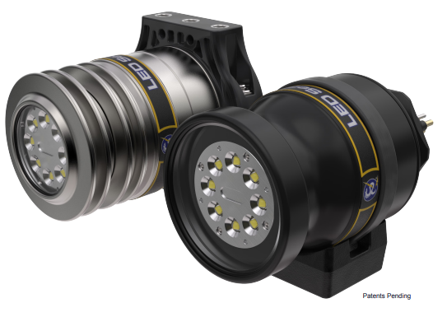
Optical Design: Light Selection
First version will use DSPL SeaLite
Easy to integrate and provides RS-485 dimming
Size: 2.5” OD x 4” long
Proven on many other MBARI assets
Can choose color from range of Cree LEDs
/Datasheet: MultirayLEDSeaLite2025_Specifications.pdf

Slide 22
Electrical Design
Key challenge: high data rate from CoaXPress camera bus to ship
Approach: CoaXPress to fiber extender with CDWM muxing
Requires: Minimum of 5 free CDWM wavelengths

Slide 23
Electrical Design: High-Level Block Diagram
Real-time visualization
Shipboard Power
GPU Machine
Research Vessel
CoaXPress<->Fiber
Winch/Slipring
surface
subsea
AC or DC
ROV
AC or DC
Legend
Control
Umbilical
Lights
HV Power
SM Fiber
CoaXPress<->Fiber
24 VDC
CoaxPress
Manip or mount
Ethernet
Camera
RS-485

Slide 24
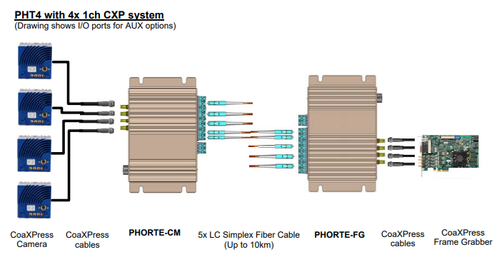
Electrical Design: CoaXPress to Fiber Conversion
One of only a few options for CoaxPress to fiber
Tested with the same frame grabber board we currently use with the camera
Fits in existing DeepPIV housing
/Datasheet: PHORTE-spec-v3.1-1.pdf

Slide 25
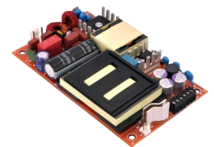
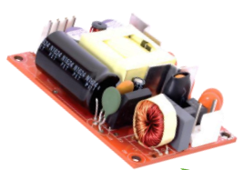
Electrical Design: Power Conversion
Universal AC and HV DC input
  80-264 VAC
  390 VDC
Very low-profile
  0.7” tall
Meets EN/IEC 60601-1
  300/100 uA leakage current
5in
3in
Bel Fuse MBC-275
3in
2in
Bel Fuse MBC-41
/Datasheets: ds-BPS-mbc275-series.pdf and ds-BPS-mbc41-series.pdf

Slide 26
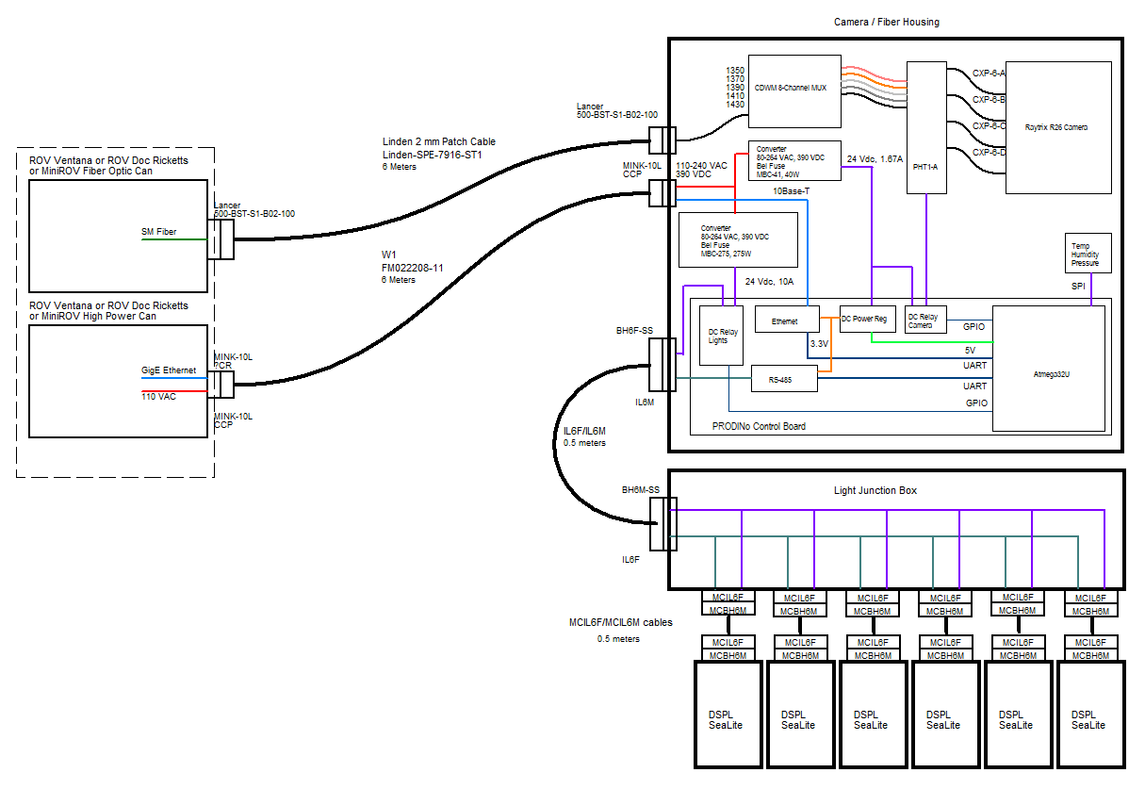
Electrical Design: System Diagram
Details: 06-EyeRIS-System-Diagram.pdf

Slide 27
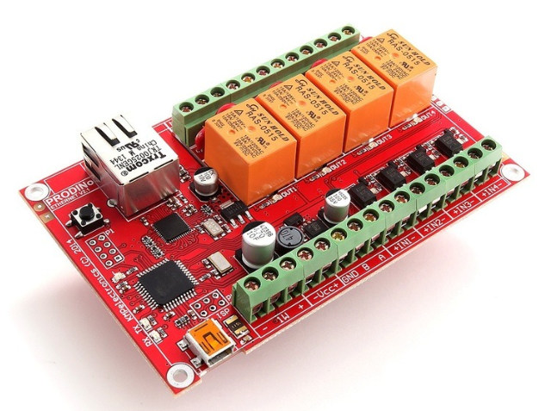
Electrical Design: Stock Control Board
Arduino Leonardo Core
Atmega32U4
10Base-T Ethernet
RS-485
15A relays
SPI interface for temperature sensors
Isolated digital inputs
/Datasheets: ProDiNo Ethernet V2.pdf and ProDinoEthV2_1_Schematic.pdf

Slide 28
Electrical Design: Power Budget
Item | Power Draw | Efficiency | Power Consumption
MBC-41: Camera: 13 W CoaxPress<->Fiber: 7 W PRODINo: < 1 W | 21 W | 90 % | 23.3 W
MBC-275: 6, DSPL lights, 40.5 W ea | 243 W | 90 % | 270 W
 |  | Total | 293.3 W

Slide 29
Mechanical Design
Match DeepPIV form factor to the extent possible
  Proven housing design
  Know the space of possible deployments and operations well
Use foldable armature for lights to facilitate large baseline when imaging
  Allow us to better control the illumination geometry and still fit in DeepPIV form factor
Package the system into a single housing
  Reduce the number of housings required to one plus lights

Slide 30
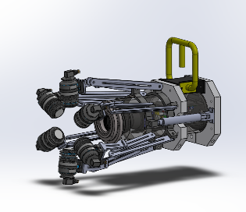
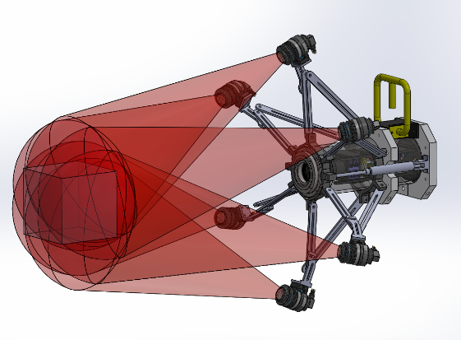
Mechanical Design: External Assembly
Folded light array with hydraulic cylinders fully retracted
Expanded light array with hydraulic cylinders fully extended and
Lights turned on
Folded OD : 42 cm
Expanded OD : 85 cm
Length: 89 cm
Approx weight in air: 25 kg
Approx weight in water: 15 kg
Hydraulic cylinders used to actuate the array
Cylinder stroke limits the extended and retracted position
Details in : 07-EyeRIS-Dimensions.pdf

Slide 31
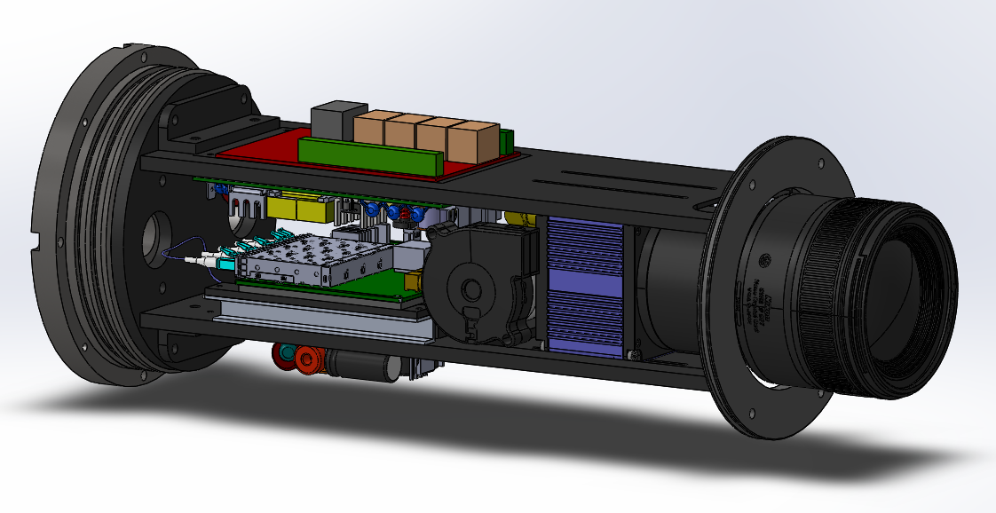
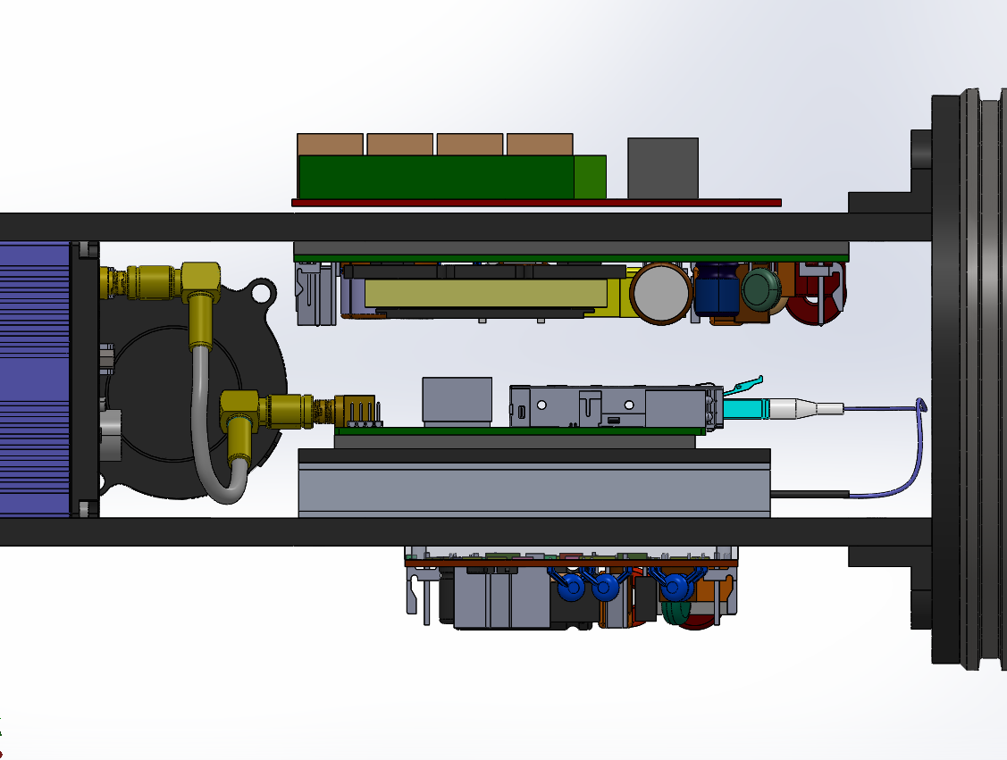
Mechanical Design : Internal Assembly
PRODINo
Two-plate assembly with camera and lens in between
Electronics and fiber coms sit behind camera
Slots for camera mount allow for adjustment to accommodate different lenses
End of plates mount to rack support with o-ring to pick up tube ID
Two blower fans bracket the space between camera and electronics and blow in opposite directions
CDWM Mux
MBC-275
MBC-41
PHT4
Fan
Camera
Lens
CoaxPress
Fiber

Slide 32
Mechanical Design: Thermal
Heat generation inside the housing
  R26 Camera : 13 W
  Fiber extender: 7 W
  MBC-275 (lights): 27 W
  MBC-41 (camera and fiber extender): 3 W
Total heat in housing: 50 W
Will use forced air plus conductive coupling to endcap
Likely will need to run lights at low power on deck

Slide 33
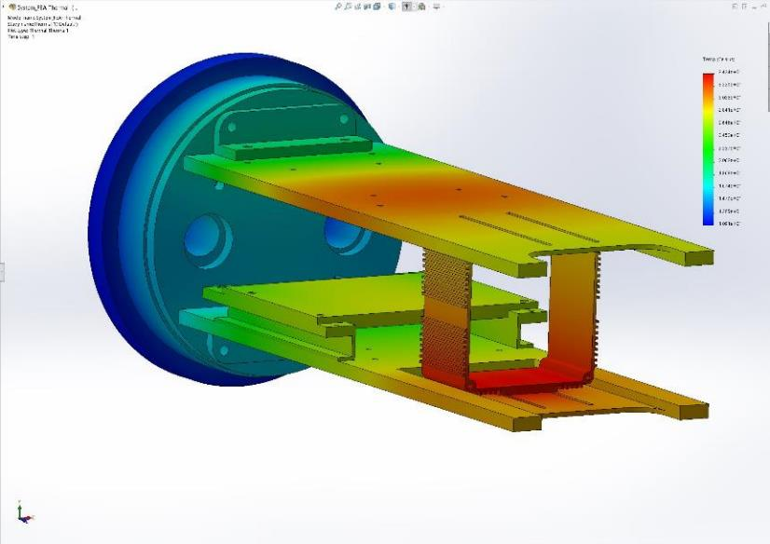
Mechanical Design: Thermal
30 C
11 C
Internal temperature of chassis for 7 C
external temperature in seawater
34.2 C
Details: 08-EyeRIS-Thermal-Calculations.pdf

Slide 34
Risks and Mitigation
Optical
  Low contrast in natural particle images or low particle densities
    Add baffles to lights to limit output at large angles
    Inject plastic particles with higher contrast
  Low contrast for featureless 3D structures
    Add structured illumination
Electrical
  CoaXPress to fiber converter does not perform well
    Work with vendor to test different laser diodes (a few options here)
    Test an extender made by Kaya instruments
  Bel Fuse converters don’t perform to spec
    Move the power conversion to a separate housing with larger CUI or Meanwell converters
Mechanical
  Folding array is not reliable
    Revise roller bearings and lengths of the bars in the linkage to improve robustness
    Reduce size of array

Slide 35
Safety
High voltage AC or DC input to housings
  Ground fault detection?
Moving parts on light array and hydraulics
Bright output from LEDs

Slide 36
Development Schedule
Phase 1a July 2019:
  Mount on MiniROV and test in the pool
  Refine illumination geometry and lens selection
Phase 1b Aug 2019:
  Deploy at sea on MiniROV
Phase 2 Jan 2020:
  Deploy on Ventana and Ricketts
Phase 3 Summer 2020:
  Deploy alongside DeepPIV on Ventana and Ricketts

Slide 37
Mounting on ROVs
Mini ROV
  Mount to tool sled in fixed position with room for manip and sampler
Ventana (tbd)
  Held by manip, hydraulics used to open and close light array
Ricketts (tbd)
  Held by manip, hydraulics used to open and close light array

Slide 38
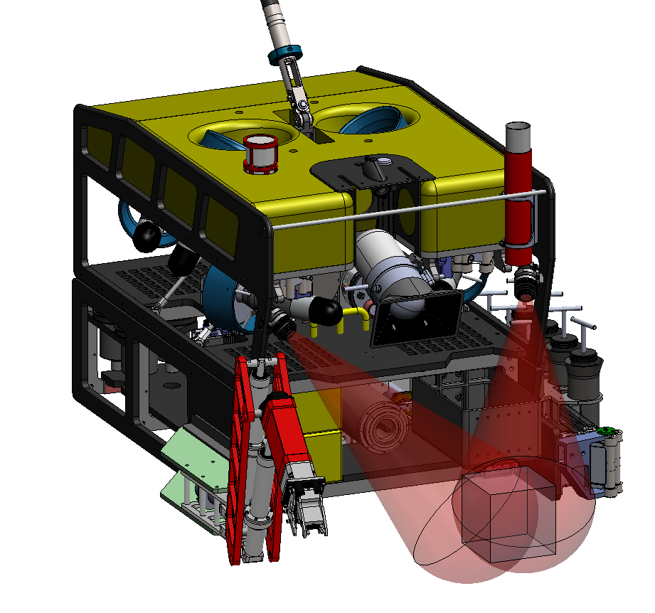
MiniROV
Mount lights directly to ROV
Fit camera between tray and foam in tool sled
Camera Housing

Slide 39
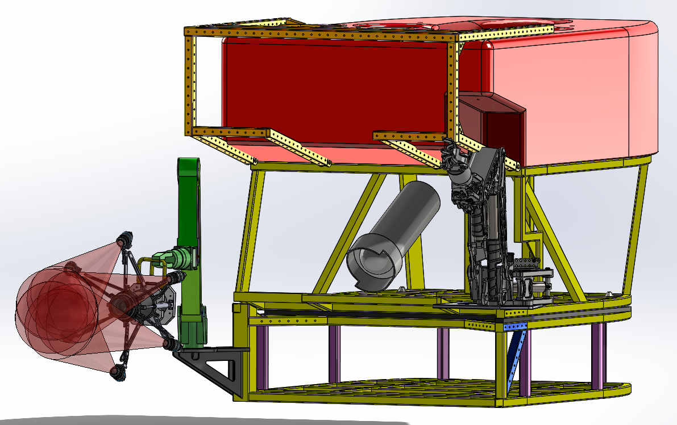
Ventana
Deploy on manip similar to DeepPIV

Slide 40
Thanks!

