Slide 1
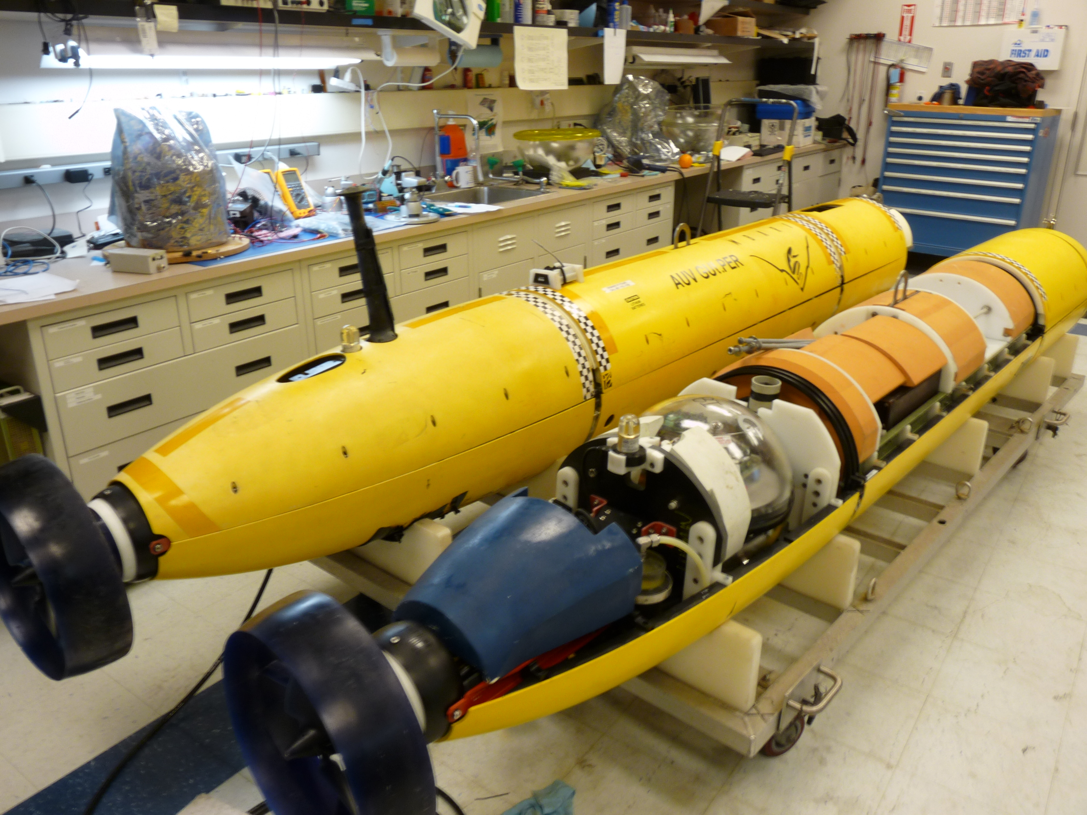
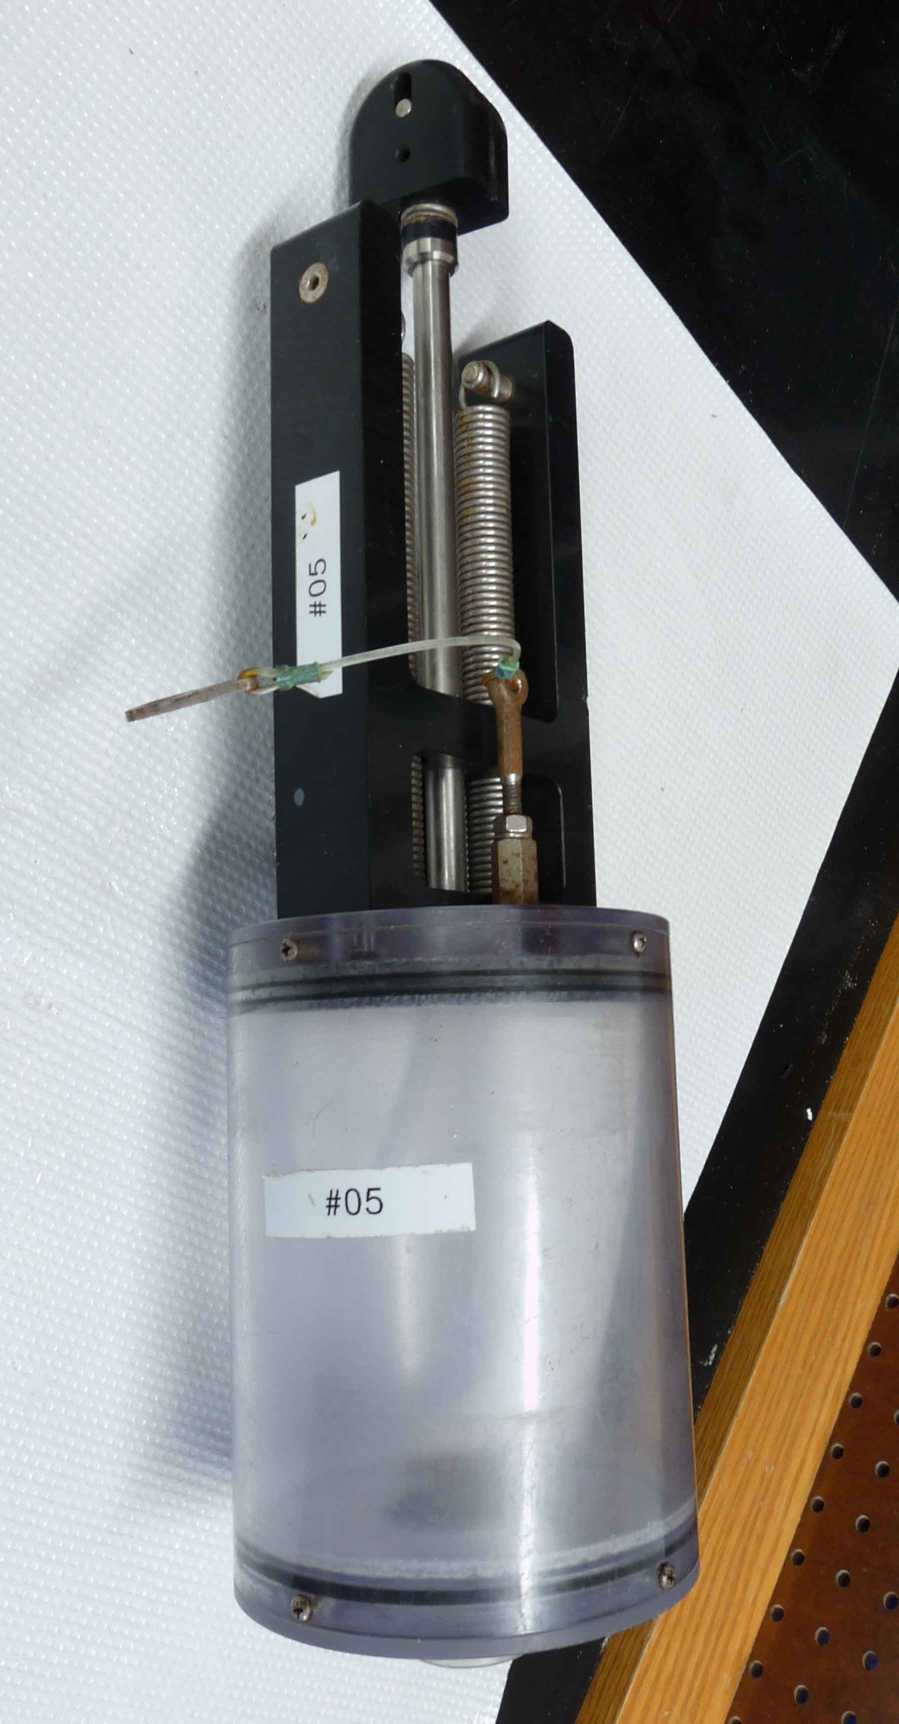
AUV-Gulper
“Autonomous platforms”

Slide 2
AUV deployments: Gulper vs Niskin
Something wrong
G4: No phytoplankton growth
G6: No phytoplankton growth

Slide 3
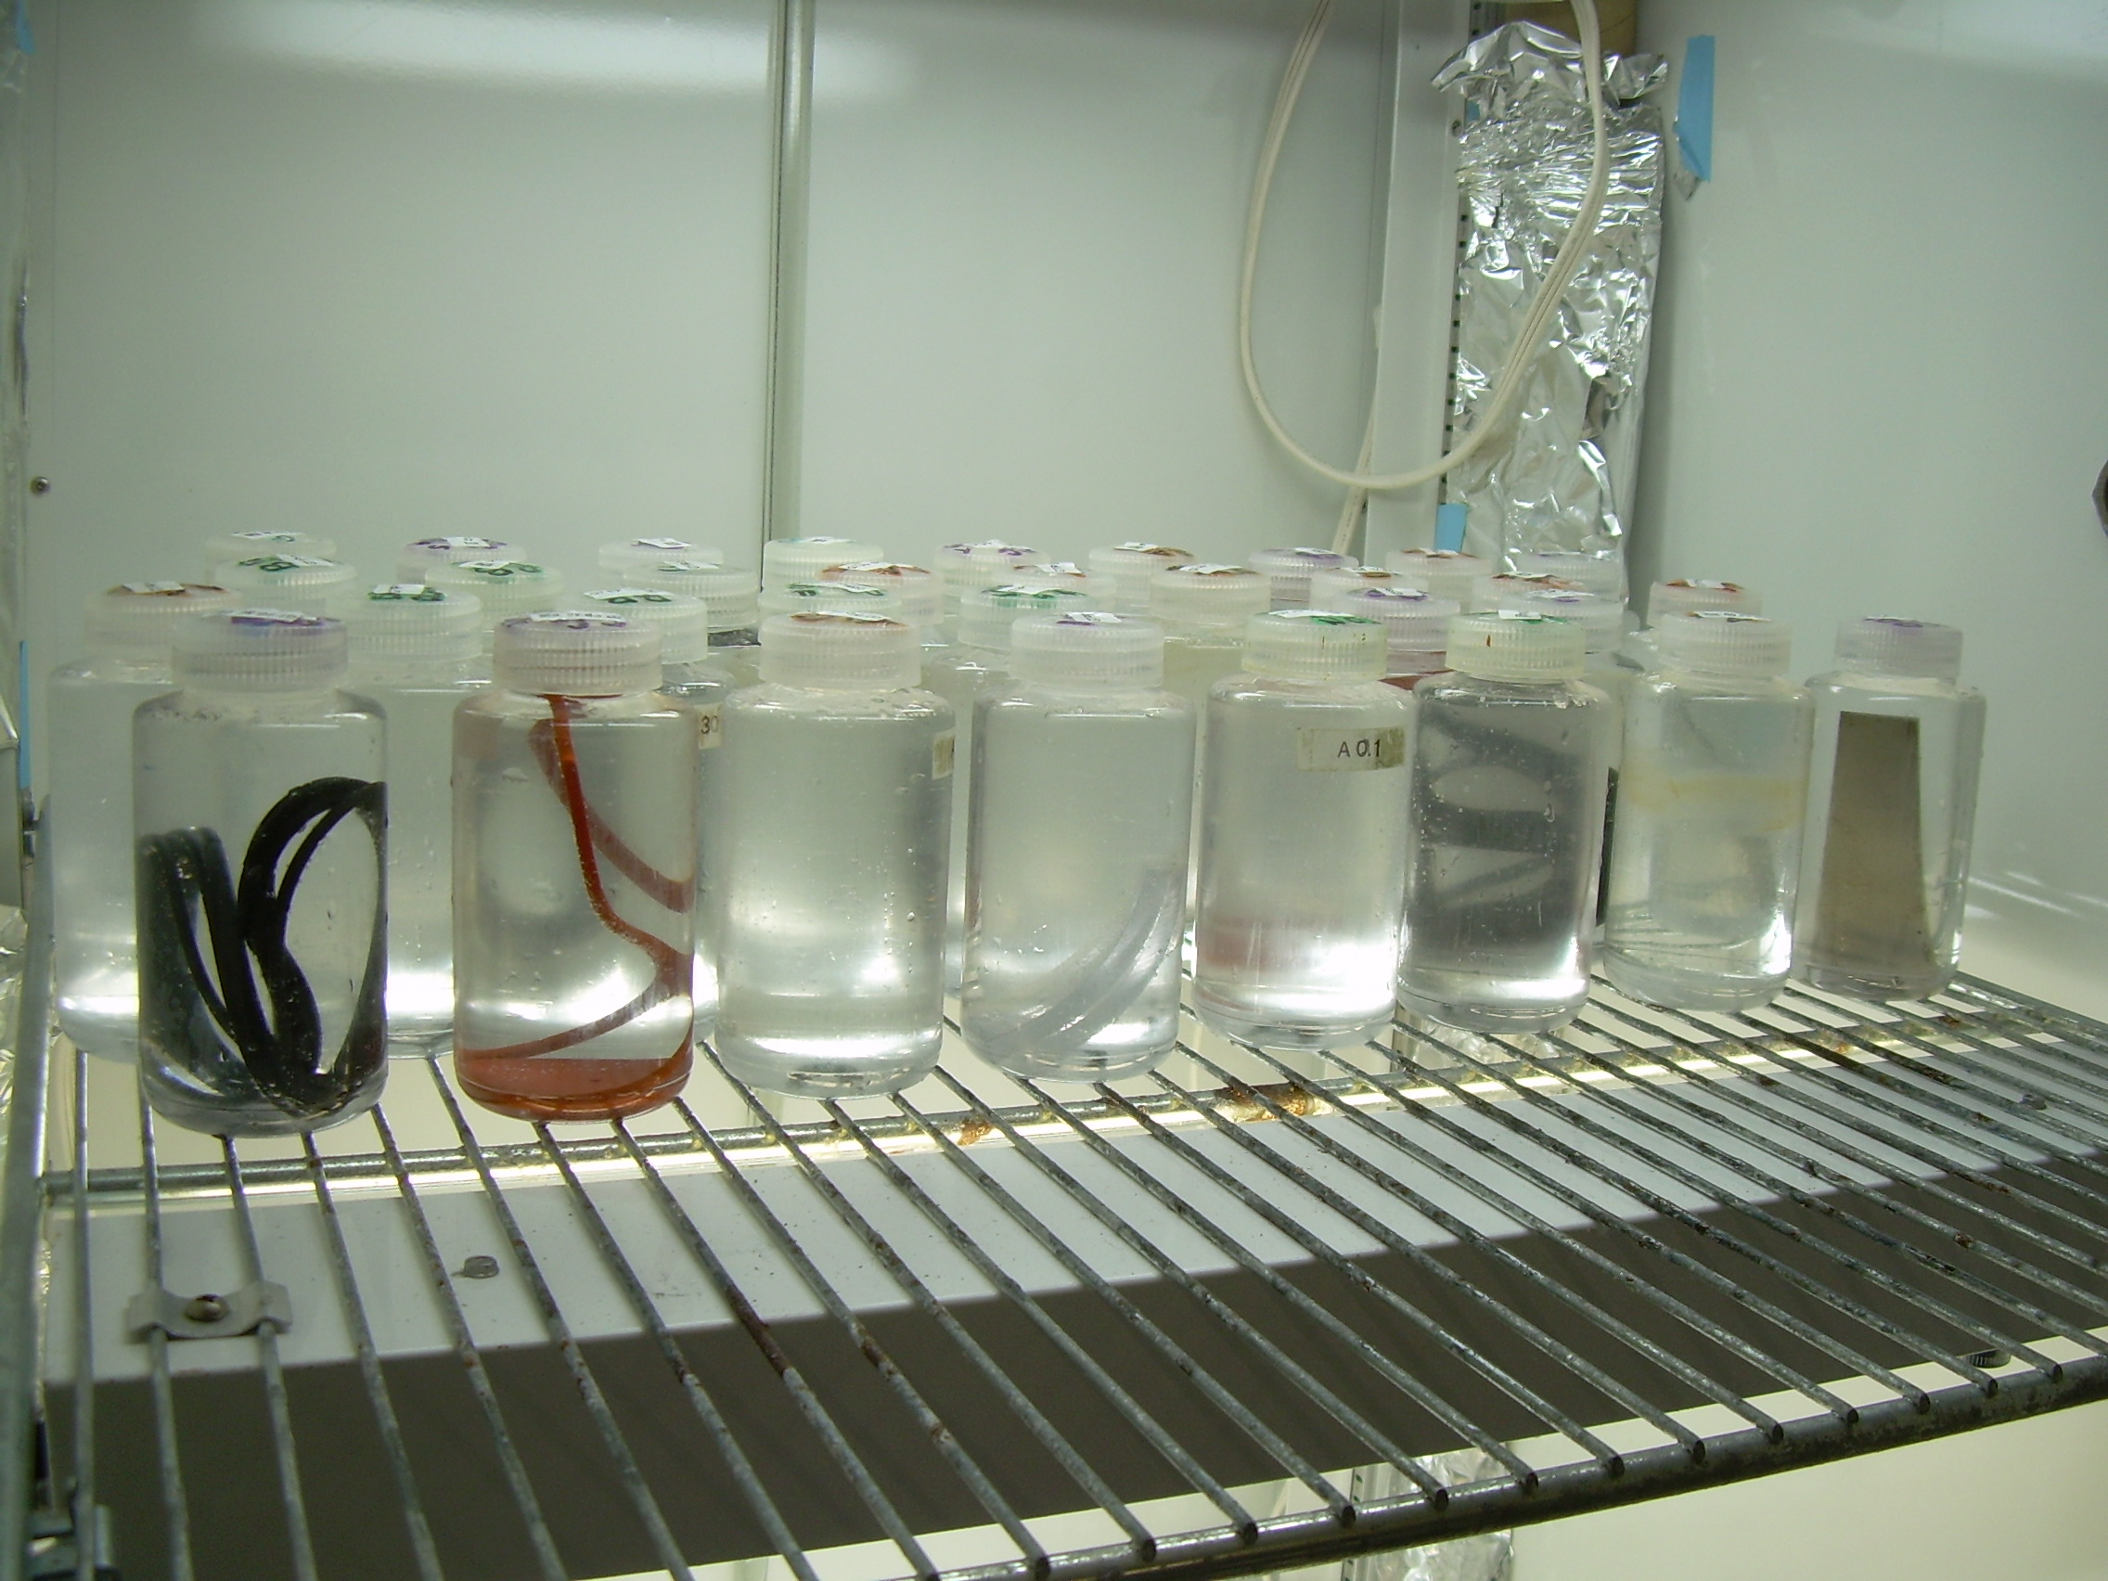
More lab experiments
--- Gulper parts ---

Slide 4
The smoking gun: Buna
%change from Blank 0 +27 -94 -22 +8 -16 +23 +16 -9 +35 -3
G9: No phytoplankton growth
G7: No phytoplankton growth
G8: No phytoplankton growth

