Slide 1
Rover Transfer Discussion
Dec 10, 2024

Slide 2
Export Control Warning
“WARNING - This document contains information whose export is restricted by the Arms Export Control Act (Title 22, U.S.C., Sec 2751, et seq.) [or the Export Administration Act of 1979 (Title 50, U.S.C., App. 2401 et seq.), as amended]. Violations of these export laws are subject to severe civil and/or criminal penalties.”

Slide 3
Outline
Rover overview
Deployment
  Previous issues
Electrical Overview
Mechanical Overview
Software Overview
Maintenance costs
Data
Other issues

Slide 4
Rover details
Weights: 3,185 lbs in air, 130 lbs in water (with 250 lb drop weight)
Size: 2.6m long, 1.7 m wide, 1.5 m high
Depth rating : 4000 m
Materials: plastic and Ti
Energy consumed in 1 year of operation- 20 kWhrs (Li primary)

Slide 5
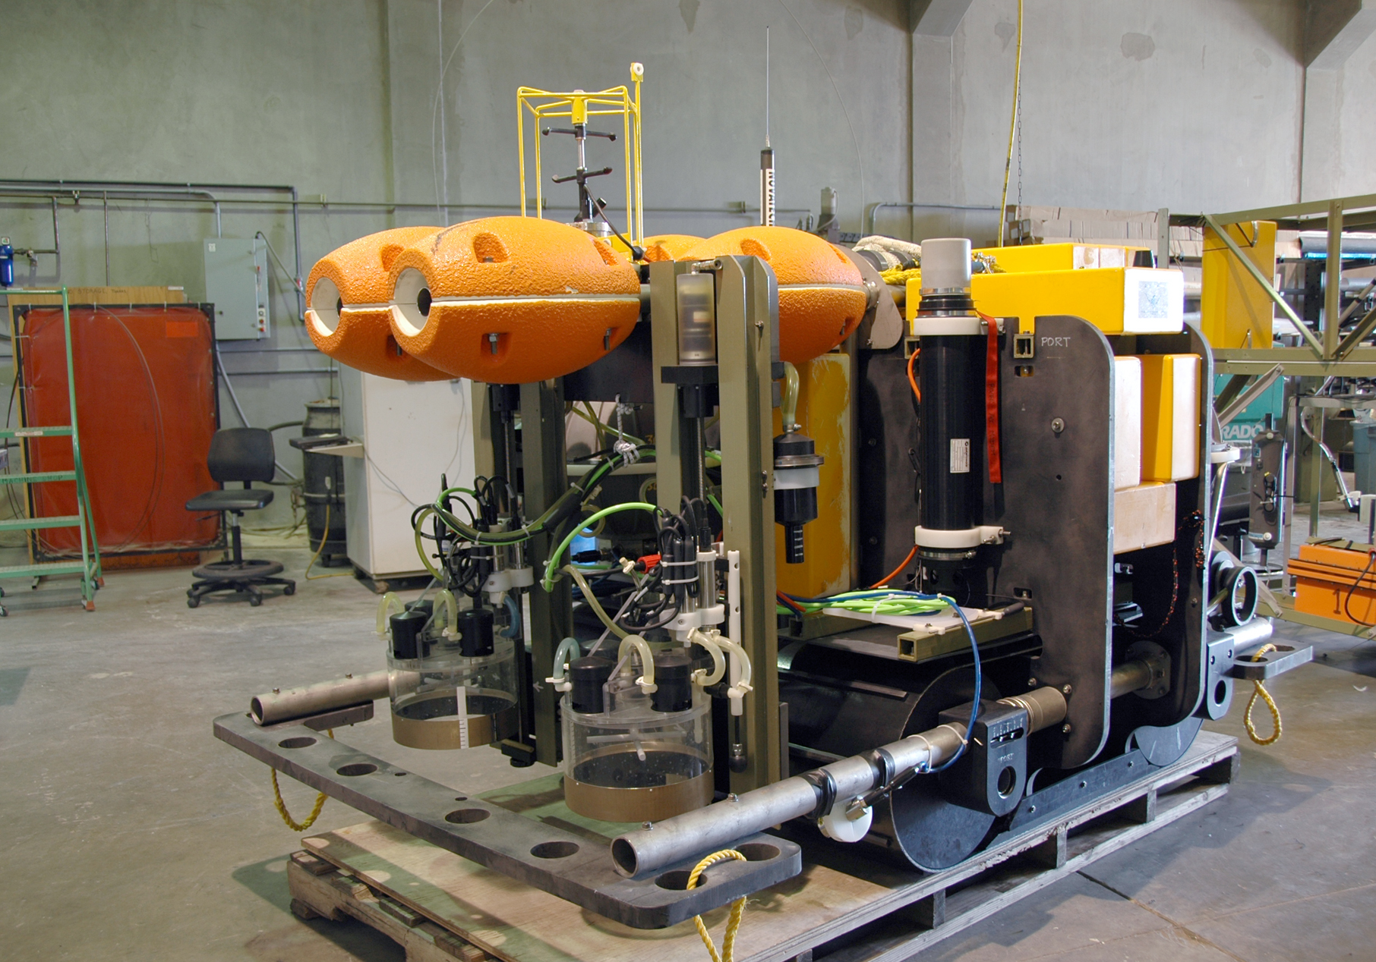
Benthic Rover Configuration
Current Meter
Chamber
Rack
Acoustic
Modem
Respirometer
Chamber
Video Cameras

Slide 6
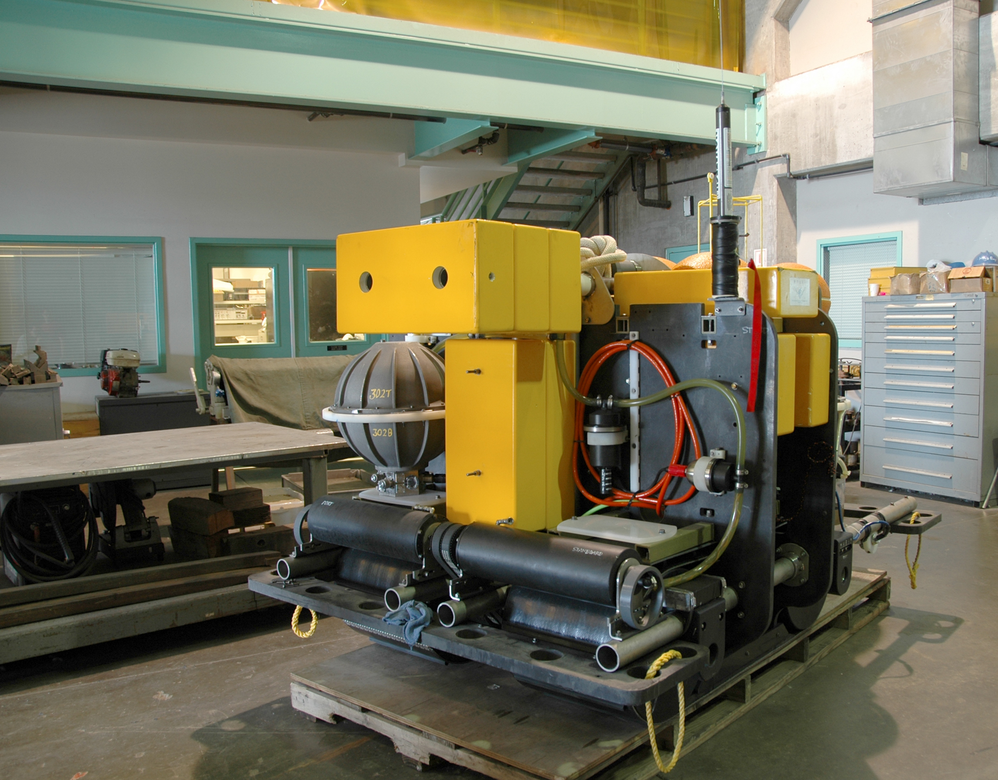
Benthic Rover Configuration
Battery
Sphere
Argos
Prop Motors
Brushes

Slide 7
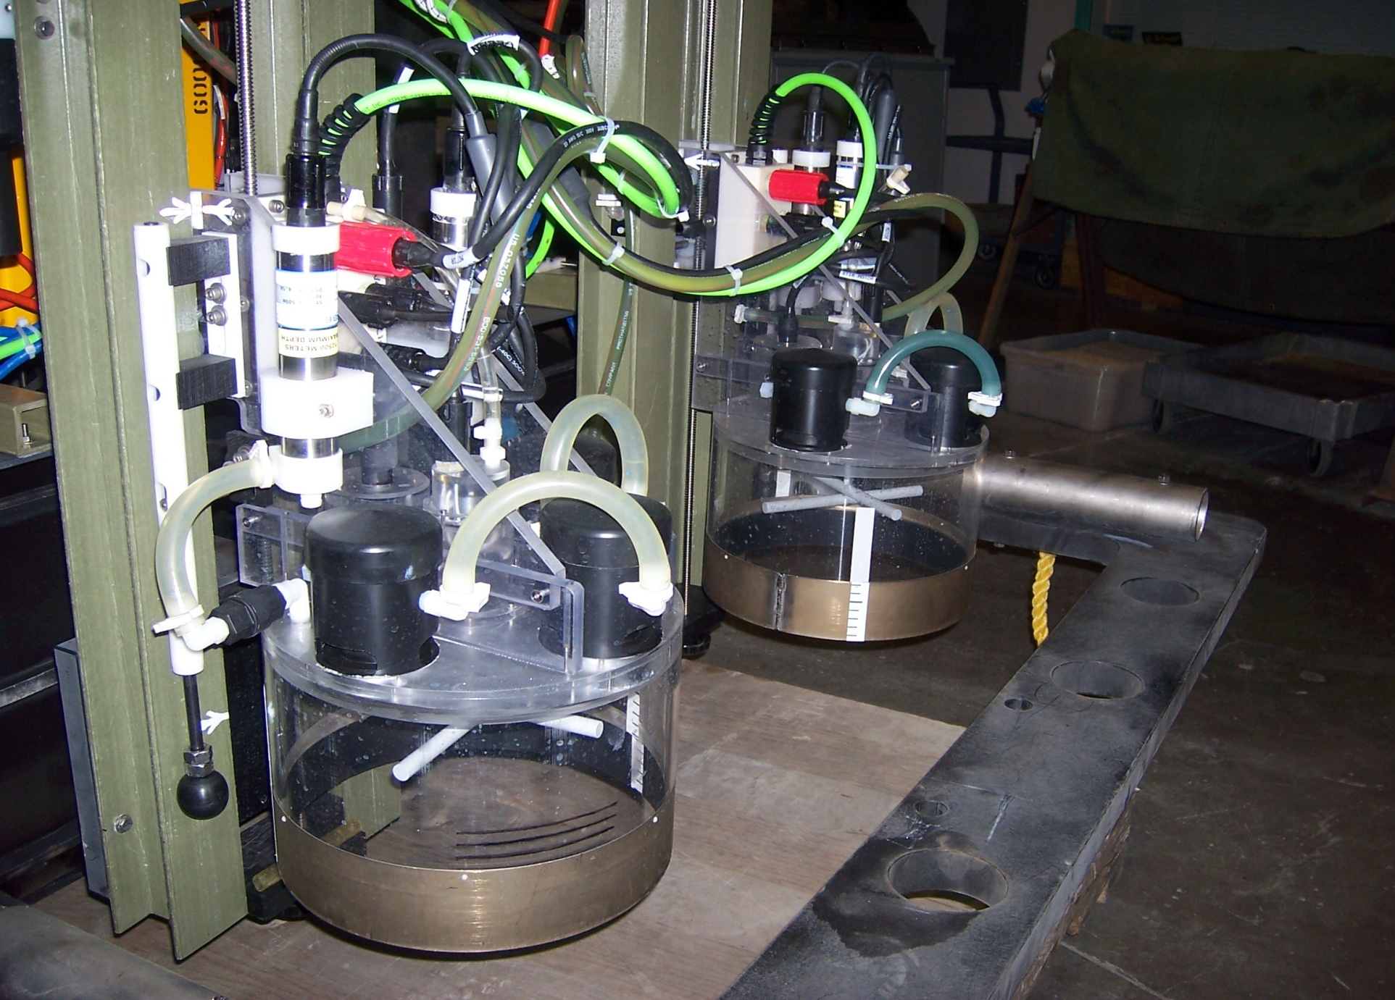
Respirometers
Cleaning
Pump
Valves
Stirrer
Touch
Pad
Ti Knife edge

Slide 8
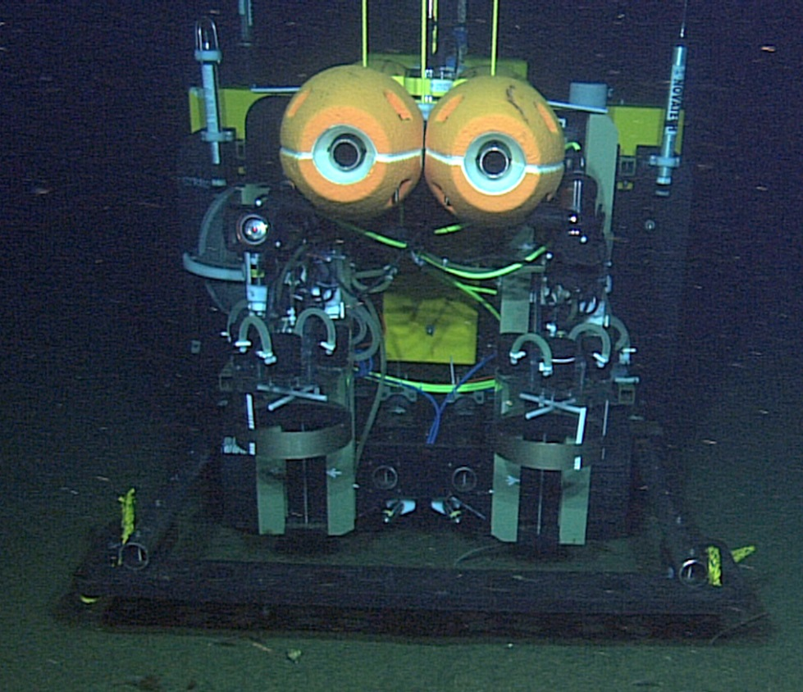
Benthic Rover Typical Mission
Operational Profile
Transit up current to measurement site
Image measurement area
Insert B-R chambers
Measure O₂ for 48hrs
Raise chambers
MBARI

Slide 9
Rover Task Cycle
Current meter cycle – 1 Hr
Transit – 5 to 10 min
Transit camera & Strobe
Dust settle period – 1 to 4 Hrs
Fluorometry camera - 1 min
Chamber cameras and video server - 1 min
Rover Tasks
Lower Respirometer Chambers – 5 min
Respirometry - 1 to 3 days
Read optode-
every 15 min for 1 min
Stir motors- 10 sec on/ 10 sec off
Raise Chambers – 10 min
Chamber cameras and video server
Time
Main Controller On
Main controller wakes up every 15 min, Stir motor controller on continuously

Slide 10
Rover Deployment

Slide 11
Deployment Movies

Slide 12
Electrical System Overview

Slide 13
Open System Diagram PDF

Slide 14
CPU Stack
“Wakey”
PC104 stack
  Real-time clk
  Serial expansion card, 12 port isolated
  TS7200 ARM 9
  Ethernet switch
Separate stirrer controller boards – PIC microprocessors

Slide 15
Rack Junction boxes
Provide power/comms directly for:
  Rack motor
  Stir motor
  2 optodes (Aanderaa RS232)
  1 pump

Slide 16
Instruments on Rover
Current Meter- FSI 2DACM
Acoustic Modems – Benthos LF and MF stand alone systems
4 Aanderaa optodes
2 Insight Nova video cameras (“chamber cameras”)
2 prosilica machine vision cameras (“transit” and “fluoro” cameras)
2 seabird pumps
1 aquaflash strobe

Slide 17
Batteries
Custom packs from Electrochem:
  Li primary
  CSC93DD cells
  4 packs per sphere, each pack 15 V
  10 kWHrs per pack
  Cost for 2 spheres of batteries approx. $20k

Slide 18
Total energy available ~20 kWHrs
Lasts about 13 months

Slide 19
Mechanical System Highlights

Slide 20
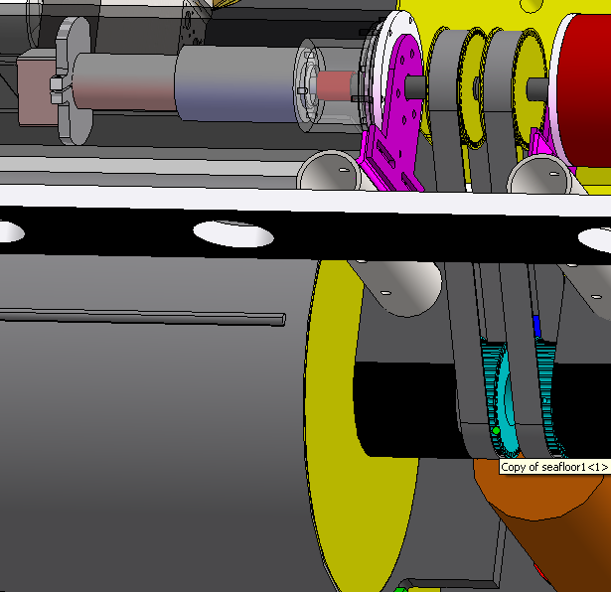
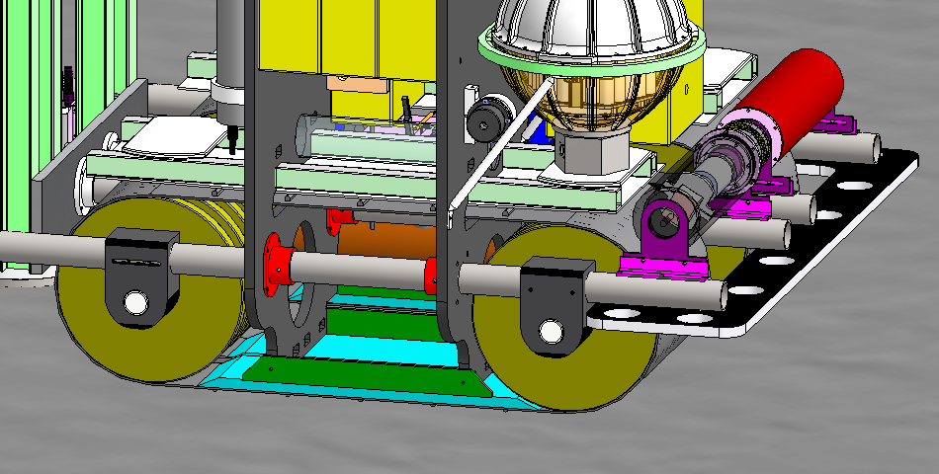
Drive System
Two Separate Drive motors
  BLDC Maxon EC60 400W
  80 N-M torque; 6-8 RPM; 58% eff.
  Oil-filled, Independent compensators
  Gates 1 ¼ sync. Drive belt, 1:1 ratio
  Independent servo controller/amplifier mounted in 1-Atm housing near motor
Tracks
  Endless 18” wide ¼” thick conveyor belt
  Bonded transverse and inside longitudinal lugs
  Low contact pres. (0.1 psi) = low disturbance
    ~150lbs vehicle weight / 1600 sq-in
  Spring energized pre-load
    Two Ti Springs,~ 650N each
  Pressure plate fitted with rock guards
  Drive and idler track wheels built with (6) 1.5” wide wheels to minimize rock capture

Slide 21
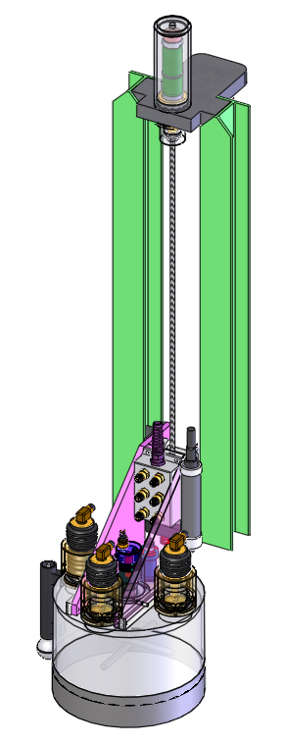
Respirometer and Racks
30cm (12”) dia, 20 cm (8”) high chambers
Mechanism to raise and lower chamber
Foot pad to stop rack
Optodes to measure O₂
Stirrer to equalize O₂ levels
Three vent valves
Sprayer to clean ID of chamber

Slide 22
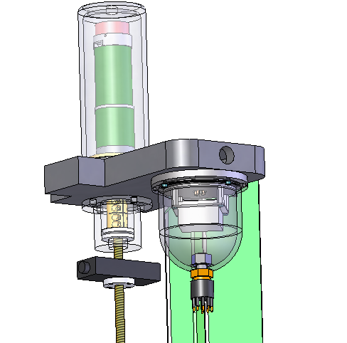
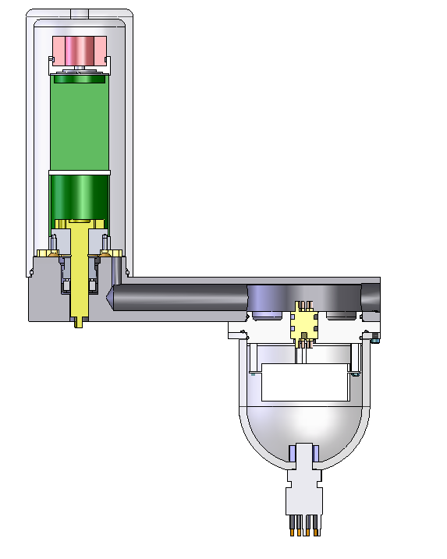
Rack Drive
1.5 cm/sec max speed
1000N max force
120 W Maxon Brushless
15:1 Planetary
Carbon/Teflon Seal
Clear acrylic
Housing with
Oil vent on top
“Torpedo” lock
Glass ball
Delrin seat
Thrust washers
High pressure feed-thru
Into oil comp’d chamber
Floating Nut
-Axial load only
Servo Controller/amp
In Ti housing
3/8-8 Acme
316 SST now
Ti later

Slide 23
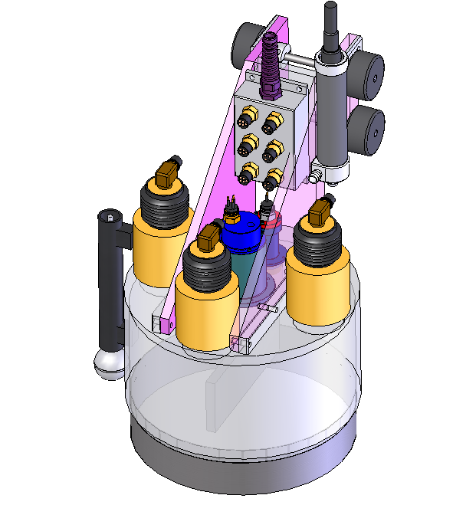
Chambers
6-Port J-box
- Re-enter-able potting
Rack Cart
-Rollers support
overhung load
Aanderra Optodes
1/chamber + 1 ref
Centrifugal Pump
- Pumps into chamber
Through check valve
- Sprayer nozzle manifold
To clean ID of chamber
(3) 7cm dia Vent Valves
Touchdown Switch
- 2” ball end-effecter
- Hall-effect limit switch
¾ “ thick top with
Sculpted “drains”
¼” thick Acrylic walls
Teflon-coated Ti knife edge

Slide 24
Software

Slide 25
Control System Overview
Reused basic ESP computer system
Technologic Systems ARM PC-104 stack
Linux 2.4-based kernel
Ruby is primary programming language
  Some utilities written in C, invoked within Ruby scripts
Simple script used for subsystem testing 2006-2008 - inadequate for actual deployments
2G system used since 2009
  Tested and evolved on MARS Aug-Oct 2009
  Improvements made in 2010 for Nov deployment

Slide 26
2G Control System
Supervisor - developed first
  Loads mission deployment file and translates into sequence of tasks (behaviors)
  Run behaviors one-at-a-time in separate thread
  ‘Acceptance’ tested 2009-2010
  Listens for messages from the…
Executive - introduced in 2010
  Starts a deployment by invoking the supervisor
  Listens for remote control requests via acoustic modem (status, abort, etc.)
  Automatically run during system startup

Slide 27
2G Control System
Executive started at boot time
Executive runs Supervisor, establishes comm channels
Supervisor loads previous state
Supervisor loads plan file, creates behavior sequence
Supervisor runs behaviors one-at-a-time
Supervisor saves state before hibernation
Supervisor requests hibernation from OS
RC messages
(1)Executive
messages
Saved
state
(2)invokes
(3)load
(2) Supervisor
plan
file
(4)load
behaviors
devices
.
.
.
drivers
(5)execute
(6)save

Slide 28
2G Control System
Why behaviors?
  Partition the mission process into logical blocks to create tailored mission plans
  Familiar concept (but not layered control)
Other benefits
  Rarely does a change in one behavior have an effect on other behaviors
  Unit-test the heck out of individual behaviors

Slide 29
Previous Mission Critical Faults
Deployment Date | Ship |  | Problem
January-07 | WF | SE | rack stuck in down position
September-07 | PL | SE | external mission watchdog killing missions
November-07 | PL | SE | motor control comm error caused system abort
January-07 | WF | SE | software problem, uninitialized variable, program did not run
September-07 | WF | EE | stbd motor shut down
September-07 | WF | ME | valve not opening/closing
October-09 | MARS | ME | water in port rack controller housing
November-10 | WF | EE | Stbd Chamber Optode did not communicate
November-10 | WF | ? | Could not communicate with modem

Slide 30
Cost of Maintenance and deployment
Cost of annual deployment:
  $20k for batteries +
  Ship time +
  Calibrating optodes
Maintenance
  Cost of replacing a mating pair of Ti connectors ~$4k
  Cost of replacing any instrument > $5k

