Slide 1
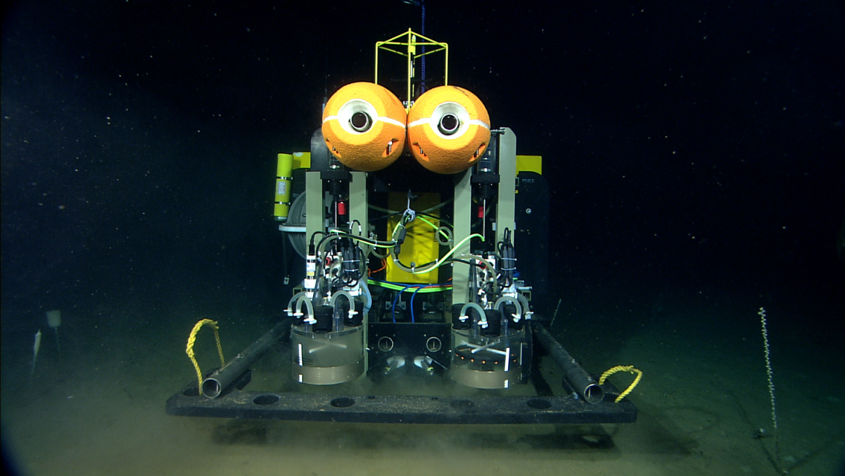
MBARI Benthic Rover at
Station M
MBARI
Towards Continuous Long-Term Deep-Ocean Observation in the Northeastern Pacific
Monterey Bay Aquarium Research Institute
Richard Henthorn
ASLO 2014 February 26, 2014
Notes:
Add name. Center MBARI.

Slide 2
Introduction
Intro Sta.M Classic Rover BR Comp Fluoro Future
Rich Henthorn
  Software Engineer at the Monterey Bay Aquarium Research Institute in Moss Landing, CA
Acknowledgements
  The David and Lucille Packard Foundation
  MBARI’s Pelagic-Benthic Coupling Lab
  Scripps Institution of Oceanography
Monterey Bay Aquarium Research Institute
Richard Henthorn
ASLO 2014 February 26, 2014

Slide 3
Introduction
Intro Sta.M Classic Rover BR Comp Fluoro Future
Agenda
  Station M Time-Series
  Classic Monitoring Methods
  Benthic Rover
  Compare Respirometry measurements
  Fluorometry
  Future Plans
Monterey Bay Aquarium Research Institute
Richard Henthorn
ASLO 2014 February 26, 2014

Slide 4
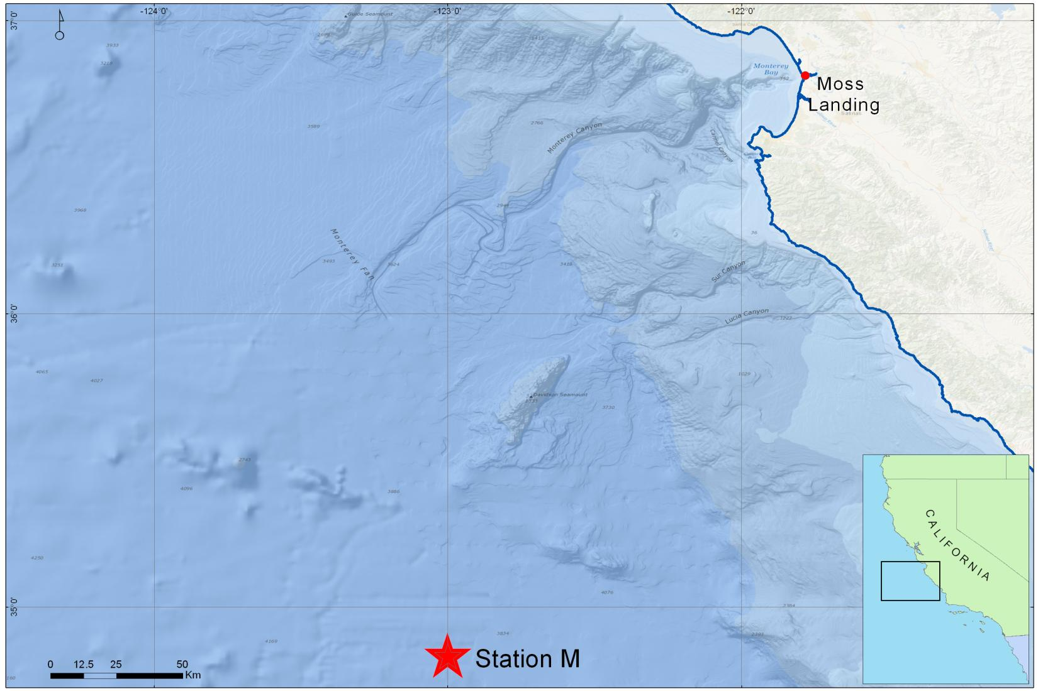
Station M
Intro Sta.M Classic Rover BR Comp Fluoro Future
Abyssal plains so many km off California coast
4000m depths
12-hours from MBARI
MBARI
Monterey Bay Aquarium Research Institute
Richard Henthorn
ASLO 2014 February 26, 2014
Notes:
Add small star to Sta.M map

Slide 5
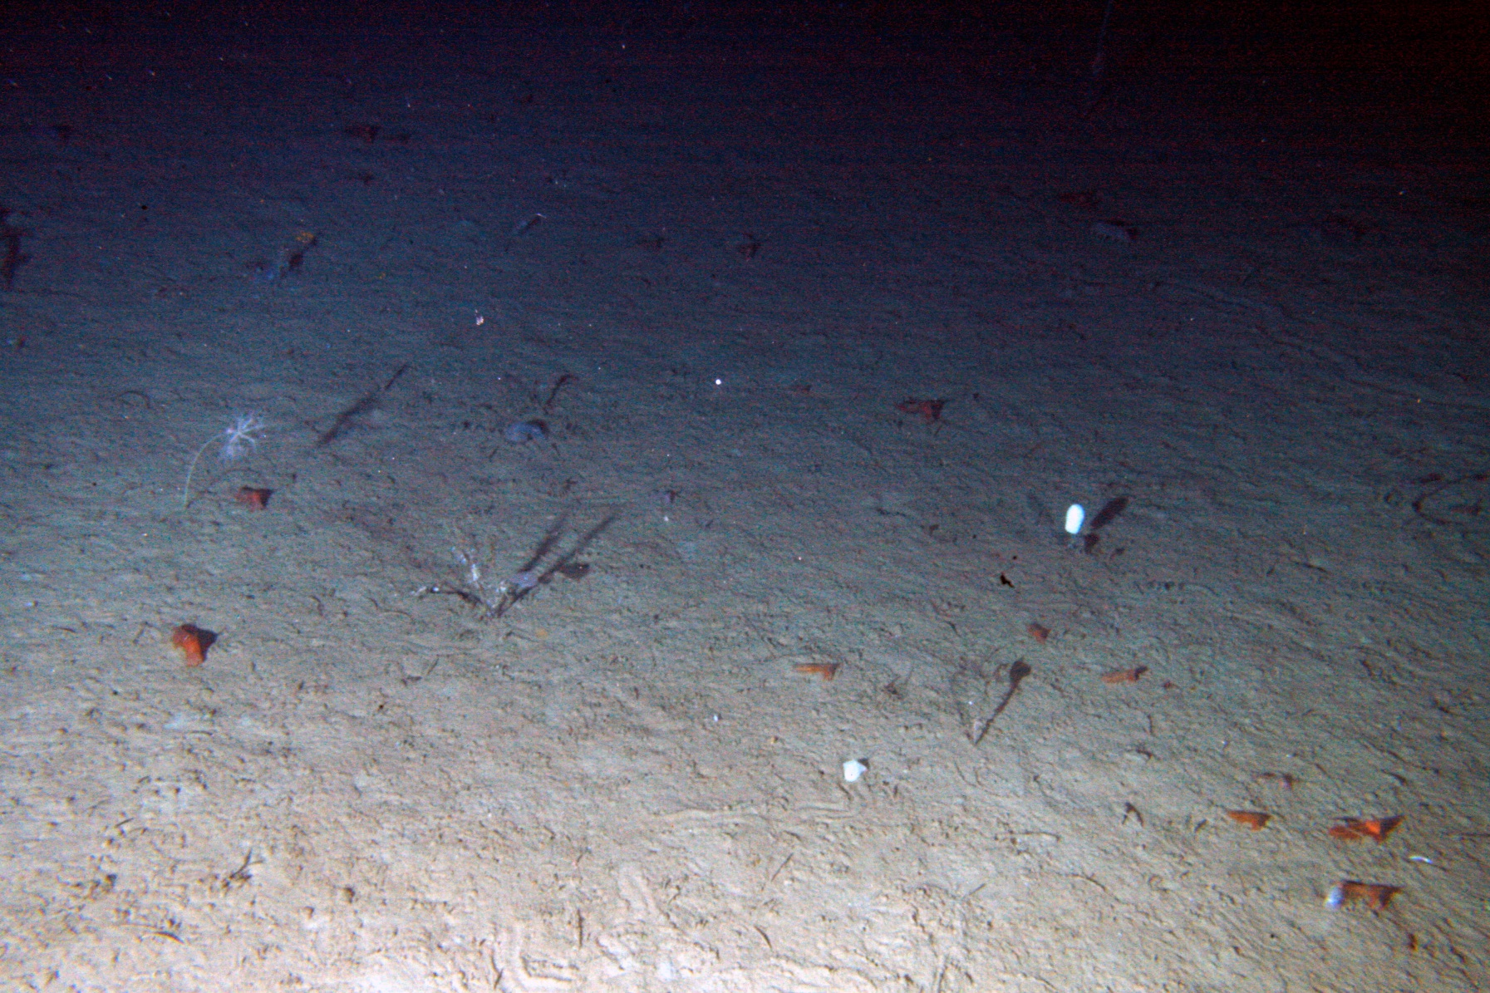
Station M
Intro Sta.M Classic Rover BR Comp Fluoro Future
MBARI
Monterey Bay Aquarium Research Institute
Richard Henthorn
ASLO 2014 February 26, 2014
Notes:
Happening place - partygoers

Slide 6
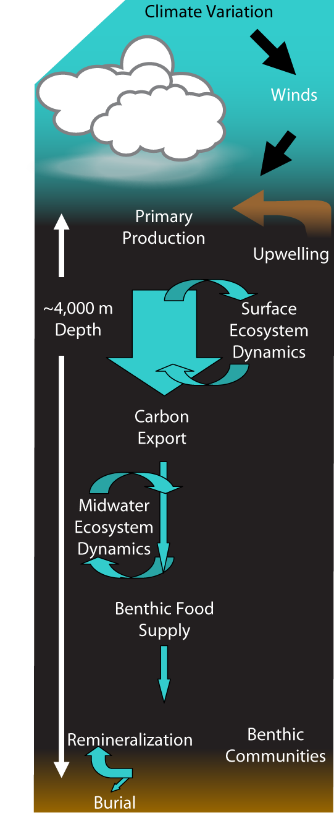
Station M Time-Series
Intro Sta.M Classic Rover BR Comp Fluoro Future
Monitor particulate organic carbon (POC) flux
Observe how changes in POC flux effect the sediment community
Begun in 1989 by Ken L. Smith at SIO
Continued at MBARI since 2006
Monterey Bay Aquarium Research Institute
Richard Henthorn
ASLO 2014 February 26, 2014

Slide 7
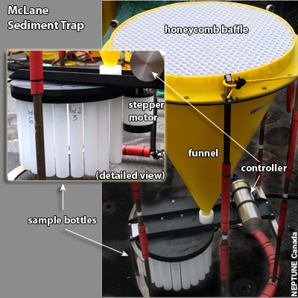
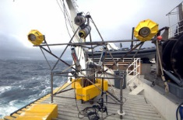
Classic Monitoring Methods
Intro Sta.M Classic Rover BR Comp Fluoro Future
Sediment Traps
Time-lapsed photography of the seafloor
Benthic respirometers
  Estimate Sediment Community O₂ Consumption
NEPTUNE Canada
MBARI
Monterey Bay Aquarium Research Institute
Richard Henthorn
ASLO 2014 February 26, 2014
Notes:
All these methods have evolved to some degree. Why do we estimate SCOC?

Slide 8
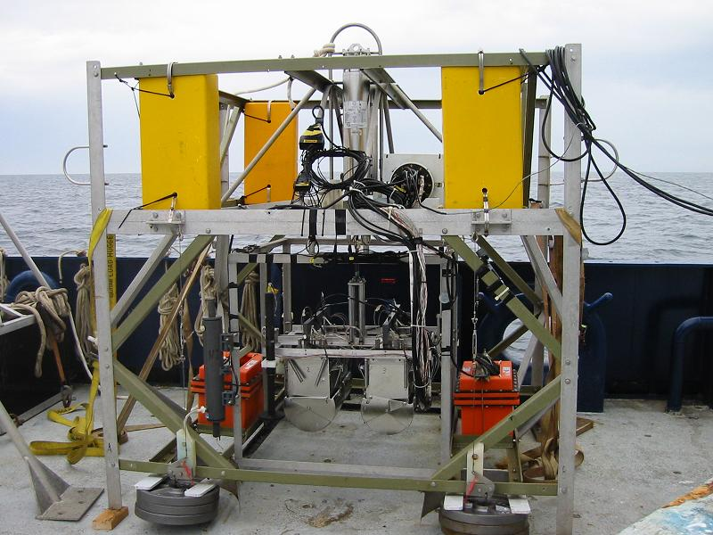
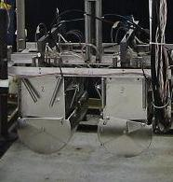
Classic Monitoring Methods
Intro Sta.M Classic Rover BR Comp Fluoro Future
Free-Vehicle Grab Respirometer
  4 respirometer chambers conduct 48 hr measurements
  Scoops grab samples of measured sediment
  Returns with measurements and samples
  ~3 samples/year
MBARI
Monterey Bay Aquarium Research Institute
Richard Henthorn
ASLO 2014 February 26, 2014

Slide 9
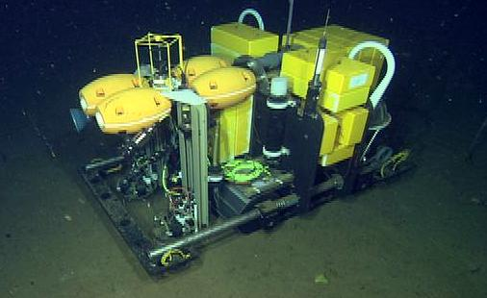
Benthic Rover
Intro Sta.M Classic Rover BR Comp Fluoro Future
MBARI Continued development begun at SIO
Untethered autonomous vehicle
6000m rated
Conduct B-R measurements continuously for 1+ year
~150 samples/year
MBARI
Monterey Bay Aquarium Research Institute
Richard Henthorn
ASLO 2014 February 26, 2014

Slide 10
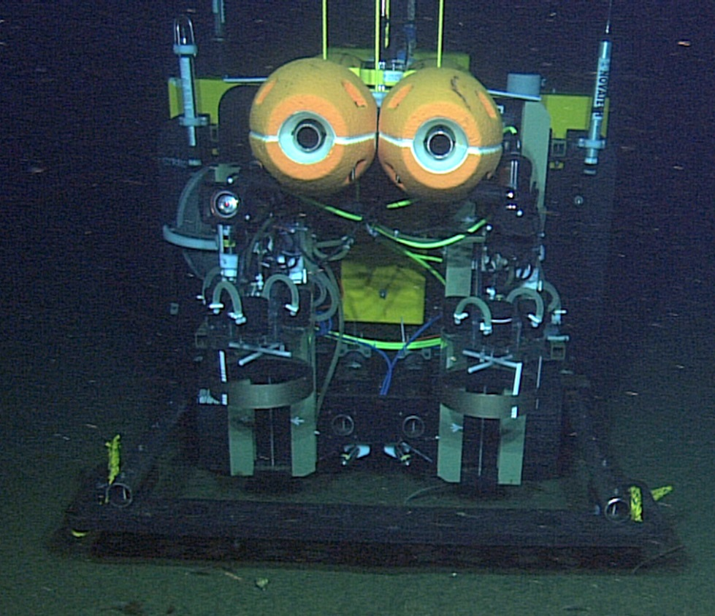
Benthic Rover
Intro Sta.M Classic Rover BR Comp Fluoro Future
Operational Profile
Transit to measurement site
Image measurement area
Insert B-R chambers
Measure O₂ for 48hrs
Raise chambers
MBARI
Monterey Bay Aquarium Research Institute
Richard Henthorn
ASLO 2014 February 26, 2014

Slide 11
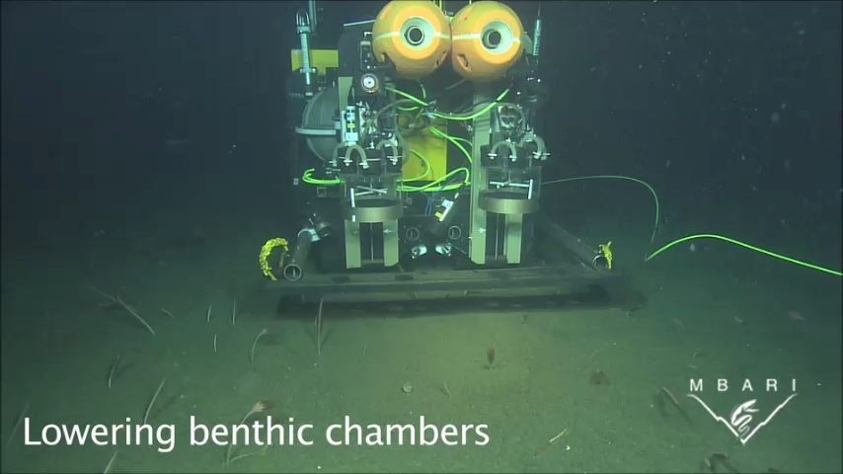
Benthic Rover
Intro Sta.M Classic Rover BR Comp Fluoro Future
Monterey Bay Aquarium Research Institute
Richard Henthorn
ASLO 2014 February 26, 2014
Notes:
Note chamber cameras and stirring rods for mixing.

Slide 12
Benthic Respirometry Comparison
Intro Sta.M Classic Rover BR Comp Fluoro Future
Increased sample frequency
  150 from 3-4 per year
  Observe seasonal and episodic changes
Add some context
  Current meter
  Other instruments TBD
Monterey Bay Aquarium Research Institute
Richard Henthorn
ASLO 2014 February 26, 2014

Slide 13
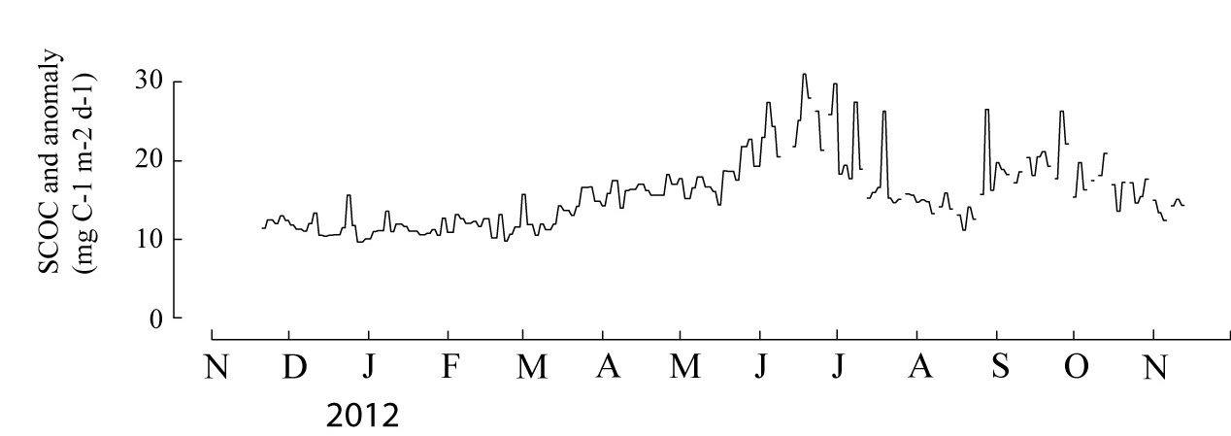
Benthic Respirometry Comparison
Intro Sta.M Classic Rover BR Comp Fluoro Future
MBARI
155 Rover SCOC estimates Nov ‘11 – Nov ‘12
3 hypothetical FVGR estimates
Bottom-line: Observing details and events
Monterey Bay Aquarium Research Institute
Richard Henthorn
ASLO 2014 February 26, 2014
Notes:
How many Rover SCOC points?

Slide 14
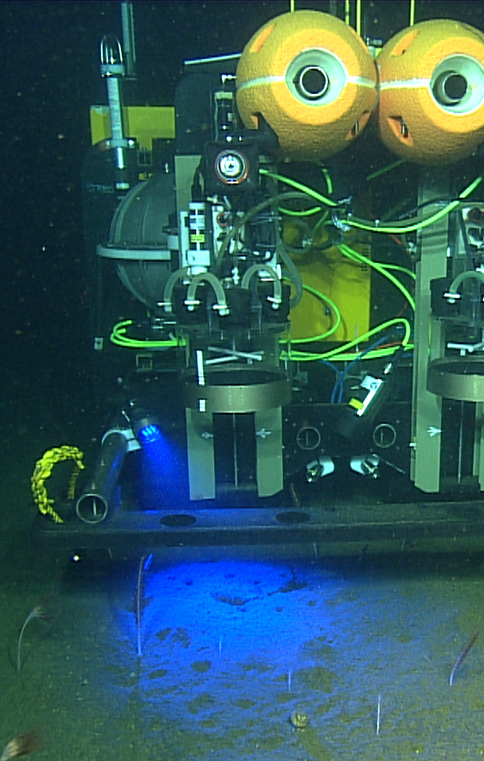
Fluorometry Images
Intro Sta.M Classic Rover BR Comp Fluoro Future
Chlorophyll-a
One image per site
MBARI
MBARI
Monterey Bay Aquarium Research Institute
Richard Henthorn
ASLO 2014 February 26, 2014

Slide 15
Fluorometry Images
Intro Sta.M Classic Rover BR Comp Fluoro Future
Mean gray fluorescence from Rover images (red)
Phytodetrital % seafloor cover estimated from hourly tripod images (black)
Monterey Bay Aquarium Research Institute
Richard Henthorn
ASLO 2014 February 26, 2014

Slide 16
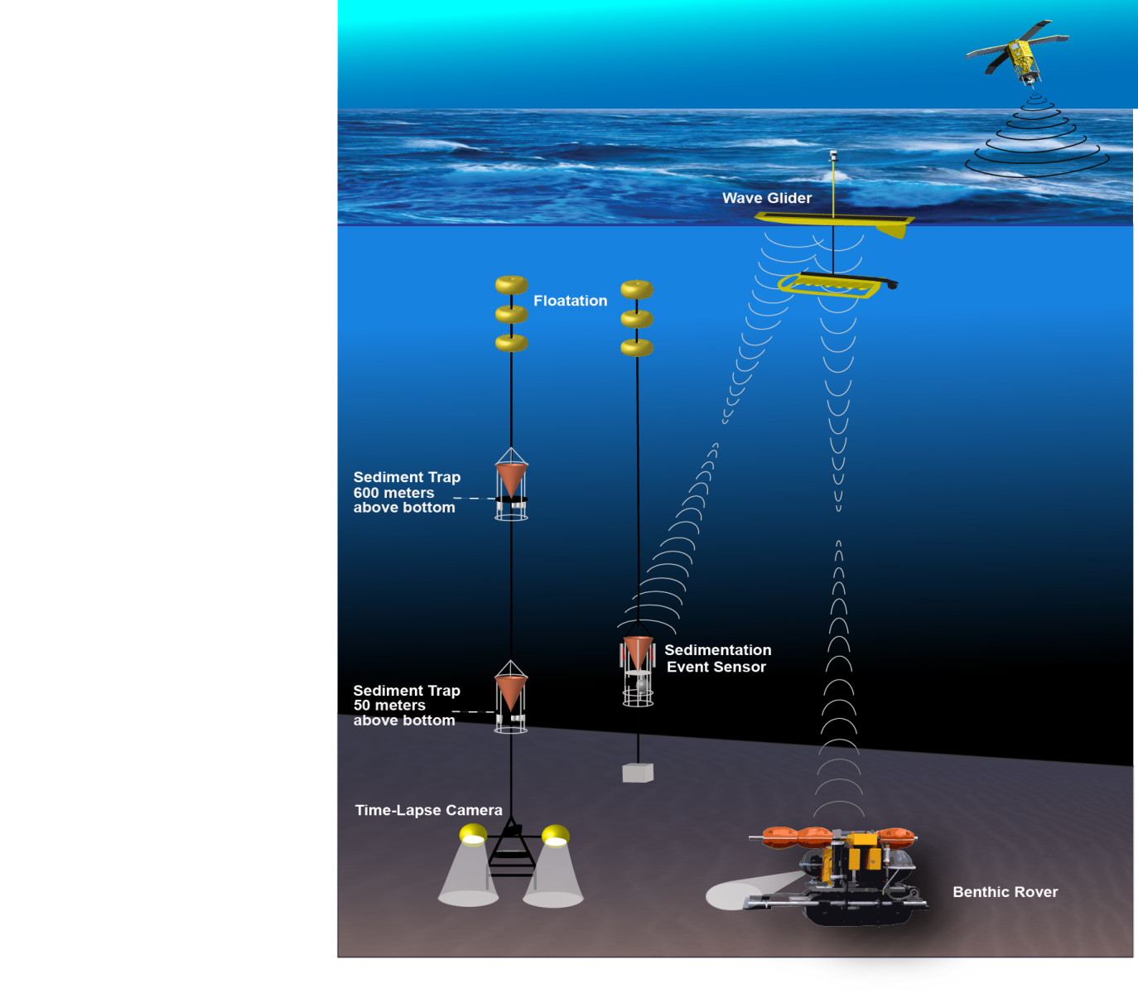
Future Plans
Intro Sta.M Classic Rover BR Comp Fluoro Future
MBARI
Remote vehicle comms and control
Expand vehicle instrument suite for additional context
Replicate vehicle for other time-series
Monterey Bay Aquarium Research Institute
Richard Henthorn
ASLO 2014 February 26, 2014

Slide 17
Questions
Intro Sta.M Classic Rover BR Comp Fluoro Future
Monterey Bay Aquarium Research Institute
Richard Henthorn
ASLO 2014 February 26, 2014
Notes:
Team images

