Slide 1
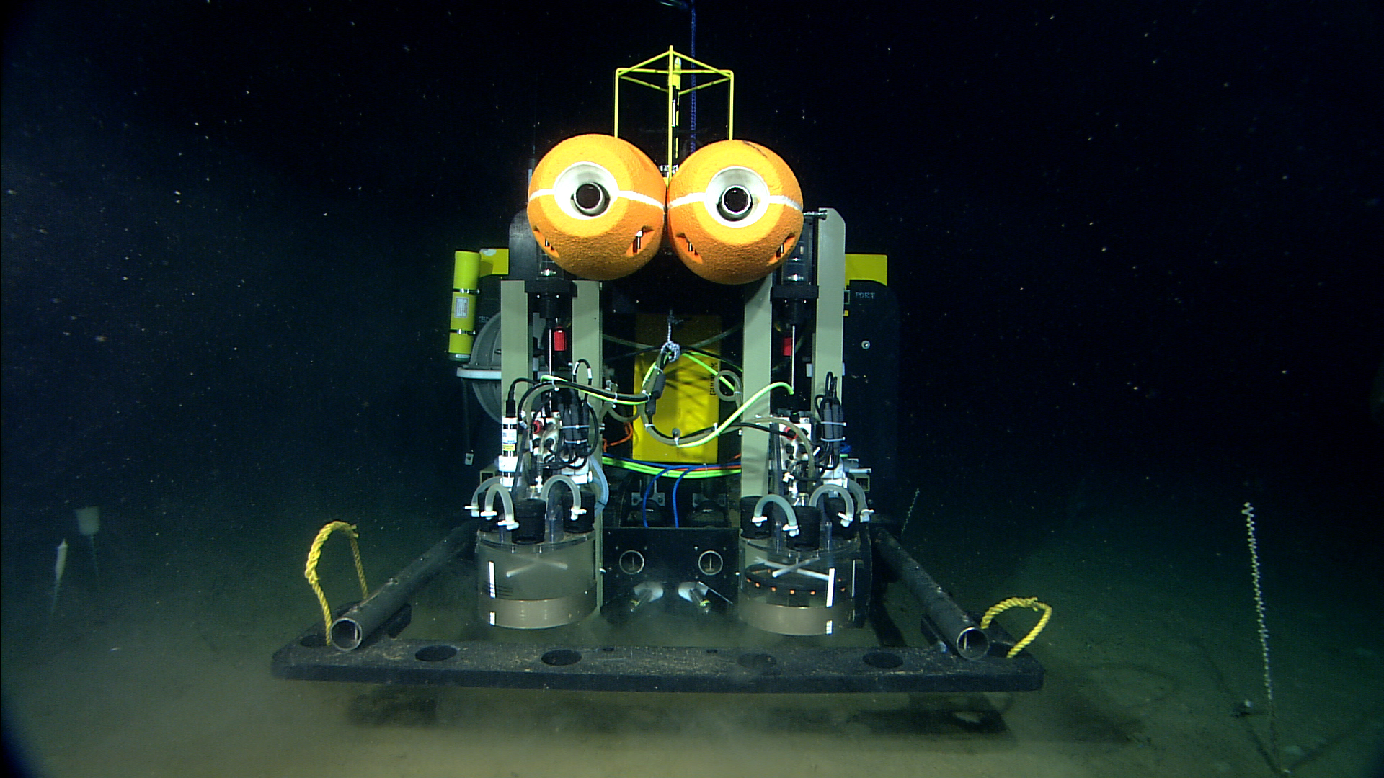
Benthic Rover

Slide 2
Science Motivation for the Rover
What is the quality and quantity of particulate carbon reaching the sea floor on temporal scales of days?
What are the dynamics of biologically produced structures in the sediment?
What responses are elicited in the sediment community by arrival of particulate carbon on the sea floor?
Notes:
(sediment community oxygen consumption, faunal activity, etc.)

Slide 3
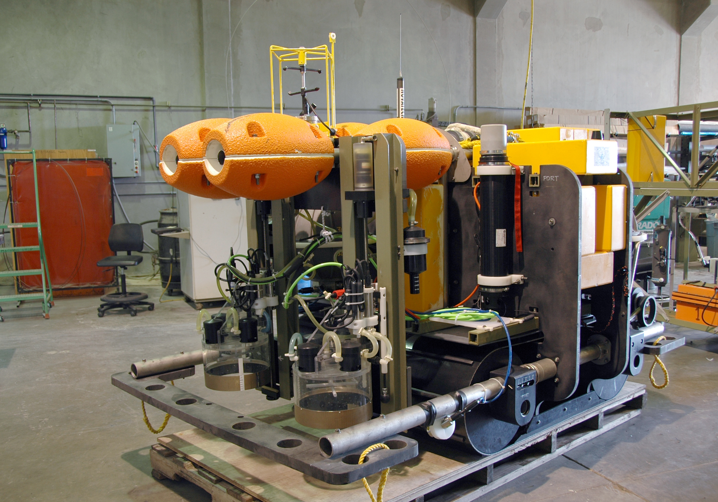
Benthic Rover Configuration
Current Meter
Chamber
Rack
Acoustic
Modem
Respirometer
Chamber
Video Cameras

Slide 4
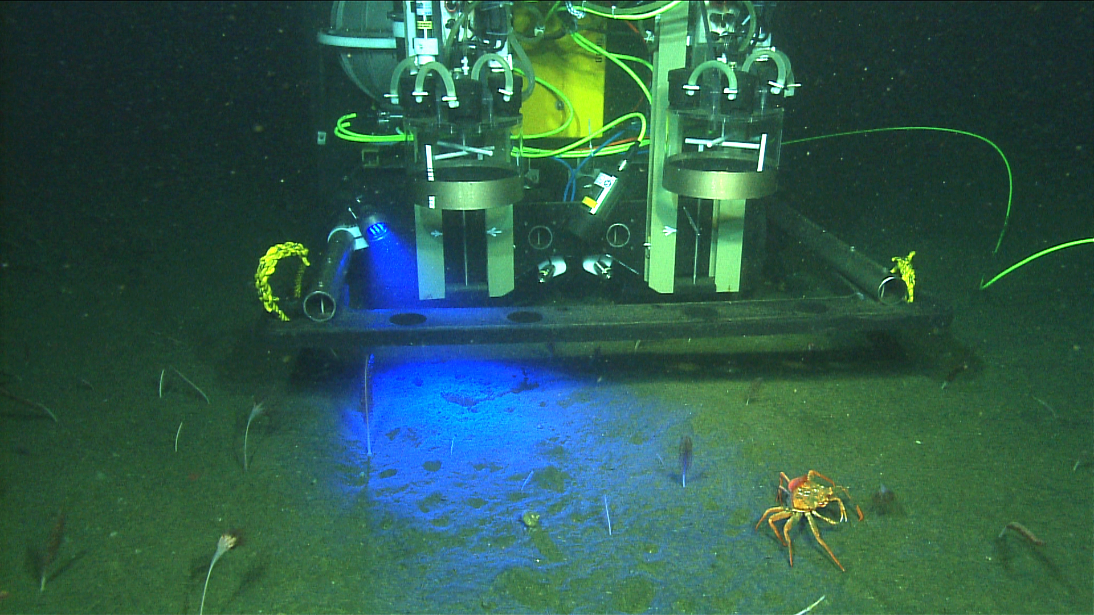
Fluorescence Camera
Prosilica, GC1380, 1.4 MPixel Monochrome Camera
Deepsea Power and Light, LED Multi-SeaLite, Blue

Slide 5
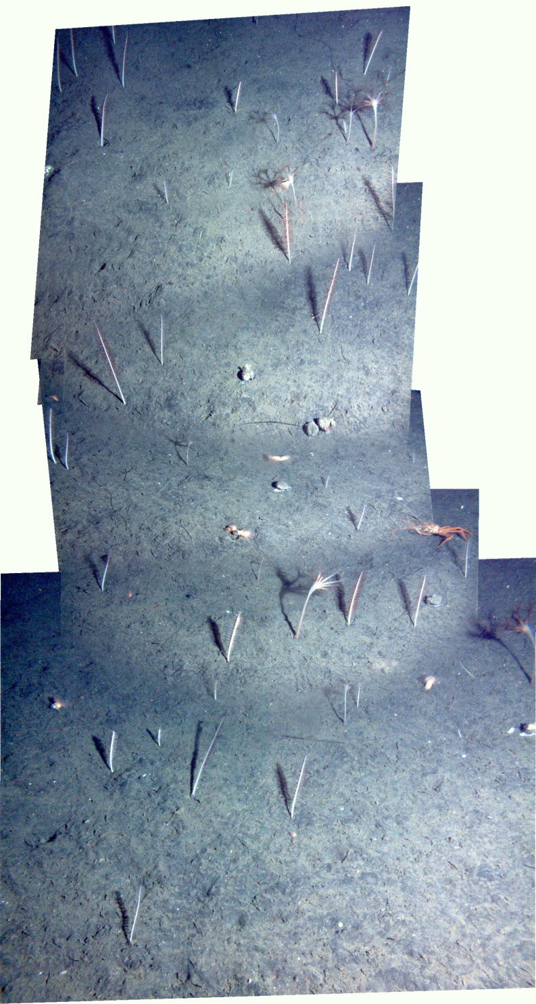
Transit Camera Image Mosaic

Slide 6
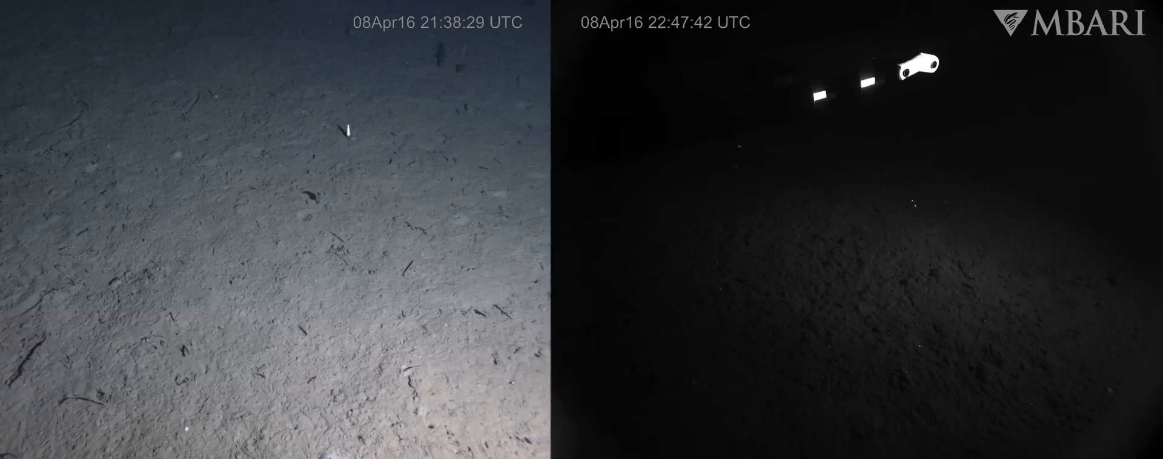
Transit Camera and Fluorescence Camera

Slide 7
Benthic Rover
Longest continuous deployment 1 year and 2 days
Has been deployed at Sta. M since 2012 with only one onshore servicing
Has travelled >10 km over this time period
Travels ~1.6 km in a year
Has captured effects of food pulses such as a massive salp bloom

Slide 8
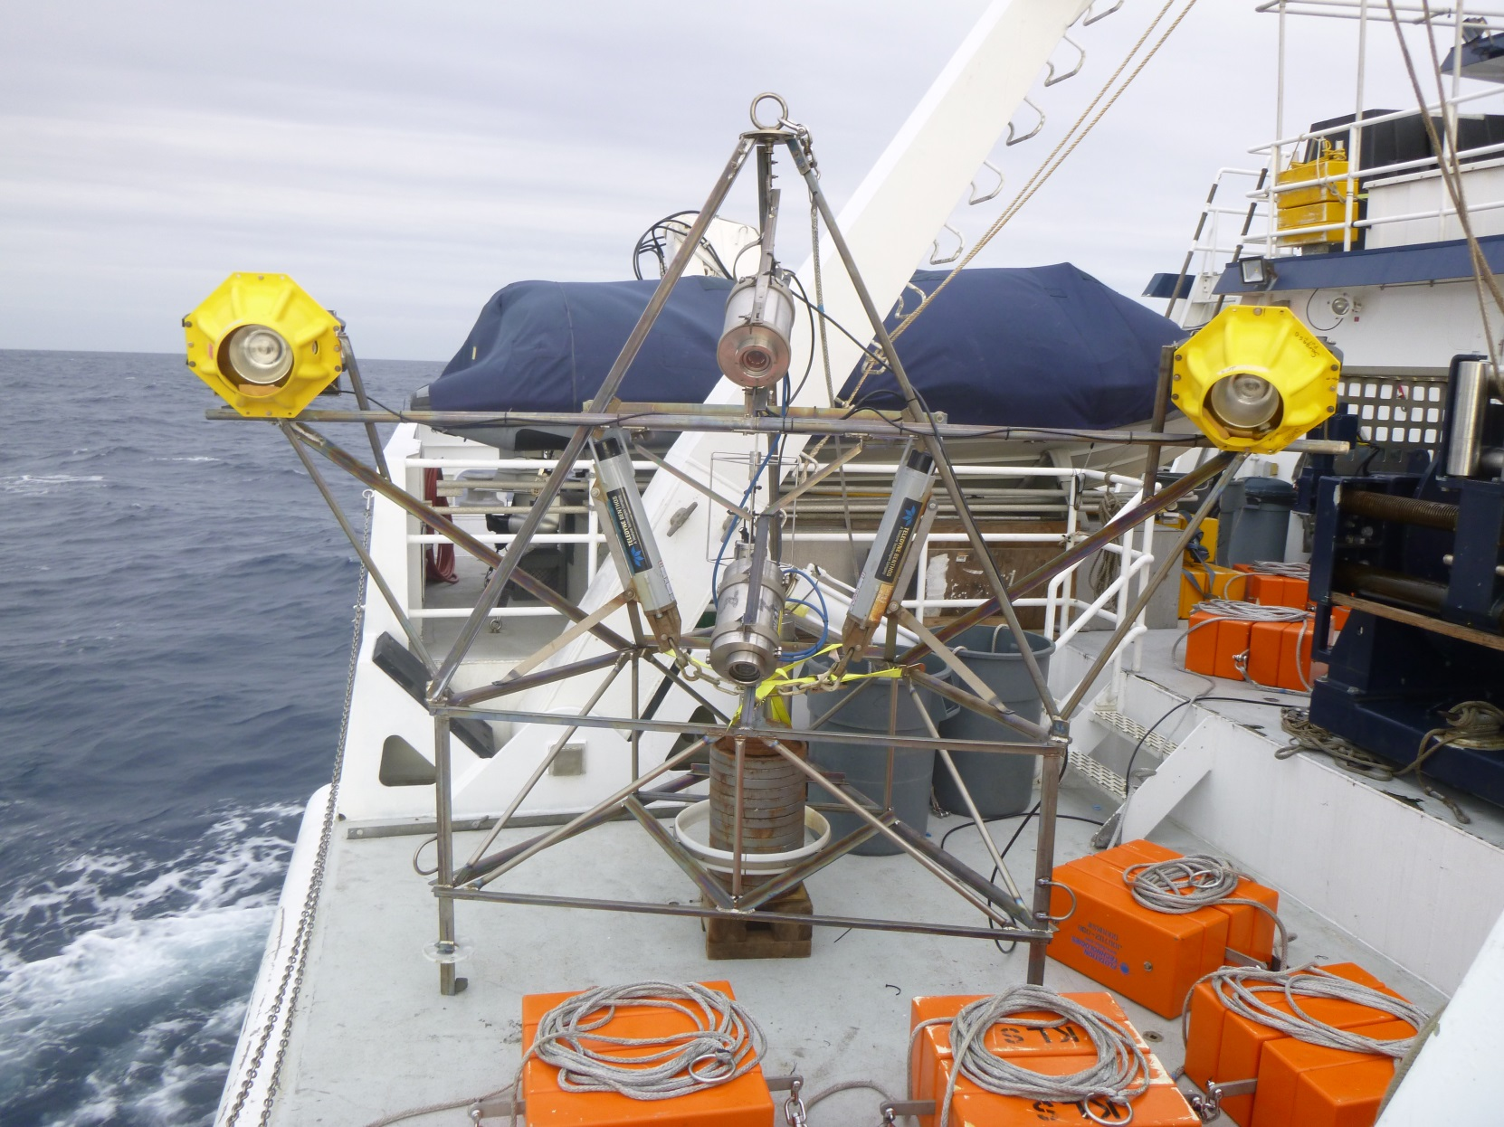
Time-lapse Camera System

Slide 9
Time-lapse Camera System
Tripod contains 2 cameras that image the near field and the far field.
Far field camera images ~20 m²
Near field camera images ~2 m²
Each camera takes one picture every hour
System can operate for over 1 year autonomously

Slide 10
Sample Images
Far Field Image
Near Field Image

Slide 11
