Slide 1
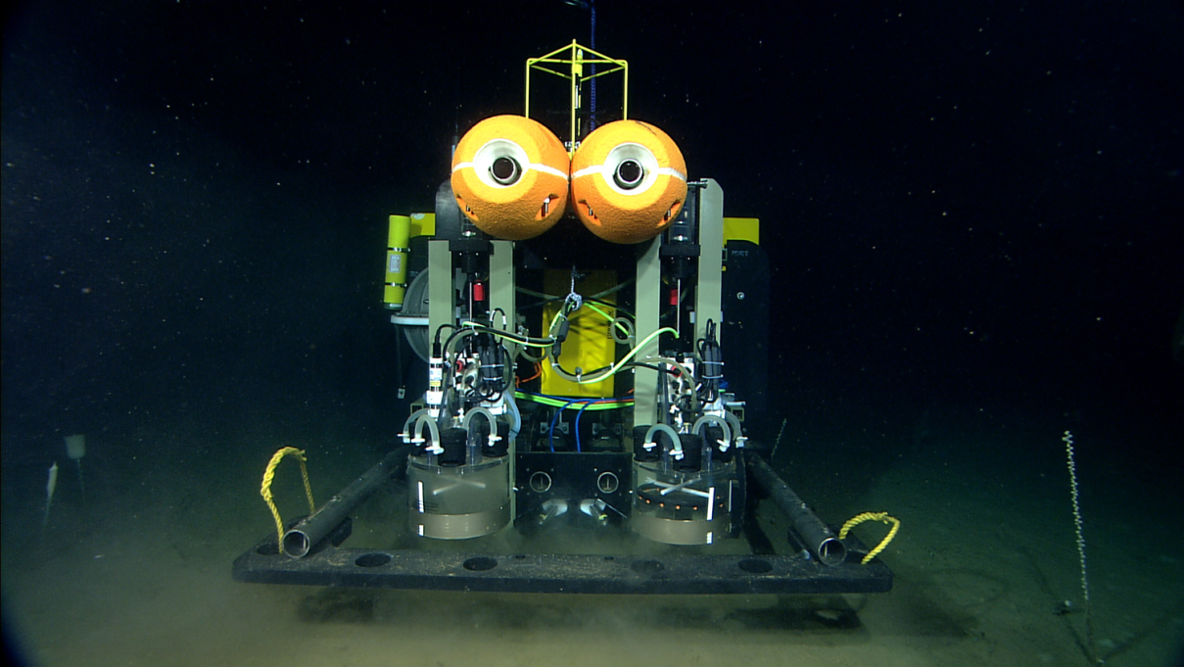
MBARI Benthic Rover at
Station M
MBARI
Towards Continuous Long-Term Deep-Ocean Observation in the Northeastern Pacific
Monterey Bay Aquarium Research Institute
ASLO 2014 February 26, 2014

Slide 2
Introduction
Intro Sta.M Classic Rover BR Comp Fluoro Future
Rich Henthorn
  Engineer at the Monterey Bay Aquarium Research Institute in Moss Landing, CA
Acknowledgements
  David and Lucille Packard Foundation
  MBARI Pelagic-Benthic Coupling Lab (Smith Lab)
  Scripps Ocean Institute
Monterey Bay Aquarium Research Institute
ASLO 2014 February 26, 2014

Slide 3
Introduction
Intro Sta.M Classic Rover BR Comp Fluoro Future
Agenda
  Station M Time-Series
  Classic Monitoring Methods
  Evolving Methods - Benthic Rover
  Benthic Respirometry Comparison
  Fluorometry
  Future Plans
Monterey Bay Aquarium Research Institute
ASLO 2014 February 26, 2014

Slide 4
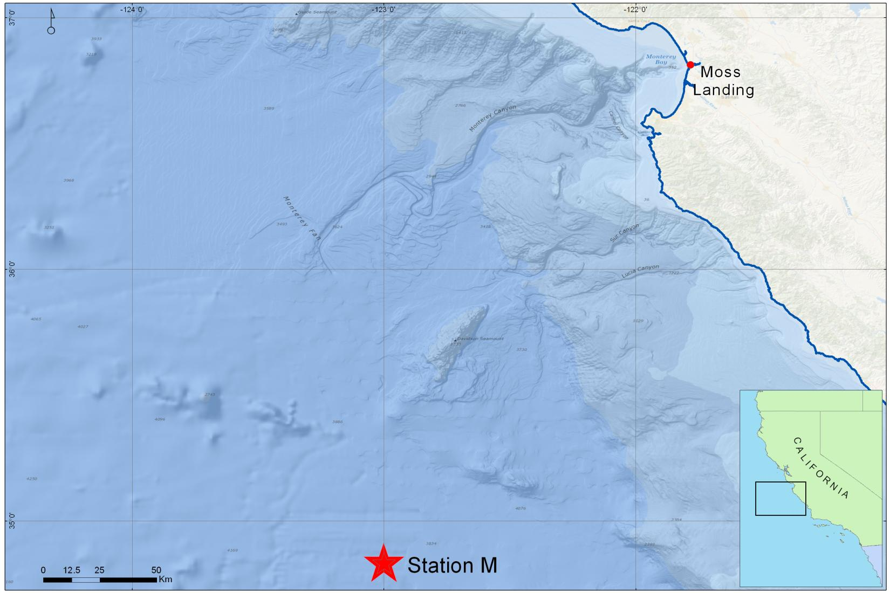
Station M
Intro Sta.M Classic Rover BR Comp Fluoro Future
So many kilometers off shore
Abyssal plains
4000m depth
MBARI
Monterey Bay Aquarium Research Institute
ASLO 2014 February 26, 2014

Slide 5
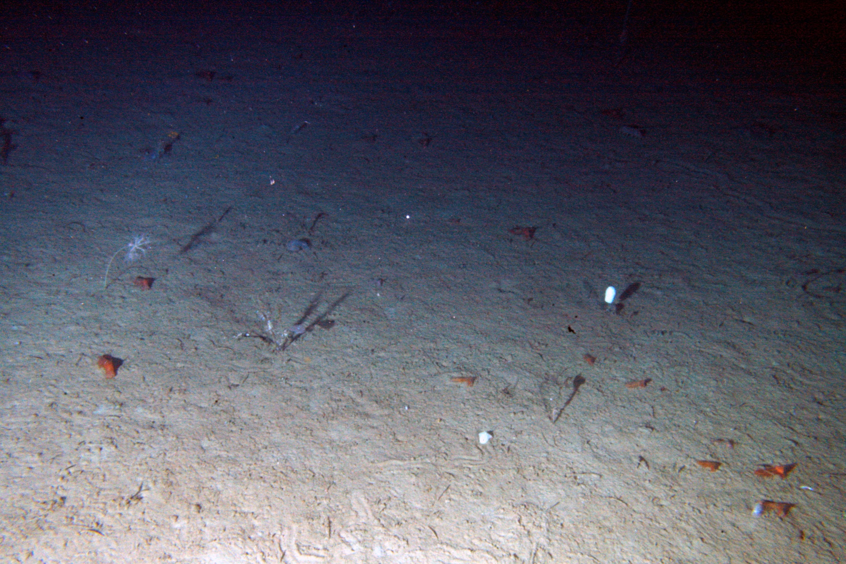
Station M
Intro Sta.M Classic Rover BR Comp Fluoro Future
MBARI
Monterey Bay Aquarium Research Institute
ASLO 2014 February 26, 2014

Slide 6
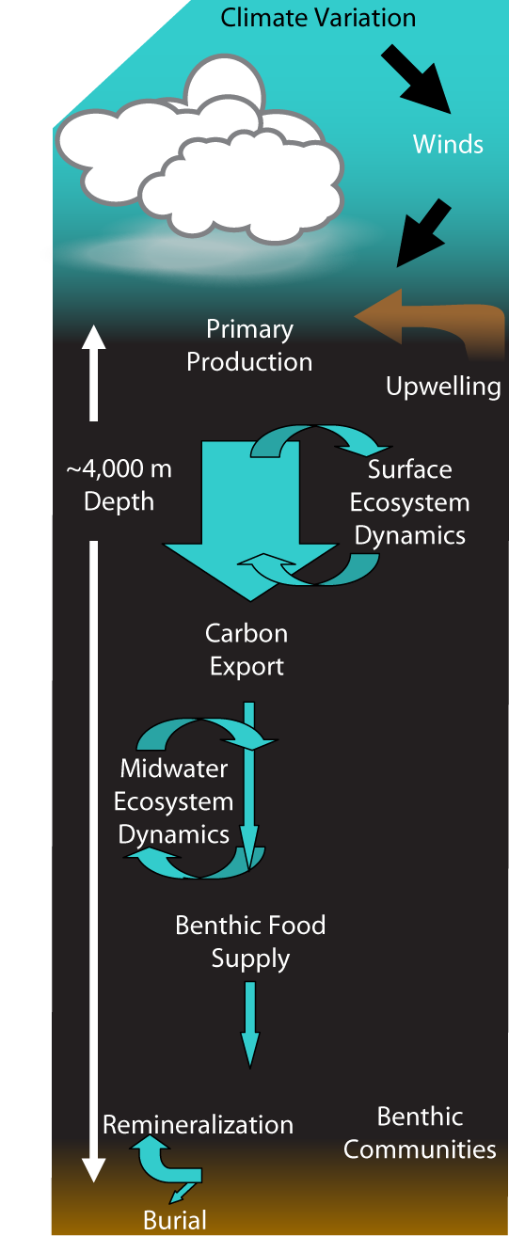
Station M Time-Series
Intro Sta.M Classic Rover BR Comp Fluoro Future
Monitor particulate organic carbon (POC) flux
Observe how changes in POC flux effect the sediment community
Begun in 1989 by Ken L. Smith at SIO
Continued at MBARI since 2006
Monterey Bay Aquarium Research Institute
ASLO 2014 February 26, 2014

Slide 7
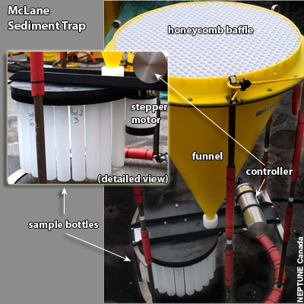
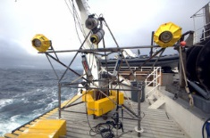
Classic Monitoring Methods
Intro Sta.M Classic Rover BR Comp Fluoro Future
Sediment Traps
Time-lapsed photography of the seafloor
Benthic respirometers
  Estimate Sediment Community O₂ Consumption
NEPTUNE Canada
MBARI
Monterey Bay Aquarium Research Institute
ASLO 2014 February 26, 2014

Slide 8
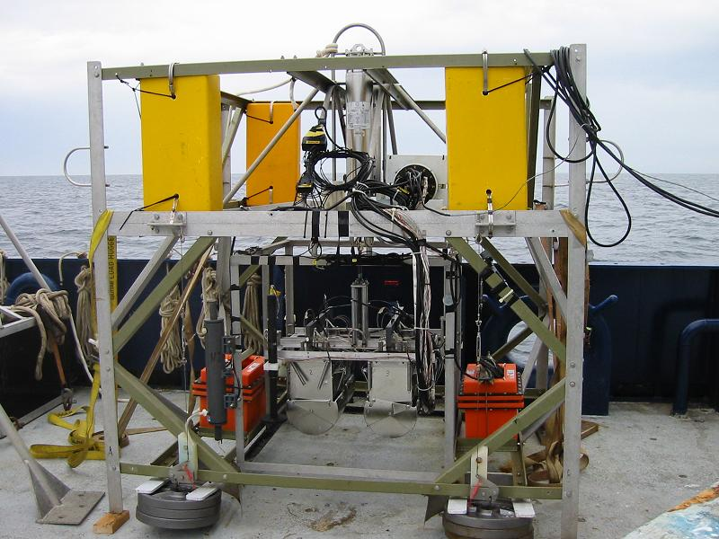
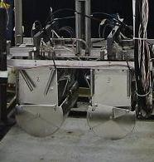
Classic Monitoring Methods
Intro Sta.M Classic Rover BR Comp Fluoro Future
Free-Vehicle Grab Respirometer
  4 respirometer chambers conduct 48 hr measurements
  Scoops grab samples of measured sediment
  Returns with measurements and samples
  ~3 samples/year
MBARI
Monterey Bay Aquarium Research Institute
ASLO 2014 February 26, 2014

Slide 9
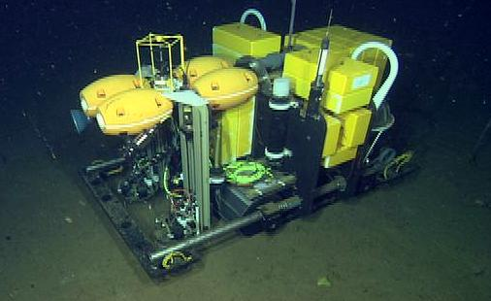
Benthic Rover
Intro Sta.M Classic Rover BR Comp Fluoro Future
Continued work begun at SIO
Untethered autonomous vehicle
6000m rated
Conduct B-R measurements continuously for 1+ year
~150 samples/year
MBARI
Monterey Bay Aquarium Research Institute
ASLO 2014 February 26, 2014

Slide 10
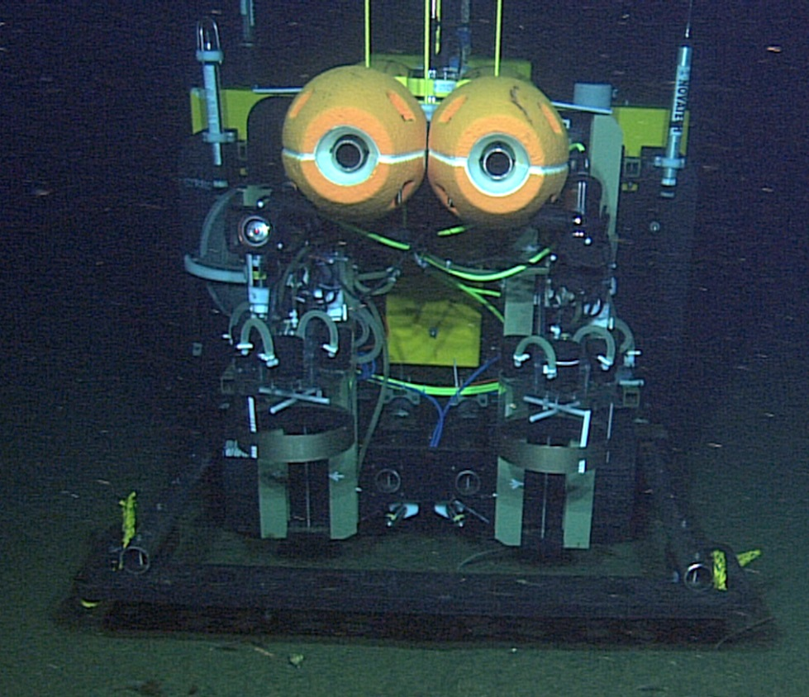
Benthic Rover
Intro Sta.M Classic Rover BR Comp Fluoro Future
Operation Profile
Transit to measurement site
Image measurement area
Insert B-R chambers
Measure O₂ for 48hrs
Raise chambers
MBARI
Monterey Bay Aquarium Research Institute
ASLO 2014 February 26, 2014

Slide 11
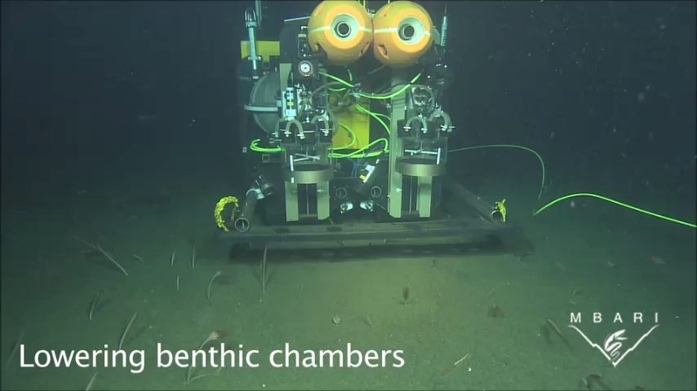
Benthic Rover
Intro Sta.M Classic Rover BR Comp Fluoro Future
Monterey Bay Aquarium Research Institute
ASLO 2014 February 26, 2014

Slide 12
Benthic Respirometry Comparison
Intro Sta.M Classic Rover BR Comp Fluoro Future
Increased sample frequency
  150 from 3-4 per year
  Can observe seasonal and episodic changes
Add some context
  Currents
  Other suggestions (nitrates?)
Monterey Bay Aquarium Research Institute
ASLO 2014 February 26, 2014

Slide 13
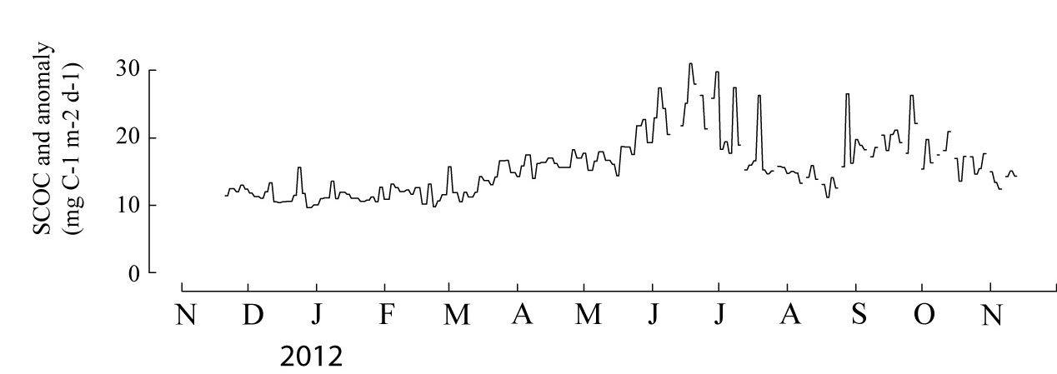
Benthic Respirometry Comparison
Intro Sta.M Classic Rover BR Comp Fluoro Future
MBARI
Rover SCOC estimates 2012
Equivalent classic FVGR estimates
Observing details and events
Monterey Bay Aquarium Research Institute
ASLO 2014 February 26, 2014

Slide 14
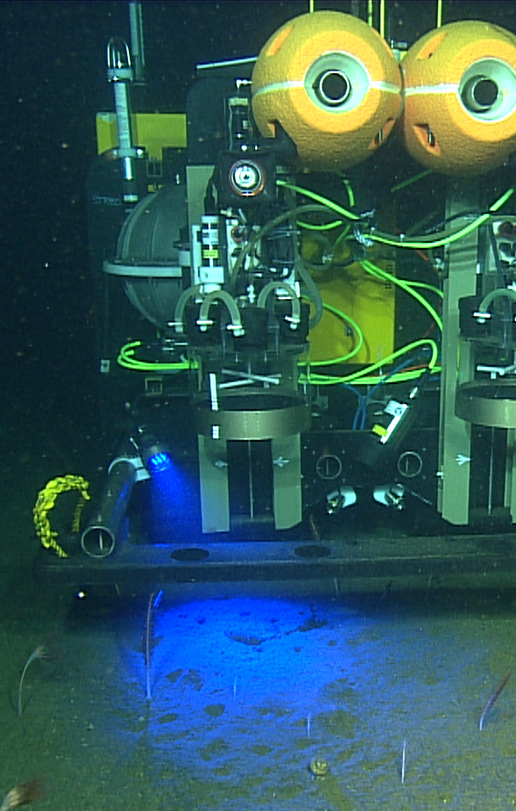
Fluorometry Images
Intro Sta.M Classic Rover BR Comp Fluoro Future
MBARI
MBARI
Monterey Bay Aquarium Research Institute
ASLO 2014 February 26, 2014

Slide 15
Fluorometry Images
Intro Sta.M Classic Rover BR Comp Fluoro Future
Mean gray fluorescence from images
Matches well with Phytodetrital % cover
Monterey Bay Aquarium Research Institute
ASLO 2014 February 26, 2014

Slide 16
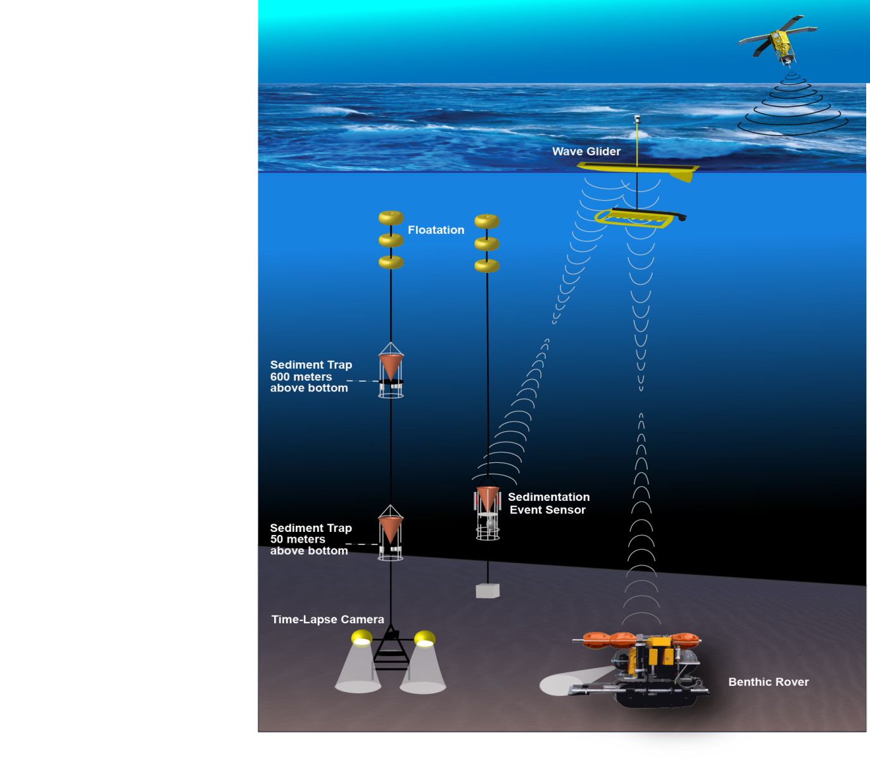
Future Plans
Intro Sta.M Classic Rover BR Comp Fluoro Future
MBARI
Remote comms and control
Expand instrument suite
Replicate / G2
Monterey Bay Aquarium Research Institute
ASLO 2014 February 26, 2014

Slide 17
Title
Intro Sta.M Classic Rover BR Comp Fluoro Future
Stuff
Monterey Bay Aquarium Research Institute
ASLO 2014 February 26, 2014

Slide 18
Classic Monitoring Methods
Intro Sta.M Classic Rover BR Comp Fluoro Future
Time-lapsed film photography of the seafloor
  So-many photos per day
  So-many months
Monterey Bay Aquarium Research Institute
ASLO 2014 February 26, 2014

Slide 19
Classic Monitoring Methods
Intro Sta.M Classic Rover BR Comp Fluoro Future
Sediment Traps
  Collect sediment for so-many days
  So-many samples
  So-many months
  Still in use with updated version
NEPTUNE Canada
Monterey Bay Aquarium Research Institute
ASLO 2014 February 26, 2014

Slide 20
Classic Monitoring Methods
Intro Sta.M Classic Rover BR Comp Fluoro Future
Free-Vehicle Grab Respirometer
  4 respirometer chambers conduct 48 hr measurements
  Spring-loaded scoops grab samples of measured sediment
  Returns to surface with measurements and samples
Monterey Bay Aquarium Research Institute
ASLO 2014 February 26, 2014

Slide 21
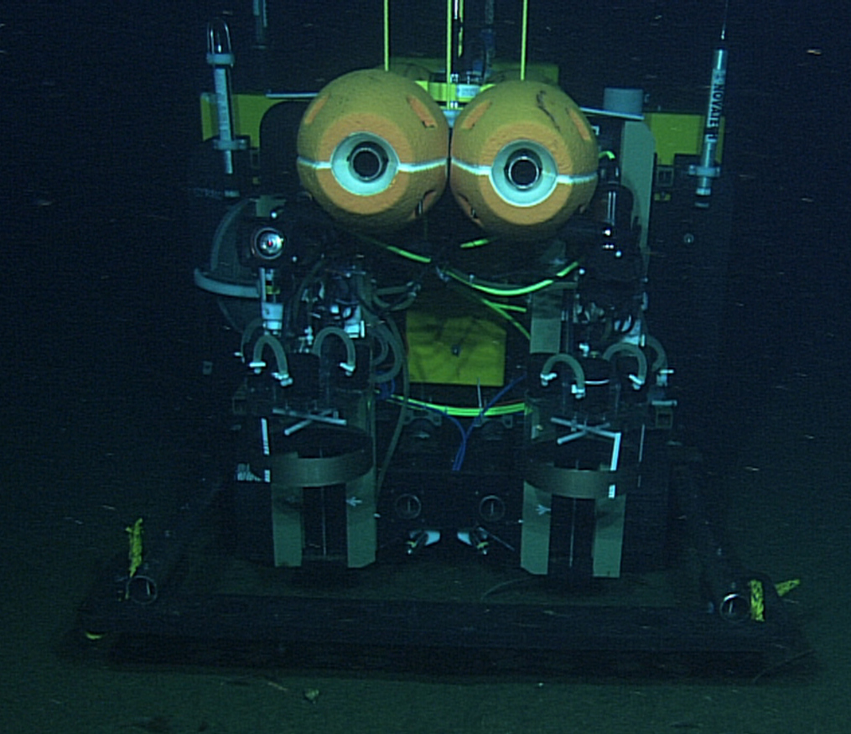
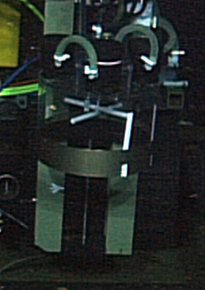
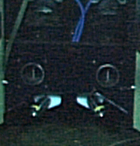
Benthic Rover
Intro Sta.M Classic Rover BR Comp Fluoro Future
Operation Profile
Transit to measurement site
Image measurement area
Insert B-R chambers
Measure O2 4/hr for 48hrs
Raise chambers
Monterey Bay Aquarium Research Institute
ASLO 2014 February 26, 2014

