Slide 1
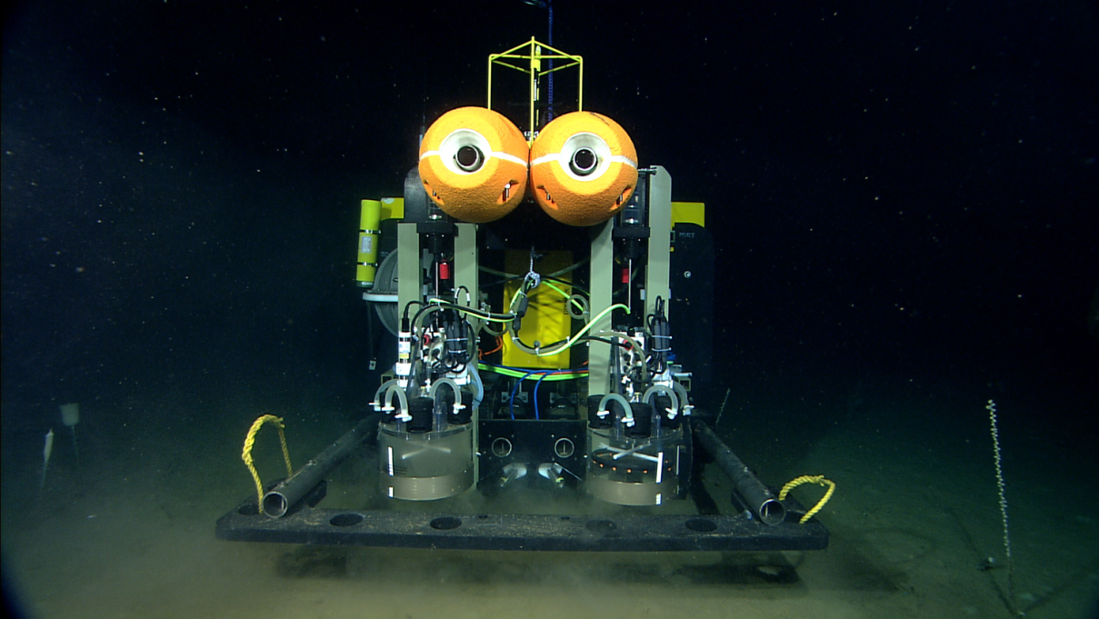
MBARI Benthic Rover at
Station M
Towards Continuous Long-Term Deep-Ocean Observation in the Northeastern Pacific
Monterey Bay Aquarium Research Institute
ASLO 2014 February 26, 2014

Slide 2
Introduction
Intro Sta.M Legacy Rover BR Comp Fluoro Future
Rich Henthorn
  Engineer at the Monterey Bay Aquarium Research Institute in Moss Landing, CA
Acknowledgements
  David and Lucille Packard Foundation
  Pelagic-Benthic Lab at MBARI
  Scripps Ocean Institue
Monterey Bay Aquarium Research Institute
ASLO 2014 February 26, 2014

Slide 3
Introduction
Intro Sta.M Legacy Rover BR Comp Fluoro Future
Agenda
  Station M Time-Series
  Legacy Methods
  Benthic Rover
  Benthic Respirometry Comparison
  Fluorometry
  Future Plans
Monterey Bay Aquarium Research Institute
ASLO 2014 February 26, 2014

Slide 4
Title
Intro Sta.M Legacy Rover BR Comp Fluoro Future
Stuff
Monterey Bay Aquarium Research Institute
ASLO 2014 February 26, 2014

Slide 5
Title
Intro Sta.M Legacy Rover BR Comp Fluoro Future
Stuff
Monterey Bay Aquarium Research Institute
ASLO 2014 February 26, 2014

Slide 6
Title
Intro Sta.M Legacy Rover BR Comp Fluoro Future
Stuff
Monterey Bay Aquarium Research Institute
ASLO 2014 February 26, 2014

Slide 7
Title
Intro Sta.M Legacy Rover BR Comp Fluoro Future
Stuff
Monterey Bay Aquarium Research Institute
ASLO 2014 February 26, 2014

Slide 8
Title
Intro Sta.M Legacy Rover BR Comp Fluoro Future
Stuff
Monterey Bay Aquarium Research Institute
ASLO 2014 February 26, 2014

Slide 9
Title
Intro Sta.M Legacy Rover BR Comp Fluoro Future
Stuff
Monterey Bay Aquarium Research Institute
ASLO 2014 February 26, 2014

