Slide 1
Capturing Episodic Events in the Deep-Sea Community using a Continuously Monitoring Instrument Suite
Alana Sherman¹, Rich Henthorn¹, Paul McGill¹, Brett Hobson¹, Henry Ruhl², Jacob Ellena¹, Ken Smith¹
¹Monterey Bay Aquarium Research Institute
²National Oceanography Center, University of Southampton

Slide 2
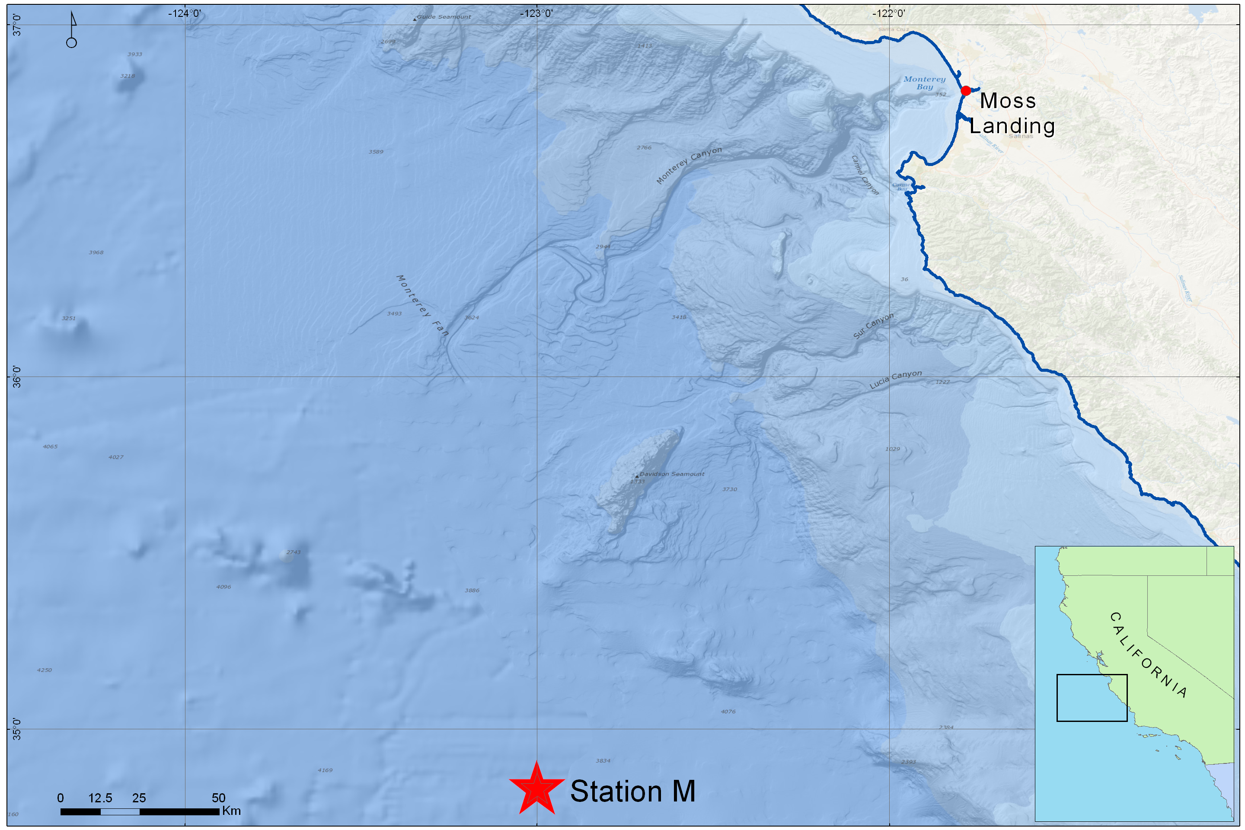
Station M: Deep Sea Study Site
23 Years of Time-Series Data

Slide 3
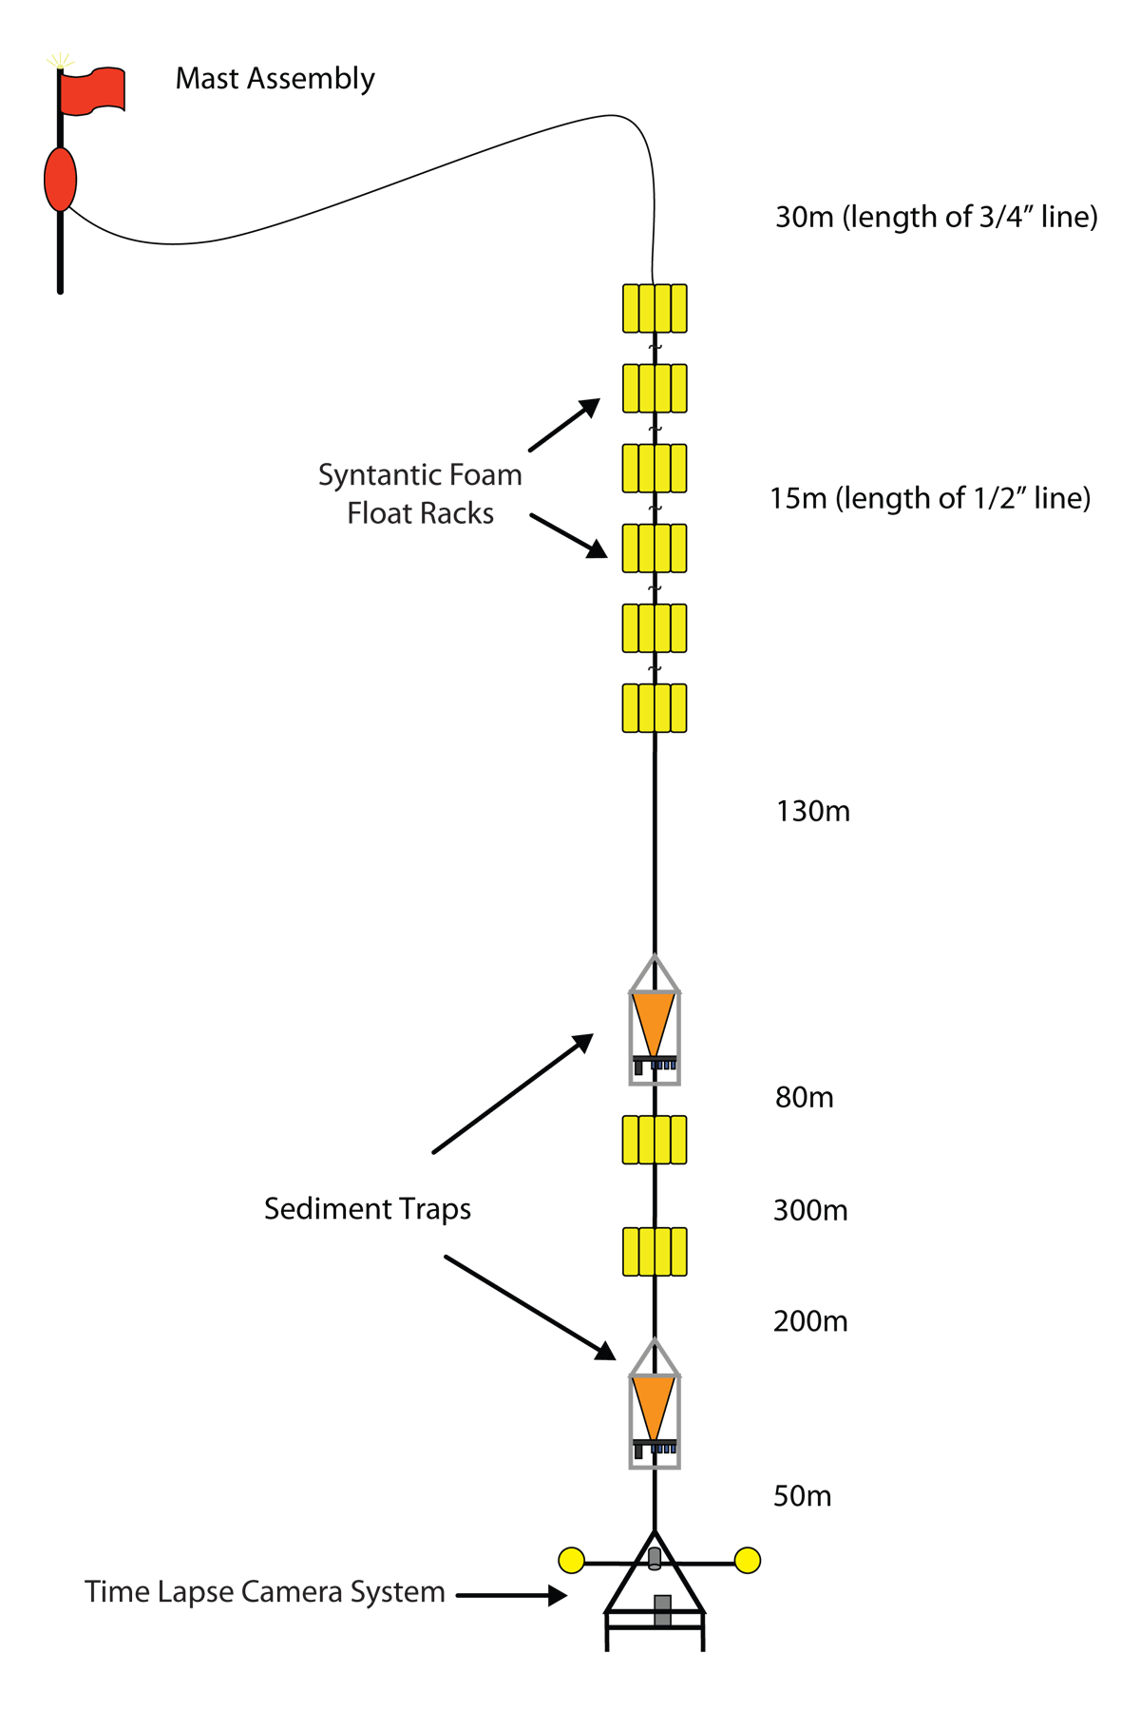
Deep Sea Observatory

Slide 4
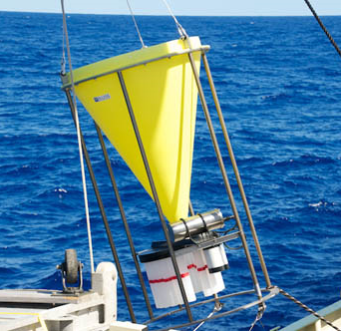
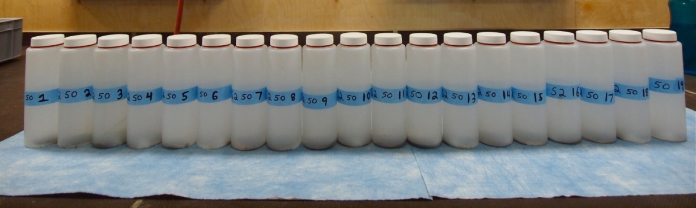
Deep Sea Observatory: Components
Sediment Traps:
Each sample bottle is collecting for 10 days
POC Flux (mg C m⁻²day⁻¹)

Slide 5
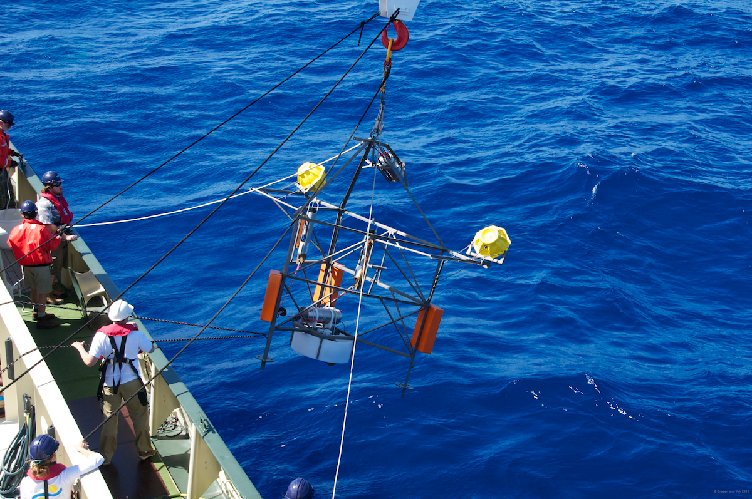
Deep Sea Observatory: Components
Time Lapse Camera: One image per hour
Images 20 m² area of sea floor

Slide 6
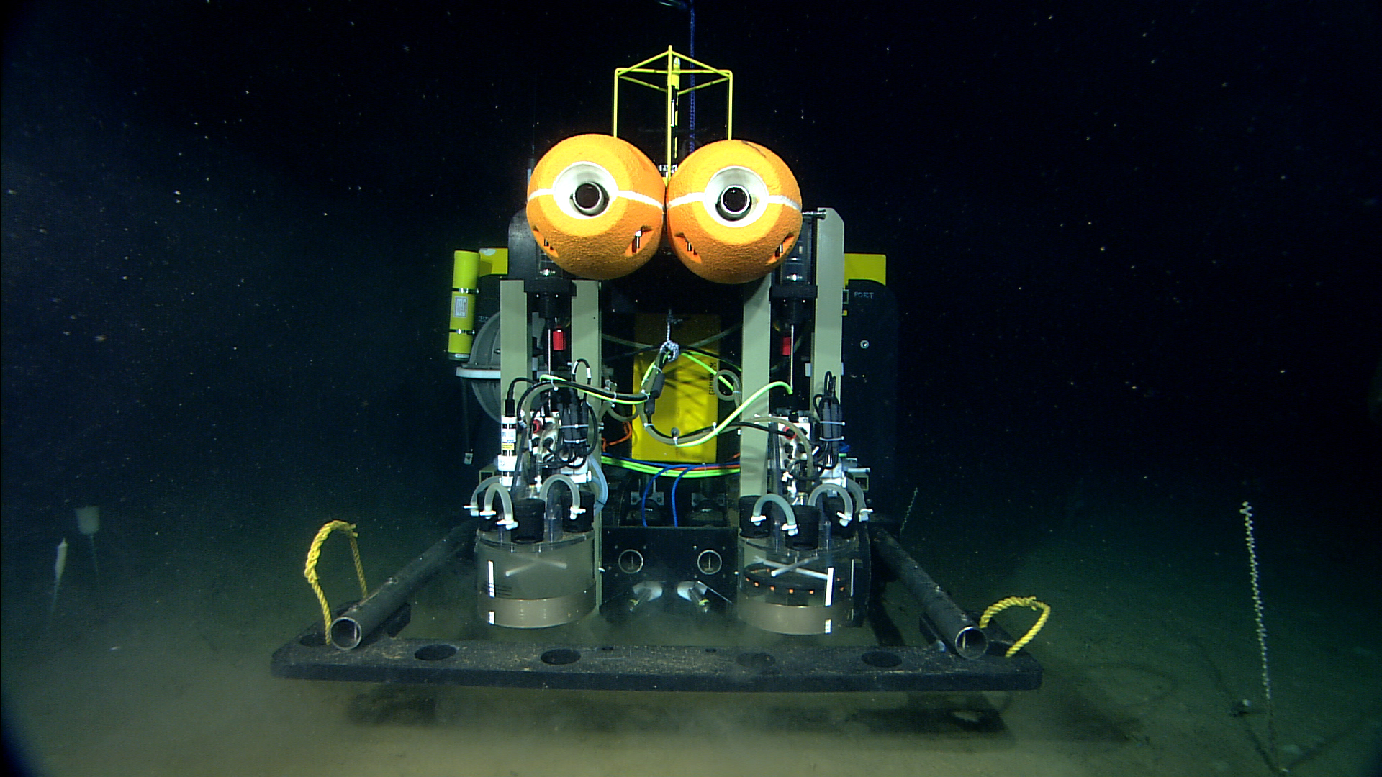
Benthic Rover

Slide 7
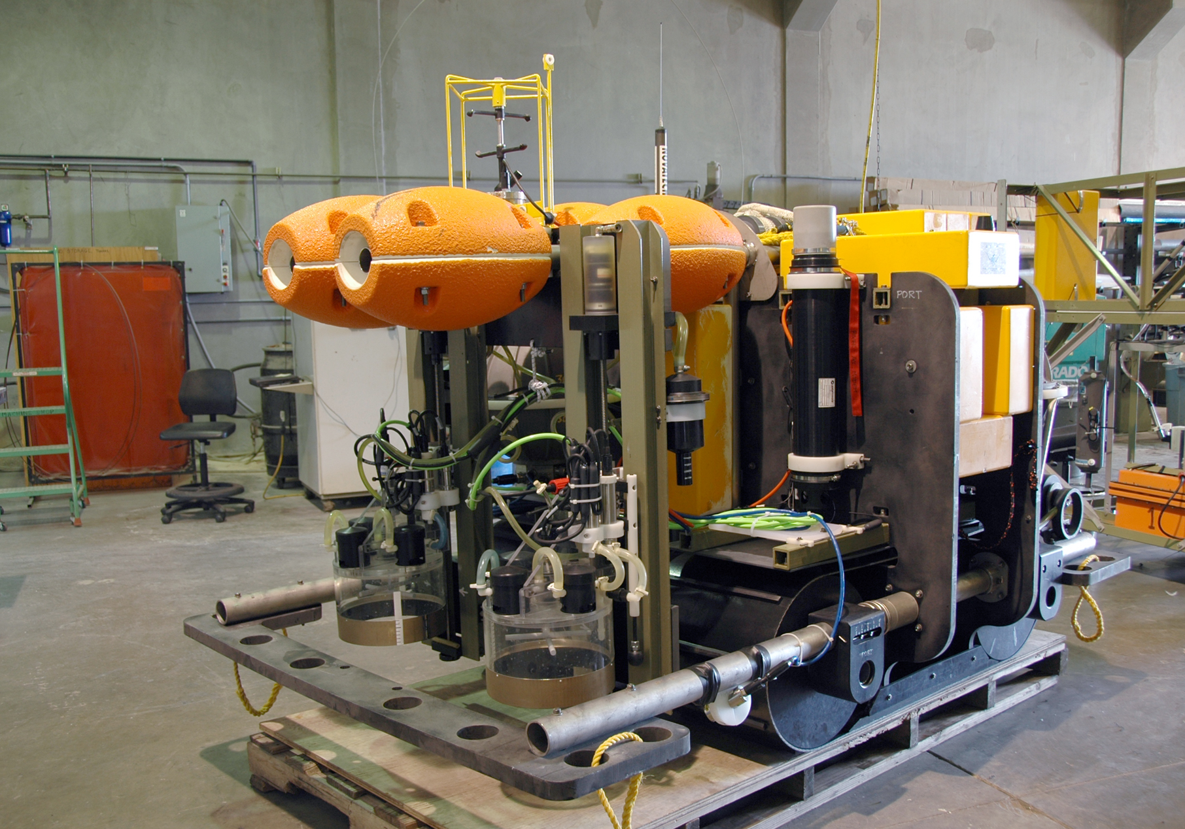
Benthic Rover Configuration
Current Meter
Chamber
Rack
Acoustic
Modem
Respirometer
Chamber
Video Cameras

Slide 8
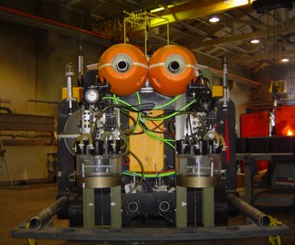
Benthic Rover
Respirometer Chambers:
Measures Sediment Community Oxygen Consumption (SCOC)
Transit Camera:
Takes high-resolution image every meter during transit
Transits 10 meters into current to next study site

Slide 9
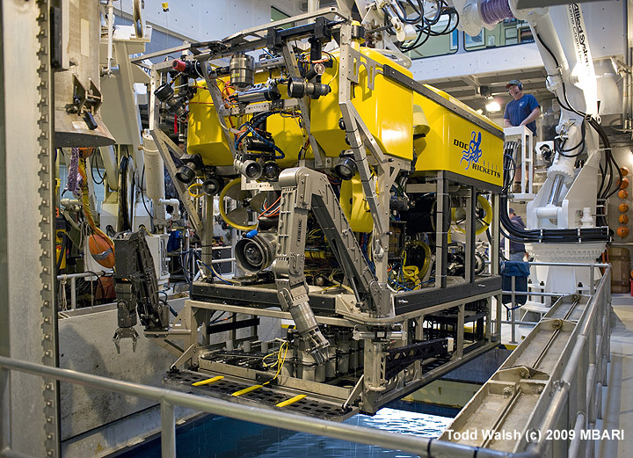
ROV Video Transects

Slide 10
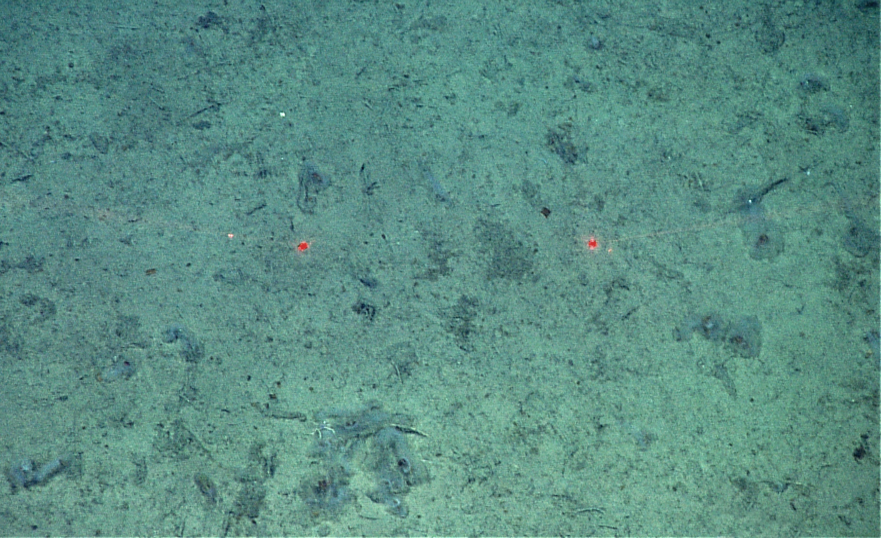
Salp Event Spring 2012
Three salps per square meter in June 2012, 0 in November 2011

Slide 11
Sediment Trap Data
600 mab

Slide 12
Camera Tripod Data

Slide 13
Rover Data

