Slide 1
Deep Sea Biology 2012

Slide 2
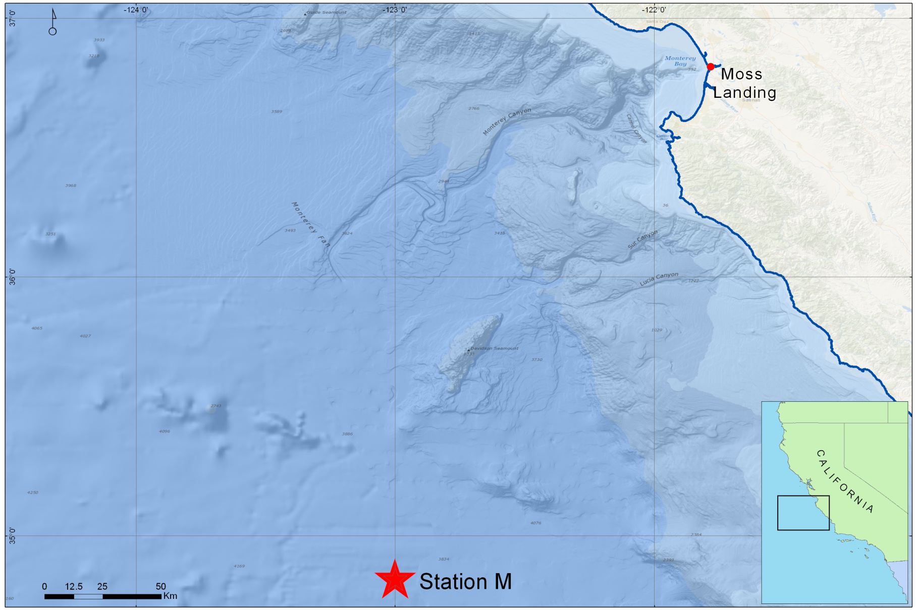
Station M: Deep Sea Study Site

Slide 3
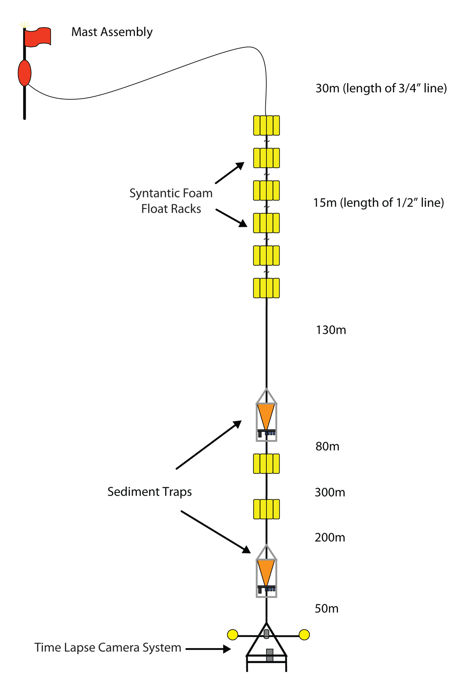
Deep Sea Observatory

Slide 4
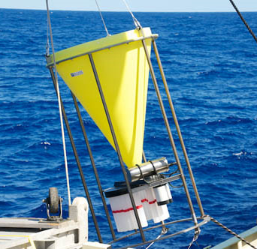
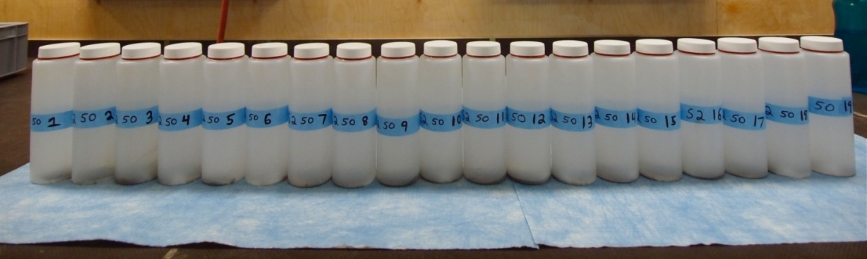
Deep Sea Observatory: Components
Sediment Traps:
Each sample bottle collects for 10 days

Slide 5
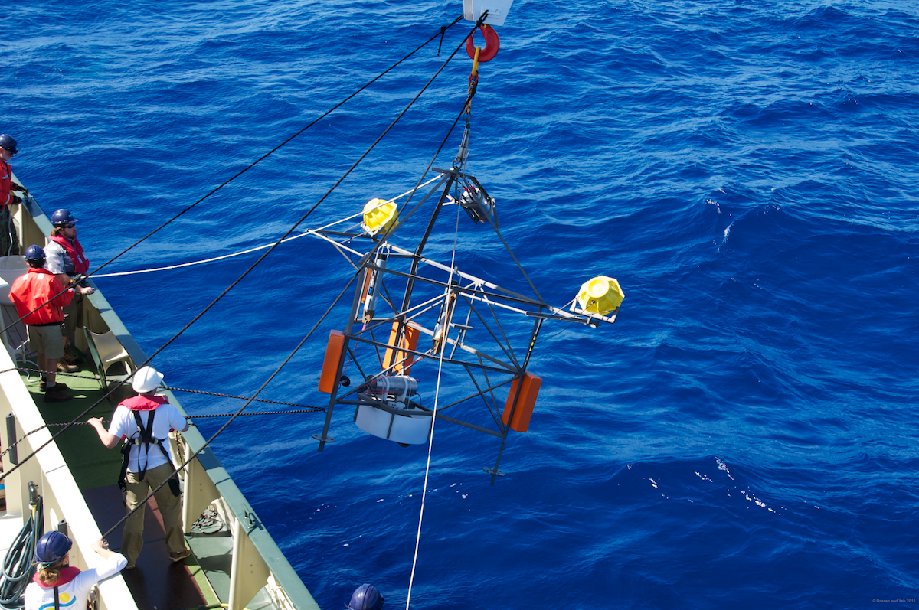
Deep Sea Observatory: Components
Time Lapse Camera: One image per hour
Images 20 m² area of sea floor

Slide 6
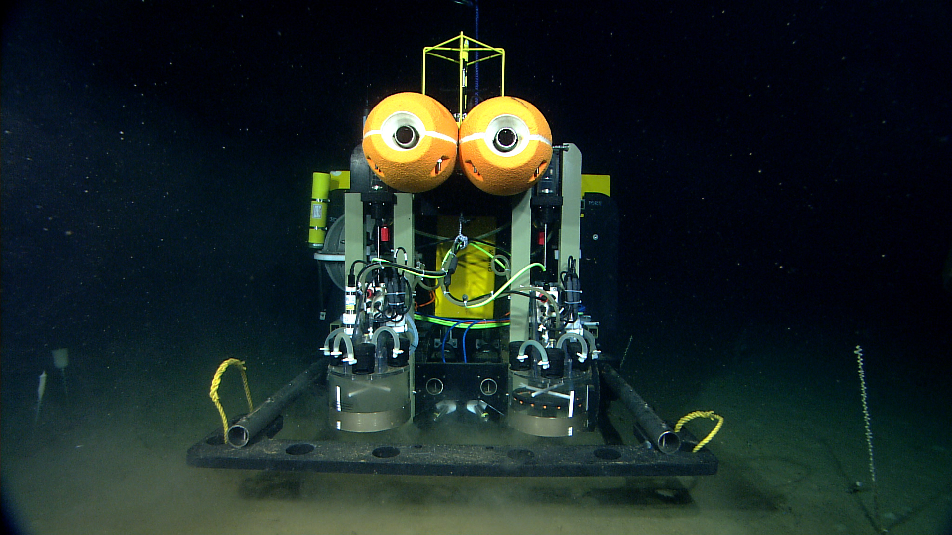
Benthic Rover

Slide 7
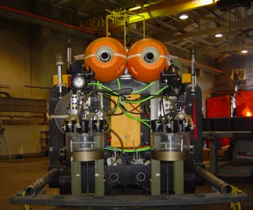
Benthic Rover
Respirometer Chambers:
Measures Sediment Community Oxygen Consumption (SCOC)
Transit Camera:
Takes high-resolution image every meter during transit
Transits 10 meters into current to next study site

Slide 8
ROV Video Transects

Slide 9
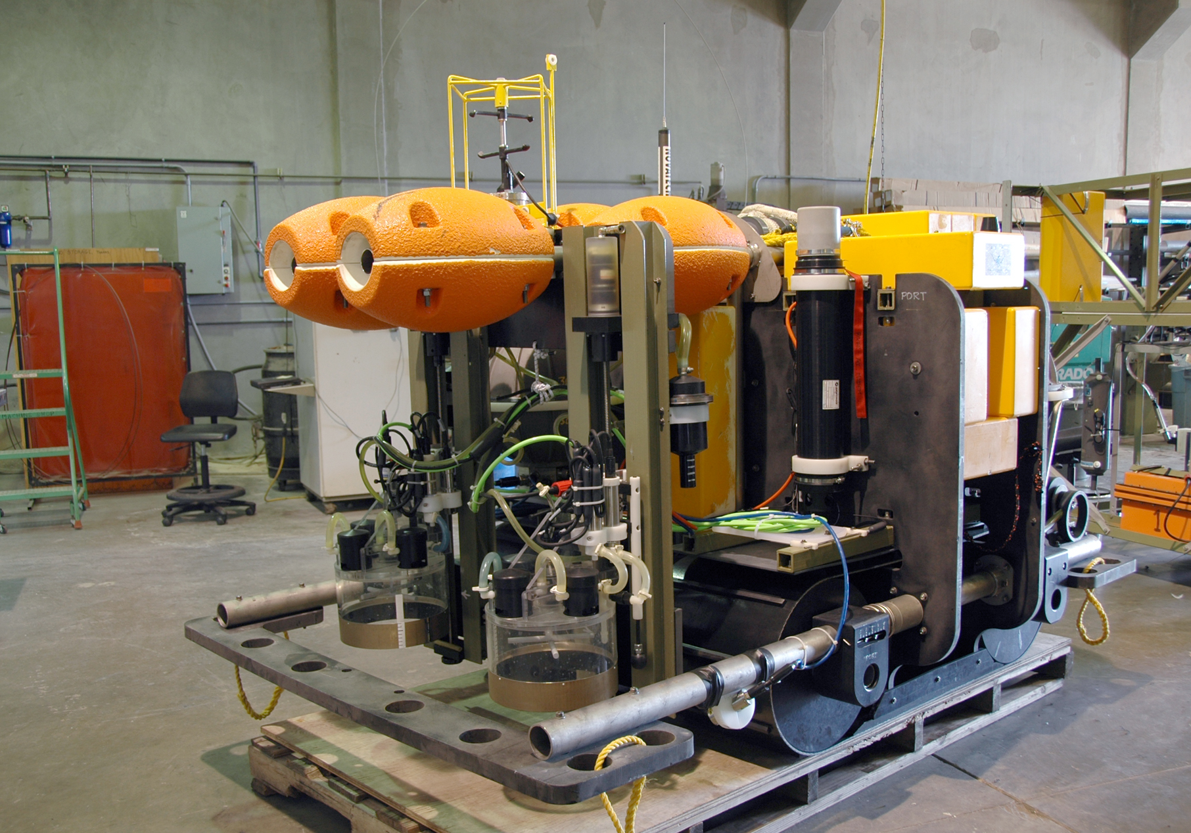
Benthic Rover Configuration
Current Meter
Chamber
Rack
Acoustic
Modem
Respirometer
Chamber
Video Cameras

