Slide 1
Capturing Episodic Events in the Deep-Sea Community using a Continuously Monitoring Instrument Suite
Alana Sherman¹, Rich Henthorn¹, Paul McGill¹, Brett Hobson¹, Henry Ruhl², Jacob Ellena¹, Ken Smith¹
¹Monterey Bay Aquarium Research Institute
²National Oceanography Center, University of Southampton

Slide 2
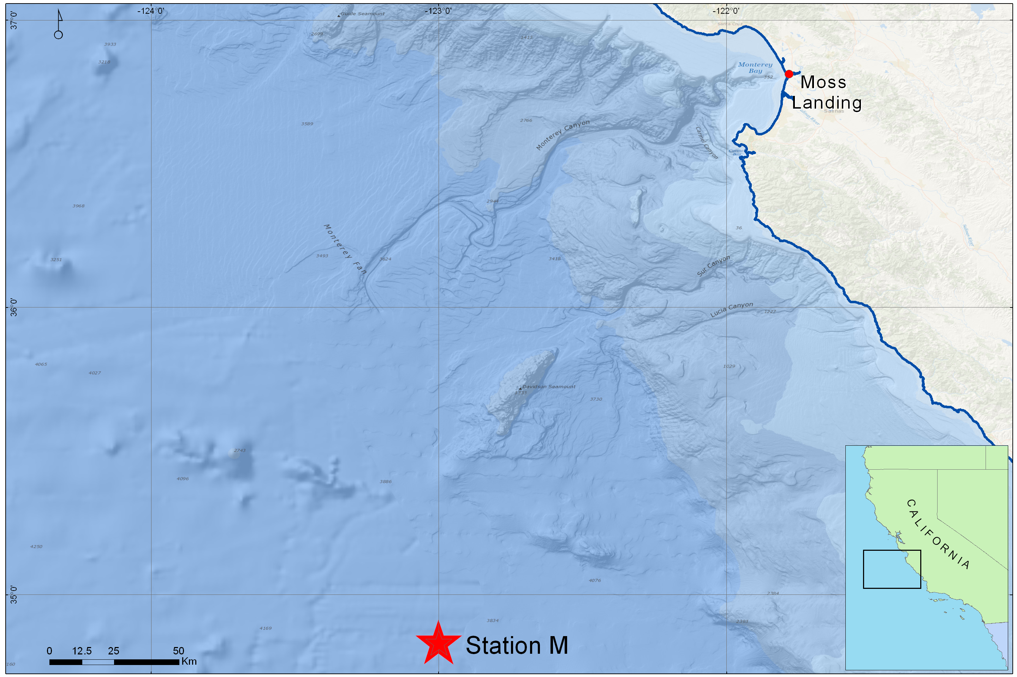
Station M: Deep Sea Study Site
23 Years of Time-Series Data

Slide 3
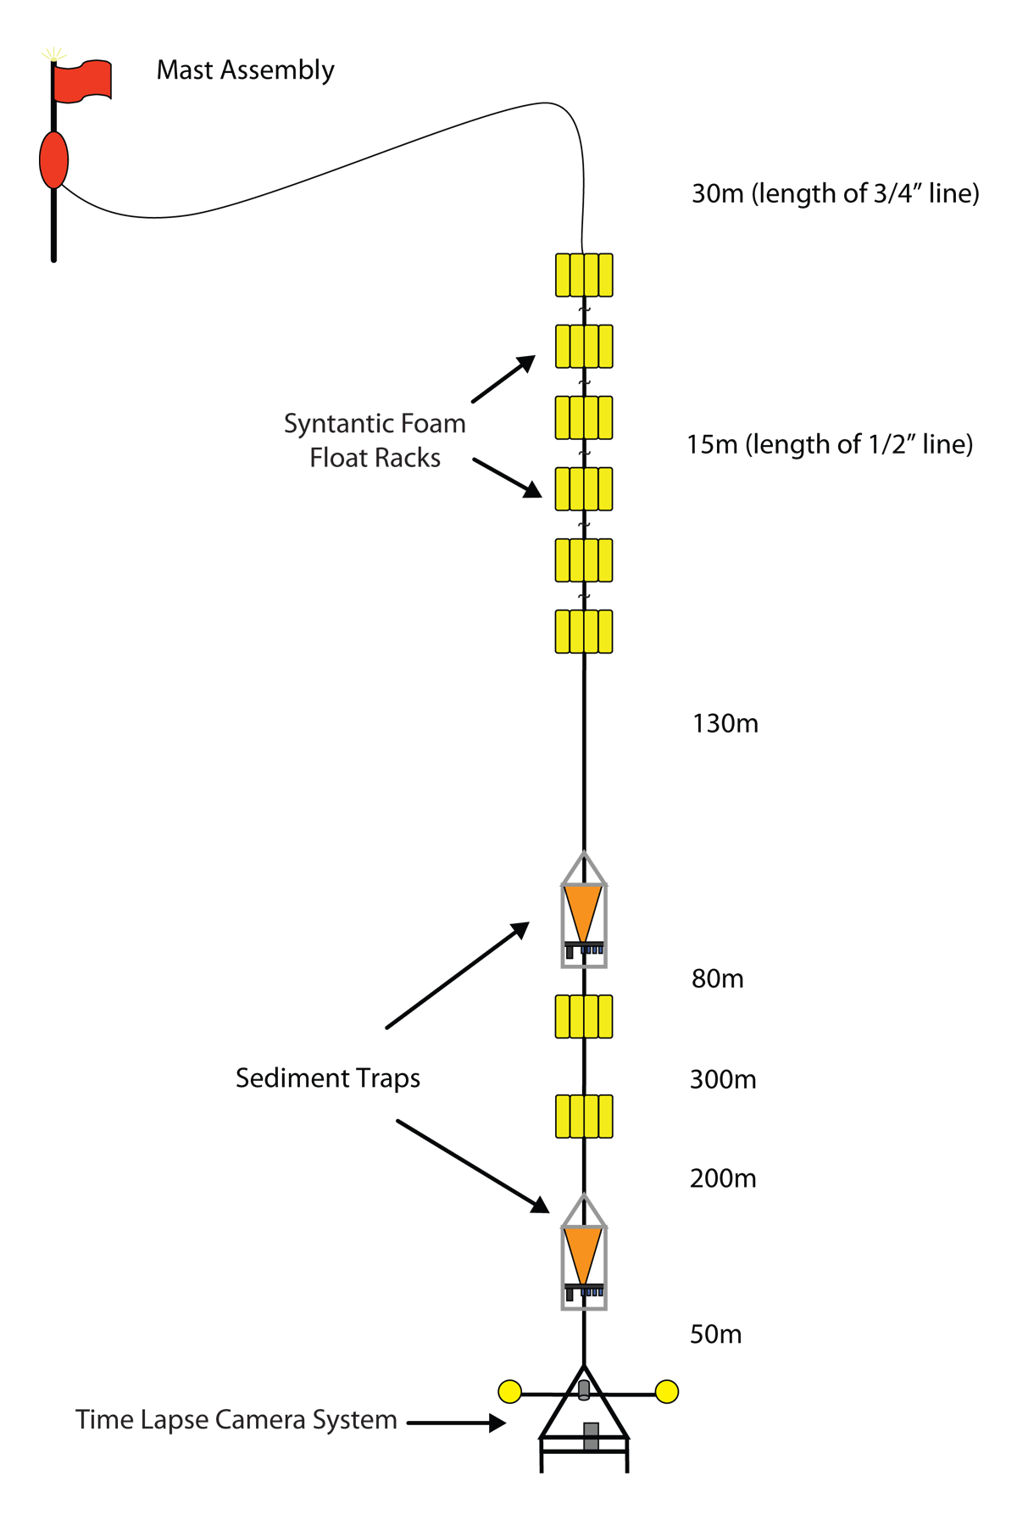
Deep Sea Observatory

Slide 4
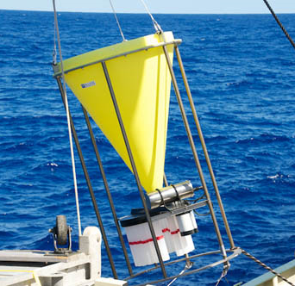
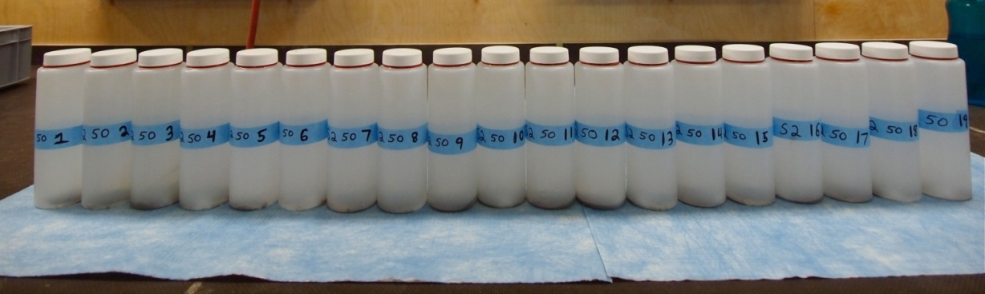
Deep Sea Observatory: Sediment Traps
Sediment Traps:
Each sample bottle is collecting for 10 days
POC Flux (mg C m⁻²day⁻¹)

Slide 5
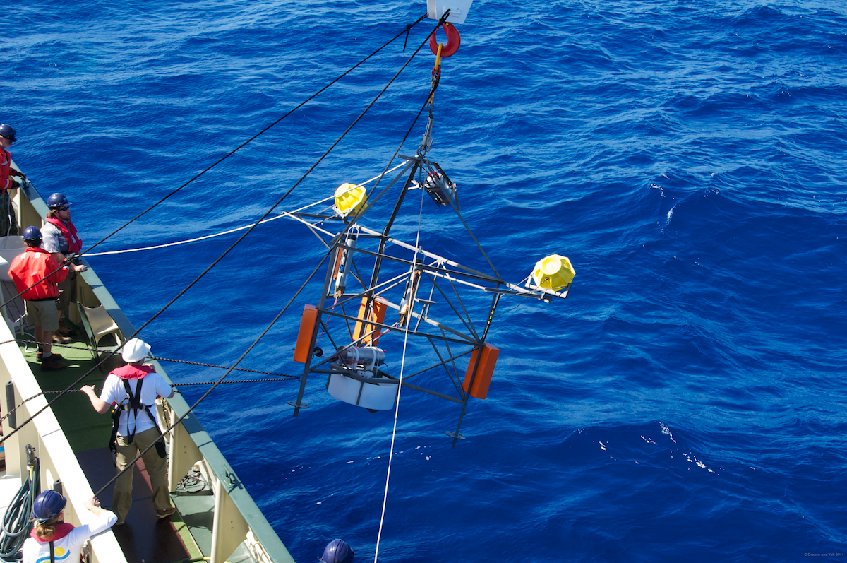
Deep Sea Observatory:
Time-Lapse Camera
One image per hour
Images 20 m² area of sea floor
Particle Counts

Slide 6
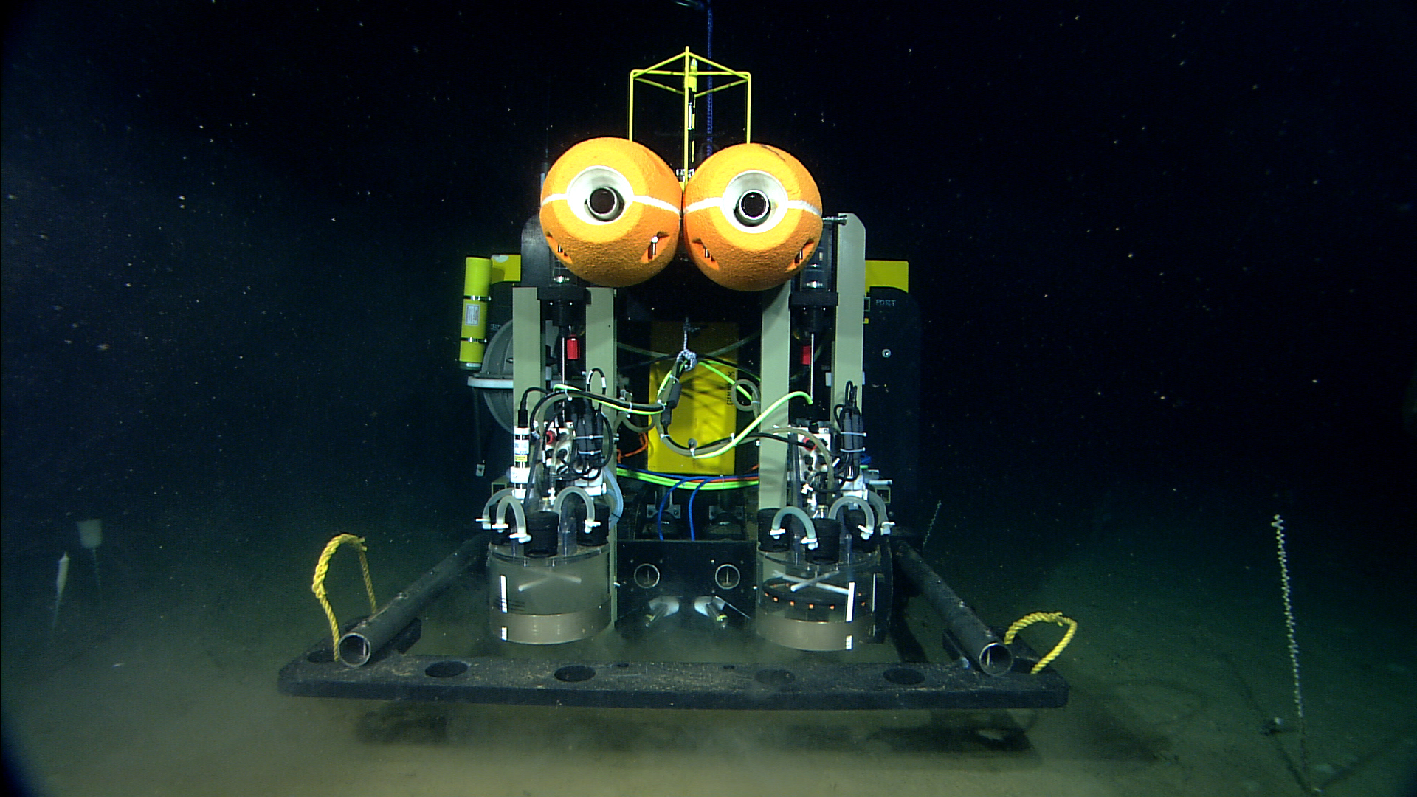
Benthic Rover

Slide 7
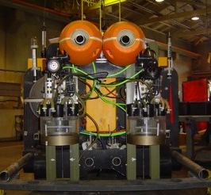
Benthic Rover
Respirometer Chambers:
  Measures Sediment
  Community Oxygen
  Consumption (SCOC)
Transit Camera:
  Takes high-resolution image every
  meter during 10 m transit between
  sites
  Particulate per square meter

Slide 8
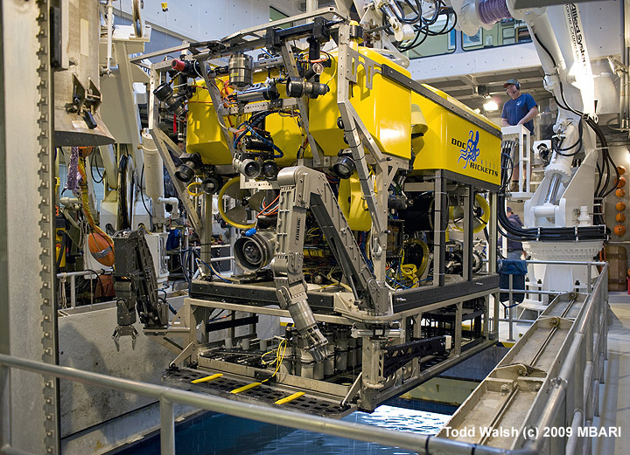
ROV Video Transects
HD Video collected during ROV transect is analyzed using VARS for population counts

Slide 9
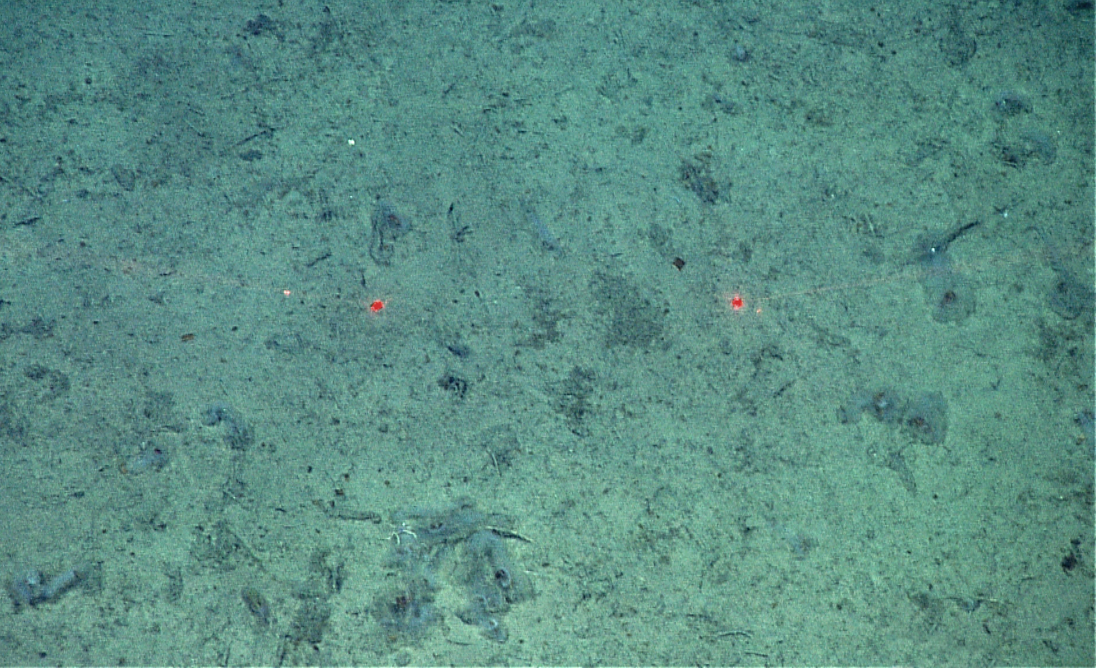
Salp Event: Spring 2012
Three salps per square meter in June 2012, 0 in November 2011

Slide 10
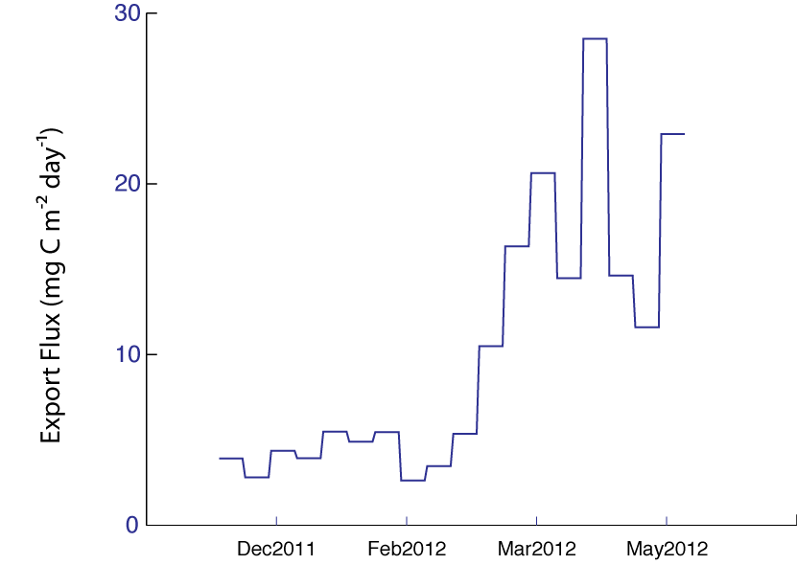
Sediment Trap Data
600 mab Trap Data

Slide 11
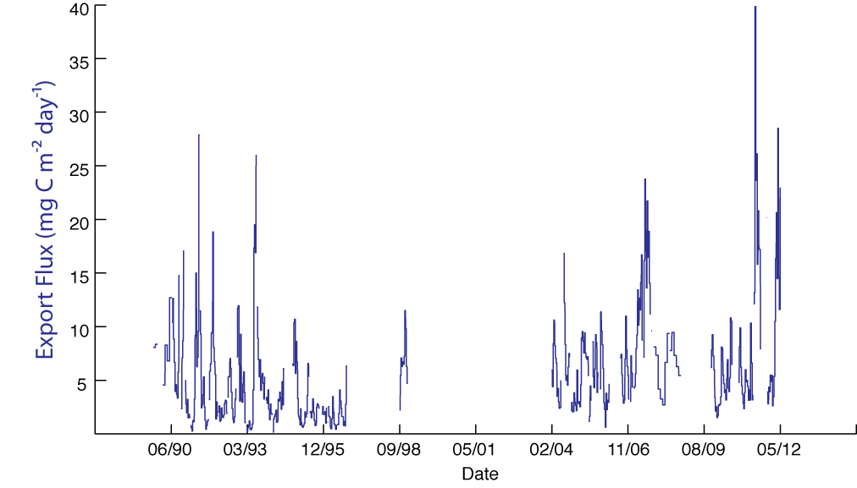
Sediment Trap Data
600 mab Trap Data

Slide 12
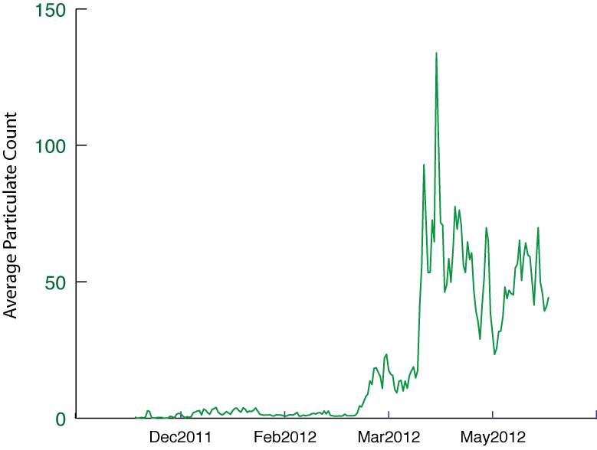
Camera Tripod Data

Slide 13
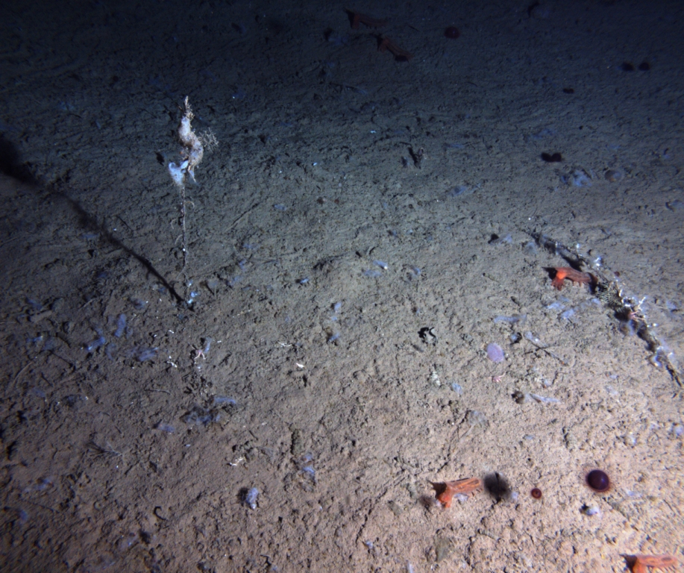
Rover Transit Images

Slide 14
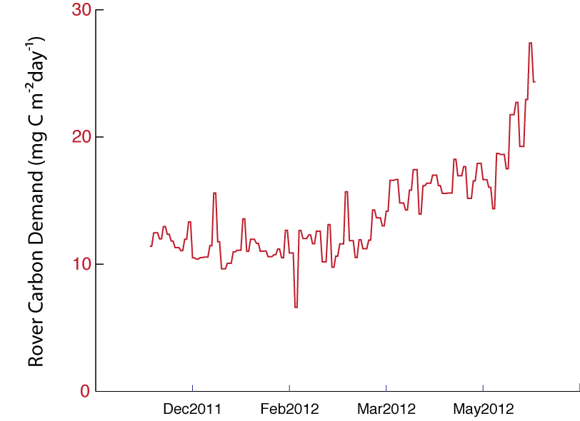
Rover Carbon Demand

Slide 15
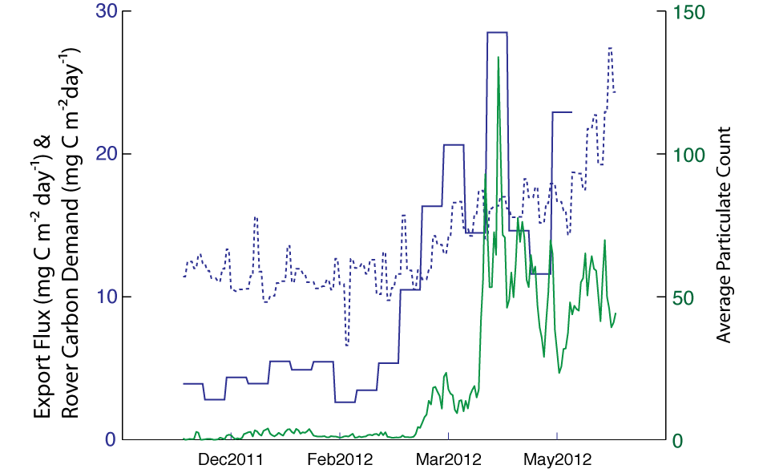
Sediment Trap, Time-Lapse Camera, and Rover Data

Slide 16
Comparing to Export Flux

Slide 17
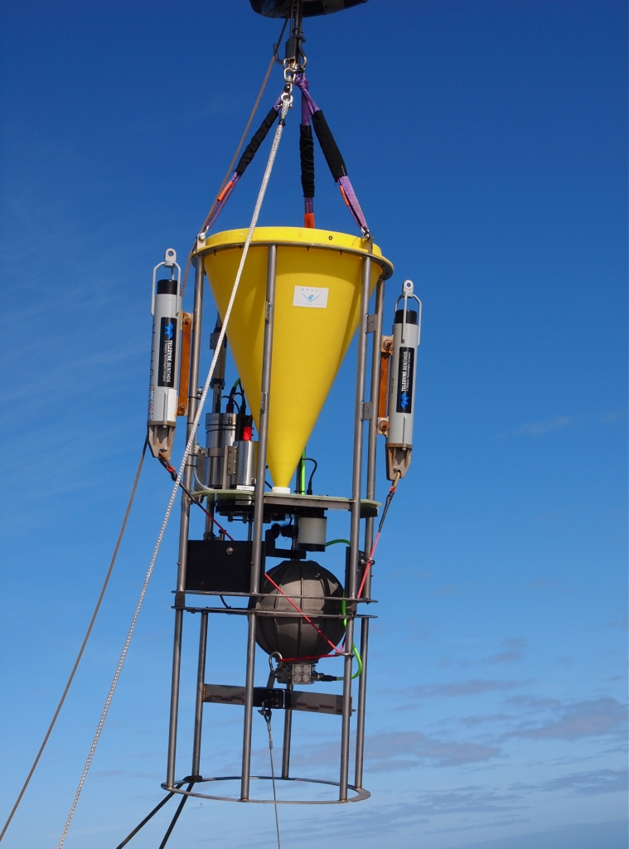
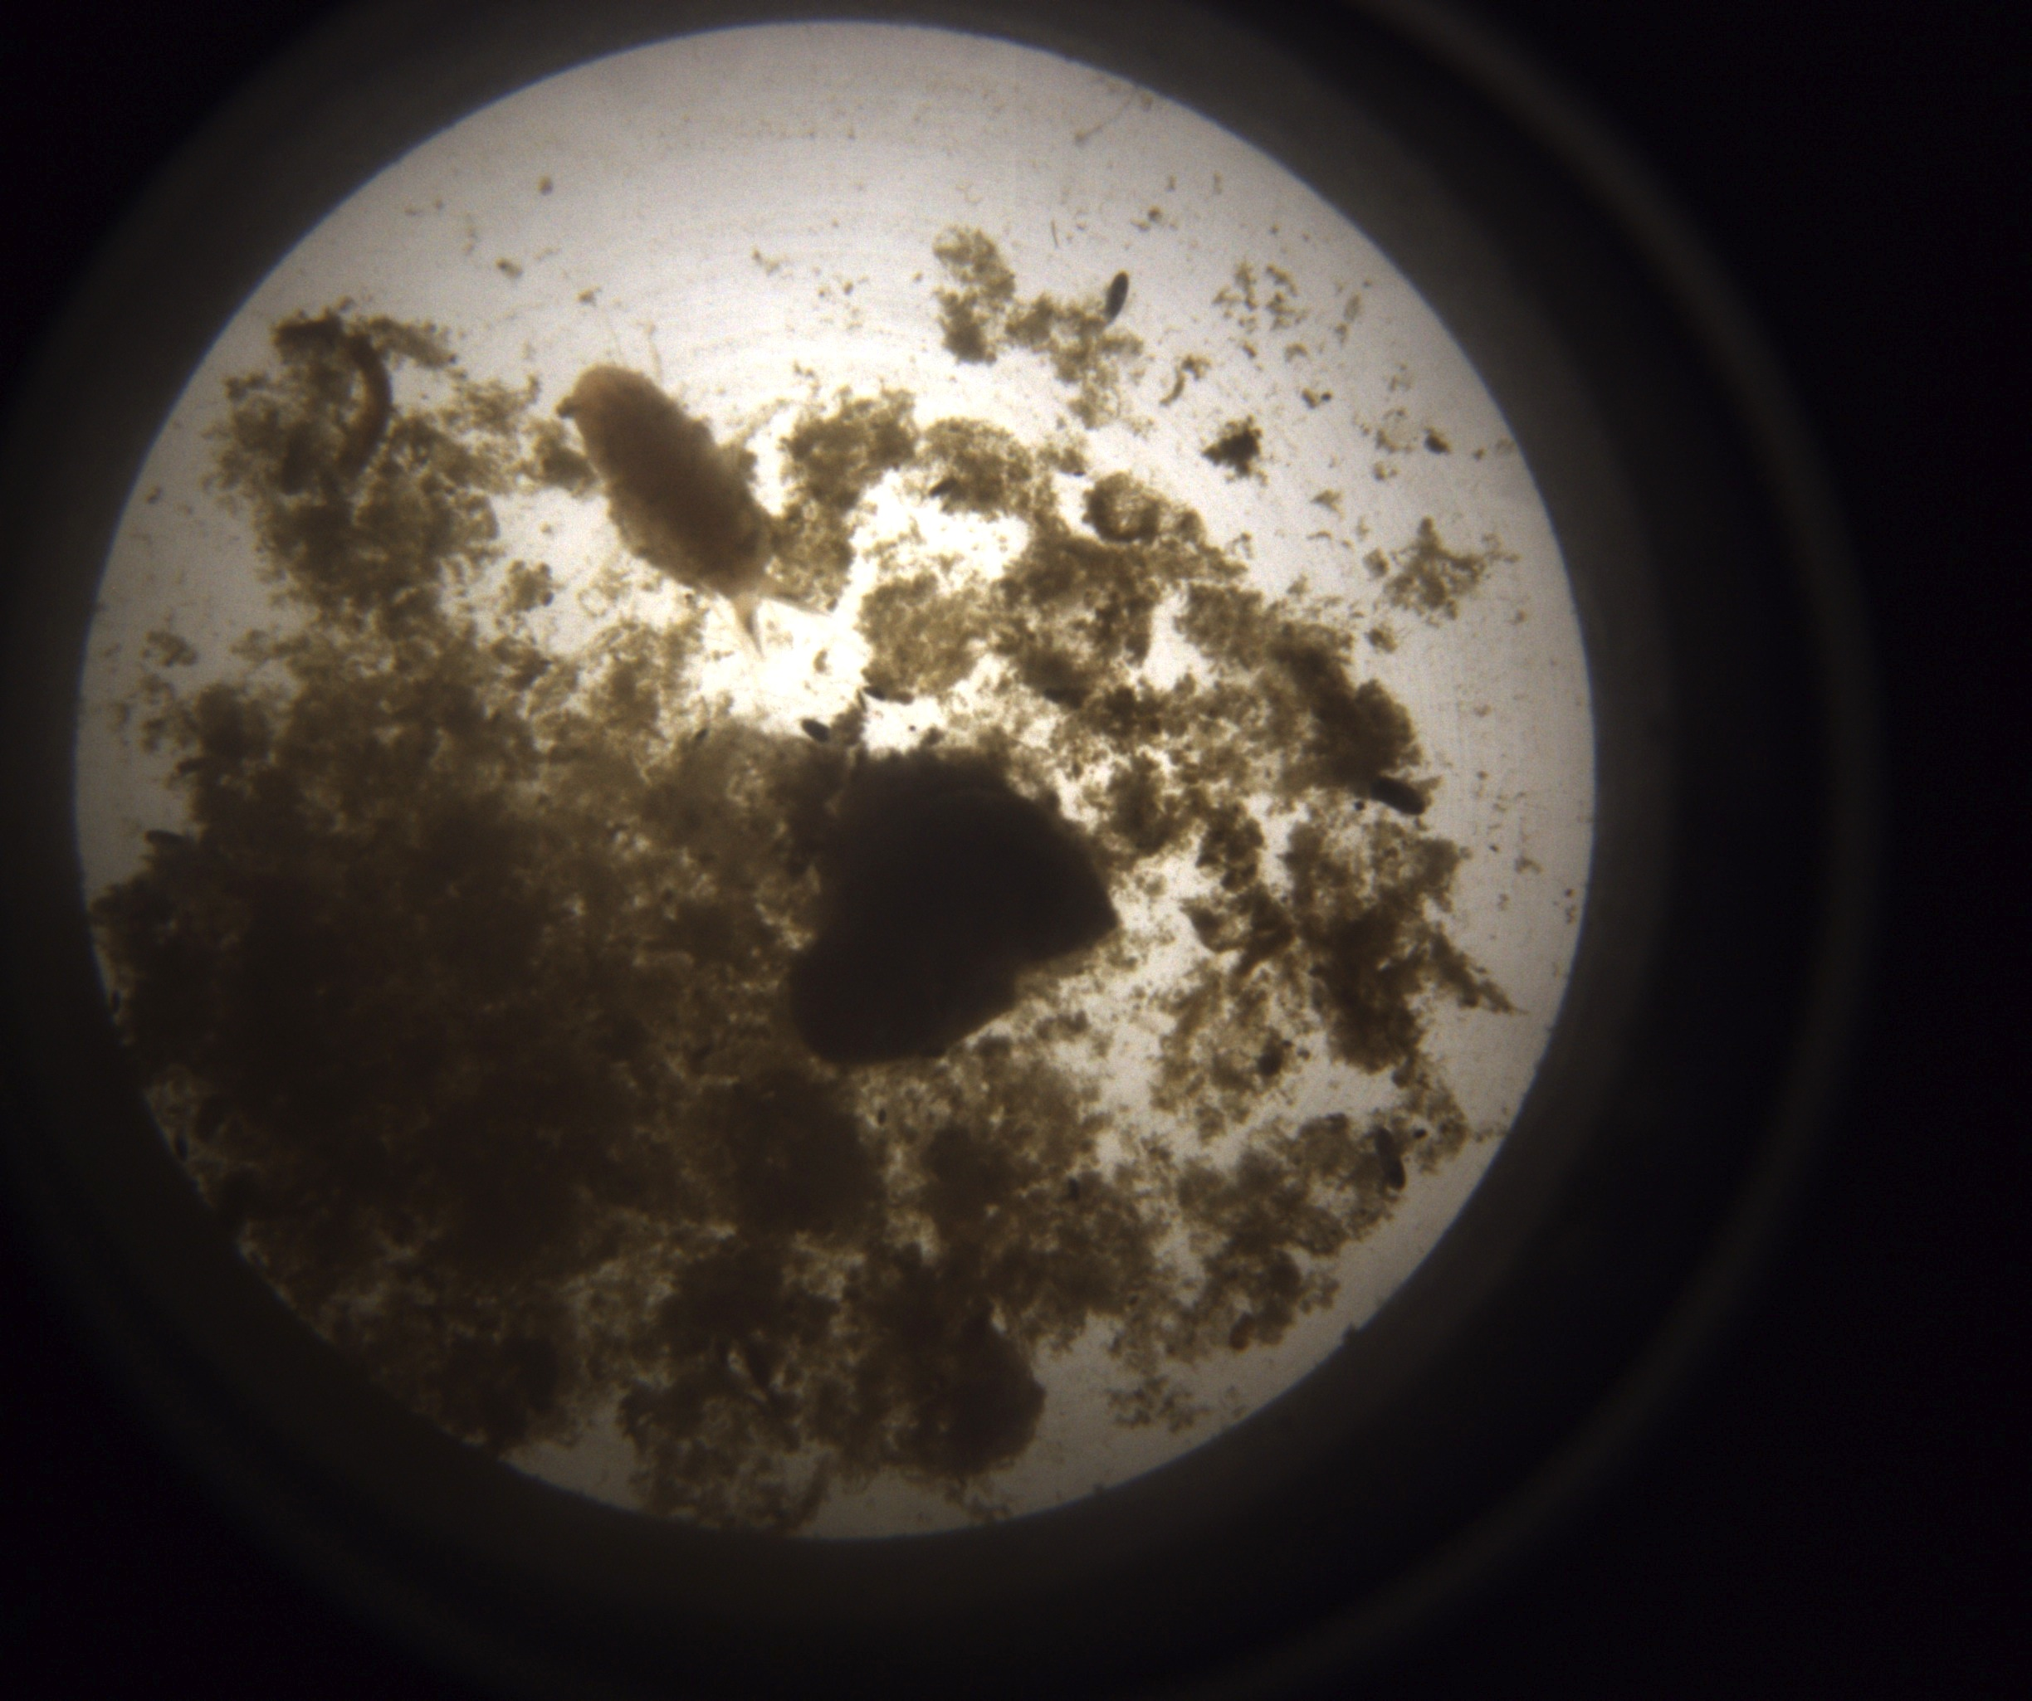
Newest Instrument:
Sedimentation Event Sensor
Images and measures fluorescence of accumulated sediment every 10 hours
Photo: C. Buchner

Slide 18
Newest Instrument:
Sedimentation Event Sensor

Slide 19
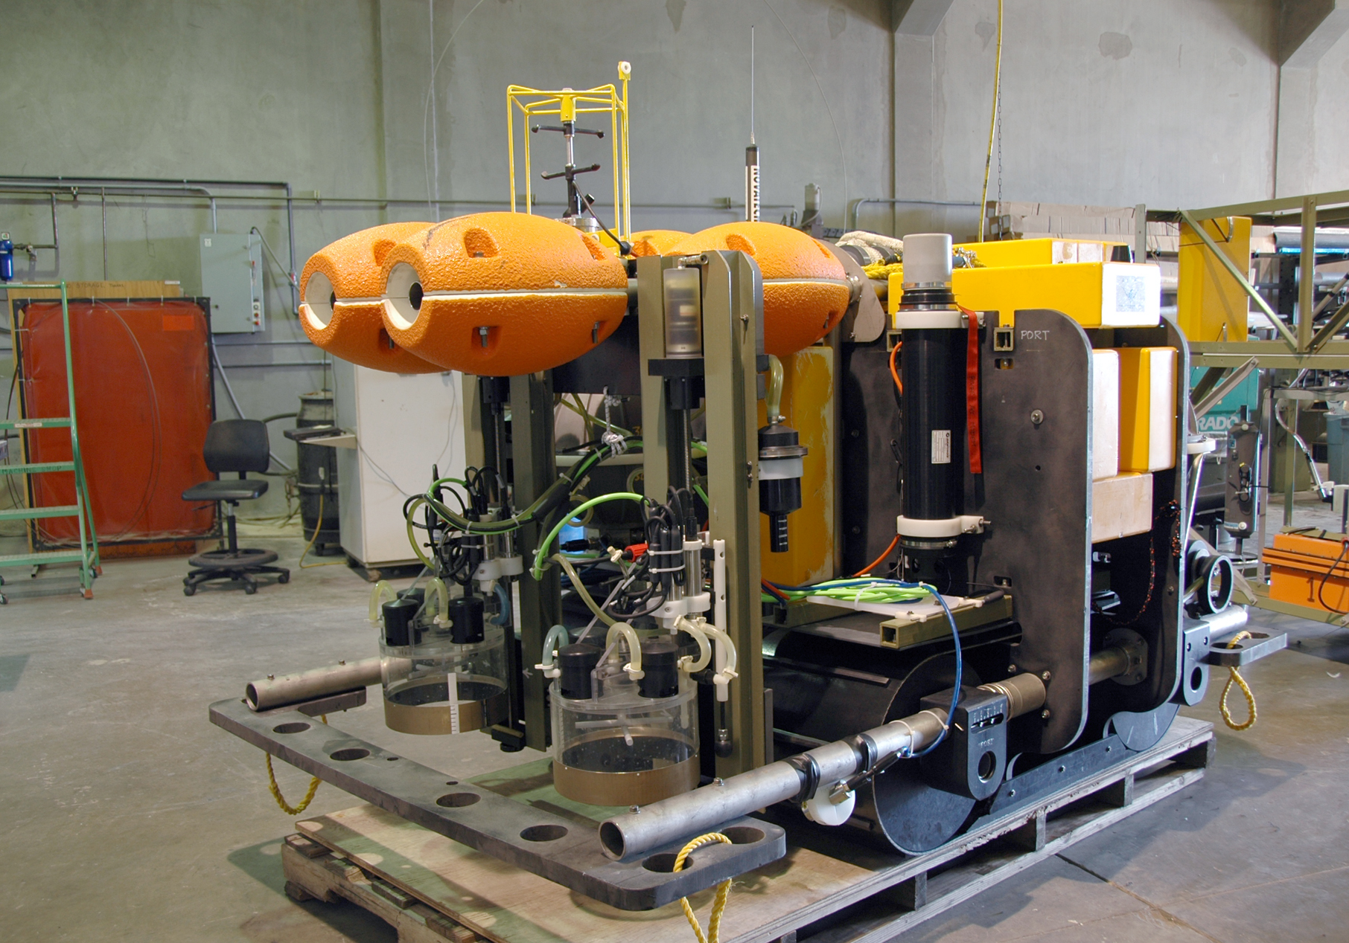
Benthic Rover Configuration
Current Meter
Chamber
Rack
Acoustic
Modem
Respirometer
Chamber
Video Cameras

