Slide 1
Capturing Episodic Events in the Deep-Sea Community using a Continuously Monitoring Instrument Suite
Alana Sherman¹, Rich Henthorn¹, Paul McGill¹, Brett Hobson¹, Henry Ruhl², Jacob Ellena¹, Ken Smith¹
¹Monterey Bay Aquarium Research Institute
²National Oceanography Center, University of Southampton

Slide 2
Capturing Episodic Events
Be in right place at right time
  …or be there all the time
Have adequate sensors to capture event

Slide 3
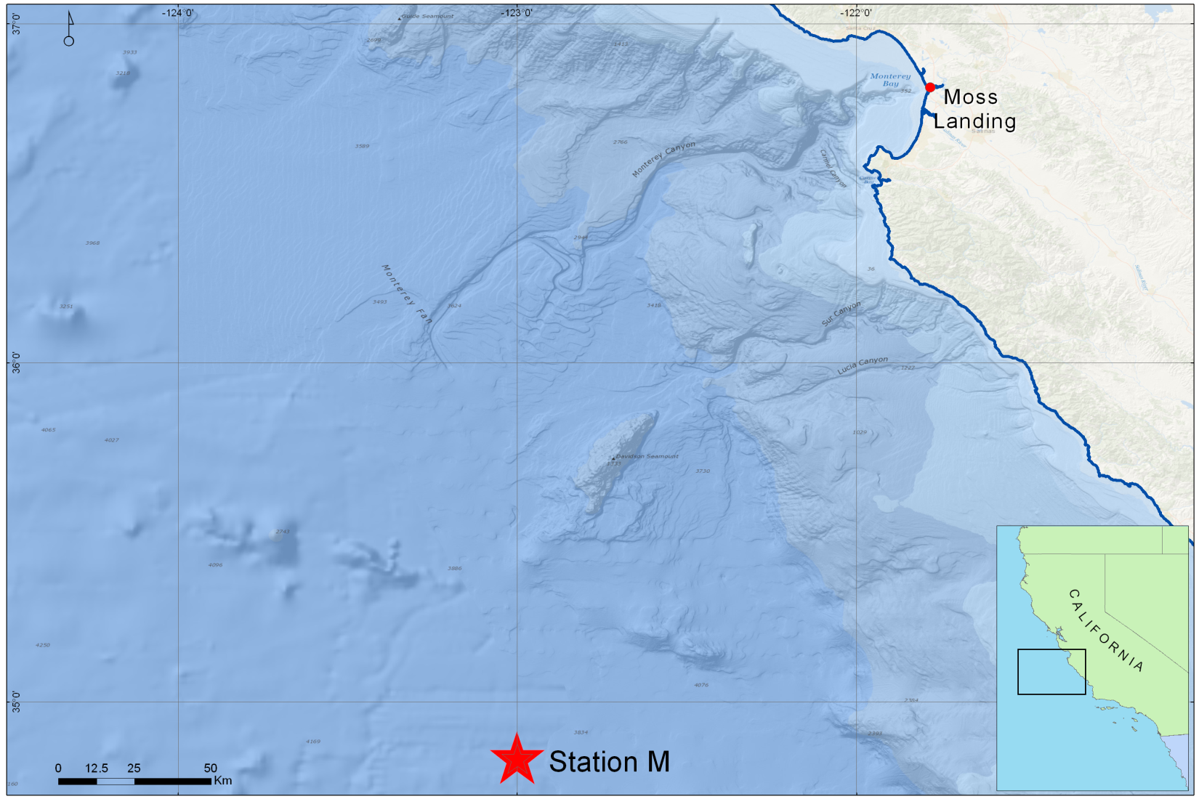
Station M: Deep Sea Study Site
23 Years of Time-Series Data
Only 1-2 Visits with a ship each year
Notes:
120 miles off shore, 4000 m water depth, and we are limited to visiting only 1-2 a year so need instruments to monitor the seafloor

Slide 4
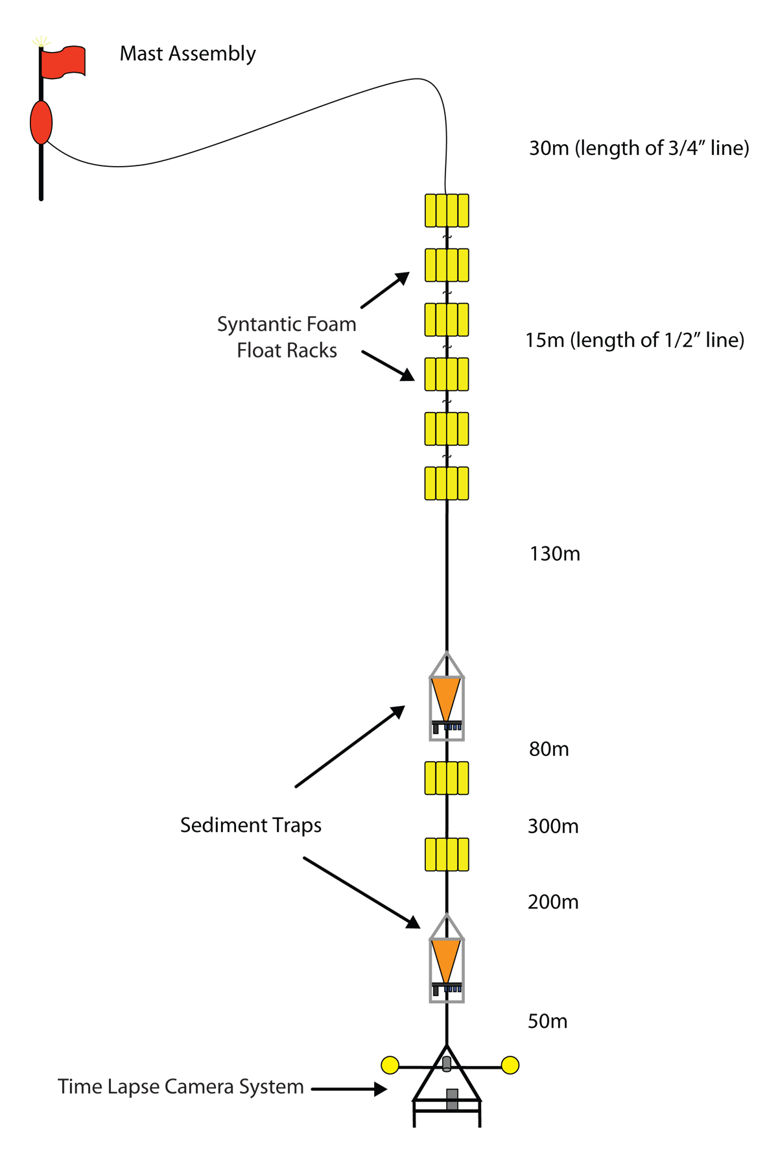
Deep Sea Observatory

Slide 5
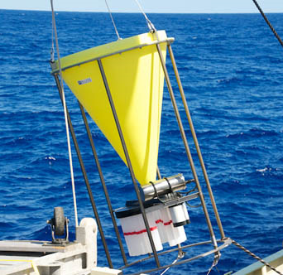
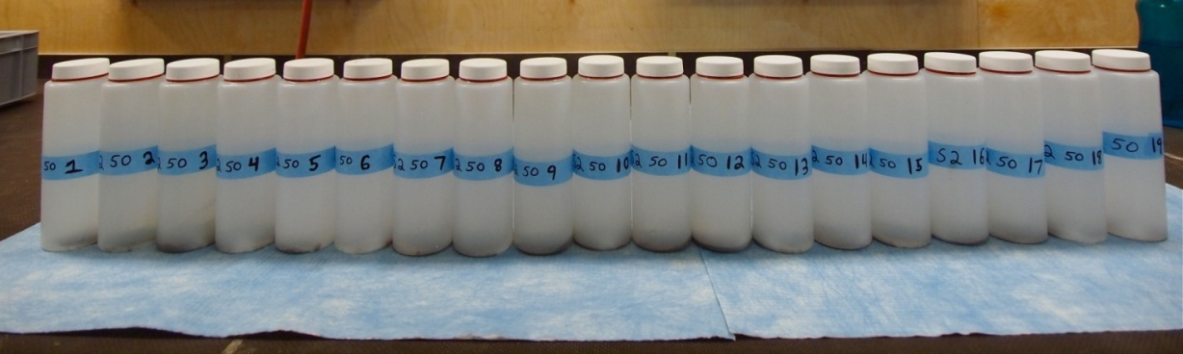
Deep Sea Observatory: Sediment Traps
Sediment Traps:
Each sample bottle is collecting for 10 days
POC Flux (mg C m⁻²day⁻¹)

Slide 6
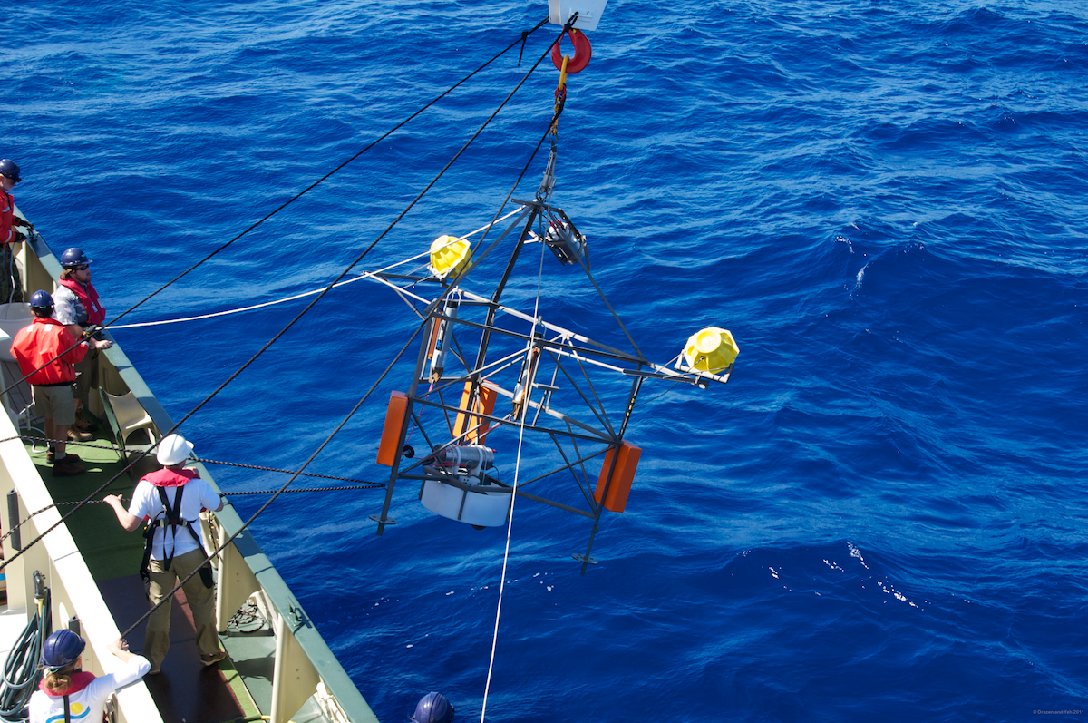
Deep Sea Observatory:
Time-Lapse Camera
One image per hour
Images 20 m² area of sea floor
Particle and Organism Counts

Slide 7
Pulse Event at St.M

Slide 8
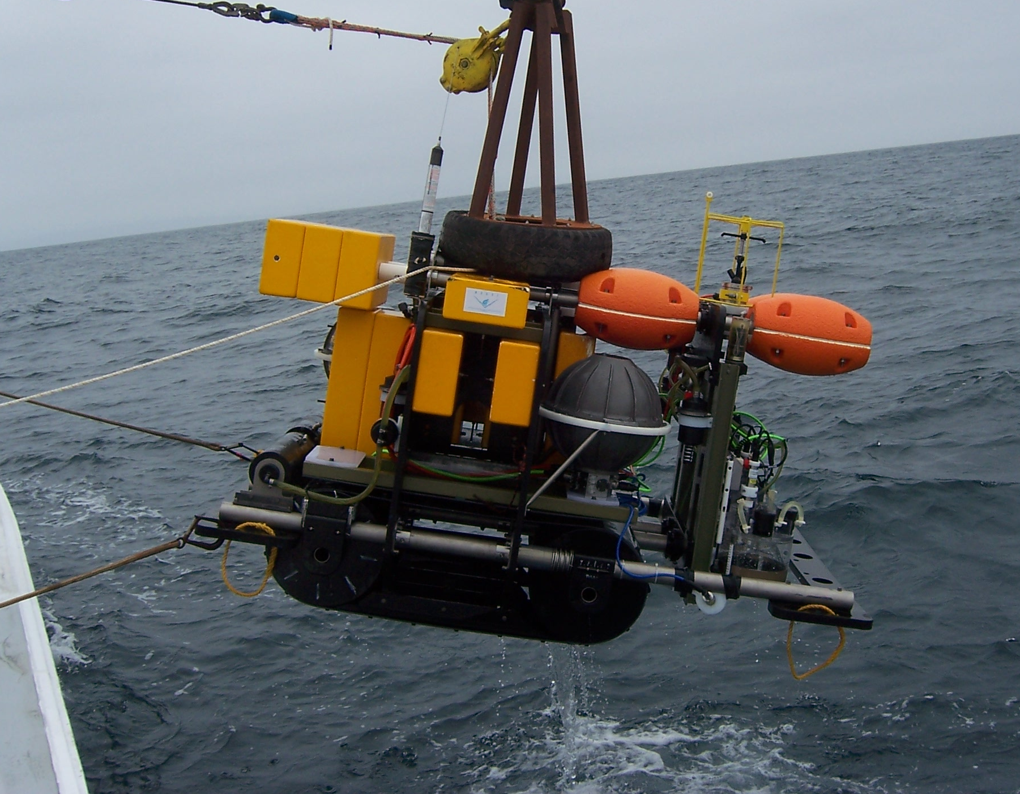
Benthic Rover
Notes:
good temporal resolution always measuring at a undisturbed site

Slide 9
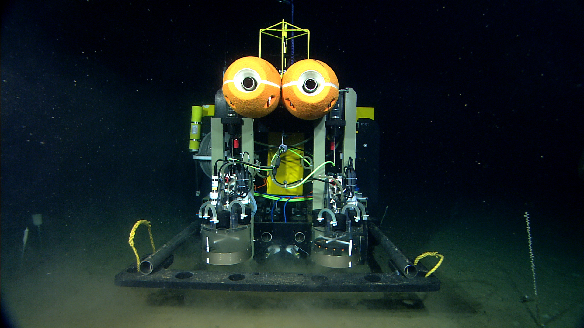
Benthic Rover
Respirometer Chambers:
  Measures Sediment
  Community Oxygen
  Consumption (SCOC)
  Can Calculate Carbon demand
Transit Camera:
  Takes high-resolution image every
  meter during 10 m transit between
  sites
  Particle count per square meter

Slide 10
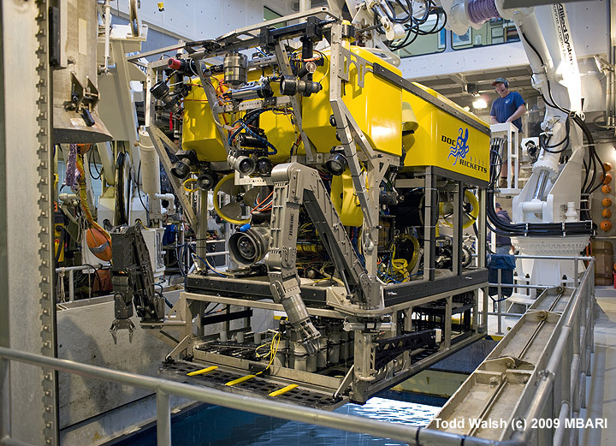
ROV Video Transects
HD Video collected during ROV transect is analyzed using VARS for population counts
Notes:
Only conducted when at St.M with ship so one-two datasets per year.

Slide 11
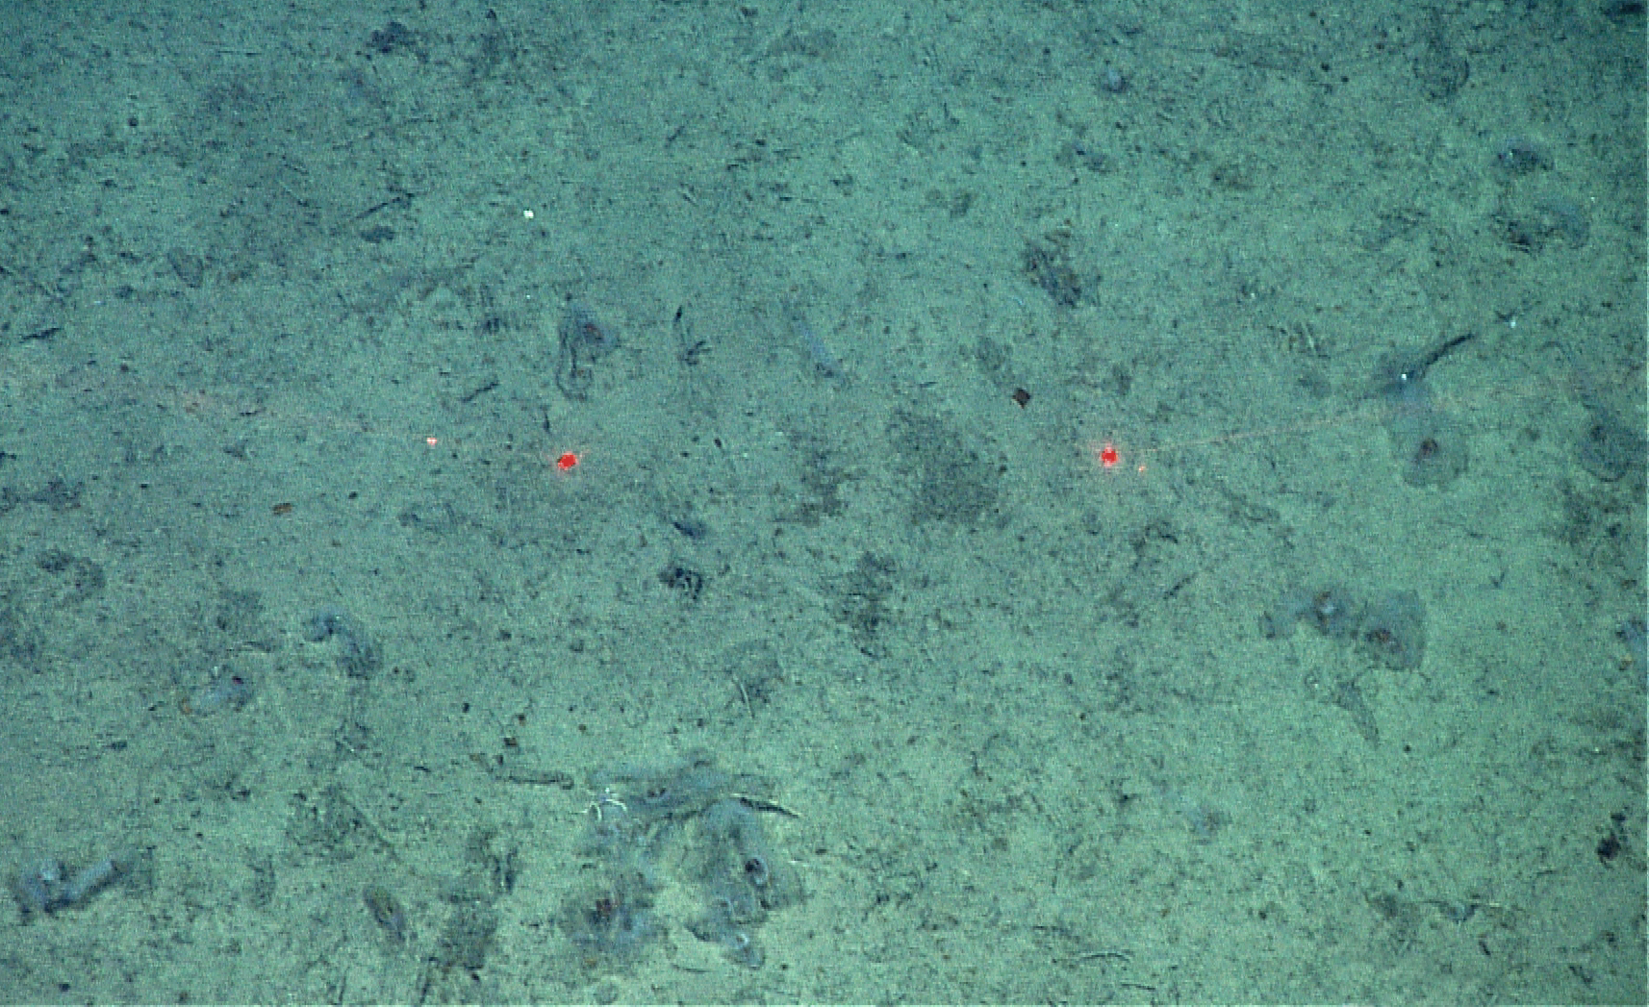
Salp Event: Spring 2012
3 salps/m² in 06/2012, 0 salps/m² in 11/2011
Notes:
Carbon export system, salps filter particulate and then deliver it to sea floor.

Slide 12
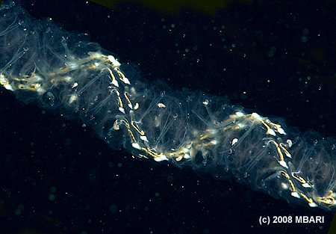
Why do we care about a Salp bloom?
Carbon Transport Mechanism
Significant impact on benthic food supply

Slide 13
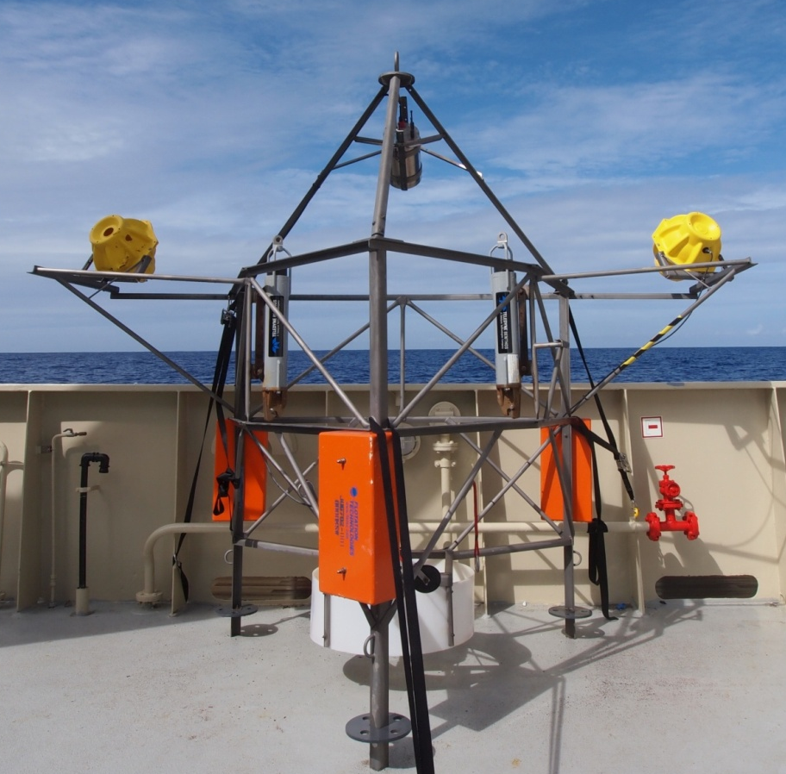
Salp Event Measured by Other Instruments

Slide 14
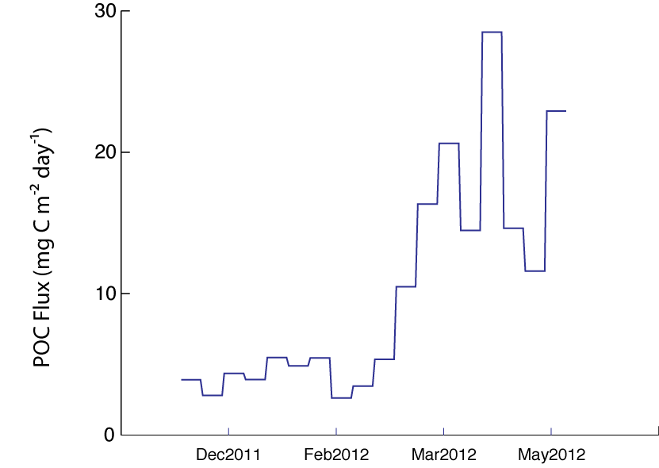
Sediment Trap Data
600 mab Trap Data
Notes:
why use 600m trap?

Slide 15
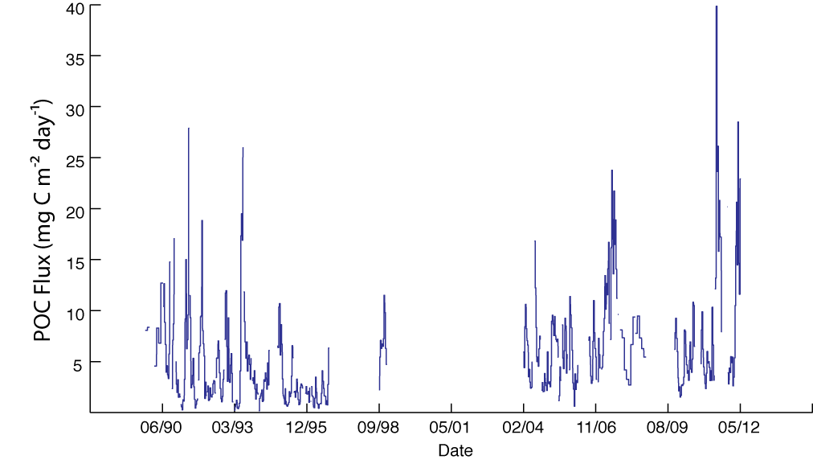
Sediment Trap Data
600 mab Trap Data

Slide 16
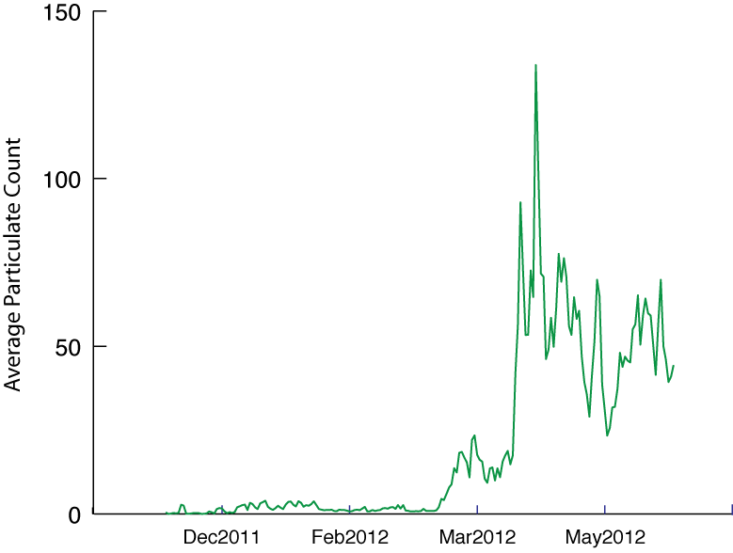
Camera Tripod Data
Counts of Salps, Larvaceans, and Siphonophres

Slide 17
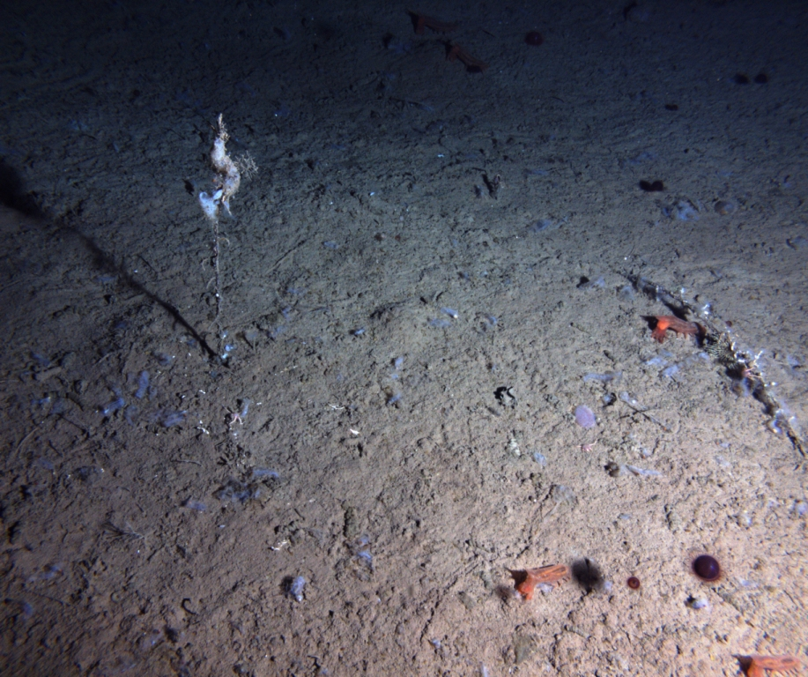
Rover Transit Images

Slide 18
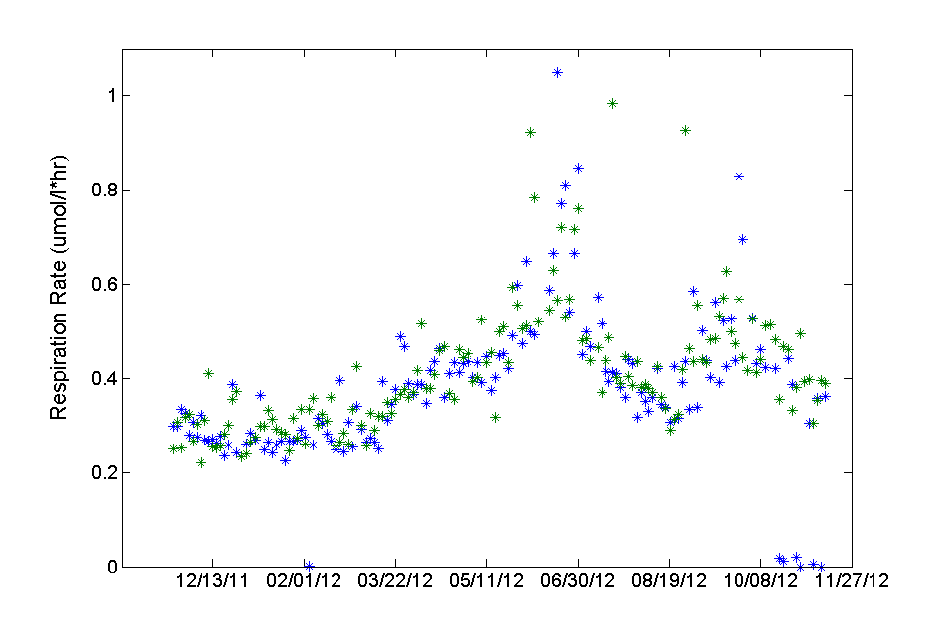
Rover Oxygen Consumption Rates
Stbd
Port
87 Sites visited by
the Rover between 11/11- 6/12

Slide 19
Rover Oxygen Consumption Rates
Stbd
Port

Slide 20
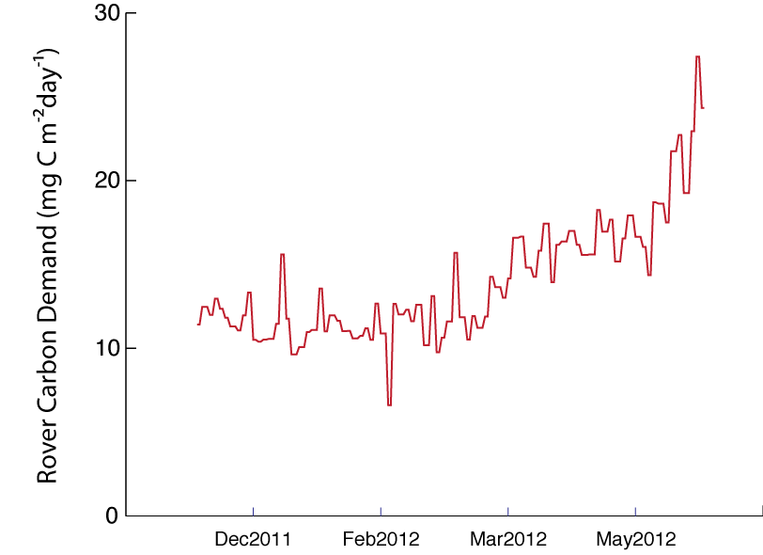
Rover Data: Carbon Demand

Slide 21
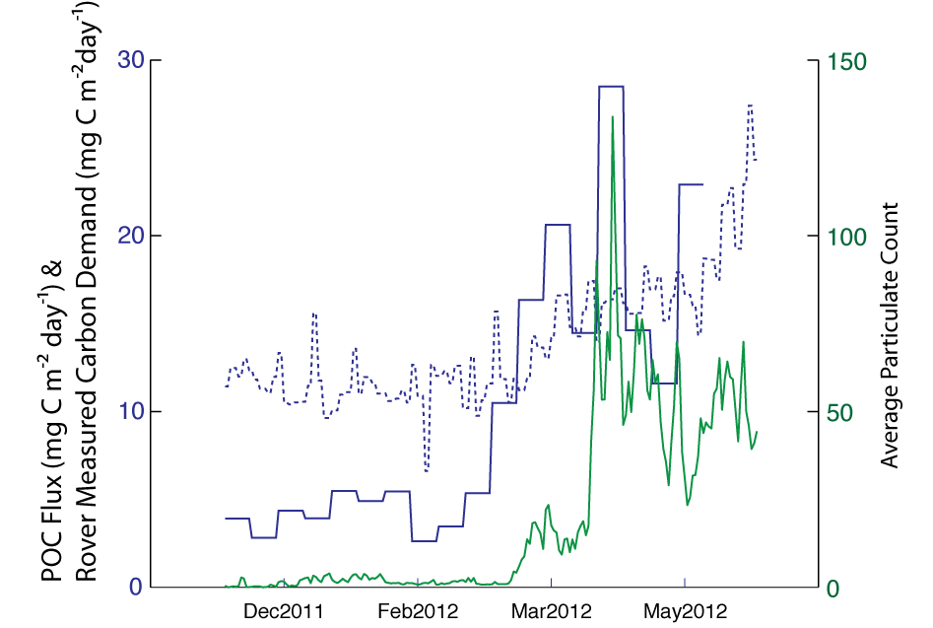
Sediment Trap, Time-Lapse Camera, and Rover Data
Rover
Trap
Camera

Slide 22
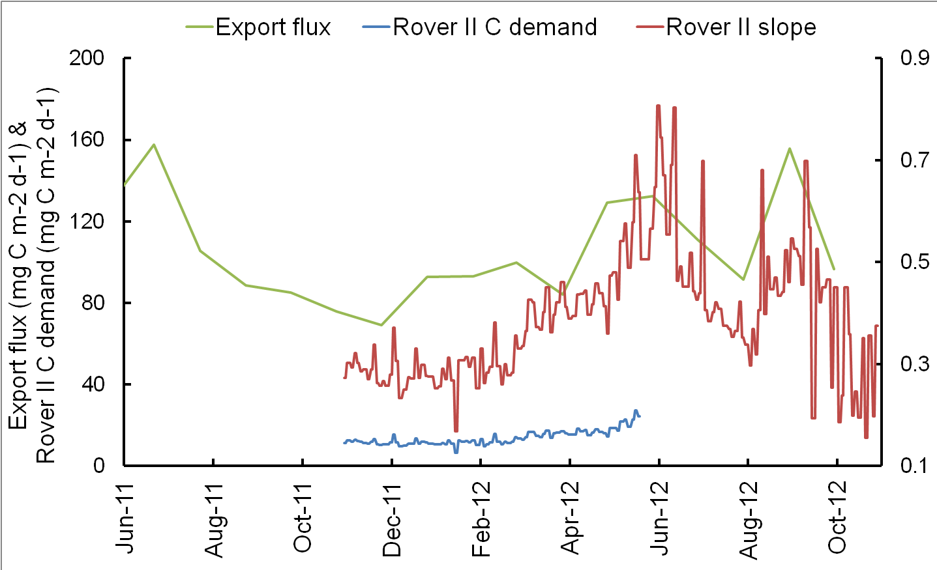
Comparing to Surface Export Flux
Rover Slope (umol O₂ l⁻¹ hr ⁻¹)
Export flux data provided by Mati Kahru, Scripps Institution of Oceanography
Notes:
export flux: sea surface temperature, ocean color, chlorophyll

Slide 23
Conclusions
Continuously monitoring can capture episodic events
A variety of data forms is required to see a more complete picture of event
Time-series data from the benthos matches well with surface water events
Improving duration and resolution of instruments remains a priority

Slide 24
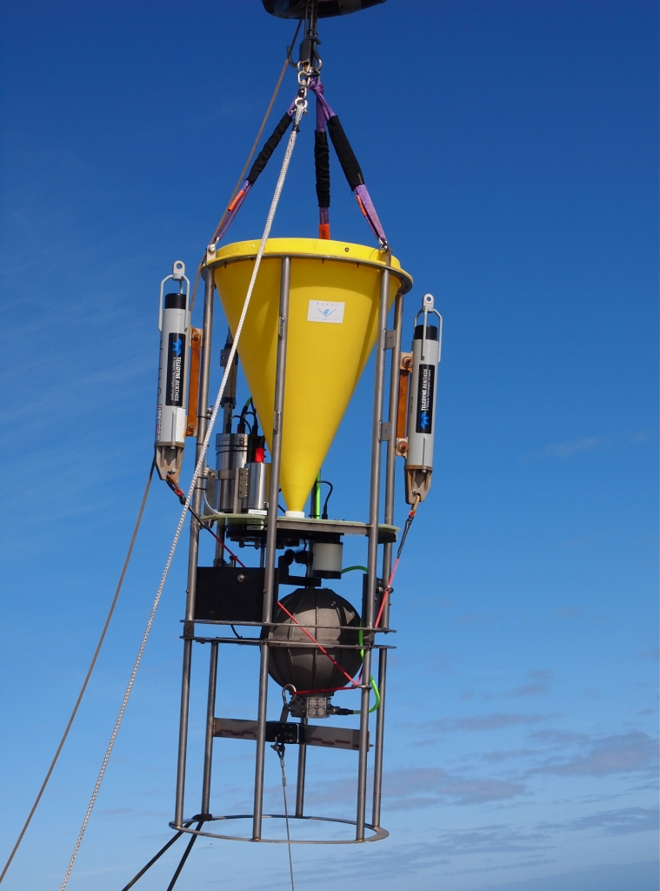
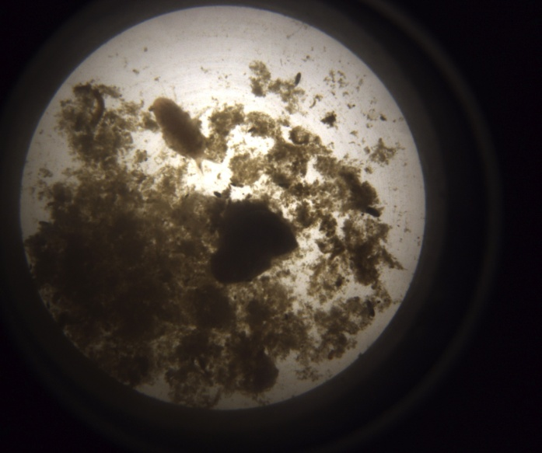
Newest St.M Instrument:
Sedimentation Event Sensor
Ken Smith and Paul McGill
Images and measures fluorescence of accumulated sediment every 12 hours
Photo: C. Buchner

Slide 25
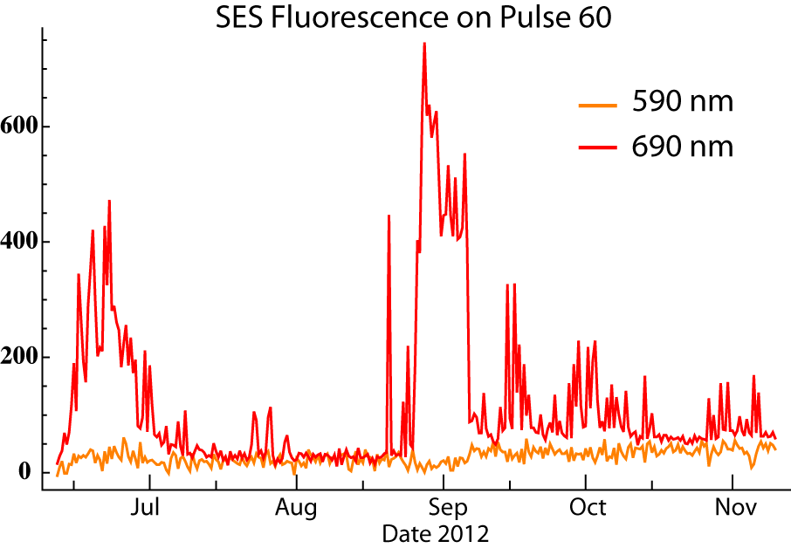
Newest Instrument:
Sedimentation Event Sensor
Fluorescence (PM Counts)

Slide 26
Acknowledgements
Team Rover: Ken Smith, Rich Henthorn, Paul McGill, Brett Hobson, Johnny Ferreira, Tom Marion
Mati Kahru, Henry Ruhl, Jake Ellena, Crew and ROV pilots on the R/V Western Flyer, the National Science Foundation, and the Packard Foundation

Slide 27
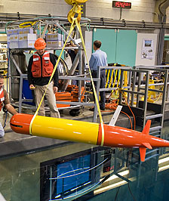
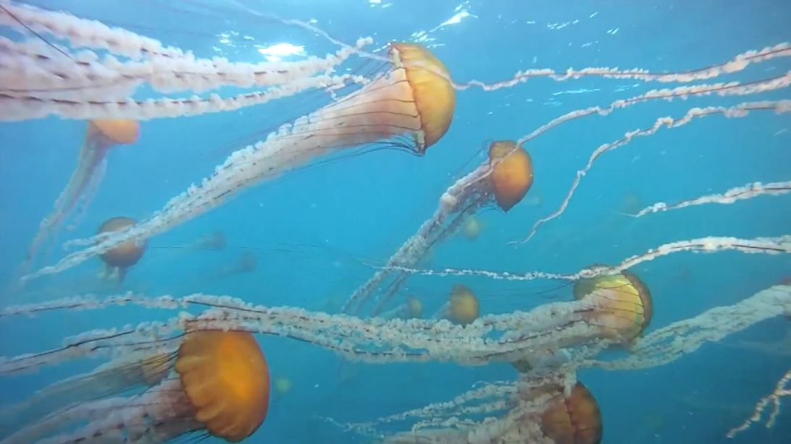
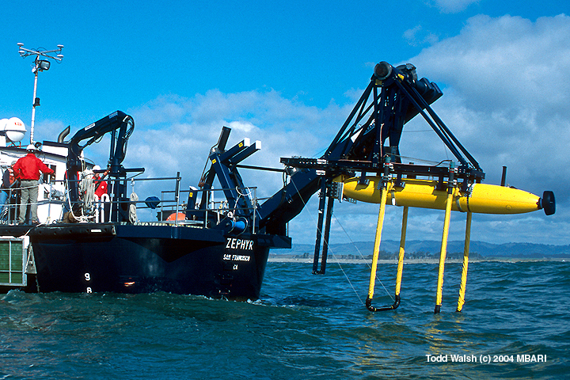
The Challenge of Sensing Episodic Events

