Slide 1
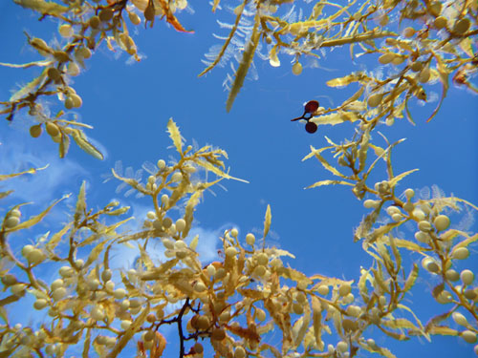
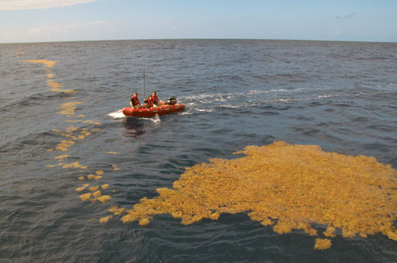

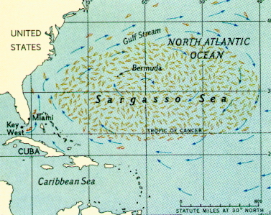
Sargasso paper update

Slide 2
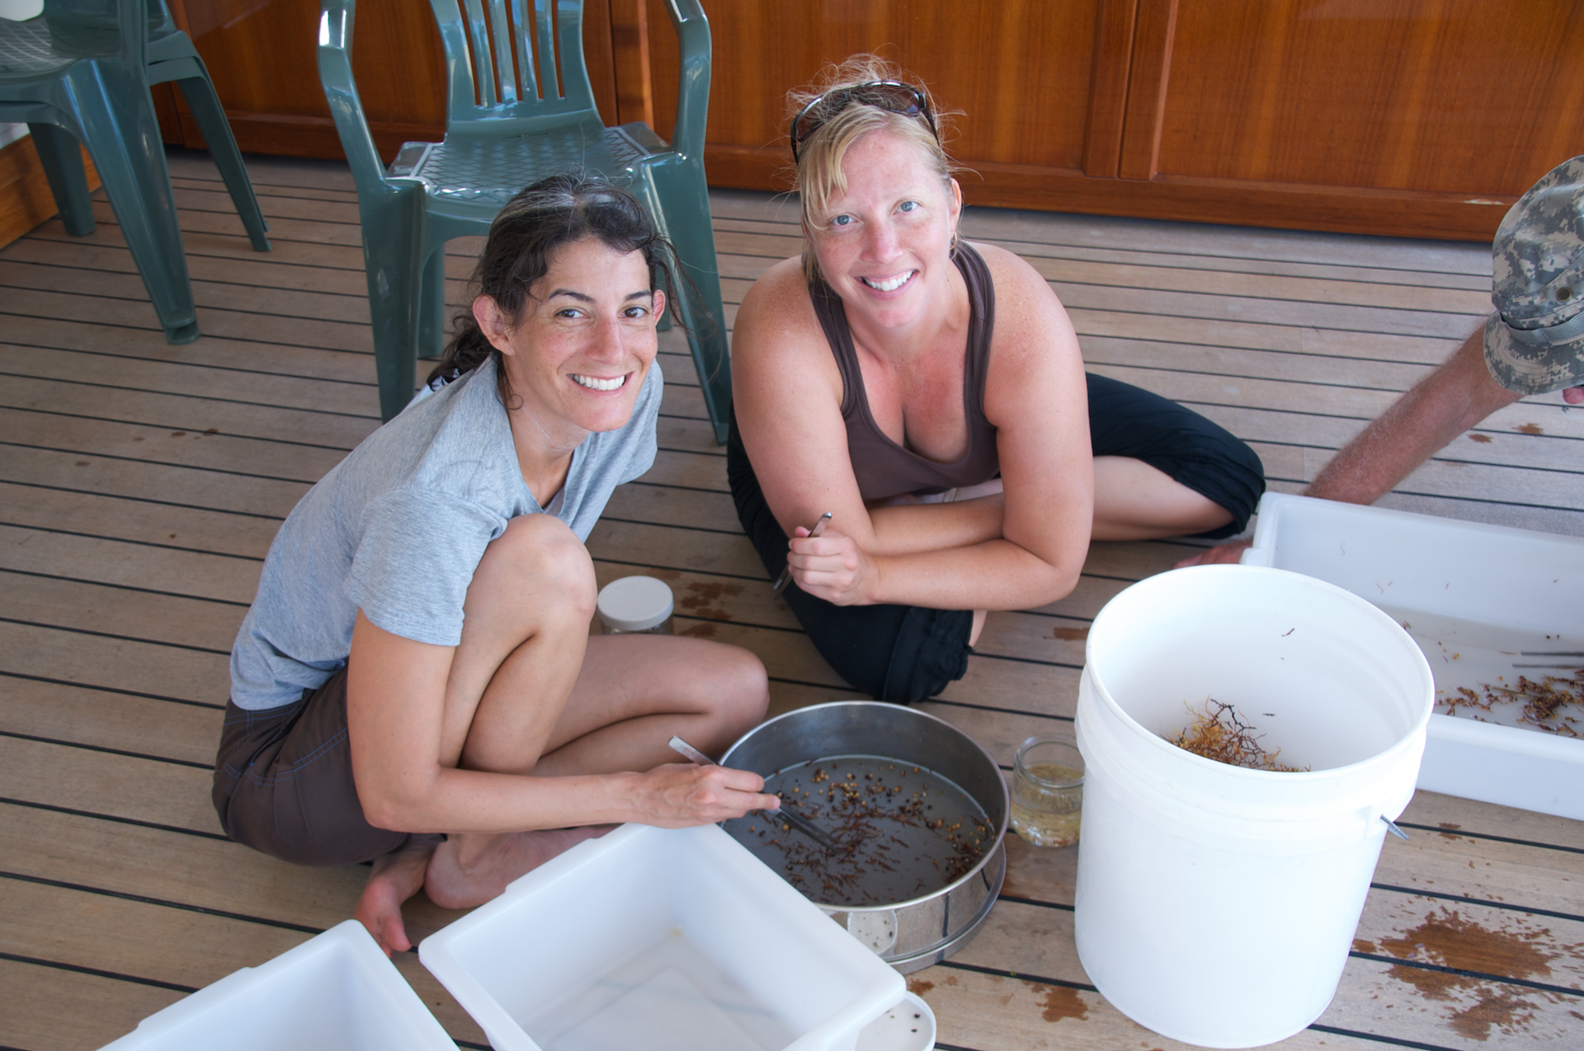
Methods

Slide 3
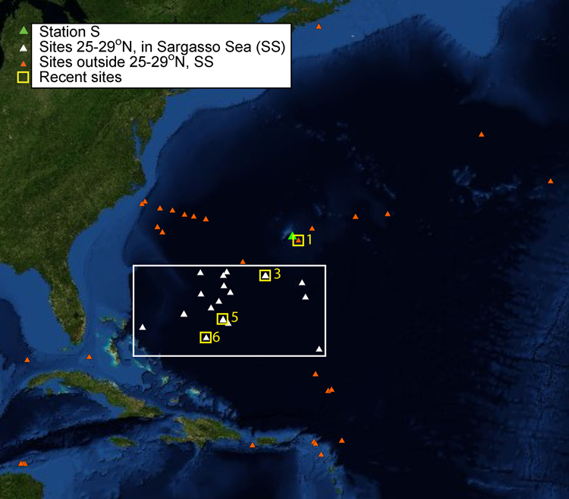
Fig. 1. Study area map: stations of recent surveys (small yellow boxes, stations numbered 1,3,5,6) and historical surveys (including Station S in green). Surveys in the Sargasso Sea, 25º-29ºN, used for direct comparison across time series (white triangles, in larger white box), and additional historical surveys included in broader analysis of all stations (orange triangles). Sea surface temperature and pCO₂ were recorded in the vicinity of Station S.

Slide 4
Analyses
Abundance standardized to 10L
Removed historical samples <70 ml
Diversity (Shannon H’)
Evenness (Pielou’s J′)
Grouped by season, split by latitude group
Multi-dimensional scaling plot to compare community structure

Slide 5
SST, pCO₂
Sea surface temperature at recent survey stations
b) Time series sea surface temperature (black line) and long term trend (red line) collected at 32° N, 64°W, near recent Station 1
c) Summer sea surface temperature (black dots) and long-term trend (red line) at Sta. 1,
d) pCO₂ (black line) and long-term trend (red line) at Sta. 1. Smoothing in b and d was performed using a negative exponential model and 0.7 sampling proportion.

Slide 6
Recent samples- community similarity, diversity,
a) Cluster diagram showing percent similarity between samples. Animal group compositions were more than 48% similar across sampling periods.
b) Shannon diversity by recent cruise date. Station 1 (black dot) lies north of the 25º-29ºN comparison range.
c) Pielou’s evenness index by recent cruise date. Station 1 (black dot) lies north of the 25º-29ºN comparison range.

Slide 7
Recent and historical surveys in Sargasso Sea, between 25º-29Nº
a) MDS of mobile fauna communities, with similarity cluster overlays. Community structures documented in 2011 and 2012 were < 13% similar to any community structure documented at stations visited in this region in 1972 and 1973
b) Shannon diversity (H′ log_{e}) and
c) Pielou’s evenness (J′). All diversity and evenness groups are significantly different from each other based on pairwise Mann-Whitney-U tests.

Slide 8
All sites
MDS of Sargassum-associated mobile fauna community structures documented in all 2011 and 2012 surveys (open shapes, legends designated with an “R”) compared with communities documented in historical surveys conducted between 1966-1975, all ecological groups and latitude groups (both orange and white triangles in Fig 1), labeled by a) ecological group, b) latitude group, C) season, and d) year.

Slide 9
Station S/ Station 1
a) MDS depicting community structures of samples collected from Station S in 1972 and 1973 illustrating seasonal cyclicity.
b) All Station S historical samples for 1971-1974 (n = 41) and recent sample (n = 1) from the nearby Station 1.

