Slide 1
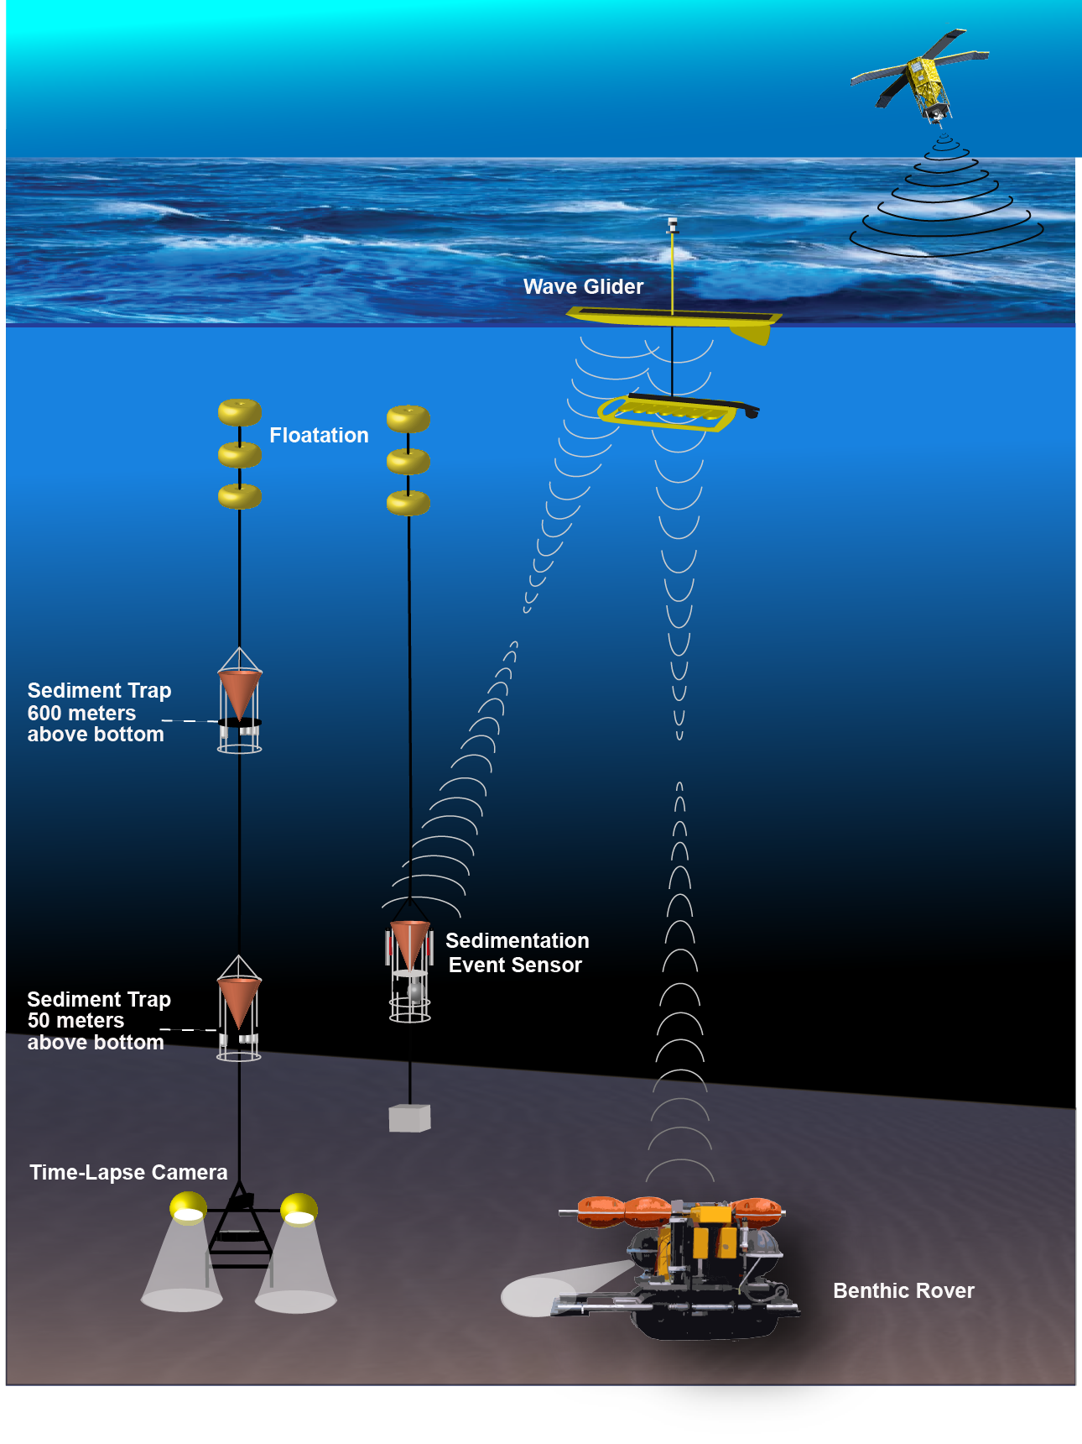
Pelagic-benthic
Coupling--Engineering
Explore options for Wave glider to communicate with Rover and SES.
Service and redeploy Rover and SES
Incorporate stereo camera system into benthic transects
Notes:
Engineering goals: Continue time series measurements. Service Rover for first time on land since initial launch in 2011. Service SES.

Slide 2
Pelagic-benthic
Coupling—Research focus:
Analyze animal sizing tools: Stereo cam, VARS + Tripod, Rover and ROV imagery.
Changes in abyssal animal size, abundance and diversity in response to food supply over time.
Notes:
Conduct an in-depth analysis of animal sizing tools using stereo camera, compared to ROV and tripod image analysis in VARS. Compare animal sizing demographics over time to fluctuations in food supply.

