Slide 1
Q: What processes determine vertical structure & fluxes in the upper water column?
Approach: a) Choose an area which is horizontally homogeneous. b) Monitor vertical transport mechanisms to infer vertical rates. c) Repeatedly measure vertical concentrations of key parameters d) Bound error due to advection & shear

Slide 2
Vertical Transport Mechanisms
Surface wave mixing
  Monitor with wave buoy and ADCP on ESP drifter
Internal Waves
  Monitor with Tethys repeat profiles
Diffusive transport
  Diffusion coefficient from turbulence sensor
  Concentrations from in situ sensors & targeted water sampling
Migration
  Repeat ADCP profiles
  Repeat optical backscatter fluorescence profiles
  Targeted water sampling
Die and sink
  Lagrangian sediment traps

Slide 3
Bounding Horizontal Terms
Attempt to maintain Lagrangian reference via use of drifter (ESP drifter)
Monitor non-Lagrangian performance by dropping STELLA drifters
Monitor shear via ADCP on ESP (up & down looking)
Monitor advective contribution to variability by observing horizontal variability

Slide 4
ESP Drifter
Wave Buoy
Surface Interactions

Slide 5
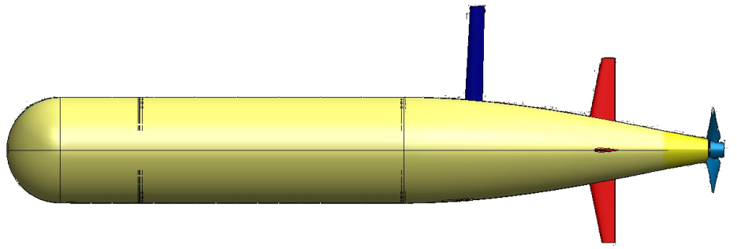
ESP Drifter
Vertical Structure
Daphne LRAUV: Turbulence package derives diffusion coefficient
Tethys LRAUV: Vertical structure, including acoustic backscatter
Lagrangian sediment trap

Slide 6
Bounding Horizontal Terms

Slide 7
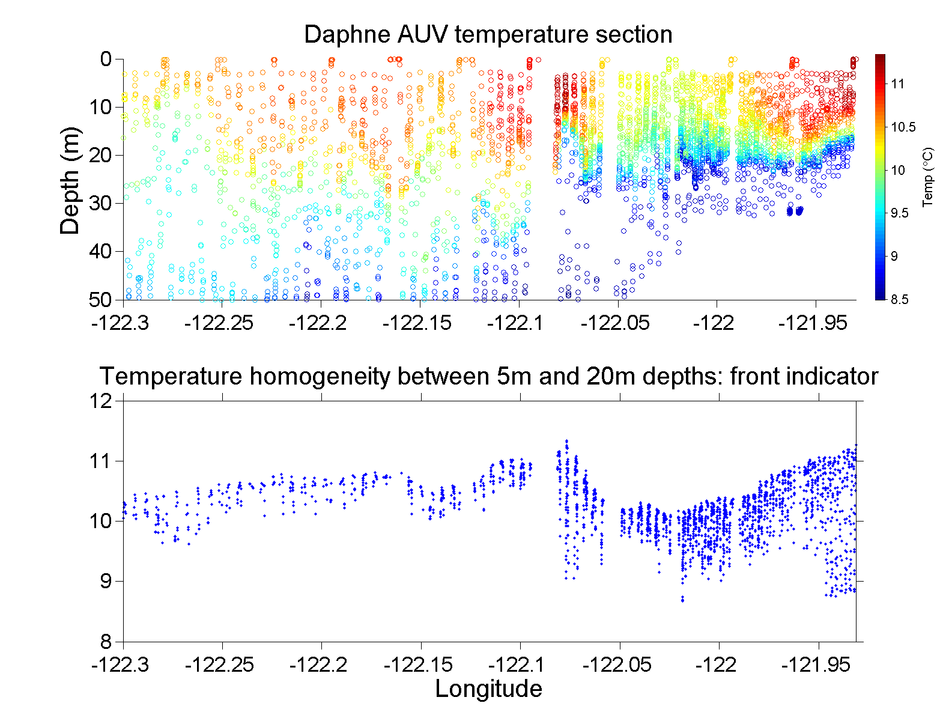
Bounding Horizontal Terms
LRAUV for horizontal gradients and sheer
ADCP for Shear

Slide 8
Bounding Horizontal Terms

Slide 9
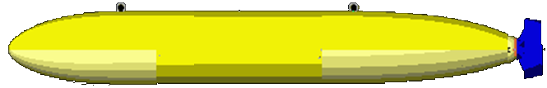
For Lab Analysis
Water Sampling

Slide 10
CANON PI Discussion
Zooplankton?
  EK60? Can it be put on a ship? Issues re integration – no internal recording, high power
  Put on a Stella??
  LISST Holo on Dorado?
  Zephyr/Dorado follow-up needed
  Steve Haddock mentions camera
  Francisco, net tows?
  ADCP backscatter + net tow

Slide 11
Vehicles & Logistics Issues
Daphne
  Daphne w turbulence sensor & reduced range
  Daphne on primaries? What is Daphne power profile w all sensors?
  Need to make sure turbulence sensor works on site (could be trashed during transit)
  Deploy and recover Daphne at sea?
Coordination between platforms
  Collision avoidance
    Give ship ability to track us?
    Display on ship bridge
Two vehicle operations
Need to do:
  Get ADCP backscatter & velocity profiling working
  Turbulence sensor integrated and working
  PAR sensor
  Nitrate on Tethys lowest priority

