Slide 1

Lasers, Lights, and Phytoplankton: Laboratory Calibration of Optical Sensors from Autonomous Underwater Vehicles
Diane Wyse
14 August 2013
Mentor: Dr Jim Bellingham
Monterey Bay Aquarium Research Institute

Slide 2
Outline
Background
Questions
Instruments
Methods
Data and Results
Discussion
Conclusion

Slide 3
Background
Plankton community succession
HABs – understanding community composition…predictive modeling
Sensor calibration
  Why? Laboratory calibration for better analysis of in situ data sets…via organism ID, to inform instrument selection/arrangement for deployments based upon targeted organism or class.

Slide 4
Questions
Can we use bench-top laboratory instruments to ground-truth sensors deployed on autonomous underwater vehicles?
What is the relationship between the instruments? (cells/mL comparison)
Can we identify organism signatures, and if so what are they?
  Using monocultures of phytoplankton grown in a laboratory setting

Slide 5
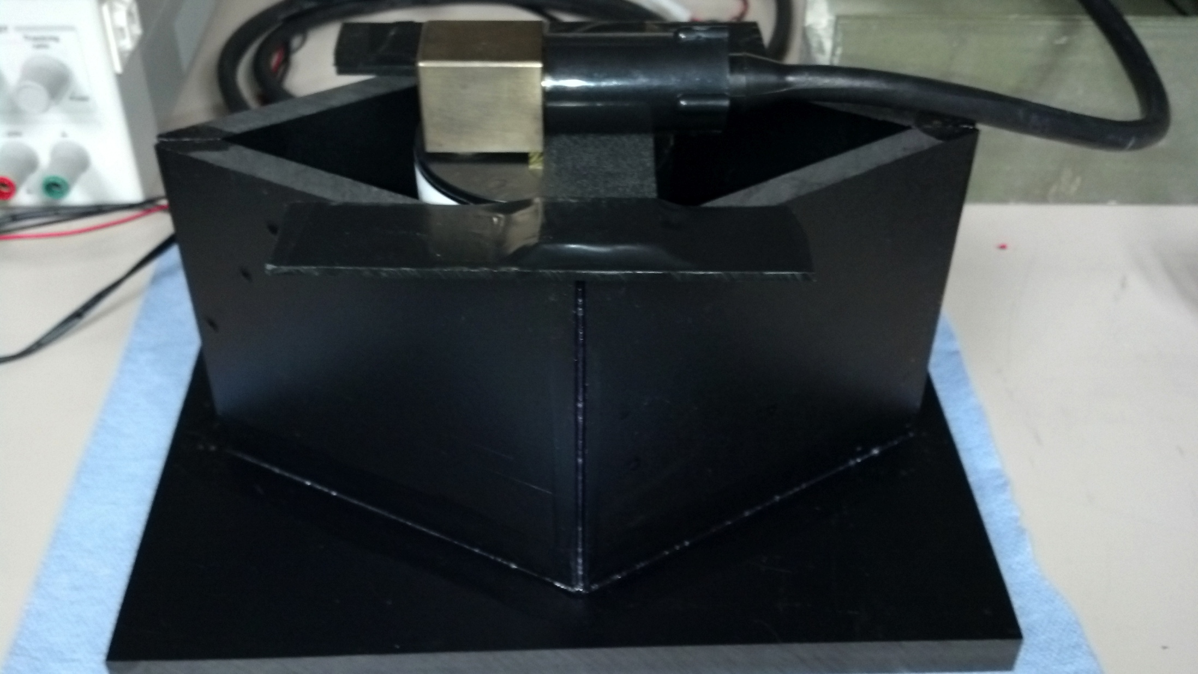
Instruments
ECO puck
10AU Fluorometer
LISST-100X
Accuri flow cytometer
Epifluorescence microscope
Notes:
Image of ECO puck w/bench top set up
Image of AU10 in Live culture rm
LISST-100 bench top set up
Jian’s pic of D & Accuri

Slide 6
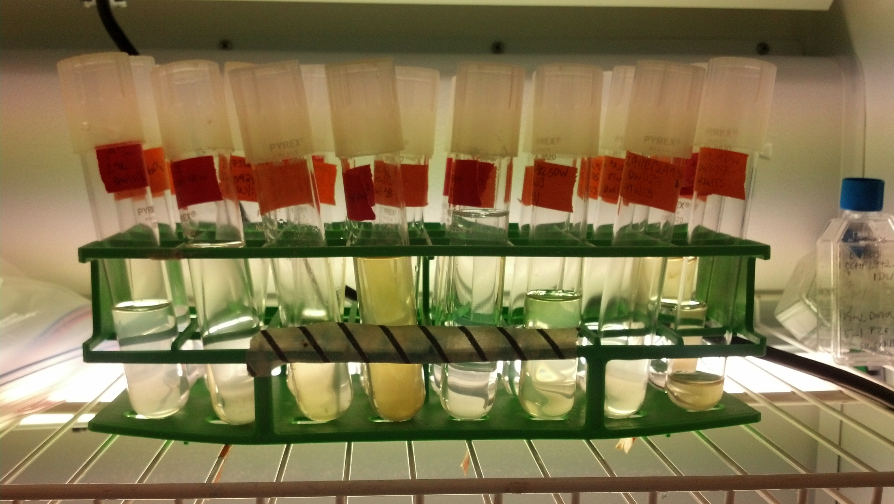
Methods
Raise two species of phytoplankton
  Micromonas sp.
  Heterosigma akashiwo
Run three concentrations of TruCount beads (4.2 um):
  A: 50
  B: 250
  C: 1008
Notes:
Include images of each plankter!
Micrographs for days…

Slide 7
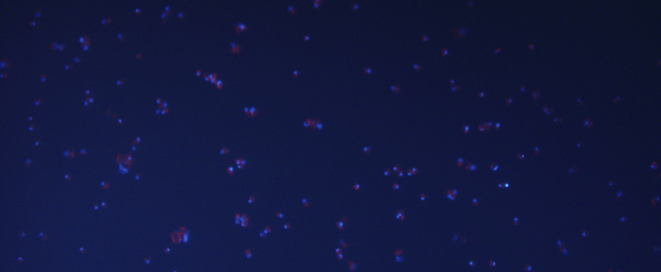
Micromonas sp.

Slide 8
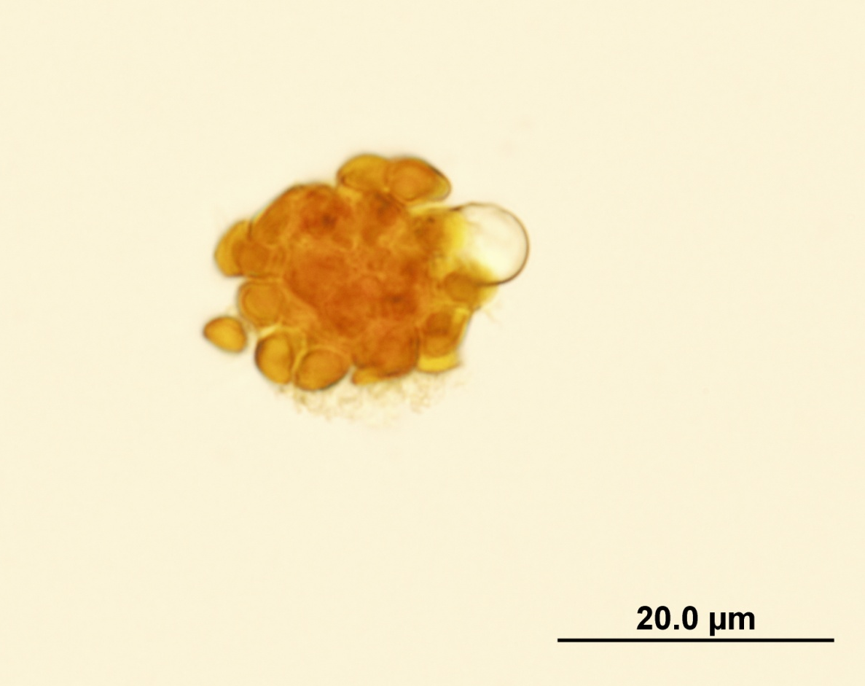
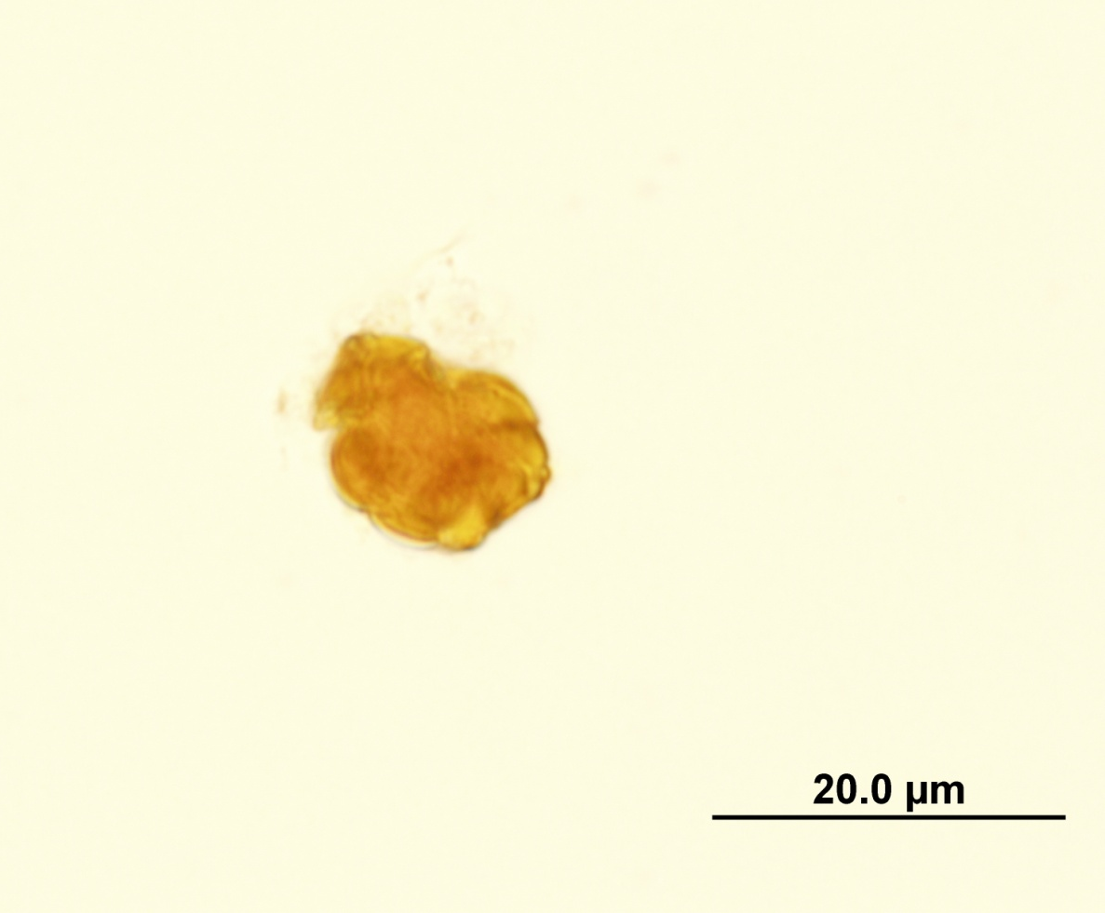

Heterosigma askashiwo
Notes:
Heterosigma: largest cell size of organisms in this study (18-34 um), HAB species – fish-killing—blocks their gills.
For comparison, Psuedo-nitzschia is

Slide 10
Notes:
Include growth curves (fluorometer) of each species?
ECO Puck data plots
LISST-100X: plots of particle size distribution with particle size
Flow cytometer cytograph for Micromonas, TruCount control beads

Slide 13
Notes:
7 Aug TruCount test: 50 uL of TC solution into 500 uL of PBS. Each test run in new fASW. Accuri data for counts on next slide

Slide 14
Notes:
TruCounts in fASW

Slide 15
Data

Slide 16
Data

Slide 18
Notes:
227400 cells/mL

Slide 19
Accuri Data for TruCounts
Plot 1 | (FSC-A/SSC-A)
All
Count | Volume (µL) | Events / µL
49 | 10 | 5
190 | 10 | 19
680 | 10 | 68
Notes:
6 Aug data for samples run on LISST-100 in 7 Aug

Slide 20
Discussion
Organism ID & instrument resolution
What sensors should we put on the vehicle?

Slide 21
Conclusion
Defined methods for laboratory sensor calibration relating fluorescence, particle size distributions, and cell concentration for organisms from 1-250 um

Slide 22
What’s Next
Test other organisms, including HAB species – Pseudonitzschia australis?
Applications in organism signature ID
  Develop an algorithm to ID organisms within in situ datasets…what steps to take

Slide 23


Acknowledgements
Jim Bellingham
George Matsumoto
Erika McPhee-Shaw
Sebastian Sudek
Thomas Hoover
Denis Klimov
John Ryan
Brian Kieft
Linda Kuhnz
2013 Summer Interns

