Slide 1
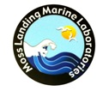

Through the Looking Glass:
A Comparison of Holographic and Molecular Detection of Plankton
Heather Fulton-Bennett

Slide 2
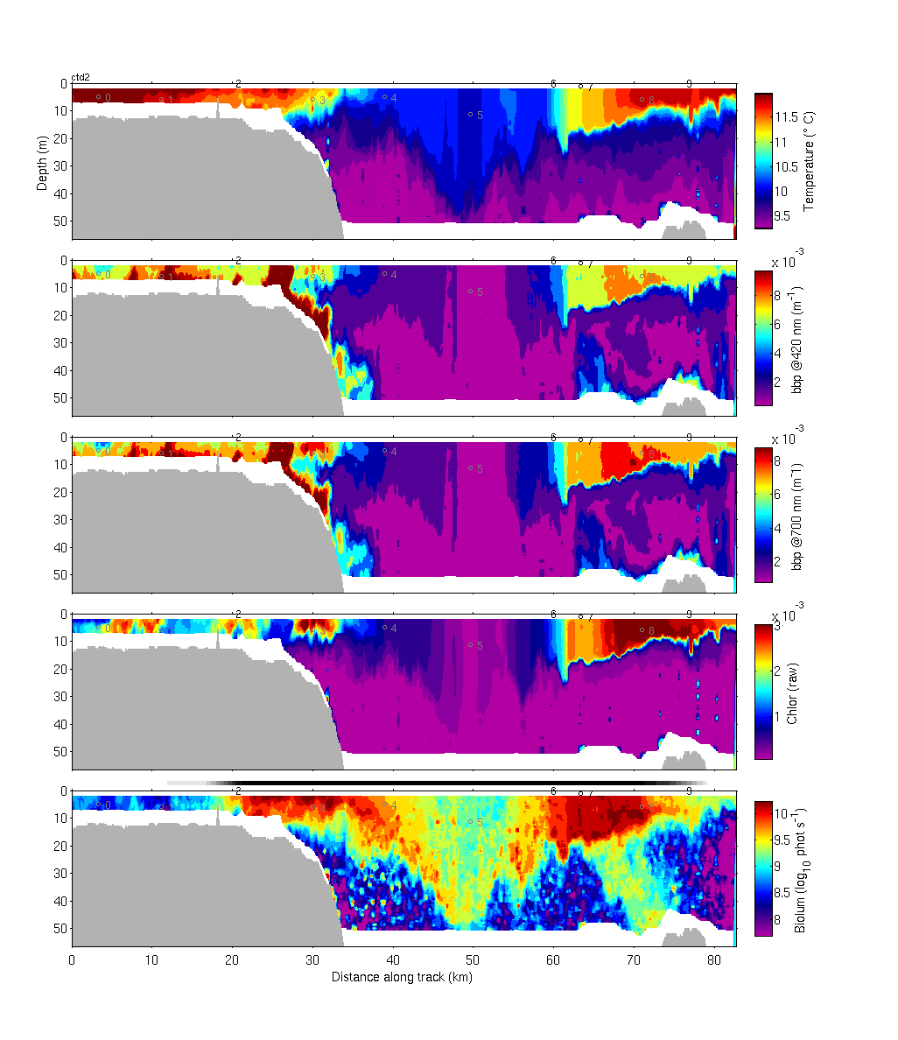
Introduction
Monitoring of plankton communities is increasingly important
AUV expeditions monitor areas of interest with biological, chemical, and physical sensors
Plankton sensing systems: fluorometers, LOPC, LISST-100x, LISST-HOLO, etc…
2009 AUV Field Campaign
03/25/2009 14:51 to 03/26/2009 09:18 PDT
Notes:
Development of communities in fronts/upwelling, HAB monitoring, larval recruitment, ocean acidification, climate change
Plankton sensors look for signatures, but what are they actually seeing? This is where the HOLO comes in
Plots: Temperature, backscatter at 420nm, backscatter at 700 nm, chlorophyll, bioluminescence

Slide 3
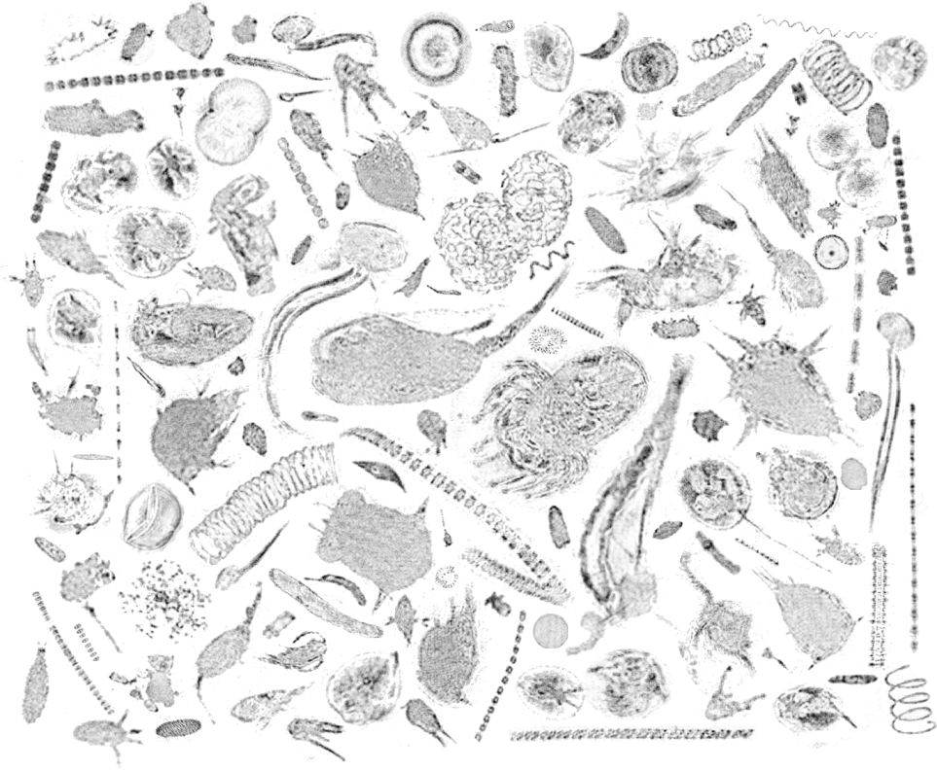
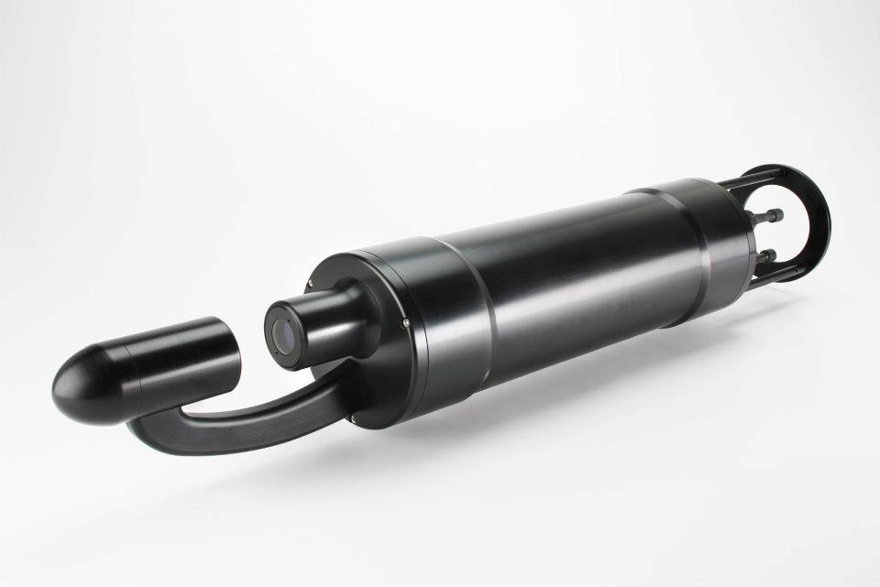
LISST-HOLO – Laser in situ scattering and transmissivity holographic system
Dorado AUV platform
Flow through system paired with the LOPC
Output statistics on particle dimensions, counts, as well as particle images
Sequoia Scientific
John Ryan/MBARI 2011
Notes:
image banks for better taxonomic analysis, more detailed particle statistics (major+minor axes, particle area+volume, numbers of particles in size classes.
Images give depth through holograph, location in holograph
Sampling rate 0.2 Hz constantly, or faster burst modes, but lags in sampling due to time for storage
Solid state laser diode @ 658 nm
2 MB hologram size
Sampling volume 1.86 cm3
Max current velocity 0.4 m/s

Slide 4
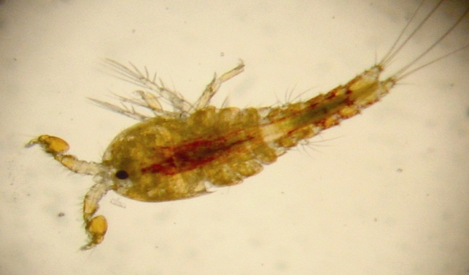
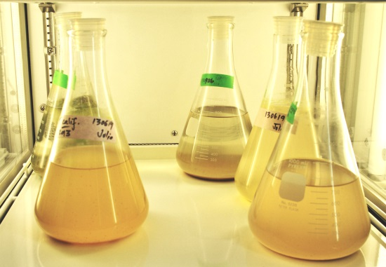
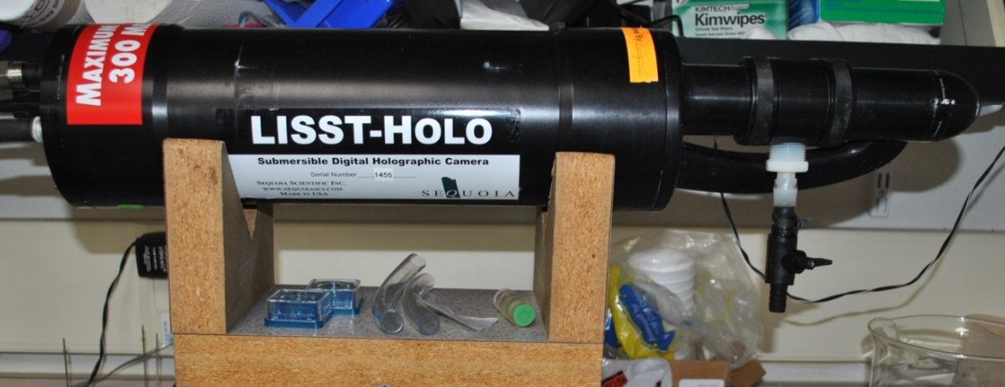
Experimental Set Up
Test organism: Tigriopus californicus (intertidal copepod)
Isolates of pre-determined numbers of organisms
Each sample in the chamber for 3 minutes, then captured on a filter
Stored in liquid
nitrogen for
further analysis
Coldwater Marine Aquatics
Heather Fulton-Bennett/MBARI 2013
Notes:
Intertidal harpacticoid copepod, very hardy in culture – keep this in mind for behavioral issues
Isolated from monospecific culture, on 80um filter using a dissecting microscope
3 min sample time in chamber, water motion with gentle pipetting, captured on 60um nylon mesh filter
Chamber rinsed with 3 washes of FSW to keep samples independent – issues with this discussed later, from controls to highest concentrations to decrease affects of any contamination
While a flow through system would be ideal, the experimental set ups tried this summer failed to provide reliable or consistent copepods detections. Especially without ripples interfereing

Slide 5
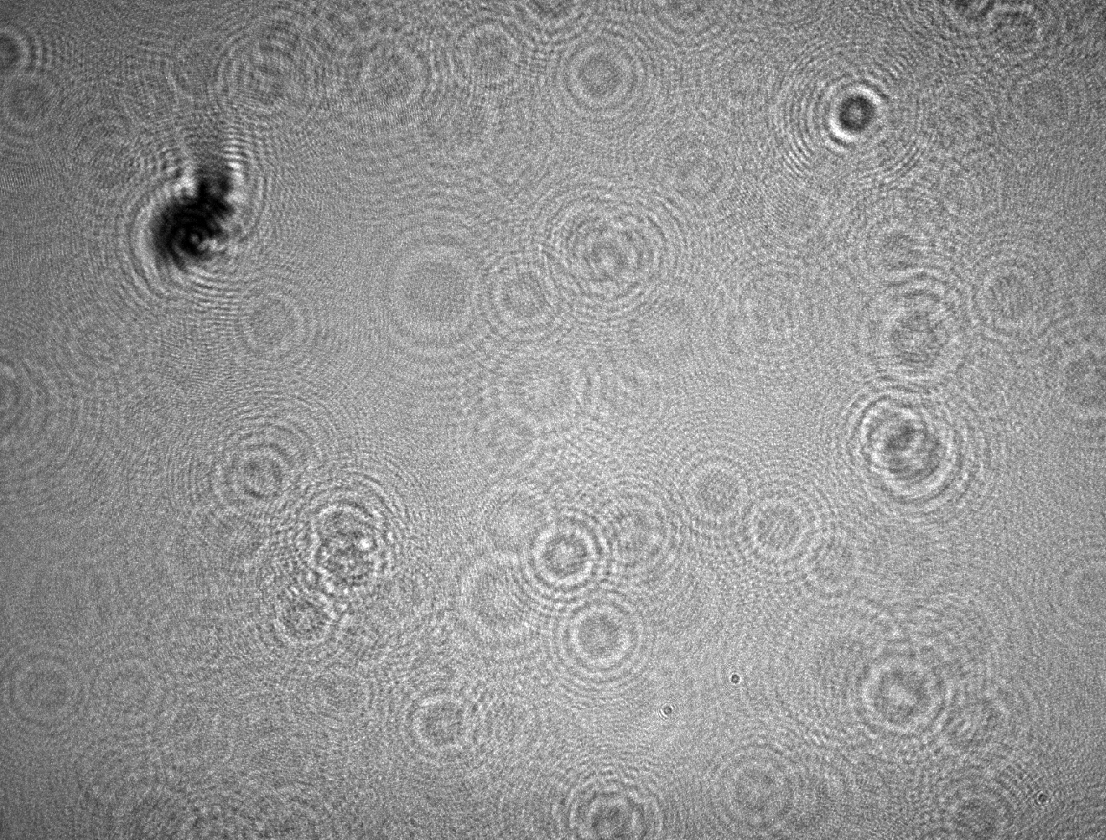
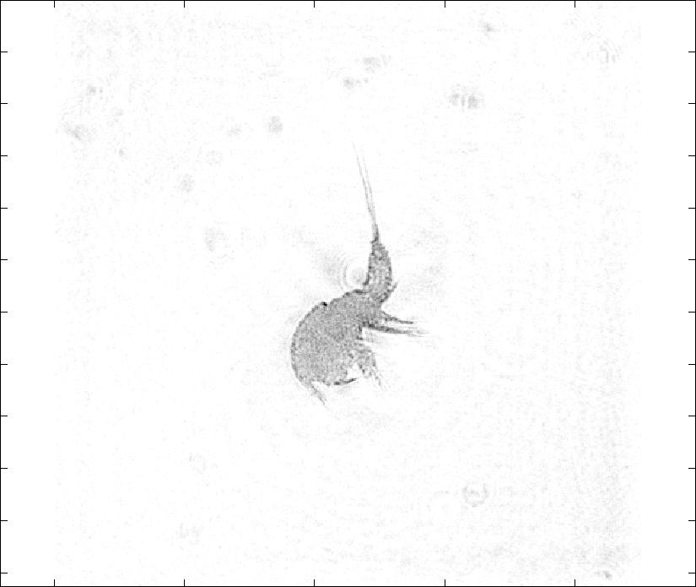
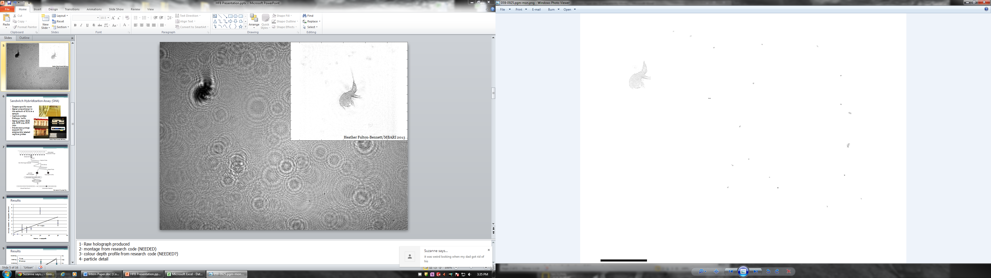
Heather Fulton-Bennett/MBARI 2013
1000 µm
Notes:
1- Raw holograph produced
2- montage from research code
4- particle detail

Slide 6

Notes:
Jim Bellingham
Steps through a raw output holograph, particle comes into focus partway through the slices

Slide 7
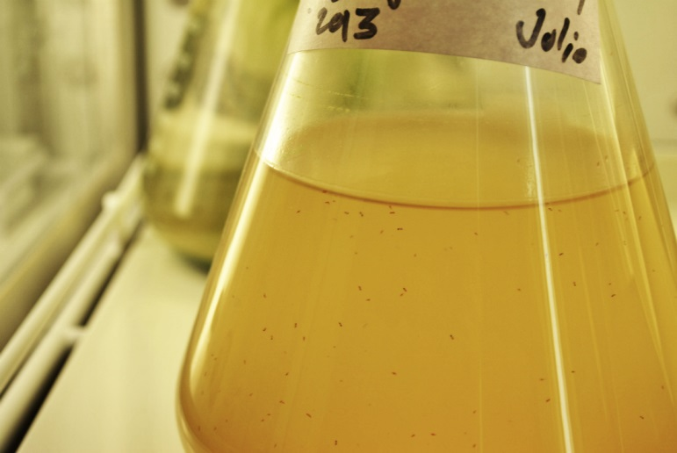
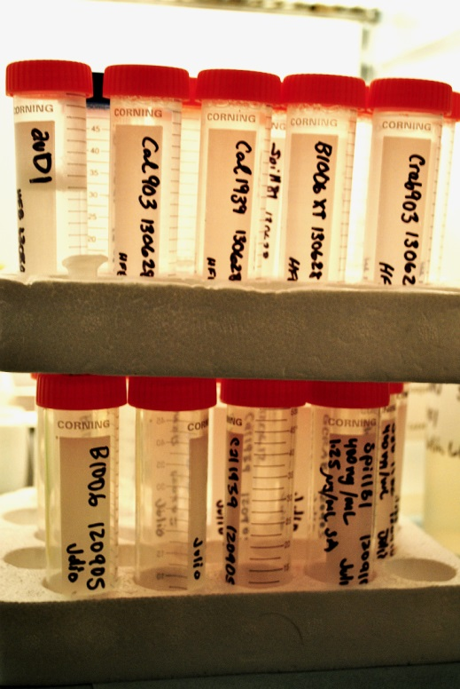
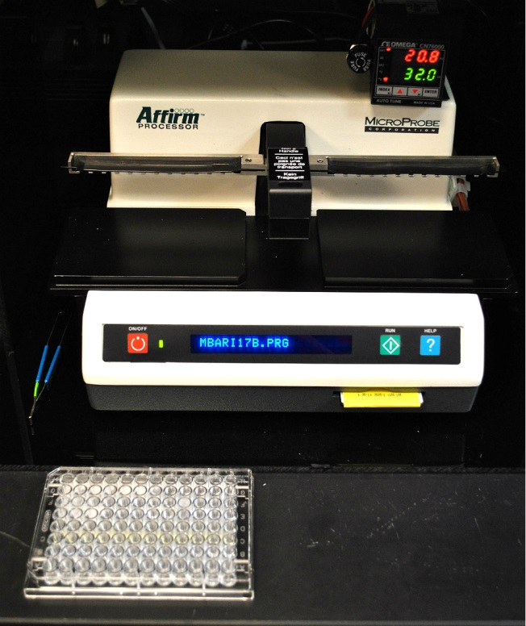
Sandwich Hybridization Assay (SHA)
Targets specific taxon e.g. podoplead copepods
Signal proportional to the amount of RNA in a sample
Capture probes:
  Pod1951
  AuD1
Signal probes:
  EUK 519, EUK 915, EUK 1194,
  PsDs TRD
Heather Fulton-Bennett/MBARI 2013
Notes:
RNA in a sample can be confused because juveniles or newer have amounts of RNA for their size than larger “fat and happy” copepods (see work by Vrijenhoek’s intern from last summer)
A single, relatively “fresh” culture was used for this experiment, so shouldn’t be much variation due to different sized/aged individuals

Slide 8
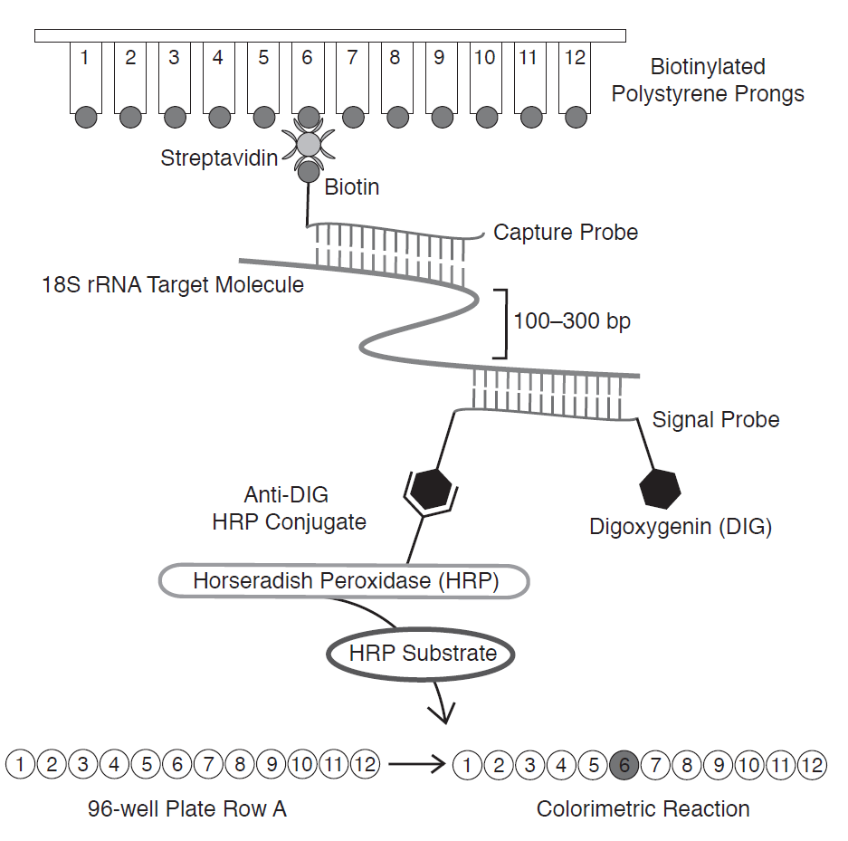
Harvey et al in press Fig. 1
Notes:
Capture probe used to isolate the rRNA of the specific taxa while the signal probe binds to a more general part of the rRNA and produces the colorimetric reaction that is read to give the signal

Slide 9
HOLO Results
Notes:
Detected vs. Actual copepods – variable, but I suspect this relationship would improve with more replicates and more consistent sampling techniques
Increase is fairly clear, but low number of replicates (3)
Average Detection rate: 9.8%
This isn’t too bad since the sample chamber is only 4% of the sample volume
For 50 evenly distributed, non-moving particles, should only pick up 2
50 picked as highest concentration as 1/mL is a very high naturally occurring concentration

Slide 10
Results
Notes:
Relationship between area, copepods and SHA, copepods – very similar, yay!
Possible leveling off of signal and area detected at higher levels, but likely and artifact

Slide 11
Results
Notes:
Actual copepods filtered – almost identical R^2 to number of copepods in sample, but steeper slope due to slightly lower numbers on filter

Slide 12
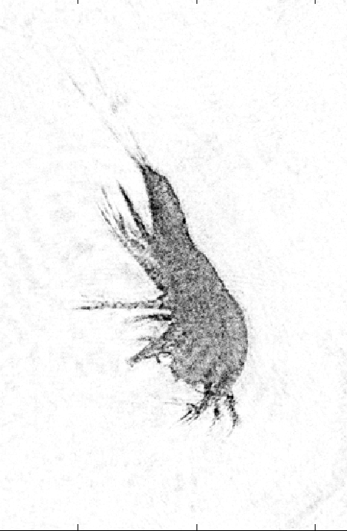
Conclusions
Strong correlation between copepods detected by the LISST-HOLO and SHA analyses
Strong correlation between known numbers of copepods and their HOLO and SHA signals
Low percentage of copepods detected
LISST-HOLO is useful for plankton imaging, but is likely under-sampling communities
Manufacturers software package requires careful use of settings to produce results comparable hand processing of holographs
Heather Fulton-Bennett/MBARI 2013

Slide 13
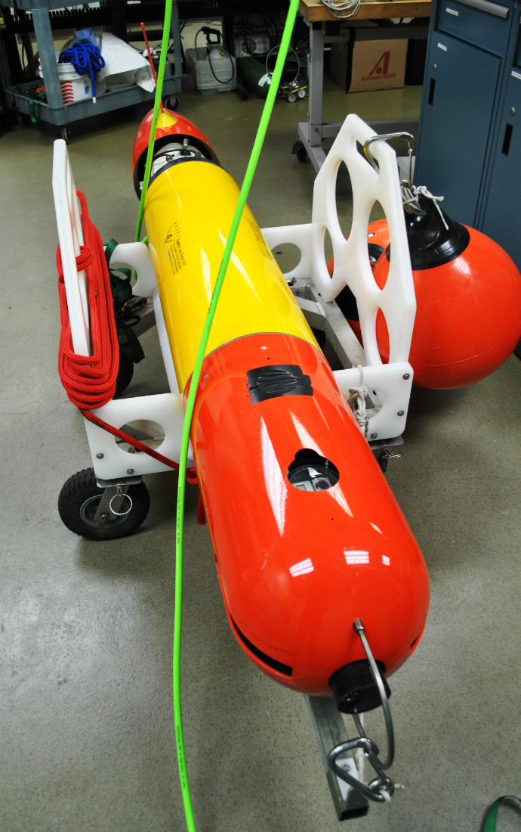
Further Work
Develop laboratory flow-through system to better mimic in situ AUV collection data
Explore detection of other zooplankton, phytoplankton, and mixed communities for instrument optimization
Compare results with LISST-100x system
Compare LISST-HOLO with other holographic imaging systems
Potential use on long range AUVs
Heather Fulton-Bennett/MBARI 2013
Notes:
Plenty of other ideas for future bench top use of this instrument –
Consistently light or dark sampling chamber so as to eliminate behavioral bias in copepods
Use on LR-AUVs with decreased housing size and weight – replace gulper samples in taxonomic analysis of plankton community

Slide 14

Acknowledgements
Drew Gashler Scholarship –
  The Gashler Family and Friends of Moss Landing Marine Labs
Jim Bellingham
Julio Harvey
John Ryan
Thomas Hoover, Elif Demir-Hilton, Danelle Cline
George Matsumoto, Linda Kunhz, and the fabulous MBARI Interns
Notes:
Thomas and the LR-AUV Lab
Elif and the Scholin Lab
Vrijenhoek Lab

Slide 15
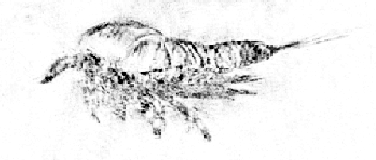
Questions?

