Slide 1
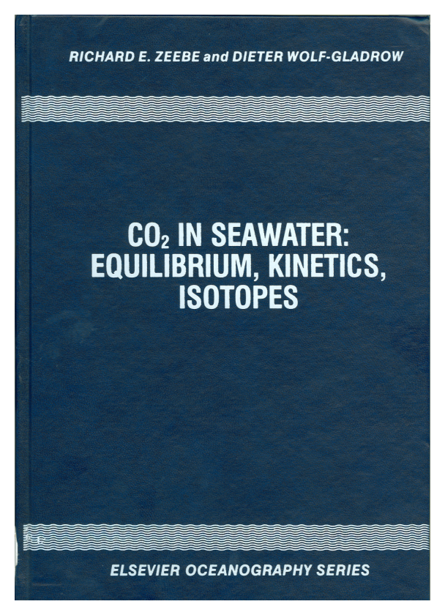
Zeebe & Wolf-Gladrow Model (2001)
dpFOCE
k
-
+
1
H
C
O
+
H
+
C
O
+
H
O
2
2
k
3
-
1
k
-
C
O
+
O
H
-
+
4
H
C
O
2
k
3
-
4
Note: reaction kinetics are a function of both CO₂ and pH.
While, the effect of pressure on the equilibrium constants can be calculated (see Z&W-G appendix A.11), the effect on the reaction kinetics is largely unknown.
F Appendix C.7:
e-Folding time
Linear differential equation:
d
(
δ
C
O
)
1
2
=
-
δ
C
O
d
t
τ
2

Slide 2
Implementing the Zeebe- Wolf-Gladrow kinetic model – T and pH dependency
The model yields a highly non-linear curve with very strong pH dependency. The reaction is quasi-autocatalytic in that as pH drops the reaction goes faster. Normal sea water is near the peak and in a very steeply sloping region.
For warm surface water (coral reef) experiments a residence time in the perturbation area of about 2 minutes is required for significant equilibration. Cold, deep waters are lower pH and the residence times are longer.

Slide 3
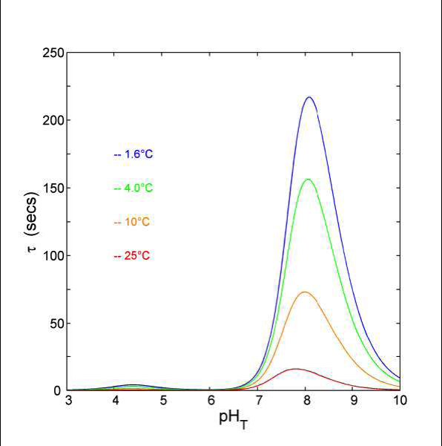
Implementing the kinetic model – T and pH dependent
The model yields a highly non-linear curve with very strong pH dependency. The reaction is quasi-autocatalytic in that as pH drops the reaction goes faster. Normal sea water is near the peak and in a very steeply sloping region.
For warm surface water (coral reef) experiments a residence time in the perturbation area of about 2 minutes is required for significant equilibration. Cold, deep waters are lower pH and the residence times are longer.

Slide 4
Specific example of the time required for CO2 hydration to occur: the figure illustrates the time for a 0.3 pH offset for deep-sea water at various temperatures and pressures. The result for the e-folding time ranges from about 15 seconds at 25ºC and the surface to 97 seconds at 900m and 4ºC.

Slide 5
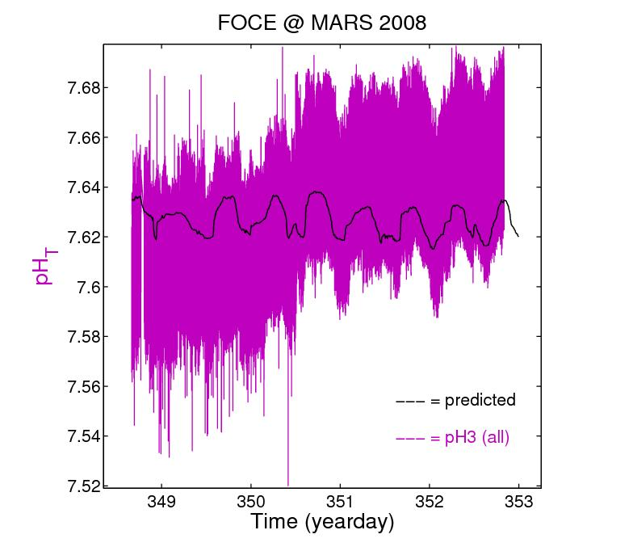
Results – Analog Sensor
Electrical interaction with other instruments and thruster motor.
Too noisy to observe background pH or for precise CO₂ control.
pH sensor would go to the ‘rail’ at times
Notes:
The new design was able to discern the tidally driven pH signal.
The MARS observatory connection enables ‘real time’ data analysis and experiment control.
In-situ calibration by offset adjustment could be made at the peak of the pH tidal cycle
Note: Vertical bars are in-situ calibration points
Data is intentional offset by 0.25

Slide 6
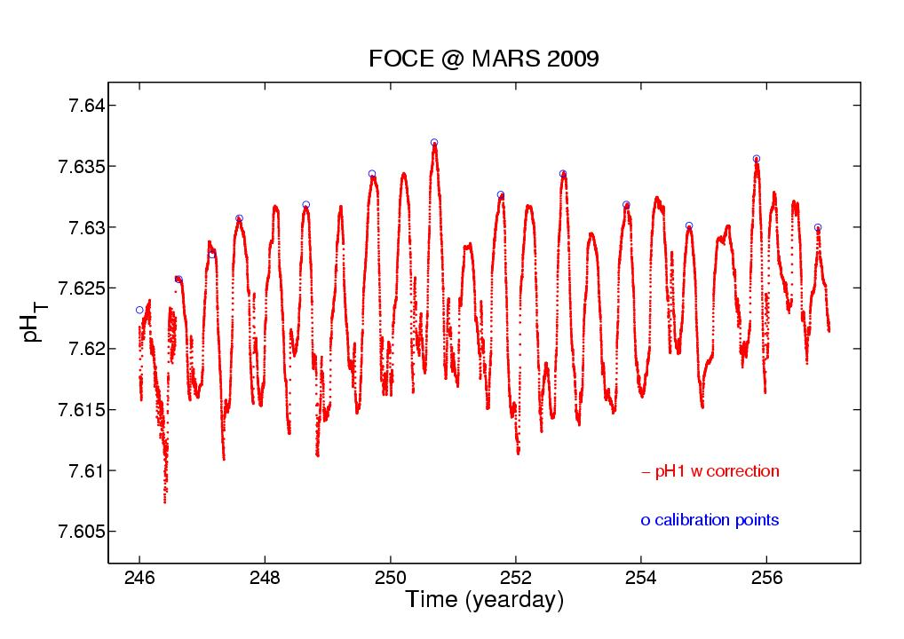
Digital pH sensor corrected
Notes:
The new design was able to discern the tidally driven pH signal.
The MARS observatory connection enables ‘real time’ data analysis and experiment control.
In-situ calibration by offset adjustment could be made at the peak of the pH tidal cycle
Note: Vertical bars are in-situ calibration points
Data is intentional offset by 0.25

Slide 7
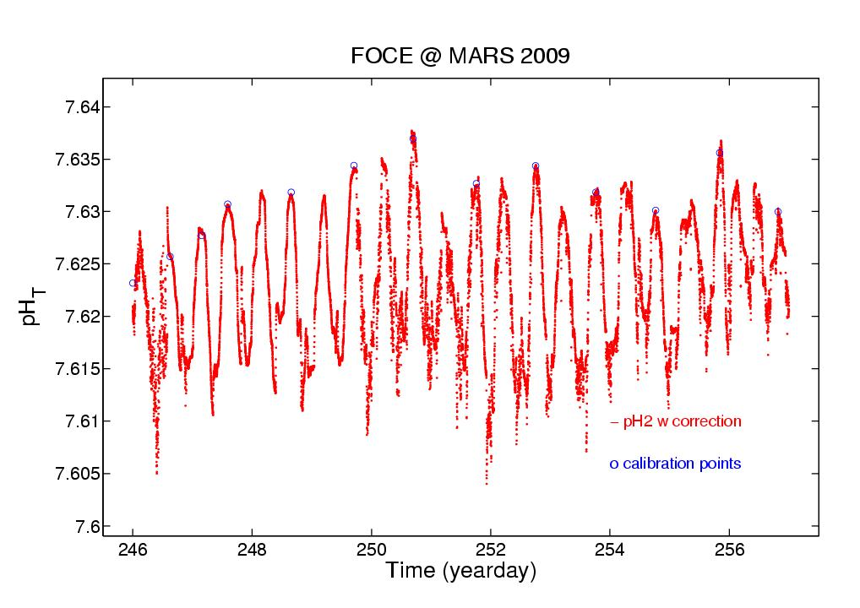
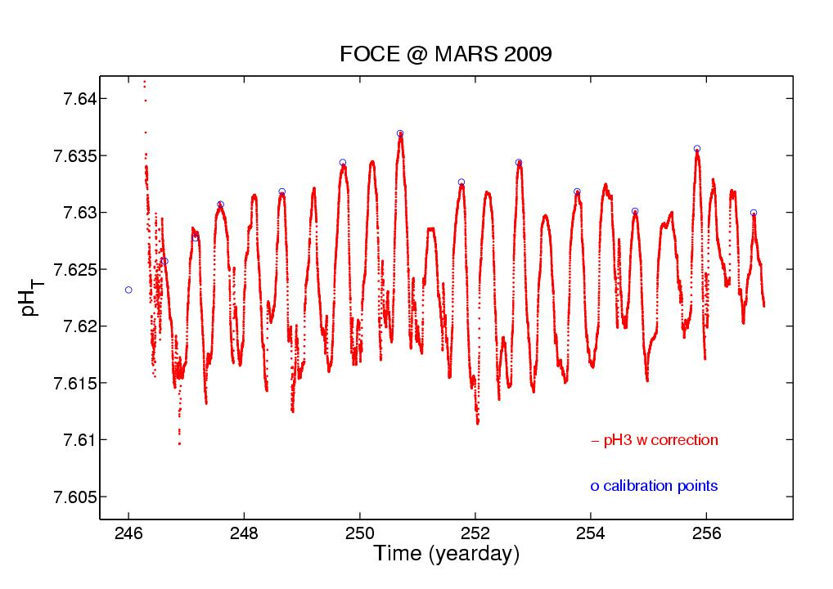
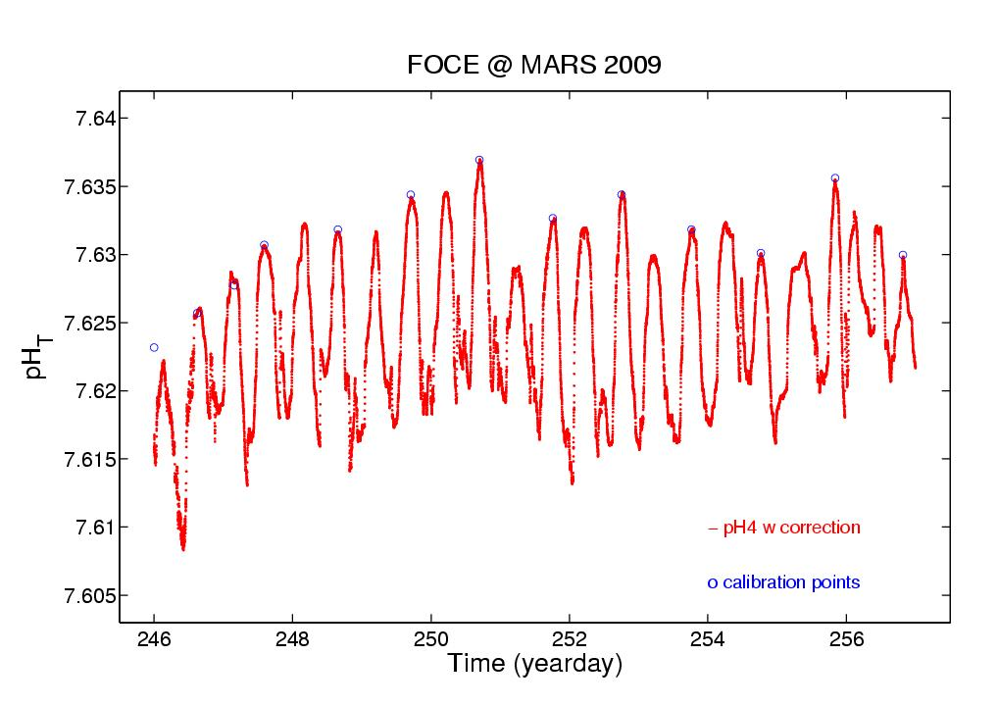
Consistency

Slide 8
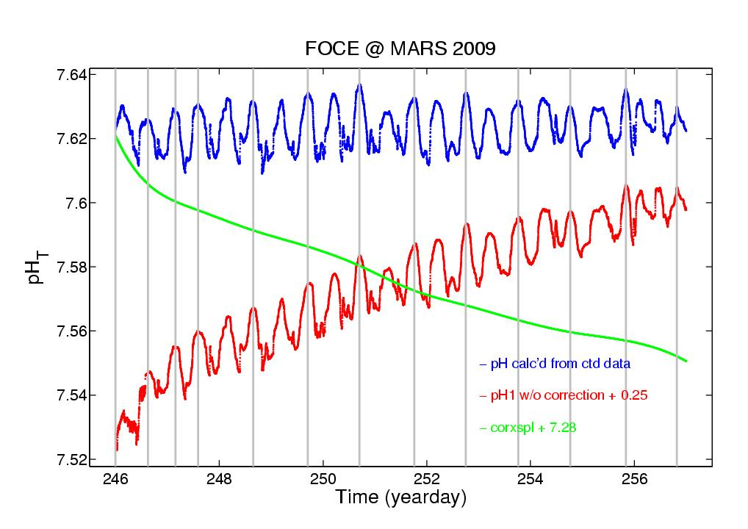
Digital pH sensor
Uncorrected Digital pH plotted against WOCE data
Digital pH sensor from installation showing the KCl buffer normalization as the sensor settles and approaches being asymptotic with the known background
Notes:
The new design was able to discern the tidally driven pH signal.
The MARS observatory connection enables ‘real time’ data analysis and experiment control.
In-situ calibration by offset adjustment could be made at the peak of the pH tidal cycle
Note: Vertical bars are in-situ calibration points
Data is intentional offset by 0.25

Slide 9
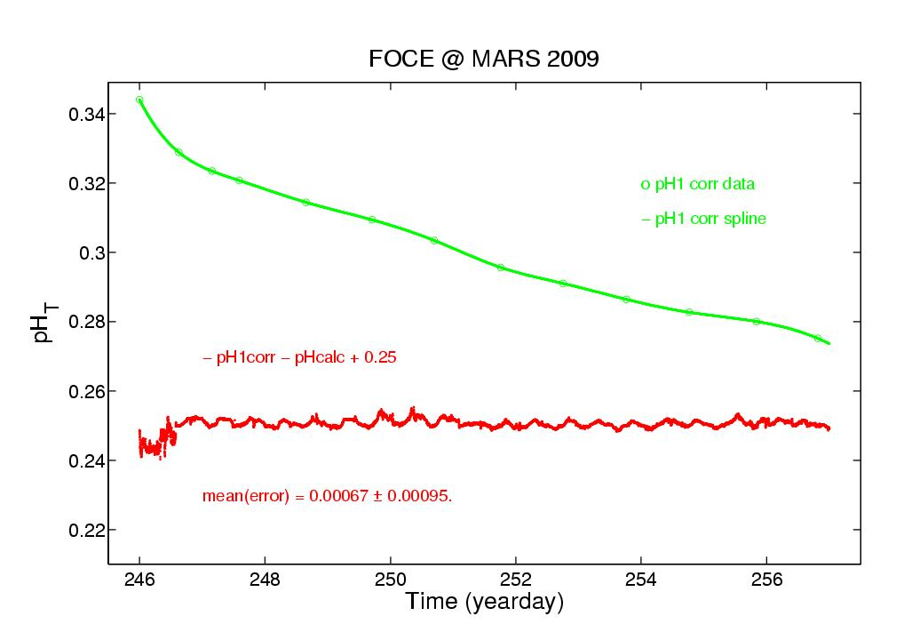
Predicted vs In-Situ Corrected
New isolation and digitization demonstrating improved performance

Slide 10
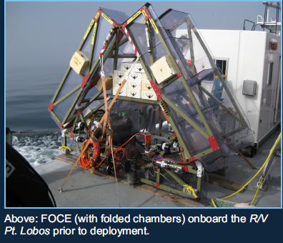
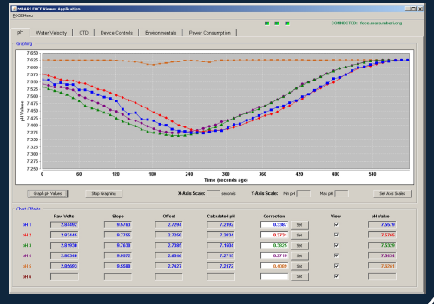
Our experience with the deep FOCE system at 850m depth:
Long arms to allow time for CO2 hydration to occur, slow flow rates through the system, sensing of external pH variations and feedback control to set a constant ΔpH offset, and control by a GUI via an ethernet link enabling at-home monitoring and adjustments. Video imaging in real time of the central experiment chamber.

Slide 11
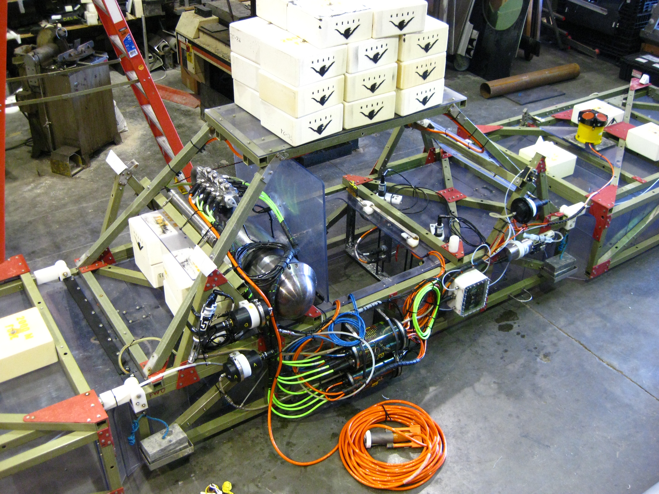
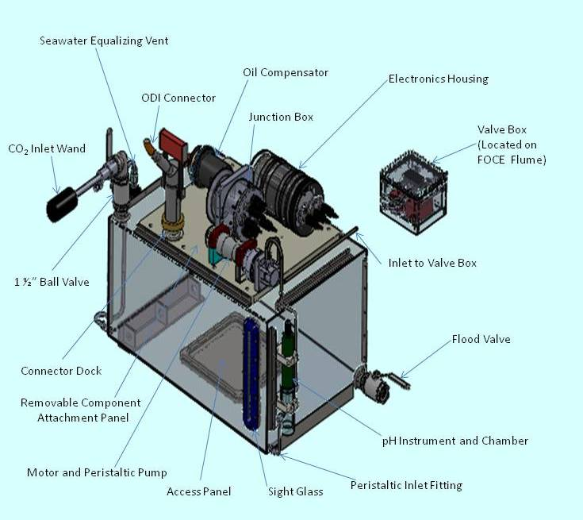

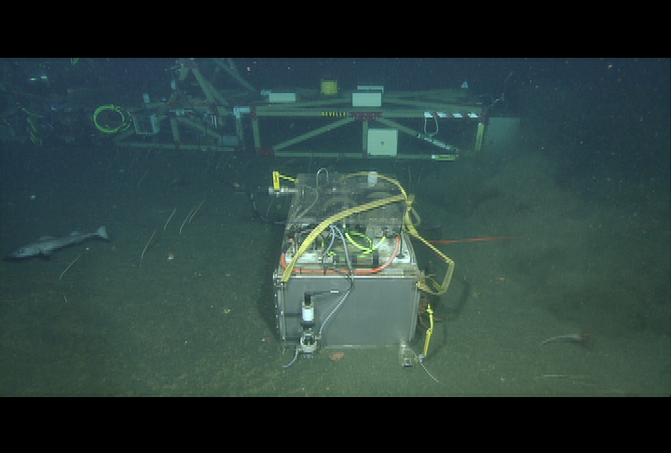
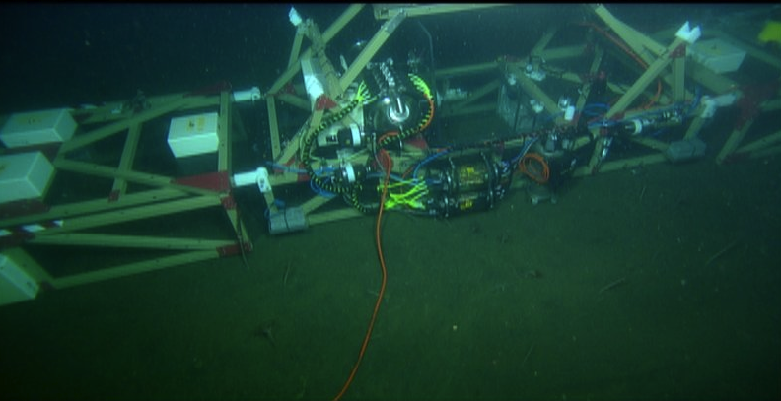
dpFOCE
Deployed for long term science – 1.4 years
In Situ CO2 upgrades, new biologic inserts, first bio experiment

