Slide 1
Building xFOCE: Open Source Technology
for In Situ Ocean Acidification Research
Plymouth Marine Laboratory
W. Kirkwood
Sr. R&D Engr.

Slide 2
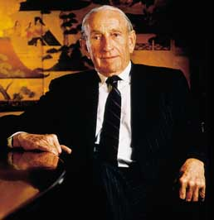
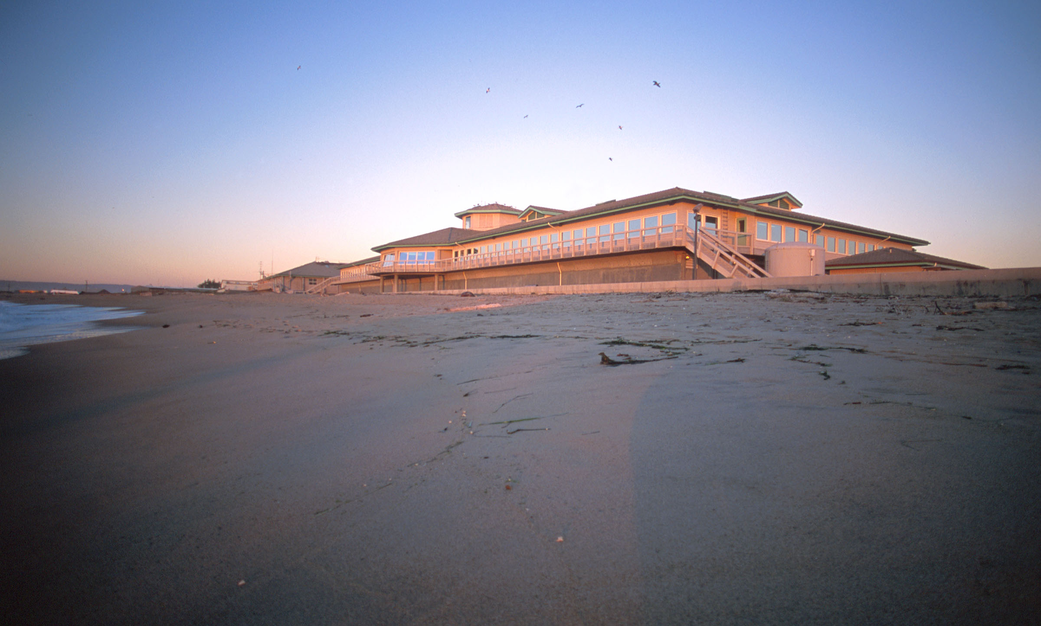
MBARI
The Monterey Bay Aquarium Research Institute
Established in 1987
Funded by the
David and Lucile Packard Foundation
Annual budget approx. $37 M
210 Staff
David Packard
http://www.mbari.org
Mission: Science and Engineering
working together to advance ocean science
Not to be confused with MBA – The Monterey Bay Aquarium

Slide 3
Points that explain what’s different
MBARI
MBARI’s strategic plan requires that we address social relevance, particularly policy and education
MBARI projects are all pre-planned with an end date (a very industrial approach)
A project that reaches the end date has a few options:
1. External funding (very rare - we have a limit)
2. Spin out as a “Center” (also has an end date), requires full external funding
(rare but if you get selected you have total control)
3. Spin out as a company (tough road but encouraged)
4. Give it away to some other place (open source)
5. Ends with no lasting impact (not very graceful – worst case)

Slide 4
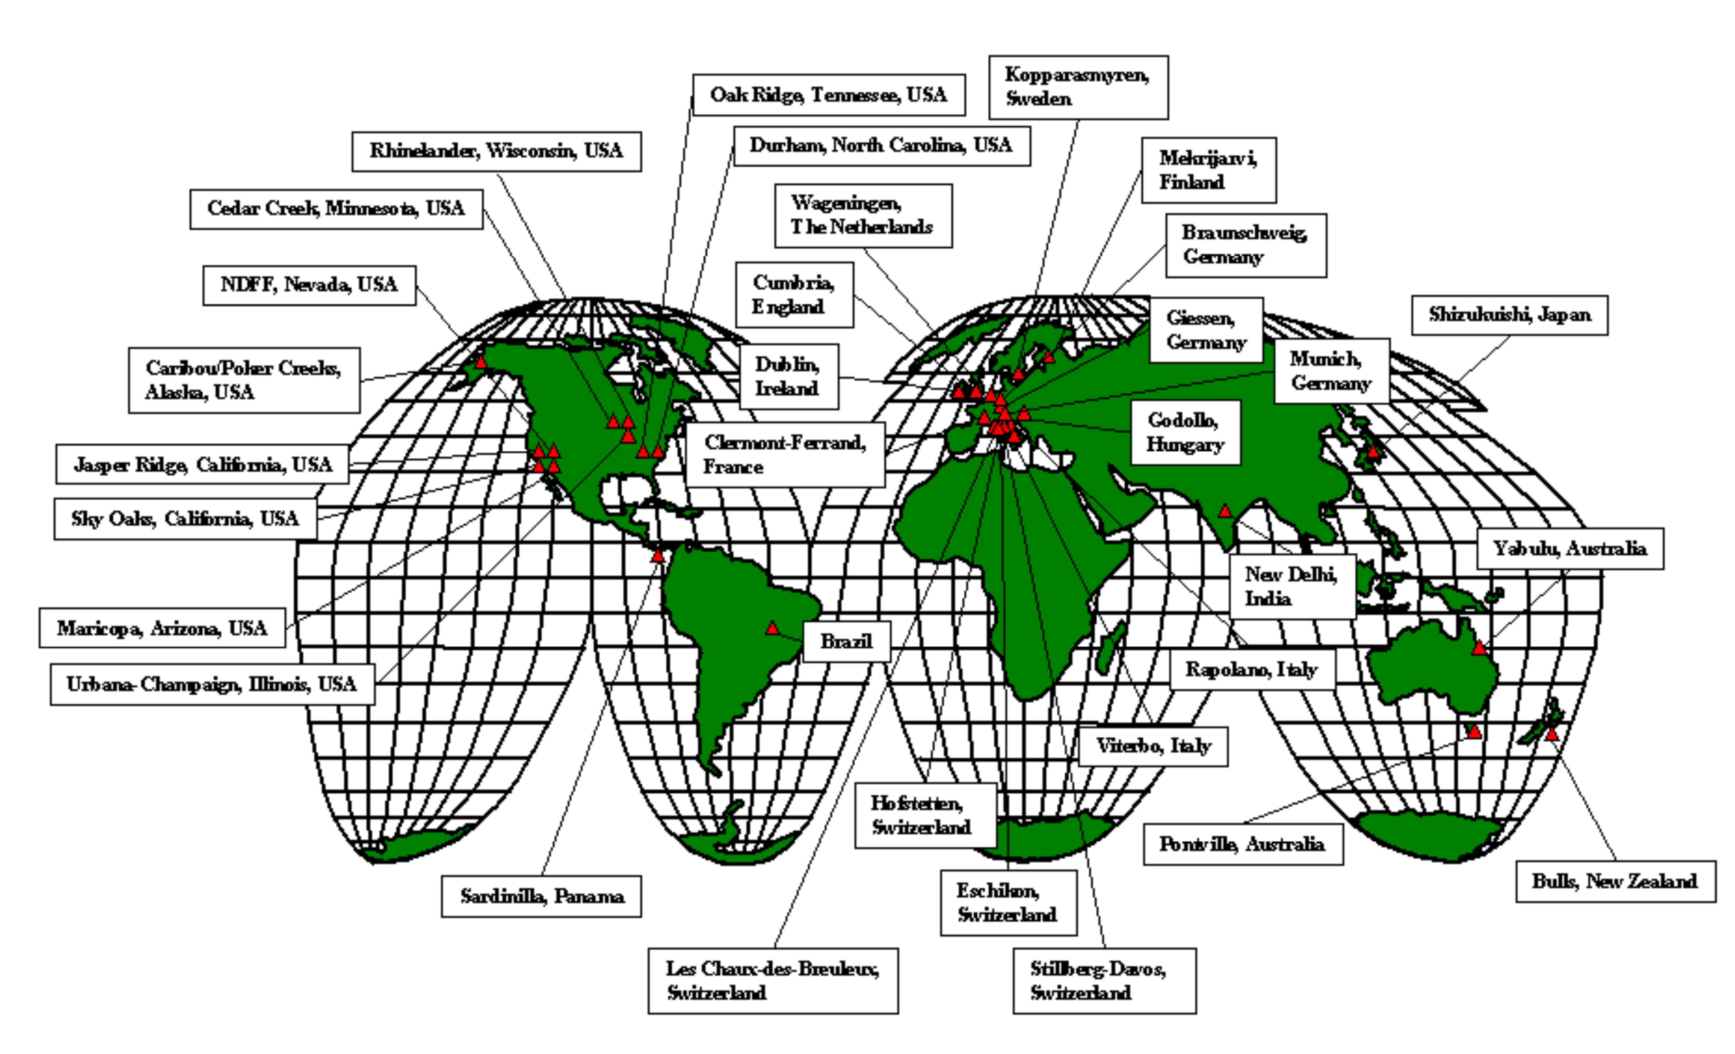
FACE
Free Air CO₂ Enrichment
The Free Air CO₂ Enrichment (FACE) experiments which eventually consisted of some 65 sites around the globe
The question: Why no FACE in the ocean?

Slide 5
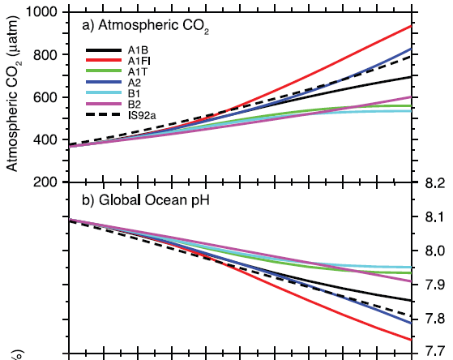
pCO₂ & pH Predictions 2100:
IPCC
Free Ocean CO₂ Enrichment
1) PreIndustrial:
280 µatm, ~pH=8.2
2) Present Day:
380 µatm, pH= 8.1
3) B2 Scenario:
600 µatm, pH=7.9
4) A1F1 Scenario
950 µatm, pH=7.75
Year
2000 2020 2040 2060 2080 2100
From IPCC 2007

Slide 6
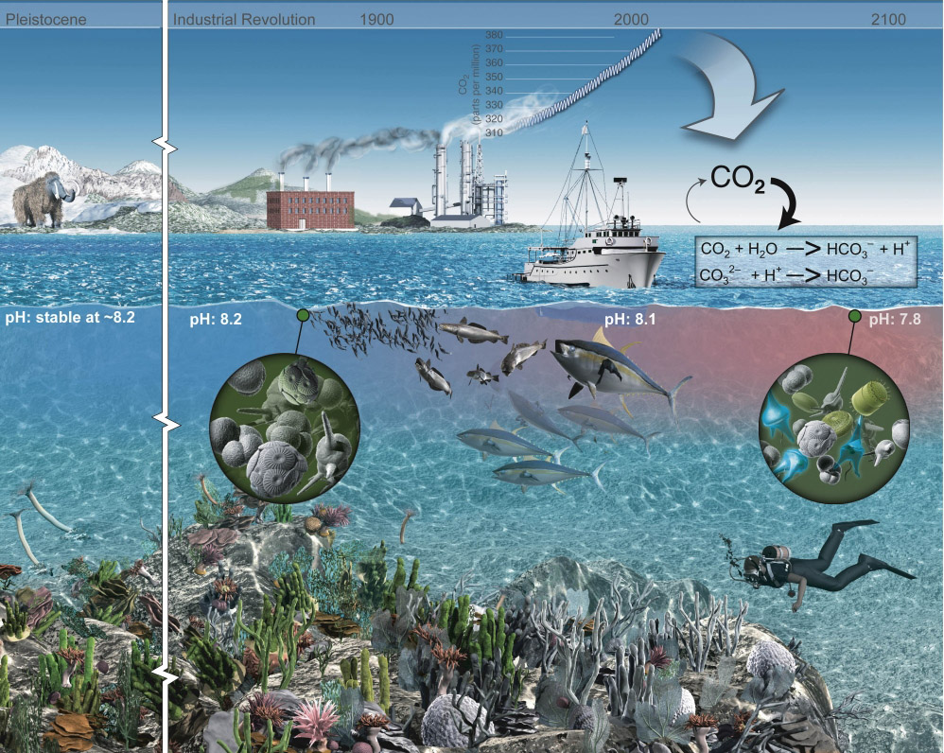
The Future Ocean
Assessing the Impacts of Ocean Acidification

Slide 7
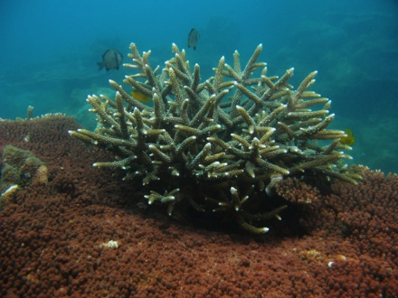
OA is a direct result of CO₂ emissions
Chemistry
Atmospheric
carbon dioxide
CO₂
(CO₂ + H₂O)
CO₂(aq)
H₂CO₃
HCO₃– + H⁺
CO₃^{2–} + H⁺
Dissolved
carbon dioxide
Carbonic
acid
Bicarbonate
Carbonate
CO_{2(aq)}
HCO₃⁻
CO₃²⁻
pH
Figure Courtesy of Joannie Kleypas
Notes:
Here is the basic process – and this is the only slide with chemistry!
Ocean acidification occurs because each year, about 25% of the CO2 we put into our atmosphere is taken up by the ocean.
Adding CO2 to water forms carbonic acid, which then breaks down into bicarbonate, and can further break down into carbonate
Without going into the chemistry, the end result is that both the CO2 concentration and the bicarbonate concentration INCREASE, while the carbonate and the pH both DECREASE.
So ocean acidification can be thought of as a SUITE of chemical changes

Slide 8
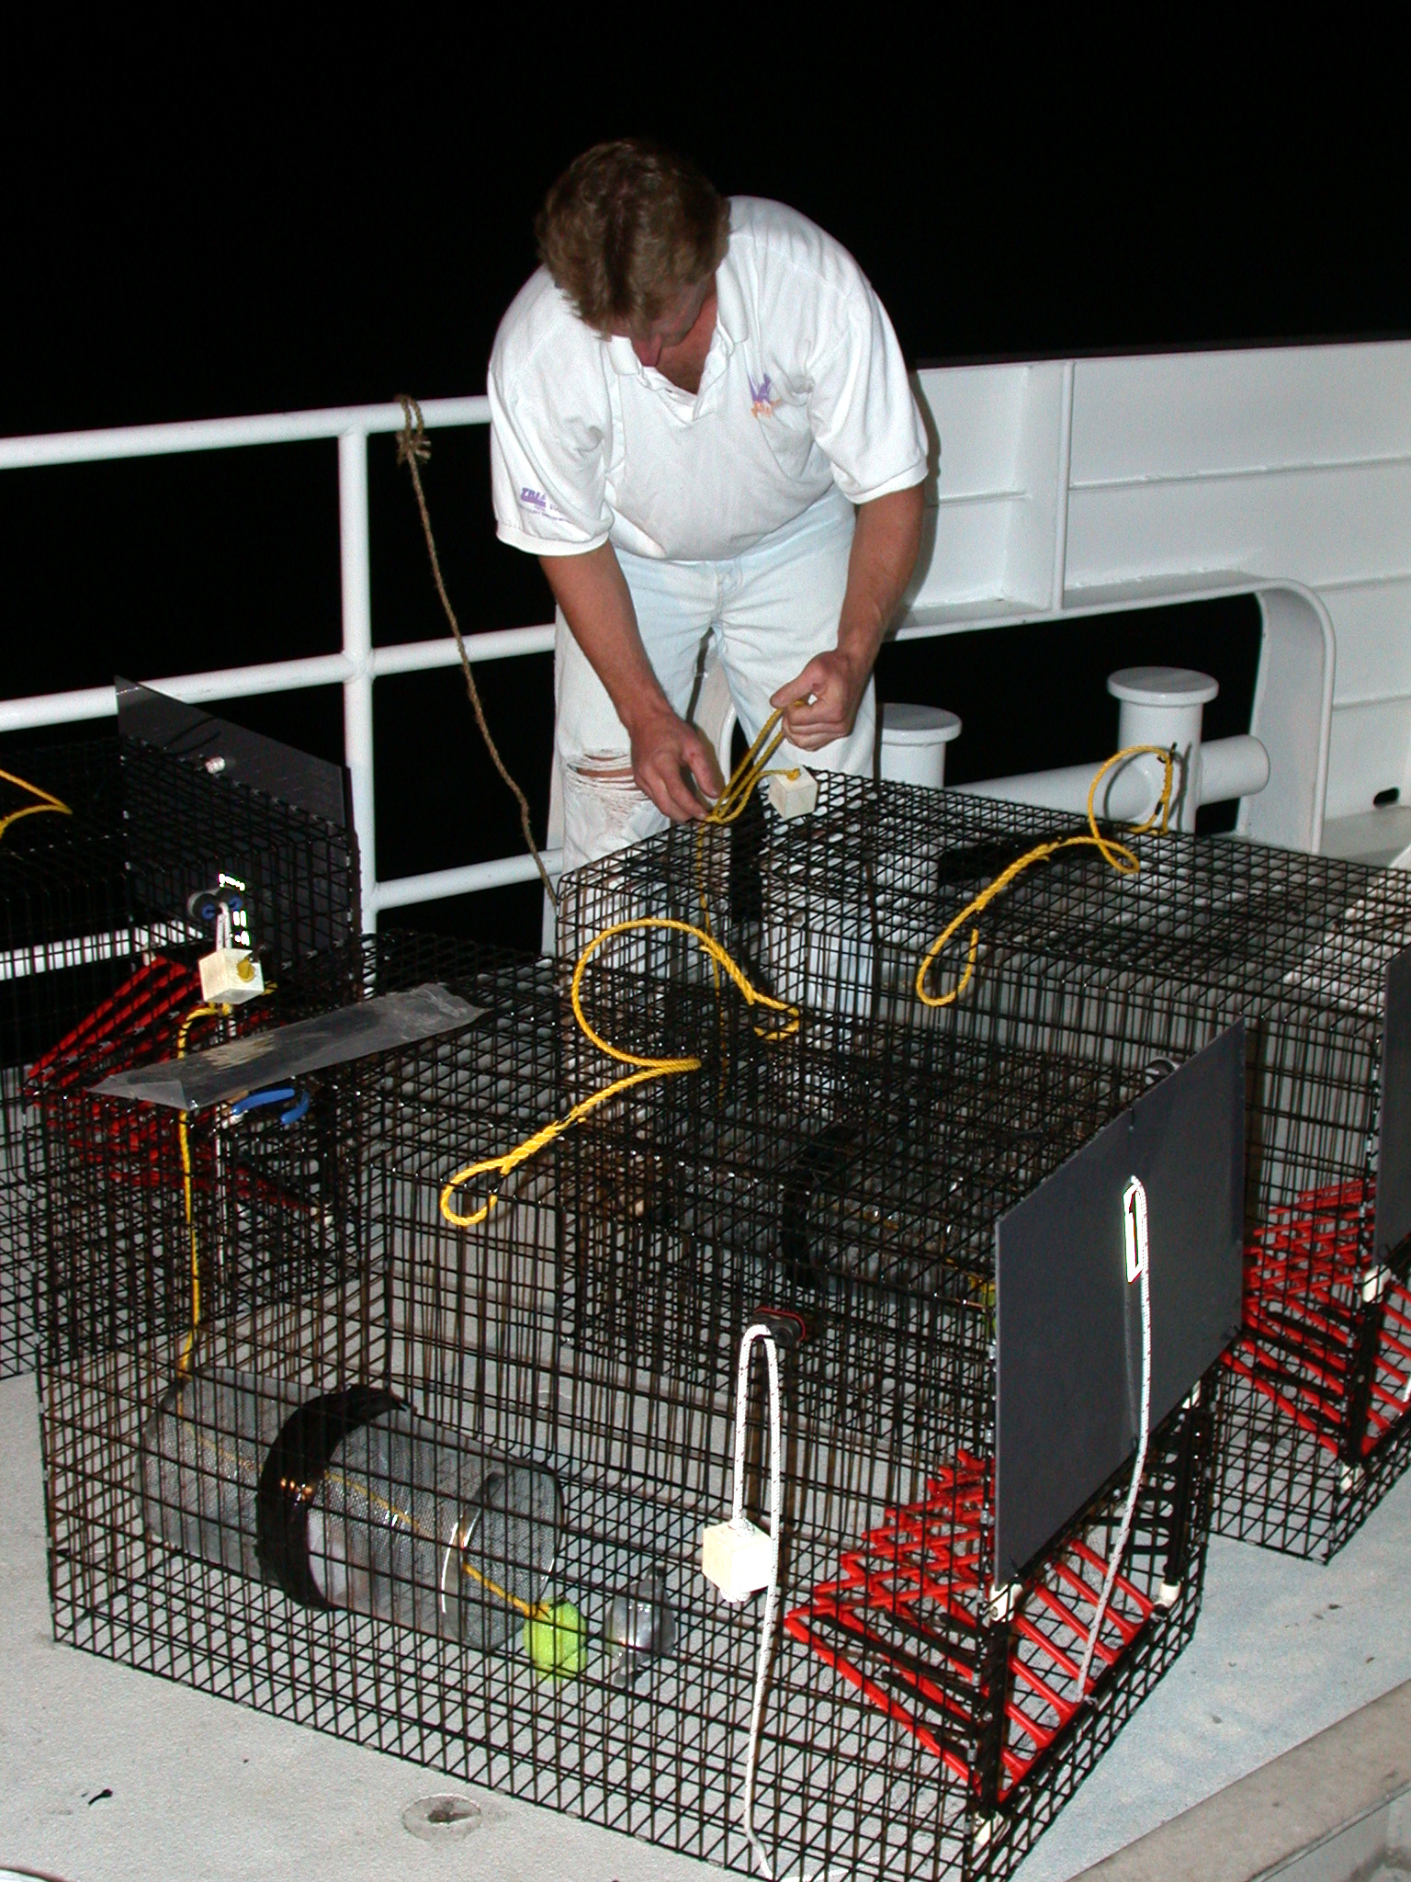
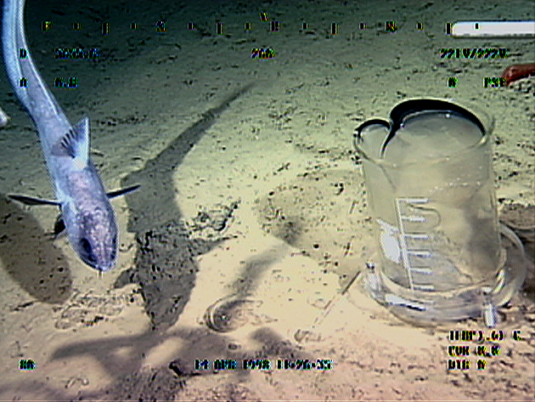
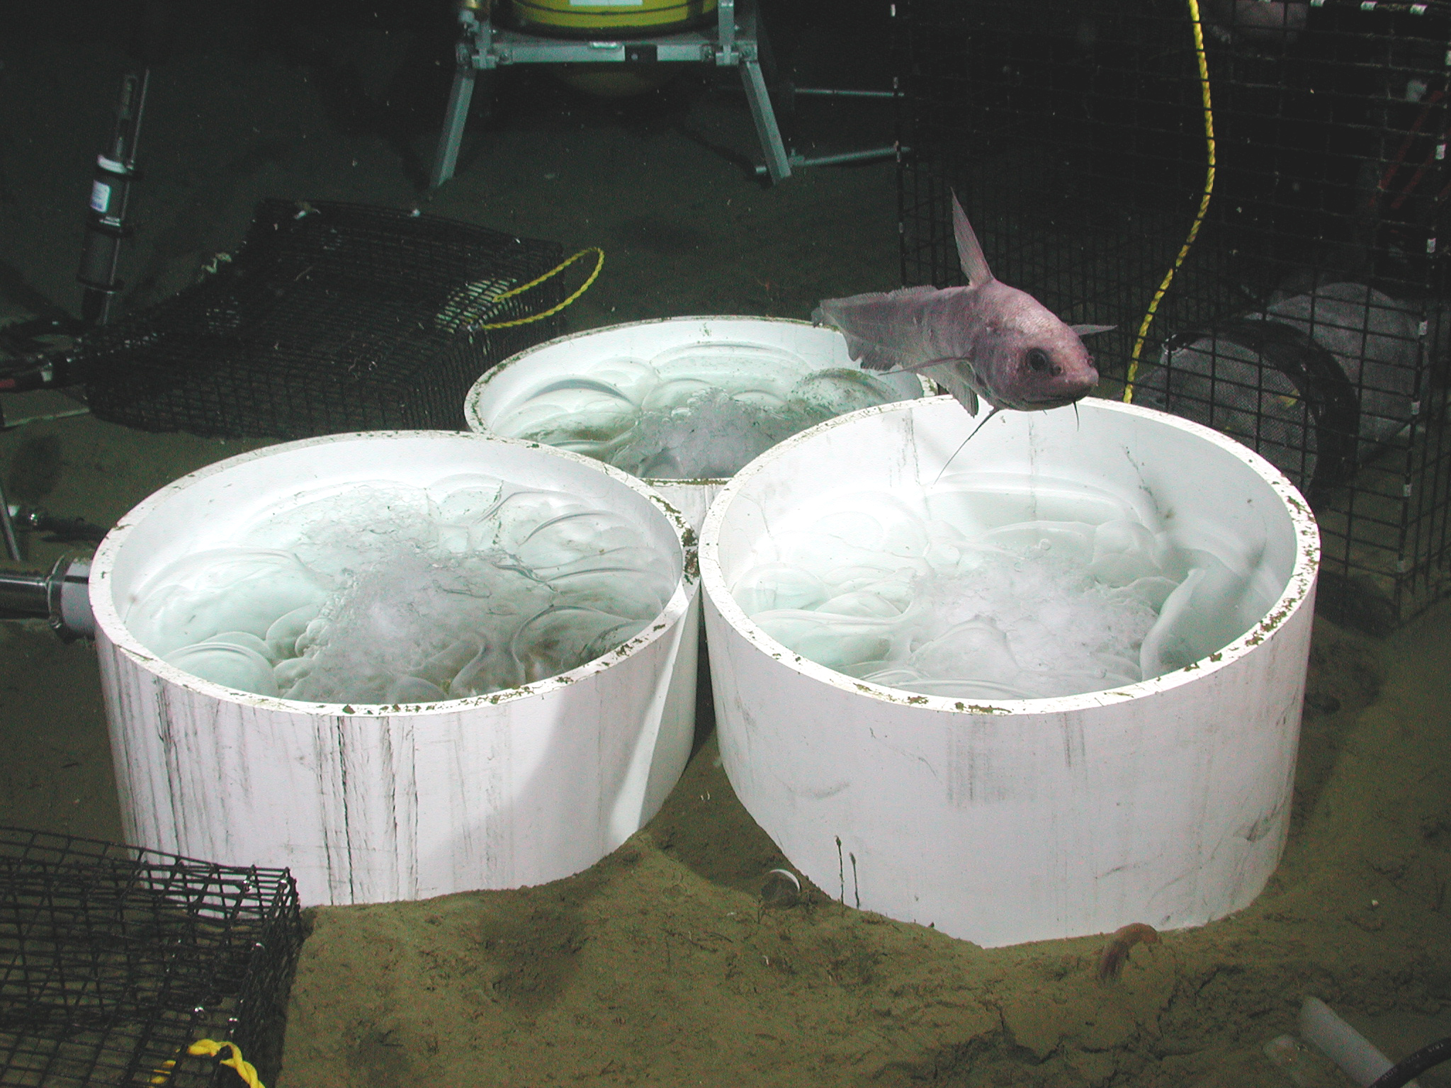
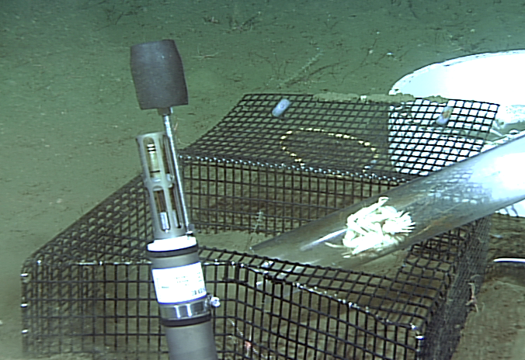
In Situ CO₂
Early Experiments
MBARI scientists have performed a number of CO₂ experiments looking at a number of questions in chemistry, biology, and resource management policy

Slide 9
In Situ CO₂
The pH results from a 3,000m deep CO2 sensing experiments – the inevitability of the tidal cycle. This profoundly affected our design thinking
Not the model for 2100

Slide 10
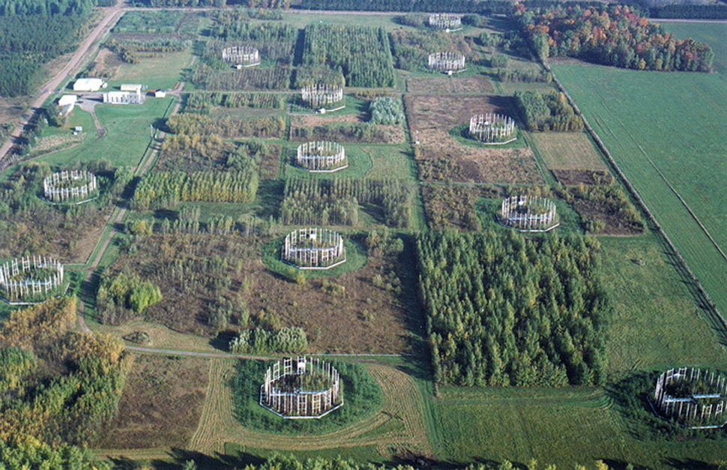


Beyond Climate
Closed loop pH control in the ocean concept
An in situ deep sea cabled observatory experiment looking at the impacts of anthropogenic CO₂ and lower pH in the deep ocean
FACE
Experiments
Concept first published
June 2006

Slide 11
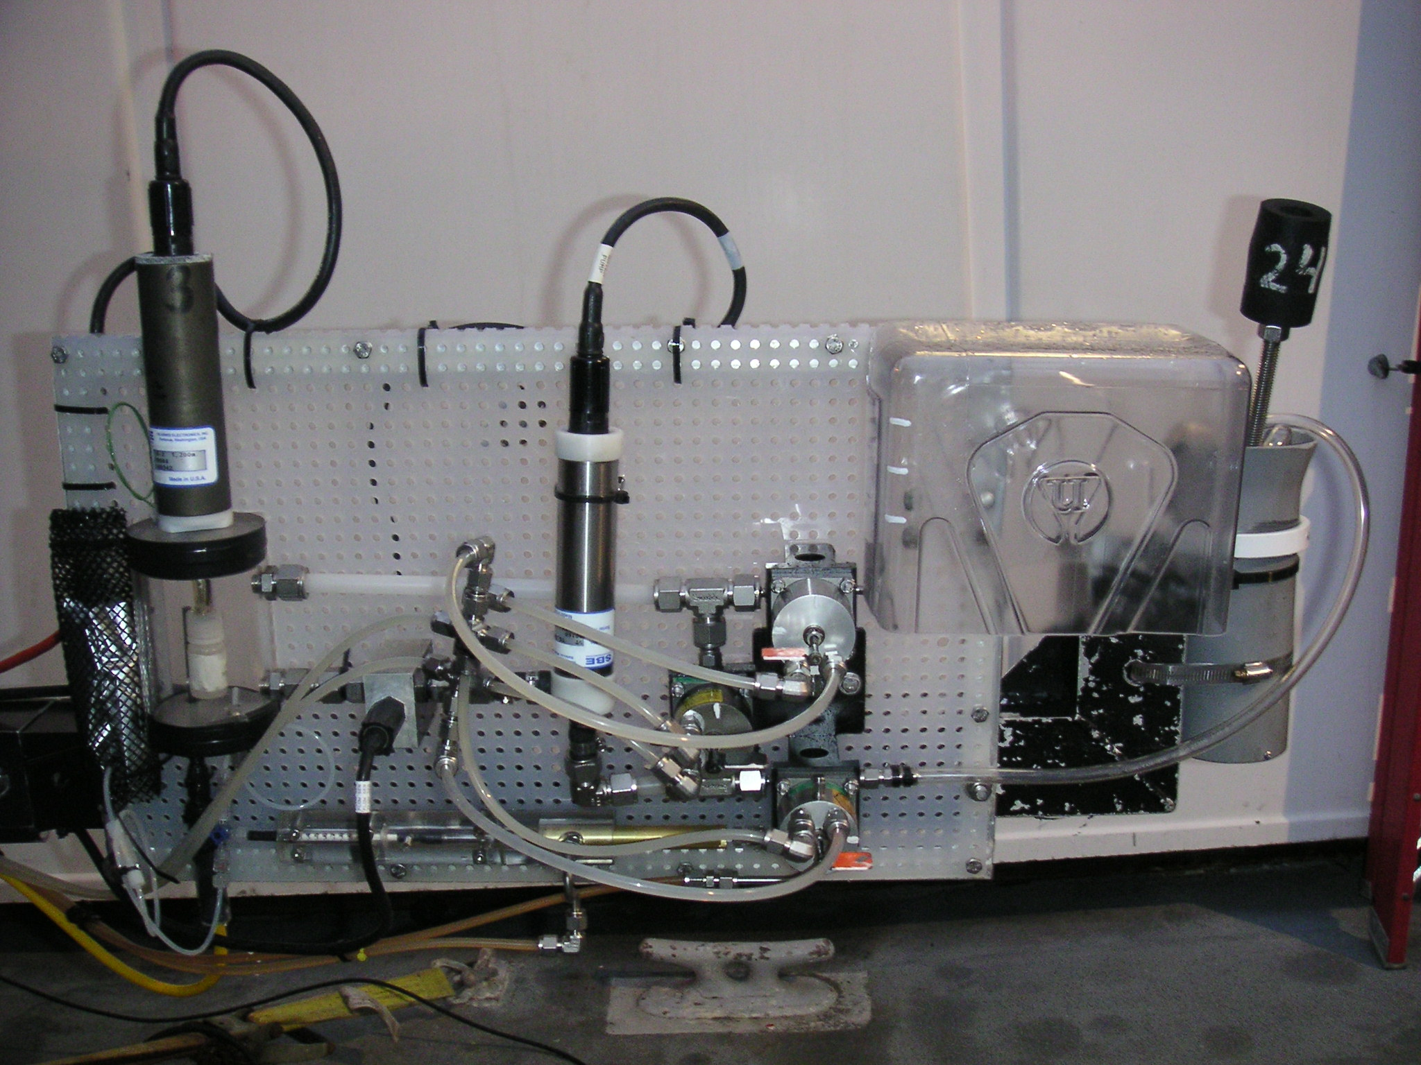
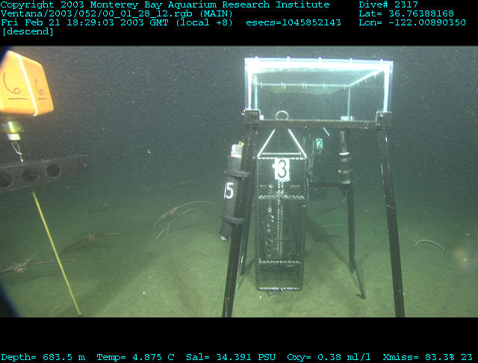
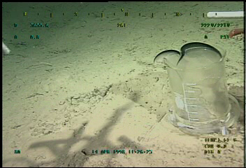
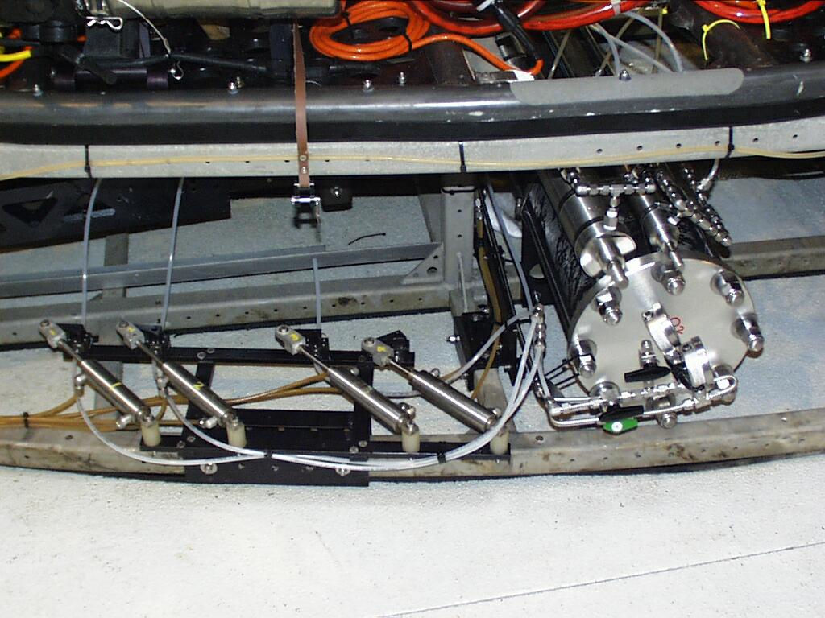
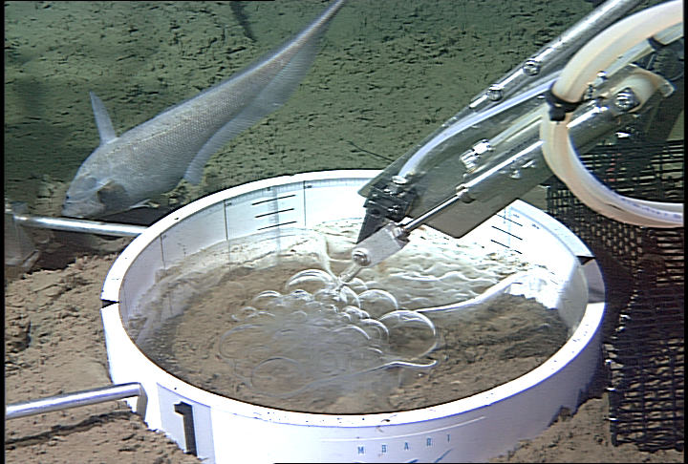
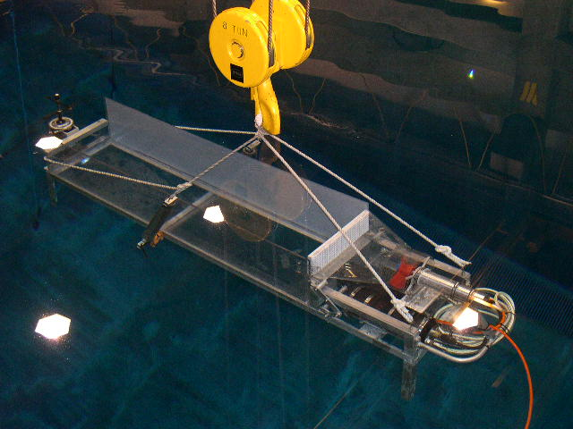
Supporting Work
CO₂ Development
CO₂ Equilibrium
CO₂ Instrumentation
CO₂ Sequestration
CO₂ Sequestration
and habitat
CO₂ Clahrates
Examples of Brewer et. al. lab and in situ work in CO₂ studies since 1996
CO₂ Mixing

Slide 12
protoFOCE
Free Ocean CO₂ Enrichment Prototype
Emitter Ring
2m
Control Volume
1m
2m
1m
0.5m
Slide courtesy of Rachel Dunk
Notes:
Surrounding this is a 2m diameter ring of 40 vertical emitters

Slide 13
protoFOCE
FOCE Prototype : HCl System
Acid Reservoir
Pumps
Acid
H₂O
Emitter Ring: 40 emitters
8 sections
5 emitters/section
d a function of current regime and chemistry
Notes:
A mixture of acid and seawater is pumped from this level through the centre of an 8 port valve and out to the emitter ring.
The section of the ring that the acidified seawater is pumped to is controlled by the valve-vane assembly…..

Slide 14
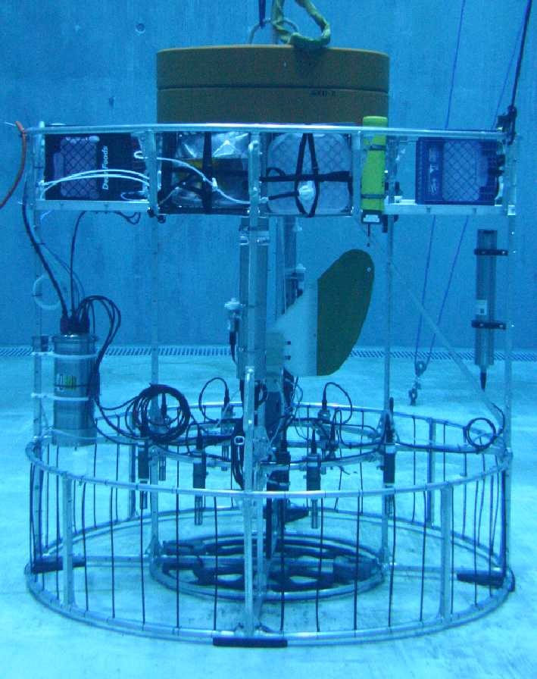
The FOCE Prototype
protoFOCE
Elevator for easy L & R
Acid Reservoir
Acid
H₂O
CTD and ADCP measurements
Eleven pH probes to record field
Notes:
And finally, here is how the schematic relates to the FOCE system prototype. Taking you through the FOCE system from top to bottom…..

Slide 15
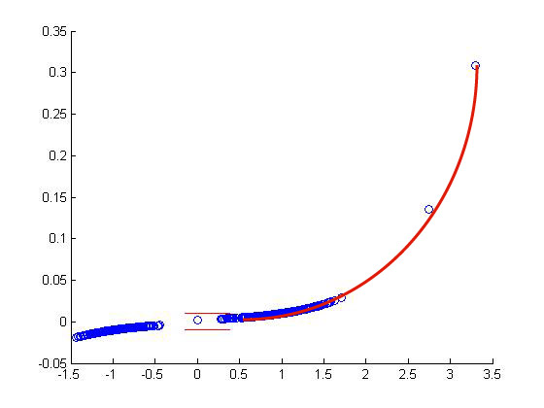
FOCE Prototype: Controls Concept
protoFOCE
6<pH<8
Data
pH 1
pH 2
pH 3
Automated quality check or manual over-ride to exclude pH probe(s)
Ave pH
Boxcar Filter
Ambient seawater pH
Desired
performance
pH
Heavily damped system to set pt.
Step function input of desired value
Time
Current Velocity
Manual over-ride to set total pump rate
Notes:
Now for some more detail on the control program.
The 3 pH probes log data every second. To remove noise from the data we applied a box-car filter, that averages the 30 most recent measurements. The smoothed pH values are then passed through a quality filter & average, where if any probe records a pH less than 6 or greater than 8 it is excluded.
In simple terms, the difference between the measured average pH, and the set-point target, then controls the ratio of acid to water.
The current speed input controls the total volume pumped.
The control algorithm used yields a heavily damped, but exponentially responsive system. This was to provide for quick adjustments in current, while minimising bounce under constant current regimes.
As a fail-safe, and because prior to our first trials we quite simply didn’t know how the system would respond, we also had manual over-ride on both control parameters.

Slide 16
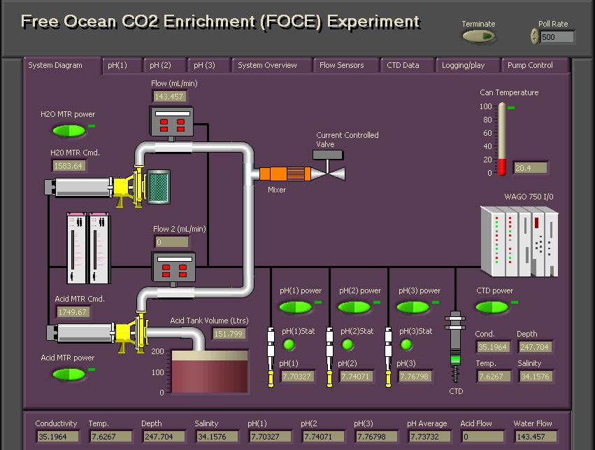
Field Trial: Controls Interface
protoFOCE

Slide 17
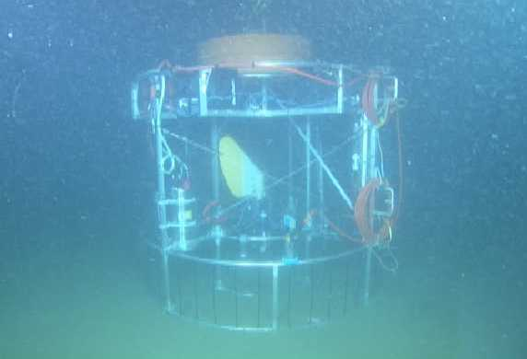
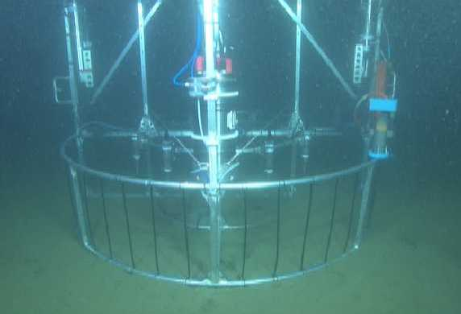
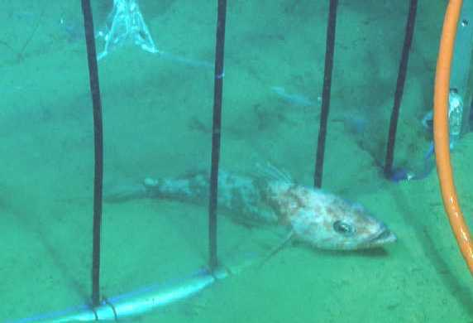
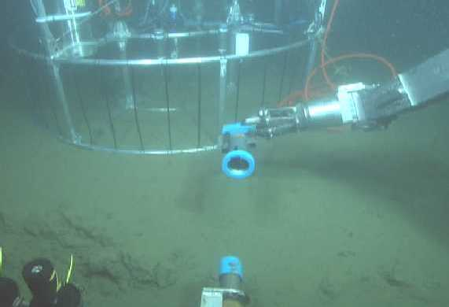
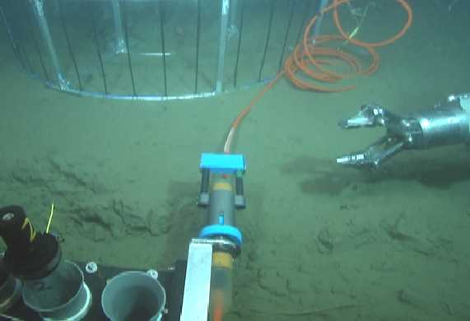
Field Trial: On the Seafloor
protoFOCE
These tests were at about 240 meters and conducted on a single day basis
First In Situ Full Scale Operational pH FOCE – April 2007
Notes:
The following pictures were taken using the camera mounted on Ventana.
At the seafloor, the visibility was very poor, and we had a few nerve wracking moments until looming out of the gloom we saw the FOCE frame.
To the RHS of the frame you can see the underwater mateable connector, which is acquired using the manipulator arm on the ROV, and plugged into the front of the ROV.
& finally here’s a nice shot of a ling-cod sitting immediately between two acid emitters.
On the first day of field trials, the current speeds were very low, ranging from no flow to ~ 8cm/s, well below our design remit, and the system did not perform particularly well. However on the 2nd day we were fortunate and had current velocities of 10-20 cm/s, and the system performed very well indeed…..

Slide 18
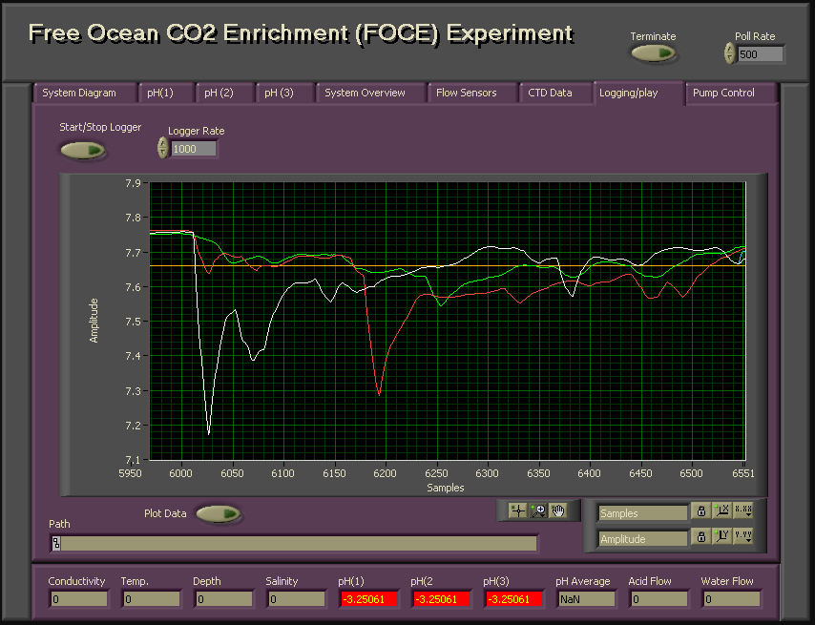
Field Trial: Data & pH Control
protoFOCE
Problem to be solved
Notes:
In an attempt to minimize the impact of this phenomenon on the feedback control, we re-ran the experiment using only pH probe 1 to control the feedback loop. This is a 10 minute segment of that data, where with the exception of a small negative spike which quickly recovered, the pH was regulated extremely well, within +/- 0.04 units from the set-point.
So what lessons did we learn from these trials, and what are our plans for the next FOCE deployments…..

Slide 19
HCl - CO₂ Hydration Kinetics
protoFOCE
CO_{2(aq)}+H₂O
slow
H₂CO₃
fast
H₂CO₃
fast
HCO₃⁻ + H⁺
fast
HCO₃⁻
fast
CO₃²⁻ + H⁺
fast
Ambient pH
Formation of an intense cloud of CO₂
ΔpH
Reaction pH
Mixing and hydration of the excess CO₂ to form HCO₃⁻
Initial rapid decrease in pH at injection point
Reaction Time
Notes:
At the point of acid injection, we essentially drive the carbonate system equilibria to the left, and form aqueous CO2. These reactions are all fast. The CO2 enriched parcel of seawater then mixes with ambient seawater – it is now out of equilibrium

Slide 20
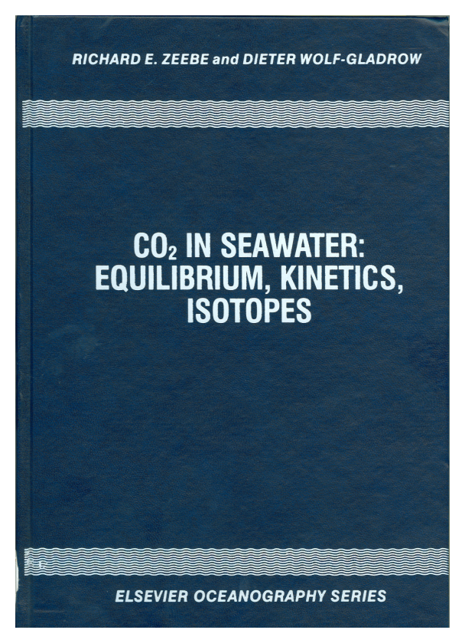
Zeebe & Wolf-Gladrow Model (2001)
FOCE
k
-
+
1
H
C
O
+
H
+
C
O
+
H
O
2
2
k
3
-
1
k
-
C
O
+
O
H
-
+
4
H
C
O
2
k
3
-
4
Note: reaction kinetics are a function of both CO₂ and pH.
While, the effect of pressure on the equilibrium constants can be calculated (see Z&W-G appendix A.11), the effect on the reaction kinetics is largely unknown.
F Appendix C.7:
e-Folding time
Linear differential equation:
d
(
δ
C
O
)
1
2
=
-
δ
C
O
d
t
τ
2

Slide 21
FOCE
Implementing the kinetic model – T and pH dependent
The model yields a highly non-linear curve with very strong pH dependency. The reaction is quasi-autocatalytic in that as pH drops the reaction goes faster. Normal sea water is near the peak and in a very steeply sloping region.
Specific example of the time required for CO₂ hydration to occur: the figure illustrates the time for a 0.3 pH offset for deep-sea water at various temperatures and pressures. The result for the e-folding time ranges from about 15 seconds at 25ºC and the surface to 97 seconds at 900m and 4ºC.

Slide 22
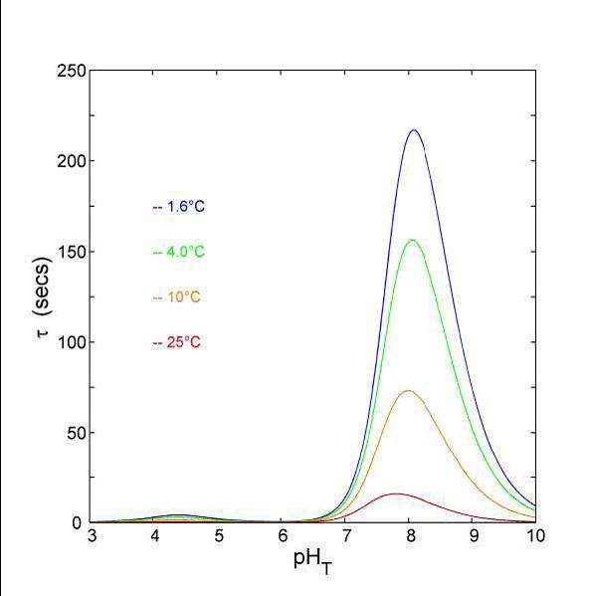
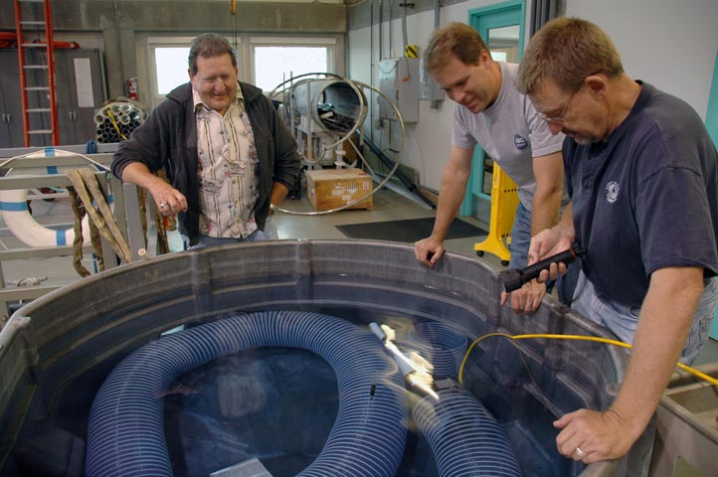
dpFOCE
The path to Deep FOCE
A series of small scale experiments
and developments took place…
Smallest In Situ FOCE to date
Approx. 8”x 8”x 8”
Control Volume

Slide 23
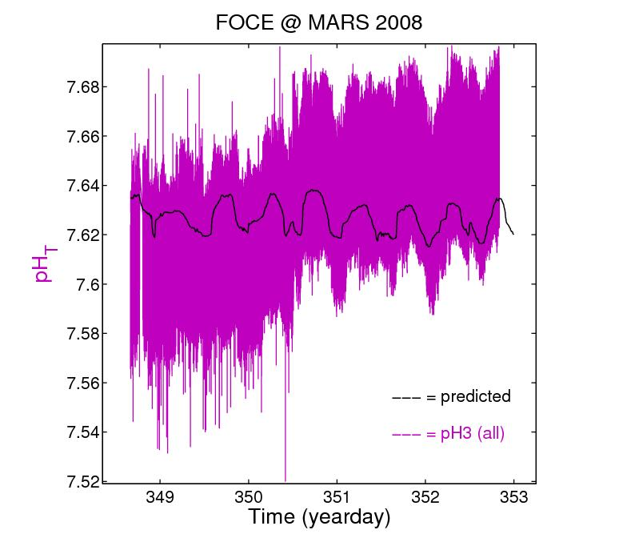
Analog pH Sensor
pH sensor
Electrical interaction with other instruments and thruster motor.
Too noisy to observe background pH or for precise CO₂ control.
pH sensor would go to the ‘rail’ at times
Notes:
The new design was able to discern the tidally driven pH signal.
The MARS observatory connection enables ‘real time’ data analysis and experiment control.
In-situ calibration by offset adjustment could be made at the peak of the pH tidal cycle
Note: Vertical bars are in-situ calibration points
Data is intentional offset by 0.25

Slide 24
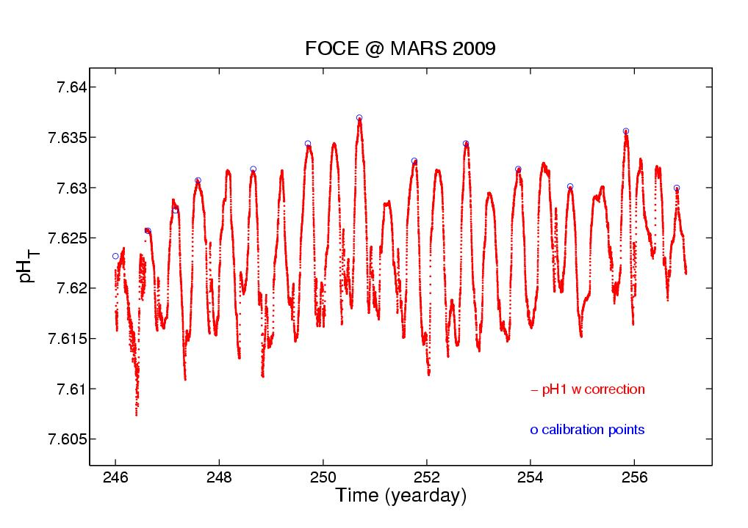
Digital pH sensor corrected
pH sensor
Calibration using WOCE Buoys
Notes:
The new design was able to discern the tidally driven pH signal.
The MARS observatory connection enables ‘real time’ data analysis and experiment control.
In-situ calibration by offset adjustment could be made at the peak of the pH tidal cycle
Note: Vertical bars are in-situ calibration points
Data is intentional offset by 0.25

Slide 25
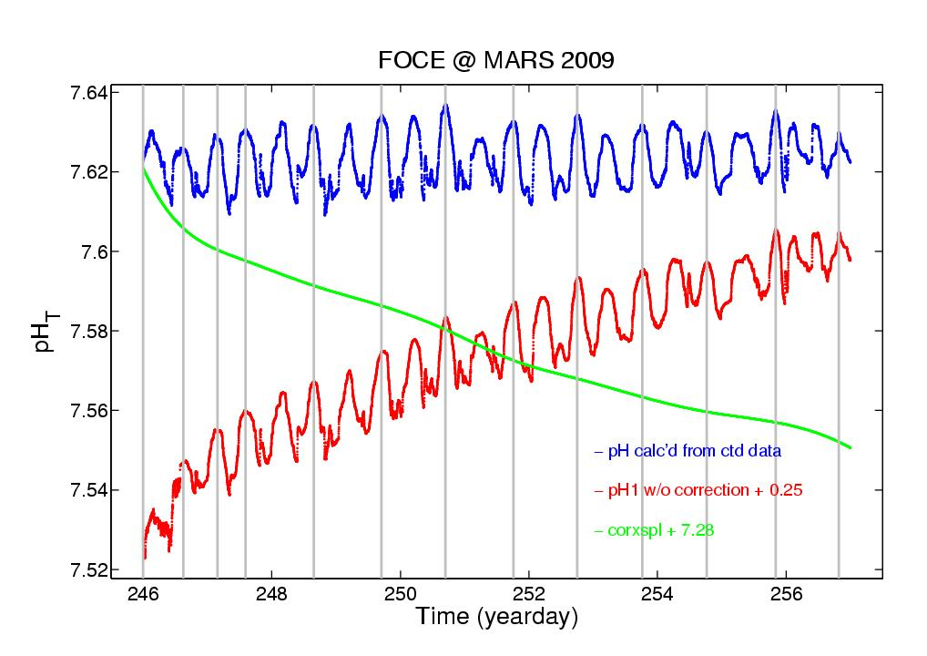
pH sensor
Uncorrected Digital pH plotted against WOCE data
Digital pH sensor from installation showing the KCl buffer normalization as the sensor settles and approaches being asymptotic with the known background
Notes:
The new design was able to discern the tidally driven pH signal.
The MARS observatory connection enables ‘real time’ data analysis and experiment control.
In-situ calibration by offset adjustment could be made at the peak of the pH tidal cycle
Note: Vertical bars are in-situ calibration points
Data is intentional offset by 0.25

Slide 26
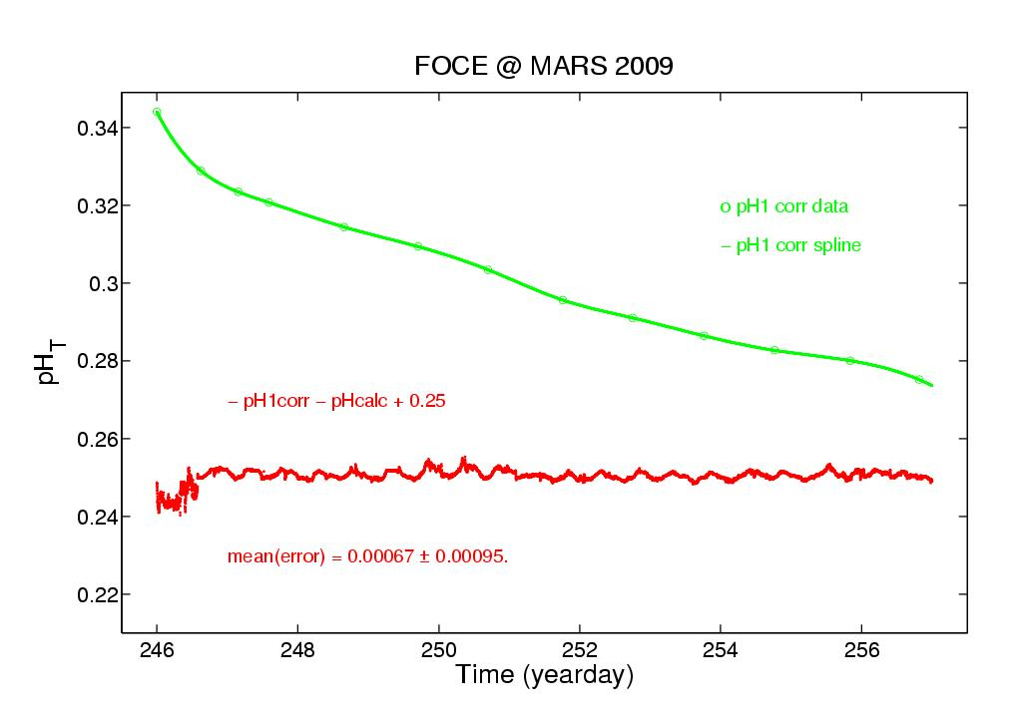
Predicted vs In-Situ Corrected
pH sensor
New isolation and digitization demonstrating improved performance

Slide 27
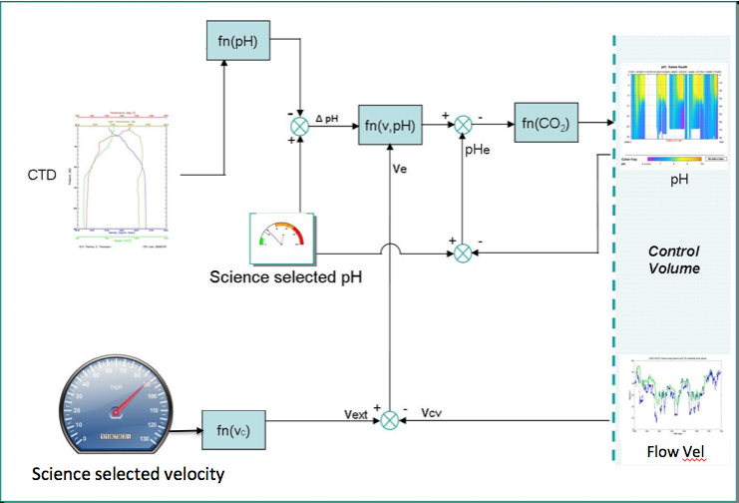
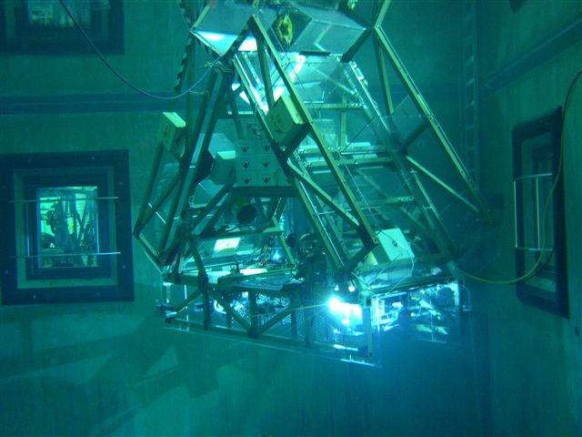
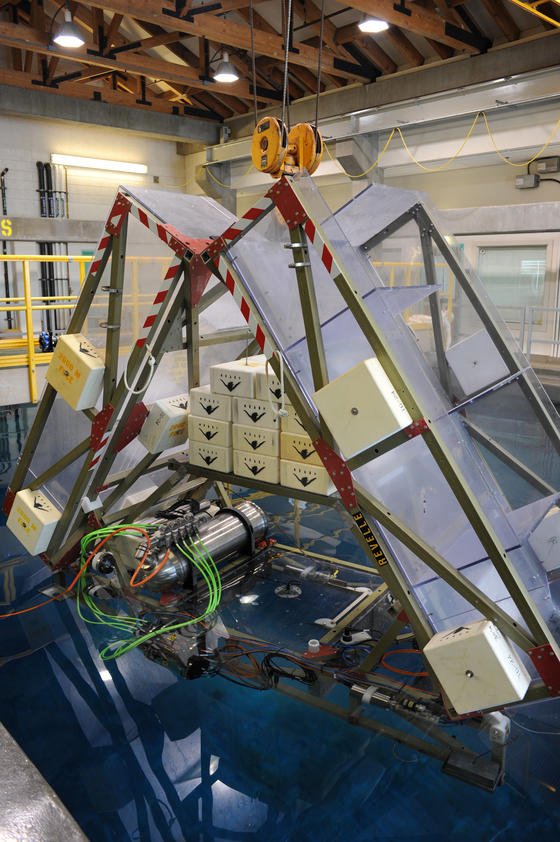
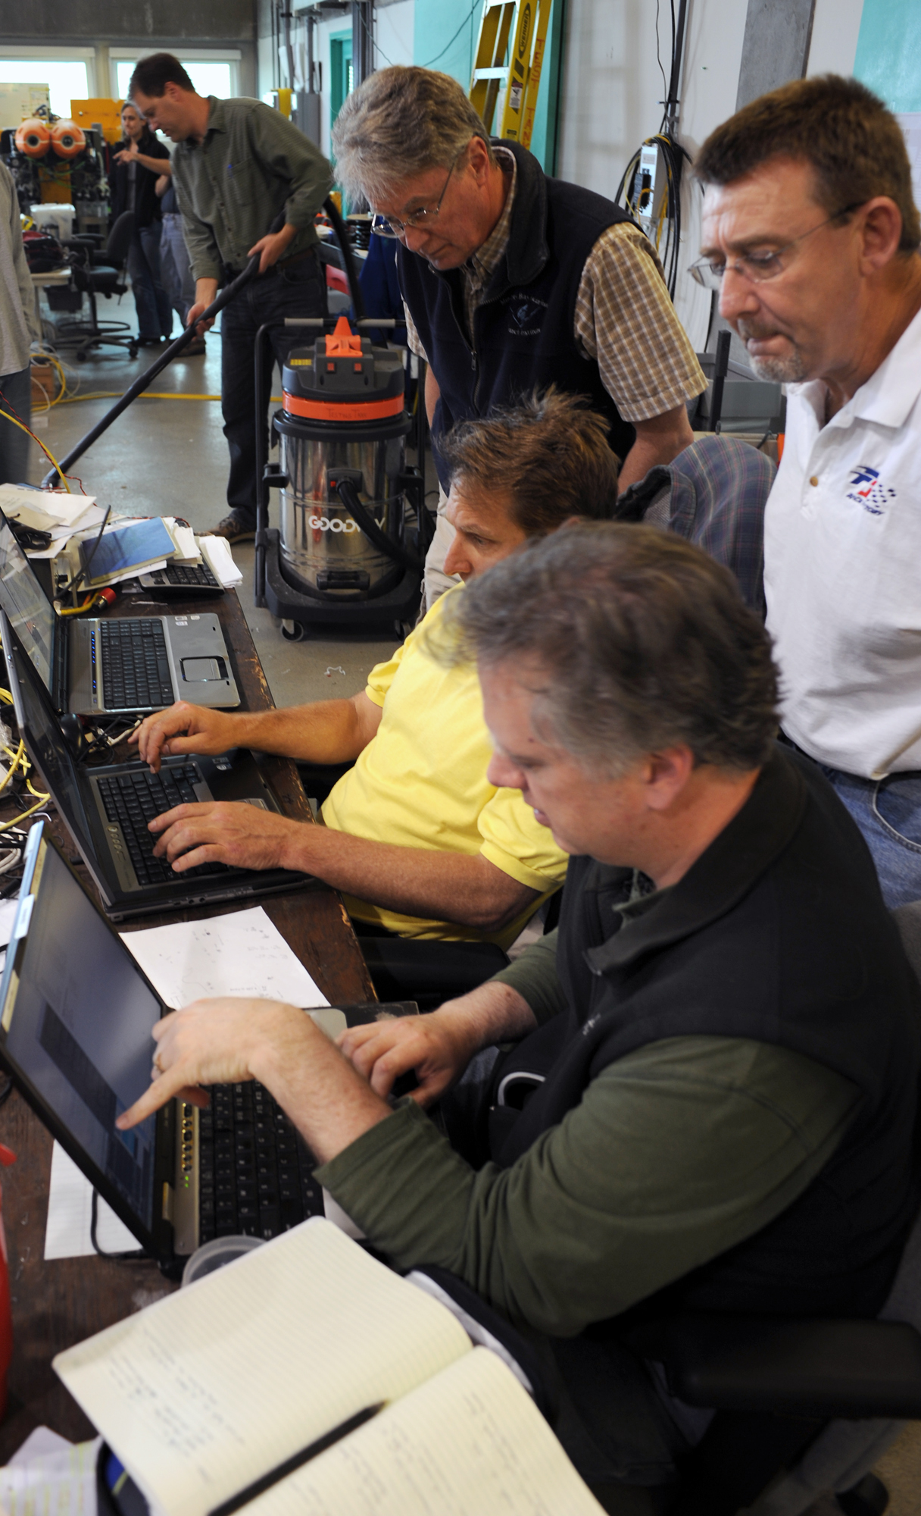
dpFOCE
Performed extensive testing in the tank – 30 days
Simplified Control Algorithm
Ran 24 hour operations
Demonstrated reliable remote operations
Data management system

Slide 28
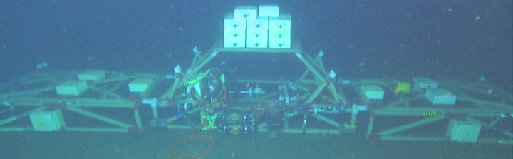
dpFOCE
9 Meters
Flotation
Hatch
Time Delay
Path
Time Delay
Path
pH
1m
pH
Fans
CTD
Fans
1m
Camera
pH
pH
CTD
pH
pCO2
To MARS
Node
JBox
Main CPU
JBox

Slide 29
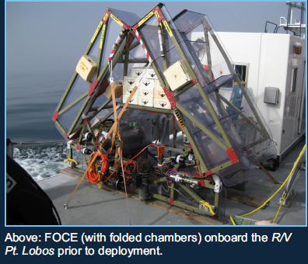
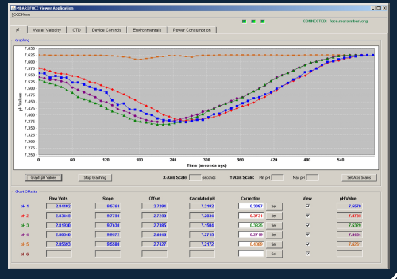
dpFOCE
Our experience with the deep FOCE system at 850m
Long arms to allow time for CO2 hydration to occur, slow flow rates through the system, sensing of external pH variations and feedback control to set a constant ΔpH offset, and control by a GUI via an ethernet link enabling at-home monitoring and adjustments. Video imaging in real time of the central experiment chamber.

Slide 30
dpFOCE
The figure below shows a month long offset in pH with compensation for variable flow all by feedback control.

Slide 31
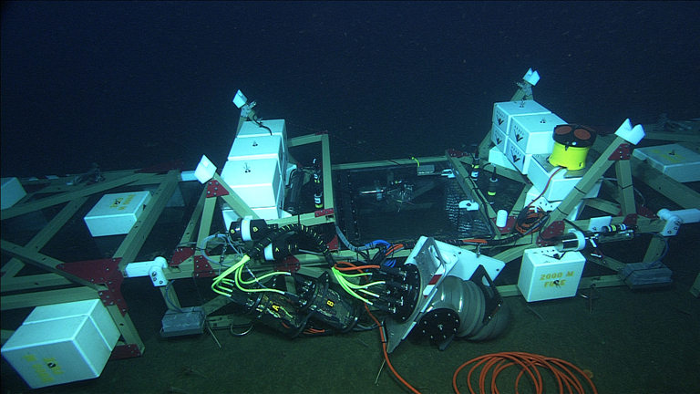
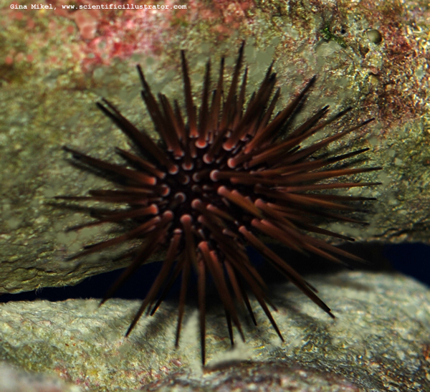
dpFOCE
First long duration deep biology experiments just completed
– 10/23/2011 using sea urchins
Time lapse video used to observe urchin motions and feeding behaviors in elevated CO2 compared with a control section located 20 meters away

Slide 32
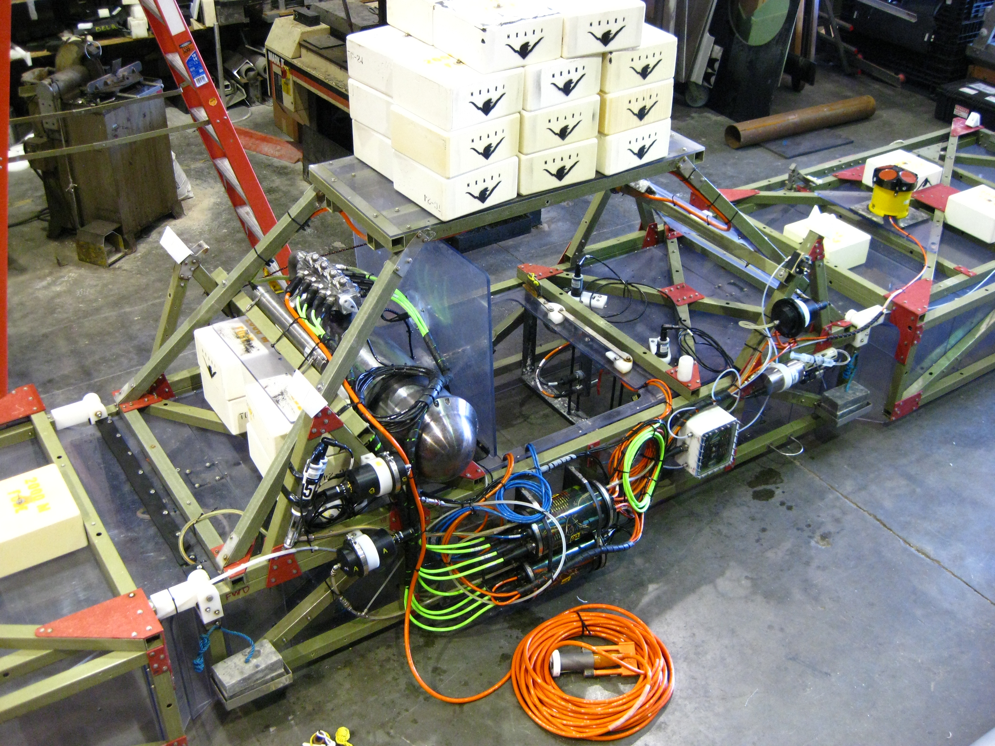
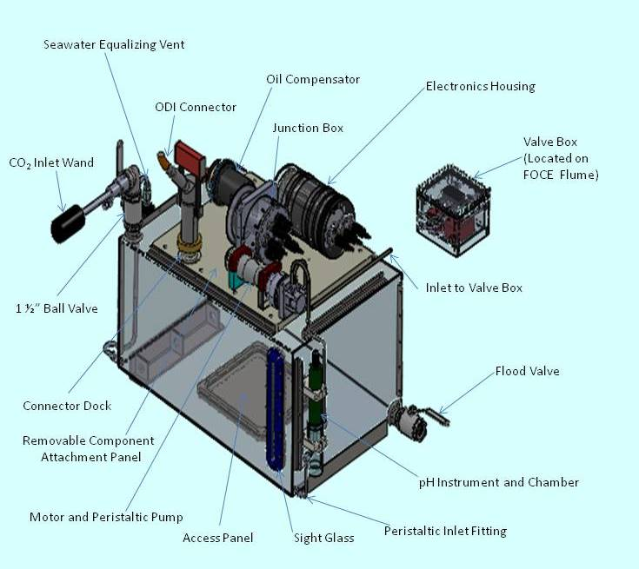

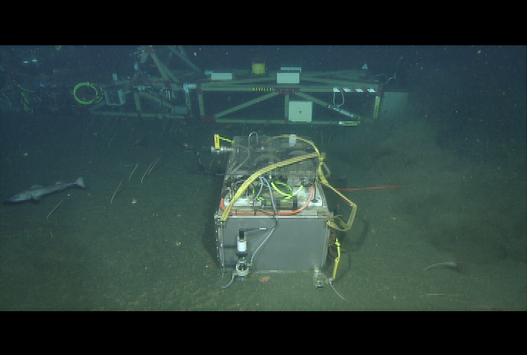
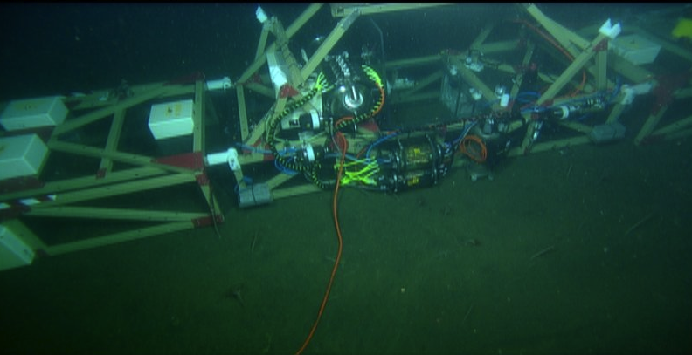
dpFOCE
Deployed for long term science – 1.4 years
In Situ CO2 upgrades, new biologic inserts, first bio experiment

Slide 33
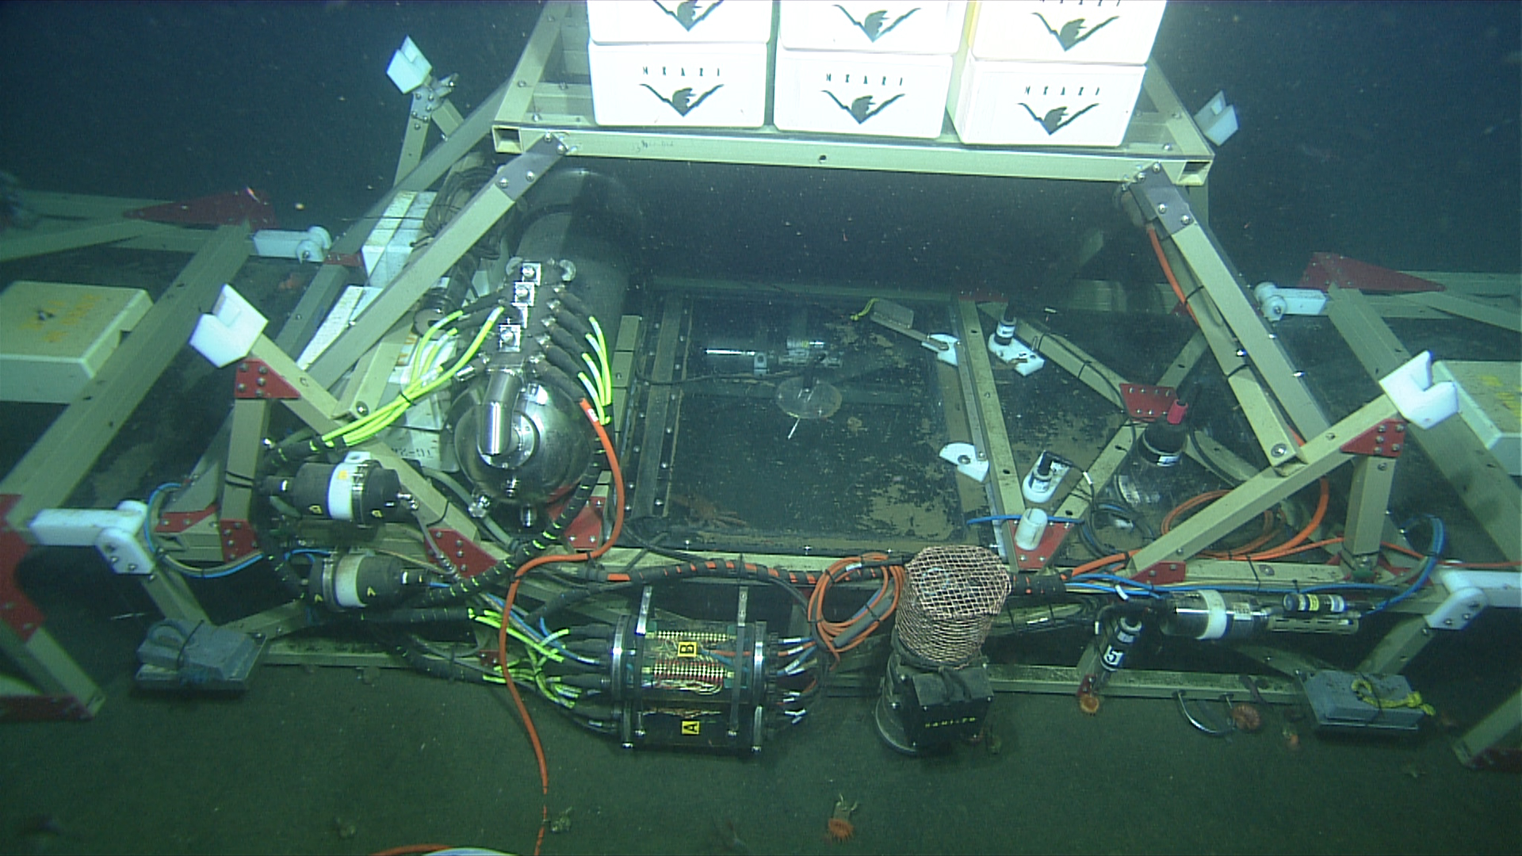
dpFOCE
Deep Free Ocean CO₂ Enrichment
Solved numerous technical challenges useful for all FOCE units
Operated on a cabled observatory at 900m depth sharing resources
Developed and demonstrated digital pH sensors
Demonstrated long term tele-operation
Demonstrated in situ OA treatment with refillable liquid CO₂ system
Open source data management and data analysis tools
Inspiration for next development - xFOCE

Slide 34



Why xFOCE?
The problem: A few scientists are misinterpreting our publications and what is required to make a FOCE system work properly. This is the first scientist to call us after he tried to build a FOCE system on his own.
MBARI was contacted and we gave feedback about how to modify the existing hardware and reconfigure it to become a functional FOCE and perform the chemistry correctly.
The scientist did some of it but still didn’t grasp what FOCE is an how to properly set up a system to get meaningful science results as a FOCE system. He refused to manage the chemistry but still called his system FOCE.
It became apparent a resource clearly outlining FOCE would be useful.

Slide 35
The Real Problem
The chemistry in the ocean is very different than that on land. However the early prototype images and name gave the impression to non-chemists that it could be operated in the same manner and have scientific validity.
The reality is – it could be done but the amount of CO₂ required is 1) cost prohibitive, 2) unfriendly to the environment and 3) is prone to the same weaknesses of FACE. So, the choice is to be “mostly” free with just enough structure to perform science for a given researchers work.

Slide 36


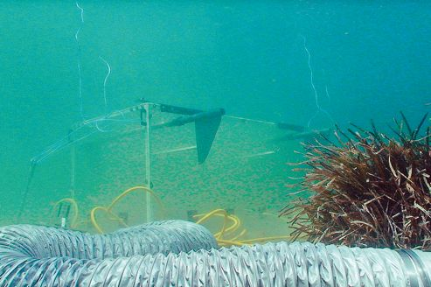





A variety of FOCE units are funded
Deep FOCE (dpFOCE) is the original FOCE built for multi-science users on a cabled observatory. Science continues.
Coral Prototype FOCE (cpFOCE) is the first tech transfer of FOCE built for multi-science users on the Great Barrier Reef. Solar and wind powered except for the creation of the enriched CO₂ water.
European FOCE (eFOCE) is currently under engineering testing. This system uses a cable but the CO₂ is delivered in bottles to a surface expression. Science begins in early 2013.
Antarctic FOCE (antFOCE) proposal submitted and partially funded. Dr. Donna Roberts and her team successfully obtained the a second grant. Congrats!!

Slide 37

FOCE and EPOCA
Basic FOCE technology for OA Science
Chapter 8 focuses on best practices and uses the FOCE as a technology example of how to form a well executed experiment for specific types of studies.

Slide 38
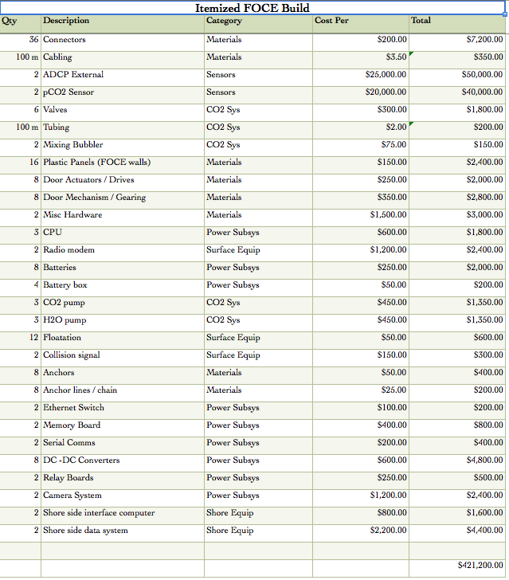
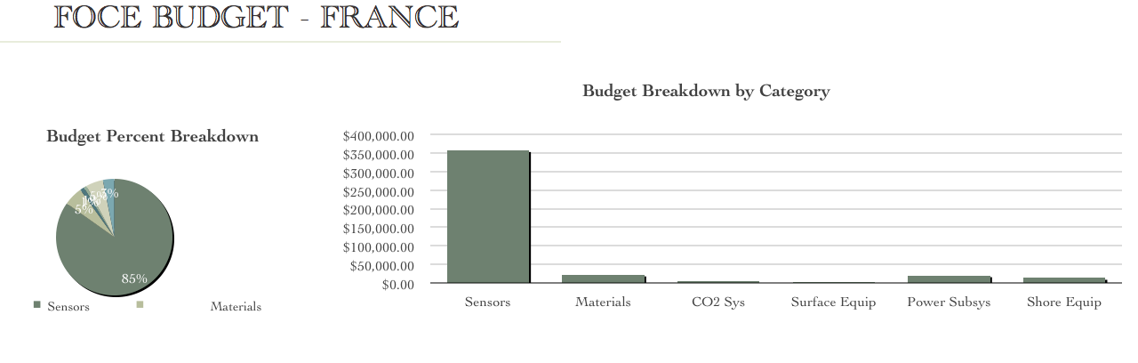
eFOCE et al
The numbers (barriers) for FOCE
The barriers to entry:
Instrument costs – Dominate!
Access to technical people
The eFOCE team ½ funded and I realize we’ve got a problem for the long haul

Slide 39
Open Source can help xFOCE
Learned some lessons along the way helping others
I’m still not good at getting the Zeebe Wolf-Gladrow model across
It is highly likely each scientist will want to modify the basic FOCE for their own science needs – need some expansion built in for future
Getting in the water early at a reasonable budget will help a lot of future proposal writers
Every FOCE has some core elements that make it a FOCE, without those the science maybe fine but it is not closed loop control of pH
Flexibility is key to success… after the proposal is won the real issues arise that force modifications usually related to the selected site.
MOST IMPORTANT: It is possible to transfer the technology out of MBARI and have an external researcher operate on their own (almost)

Slide 40
xFOCE Concept of Ops- Cabled
Science interface on shore
CO₂ and Enriching process on shore
Air / sea interface managed using buried cable
Capable of supporting 6 to 8 xFOCE units
(4 active pH chg and 4 control)
Depth rating
min - ??
max – 40m ??
Anchored to bottom

Slide 41
xFOCE Concept of Ops - Non cabled
Science interface on shore
CO₂ and Enriching process off shore
Air / sea interface managed using surface expression
Capable of supporting 2 xFOCE units minimum
1 active pH chg and 1 control, 3 active and 3 control desired
Buoy or Platform
Comms by telemetry
Depth rating
max – 40m
Anchored to bottom

Slide 42
xFOCE Functional Interfaces
OR
Internet
Power
House Power
Generation
CO2
ESW
Mixer
Comms
Data
Distribution
GUI
Distribution/Protection
SW Pump
Configuration & Control
Data Archive
Control System
Storage
Console
Enriched
Seawater
System
Monitoring/
Health/Status
Data Acquisition
Surface
xFOCE Control
Science / Control System
Subsea
Subsea Electronics
ESW Distributor
ESW injector(s)
Instruments
ESW injector(s)
Flow effector(s)
Camera(s)
Flow effector(s)
Not to worry… we pre-do this but make it available for those who want to modify the system

Slide 43
xFOCE Concept of Controls
What is the minimum that comprises a FOCE system?

Slide 44


FOCE Unit Instrumentation:
Flow Meter
Ducting
pH Sensor
Camera and Light
Animal
Restrictor
CTDO Sensor
Thruster
Anchors
CO₂ Enriched Water
Power and Comm
Cabling
FOCE Controller

Slide 45




xFOCE Topside System Options Remote Ops
Exhaust used for CO₂
Diesel Fuel
Particle Scrubber
CO₂ Mix Electronics
System Control Electronics
Heater

Slide 46


swFOCE
Shallow Water FOCE
After cpFOCE, eFOCE, and antFOCE being funded we started a new FOCE in Monterey for shallow water - swFOCE. However, it was eFOCE and antFOCE that got me started on the path to xFOCE… swFOCE should be the demonstration of that technology “ belief ”.

Slide 47

Minimum FOCE??

Slide 48







Potential xFOCE Components
With a basic chamber size of .5 x .5 x 1 m long – what works well enough?
Epoxied Anchor Pins in Coral
Trolling Motor
Installation of
Anchor Pins
Single or
Multiple Helix
Deadweight Block
Submersible Bilge Pump
Helix Anchor
Trolling motor in testing looks to be a winner currently
Proven in the field – now part of xFOCE

Slide 49

Fabrication Methods
xFOCE Reference Material
Outer Angle
Inner Angle
Wall
Outer Angle
Clearance
Wall
Threaded
Inner Angle
Fastening Angles for Stiffness
FABRICATION Note: Drilling holes in plastics, polycarbonate and especially acrylic can be difficult because the drill tends to grab and “dig” into the material. Modify the cutting edge of the drill’s flutes by filing or sanding the cutting edge to a more vertical “scraping” edge (i.e. perpendicular to the surface being cut). Keep it sharp and a very nice hole without breakout on the back surface will result.
Use of appropriate materials will maximize light
transmission into the test chamber.
-1/4” Clear Acrylic Panels
-3/16” x 1.5” x 1.5” clear PVC angle used as outside support structure.
-3/16” x1.25” x1.25” clear PVC used inside.
-8-32 x 5/8” screws tapped into inner PVC pieces, 6” Center to Center.

Slide 50
XFOCE Reference Material
Low Cost Shallow Water Pressure Housing Case Fabrication
PVC - Polyvinyl Chloride
strong and rigid
resistant to a variety of acids and bases
maximum usable temperature 140ºF (60ºC)
PVC
Nominal Pipe Size (inches) | Schedule 40 | Schedule 80
1/2 | 358 | 509
3/4 | 289 | 413
1 | 270 | 378
1 1/4 | 221 | 312
1 1/2 | 198 | 282
2 | 166 | 243
2 1/2 | 182 | 255
3 | 158 | 225
4 | 133 | 194
5 | 117 | 173
6 | 106 | 167
8 | 93 | 148
10 | 84 | 140
12 | 79 | 137
Operating Temp (°F) | De-Rating Factor
73 | 1.00
80 | 0.88
90 | 0.75
100 | 0.62
110 | 0.51
120 | 0.40
130 | 0.31
140 | 0.22
Operating Depth = 40 Meters (~131 ft.)
Maximum Pressure = .444 x Depth (ft.) +14.7 psi → 73 psi
Factor of Safety = 2 Therefore 2 x 73 psi = ~146 psi

Slide 51


xFOCE Engineering Trades
Color Frequency Wavelength
violet 668–789 THz 380–450 nm
blue 631–668 THz 450–475 nm
cyan 606–630 THz 476–495 nm
green 526–606 THz 495–570 nm
yellow 508–526 THz 570–590 nm
orange 484–508 THz 590–620 nm
red 400–484 THz 620–750 nm
infrared longer than 750 nm
Since these wavelengths penetrate water easier but most plastic materials respond poorly to high freq light the materials selections will focus on this end of the spectrum
The selection of materials will likely transmit this end of the spectrum fairly well but in selection, if required, we would trade attenuation here to maximize shorter frequencies.
Acrylic (vs Polycarbonate) has less attenuation overall and carries much further into the ultraviolet when comparing the blue lines.

Slide 52
xFOCE Data Reqs.
Health and Status: Ability to query system status from web page (data dependent on sensors included)
Timing Accuracy: Network Time Protocol (NTP) protocol for synchronizing computers
Sample Rates: System will support 10 Hz standard operation
Basic Data Format: Comma delimited string, time stamped
swFOCE: Compatible with the current dpFOCE data streams and SSDS (Shore Side Data System*)
Near real time ground fault monitoring
*SSDS – Open source from MBARI

Slide 53

Cheap, Reliable, Multi-function Connectors

Slide 54


Winter Test xFOCE / swFOCE
Target – Develop a FOCE technology that a Biology Lab with 1 to 2 grad students and access to a decent technician could be up and running in 6 months. The dollar target is in trade studies now.
Support
Frame
Test Enclosure
w/Access Hatches
Critter
Prevention
Anchors
CO2 / Seawater Inlets
(Bi-directional)
Bent Rebar
Conformable
Sealing Skirt
Duct Weighted
Support Blocks
Flexible Duct
Sections
Open bottom – as close to natural as possible

Slide 55


xFOCE / swFOCE Testing
We’ve tested a couple configurations to develop methods for control of erosion, minimizing burrowing animals, periods for maintenance and to minimize costs.
We’re on our third test set because we happen to have some time, but the latest protocol has shown to be very robust in very rough shallow waters (40 feet).

Slide 56


Getting xFOCE into the hands of Science
First: Create a resource for the general public and researchers
Second: Create an identity that can be recognized – i.e. xFOCE.org

Slide 57


Getting xFOCE into the hands of Science
Build a community, give them tools that are useful, offer a reference design for the new folks but more importantly

Slide 58
pmlFOCE
Plymouth Marine Lab FOCE Concept
Stephen Widdecombe visited MBARI to learn about FOCE and how it might be used for his OA research. We built a concept outline that could be the basis of pmlFOCE.
Timing baffles
(TBD)
6 to 30 m
pH
ADV
pH
ADCP
CTDO
Support leg
Soft sediment
Access via side door
Valve box and electrical interconnect
Planar optode option
1m long x .5m wide
Exposed seabed experiment area

Slide 59

pmlFOCE
pmlFOCE Surface Support Concept
Comms to and
from shore
Solar power
Wind generator
CO2 enriched fluid sub-system
Electronics
and energy storage
Pontoon Platform
PML’s site had some new twists, remote site with fairly regular access but not daily… would like extended maintenance possible. Move most of the system topside.
Soft sediment

Slide 60

Questions? / Discussion
Acknowledgements:
MBARI’s FOCE efforts are funded by the
David and Lucile Packard Foundation

Slide 61










Additional Topics of Potential Interest

