Slide 1
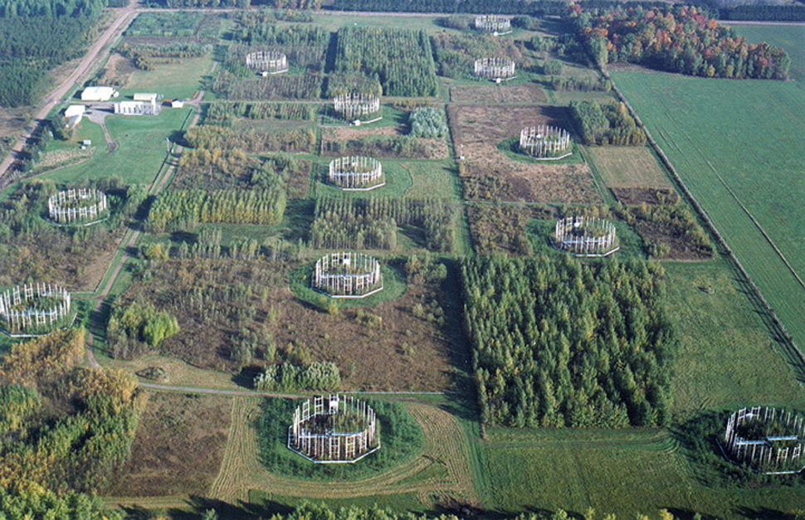


dpFOCE
Closed loop pH control in the ocean
began as Beyond Climate
for a deep sea cabled observatory
FACE
Experiments
First published
June 2006

Slide 2
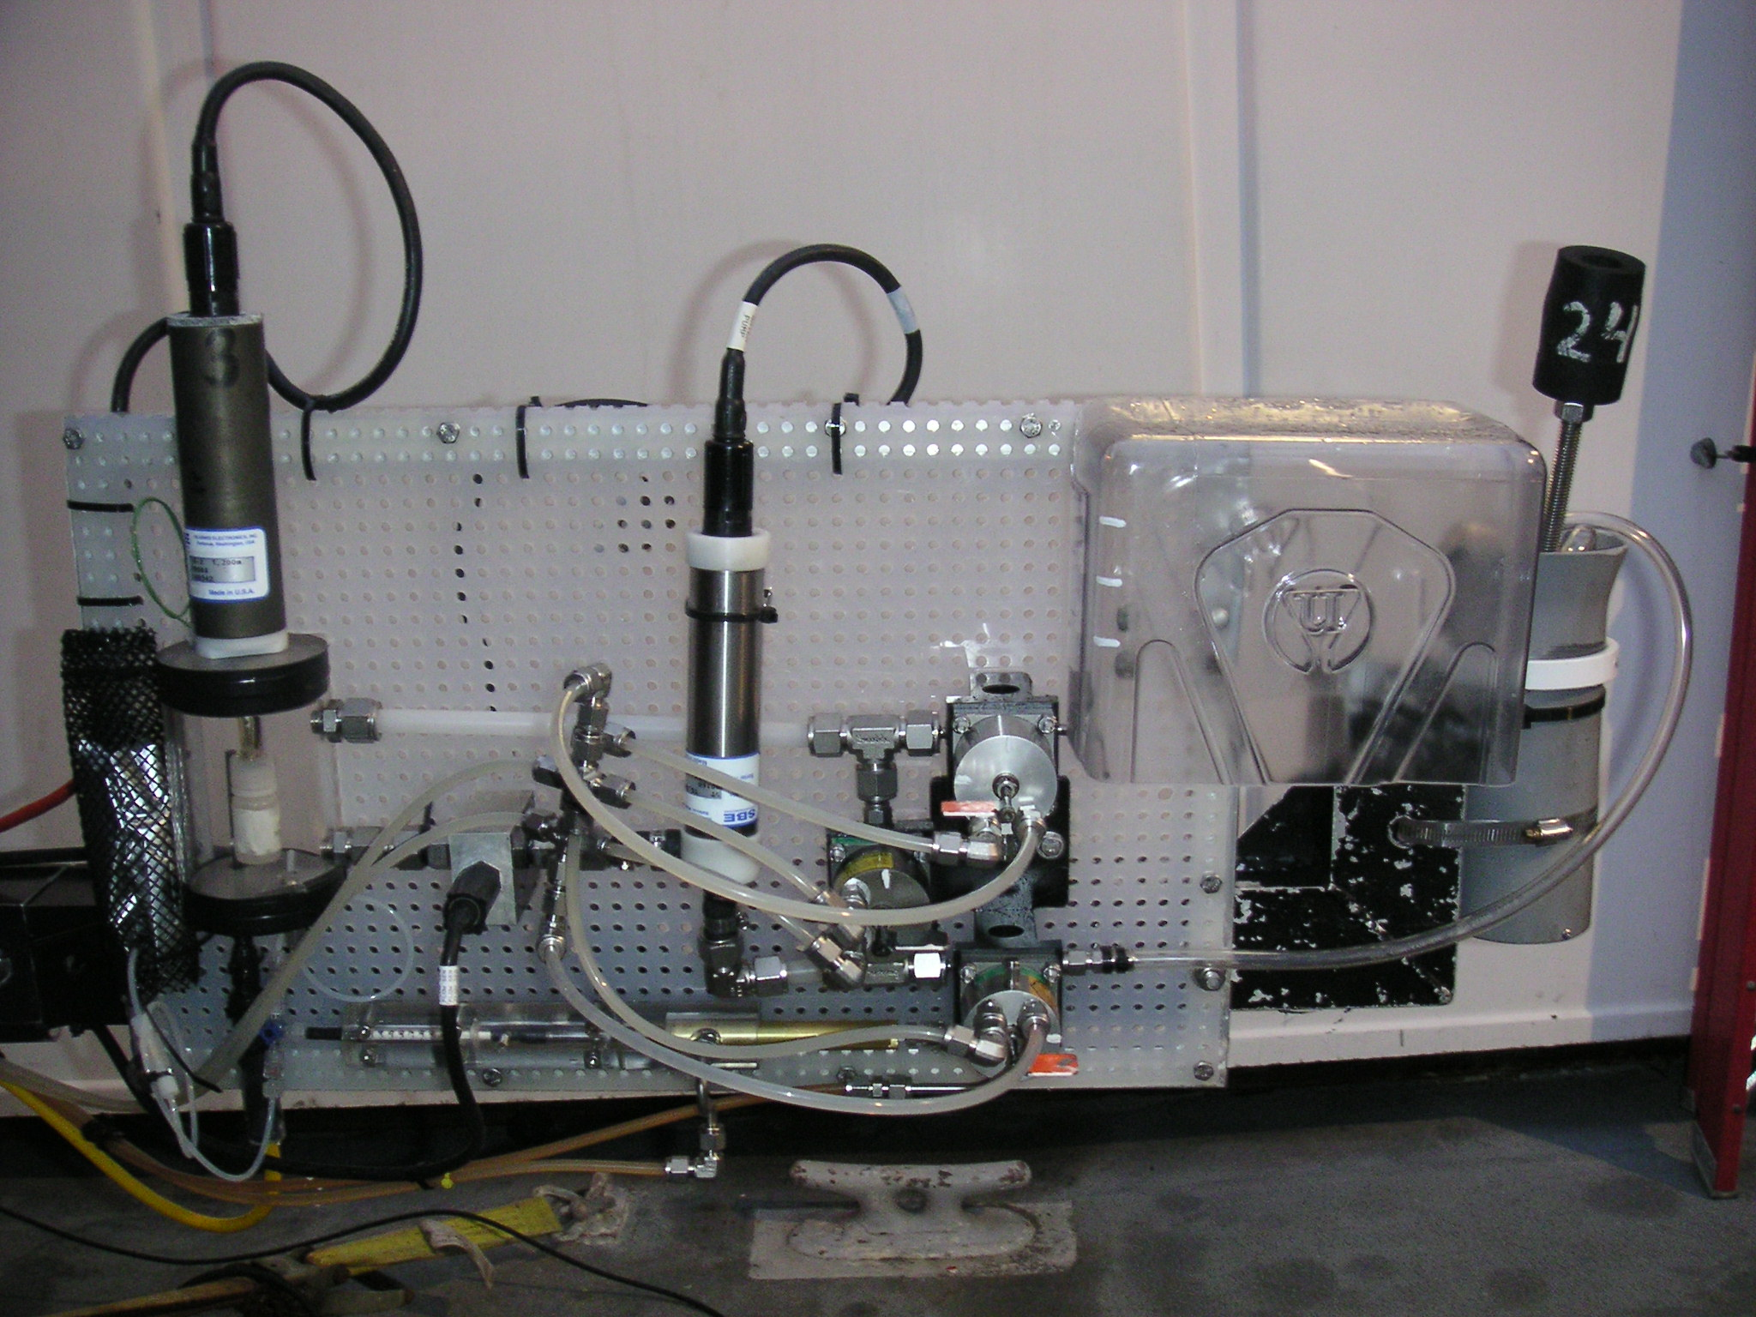
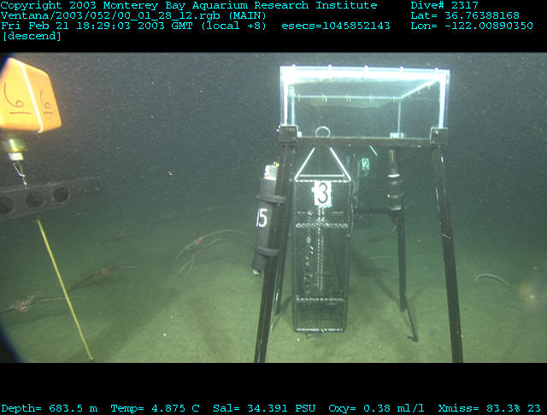
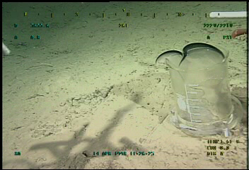
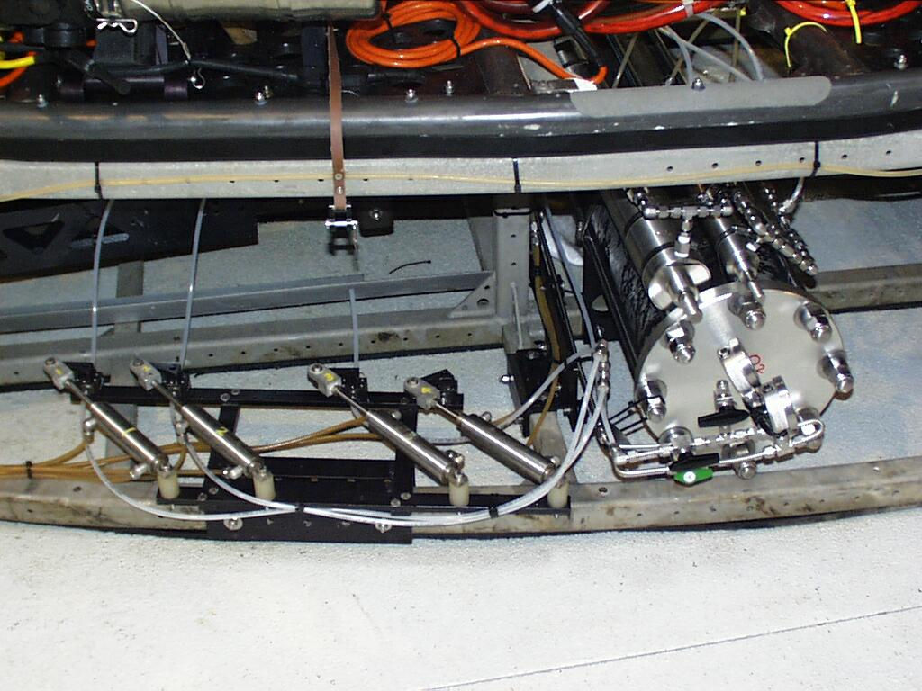
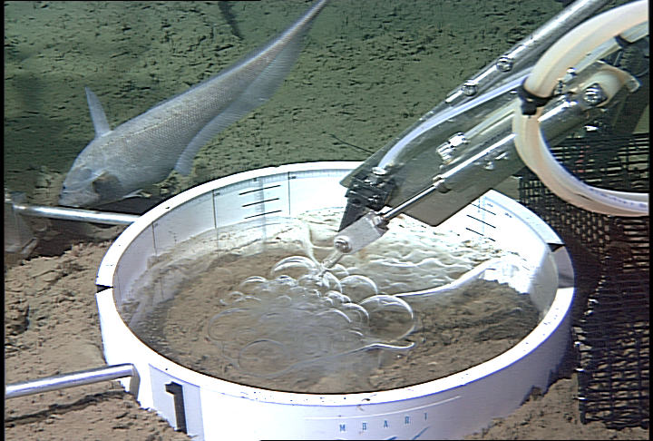
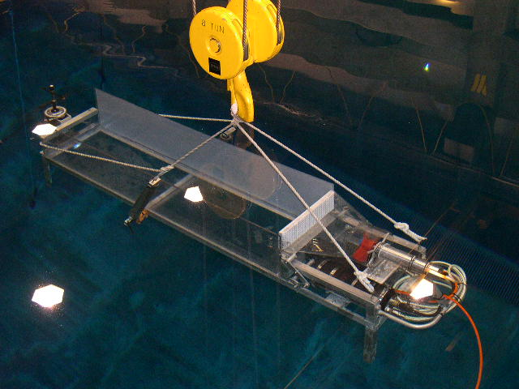
Supporting Work
dpFOCE
CO2 Equilibrium
CO2 Sequestration
CO2 Clahrates
CO2 Instrumentation
CO2 Sequestration and habitat
CO2 Mixing
Examples of Brewer et. al. lab work in CO₂ studies since 1996

Slide 3
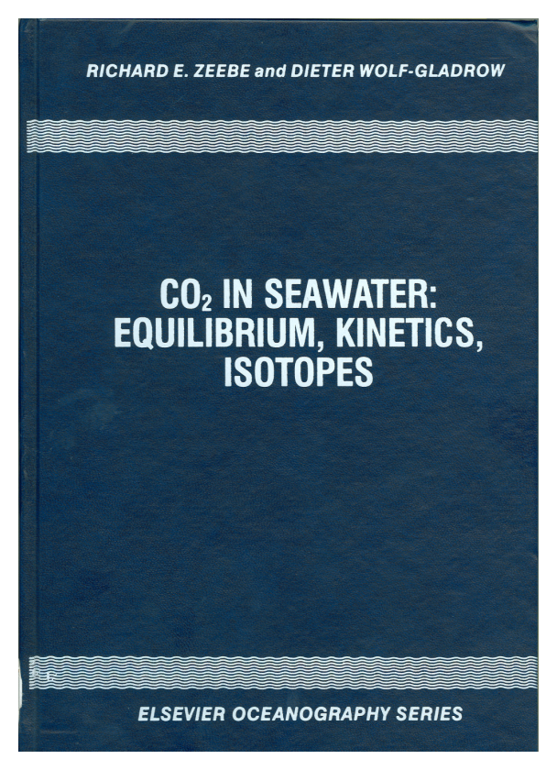
Zeebe & Wolf-Gladrow Model (2001)
dpFOCE
k
-
+
1
H
C
O
+
H
+
C
O
+
H
O
2
2
k
3
-
1
k
-
C
O
+
O
H
-
+
4
H
C
O
2
k
3
-
4
Note: reaction kinetics are a function of both CO₂ and pH.
While, the effect of pressure on the equilibrium constants can be calculated (see Z&W-G appendix A.11), the effect on the reaction kinetics is largely unknown.
F Appendix C.7:
e-Folding time
Linear differential equation:
d
(
δ
C
O
)
1
2
=
-
δ
C
O
d
t
τ
2

Slide 4
FOCE Prototype: Controls Concept
dpFOCE
6<pH<8
Data
pH 1
pH 2
pH 3
Automated quality check or manual over-ride to exclude pH probe(s)
Ave pH
Boxcar Filter
Ambient seawater pH
Desired
performance
pH
Heavily damped system to set pt.
Step function input of desired value
Time
Current Velocity
Manual over-ride to set total pump rate
Notes:
Now for some more detail on the control program.
The 3 pH probes log data every second. To remove noise from the data we applied a box-car filter, that averages the 30 most recent measurements. The smoothed pH values are then passed through a quality filter & average, where if any probe records a pH less than 6 or greater than 8 it is excluded.
In simple terms, the difference between the measured average pH, and the set-point target, then controls the ratio of acid to water.
The current speed input controls the total volume pumped.
The control algorithm used yields a heavily damped, but exponentially responsive system. This was to provide for quick adjustments in current, while minimising bounce under constant current regimes.
As a fail-safe, and because prior to our first trials we quite simply didn’t know how the system would respond, we also had manual over-ride on both control parameters.

Slide 5
Initial Lessons Learned
dpFOCE
No Show Stoppers
→ all systems go for July field trial
Functions well @ 10-20 cm/s, but does not cope well with low/no flow
→ optimize test time by choosing location with higher currents
Current velocity measured from ROV does not match bottom currents
→ add current meter to FOCE frame
Large spikes on lower pH probe due to pooling of dense acid
→ density match acid to seawater (reduce acid strength)
Disequilibrium between added acid & seawater
→ quantify extent of this problem using recirculation pH loop
After finding solutions we began deep FOCE
Notes:
So the only changes made to the system for the second field trials were to incorporate a current meter into the FOCE frame, and to density match the HCl strength to ambient seawater. We also changed study site, to a 500m depth location with stronger currents.
The average current speeds we experienced in the second field trials were on the order of 25-30 cm/sec. Under this ‘fast’ flow regime, we were unable to achieve our target pH set-points – where this relates to the last point on the list above – to quantify the extent of disequilibrium between the added acid and seawater – and it is these experiments I will take you through now.

Slide 6
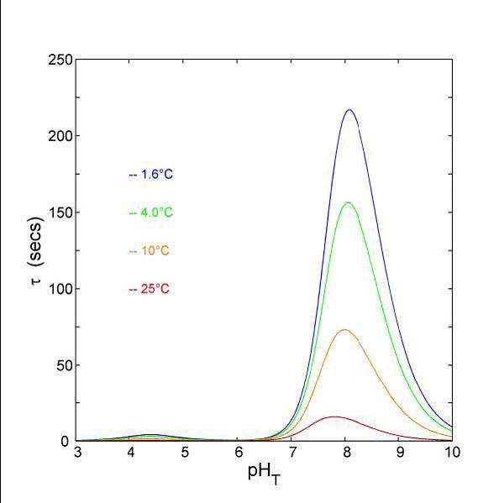
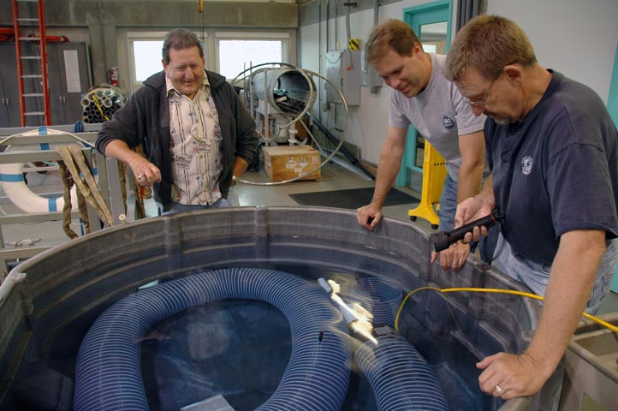
dpFOCE
The path to FOCE for MARS
A series of small scale experiments
and developments took place…
Smallest In Situ FOCE to date
Approx. 8”x 8”x 8”
Control Volume

Slide 7
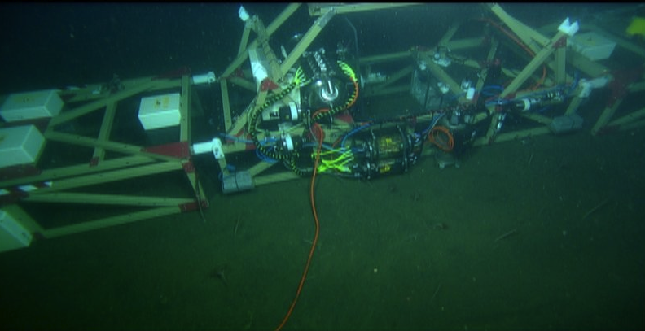
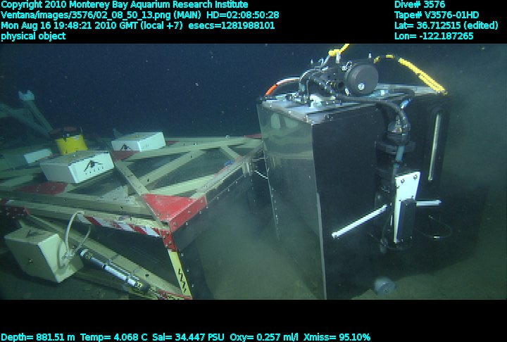
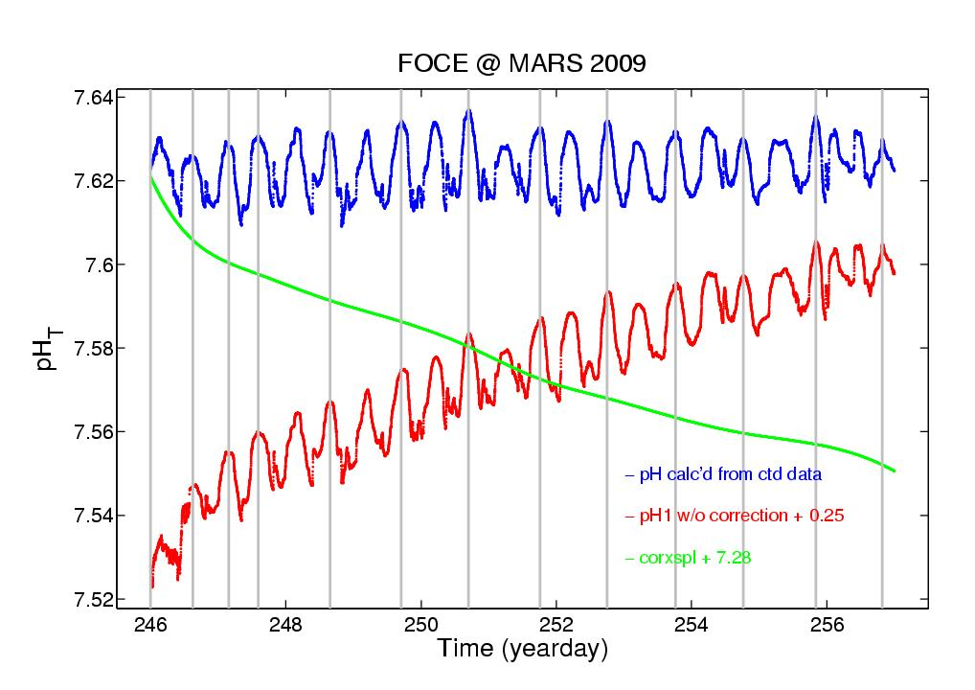
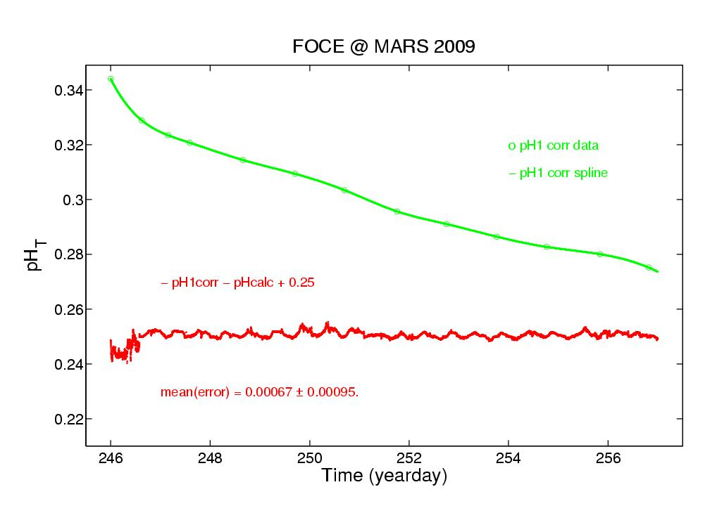
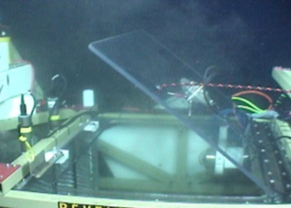
dpFOCE
Deployed for long term testing – 10 months
CO₂ chemistry experiments
Proved out long term in situ ops and digital pH probes
+
pH Mean (error) = 0.00067 0.00095
-

Slide 8
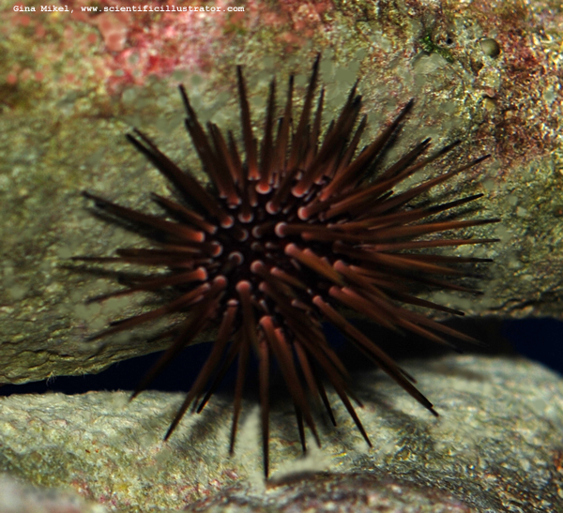
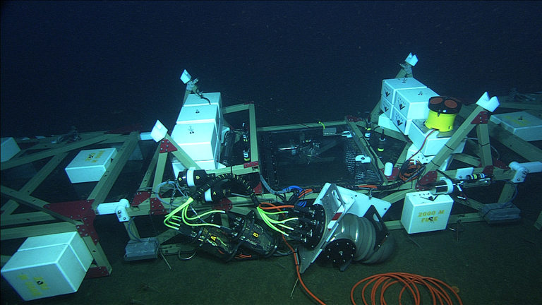
dpFOCE
First long duration deep biology experiments just completed
– 10/23/2011 using sea urchins
Time lapse video used to observe urchin motions and feeding behaviors in elevated CO2 compared with a control section located 20 meters away

