Slide 1
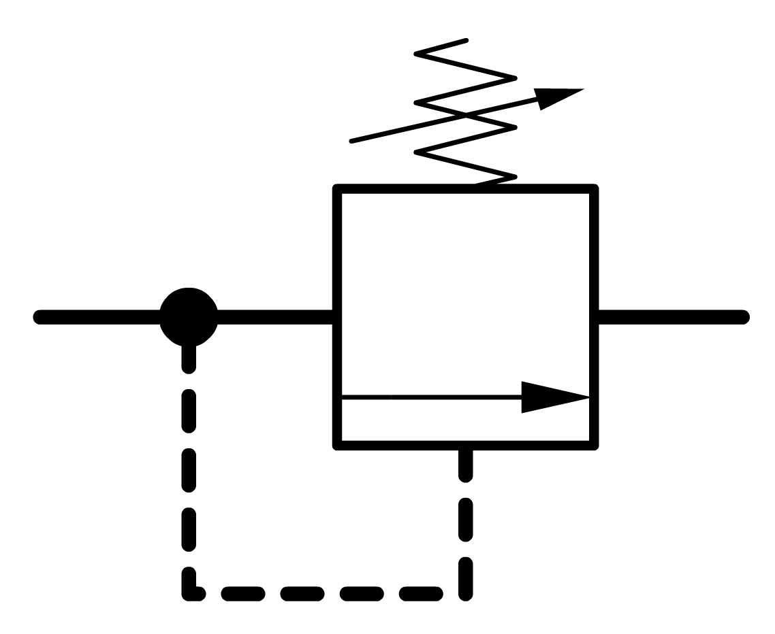
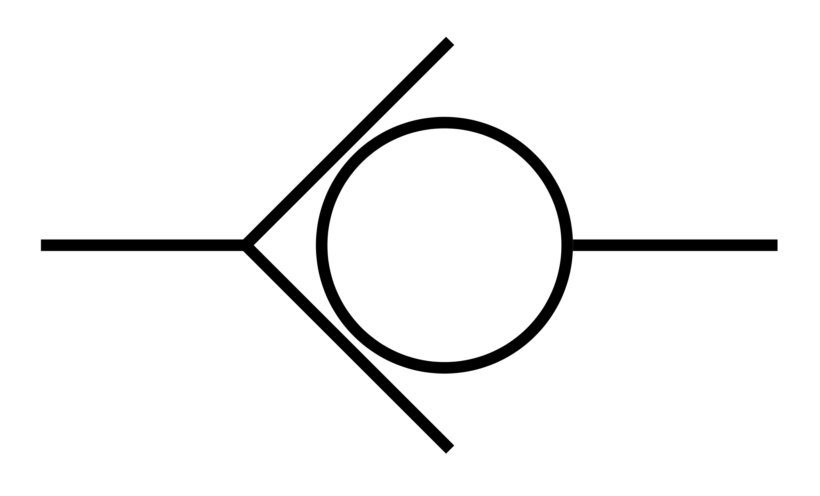
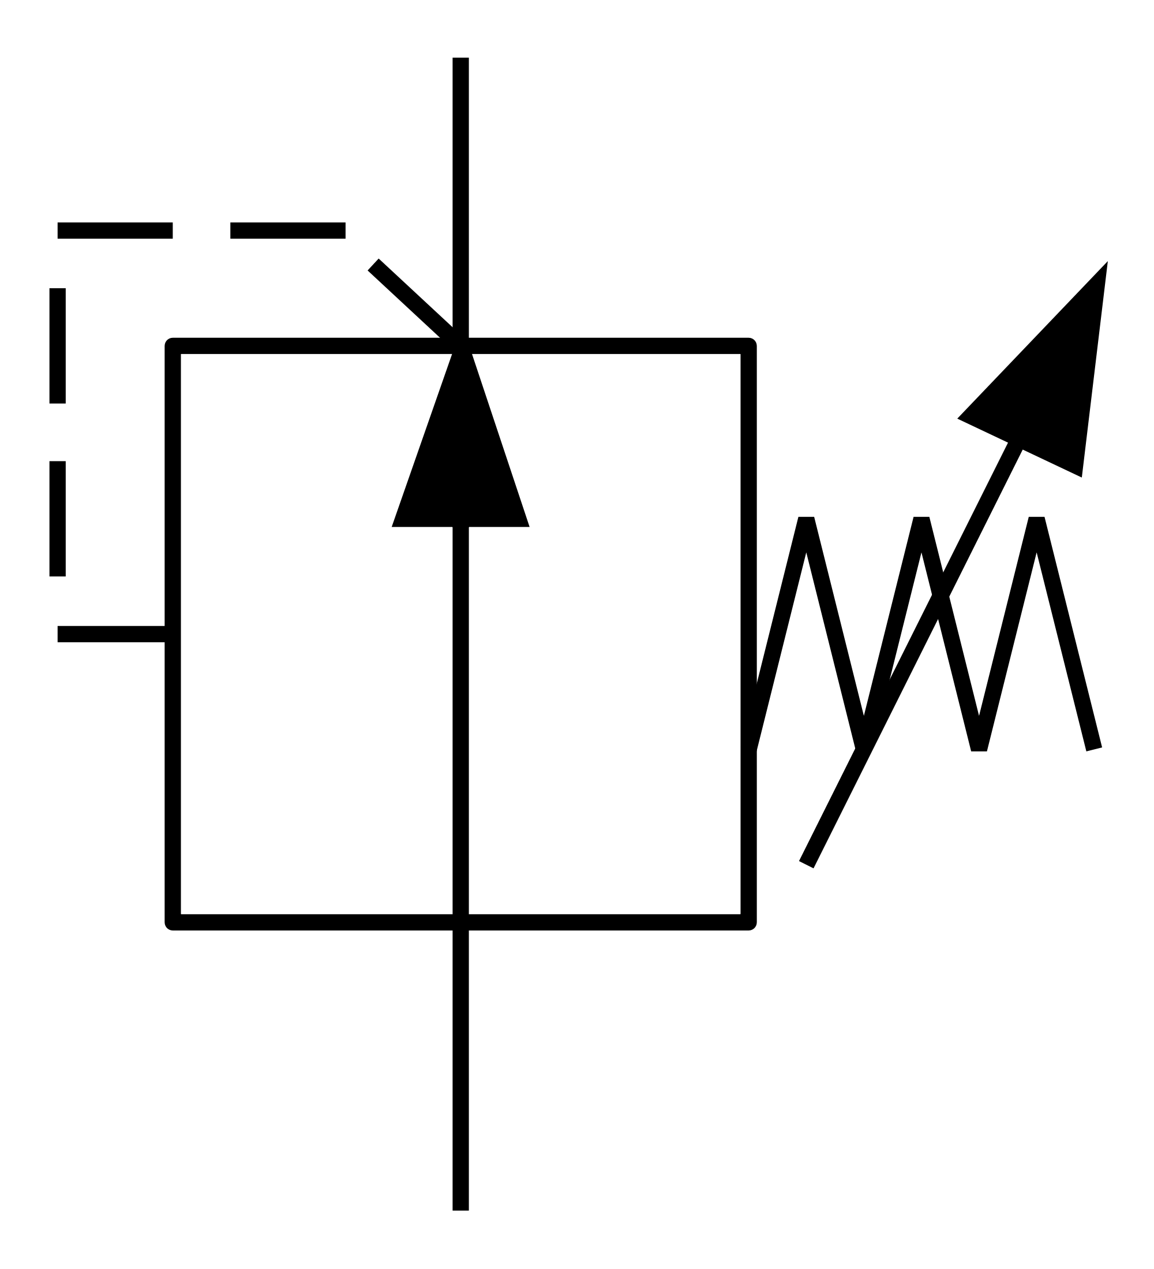
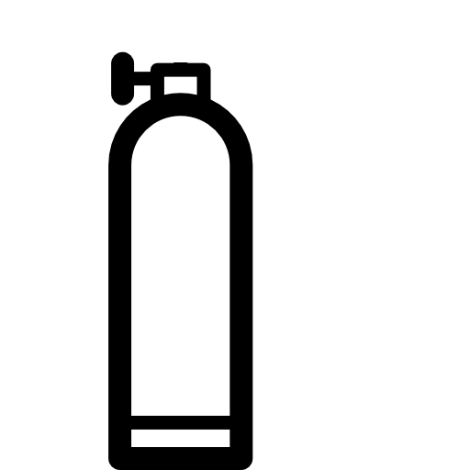

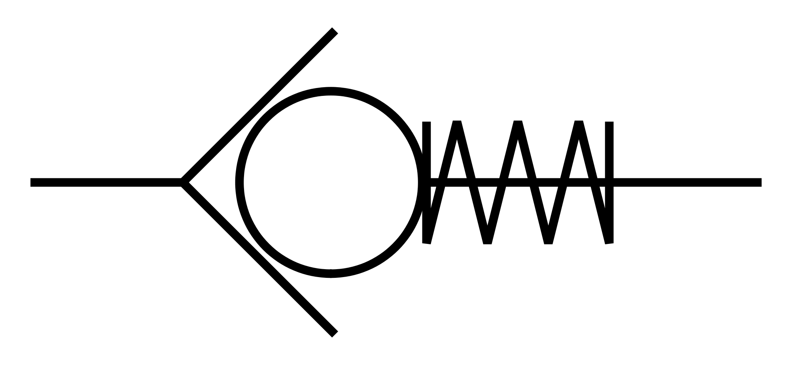


30 m = 45 psi approx.
In Situ Acidification Chamber
Regulator
Relief Valve
CO₂
Check Valve
45psi + X psi
Check Valve
Pump
To FOCE
CO₂ Tank
Access Panel
w/ Seal
Filter
H₂O INLET

Slide 2
Concept of Operation
Box would have suitable legs or support for location
Box is built to withstand desired pressure, clear plastic if possible to
make operations easier
Diver goes down with access panel open (use a lowering bag)
As water rises internally adjust CO₂ regulator to push water back down
Repeat until on site
Once located adjust CO2 regulator so that water is at desired height. This would be determined by calculation. Volume to surface area exchange of CO2 into the water. Lock access panel which is sealed to prevent leakage of fluid.
Pump pushes water into tank, the set check valve with filter opens due to pressure differential and allows water delivery to FOCE. The Regulator maintains the water to gas height internally.
Relief value allows the system to be worked around safely and to be retrieved safely.
The Theory of Operation
The sea water being pulled in is buoyant versus the seawater that is saturated with CO₂. This causes a gradient with the heavier enriched seawater to sink to the bottom, exposing the buoyant seawater to the CO₂ gas interface. The angled floor lets the most dense seawater sink to the output port. This cycle repeats as water is pushed through. IMPORTANT: Tank sizing is dependent on demanded quantity of enriched seawater… temperature and pressure determine the time required against volume.

