Slide 1
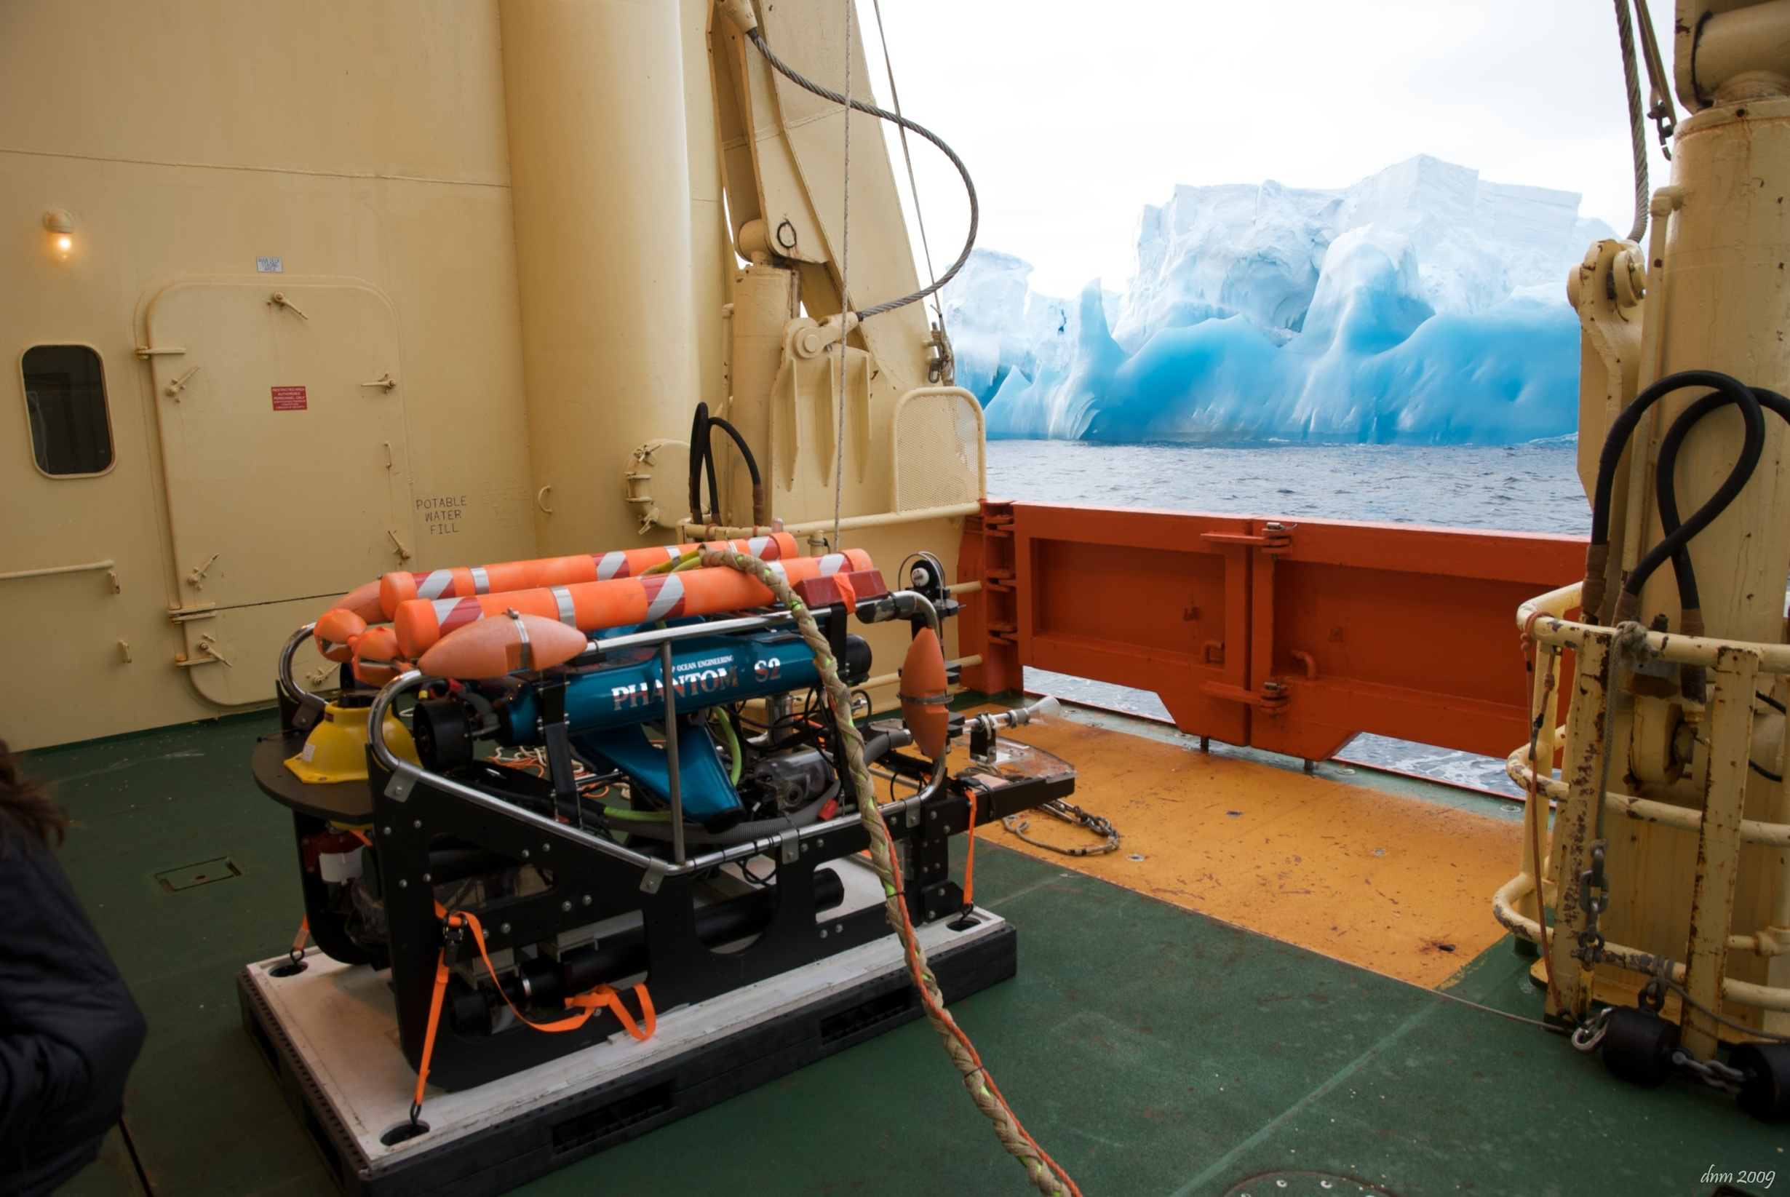
Technology for Studying the Polar Regions
Alana Sherman
June 21, 2011

Slide 2
Study the Polar Regions
Polar regions are changing more
rapidly than any other part of the
earth
  Proliferation of icebergs in the Antarctic
  Rapid melting of Arctic ice cover

Slide 3
Technology
Technology developed at
MBARI, to study the local
ocean, can have great impact on
studying the world oceans

Slide 4
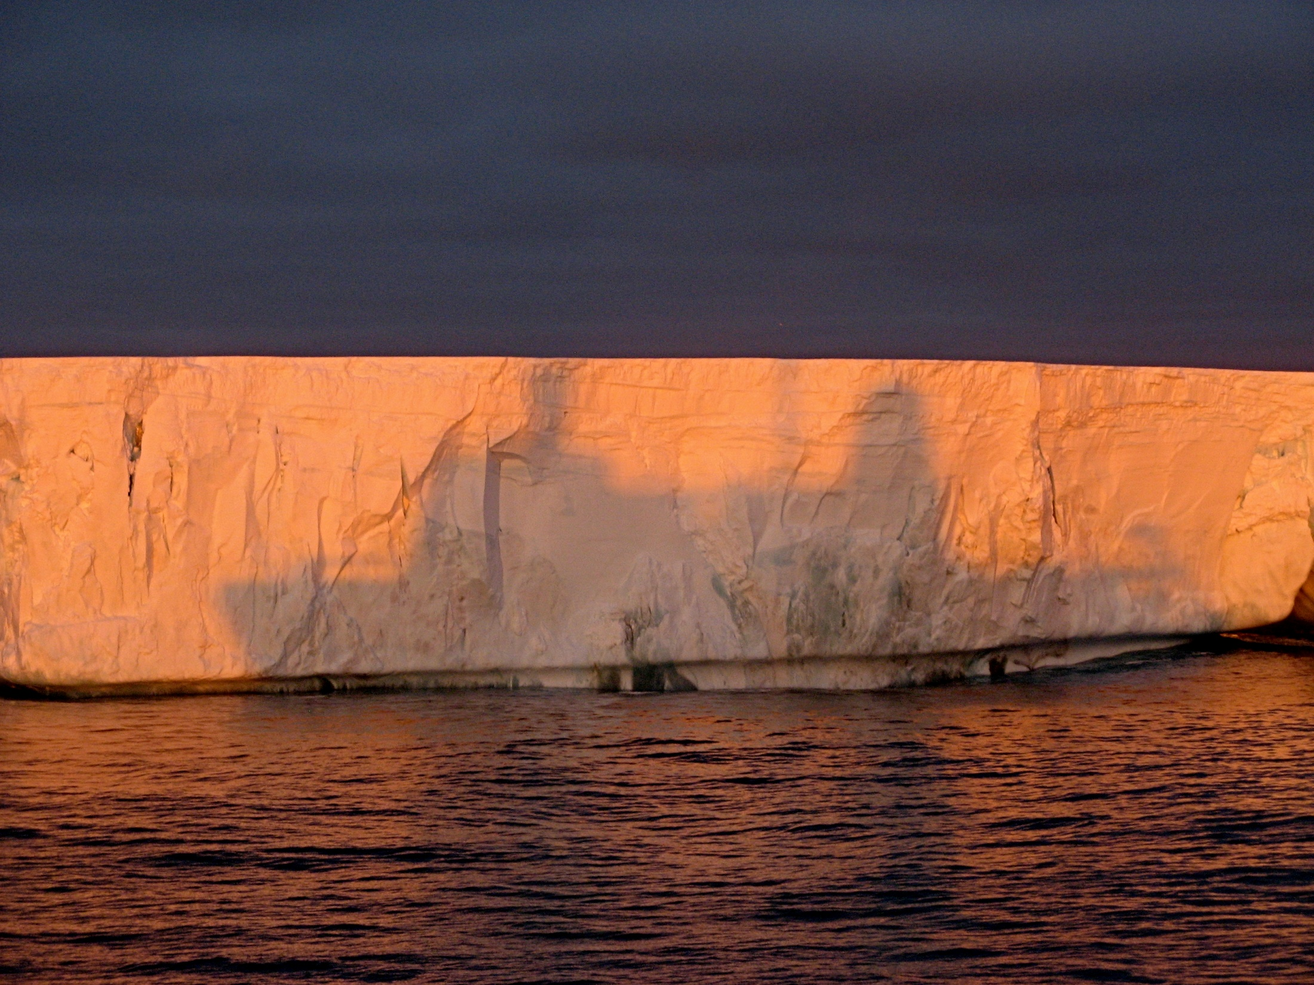
The Antarctic:
Drifting Icebergs

Slide 5
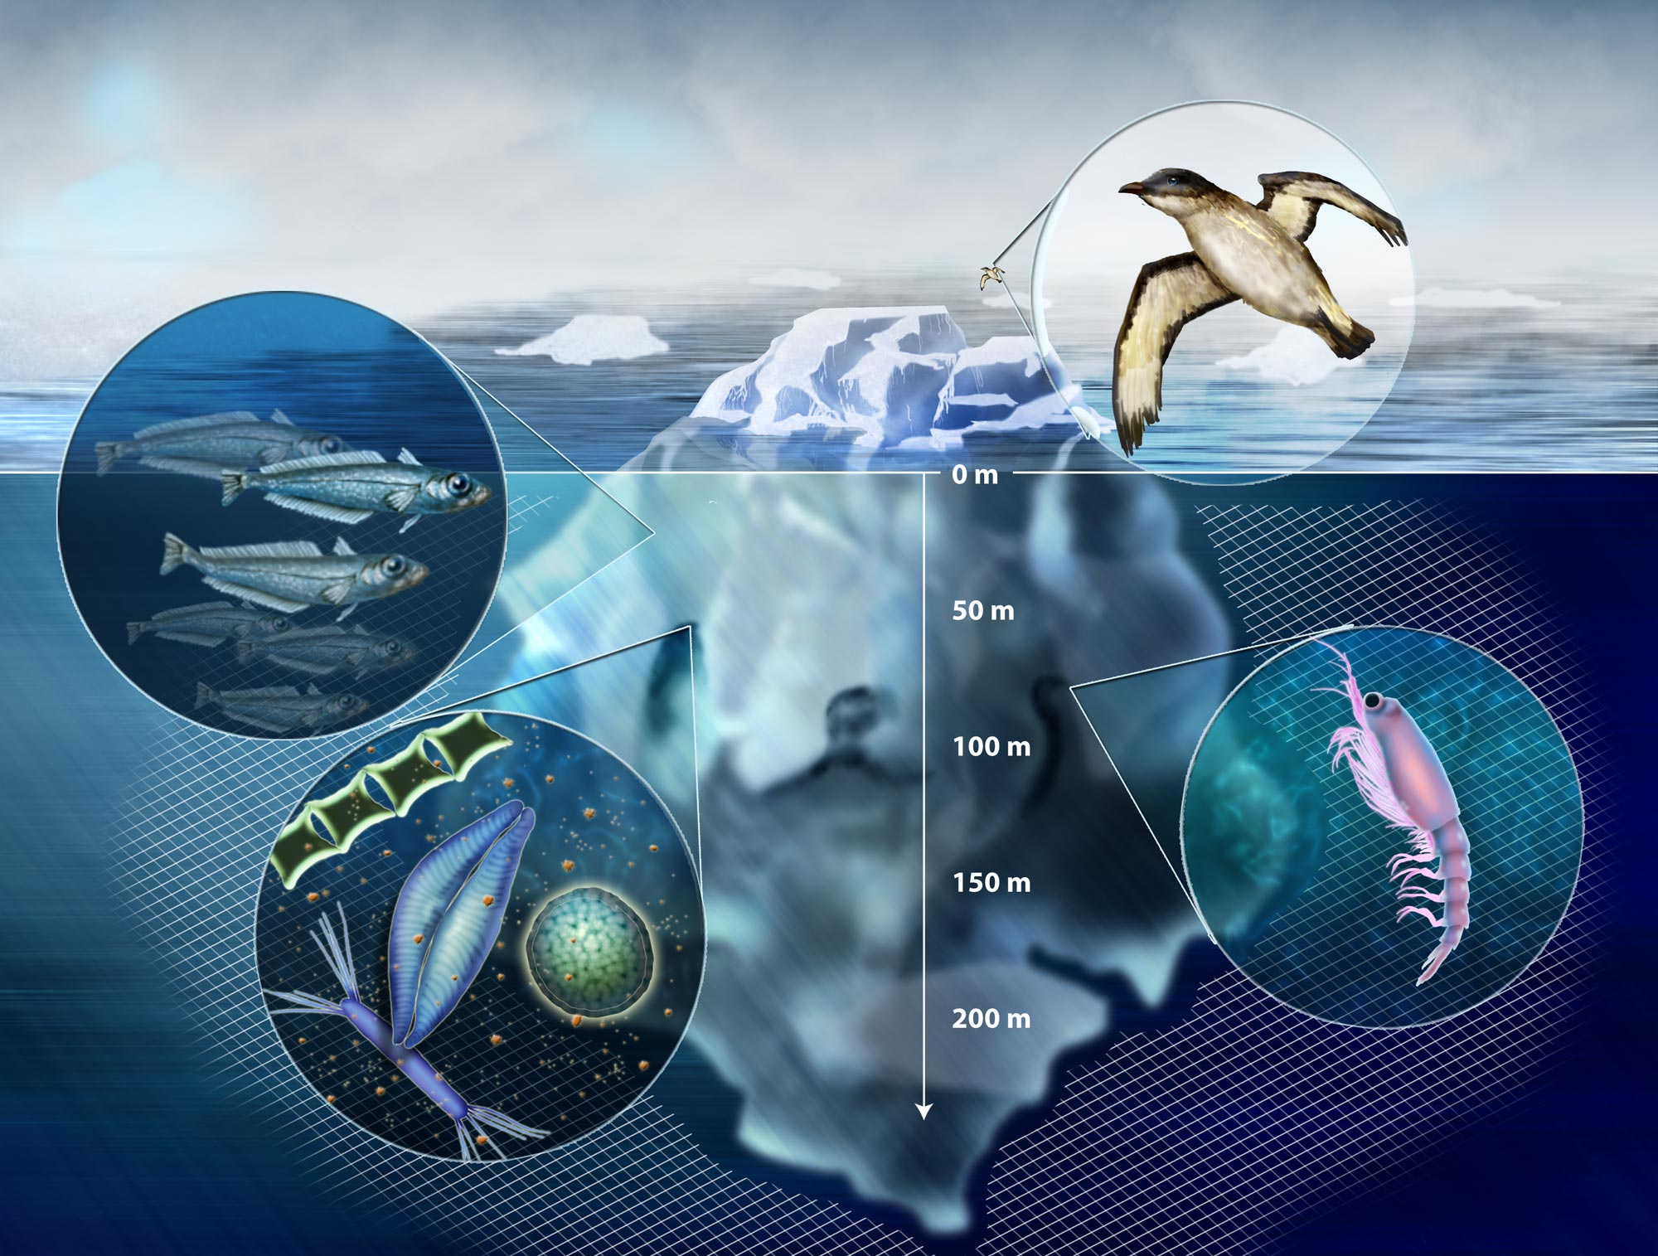
The Question
  Do drifting icebergs significantly increase the
  production and export of carbon in the
  Southern Ocean?

Slide 6
The Collaborators
  University of San Diego
  University of California, San Diego
  University of South Carolina
  Scripps Institute of Oceanography
  Desert Research Institute

Slide 7
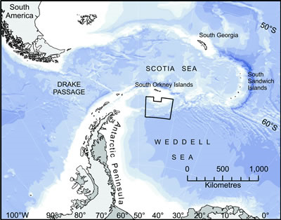
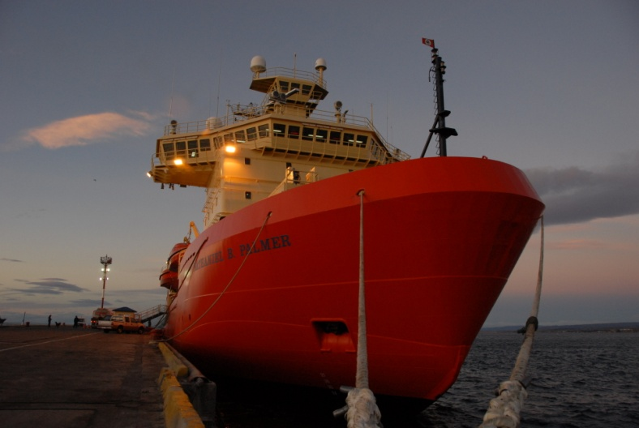
Where: Weddell Sea
When: 2005, 2008, 2009
RVIB Nathaniel B. Palmer
Notes:
Fueled by a larger NSF grant and engineering support from MBARI we headed back to the Southern Ocean in June, armed with a pile of new technology that Paul, Alana and I will be describing in this presentation. There will be third expedition next March, so our mid-winter cruise was essentially a field test of this new technology, so it was very fortunate the three of us were able to join the expedition, just in case there were any surprises that required significant modifications at sea.
We set out from Punta Arenas Chile on May 31st, traveled south to Elephant Island off the northern Antarctic Peninsula, then essentially traced Earnest Shackelton’s famous boat trip towards South Georgia Island looking for bergs. We worked around five different bergs ranging in size from a ¼ mile to over 26 miles long.
We sampled the water to measure nutrients, trace metals and microscopic critters and trawled the water to collect larger animals. These tasks were well handled with existing ship-based tools.
However, we weren’t allowed to bring the ship in close to the bergs to sample the water within 200m of the berg.

Slide 8
Sampling: Iceberg Sphere of Influence
Biological and Chemical
sampling of the iceberg face
Sample organic
material from beneath
iceberg
Notes:
We planned to use an ROV to sample near the berg, then compare those data with what we found far from the berg – Alana will be describing the ROV operations in more detail in a bit.
Now, we need to know where the best place to sample
The first task we always did was a detailed circumnavigation
Look for interesting features that focus activity
Can’t see below the water

Slide 9
The Challenge:
Collect material sinking beneath a drifting iceberg

Slide 10
The Challenge:
Collect material sinking beneath a drifting iceberg
Without knowing where the iceberg will drift

Slide 11
The Challenge:
Collect material sinking beneath a drifting iceberg
Without knowing where the iceberg will drift
And be able to recover the instrument

Slide 12
The Challenge:
Collect material sinking beneath a drifting iceberg
Without knowing where the iceberg will drift
And be able to recover the instrument
And detect the presence or absence of an iceberg above the instrument

Slide 13
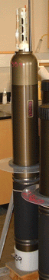
The Technology
Scripps SOLO drifter float +
Sediment traps +
Acoustic modem =
Lagrangian Sediment Traps

Slide 14
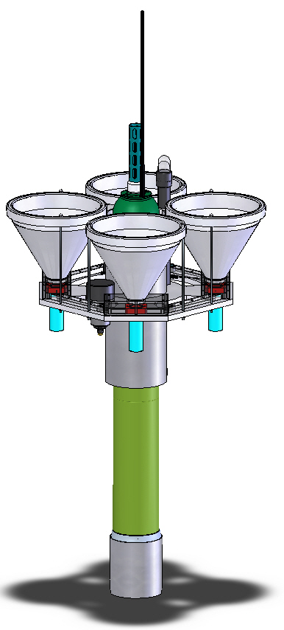
Argos Sat-com
Seabird CTD
(4) Sediment
Collection Funnels
- Work in parallel
Benthos Acoustic Modem
- Tracking
- Burn wire
- Upward-looking
Acoustic Ranging
6’
Sediment
Collection Cups
Burn-wire Actuators
(2) For sediment trap
(1) Ascent weight drop
SOI/Russ Davis’
Solo Float
Notes:
Lagrangian Sediment Traps Goals
Demonstrate a clear path under berg - Drone
Collect falling particulate matter from below the berg
Measure the CTD below the berg
Measure the distance from the LST to the berg
Measure the slant range between LST and ship
Remotely trigger sampler and drop weight

Slide 15
Deployment

Slide 27
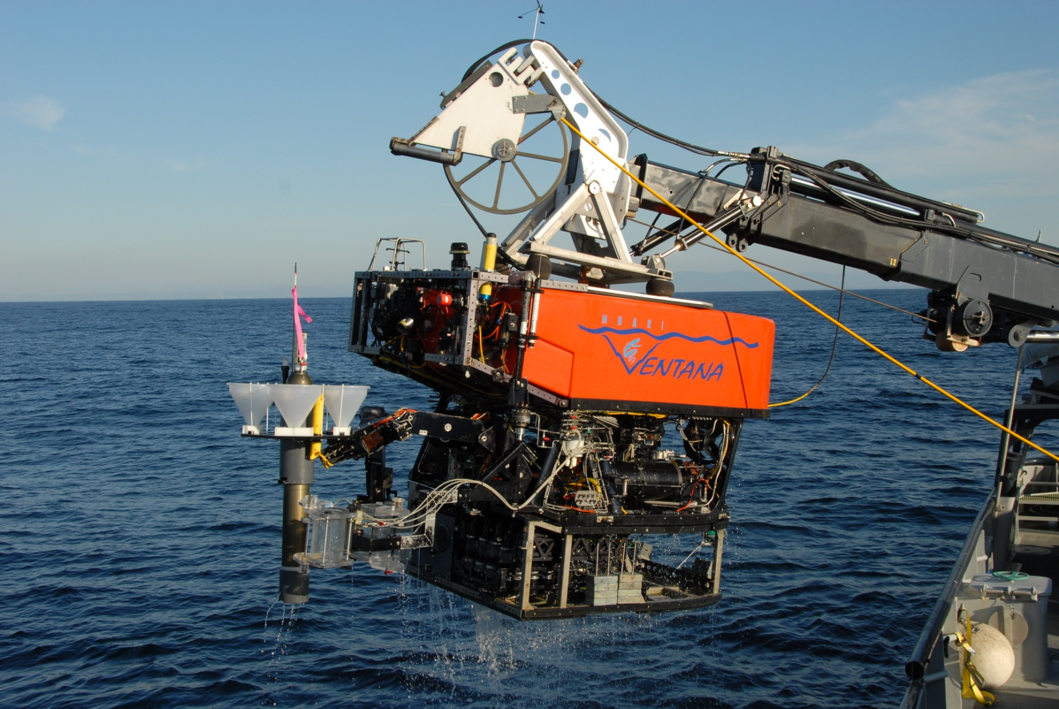
Monterey Bay Testing

Slide 28
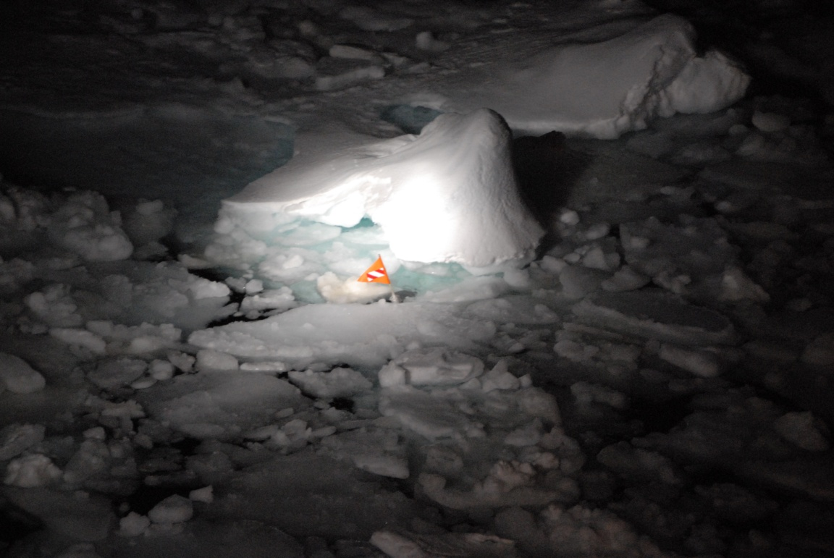
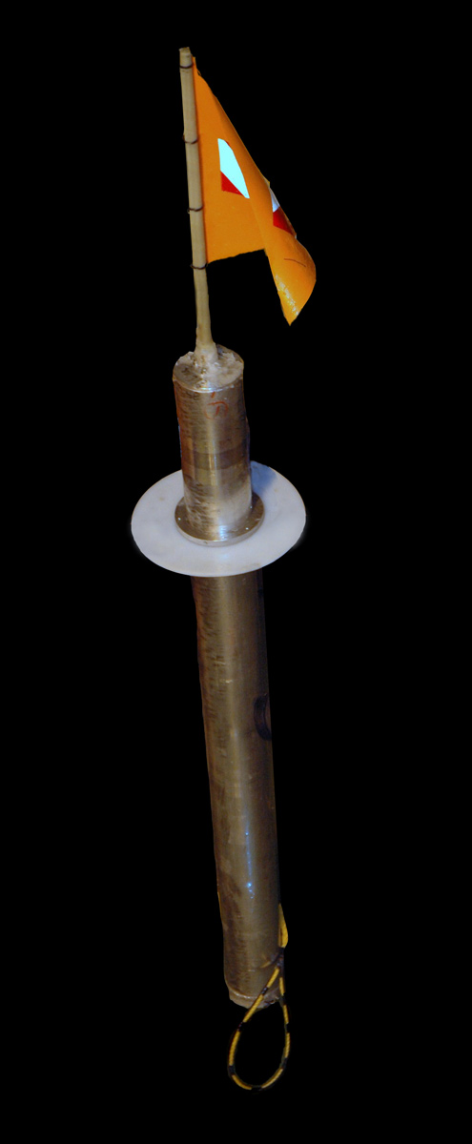
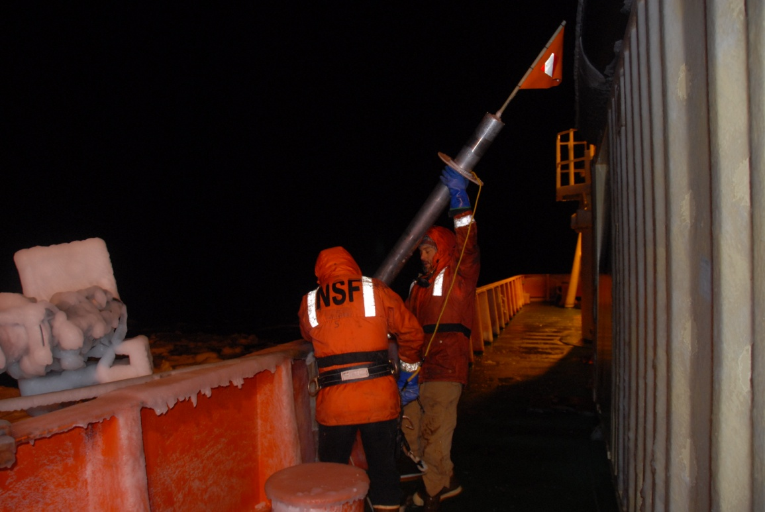
Notes:
Demonstrate a clear path under berg – Drone
pressure triggered guillotine drops descent weight at 500m and ascent at weight at 1800m
galvanic release drops ascent weight ~18 hours
No RDF on surface
Sea ice invaded operations area 24 later – abandoned search after 28 hours
RDF hit 32 hours later – safely recovered in sea ice
Drone drifted 11 miles at ~ 1/3 knot
Galvanic release slower in cold water
One Drone dive
Delayed weight drop, came up under pack ice

Slide 29
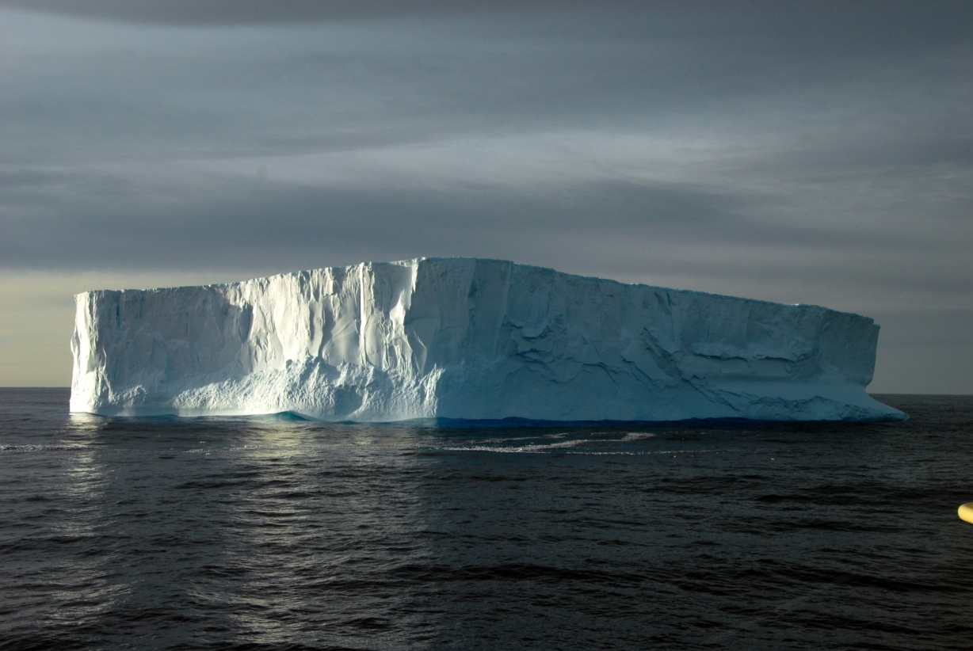
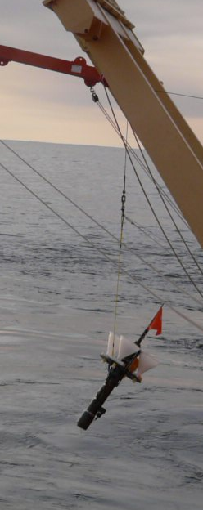
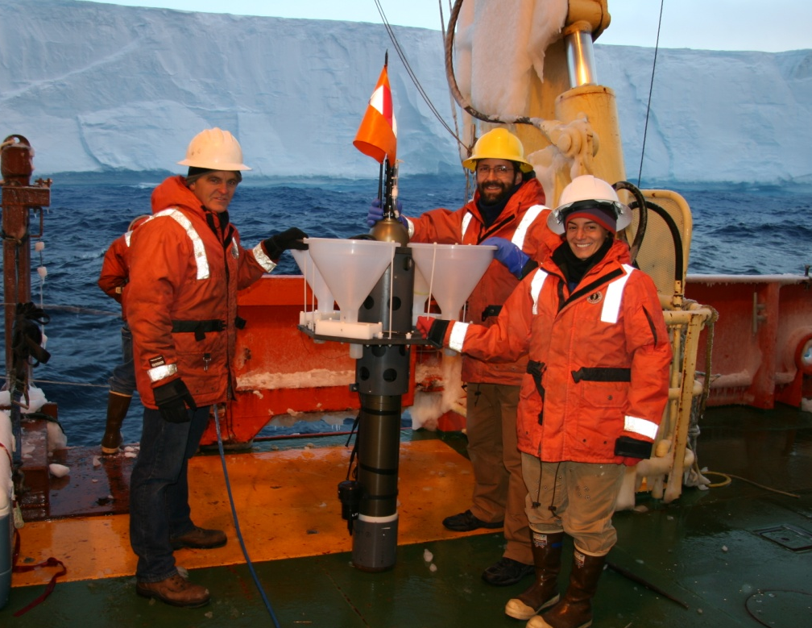
Notes:
Buoyed by the success of the drone we moved to another iceberg farther from the pack ice. We tracked the berg for several hours to determine the course speed and direction, then deployed the LST about 200m in front of the berg. Using the acoustic modem, we monitored the fast descent to 500m and confirmed it began maintaining station at that depth. Then, for some reason, the iceberg seemed to stop and reverse direction. Four hours later, we commanded an early ascent of the LST since it was clear the berg wasn’t going to pass over it. We located the vehicle on the surface and the helmsman maneuvered along side for recovery. Unfortunately, the ship approached the vehicle too fast and the deck crew wasn’t able to grab the lift line before the vehicle was sucked under the ship when the helmsman revved the engines to stop. We then noticed a few white pieces of plastic floating on the surface and were never able to establish acoustic or RF combs.
LST Results
One LST dive – LST was lost before recovery
Dove to proper depth, measured slant range, commanded sampler and drop weight
No info on acoustic ranging, CTD or seed samples
Delay in Argos radio transmission – software change
Needs a ~10m floating line to grapple from distance
Better grapple anchors on vehicle
Will make instrument more deeper diving

Slide 30
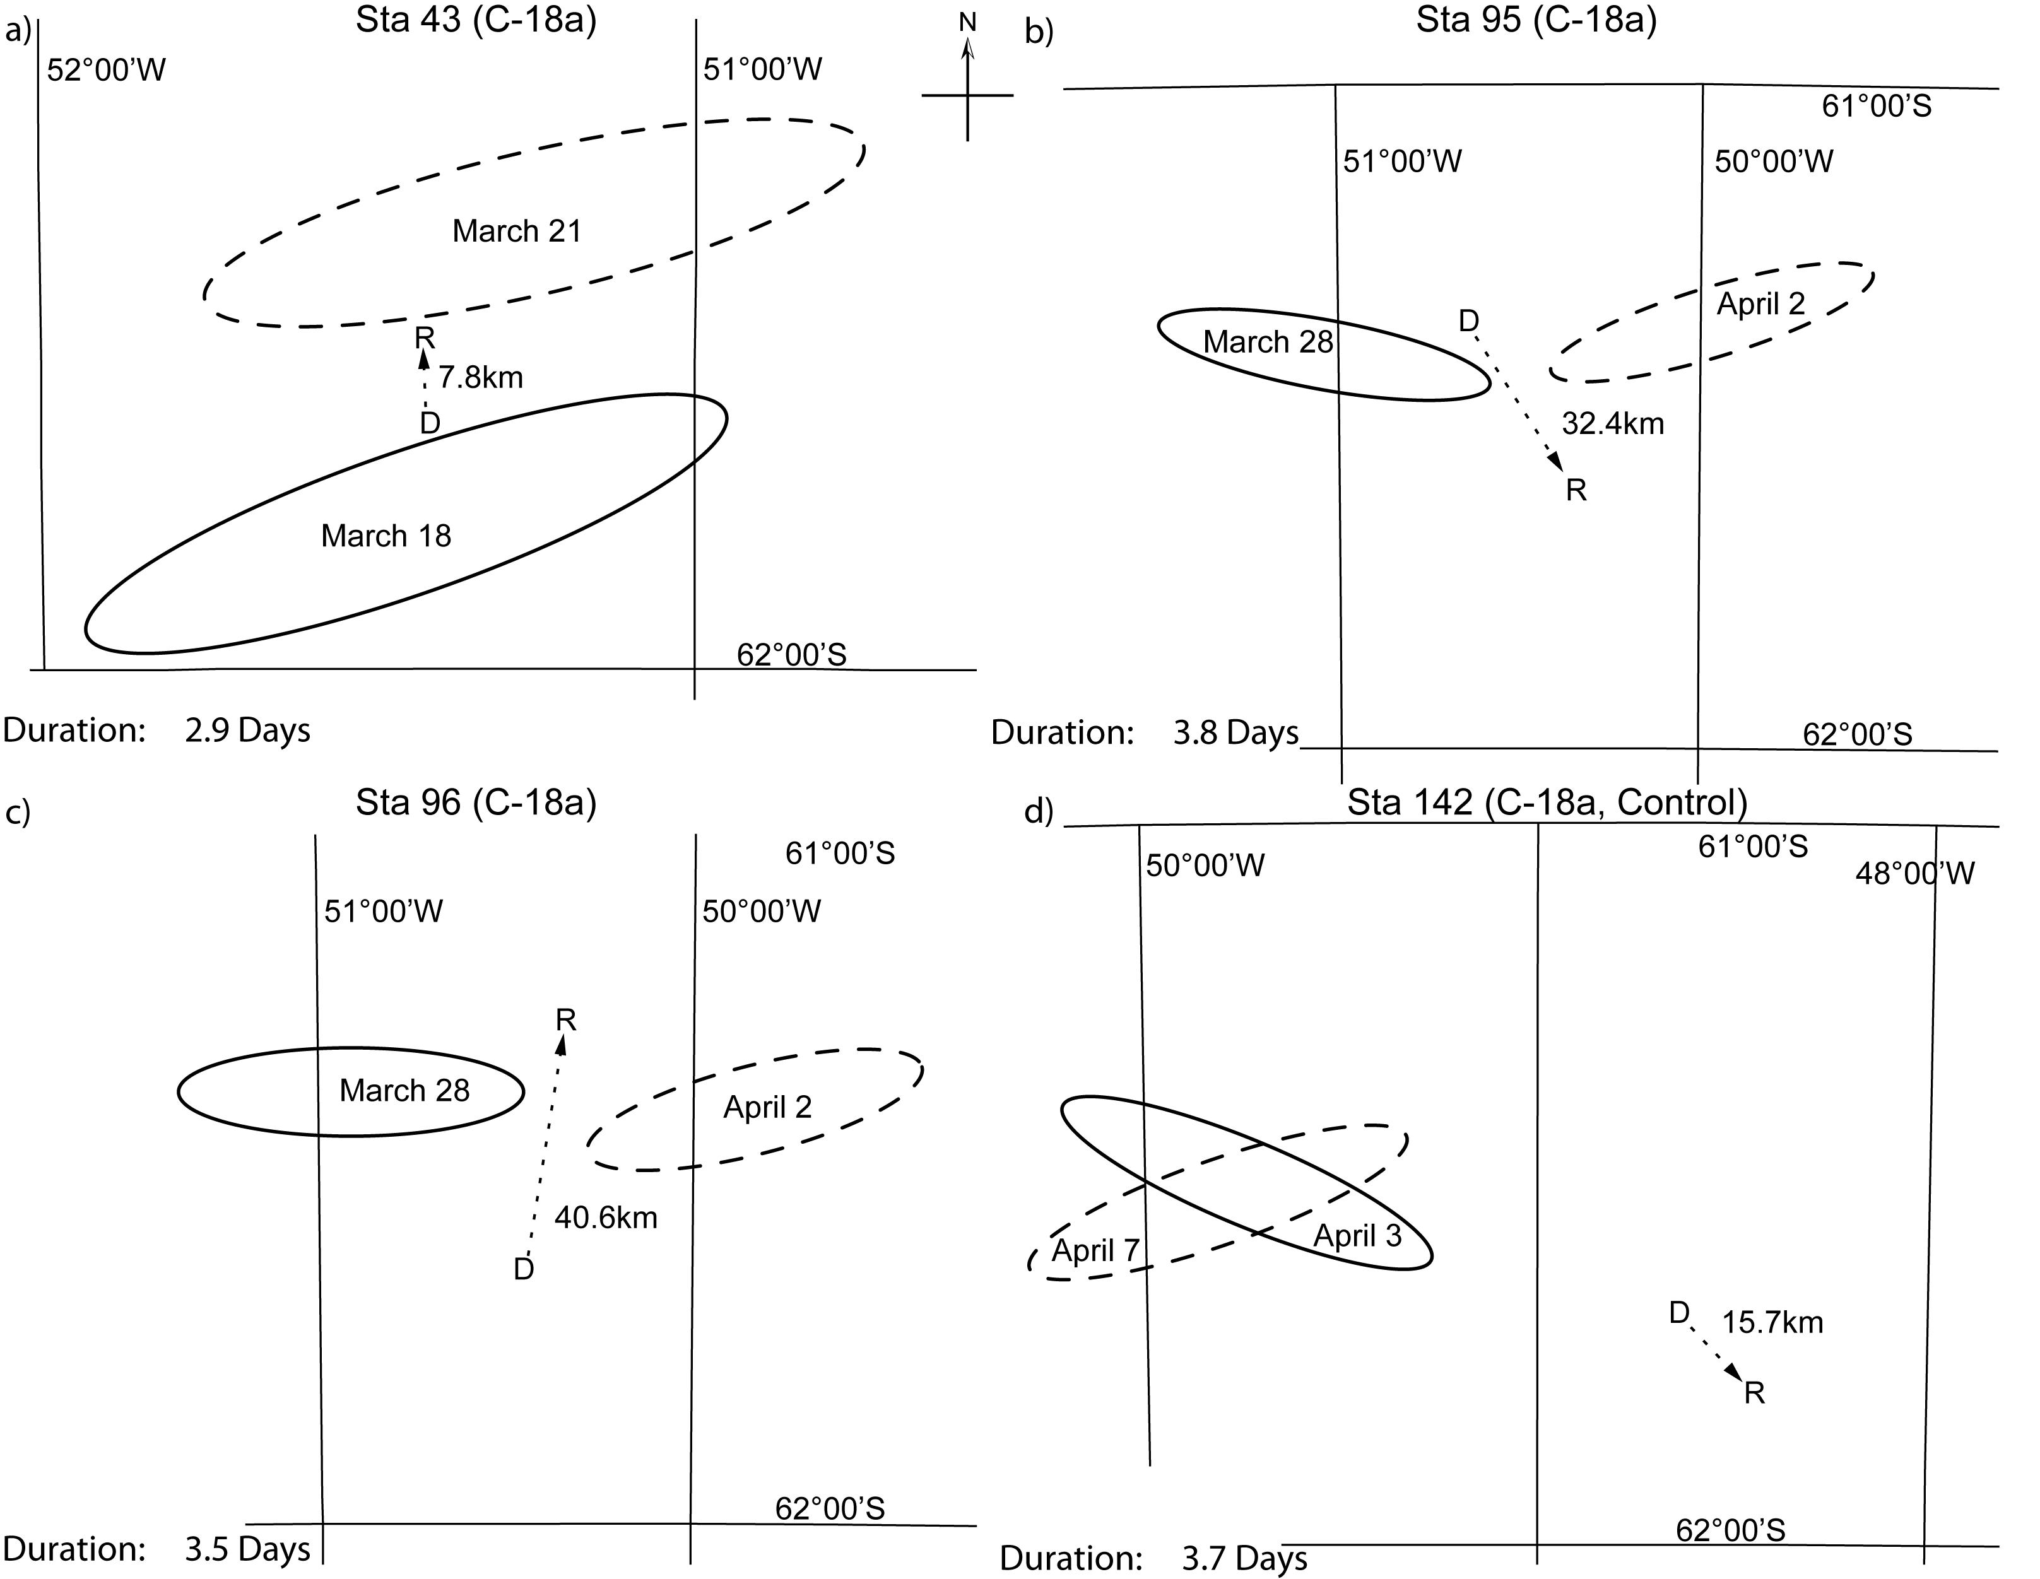
Four Deployments 2009

Slide 31
Four Deployments 2009

Slide 32
Results

Slide 33
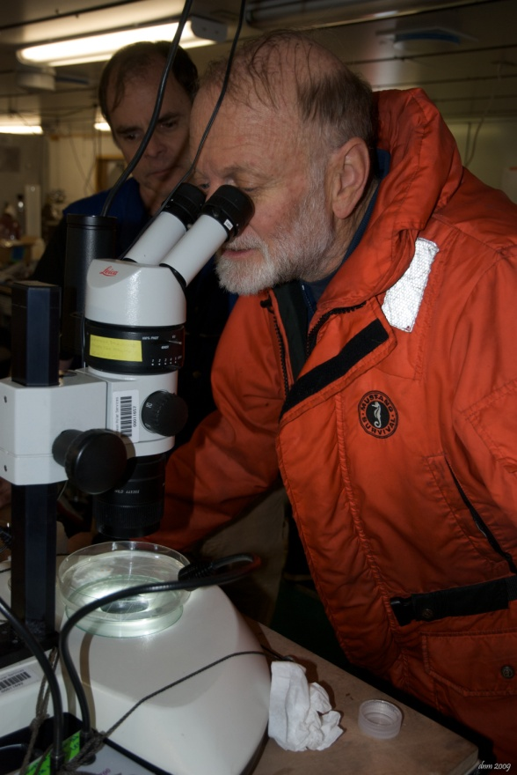
Results!

Slide 34
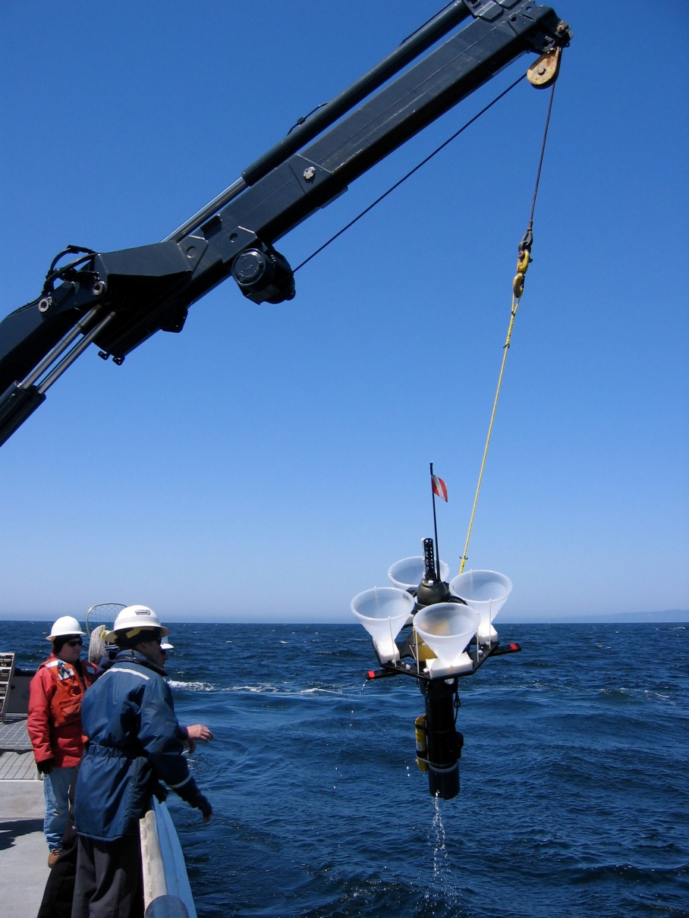
Future of the LST…
Deployed in Monterey
Bay July 2010 concurrently
with SIO/ Texas A&M in
particle flux study
Shallow version in development
for Canon experiment in
Monterey Bay

Slide 35
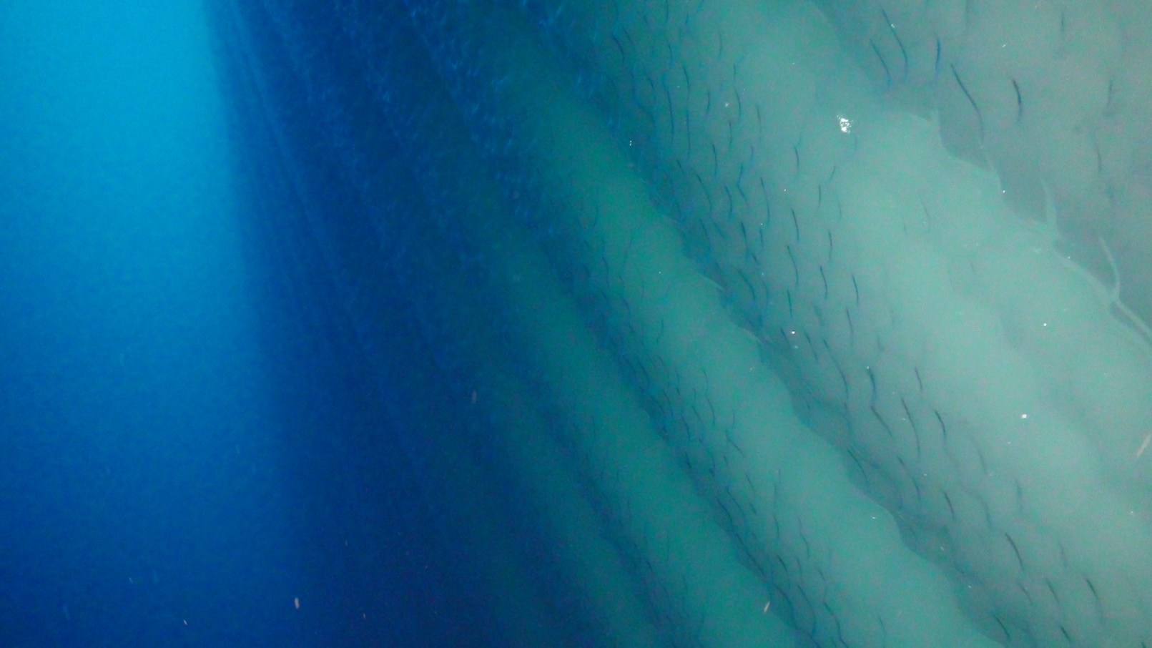
The Question:
Is there increased iron content near
drifting icebergs?

Slide 36
Water Sampling
Notes:
We want to sample at and beneath the iceberg, as well as far away from the berg to see the halo effect.
Why

Slide 37
Ship based sampling??
video
Videos from Claire Allen and Kyle Saari
Notes:
I believe this footage was captured aboard the Palmer near the base of a glacier
Nobody was hurt, though it shows why the captain was hesitant to get too close to the bergs
We witnessed many calving events and 1/3 of one of our bergs broke off one night. These are definitely dynamic structures.

Slide 38
Phantom Missions
Notes:
We want to sample at and beneath the iceberg, as well as far away from the berg to see the halo effect.
Why

Slide 39
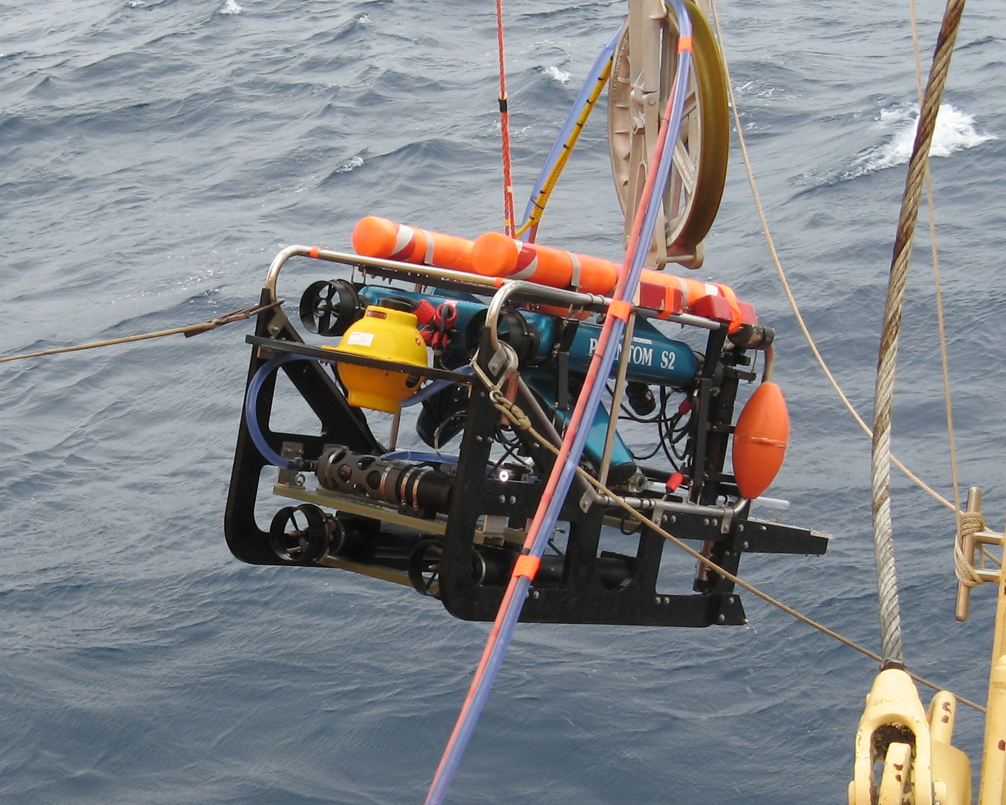
ROV for Iceberg Sampling
Nozzle
Pump

Slide 40
Video

Slide 41
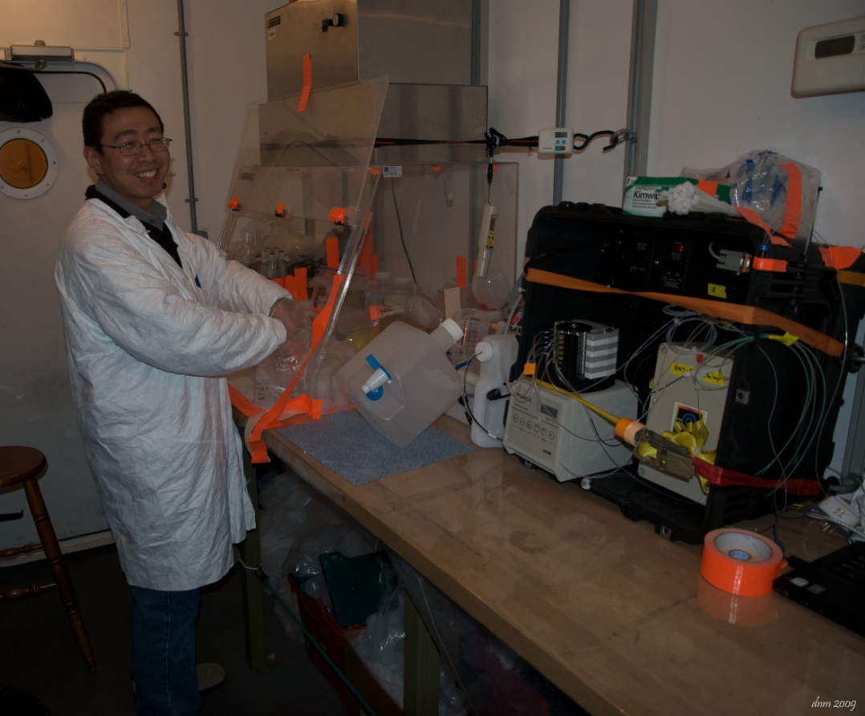
Results!
Increased levels of Fe II around drifting icebergs
Fe II associated with melt water
This is an essential micro-nutrient for phytoplankton
Passed on through the food web

Slide 42
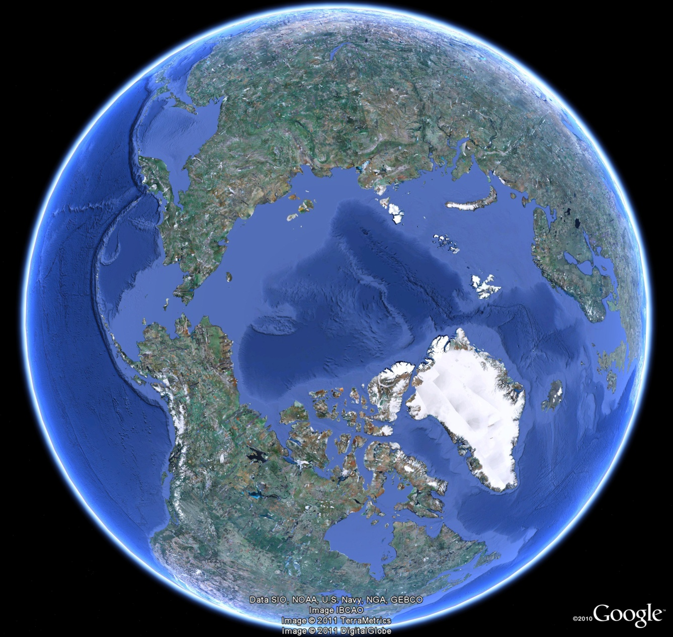
Next Up for Phantom:
The Arctic

Slide 43
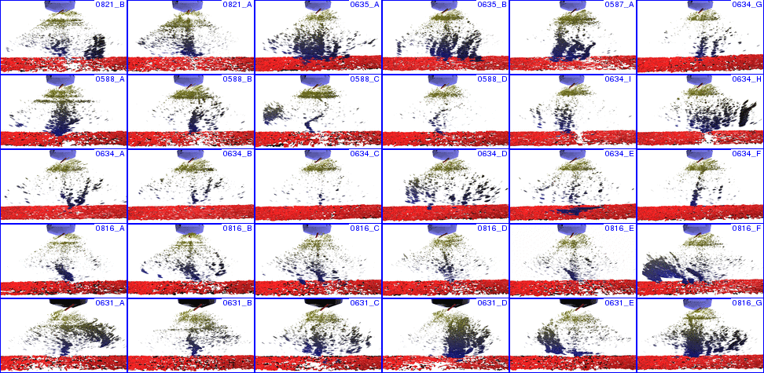
Background
In 2009, acoustic images shows
what appears to be gas plumes in the
Beaufort Sea
Courtesy J. Hughes-Clark, University of New Brunswick

Slide 44
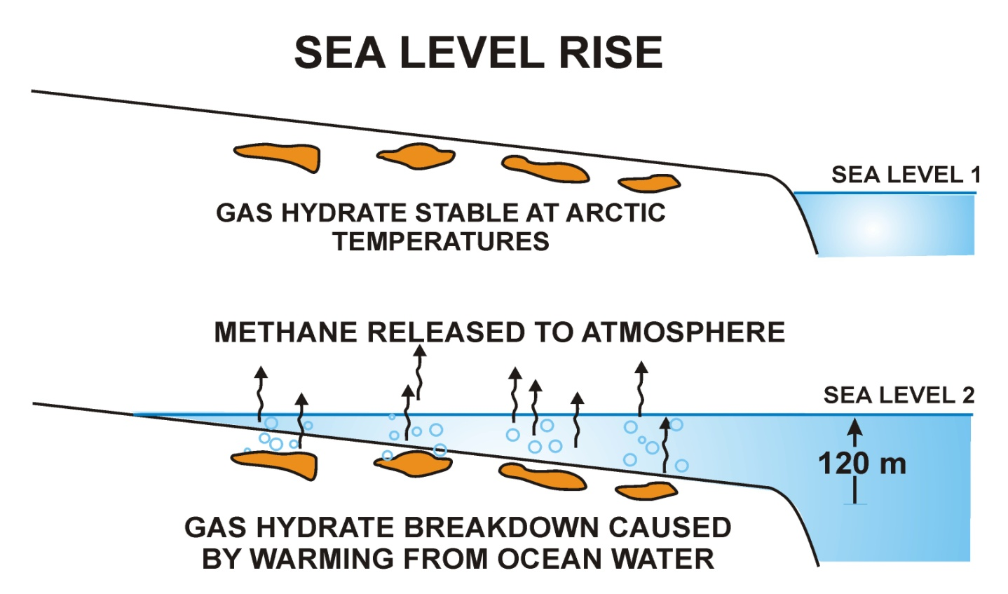
The Question:
Are the gases found in these vents the result
of warming of the Arctic permafrost?
GAS HYDRATE & PERMAFROST STABLE AT ARTC TEMPERATURES
GAS HYDRATE & PERMAFROST BREAKDOWN CAUSED BY WARMING FROM OCEAN WATER

Slide 45
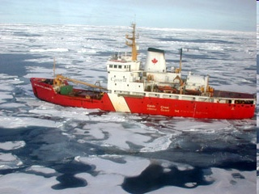
Collaborators
Geological Survey of Canada
Fisheries and Oceans, Canada
University of New Brunswick, Canada
USGS

Slide 46
The Technical Challenge:
Collect enough gas from vents to test whether the gas:
  Is methane
  Is fossil methane, which is consistent with melting permafrost

Slide 47

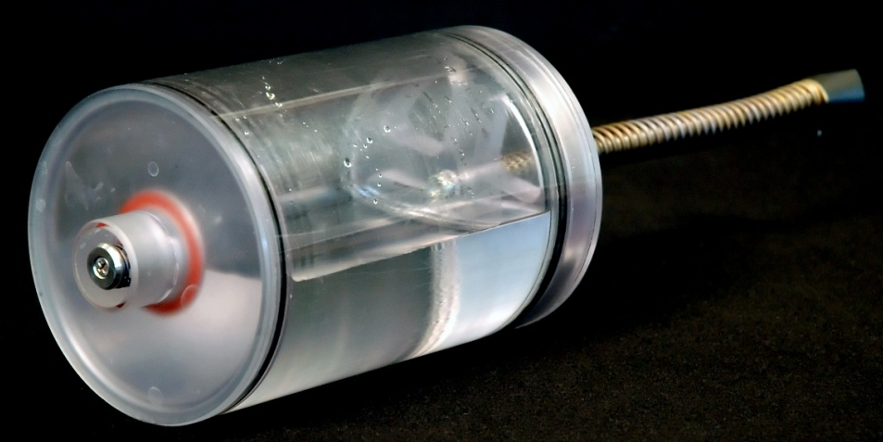
The Technology
+
T. Walsh
Phantom
Gulper

Slide 48
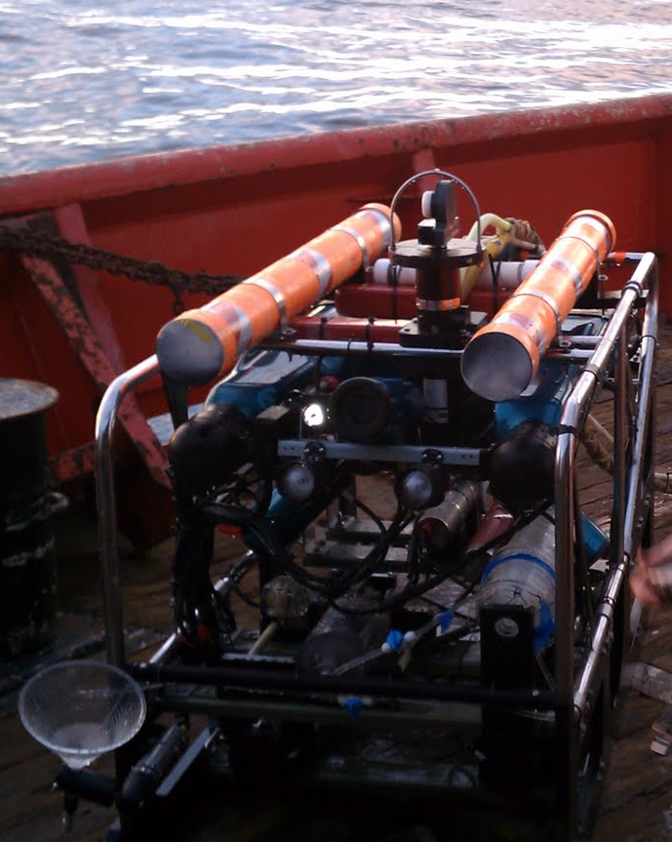
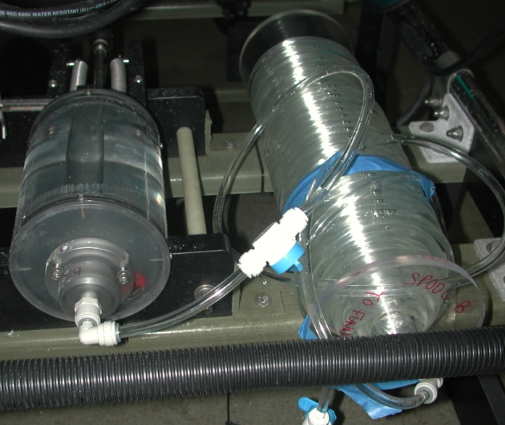
The Technology
ROV-mounted Gas Sampler

Slide 49
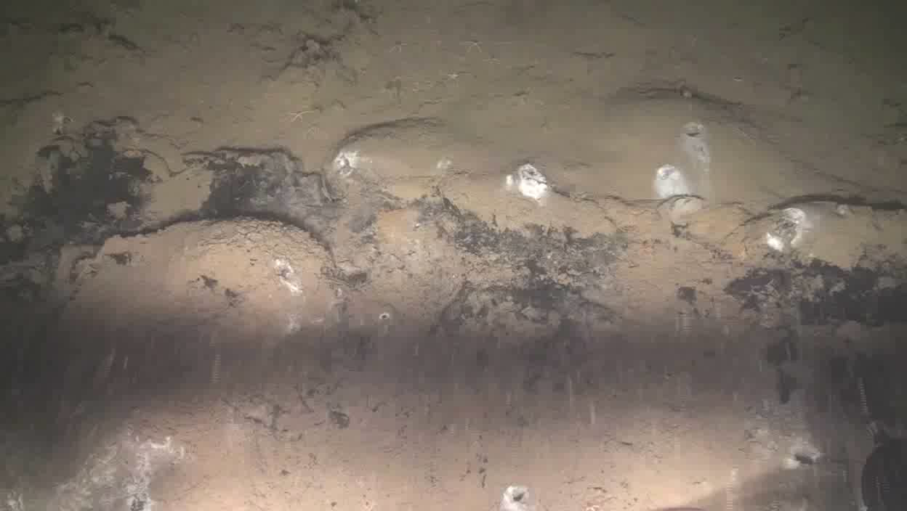
Gas Sampling

Slide 50
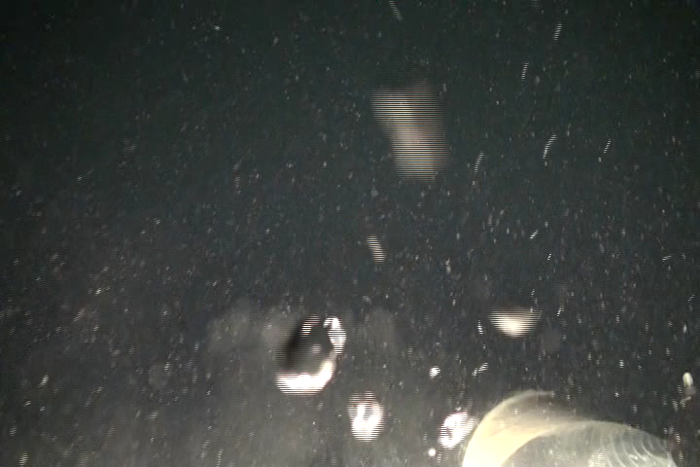
Bubble Catching

Slide 51
Results
Enough gas collected for analysis
¹⁴C testing post-cruise indicates gas is fossil methane
Results are consistent with hypothesis of warming of arctic permafrost

Slide 52
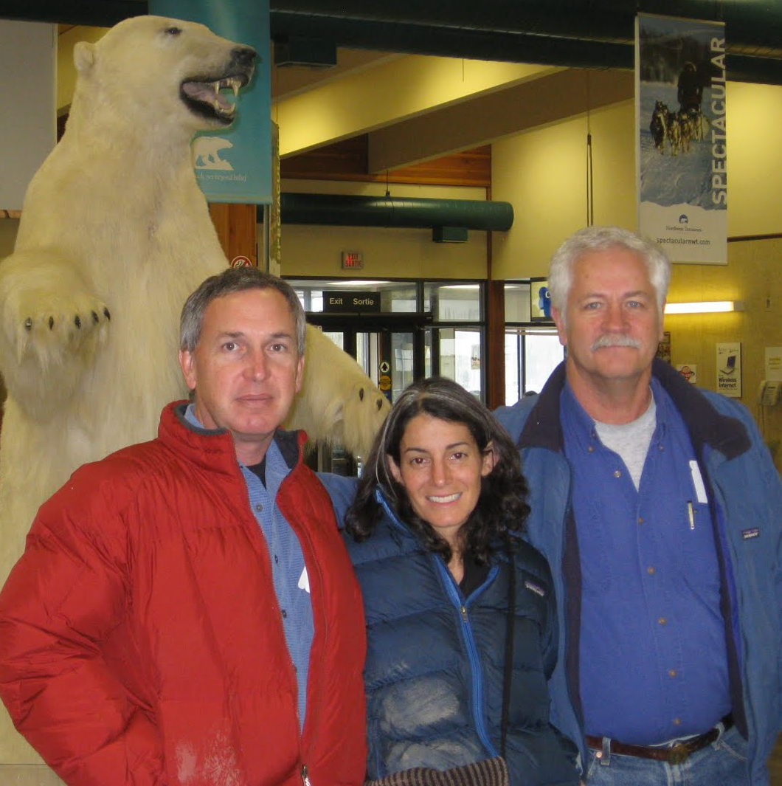

Results
Gas Vents Found
Polar Bears Found

Slide 53
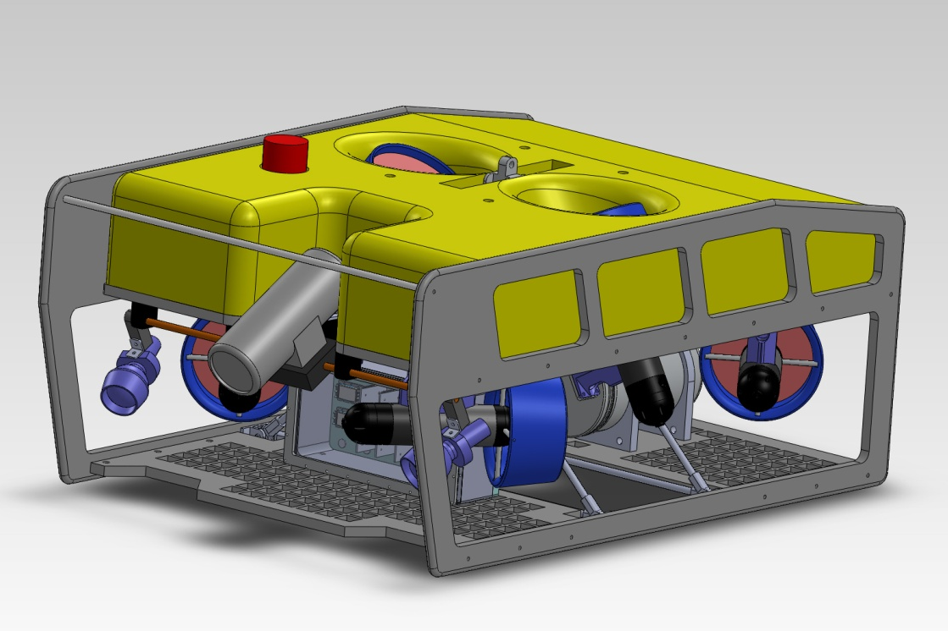
Next Steps
New ROV- deeper, stronger, more payload…
Return to arctic in 2012

Slide 54
Acknowledgements
MBARIans: Charlie Paull, Ken Smith, Dale Graves, Bill Ussler, Brett Hobson, Paul McGill, Larry Bird, John Ferreira, Tom Marion, Jose Rosal
All of our collaborators
The MBARI management team

Slide 55
Questions???

Slide 56
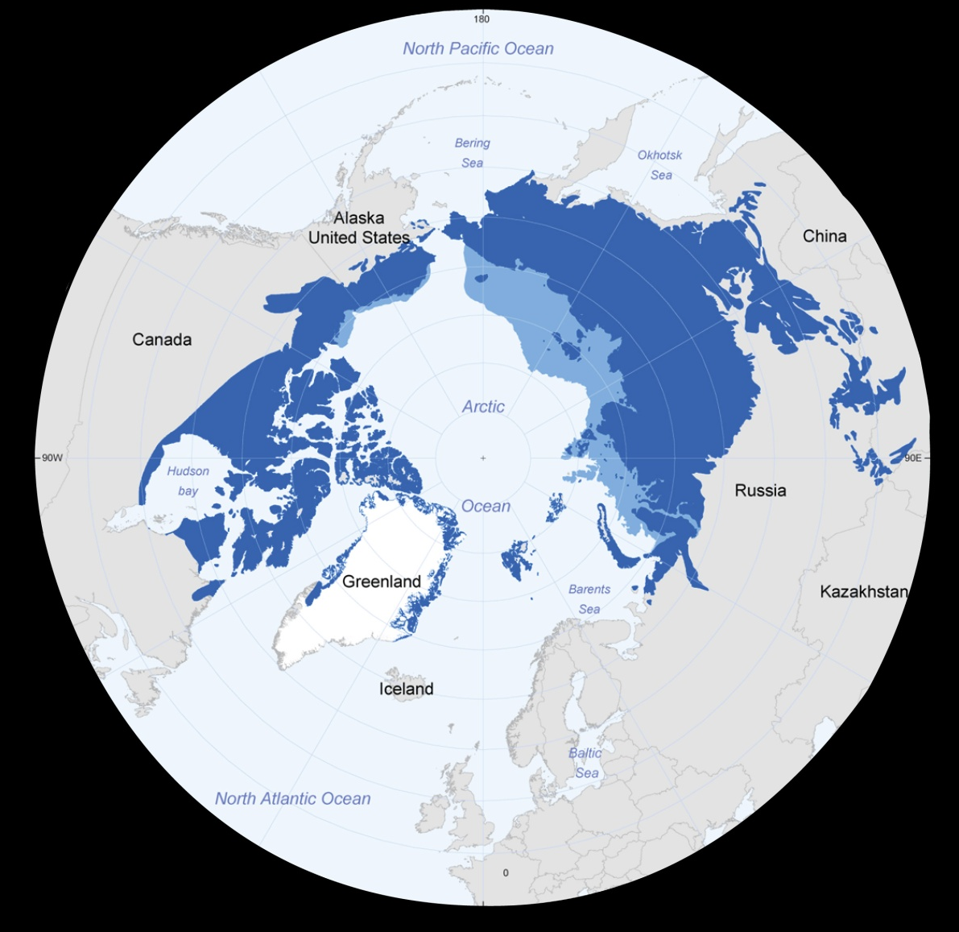
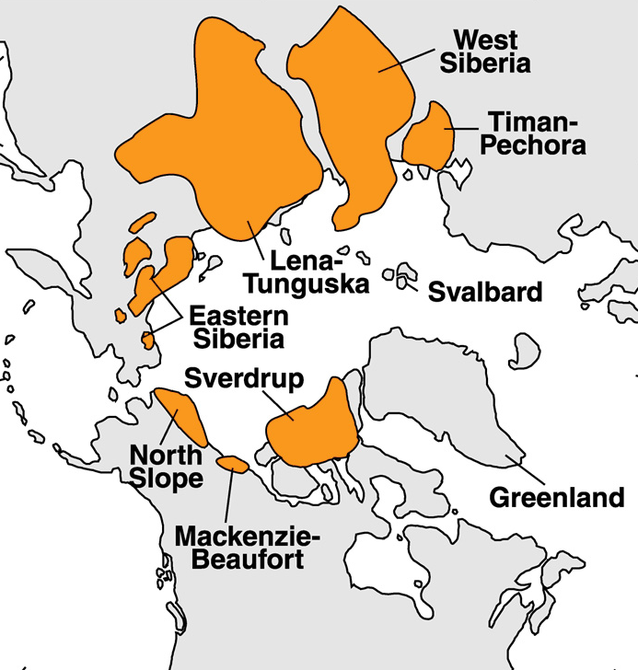
Distribution of Permafrost and Gas Hydrate on the Arctic Margin
Arctic Shelf Sediment Warming
Indications of Methane Release
Climate & Geo-Hazards Implications
Offshore relic permafrost
Continuous permafrost
Gas hydrate
Notes:
56

Slide 57
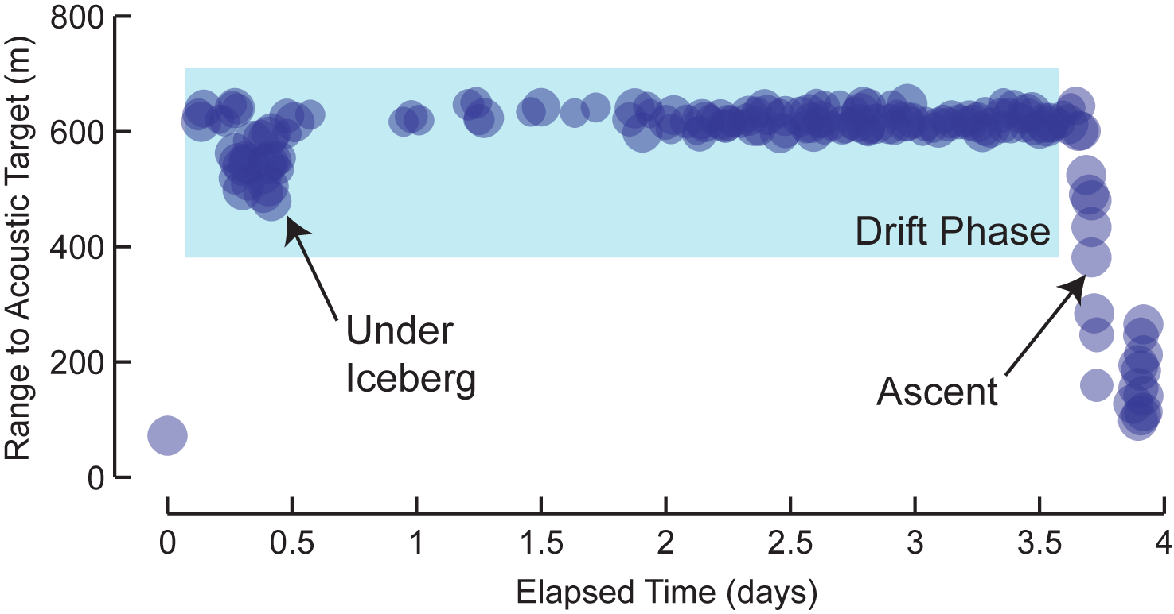
Acoustic Detection of Icebergs

Slide 58
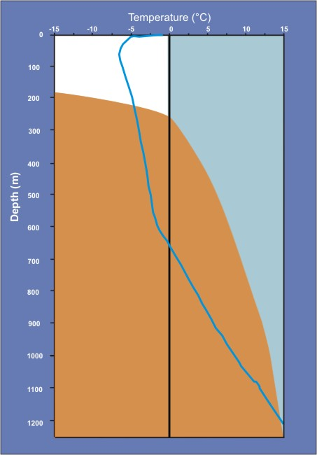
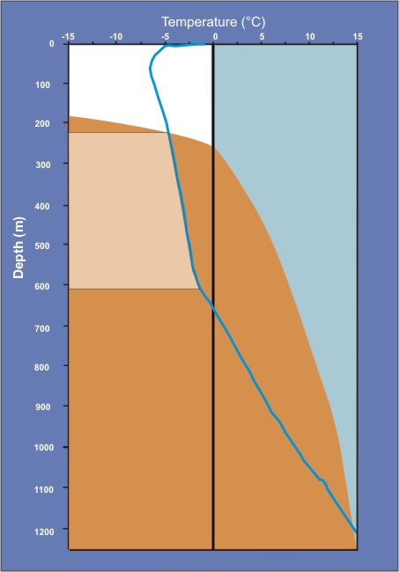
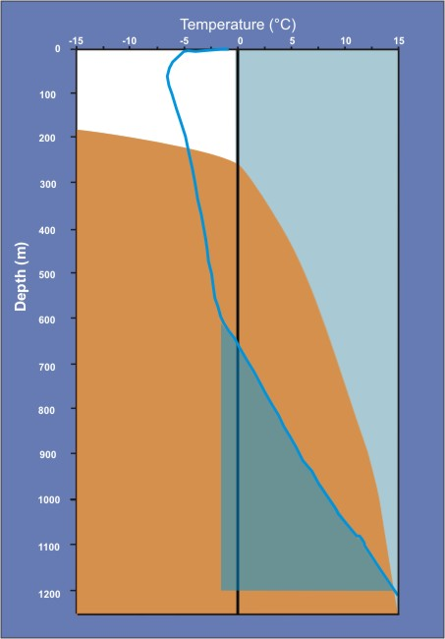
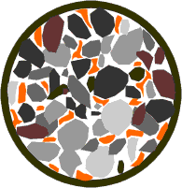
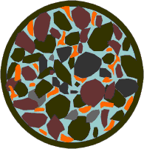
Permafrost & Gas Hydrate
Sub-permafrost gas hydrate
Intrapermafrost gas hydrate
Sediment + Ice
Sediment + Water
Sediment + Ice + hydrates
Negative mean annual ground temperatures establishes significant interval where gas hydrate-ice-sediment exist in equilibrium
Temperature regime and hydrostatic pressure similar to many marine deposits but different effective stress regime
Concentrated sub-permafrost hydrate
Sediment + Water + Hydrates
Notes:
58
IDEA HERE IS THAT THE AUDIENCE WILL BE LARGELY MARINE GAS HYDRATE FOLKS..
WE WANT TO EMPHASIZE ICE BONDED INTRAPERMAFROST HYDRATES AND LOWER FREE WATER HYDRATES

Slide 59
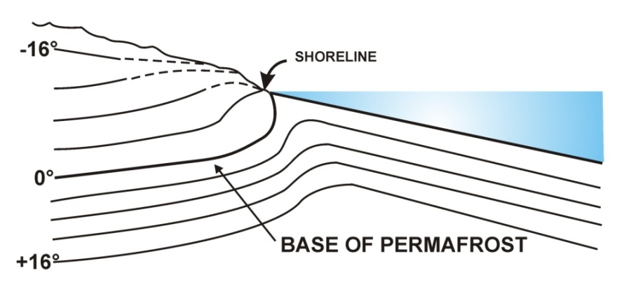

Thermal Warming on the Arctic Shelf
Equilibrium thermal gradients very different on shore and offshore
Transgressions will significantly alter profiles
Sea level rise will shift surface temperatures from < -12° C to ≤ -1.8° C
Arctic shelf permafrost and gas hydrate should be decomposing associated with thermal warming
GAS HYDRATE & PERMAFROST STABLE AT ARTC TEMPERATURES
GAS HYDRATE & PERMAFROST BREAKDOWN CAUSED BY WARMING FROM OCEAN WATER
Notes:
59
59
59

Slide 60
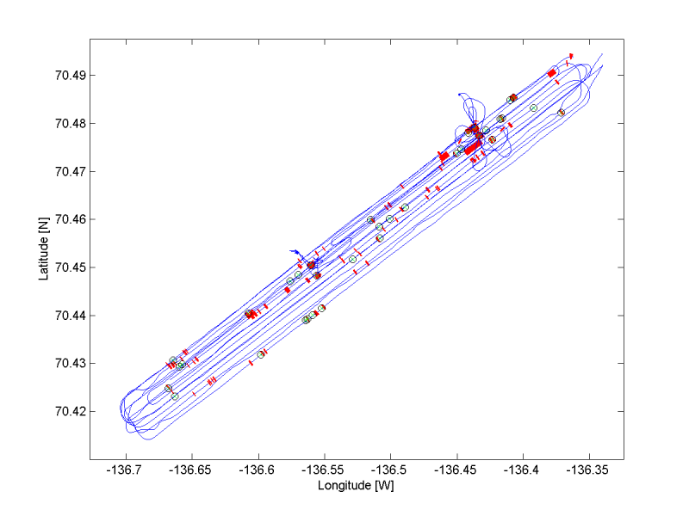
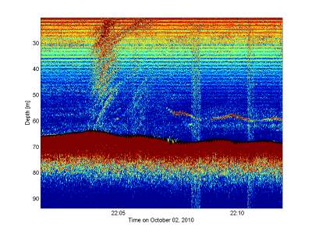
Shelf Edge Seep Area
Ship tracks and water column acoustic anomalies detected in 2010(red) and UNB 2009 events (green circles)
From Svein Vagle

Slide 61
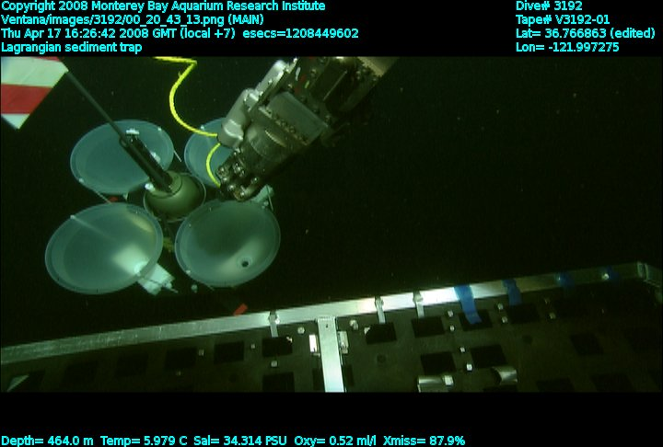
In-situ Vehicle Trimming

