Slide 1
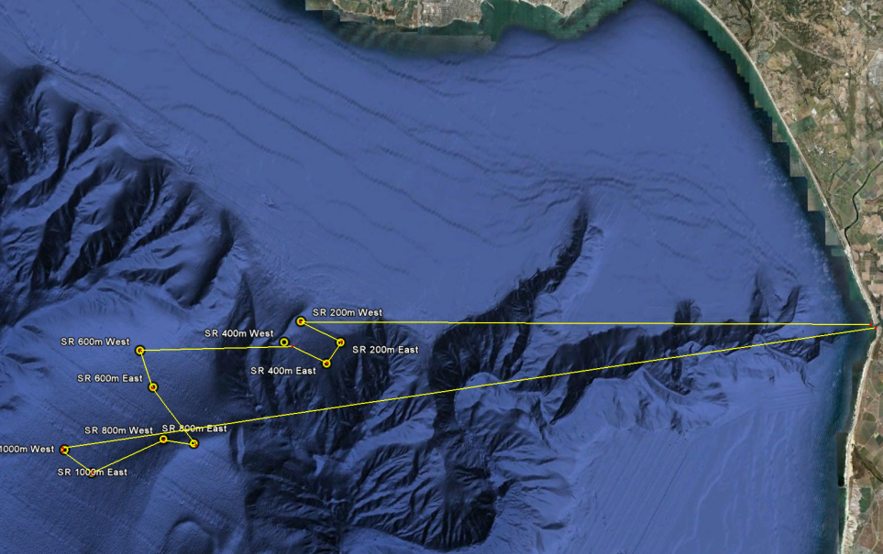
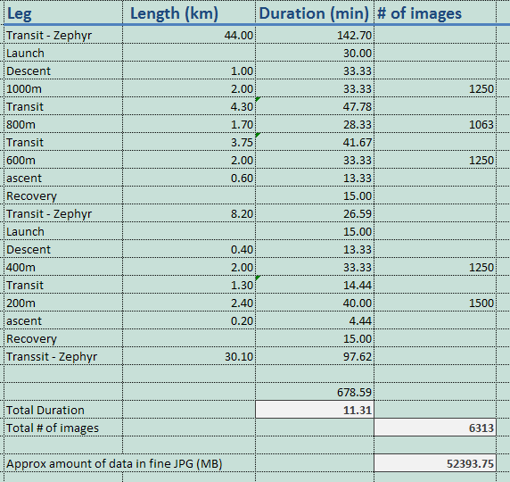
Benthic Transect up Smooth Ridge
Mission Planning for July 2010

Slide 2
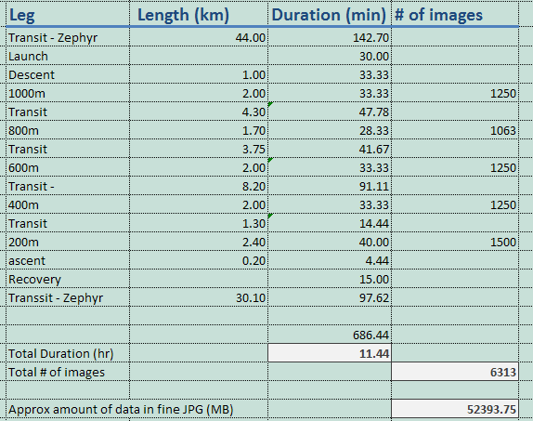
All transects underwater

Slide 3
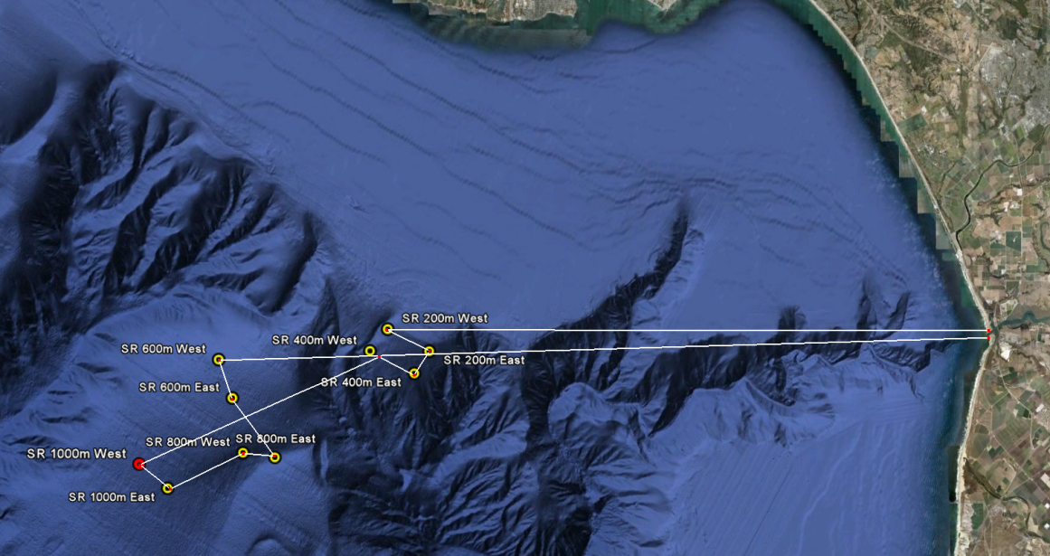
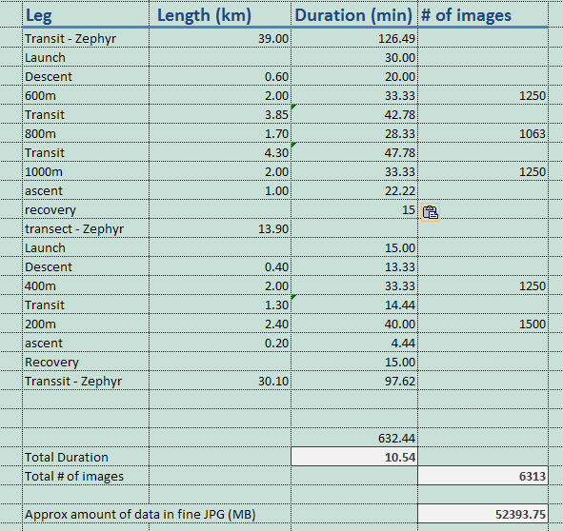
Zephyr to 600m site
Recover at end of 1000m site – drive to 400m

