Slide 1
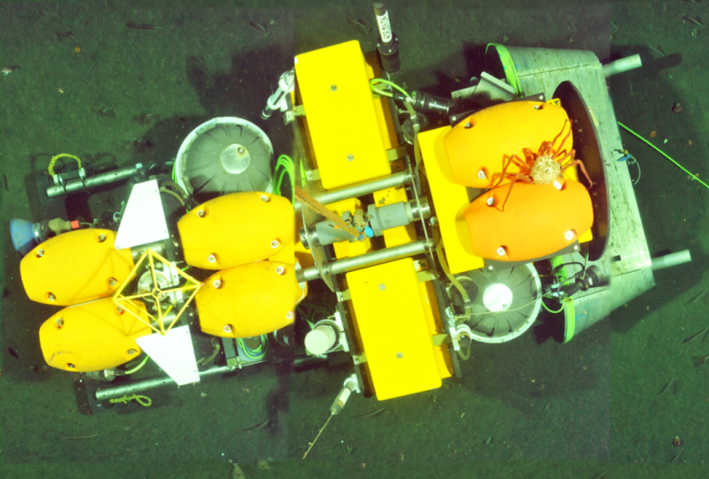
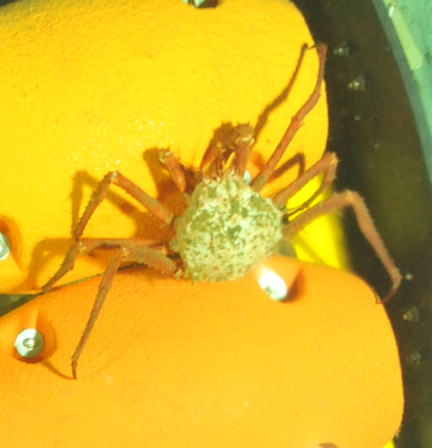
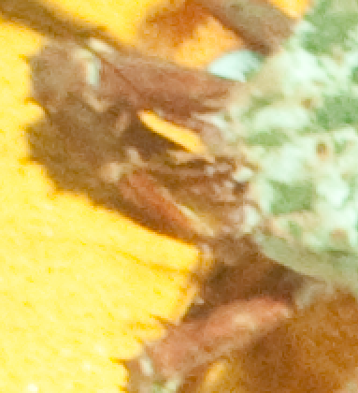
30m x 5m Blended Photo Mosaic Showing the Benthic Rover near MARS
2.8 m long Benthic Rover
< 2mm Diameter Whiskers
20 cm King Crab

