Slide 1
BIAUV Engineering Dives: July 14, 15
Quantify maneuvering (Pitch) performance
  Pitch rate: how quickly can we “pull up” and dive
Adjust limits and tune controllers to improve
Calibrate compass
Test systems prior to Barry dives the following week

Slide 2
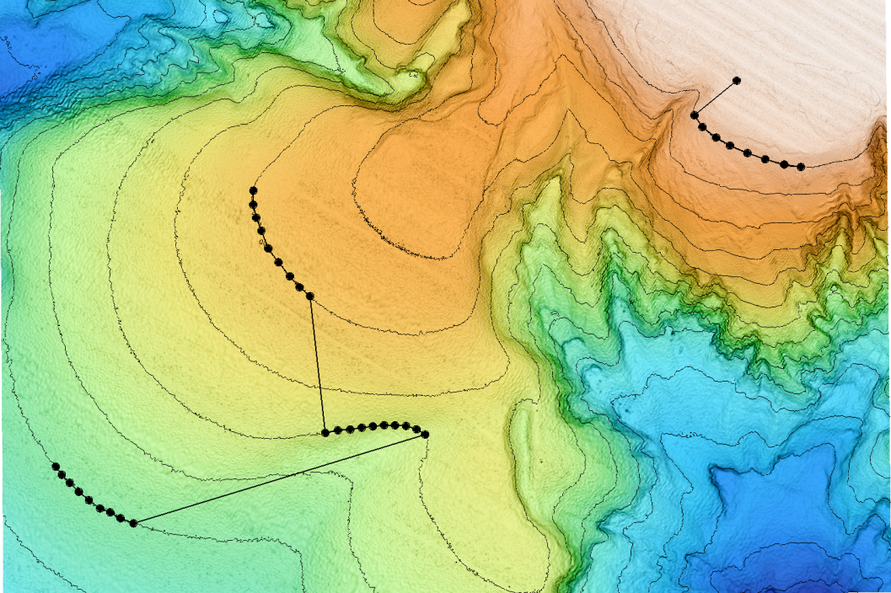
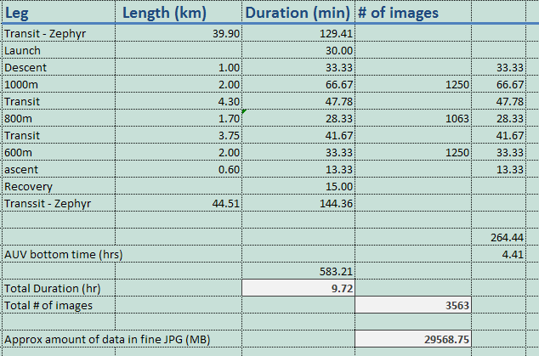
Barry Benthic Transect July 20, 21

Slide 3
AVED

Slide 4
Data

Slide 5
AUV

Slide 6
Camera
Existing camera takes excellent images
Poor housing optics
    No correction optics – big CMOS sensor is a challenge to maintain focus
    Inconsistent glass properties of existing glass ball
Images stored on camera
    Limited to 64 GB – OK for all surveys planned so far
      3k uncompressed RAW images = 5 km of trackline with ~50% overlap
      6k with 1:4 JPG compression = 10 km of trackline = 2.75 hrs
      11.5k with 1:8 and 22.6k with 1:16 = ~20 and 40 km respectively
    Offload speed limited to 4 MB/s max (~5 hours to pull 64 GB)
In-ellegant to control
Housing is giant: 11.1” diameter x ~15” long

