Slide 1
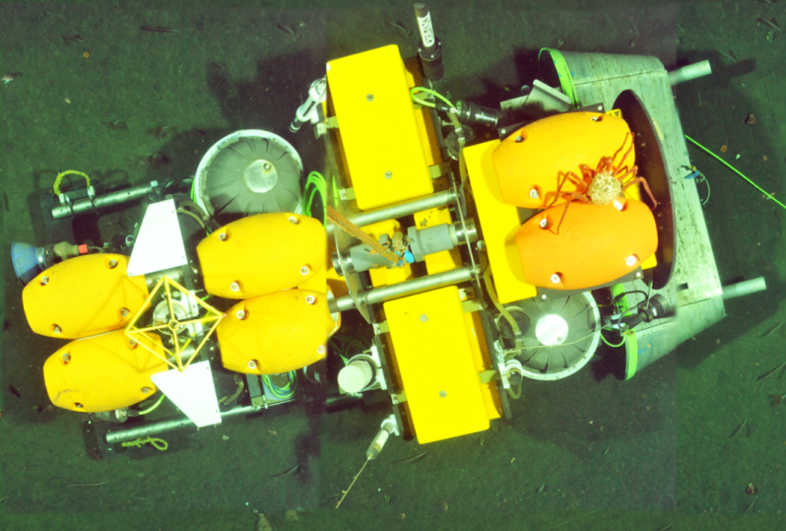
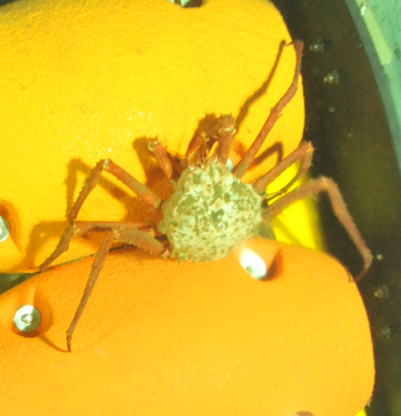
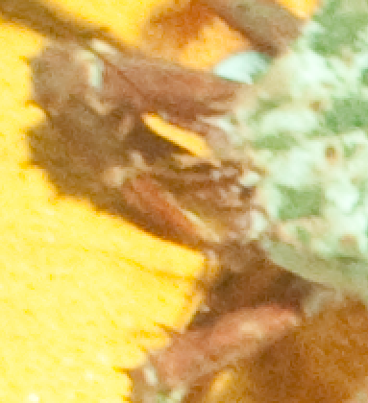
30m x 5m Blended Photo Mosaic Showing the Benthic Rover near MARS
2.8 m long Benthic Rover
< 2mm Diameter Whiskers
20 cm King Crab

Slide 2
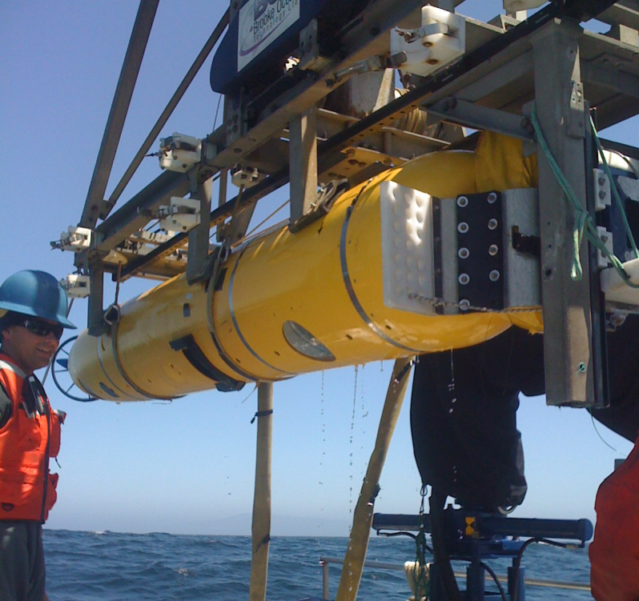
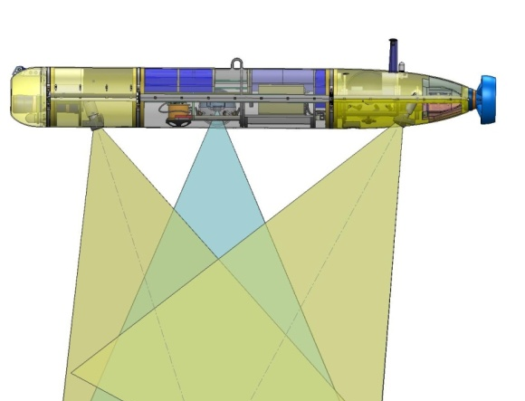
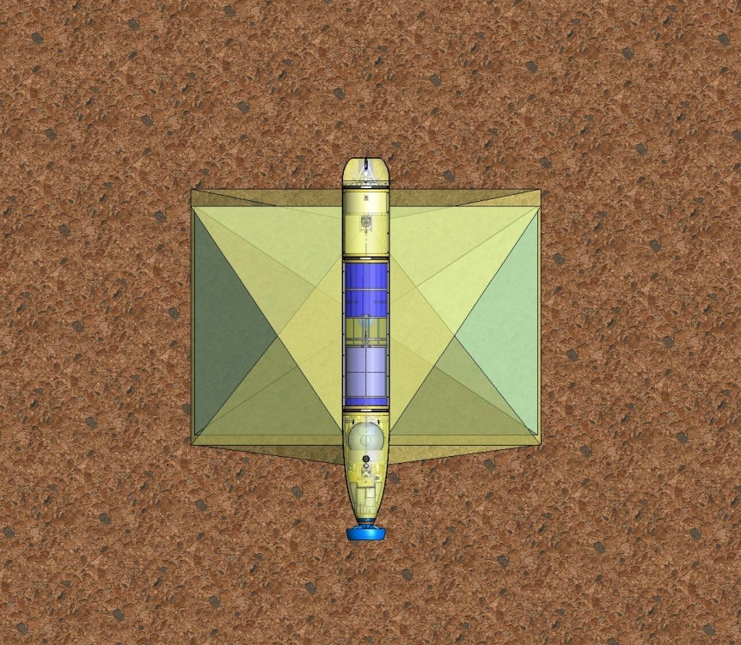
Imaging AUV
Current:
Downward looking, hi-res color still images
Two xenon strobes
3m altitude max over smooth terrain
.6 Hz, with 50% overlap for mosaics
16 hr. endurance
  20,000 images at .5 hz (128GB @ 7 MB/JPG image)
  32 km of continuous mosaic
Multi navigation modes
  iUSBL A-Nav
  DVL-aided DR
  Surface tracking a-modem telemetry
Proposed:
Add Midwater imaging system for Biodiversity
Integration of additional sensors
  Forward, side, or upward looking sonars for Biodiversity
  CTD, DO, pH, chl/backscatter
Improve terrain following
  Sonar to define terrain, control algorithms, fwd planes or thruster to increase climb rate
Improve data handling and analysis

