Slide 1
Imaging AUV
2010 Kick Off
12 January 2010

Slide 2
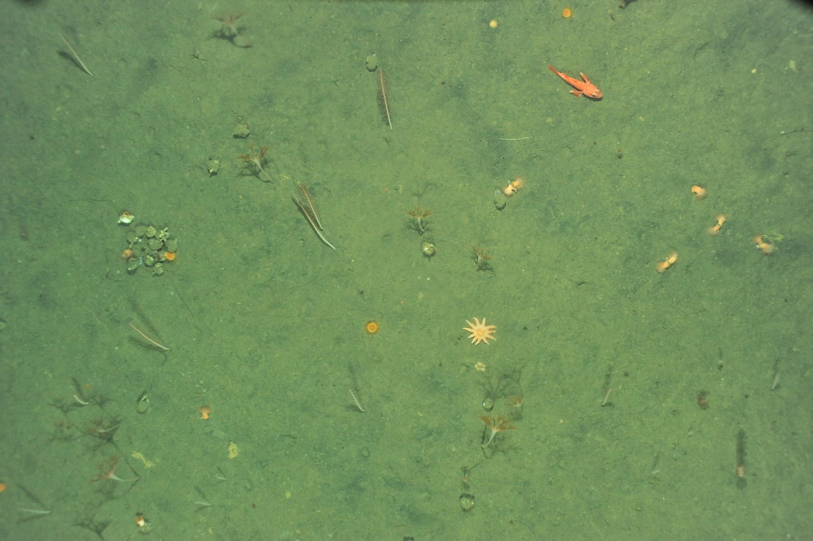
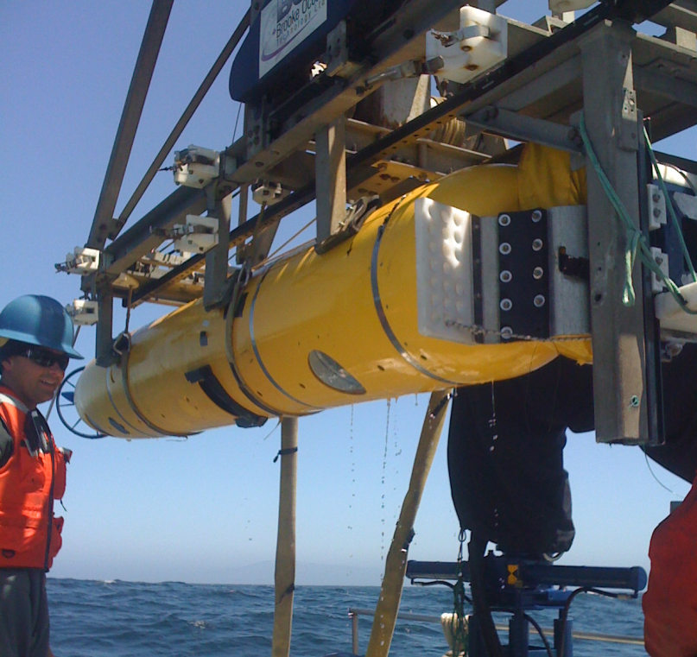
Imaging AUV
Project Team:
Brett Hobson
Rob McEwen
Jon Erickson
Alana Sherman
Danelle Cline
Mike McCann
Farley Shane
Dave Caress
and
Hans Thomas
Lonny Lundsten
Jim Barry
Ken Smith
Charlie Paull
Steve Rock

Slide 3
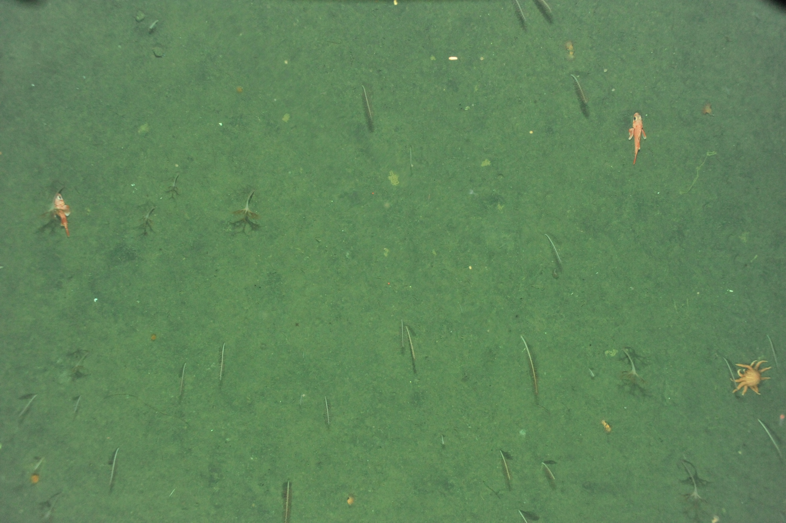
Current Status
Operational BIAUV asset in 2010
  Technology Pull from Science
Navigates accurately to a homer beacon
DR Nav updated with surface fixes
Terrain-based nav mode in development (Rock et al)
Acquired 1120 overlapping images along (near) Barry’s 200m transect
Lawnmower mosaic at MARS (890m)

Slide 4
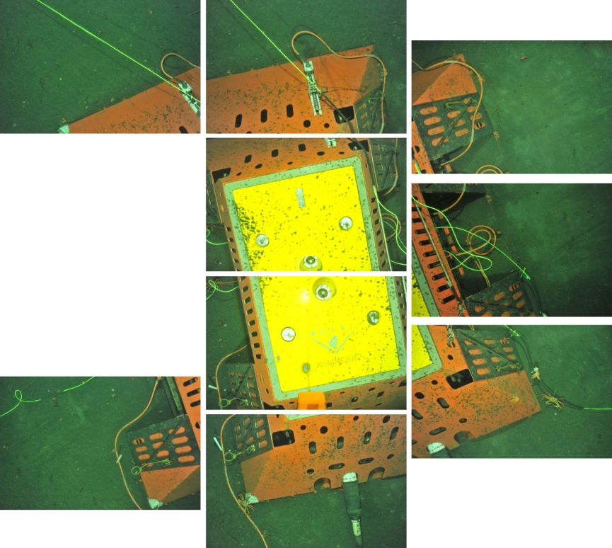
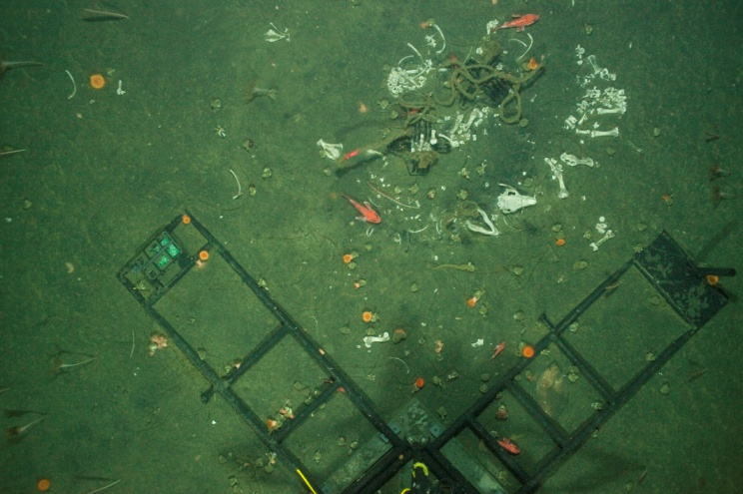
BIAUV at MARS in Dec. ‘09

Slide 5
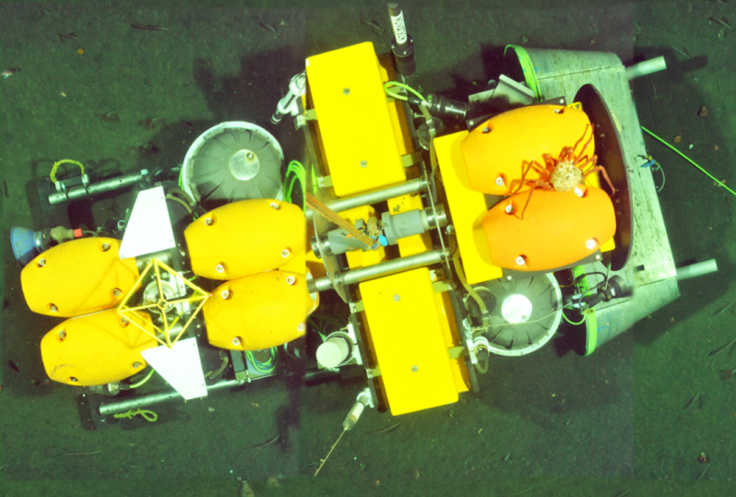
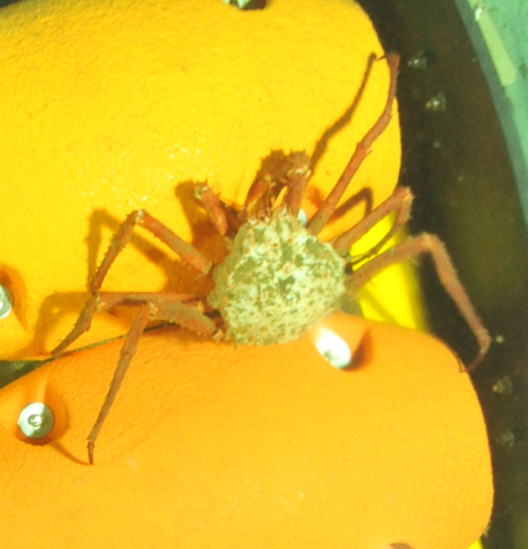
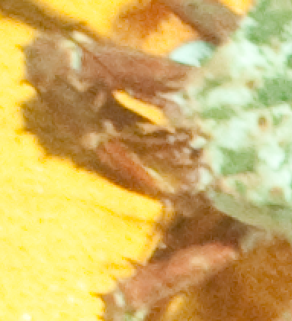
30m x 5m Blended Photo Mosaic Showing the Benthic Rover near MARS
2.8 m long Benthic Rover
< 2mm Diameter Whiskers
20 cm King Crab

Slide 6
2010 Work Plan
  First half of year is focused on refining and operating the existing system
    DMO operations
      Operations at 4km
        Upgrade some components: SSM beacon, 3km foam section in tail
        Pressure test any un-tested components
        Upgrade camera housing, or pressure test existing sphere. It was rated to 6km, but we ground and polished a port in the bottom hemi.
    Useful data for science
      How do we move from good pictures to quantitative science data?
        Move the images off the AUV
        attach relevant metadata
        Develop an efficient method for the scientists to view and process the images
        Archive images

Slide 7
  Second half is to improve the system
    AUV
      Mission planning – Increasing desire to run the AUV in rough terrain. We need to know where it is safe to fly.
        Define the maneuverability of the AUV
        Define the exact path and predict the terrain profile before the mission.
        Determine if the vehicle can follow that profile
      Sensing/Navigation
        Ensure the AUV is where it was supposed to be
        Use sonar to define the terrain profile in front of the vehicle
        Plan a path to follow over the terrain that doesn’t crash, and if possible, low enough to take images
      Actuation
        Improve the maneuverability of the AUV
          Optimize the existing system
          Add control surfaces or thruster(s)
      Testing

Slide 8
    Data systems
      Improve
    AVED
    Improve terrain following performance
      forward looking sonar
      control augmentation – thruster or control surfaces
    Data Systems
      AVED
      SIMPA-VARS
      Google Earth

Slide 9
Issues
  File transfer speed
    From Functional Requirements: It shall be possible to download images from the camera without removing the camera from the vehicle, or removing any underwater cables. It should not take longer than 1 minute for 10 images. (10 Mbps)
      Typical missions are collecting many 1000s of images. 100 minutes/1000 images
  New camera housing
    Electronics for camera
    Integration of camera into vehicle
  Improve mission planning
  Ready for DMO operations
      New camera housing
        Re configure electronics
        New housing
        Review
      Train DMO (Doug and Duane) in camera operation

Slide 10
Tasks
  Rob:
    Continue to work on AUV navigation
  Alana:
    Investigate separate USB cable for uploads. Use a loop-back
  Jon:
    New camera housing installation
  Dave:
  Danelle:
    Data processing –
      get a start by hand building one image file metadata
      Talk to Mike about existing Matlab script to add image data csv file
      another process to move image files along with other auv data that is packed into a tar ball
      develop a new packer that will load the image data into VARS with links to images in their original location
    AVED

Slide 11
Other Issues
  Resources
      2010 Ship days:
        Rock: Jan 27, Feb 10, April 28th
        Paull: Feb 17-21, March 23-27, Nov 10,11 ??
        Smith: May 7-13 at Station M
        Barry: July 14, 15 at Smooth Ridge
        Engineering: July 20, 21, Nov 30th, Dec 21
      Engineering
        Brett: 441 h
        Rob: 540 h
        Alana: 360 h
        Jon: 100h
        Farley: 305 h
        Danelle: 549 h
        Mike: 90 h

Slide 12
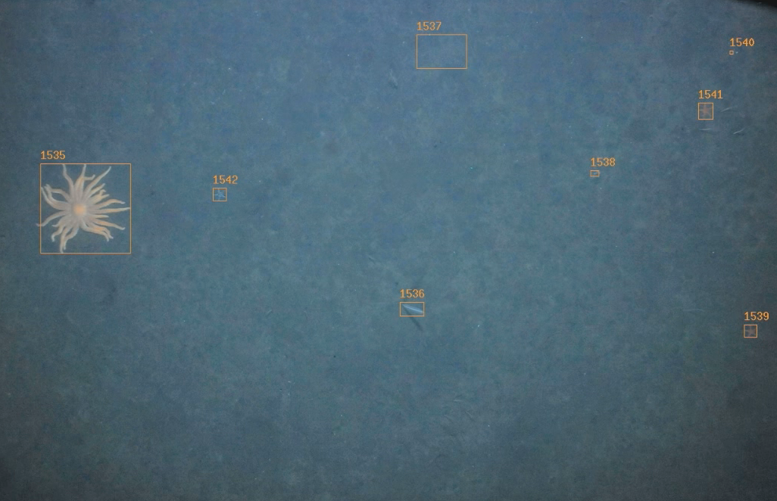
AVED
Automated Visual Event Detection

Slide 13
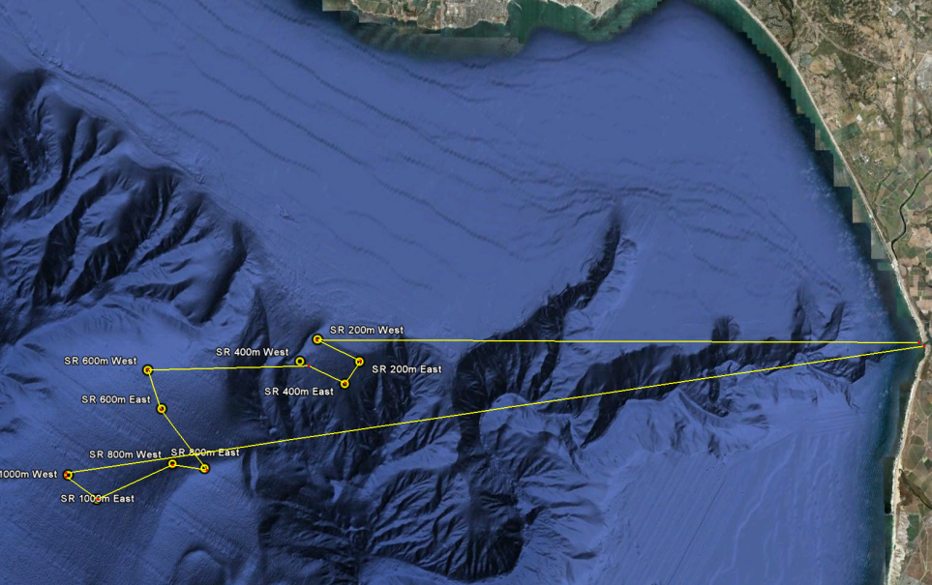
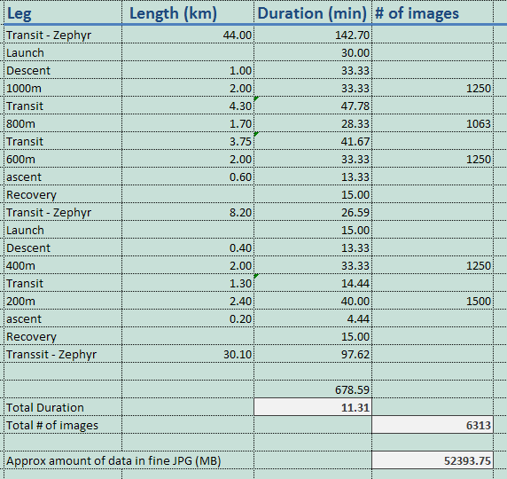
Benthic Transect up Smooth Ridge
Mission Planning for July 2010

Slide 14
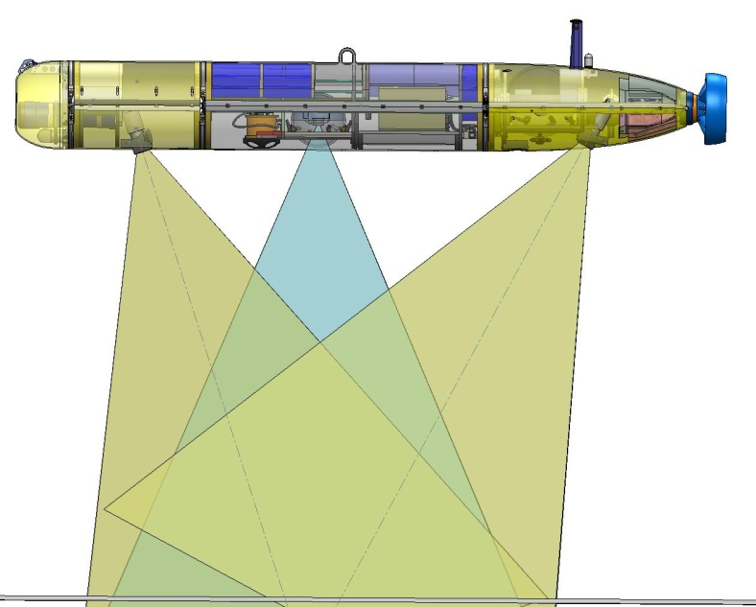
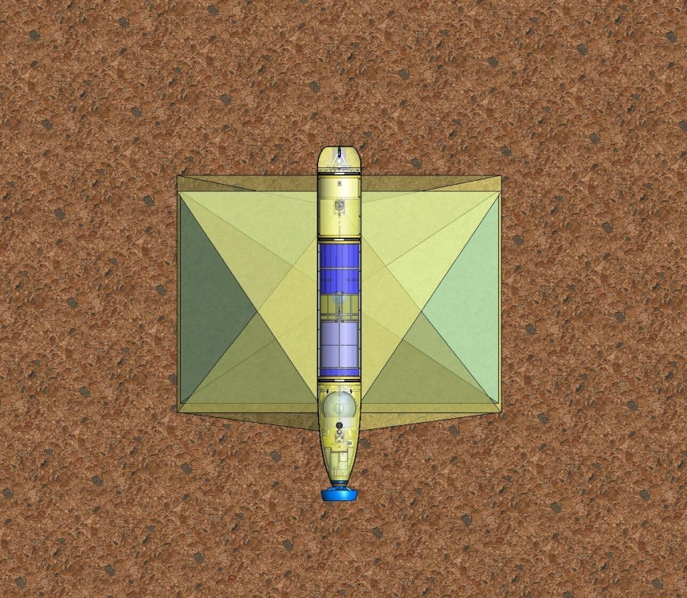
BIAUV - Field of View
3 meter altitude
  4.5 m wide
  3 m tall
Twin parallel lasers
  32 cm separation

Slide 15
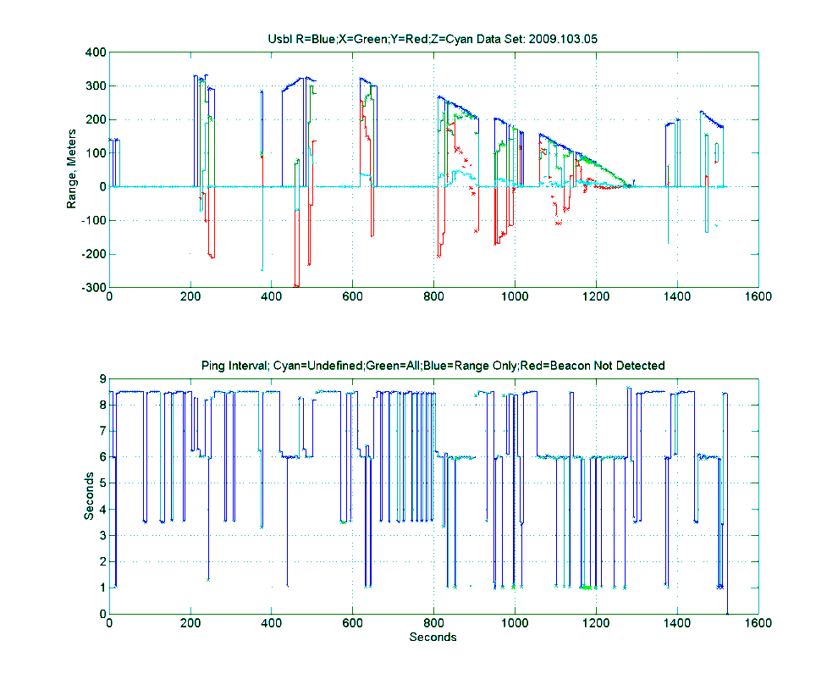
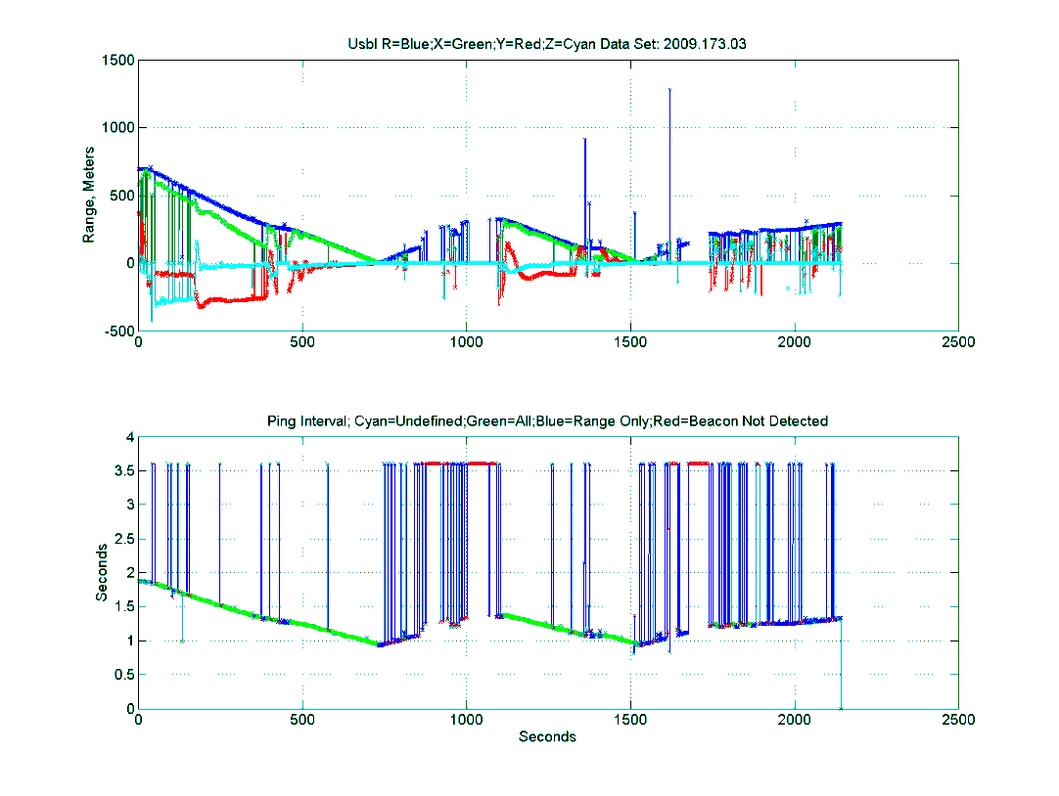
iUSBL Performance

Slide 16
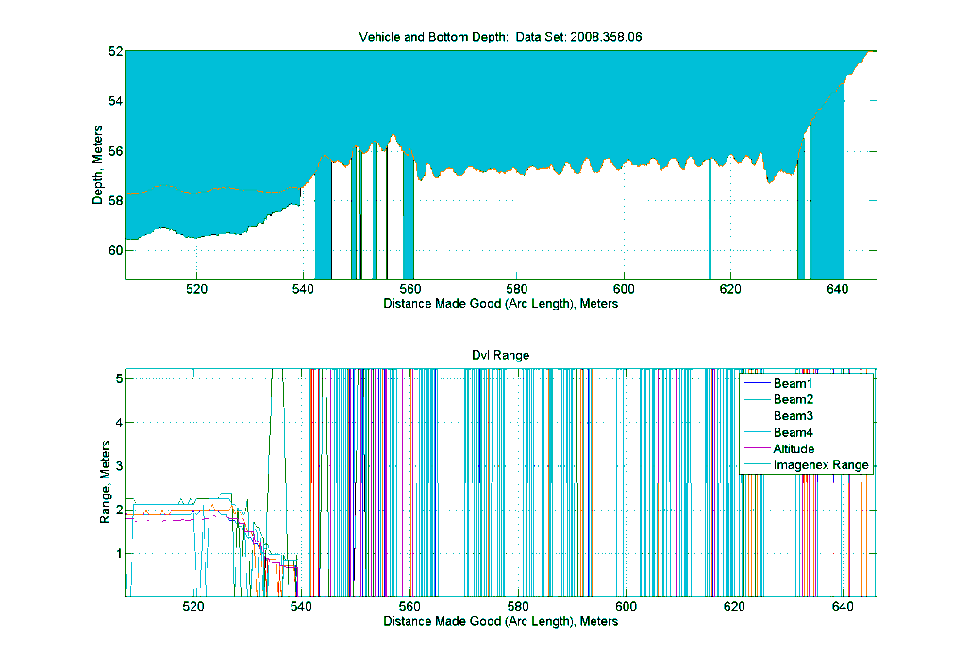
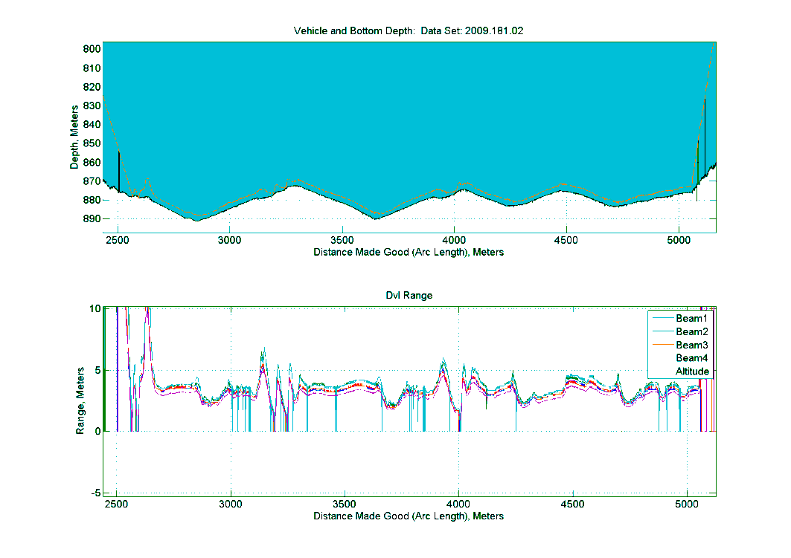
Current Terrain Following

