Slide 1
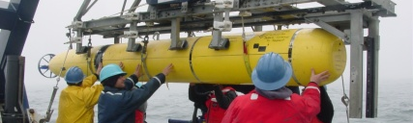
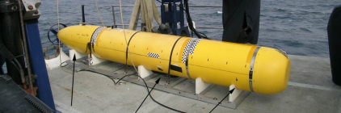
Multibeam/subbottom/sidescan
MAUV
Benthic Imaging
+ Midwater Imaging
Benthic Imaging

