Slide 1
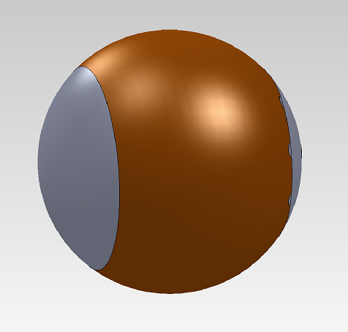
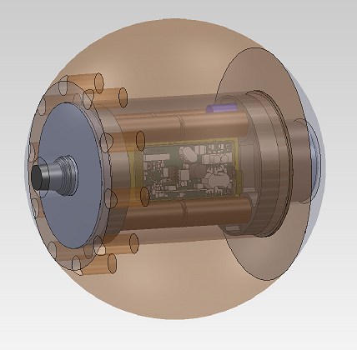
Specifications
General Specifications
Weight: 50lb (23 kg)
Dimensions: 15” (0.38m) sphere
Displacement: 0.58 cu.ft (16L)
Operating temperature: 10-35C, non-condensing
Max operation depth: 500m
Motion detection performance
Gyro resolution: 0.062 deg/sec
Gyro full range: +/- 2000 deg/sec (5.5 turns/sec)
Linear acceleration resolution: 0.5 mg (0.005 m/s²)
Linear acceleration full range: +/-16 g (+/-157 m/s²)
Depth resolution: 0.03m (at 14bit ADC)
Depth accuracy: ~ 0.2%span or 1m
Depth full range: 500m
Battery and electrical:
Pack configuration: Electrochem CSC93, 7s2p
DC load discharge range: 27.5 to 17.5 VDC
Pulse load discharge range: 17.5 to 13.5V at 4A peak
Acoustic link performance:
Max range: 2-3km (horizontal range in water)
Operating range when buried: TBD
Frequency bands: 9–14 kHz (LF)
Baud rate: 300-10240 bps
Deployment performance:
Max length of deployment at Event Duration Transmitted:
  500 days at 0 hours
  400 days at 0.5 hours
  300 days at 1.0 hours
  200 days at 1.5 hours
  100 days at 2.0 hours

