Slide 1
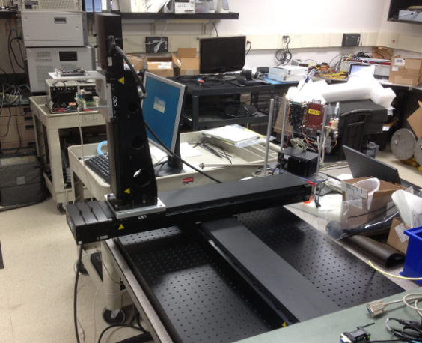
BEDs Testing
Motion thresholds and event detection
Acceleration, full range
Rotation
Calibration of RTC
Whole assembly on X-Y stage,
Or IMU on X-Y-Z
GPS
H
Delta
H
Environmental chamber
RTC

