Slide 1
BEDS Preliminary Design Review
June 20, 2012
Project Team:
PI: Charlie Paull
Lead Scientist: Bill Ussler
EE: Denis Klimov (2012)
SE: Bob Herlien
ME: Larry Bird, Dale Graves
Project manager: Brian Kieft

Slide 2
Outline?

Slide 3
What is a Benthic Event Detector?
Characterizes motion and frequency of submarine canyon sediment debris flows
Allows for data recovery without instrument recovery
May not necessarily be recovered
Doesn’t require MBARI ships for operation

Slide 4
BEDs High Risk Elements
Can data be retrieved from device?
Can motion be resolved in a way useful to science?

Slide 5
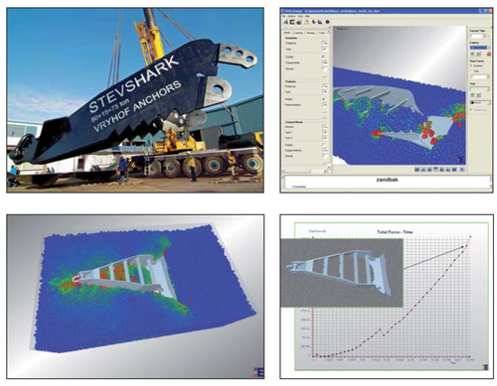
BEDs Data Retrieval
Acoustic modem
  Burial test .7m @1200 bps – 2560 bps
  Vryhof Anchors: 13m in 300m water @ 300 bps
  Frequency hopping scheme for modem if needed

Slide 6
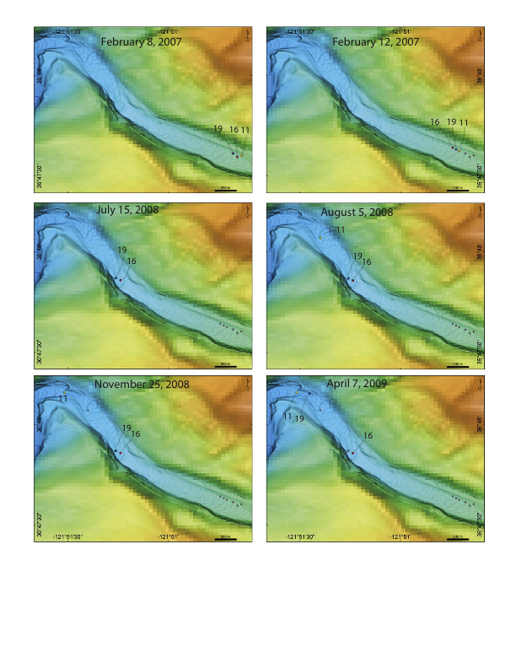
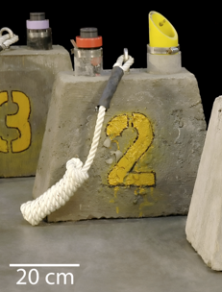
BEDs Motion
Bound events
  Duration
  Frequency
  Orientation changes
  Accelerations
Linear Displacement
  Performed off-board initially and validated through survey

Slide 7
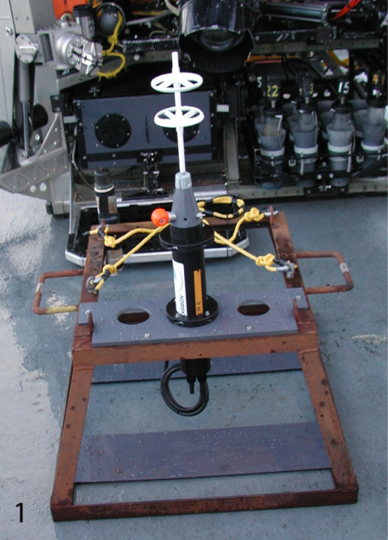
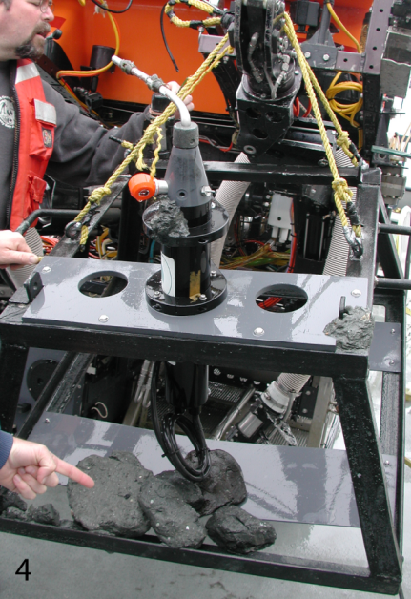
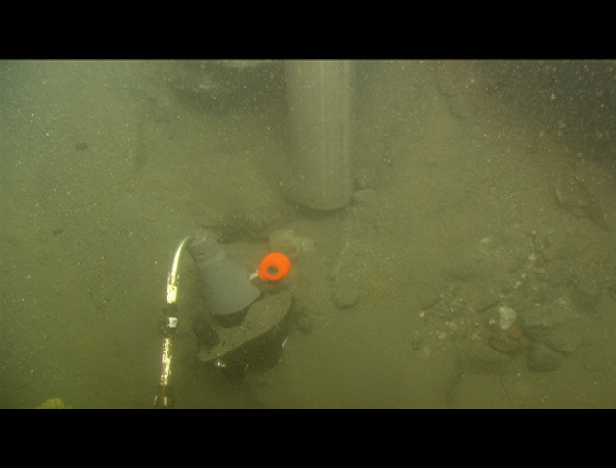
BEDs Motion
December 21, 2001 Event
Single event data recorded
  550 m translation
  11.9 dbar pressure increase
  ~10 minutes long
Would also like…
  Orientation during event
  Insight into type of motion (constant velocity or accel?, jerky, etc)
  Maximum acceleration and rotation rates
  Sediment depth of no motion
  Velocity

Slide 8
BEDs Operation Flowchart
Watch Cycle
Event recording
Command mode
Read Sensors
Read Sensors
Listen
Motion detection
Thresholds
Execute
No Motion
thresholds
Set thresholds
Time period (~1H)
Read status
Calculate and scale data
Context data
Set upload range
Decimated data
upload
Duty cycle ~5Min/1Hour
Log data
Context data
Specified Data upload
Motion thresholds
Activate modem
Time-out
Listen for acoustic communication
Exit command
~ 1Hz loop
~ 100Hz loop
Acoustic loop

Slide 9
BEDs Architecture

Slide 10
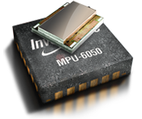
Why Invensense?
Cost $15
Low power
Sensor Fusion Algorithms onboard
Gyro drift and accel bias compensated
Event detection logic
Open source community and COTs devel boards
  Paparazzi code base includes peripherals like magnetometer, pressure
  Integrated 9 DOF solutions available for MSP430

Slide 11
BEDs Electrical

Slide 12
BEDs Electrical
Data and Power Budget:
Operating modes: Watch Cycle; recording Cycle; Command mode
Power of subsystems and duty cycles defined in each mode
Data rates and number of bytes per point defined
Parameter | Watch cycle | Recording cycle | Command mode
Acoustic modem power, W | 0.60 | 0.60 | 21.00
Acoustic modem duty cycle, % | 10% | 10% | 100%
Inertial sensor & microcontroller power, W | 0.16 | 0.40 | 0.40
Peripherals power, W | 0.04 | 0.20 | 0.20
Peripherals and sensor duty cycle, % | 20% | 100% | 100%
Cycle average power, W | 0.10 | 0.66 | 21.60
Duration in mode, hrs | Depends on length of deployment | Depends on length of event(s) | Depends on data to be transmitted
Cycle energy, WHr
Parameter | Watch cycle | Recording cycle
Bytes/data point | 6 | 24
Data rate | 1 / Hour | 100 / sec
Event data, kB | Depends on length of deployment | Depends on length of event(s)

Slide 13
BEDs Electrical
Data and Power Budget:
Energy is limited and defines everything else
Lithium DD cells 72 W*H x 18 for deployable article
Alkaline D-cells for prototype
Available Energy
Watch Cycle
Recording cycle
Data transfer
Trade-off
Deployment length
Event recording time

Slide 14
BEDs Electrical
Trade-off
Deployment length
Event recording time

Slide 15
BEDs Electrical
Data and Power Budget reference

Slide 16
BEDs Software

Slide 17
BEDs Mechanical

Slide 18
Mechanical Requirements
Operational Depth = 500 meters
Deployment duration = up to 12 months
Temperature range = -3 to 50 degrees C.
“Ruggedized” to withstand acceleration shocks associated with transport
Package density = 1.5 to 1.8 G/CC

Slide 19
Mechanical Requirements
The system shall be packaged such that its density could be increased to 3 times the default package density so that self-burial can occur (i.e., it can be made more dense).
The system shall be designed as small as possible to approximate the natural motion of sediment within the canyon floor
Be deployable and recoverable from an MBARI ROV
The system shall communicate at any package orientation

Slide 20
Main Components
Instrument housing
  7”ID X 10.5” cylinder w/modem & transponder transducers
Trim/ballast/system
  15” Flotation sphere - collar w/ballast weights
Transducer guards
  UHMW “windows”

Slide 21
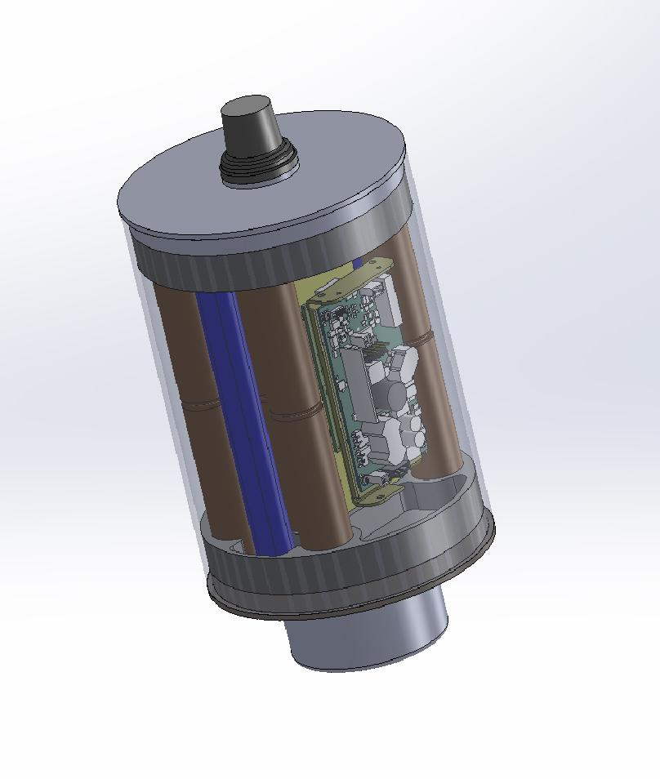
Instrument Housing
(internal components)
Homer transducer
Homer PCB
Homer battery pack
Inertial sensor board
Pressure transducer
Benthos G4 modem PCB assembly
Benthos modem transducer
Modem battery pack
Instrument battery pack

Slide 22
Instrument Housing
(materials)
Options
  Ti
    Pros – last for ever
    Cons – high cost
  Composite tube/Ti end caps
    Pros – Very long life
    Cons – higher costs than mild steel
  Aluminum
    Cons – very limited life due to corrosion and not predictable
  Mild steel w/coating and or anodes
    Pros – no crevice corrosion problems
      Corrosion is predictable and design can accommodate for this
      Inexpensive
    Cons – limited life time (2-3 years)
      Heavy compared to the Ti and Composite/Ti options

Slide 23
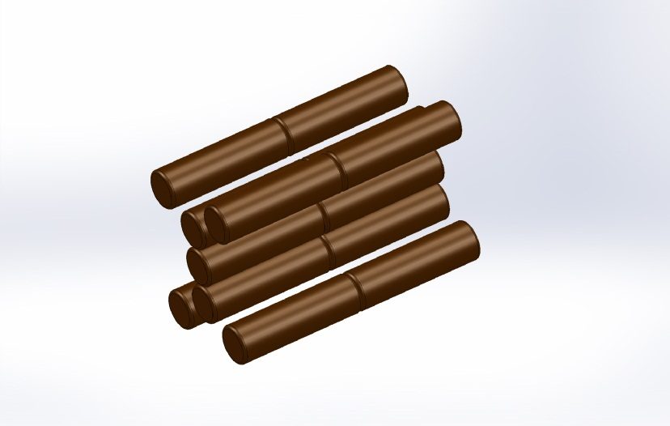
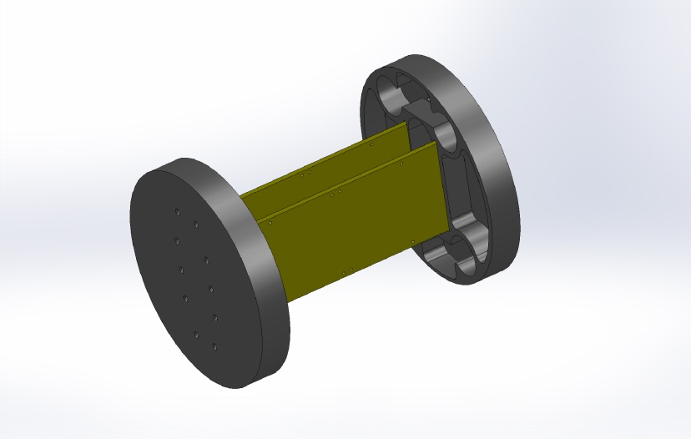
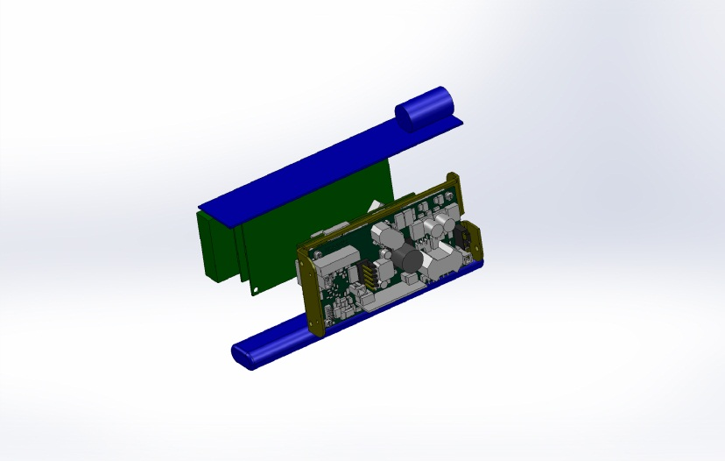
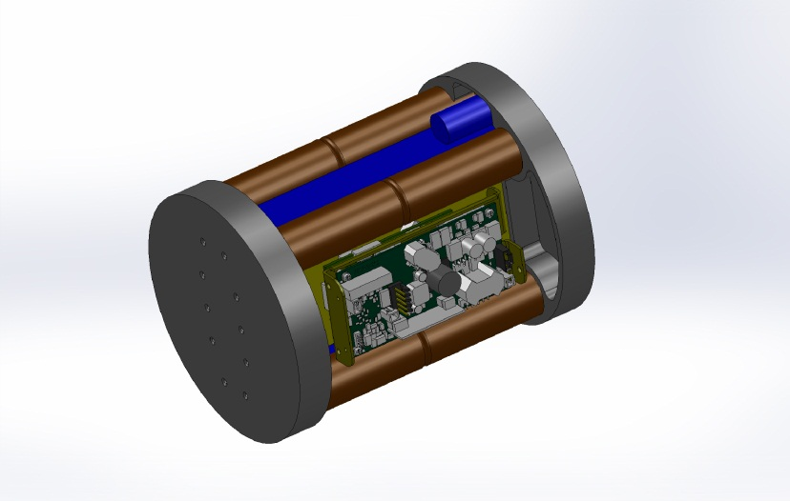
Instrument Housing
(internal packaging)

Slide 24
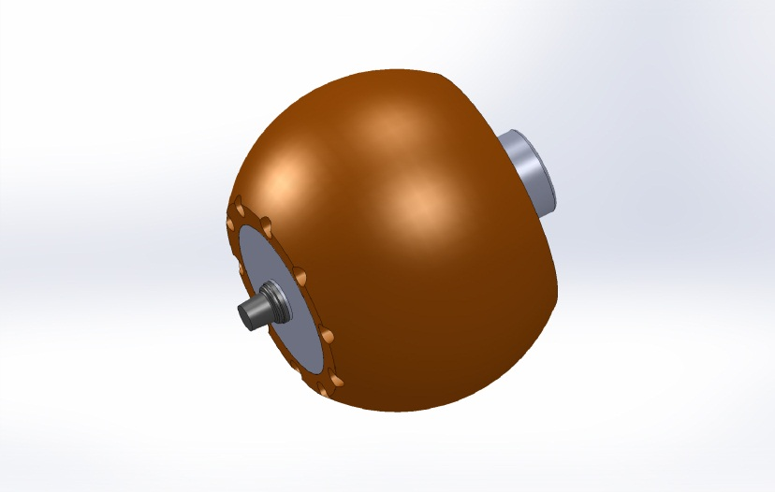
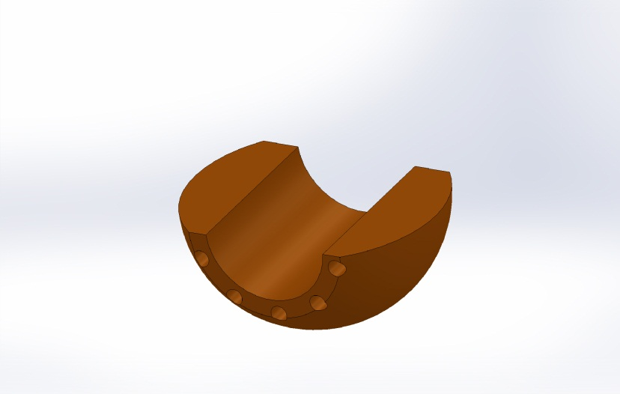
Trim & Ballast System
Collar provides a hydrodynamic shape to the instrument housing that can be modified as needed.
  In addition, the collar provides flotation, ballast & trim adjustments

Slide 25
Weights & Balance
Still working on this section

Slide 26
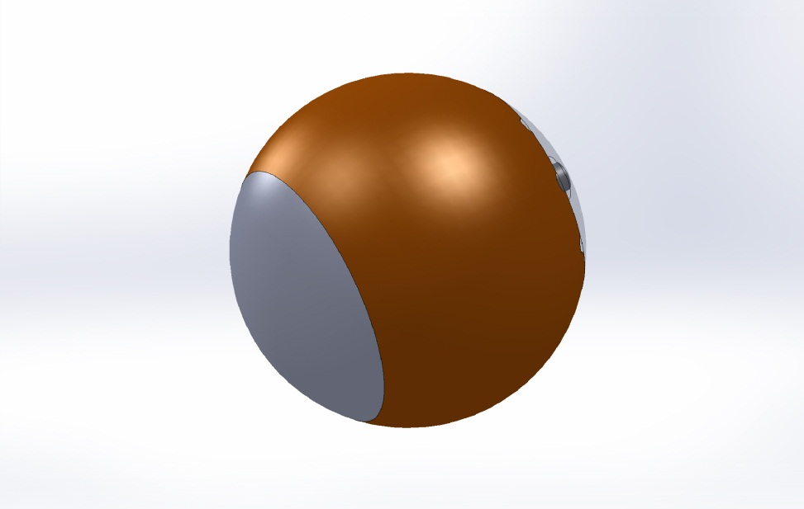
Transducer Guards
Protects transducers
Provides hydrodynamic profile
UHMW properties provide good acoustic path.

Slide 27
BEDs Integration and Test
Test jig
Prototype

Slide 28
BEDs Prototype
250 m and 300 m test sites
4 km from ML harbor

Slide 29
BEDs Future Improvements
Onboard linear displacement calculation?
Adaptive TX power reduction?
Clock drift reporting?
Adaptive Decimation (zip?)
Adaptive baud rate?
Drop weight system?
Atomic clock

Slide 30
BEDs Resources and Schedule

