Slide 1
BEDS Preliminary Design Review
June 20, 2012
Project Team:
PI: Charlie Paull
Lead Scientist: Bill Ussler
EE: Denis Klimov
SE: Bob Herlien, Mike McCann
ME: Larry Bird, Dale Graves
Project manager: Brian Kieft

Slide 2
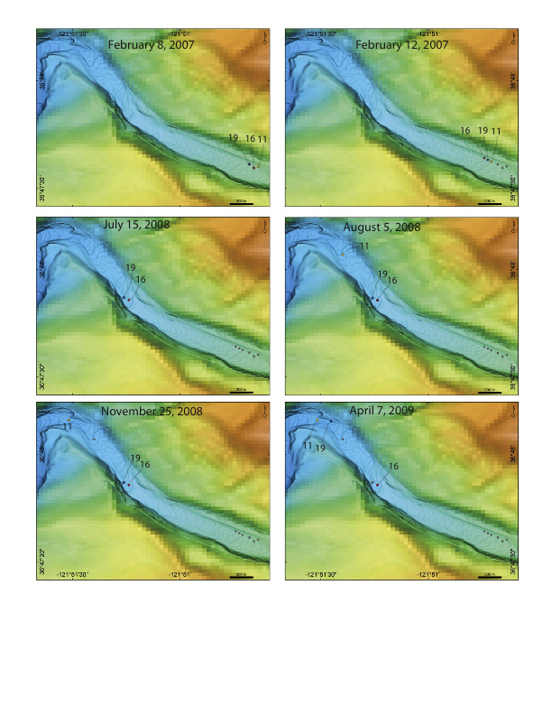
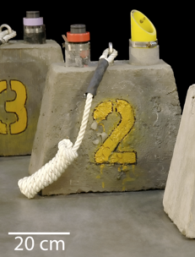
What is a Benthic Event Detector?
Characterizes motion and frequency of submarine canyon sediment debris flows
Allows for data recovery without instrument recovery
May not necessarily be recovered
Doesn’t explicitly require MBARI ships for operation

Slide 3
BEDs Considerations from Concept Review
Can data be retrieved from device?
Can motion be resolved in a way useful to science?

Slide 4
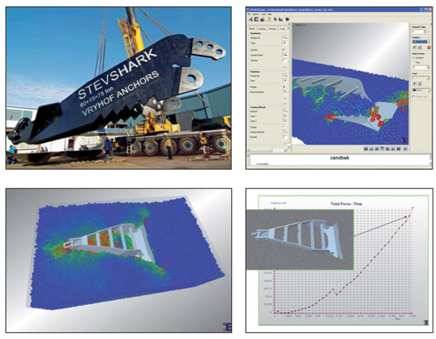
BEDs Data Retrieval
Acoustic modem
  Burial test .7m @1200 bps – 2560 bps
  Vryhof Anchors: 13m in 300m water @ 300 bps
  Frequency hopping scheme for modem if needed

Slide 5
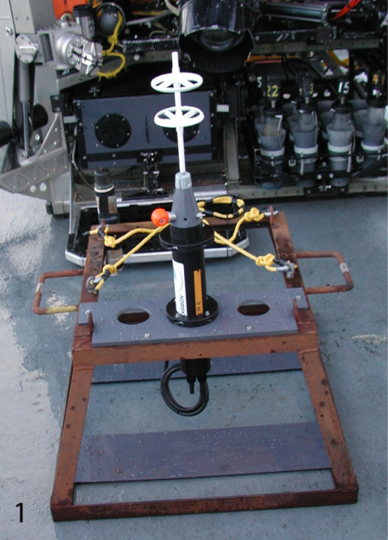
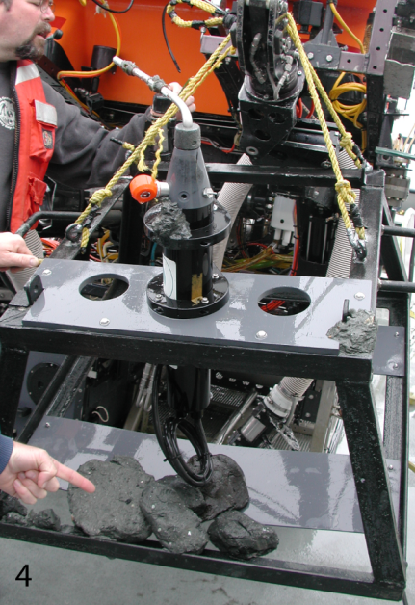
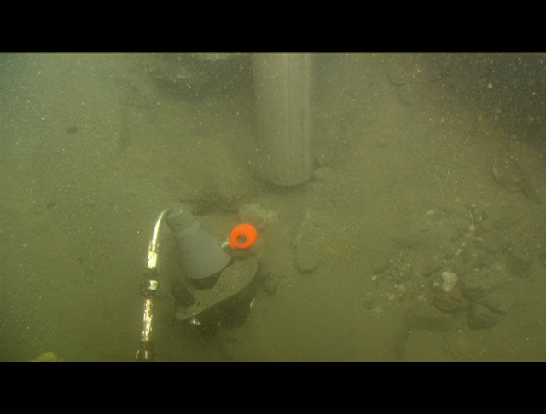
Sediment Debris Flows in Monterey Canyon
Only transport data obtained in 12 years is from a single debris flow event - what we know is:
  550 m down canyon translation of current meter
  11.9 dbar pressure increase
  ~10 minute duration
Would like to know more:
  Onset and duration of events
  Maximum acceleration
  Insight into type of sediment grain motion:
    Sliding
    Rotation
  Depth of no motion
  Velocity
December 21, 2001 Event
before
after
Current meter buried
in ~1 m sediment

Slide 6
Method
Benthic Event Detector
Deployment
Sediment motion
Data transmission
Compact autonomous motion detector and transmitter
Top or inside of sediment layer
Blending into sediment layer
Acoustic

Slide 7
BEDs Architecture
BEDs pressure housing
CPU Board
RS-232 console port
Acoustic modem Benthos ATM-885-4G
RS-232 controller
Pressure sensor
IMU: MPU 60X0 (I2C)
Processor
Data Storage, SD or CFM
SPI
Homer
Internal battery
RTC (SPI)
PCB
Temperature (analog)
ADC
Humidity (analog)
Power distribution
Analog I/O
Digital I/O
Battery pack

Slide 8
BEDs Operation Flowchart
Watch Cycle
Event recording
Command mode
Read Sensors
Read Sensors
Listen
Motion detection
Thresholds
Execute
No Motion
thresholds
Set thresholds
Time period (~1H)
Read status
Calculate and scale data
Context data
Set upload range
Decimated data
upload
Duty cycle ~5Min/1Hour
Log data
Context data
Specified Data upload
Motion thresholds
Activate modem
Time-out
Listen for acoustic communication
Exit command
~ 1Hz loop
~ 100Hz loop
Acoustic loop

Slide 9
BEDs Electrical
Data and Power Budget: EnergyBudgetv2.3-Electrochem14cells.xls
Operating modes: Watch Cycle; recording Cycle; Command mode
Power of subsystems and duty cycles defined in each mode
Data rates and number of bytes per point defined
Parameter | Watch cycle | Recording cycle | Command mode
Acoustic modem power, W | 0.60 | 0.60 | 21.00
Acoustic modem duty cycle, % | 10% | 10% | 100%
Inertial sensor & microcontroller power, W | 0.16 | 0.40 | 0.40
Peripherals power, W | 0.04 | 0.20 | 0.20
Peripherals and sensor duty cycle, % | 20% | 100% | 100%
Cycle average power, W | 0.10 | 0.66 | 21.60
Duration in mode, hrs | Depends on length of deployment | Depends on length of event(s) | Depends on data to be transmitted
Cycle energy, WHr
Parameter | Watch cycle | Recording cycle
Bytes/data point | 6 | 24
Data rate | 1 / Hour | 100 / sec
Event data, kB | Depends on length of deployment | Depends on length of event(s)

Slide 10
BEDs Electrical
Data and Power Budget:
Energy is limited and defines everything else
Lithium DD cells 30AH, 90 W*H for deployable article
Pack configuration 7s2p
Alkaline D-cells for prototype
Available Energy
Watch Cycle
Recording cycle
Data transfer
Trade-off
Deployment length
Event recording time

Slide 11
BEDs Electrical
Trade-off
Deployment length
Event recording time

Slide 12
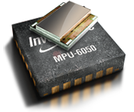
Why Invensense?
Low power
Sensor Fusion Algorithms onboard
Gyro drift and accel bias compensated
Event detection logic
Cheap
Open source community and COTs devel boards
  Paparazzi code base includes peripherals like magnetometer, pressure
  Integrated 9 DOF solutions available for MSP430

Slide 13
BEDs Software
Onboard
Post processing
Visualization
Single-threaded state machine
Three operating loops with defined transitions
C++
Software runs on shore
Algorithm to reconstruct linear motion (displacement)
C, Java; or MatLab
Low-resolution (contextual) data panel
Event data panel to represent high resolution data
VRML can provide 3D modeling

Slide 14
Mechanical Requirements
Operational Depth = 500 meters
Deployment duration = up to 12 months
Temperature range = -3 to 50 degrees C.
“Ruggedized” to withstand acceleration shocks associated with transport
Package density = 1.5 to 1.8 G/CC

Slide 15
Mechanical Requirements
The system shall be packaged such that its density could be increased to 3 times the default package density so that self-burial can occur (i.e., it can be made more dense).
The system shall be designed as small as possible to approximate the natural motion of sediment within the canyon floor
Be deployable and recoverable from an MBARI ROV
The system shall communicate at any package orientation

Slide 16
Main Components
Instrument housing
  7”ID X 10.5” cylinder w/modem & homer transducers
Trim/ballast/system
  15” Flotation sphere - collar w/ballast weights
Transducer guards
  UHMW “windows”

Slide 17
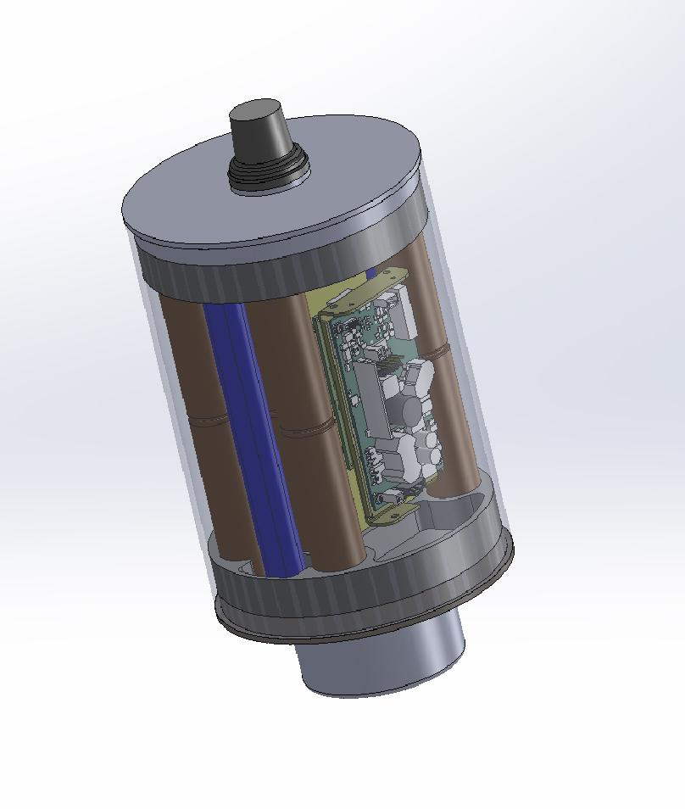
Instrument Housing
(internal components)
Homer transducer
Homer PCB
Homer battery pack
Inertial sensor board
Pressure transducer
Benthos G4 modem PCB assembly
Benthos modem transducer
Modem battery pack
Instrument battery pack

Slide 18
Instrument Housing
(materials)
Options
  Ti
    Pros – last for ever
    Cons – high cost
  Composite tube/Ti end caps
    Pros – Very long life
    Cons – higher costs than mild steel
  Aluminum
    Cons – very limited life due to corrosion and not predictable
  Mild steel w/coating and or anodes
    Pros – no crevice corrosion problems
      Corrosion is predictable and design can accommodate for this
      Inexpensive
    Cons – limited life time (2-3 years)
      Heavy compared to the Ti and Composite/Ti options

Slide 19
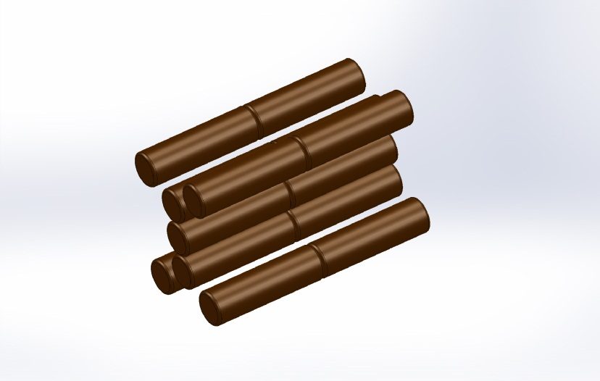
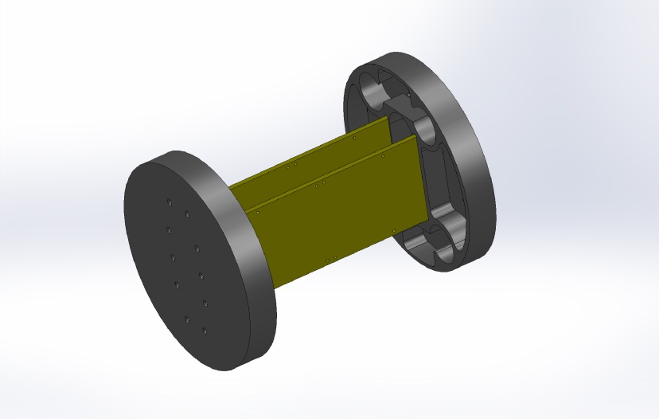
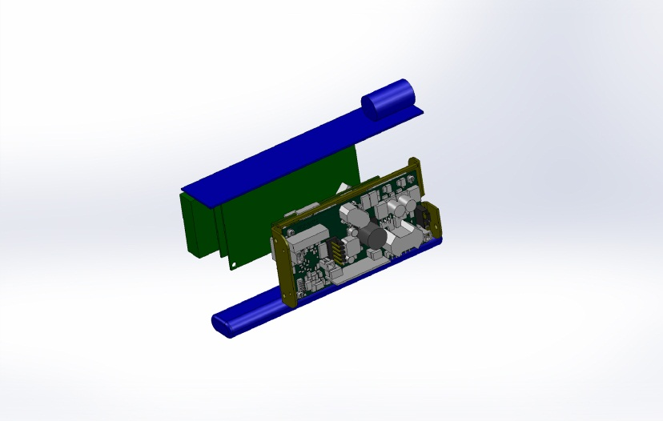
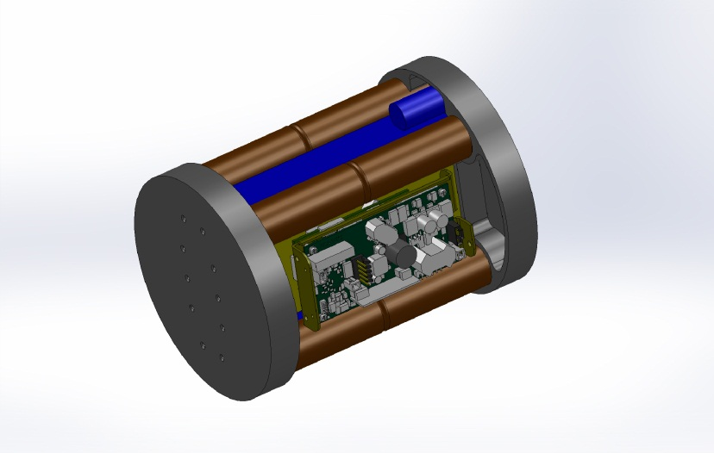
Instrument Housing
(internal packaging)

Slide 20
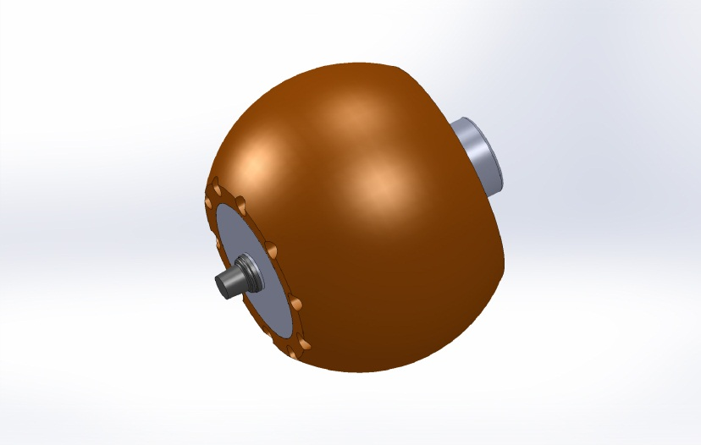
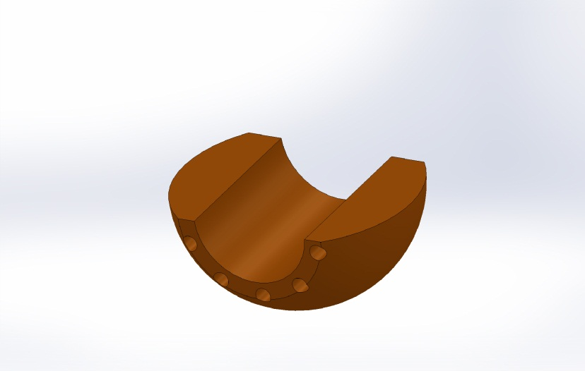
Trim & Ballast System
Collar provides a hydrodynamic shape to the instrument housing that can be modified as needed.
  In addition, the collar provides flotation, ballast & trim adjustments

Slide 21
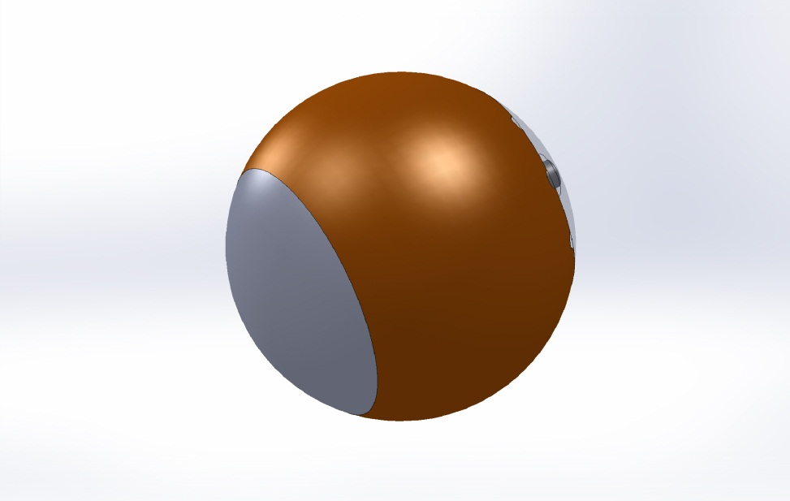
Transducer Guards
Protects transducers
Provides hydrodynamic profile
UHMW properties provide good acoustic path.

Slide 22
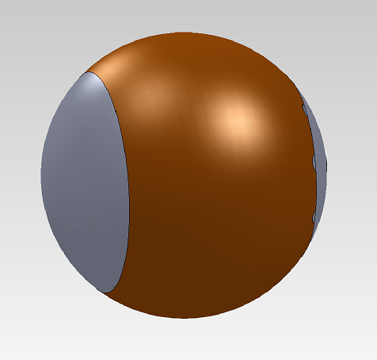
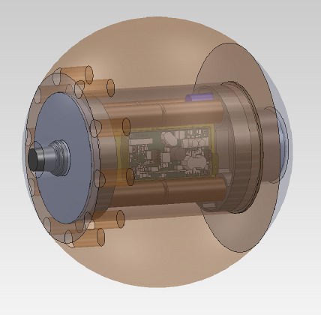
BEDs Specifications
General Specifications
Weight: 50lb (23 kg)
Dimensions: 15” (0.38m) sphere
Displacement: 0.58 cu.ft (16L)
Operating temperature: -10 to +50C
Transportation temperature: -20 to 80C
Max operation depth: 500m
Motion detection performance
Gyro resolution: 0.062 deg/sec
Gyro full range: +/- 2000 deg/sec (5.5 turns/sec)
Linear acceleration resolution: 0.5 mg (0.005 m/s²)
Linear acceleration full range: +/-16 g (+/-157 m/s²)
Depth resolution: 0.03m (at 14bit ADC)
Depth accuracy: ~ 0.2%span or 1m
Depth full range: 500m
Battery and electrical:
Pack configuration: Electrochem CSC93, 7s2p
DC load discharge range: 27.5 to 17.5 VDC
Pulse load discharge range: 17.5 to 13.5V at 4A peak
Acoustic link performance:
Max range: 2-3km (horizontal range in water)
Operating range when buried: TBD
Frequency bands: 9–14 kHz (LF)
Baud rate: 300-10240 bps
Deployment performance:
Max length of deployment at Event Duration Transmitted:
  500 days at 0 hours
  400 days at 0.5 hours
  300 days at 1.0 hours
  200 days at 1.5 hours
  100 days at 2.0 hours

Slide 23
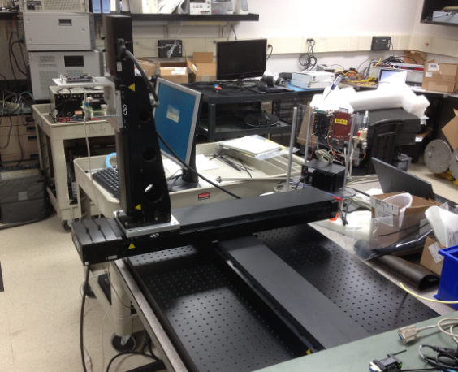
BEDs Testing
Motion thresholds and event detection
Acceleration, full range
Rotation
Calibration of RTC
Whole assembly on X-Y stage,
Or IMU on X-Y-Z
GPS
H
Delta
H
Environmental chamber
RTC

Slide 24
BEDs Prototype Deployment
250 m and 300 m test sites
Close proximity for survey (4 km from ML harbor)
High probability of sediment debris flows

Slide 25
BEDs Future Improvements
Onboard linear displacement calculation?
Adaptive TX power reduction?
Adaptive baud rate?
Acoustic frequency hopping?
Clock drift reporting?
Adaptive Decimation (zip?)
Drop weight system?
Depth in sediment layer?
Measure viscosity/ density of sediment by vibration?
Atomic clock

Slide 26
BEDs Resources & Budget
 | Total Resources Assigned for each resource category | Labor YTD
EE | 500 | 186
SE | 640 | 376
ME | 460 | 53
EE Tech | 200
SE Tech
ME Tech | 280
Machine Shop | 200
Divers
Bill | 160 | 27
PM/SE |  | 80
Total | 2440 | 722
Project Number | Project Name | Budget Amount | Paid Amount | Total Commitment | Available | Percent Available
901006.00 | Benthic Event Detectors | 343,072 | 74,662 | 7,327 | 261,084 | 76%
901006.04 | Acoustic Modem & Transduc | 22,091 |  |  | 22,091 | 100%
901006 Benthic Event Detectors |  | $365,163 | $74,662 | $7,327 | $283,175 | 78%

