Slide 1
BEDs:
24 BED motions were recorded over the course of 9 events
2015: Dec 1st
2016: Jan 15, Feb 17, March 6, Sept 1, Nov 24
2017: Jan 9, Feb 3, Feb 18
Events:
1 event with only one BED moving
3 events with 2 BEDS moving
3 events with 3 BEDS moving
1 event with 4 BEDS moving
1 event with 5 BEDS moving Plus one BED on AMT frame
Largest spread of depths recorded by a set of BEDS in a single event: 145 m over ~ 30 minutes (Nov 24th 2016) (about 5 Km)

Slide 2
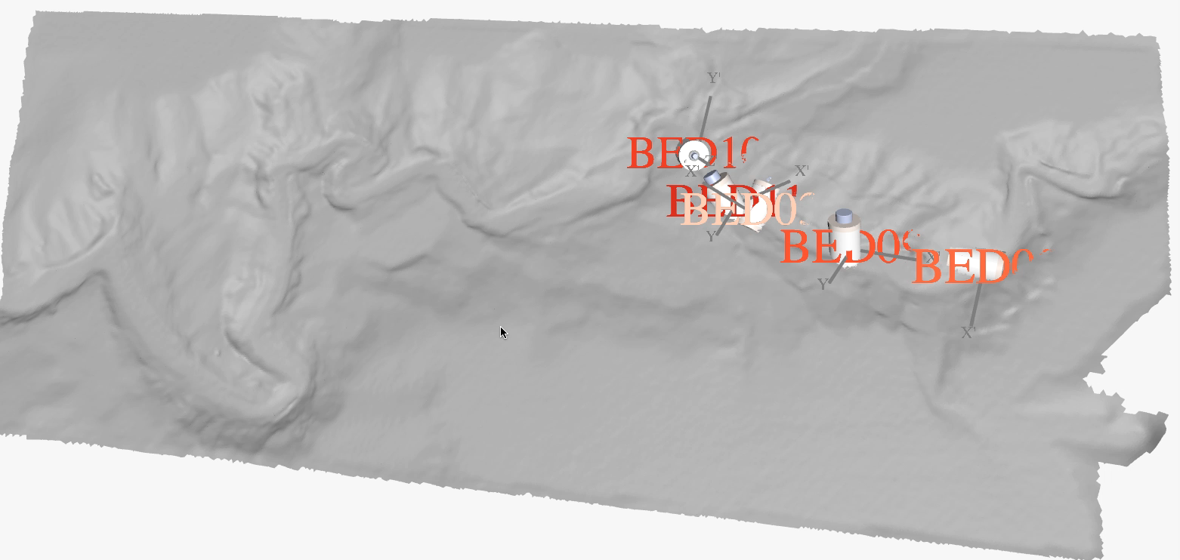
BEDs move at speed of the event or slower
V_{Bed}=ΔX/ΔT=~ 1.3 m/s
V_{event} =ΔX/ΔT
~ 5.2 m/s
Synchronous movement from 220 m to 332 m
AMT
Seafloor moves for at least 10 minutes at a one site
One BED overtake others.
At this depth some sections of the seafloor move and others do not
For STOQS installation: https://github.com/stoqs/stoqs/blob/python3/README.md

Slide 3
17 m
8 m
9 m
22 s
11 s
17 s
Ascents
Through mud?
Through water?
Up and down a wall?
Pressure sensor artifact
6.5 m
36 s

Slide 4
BED moving at event velocity
BED moving slower than the event velocity
V_{event} =ΔX/ΔT
~ 3.7 m/s
V_{event} =ΔX/ΔT
~ 6.1 m/s

Slide 5
Retrograde progression?
Time

Slide 9
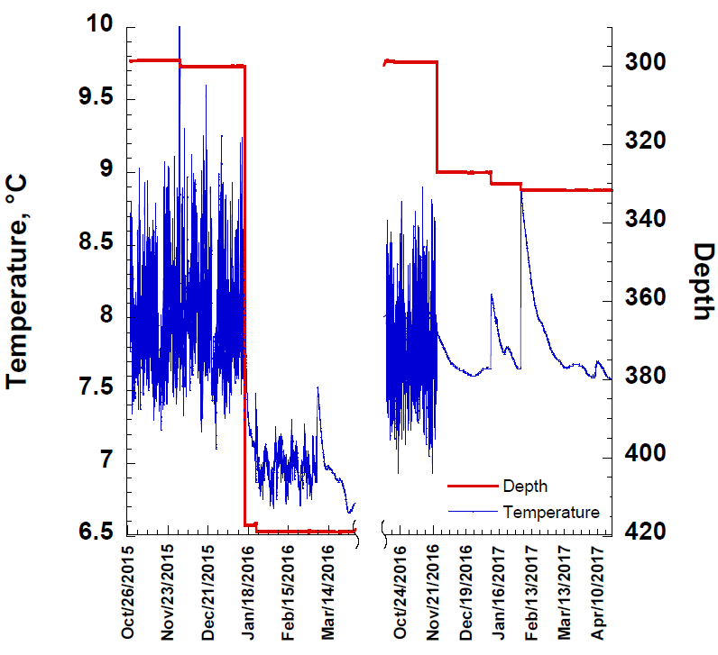
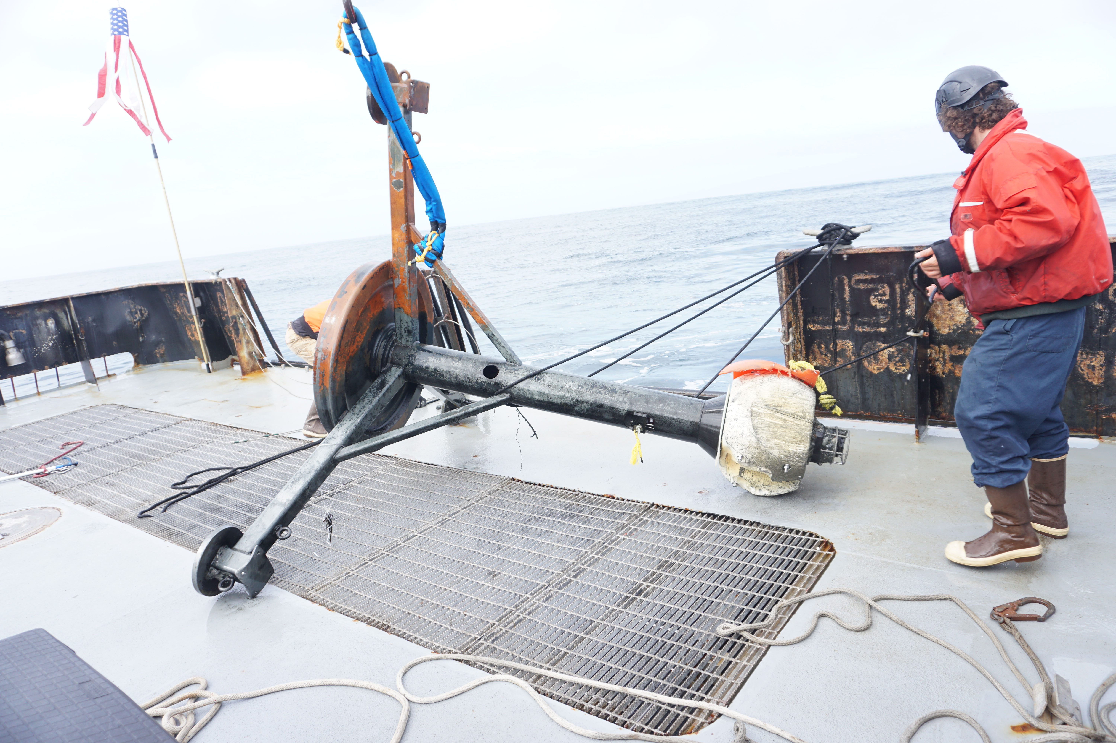
12/1/15
AMT
1/15/16
11/24/16
Temperature tidal oscillations => AMT on the surface
Dampened tidal oscillations =>
AMT half buried
No tidal temperature oscillations =>
AMT buried
1/9/17
2/3/17
Peak in temperature =>
  AMT exhumed and re-buried
3/6/16

