Slide 1
Benthic Event Detectors
    Work began in 2010 to further quantify sediment debris flows
      Event Detection
      Event Frequency
      Event Duration
      Dynamics of motion
C. Paull, K. Anderson, L. Bird, D. Graves, R. Herlien, B. Kieft,
D. Klimov, E. Lundsten, M. McCann, A. Sherman, E. Sumner

Slide 2
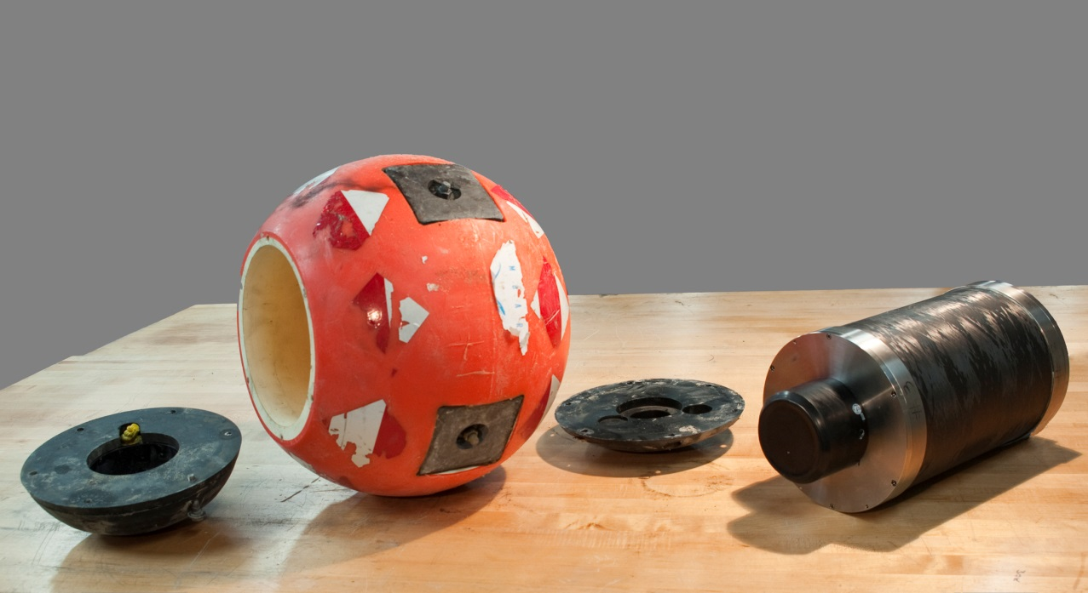
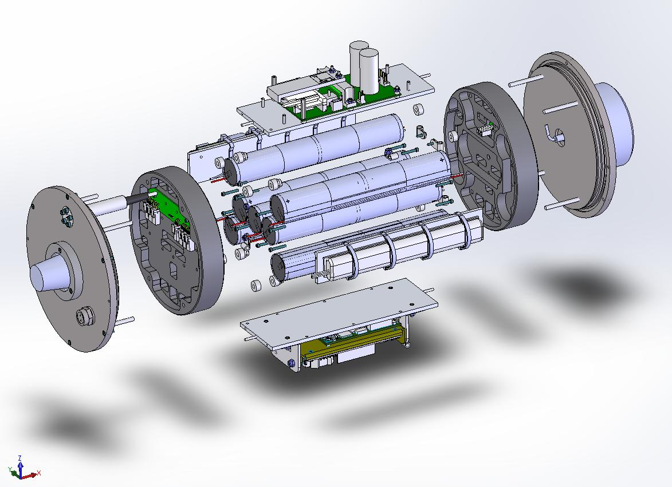
Overview
Core instrument housing (1000m/1 year)
Acoustic modem for data
Transponder for geolocation
Inertial motion unit

Slide 3
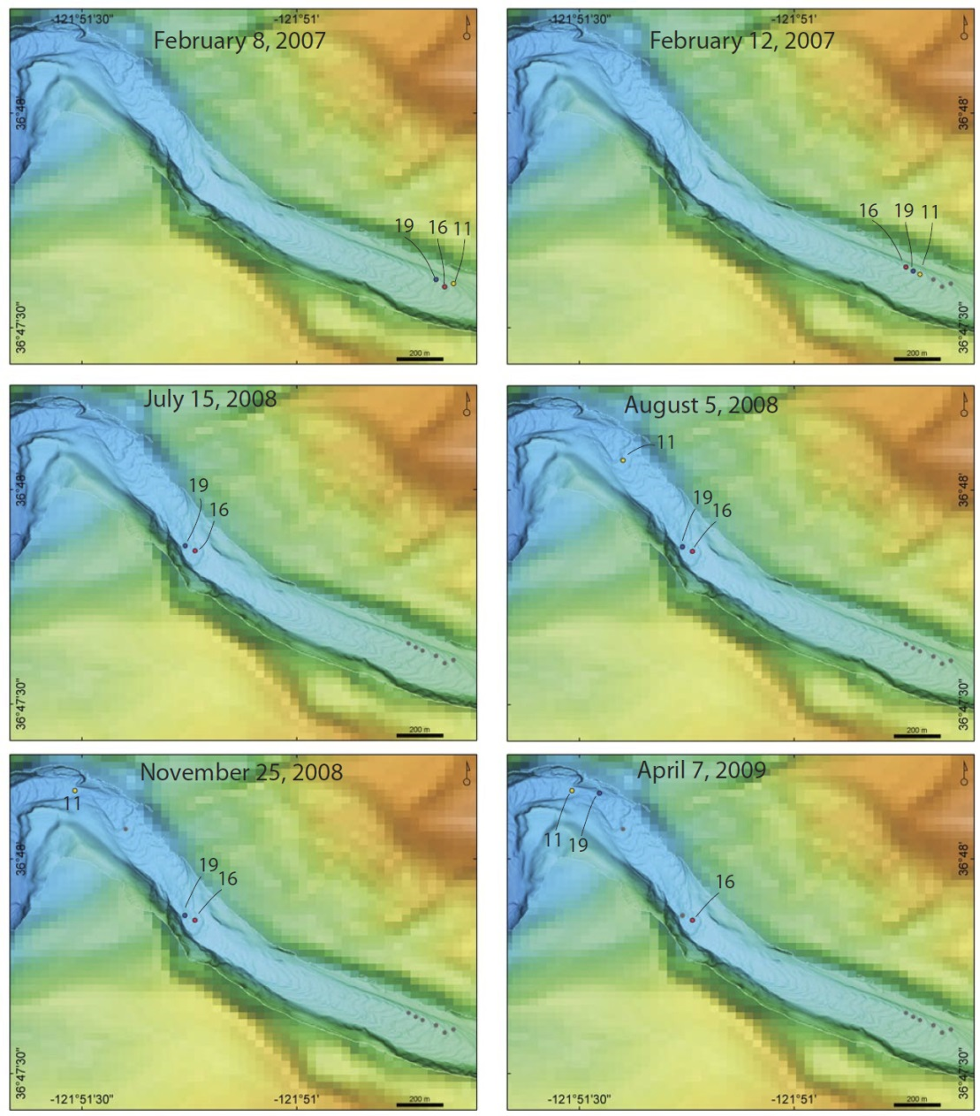
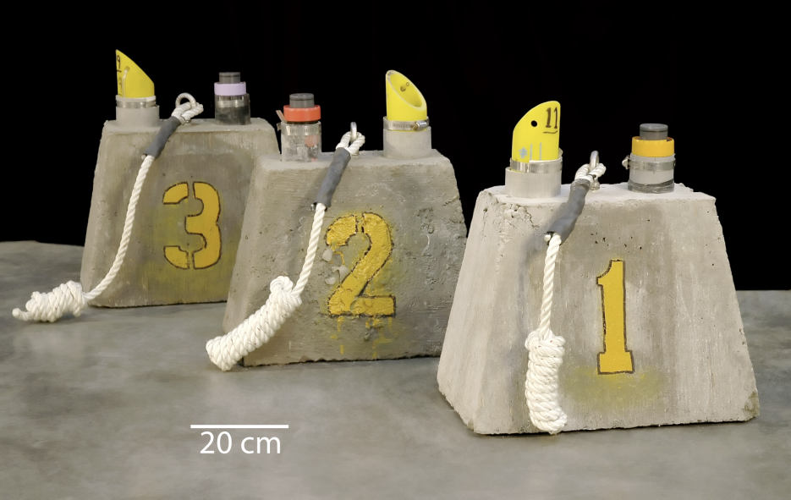
Episodic Events
When?
How Long?
How Many?
Is the ship available for survey?

Slide 4
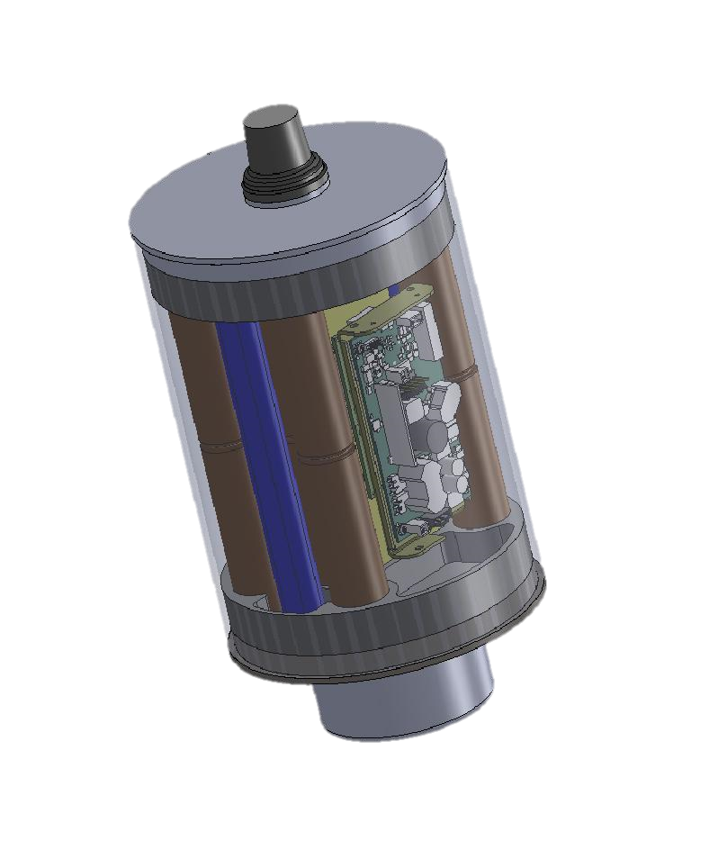
BEDs Functionality
Awakens with motion
Measures time/duration of events
  Accurate clock:
  .31 ppm observed (0.8 seconds/month)
Measures pressure (accuracy 0.3% 70bar @1 Hz)
Records dynamics of motion (@ 50 Hz)
Monitors internal health
Data transferred acoustically

Slide 5
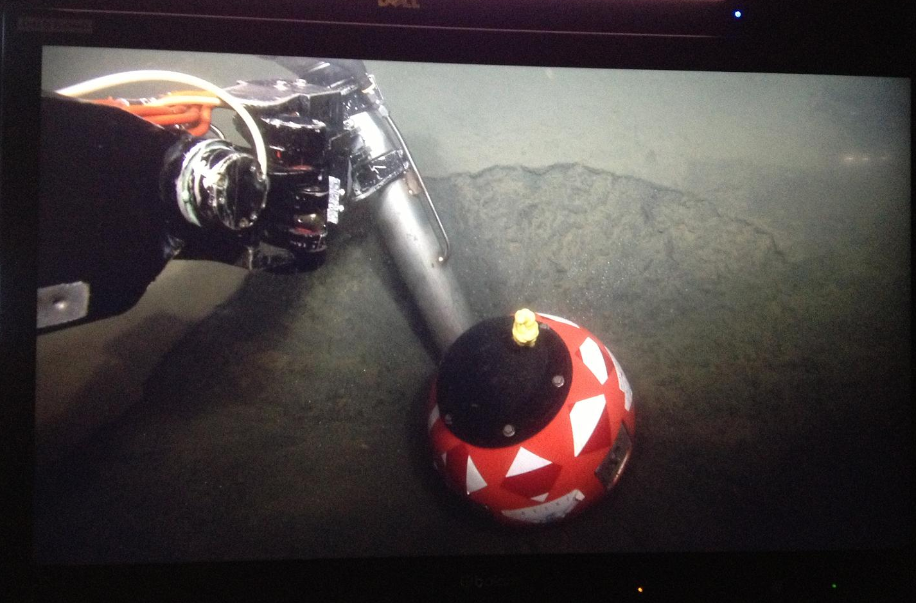
Deployment

Slide 6
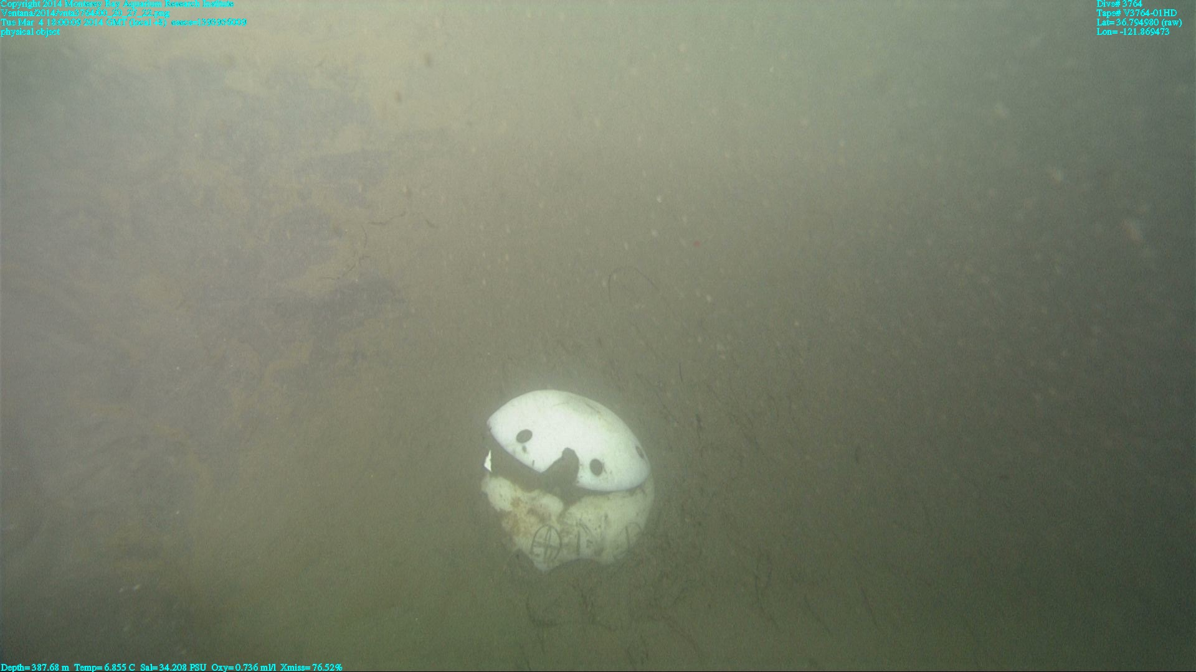
Recovery (sometimes)

Slide 7
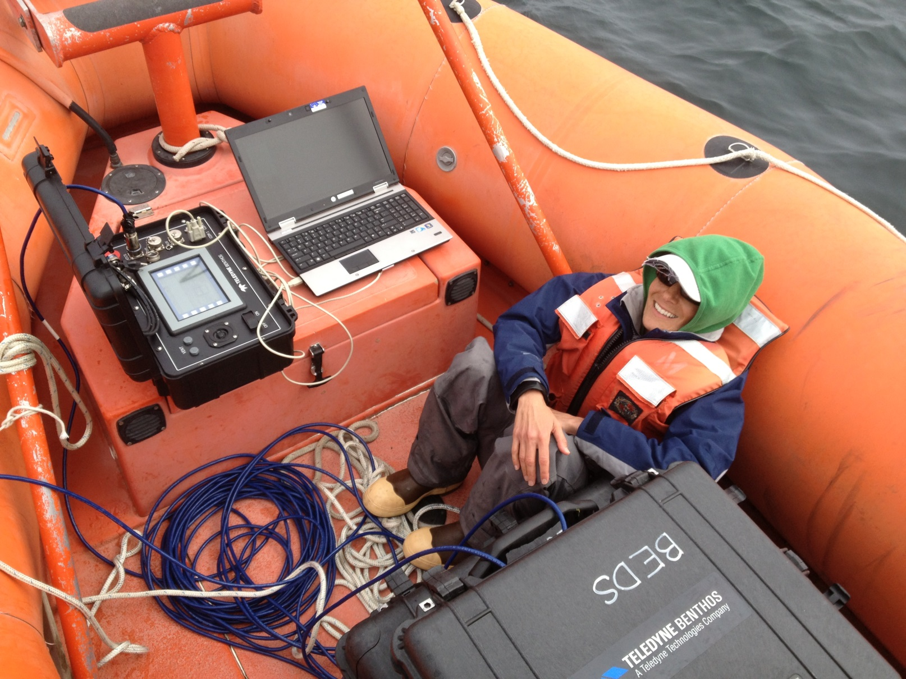
Data Recovery

Slide 8
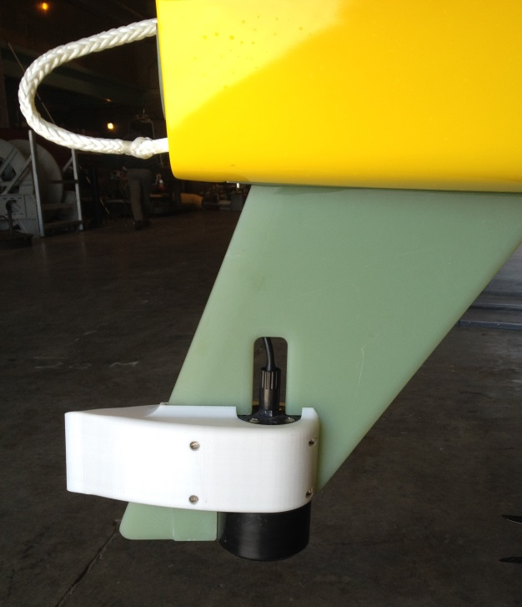
Data Recovery

Slide 9
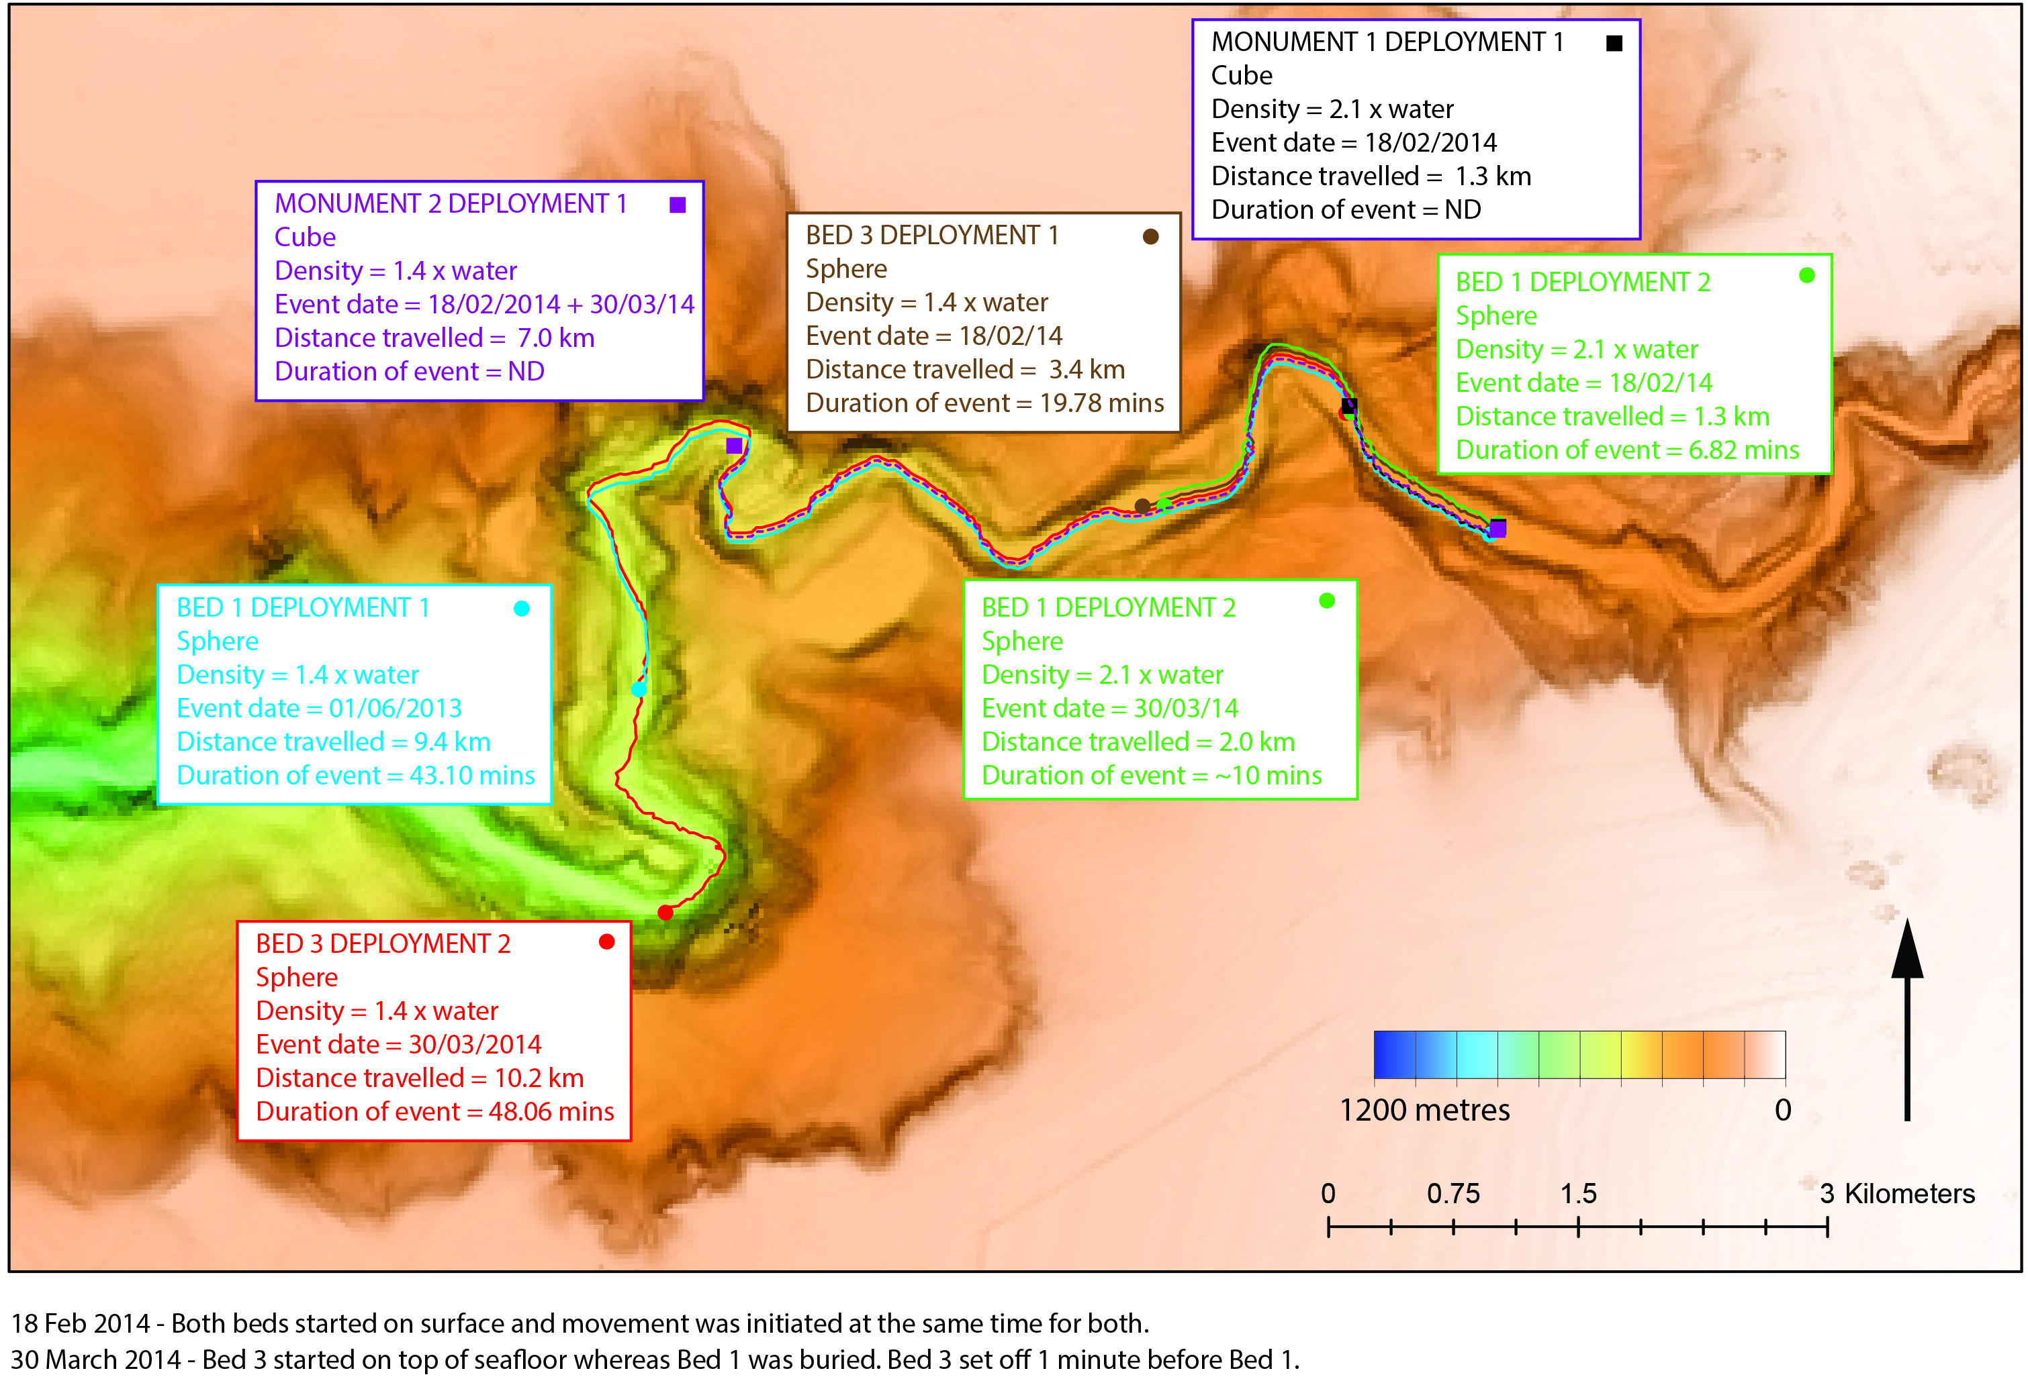
Events Since April, 2013

Slide 10
Depth – June 2013

Slide 11
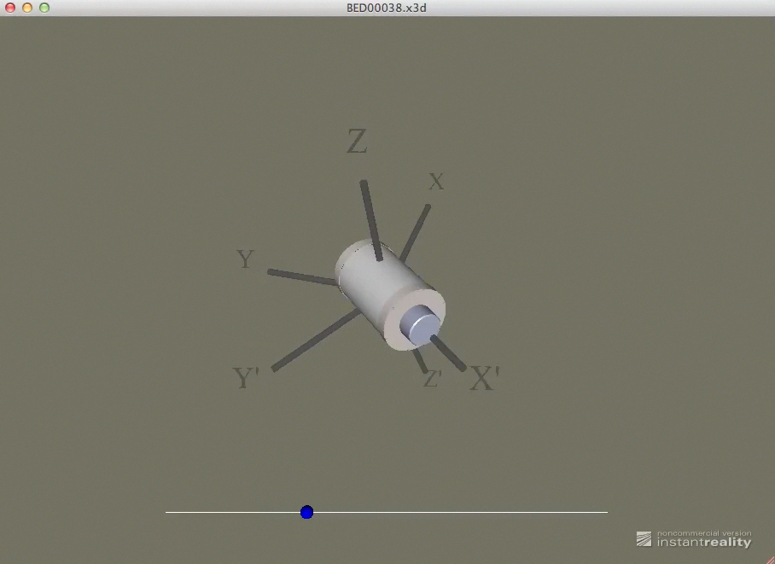
Motion – June 2013

Slide 12
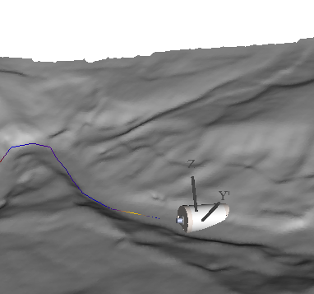
Visualization

Slide 13
Ongoing Efforts
Refining data transfer protocol
Waveglider operations
  Data transfer
  Geolocation?
Impact of shape/density
8 BEDs available for experiment
  Deploy all or 4 at a time?
  Deployment Location?

Slide 15
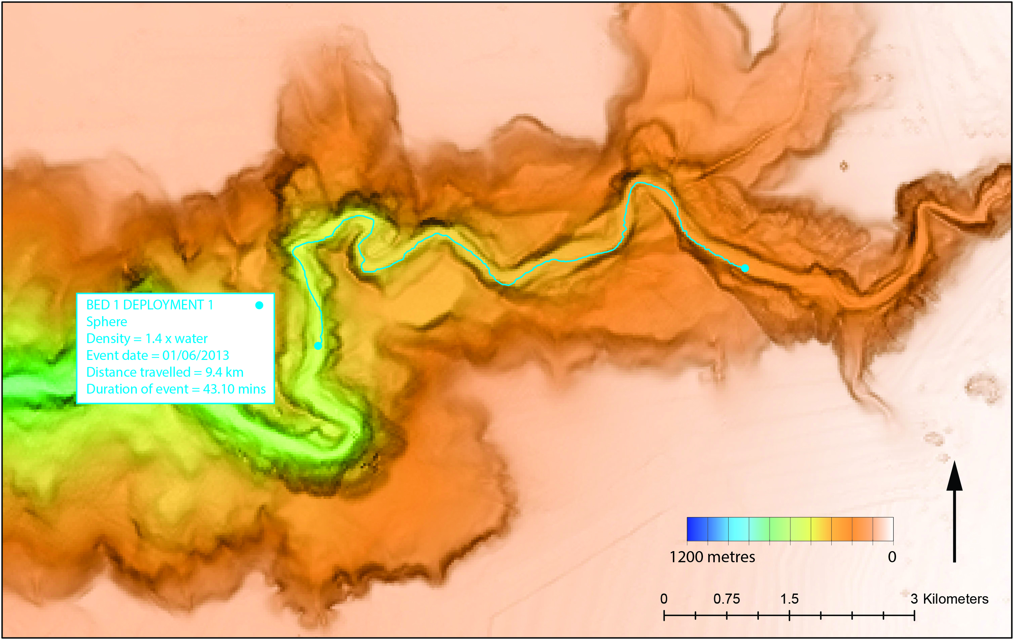
June 1, 2013

Slide 16
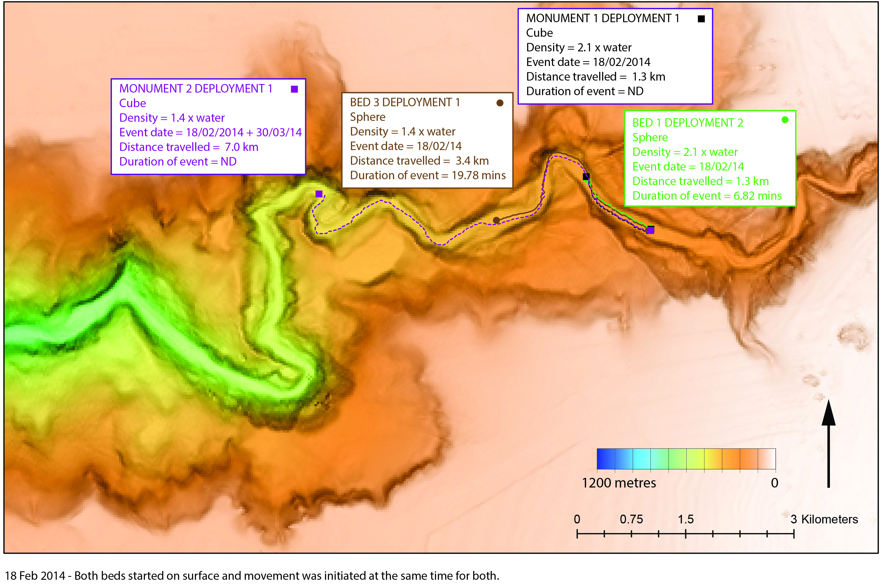
February 18, 2014

Slide 17
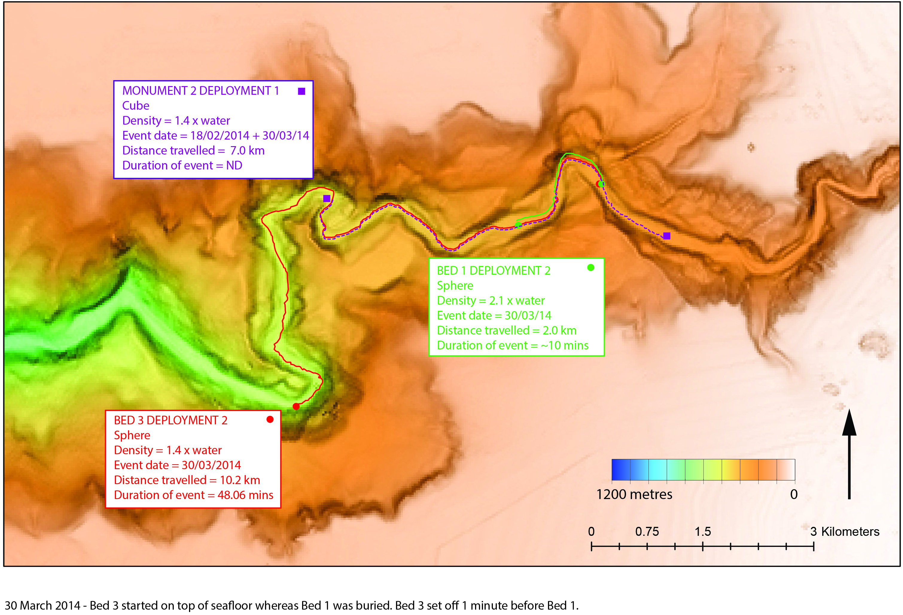
March 30, 2014

