Slide 1
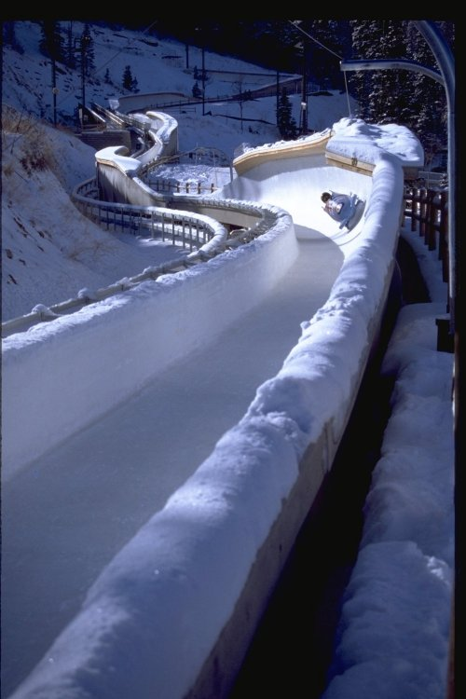
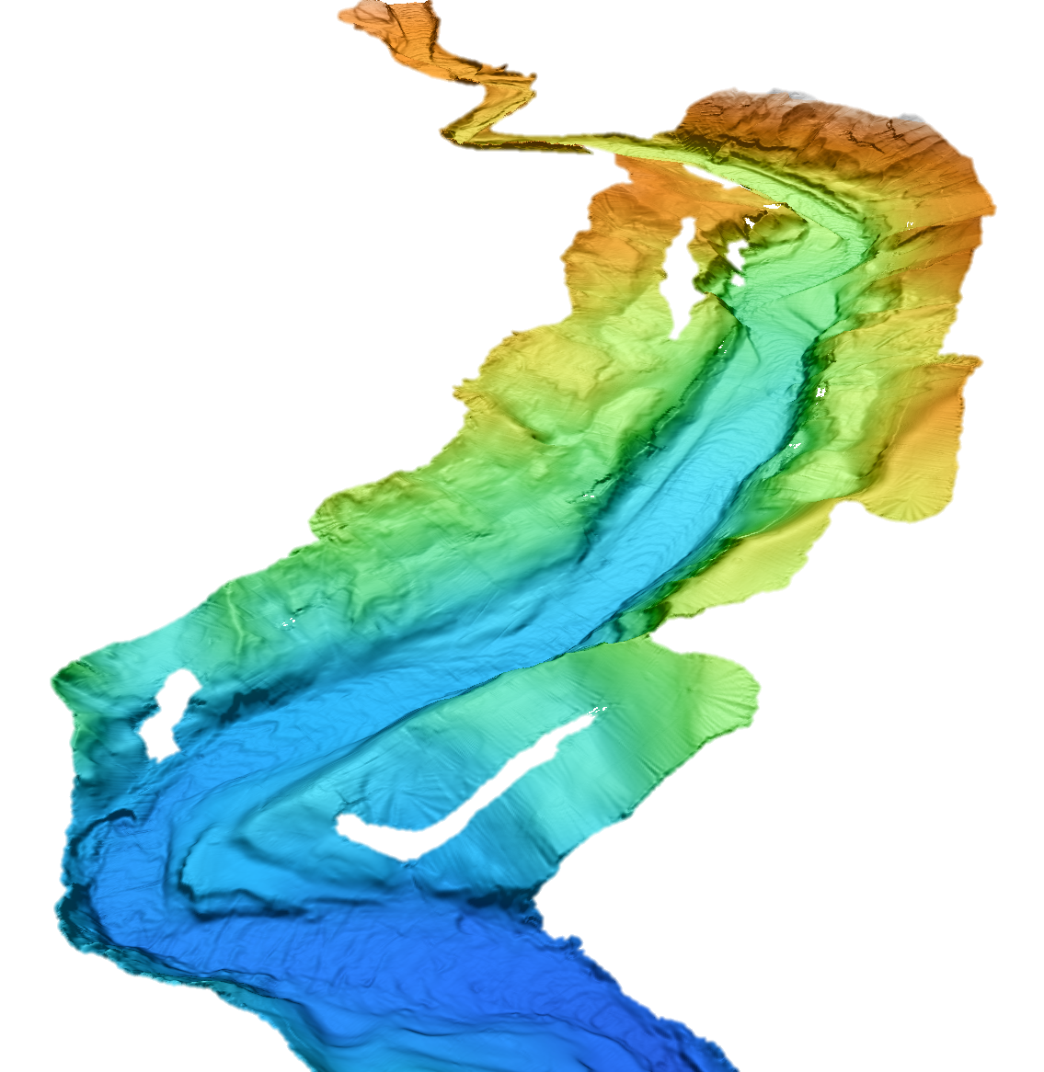
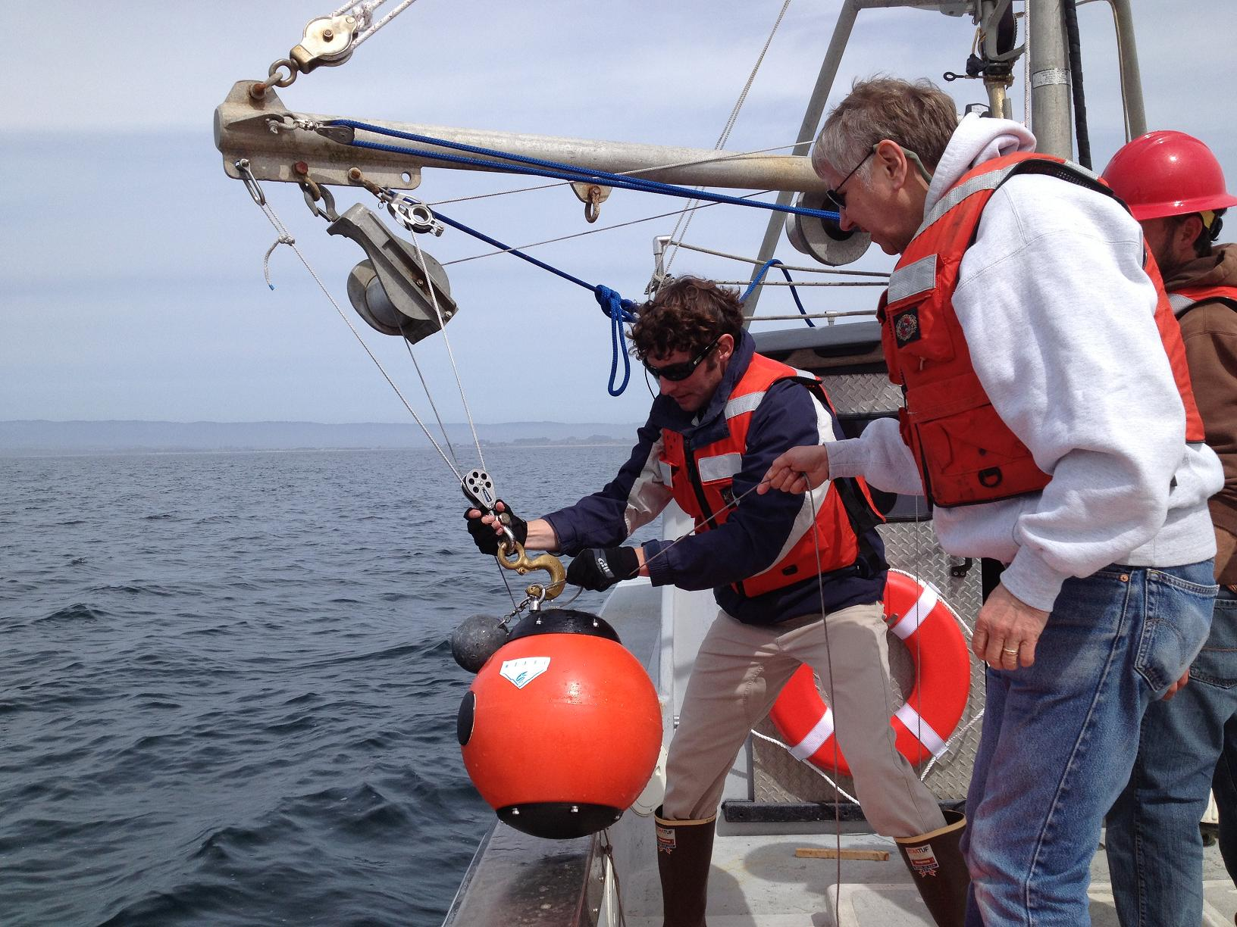
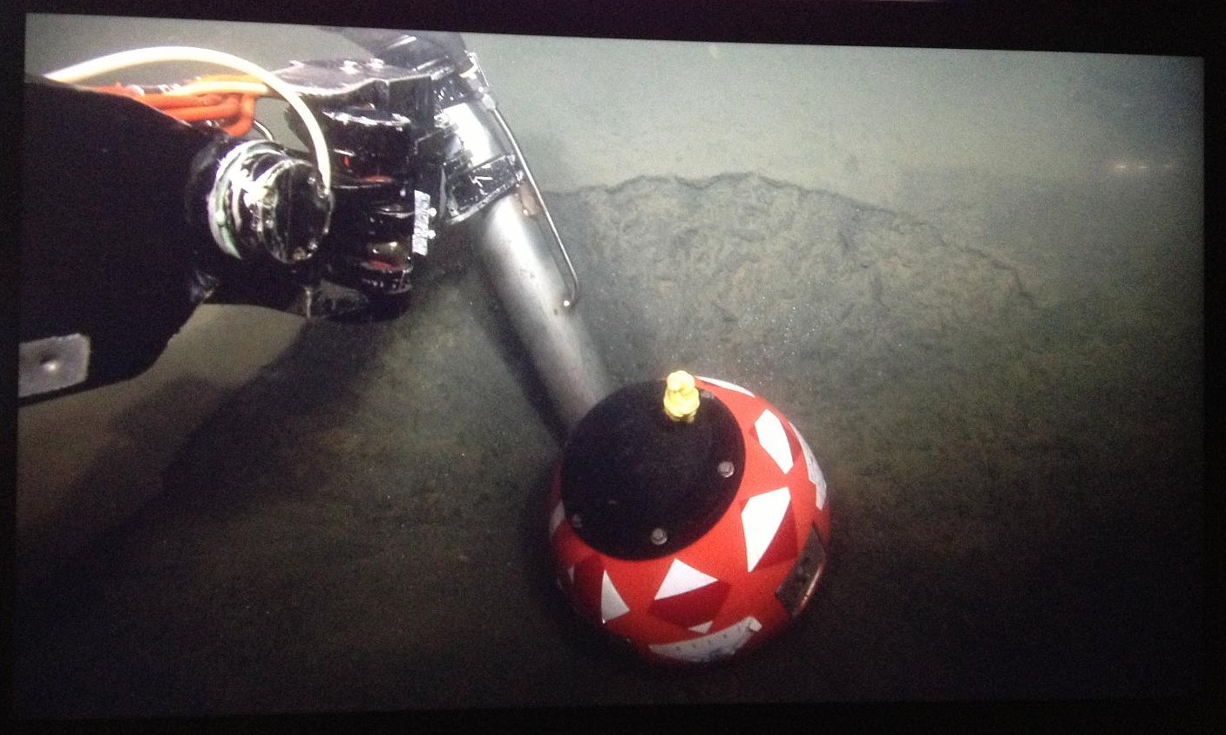
Bobsled track
Monterey Canyon
Initial Position
Also
Measures
Motion
During
Movement
Measure
Time &
Distance
New Position
BED
Notes:
We are intending to deploy several BED instruments on the canyon floor. During periodic events they will move unknown distance down canyon.
Relocating BEDs after they are displaced is possible because the BED instruments contain Homer Beacons (acoustic responders) that can communicate through modest thicknesses of sediments. This involves establishing communications from the surface. While this can be done from a small boat, it is a slow process, and still needs to be almost in a line of sight path. Thus, we intend to program the Wave-Glider to conduct these searches by systematically looping above the canyon floor. This slide shows a cartoon of a search pattern that the Wave Glider might take over the canyon’s floor when it is searching for the beacons.

Slide 2
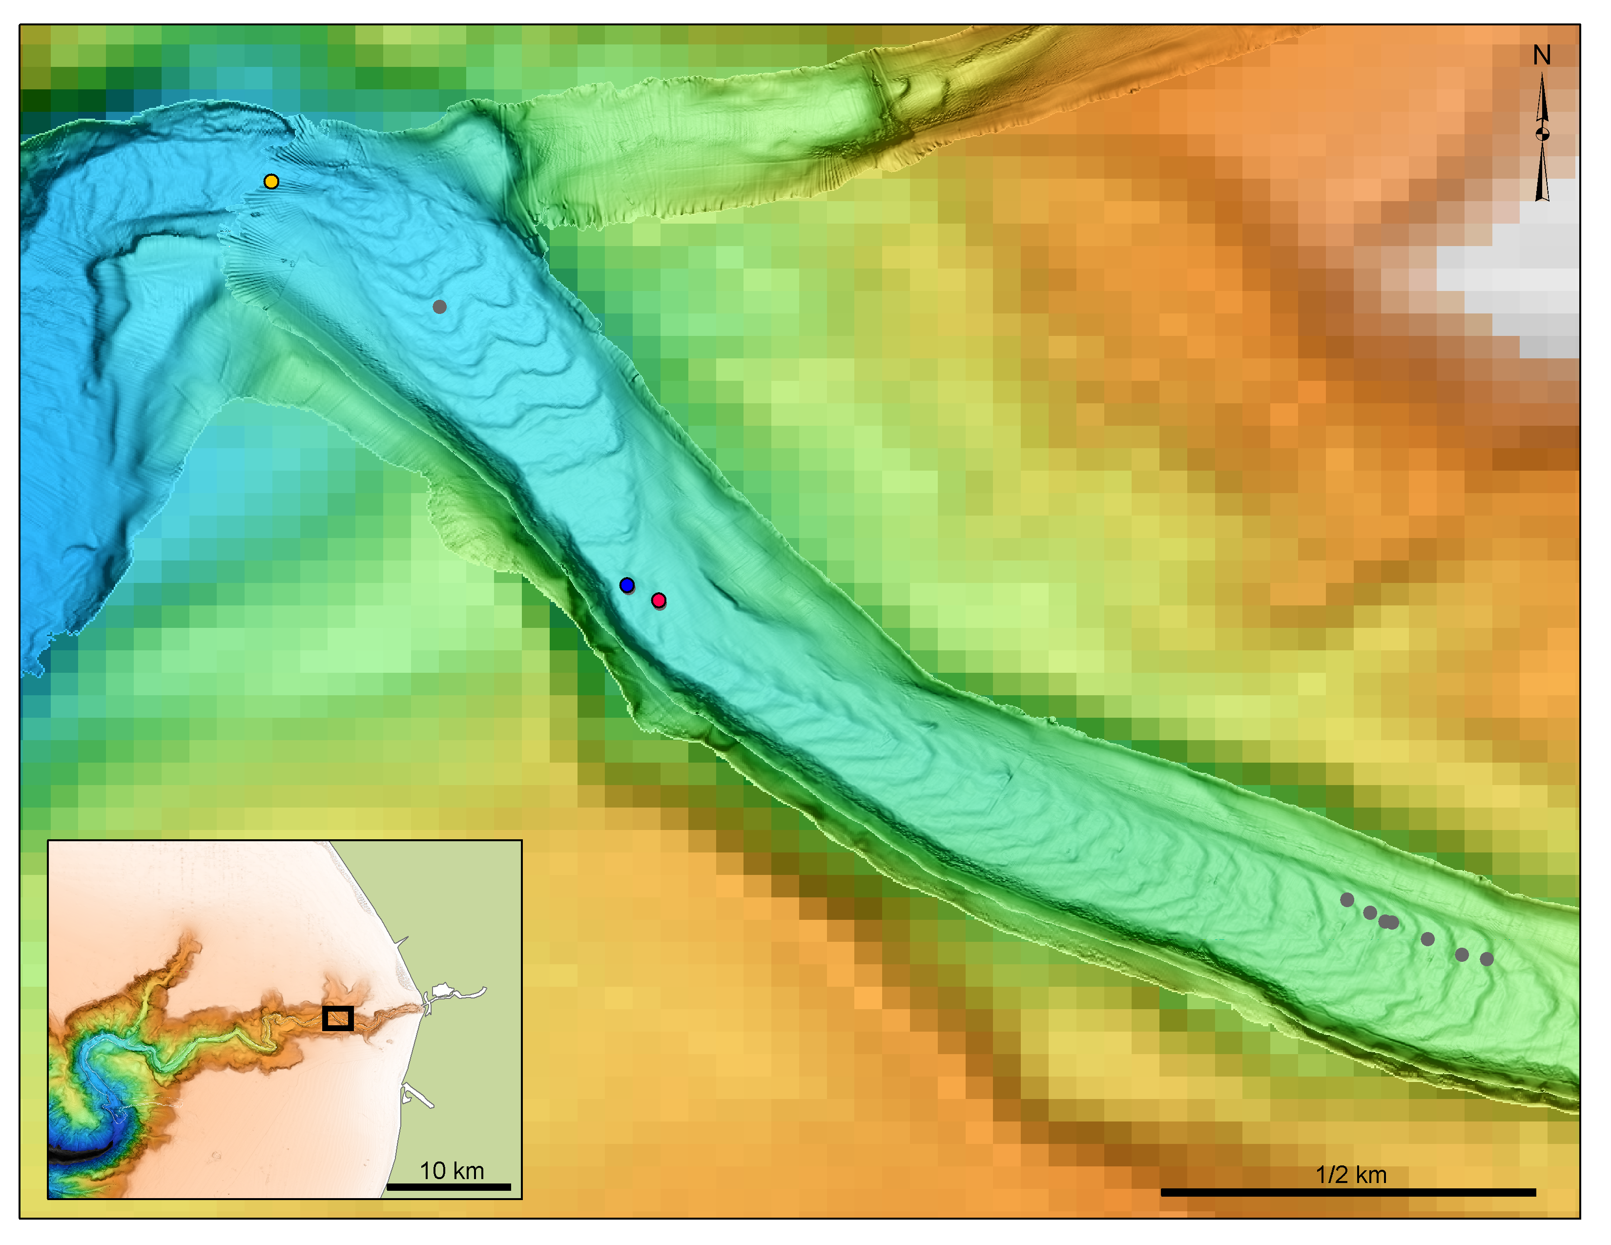
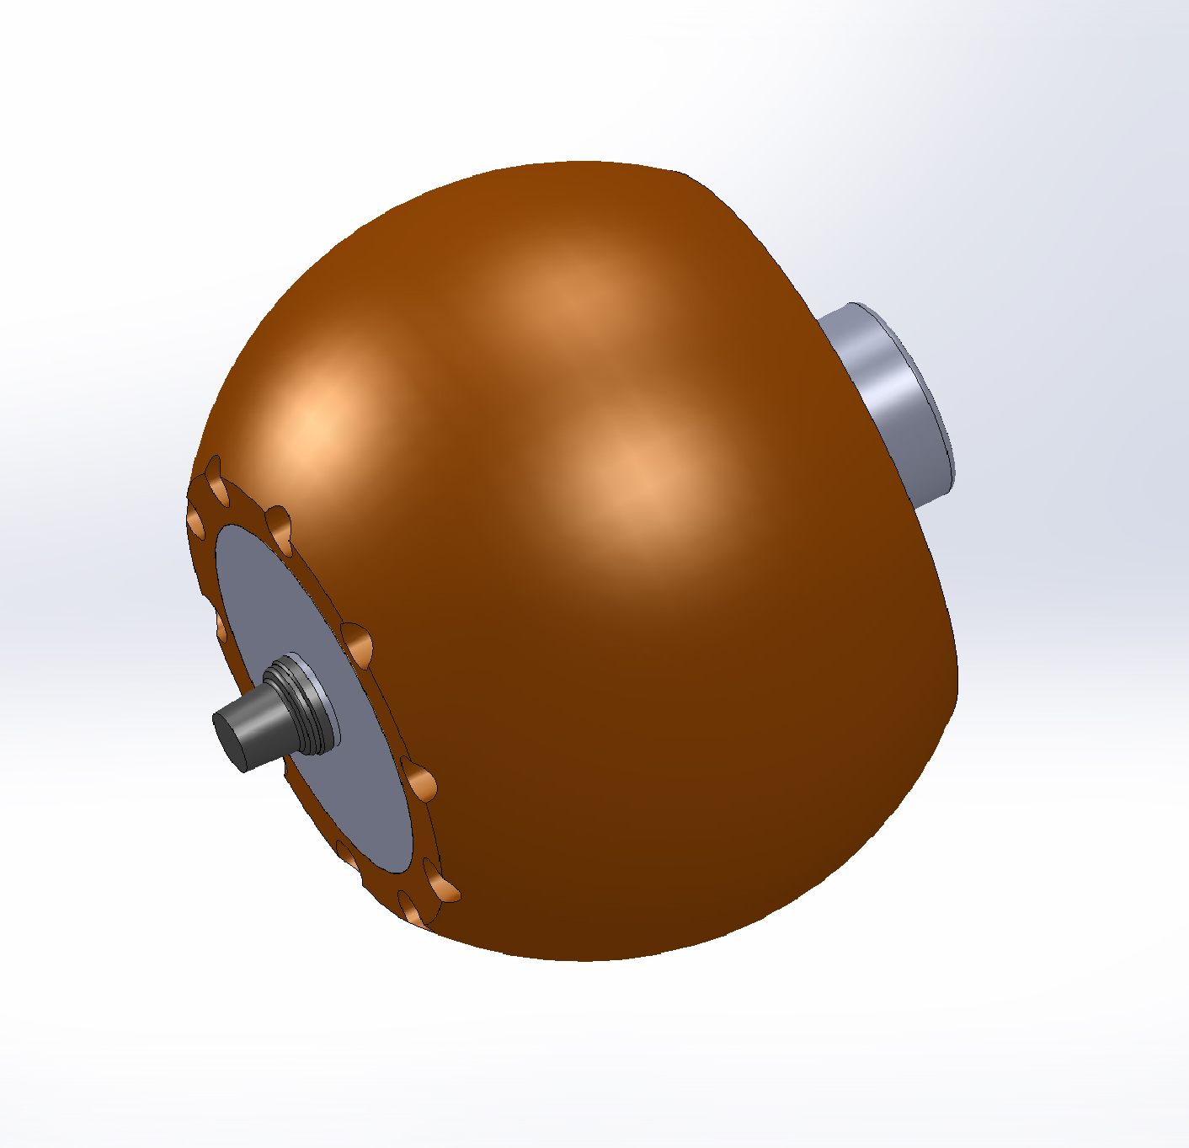
(280 to 375 m)
Surveying to
locate displaced
BEDs
Notes:
2
Relocating BEDs after they are displaced is possible because the BED instruments contain Homer Beacons (acoustic responders) that can communicate through modest thicknesses of sediments. This involves establishing communications from the surface. While this can be done from a small boat, it is a slow process, and still needs to be almost in a line of sight path. Thus, we intend to program the Wave-Glider to conduct these searches by systematically looping above the canyon floor. This slide shows a cartoon of a search pattern (looping black line) that the Wave Glider might take over the canyon’s floor when it is searching for the beacons. Red dots are actual positions where beacons on our 2007 monument experiment rested for days to months.

Slide 3
(280 to 375 m)
Notes:
3
Once located the Wave Glider has two other functions. After the general location of the BED instrument is determined, more detailed surveys will be conducted to refine its position to sub meter accuracy. This will again involve programing the Wave Glider to circle or figure-eight in the vicinity of the BEDS until ~1000 returns have been recorded. Red arrow indicates the illustrates the location of two beacons. Figure 8 pattern illustrates Wave Glider track….
The third potential use of the Wave Glider is to download data. A full download of the data from a BEDS instruments can take several hours. During this time the Wave Glider will hover over the instrument and act as a mobile hot-spot.

