Slide 1
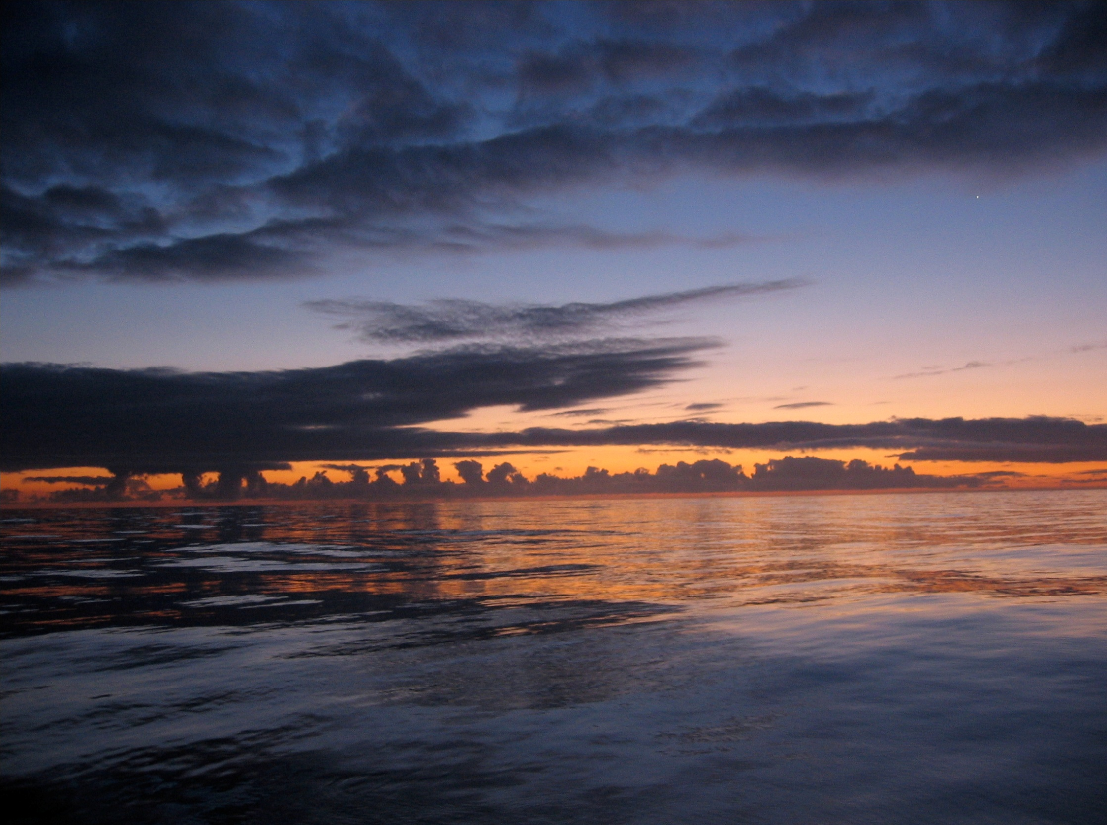
Deep Ocean Research and
Acoustic Platforms at MBARI
Brian Kieft
Monterey Bay Aquarium Research Institute
bkieft@mbari.org

Slide 2
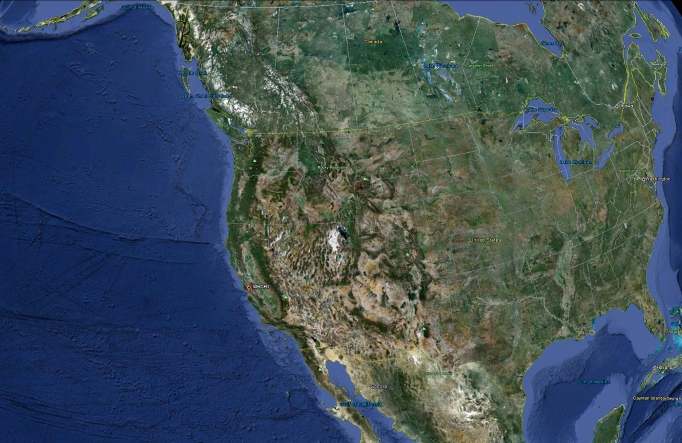
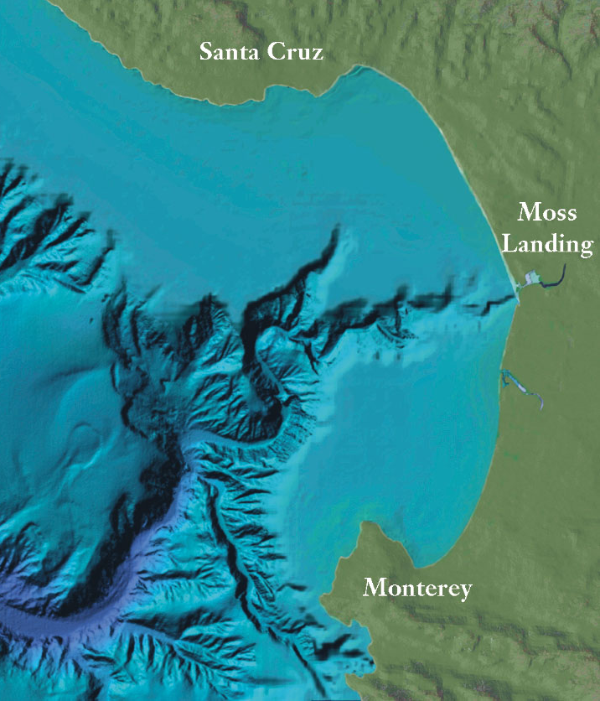
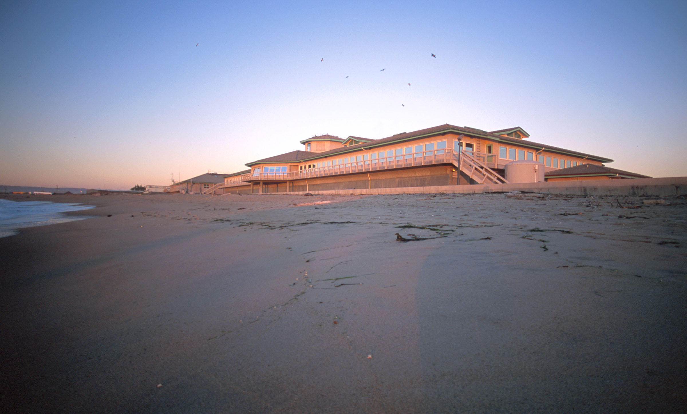
Monterey Bay Aquarium Research Institute (MBARI)

Slide 3

Monterey Bay Aquarium Research Institute (MBARI)
Established in 1987
Funded by the David and Lucile Packard Foundation
Annual budget approx. $45 M
210 Staff
David Packard
Mission: Science and Engineering
working together to advance ocean science (paraphrased)
www.mbari.org

Slide 4
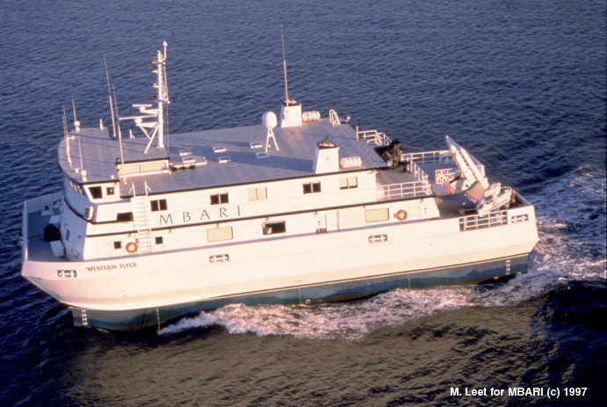
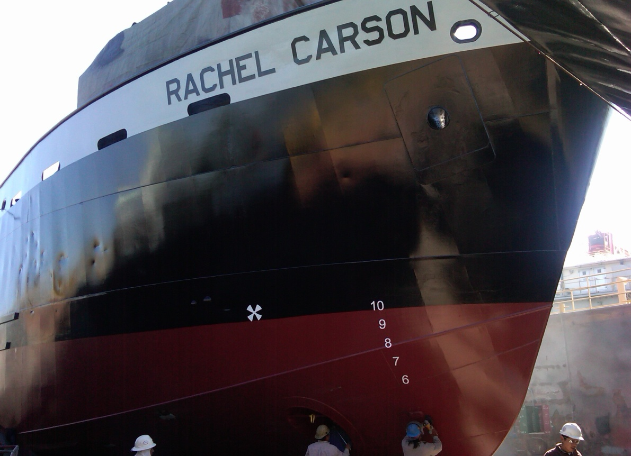
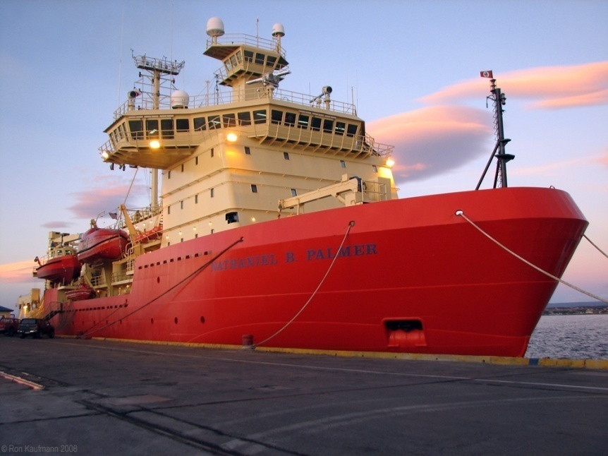
Ships

Slide 5
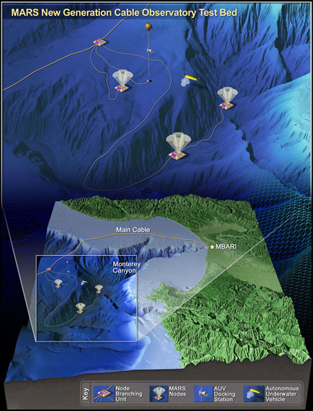
MARS
Monterey Accelerated Research Site
60 km distance
10 Kva power
Gigabit Ethernet
A community asset

Slide 6
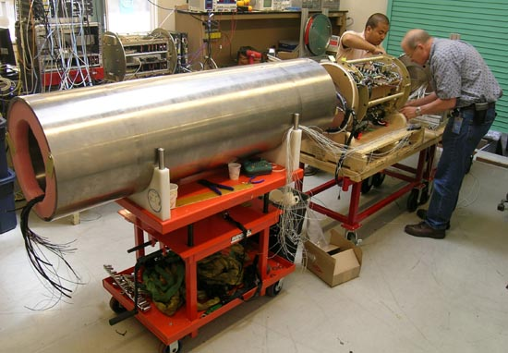
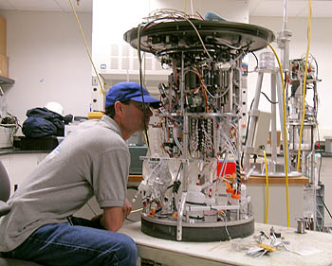
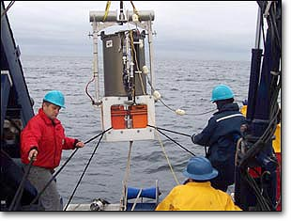
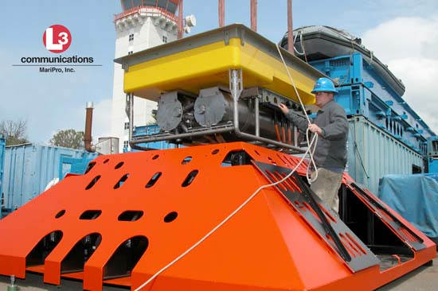
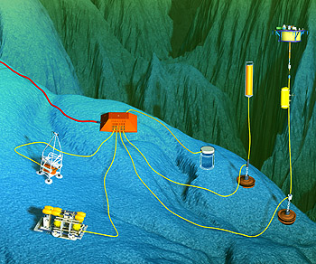
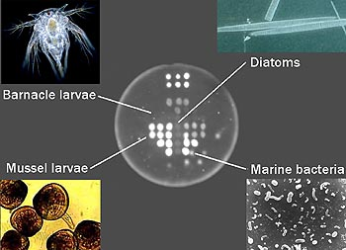
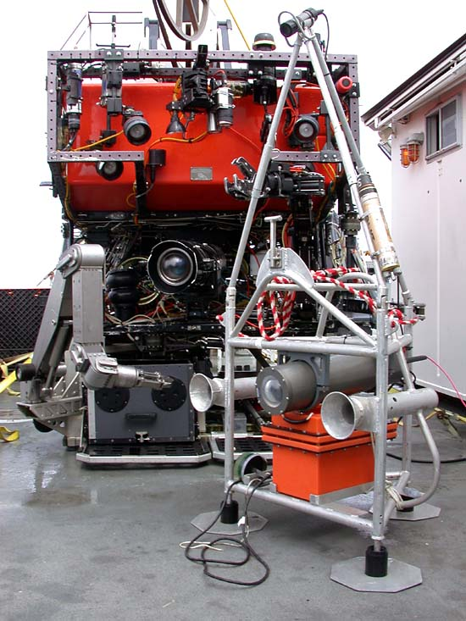
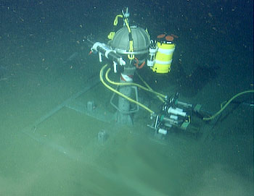
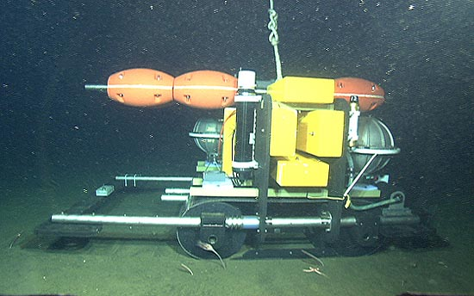
MARS Experiments

Slide 7
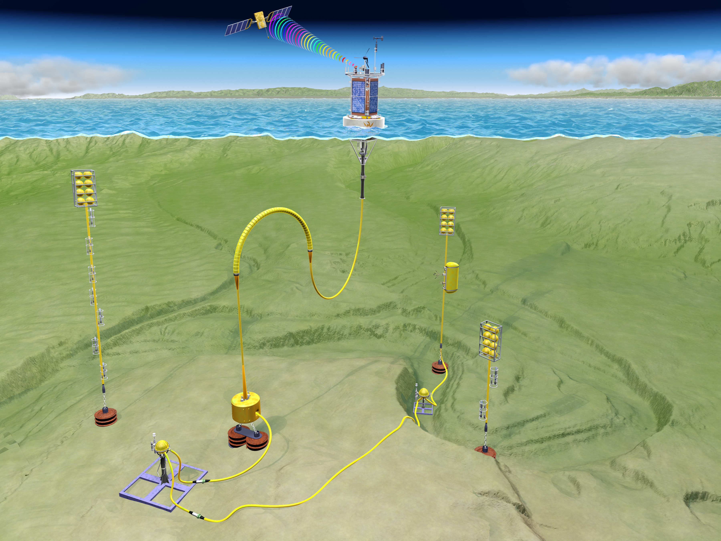
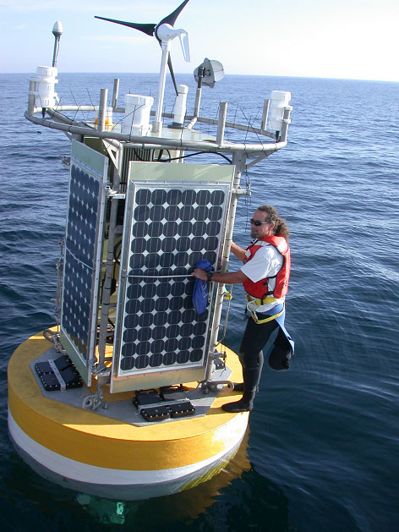
MOOS System
MBARI Ocean Observing System:
Mobile, 1 to 2 years, but power limited

Slide 8
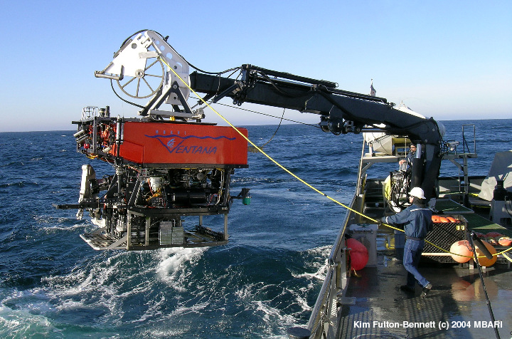
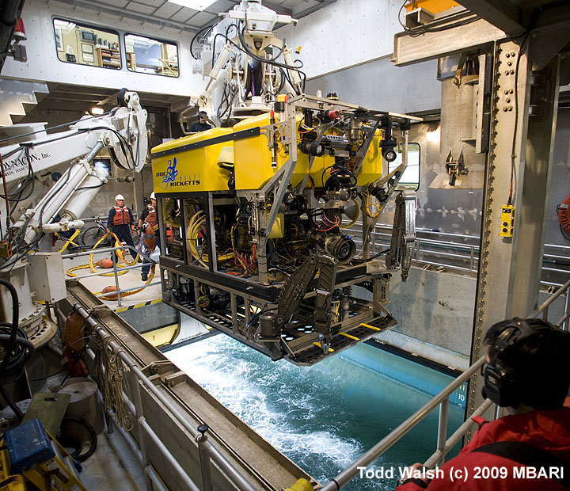
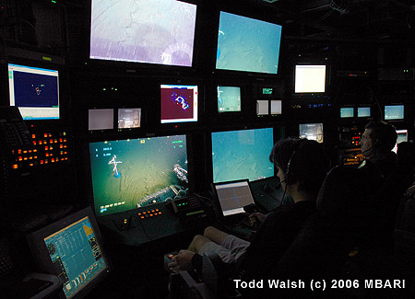
Underwater Vehicles:
Remotely Operated Vehicles (ROVs)

Slide 9
ROV Video
ROV Video

Slide 10
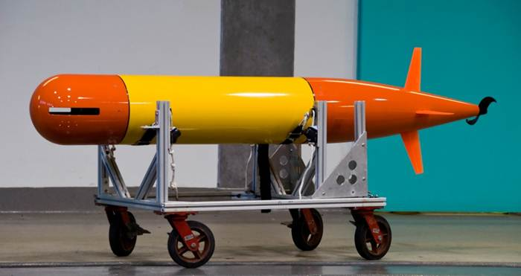
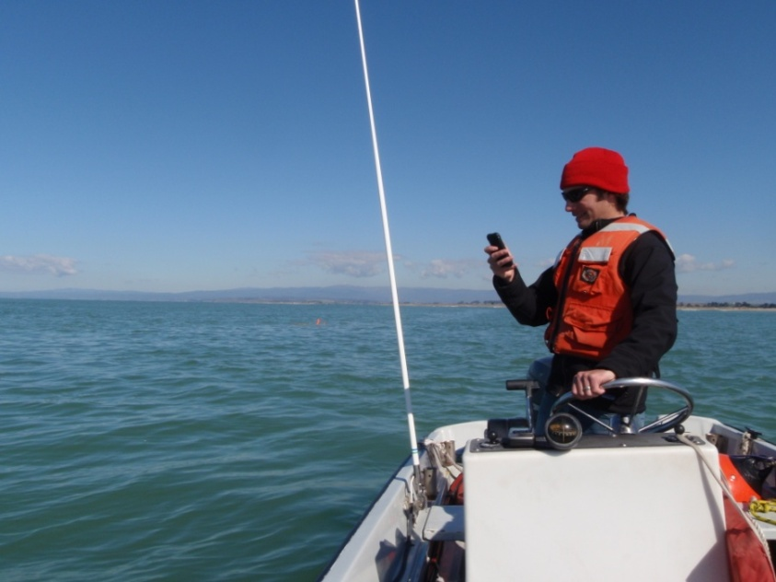
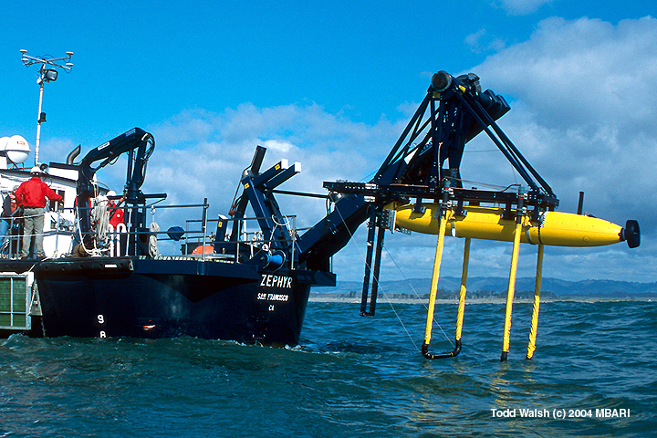
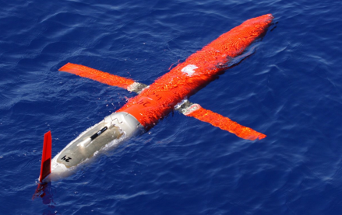
Underwater Vehicles:
Autonomous Underwater Vehicles (AUVs)

Slide 11
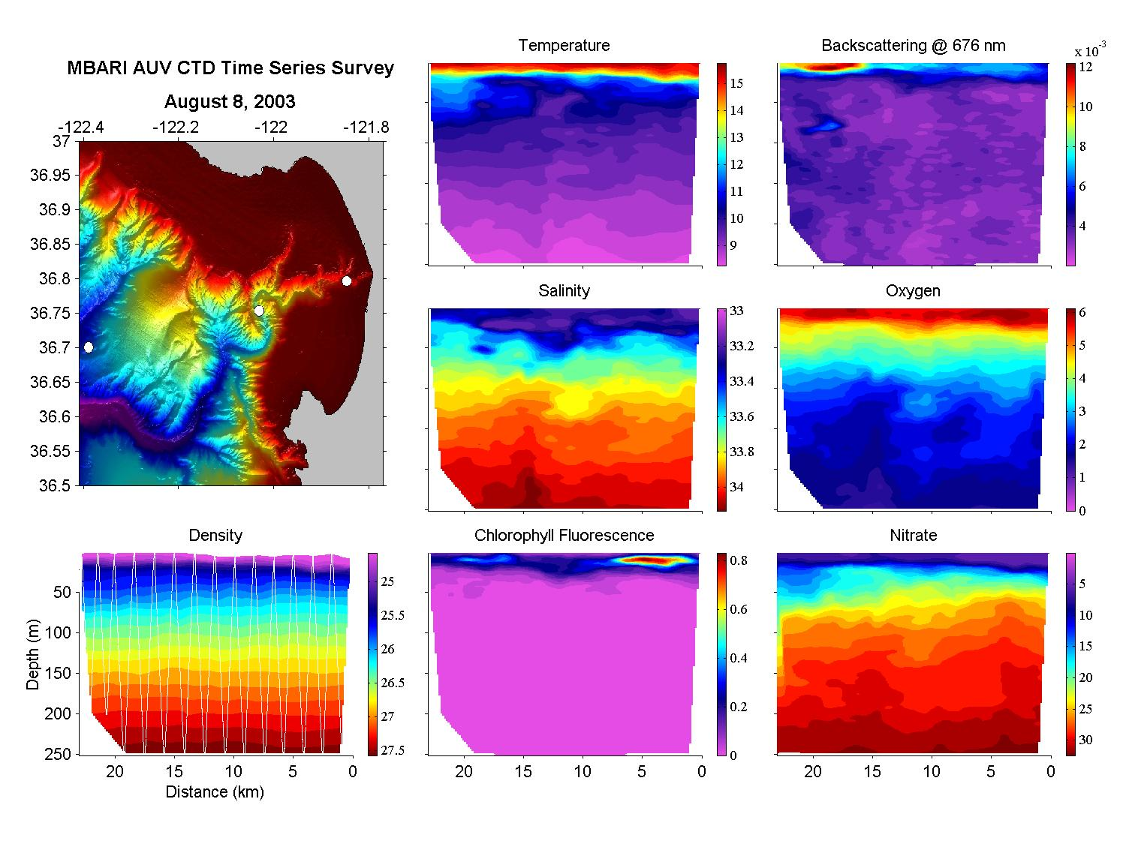
Routine AUV Operations for Science

Slide 12
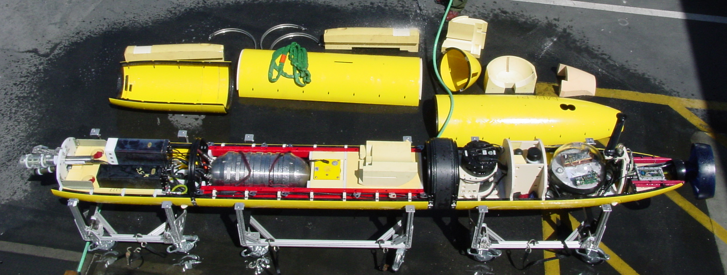
Interior of the Mapping AUV
6000 m rated syntactic foam
ABS Fairings
Tailcone
Sonar
Controller
MVC
GPS
Comms
Sidescan
Sonars
INS
CTD
USBL &
Acoustic
Modem
Li-Ion
Batteries
Subbottom
Profiler
Multibeam
Sonar

Slide 13
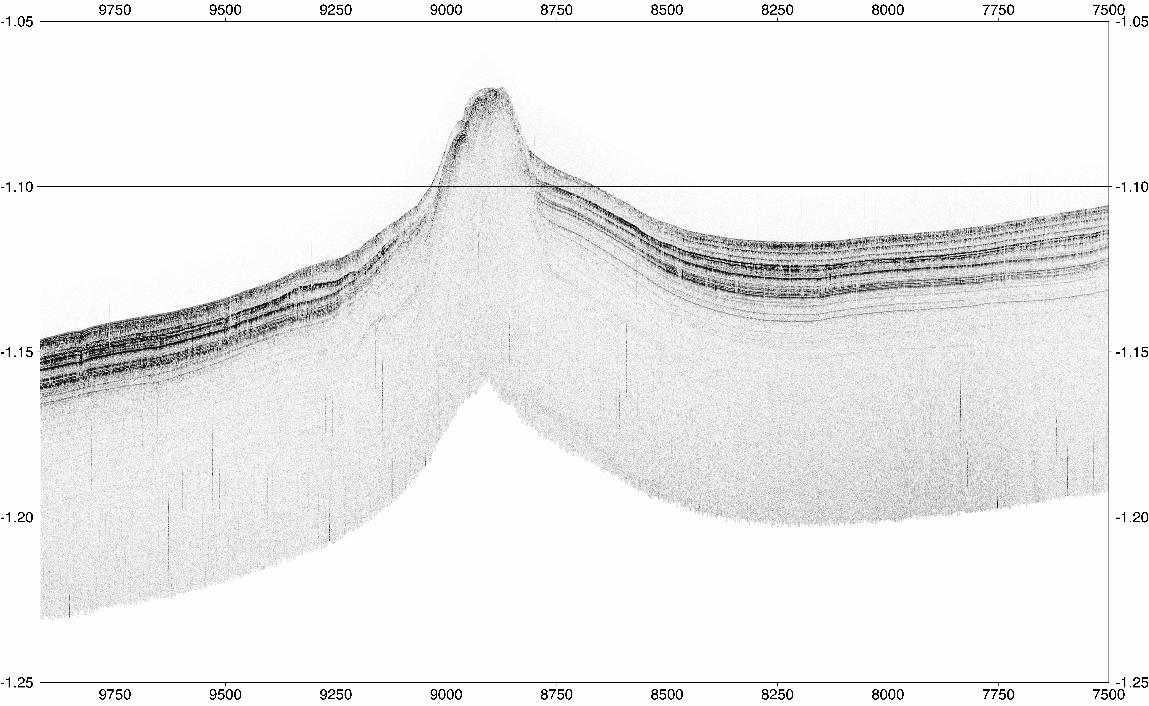
Sub-bottom Profile
Off shore of Los Angeles, California in the Santa Monica Basin
Mud Volcano - previously suspected but not found due to shipping lanes
S-to-N crossing of north mound directly over the gas seep site

Slide 14
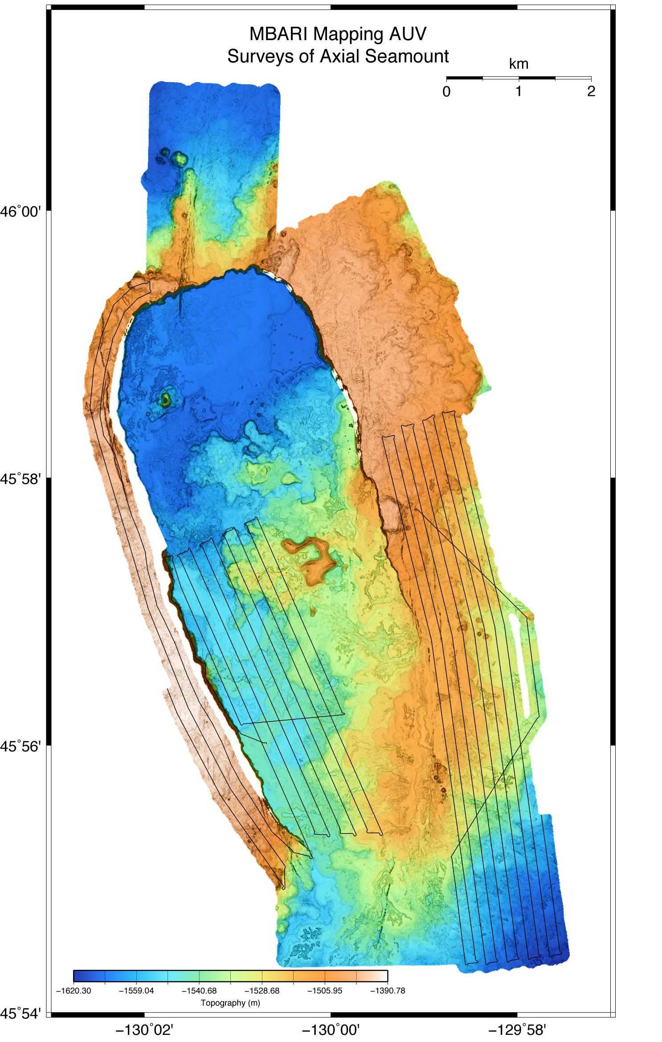
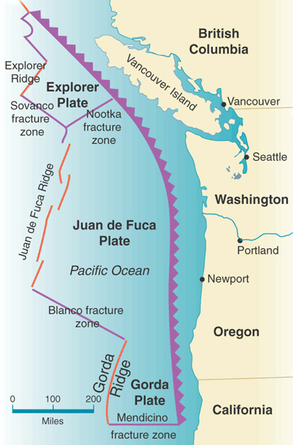
Axial Seamount
Combination of data from 2006, 2007, and 2008 cruises aboard R/V Thompson and R/V Atlantis
1 x 1 m resolution or better and 30 cm or better vertical…

Slide 15
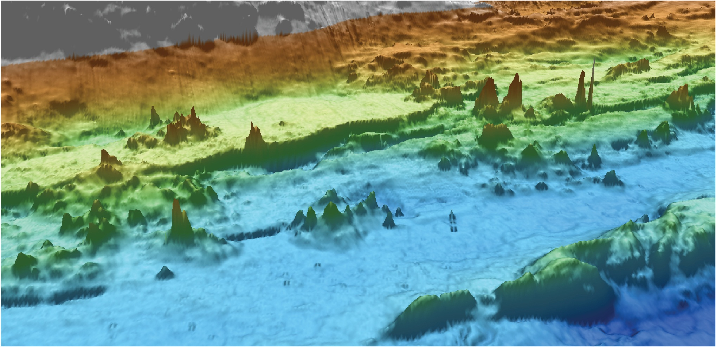
Endeavour Chimneys
Zooming in and tilting shows greater detail of chimney structures

Slide 16
Acoustic Platforms

Slide 17
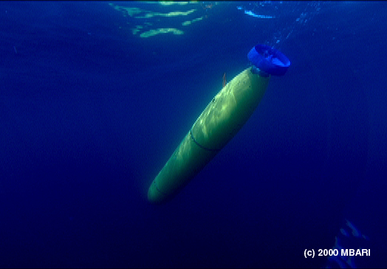
Acoustic Modems
Dorado Class AUV usage
  LF (8-14 kHz)
  Vertical channel
Routine comms: 4km
Longest comms: 7km @300-800 bps
Biggest degradation
  Surface bounce ( installation & baffling)
  Bottom bounce (wait until closer)
  Ship noise
Would go MF if we could do it again
  Less background noise
  More directional

Slide 18
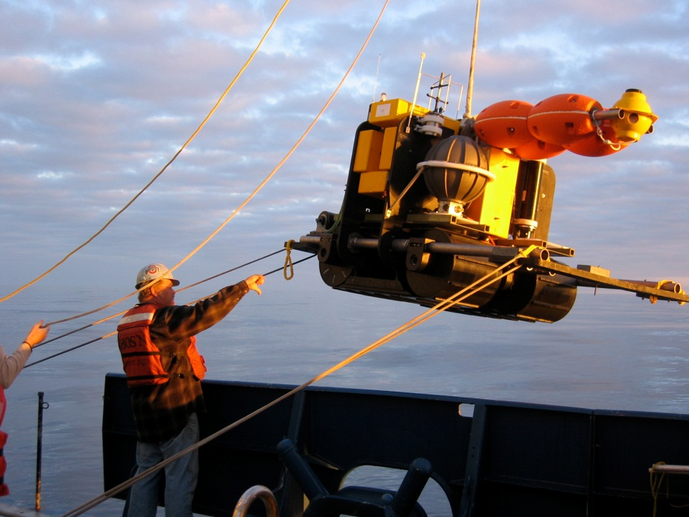
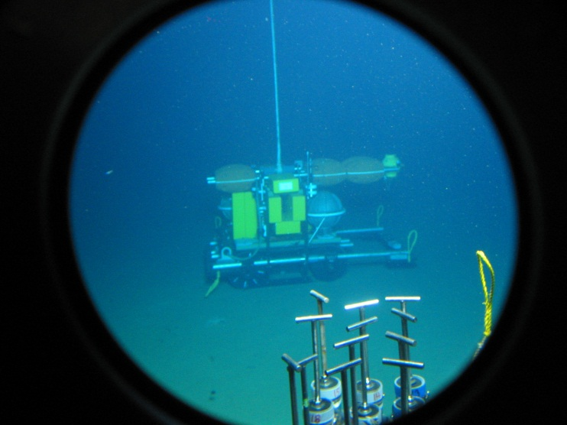
Acoustic Modems
Benthic Rover – Ship <-> vehicle
  MF (16-21 kHz) & LF
  Vertical channel
  Baffled top-side dunking transducer
Longest comms: 4km
Used for minimal communication (300 bps), and release via burnwire
Difficulty communicating on louder ships,
especially before addition of baffle

Slide 19
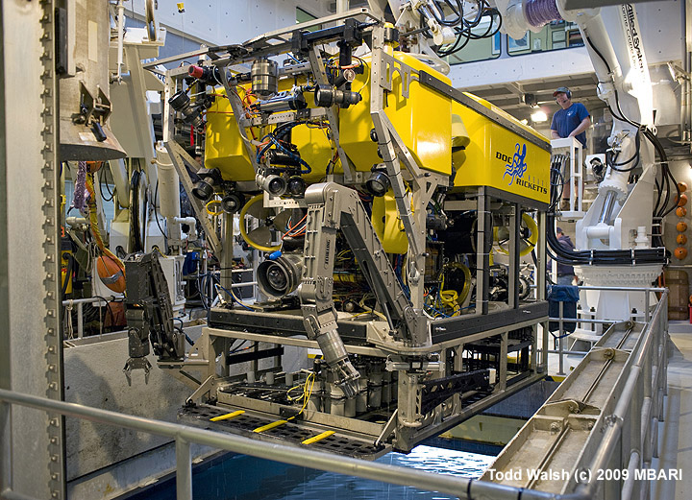
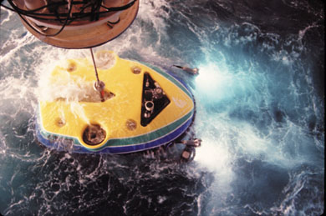
Acoustic Modems
Doc Ricketts & Tiburon ROV usage
  LF (8-14 kHz)
  50 m up tether - twist counter
Outages and spotty communication due to motor controller noise on Tiburon (electric vehicle)

Slide 20
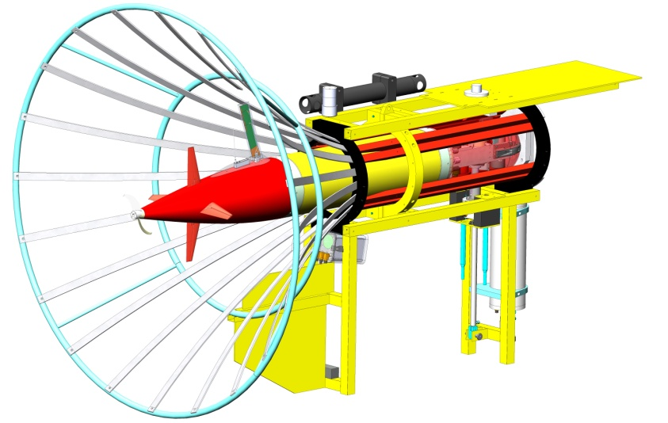
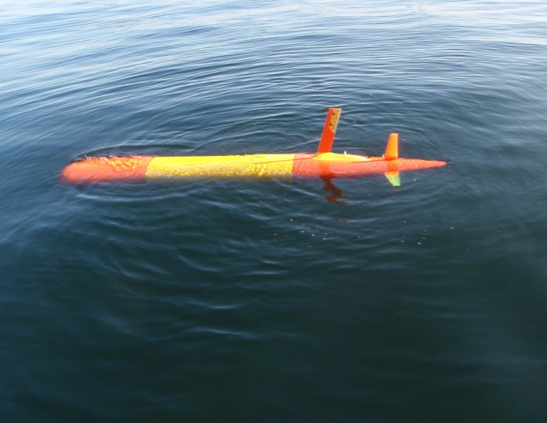
Directional Acoustic Transducer (DAT)
Tethys class Long Range AUV
Combination acoustic communication and iUSBL
iUSBL estimates azimuth and vertical arrival angles from remote acoustic modem
USBL range calculated via two-way comms and measured travel time
Accuracy specified at 2 degrees and 0.5 m range
Multipath and calibration have been major issues

Slide 21
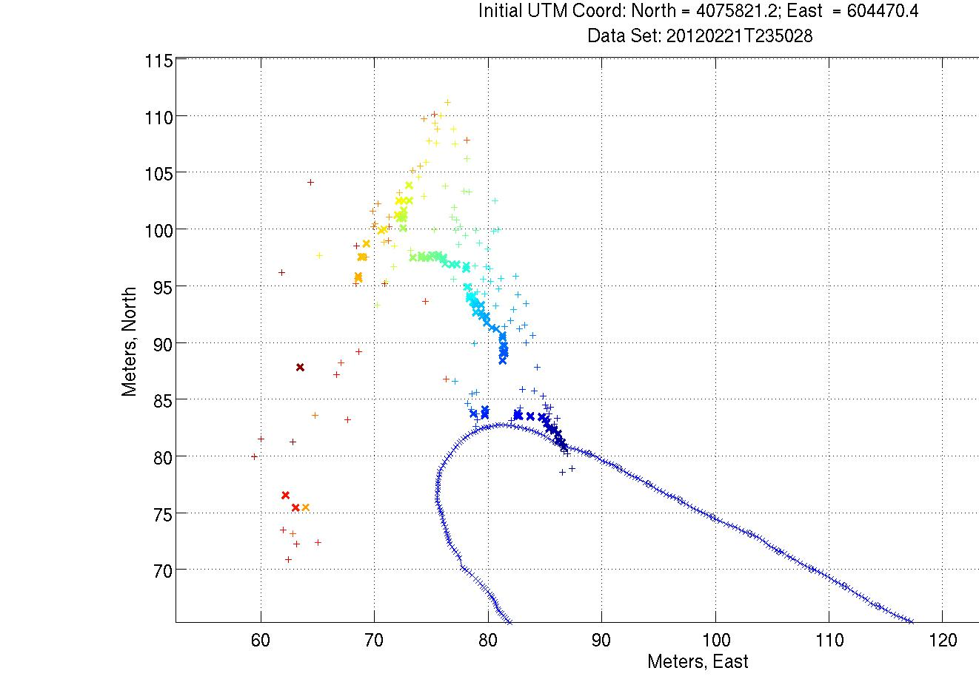
Directional Acoustic Transducer (DAT)

Slide 22
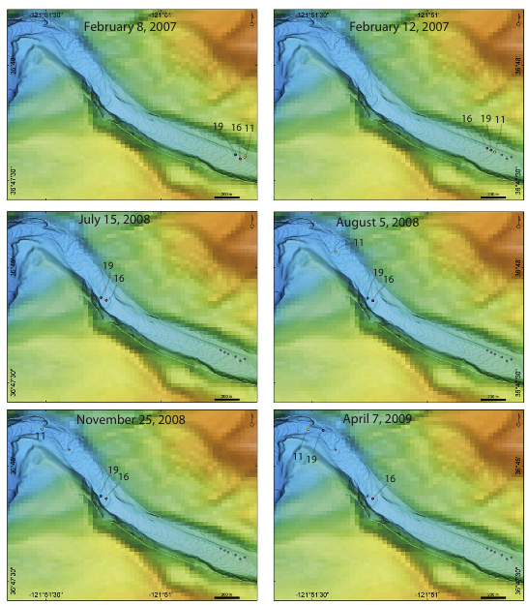
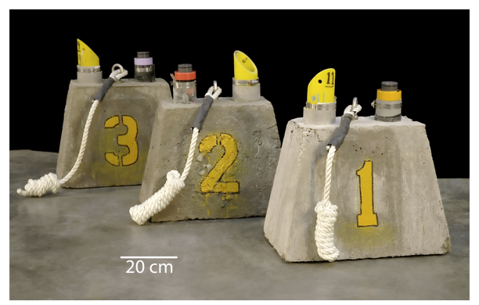
Acoustic Modems – Benthic Events
Benthic Event Detector (BED)
  Measure motion of benthic events
  Return data acoustically through sediment (up to 3m)
Will we be able to transmit data through the sediment? Benthos said “It should work… Let us know”

Slide 23
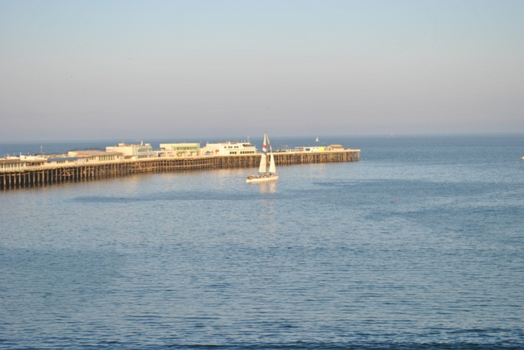
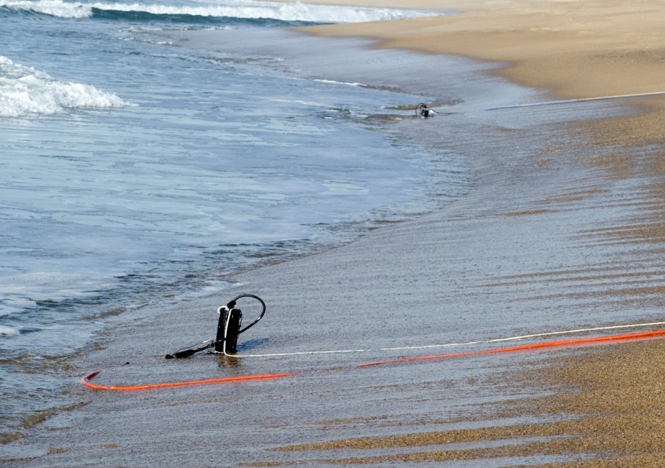
Acoustic Modems – Benthic Events
Will we be able to transmit data through the sediment? Benthos said “It should work… Let us know”
Data transfer tests
  Tank tests – 1200 bps @ 3’ depth
  Sediment to sediment – 10kbps @ 91 m
  Wharf /burial sea test – 1200 – 2560 bps @ 1m depth
d

Slide 24
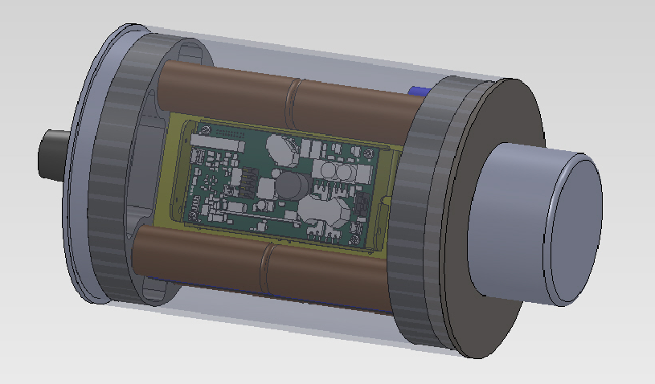
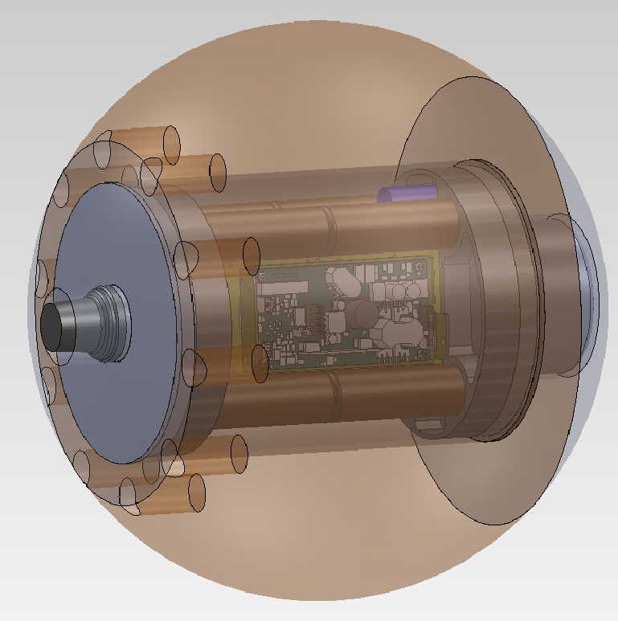
Acoustic Modems – BEDs Housing
Main cylindrical housing with common mechanical interface

Slide 25
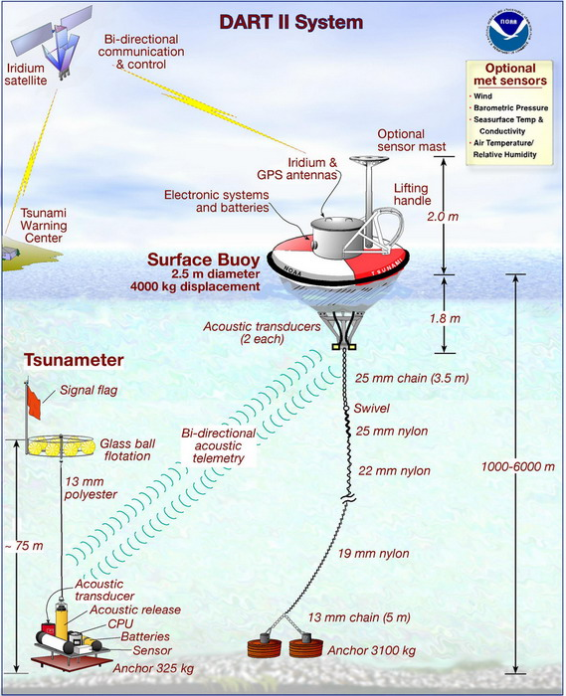
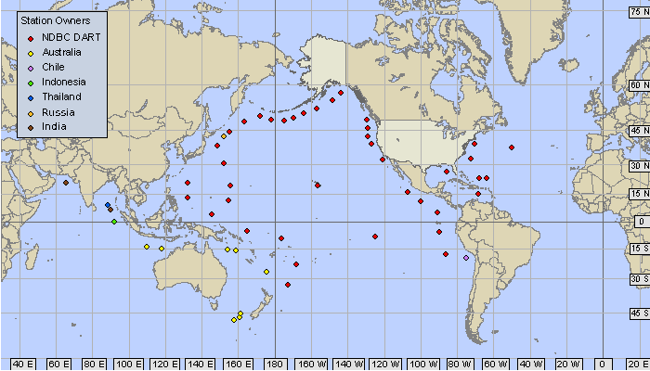
Acoustic Modems – non MBARI Specific
DART Tsunami detection and reporting buoy designed by Pacific Marine Environmental Laboratory (PMEL)
Acoustic link from seafloor sensors
to surface buoy
http://nctr.pmel.noaa.gov/Dart/

Slide 26
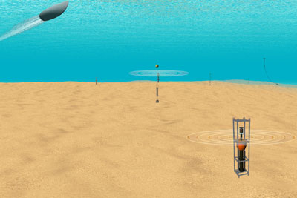
Acoustic Modems – non MBARI Specific
Naval Post Graduate School (NPS) “Seaweb”
  An underwater wireless wide-area network using acoustic modems
  Underwater network nodes linked to surface gateway node
  Bidirectional real-time communication to the underwater network
http://www.nps.edu/About/News/NPS-Pioneers-Seaweb-Underwater-Sensor-Networks.html

Slide 27
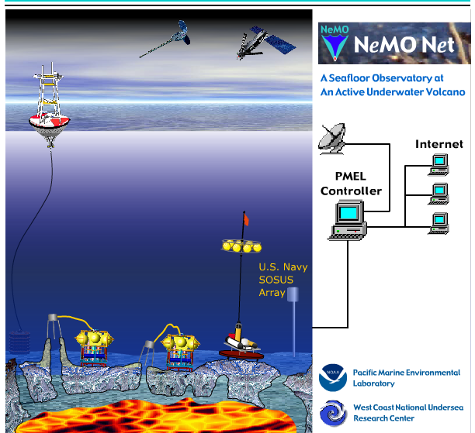

Acoustic Modems – non MBARI Specific
NeMO Net (New Millennium Observatory
  Bidirectional link to seafloor instruments on the Axial volcano
  NeMO Net buoy on surface communicates acoustically @ 600 baud and back to shore via Iridium (2400 baud)
http://www.pmel.noaa.gov/vents/nemo/realtime/index.html

Slide 29
AUV Transit Jellies

Slide 30


Tank Ping Test

