Slide 1
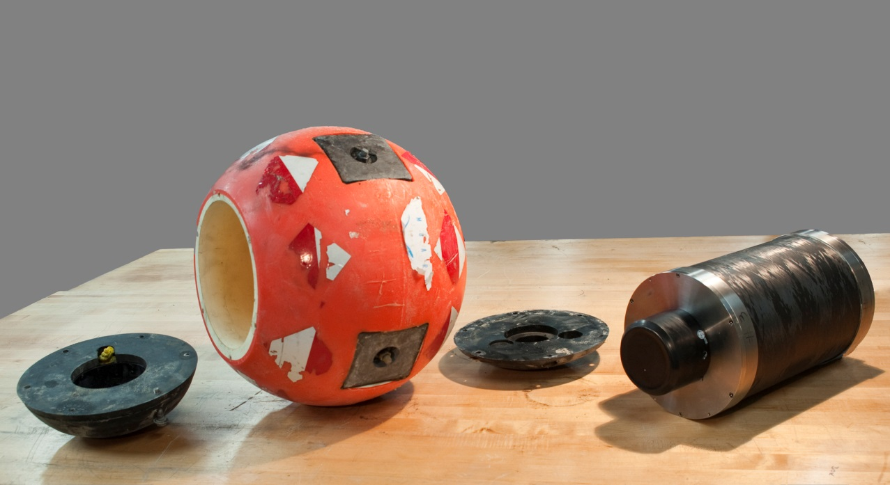
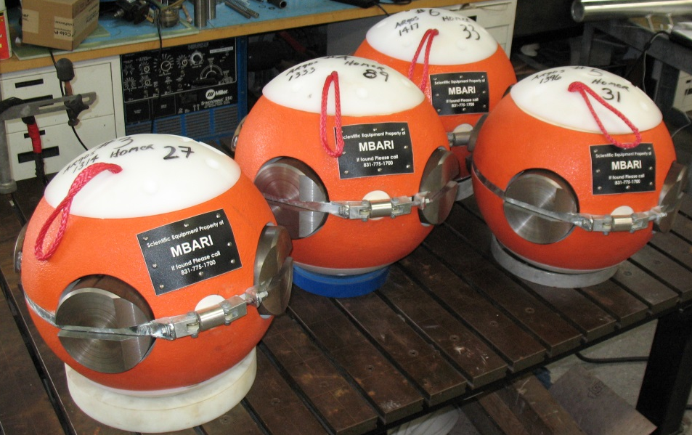
Overview
Core instrument housing (1000m/1 year)
Acoustic modem for data
Transponder for geolocation
Inertial motion unit

Slide 2
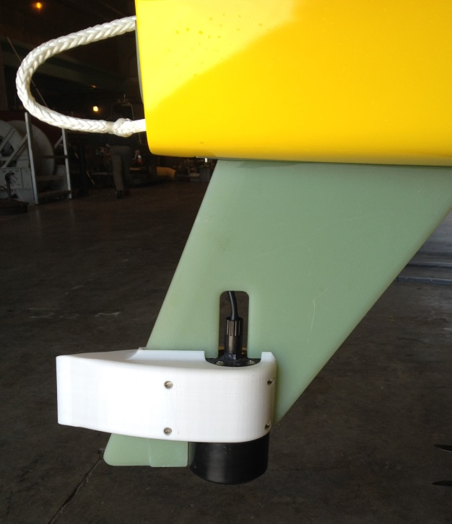
Acoustic Data Recovery

Slide 3
Events more frequent than expected
4 since Coordinated Canyon experiment began (late 2015)
Order of kilometers at 3 m/s

Slide 4
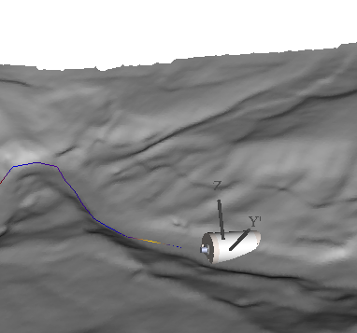
Animated visualization of motion

Slide 5
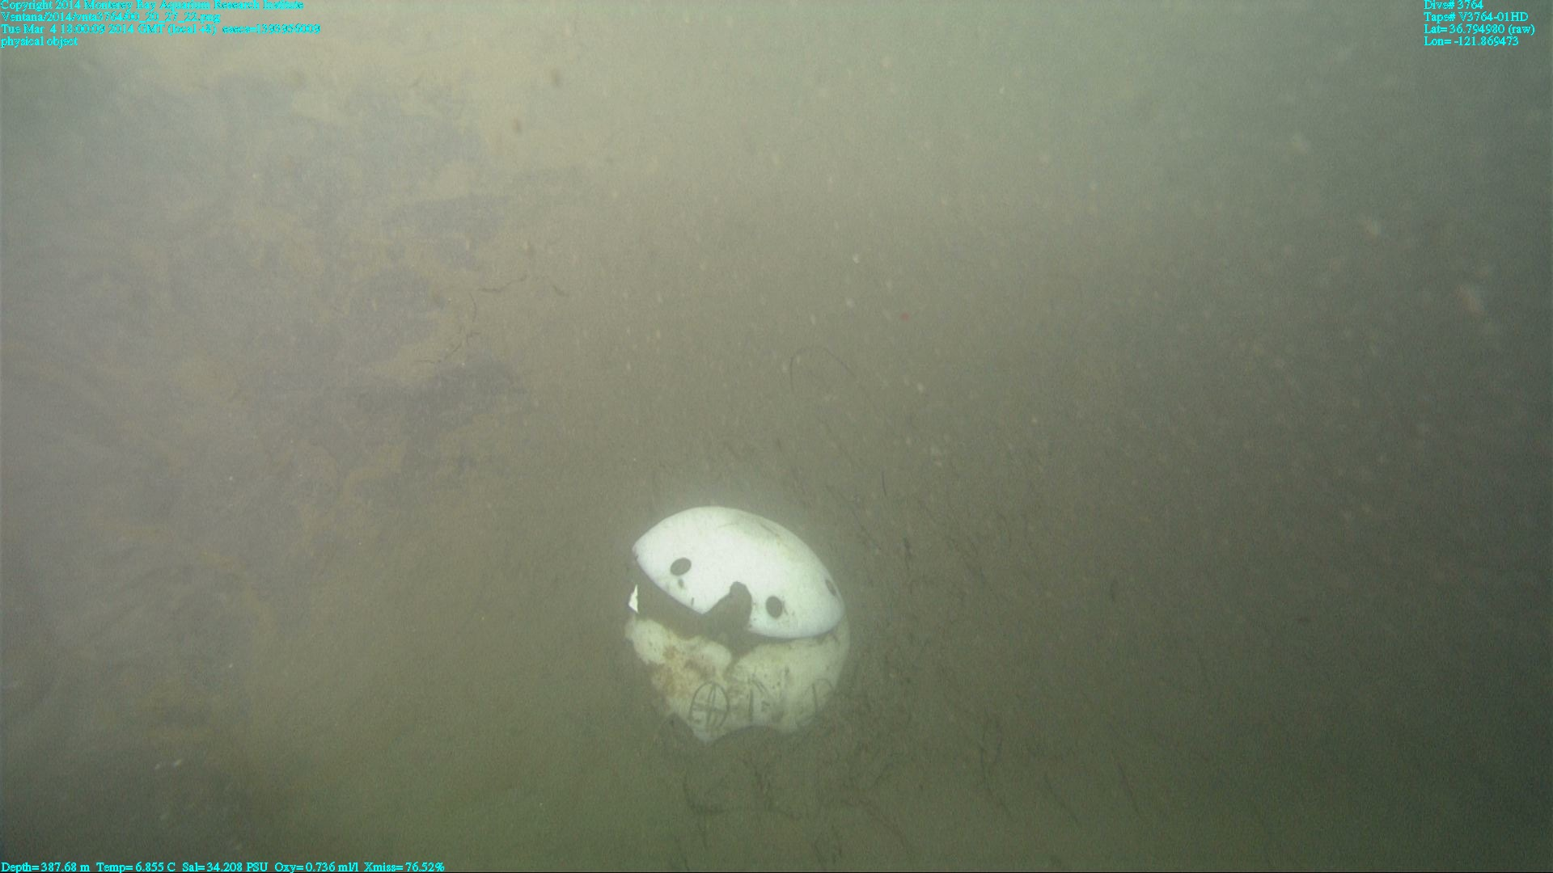
ROV insturment recovery is rare due to burial

Slide 6
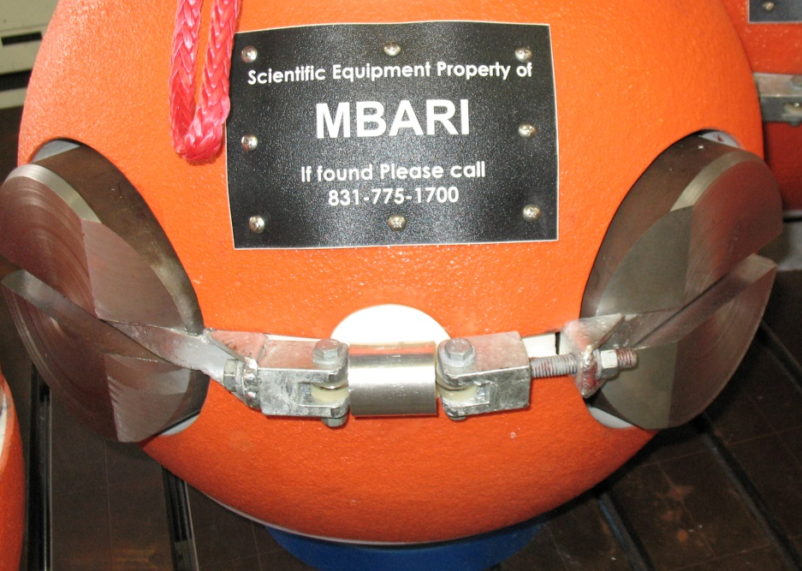
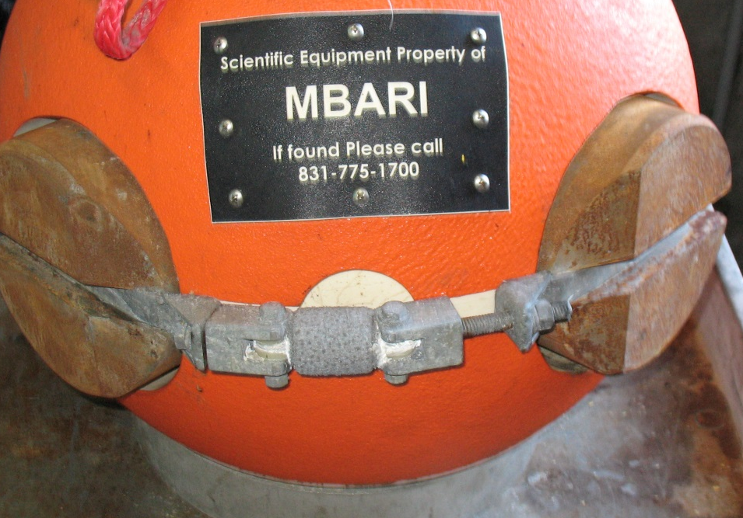
Steel ballast recently added
Galvanic time release corrodes away releasing weights
Instrument floats at surface and transmits location via Argos satellite and VHF
2 recovered already using this method
galvanic release
ballast
Notes:
The BEDs instrument pressure case is packaged within a positively buoyant syntactic foam sphere. The sphere is ballasted with steel weights to the density of the material to be studied (currently 2.1). The steel weights are constrained in pockets around the equator of the sphere by a steel band. The band is held together by a Galvanic Time Release (GTR). After a period of approximately six months, the GTR fails releasing the weights and the now positive buoyant sphere and instrument return to the surface. At the surface an Argos satellite transmitter notifies MBARI personnel that the instrument is on the surface and provides the location.

