Slide 1
Spring experiment
Upwelling to relaxation to upwelling
Great datasets
Highest levels of CO2 ever observed at M1

Slide 2
Comments/questions
ODSS useful but still clunky
Data layer mostly missing
DAC mostly missing
How do we juggle priorities?
What is our plan for synthesis
How do we use this to prepare for September
Gulpers missing the front?

Slide 3
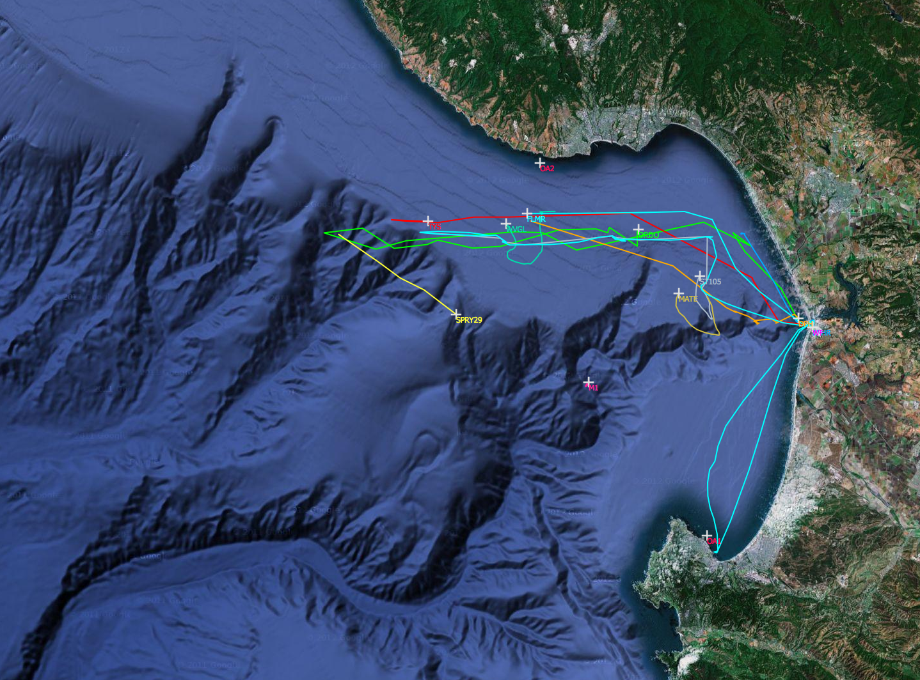

Slide 4
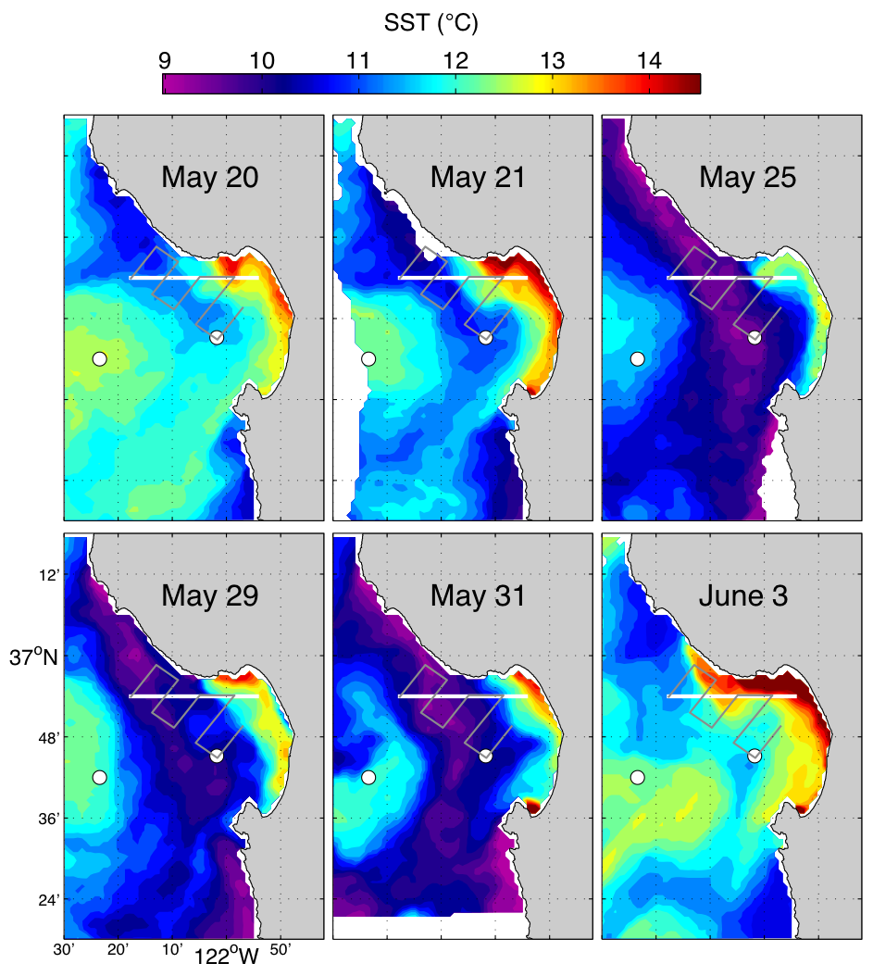
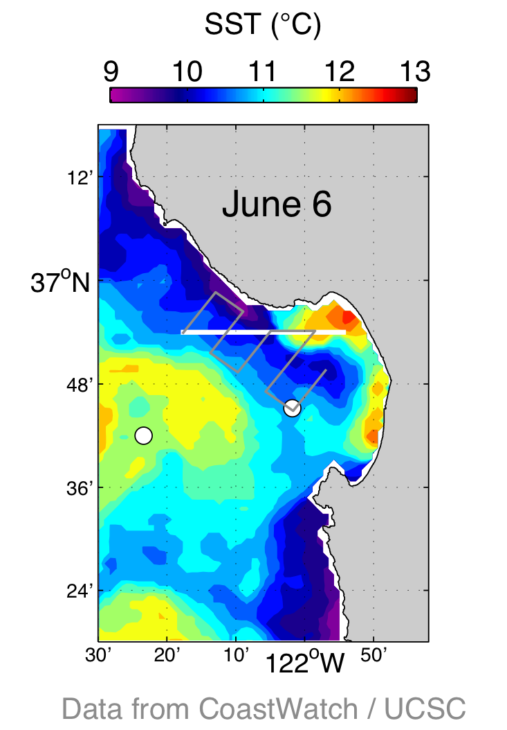
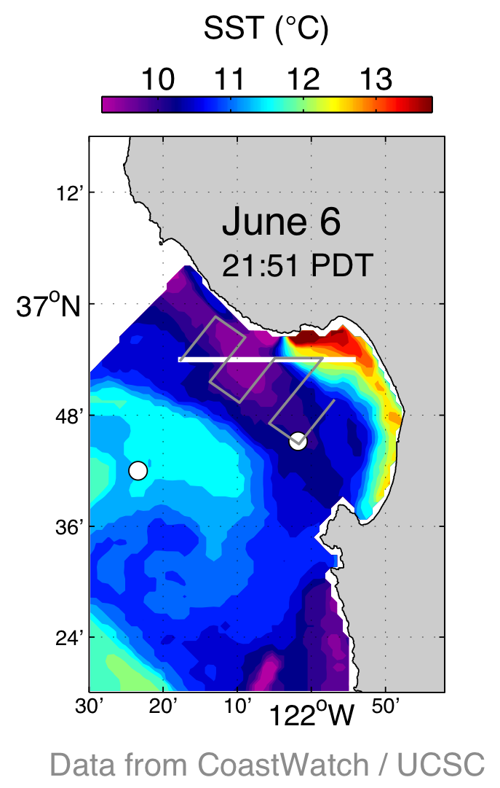

Slide 5
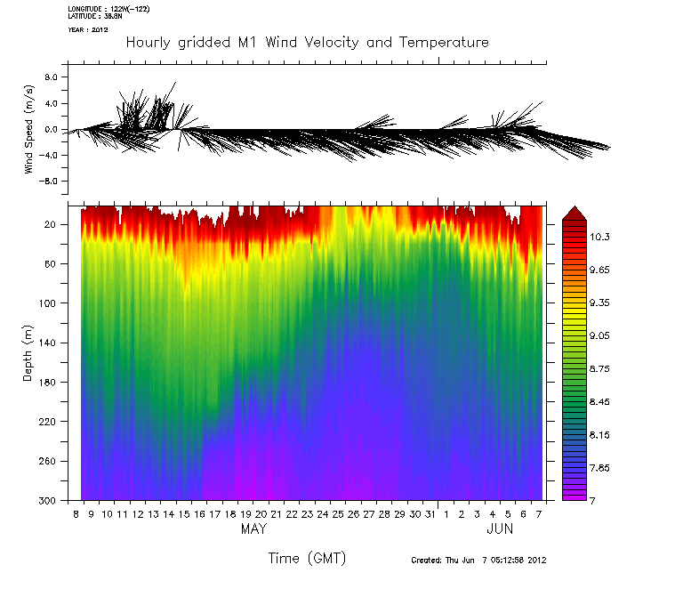

Slide 6
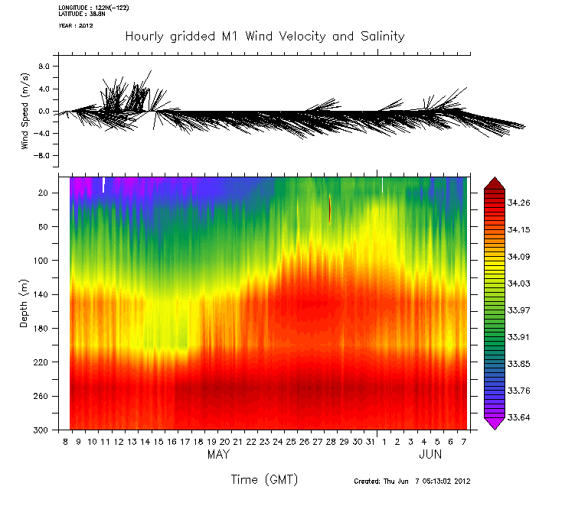

Slide 7
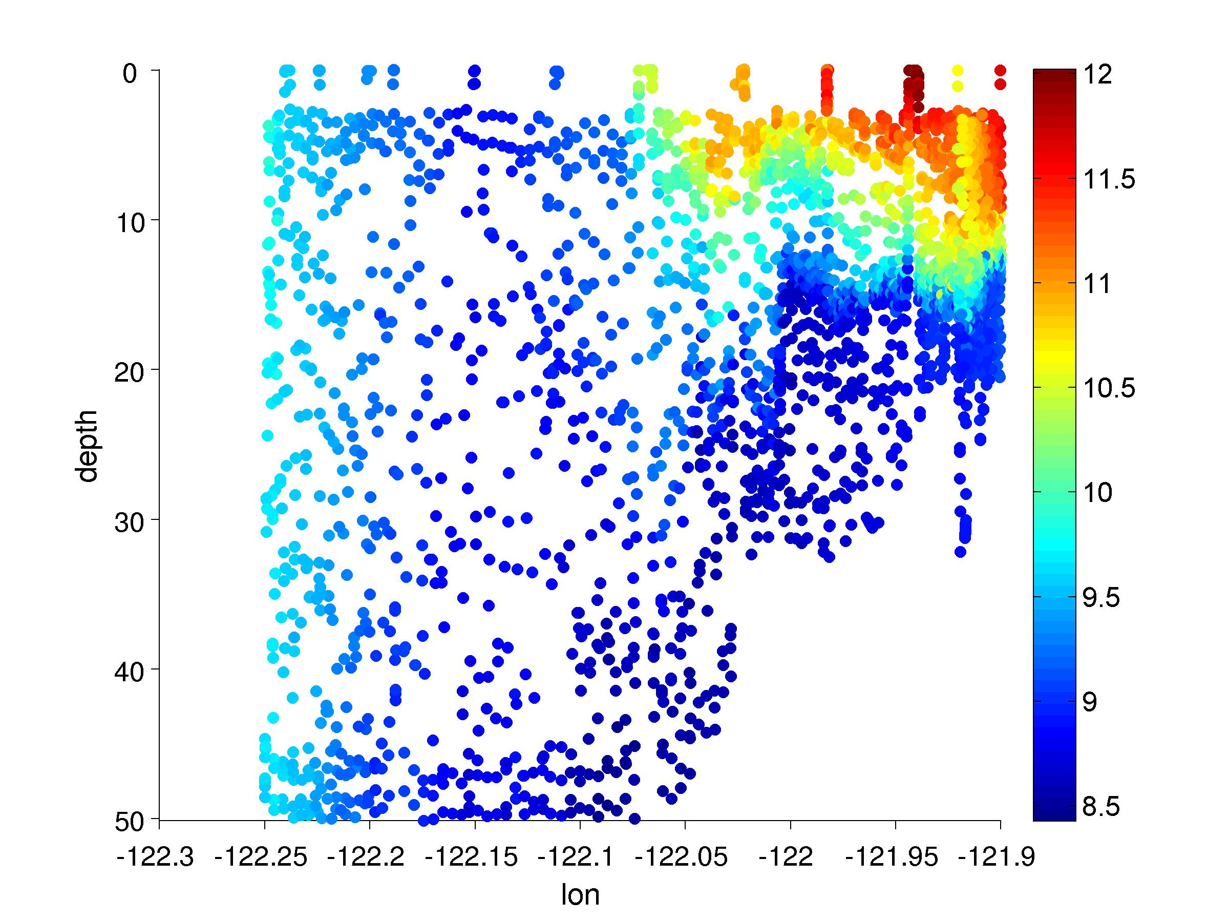

Slide 8
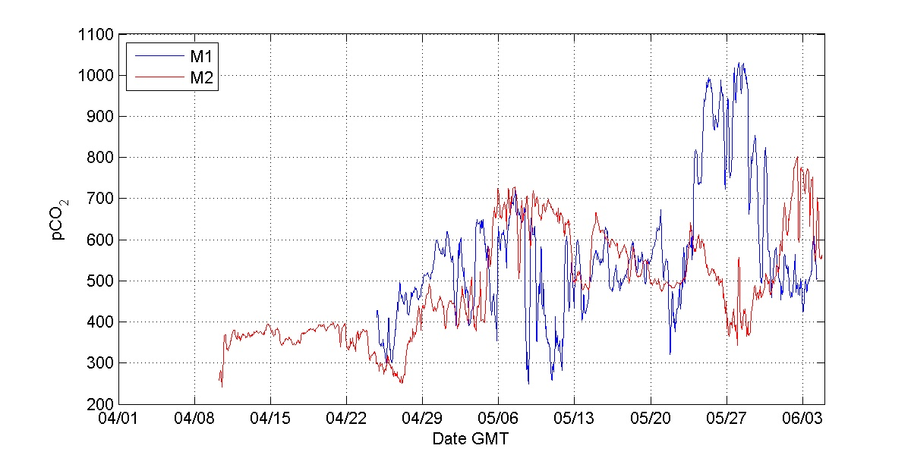

Slide 9
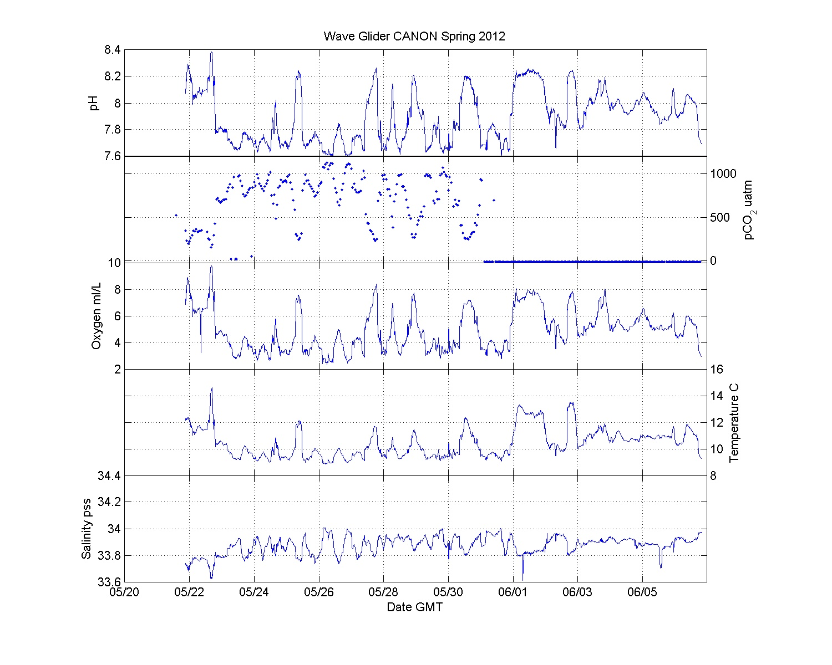

Slide 10
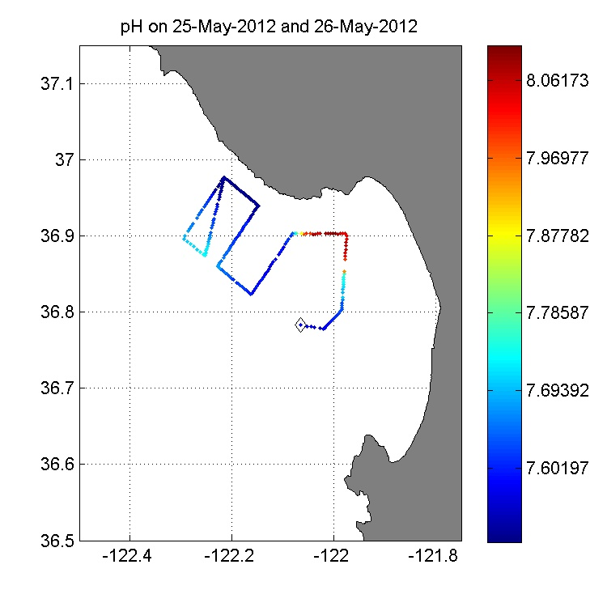


Slide 11
